Slide 1
TG-SPDCL
ELECTRICITY CONSUMPTION
15,947
20
& MONITORING ANALYSIS
Total Records
Circles
Data Analytics & Visualization Project • July 2026
1,245 GWh
92.68%
👥 Team Members
Total Energy
Billing Rate
D. Chander • K. Arjun • P. Sachin
Roll No: 2503A52214 • 2503A52235 • 2503A52240
Source: TG-SPDCL Domestic Consumption Dataset

Slide 2
📋 Project Agenda
▸ Dataset Overview & Source
▸ Dataset Structure — Rows, Columns, Data Types
▸ Key Performance Indicators (KPI Summary)
▸ Circle-Wise Consumption Rankings
▸ Top 20 High-Demand Areas
▸ Billing Efficiency Analysis
▸ Load vs Consumption Correlation
▸ Statistical Distributions & KDE
▸ Seaborn Correlation Heatmap
▸ Data Quality Issues & Outliers
▸ Limitations & Conclusions
02

Slide 3
🗃️ Dataset Overview & Source
Each row = one electricity consumption record for a specific area & consumer category
Source
TG-SPDCL (Telangana Southern Power Distribution Company Ltd)
Period
July 2026 • Domestic Consumer Category Only
Rows
15,947 sector-level records
Columns
11 columns (6 categorical, 5 numerical)
Coverage
20 Circles • 49 Divisions • 131 Subdivisions • 476 Sections
Category
DOMESTIC only — No commercial or industrial segments
Missing Values
247 in BILLDSERVICES, 47 in AREA
Negative Values
15 rows with negative UNITS (billing corrections)
03

Slide 4
📋 Dataset Column Descriptions
Categorical: CIRCLE, DIVISION, SUBDIVISION, SECTION, AREA, CATDESC | Numerical: CATCODE, TOTSERVICES, BILLDSERVICES, UNITS, LOAD
CIRCLE
Top-level geographic region (20 circles)
DIVISION
Sub-region within a circle (49 divisions)
SUBDIVISION
Subdivision within division (131 total)
SECTION / AREA
Smallest geographic unit — neighborhood/locality (476 sections)
CATDESC / CATCODE
Consumer category — all DOMESTIC (code=1) in this dataset
TOTSERVICES
Total registered electricity connections (integer)
BILLDSERVICES
Number of actually billed connections (float, has 247 NULLs)
UNITS
Total electricity consumed in kWh (float, can be negative)
LOAD
Sanctioned connected load in kW (float, decimal values)
04

Slide 5
📊 Key Performance Indicators — July 2026
Total Records
Electricity Circles
Total Connections
Billed Connections
15,947
20
8,867,827
8,218,867
Sector-level area records
20 circles, 49 divisions
Registered domestic services
Actually billed services
Billing Efficiency
Total Energy (GWh)
Total Load (MW)
Avg/Household
92.68%
1,245.52
13,778.82
151.5 kWh
Target: 95%+ | Gap: ~649K unbilled
1.24 billion kWh total monthly
Sanctioned connected capacity
Per billed connection monthly
05

Slide 6
Circle-Wise Energy Consumption Rankings
🏆 Top 5 Circles (Highest)
📉 Bottom 5 Circles (Lowest)
▸ Medchal — 141.7M units (11.4%)
▸ Gadwal — 10.0M units
▸ Habsiguda — 138.1M units (11.1%)
▸ Wanaparthy — 10.1M units
▸ Cybercity — 125.4M units (10.1%)
▸ Nagarkurnool — 13.1M units
▸ Hyderabad Central — 112.5M (9.0%)
▸ Medak — 15.9M units
▸ Saroornagar — 112.3M units (9.0%)
▸ Vikarabad — 17.9M units
▸ Top 10 circles ≈ 90% of all units
▸ District circles use ~⅓ per service vs Banjara Hills
06

Slide 7
🔌 Average Consumption Per Billed Connection
Urban-rural consumption gap is stark — per-service average reveals intensity better than totals
▸ Banjara Hills — ~240 units/service (luxury residential, high-value areas)
▸ Cybercity — ~219 units/service (tech/IT zone proximity)
▸ Hyderabad Central — ~217 units/service
▸ Secunderabad — ~194 units/service
▸ District circles (Wanaparthy, Nagarkurnool, Vikarabad) — ~75 to 83 units
▸ Hyderabad-region circles use ~2x more per service than district circles
▸ Top divisions: Kukatpally (62M), Sainikpuri (55.2M), Saroornagar (52.8M)
▸ Largest single areas: Hydernagar (2.32M), Moosapet (1.81M), Vinayaknagar (1.47M)
07

Slide 8
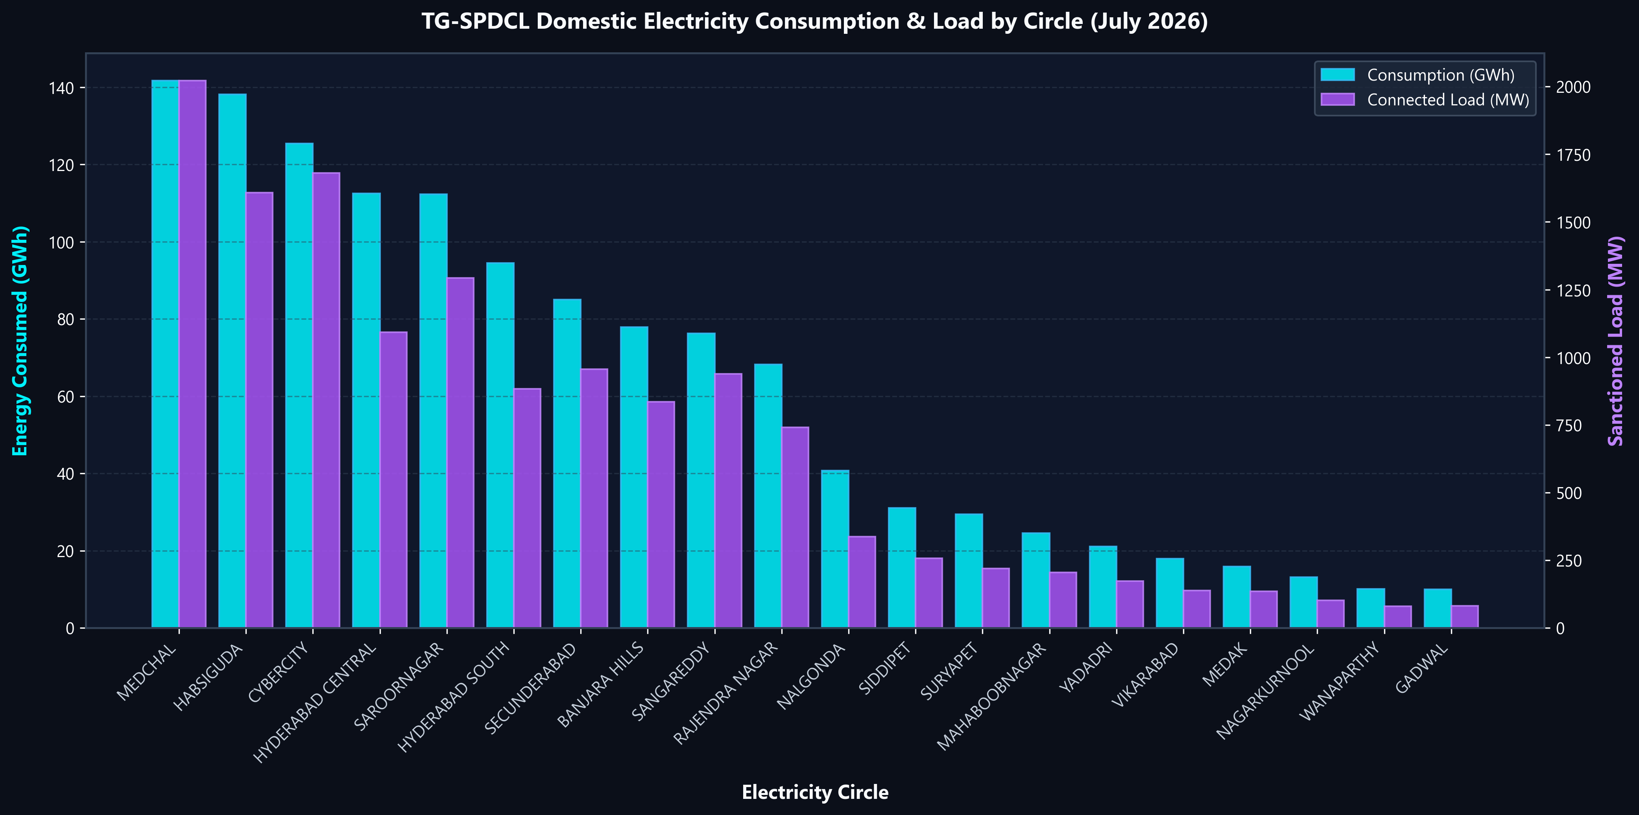
📈 Circle-Wise Consumption (GWh) & Sanctioned Load (MW)
Cyan bars = Energy consumed (GWh) | Purple line = Connected load (MW) — sorted highest to lowest
08

Slide 9
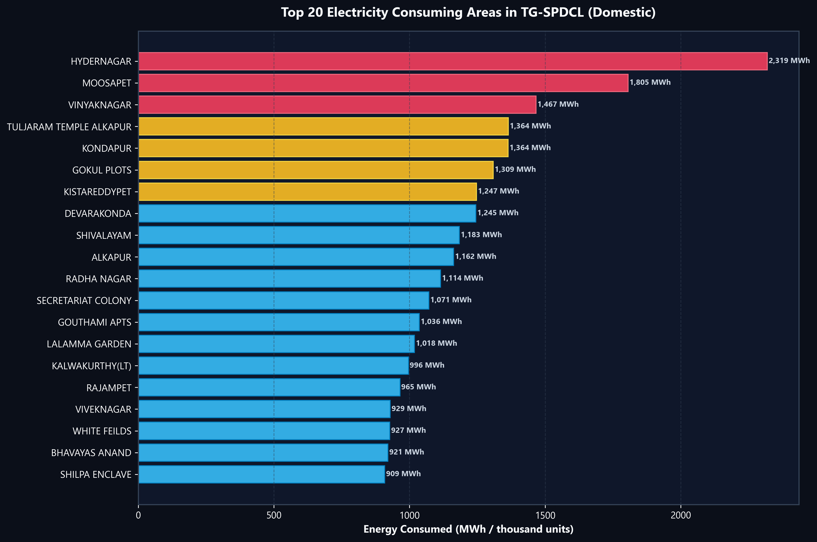
📈 Top 20 Highest Electricity Consuming Areas
Seaborn barplot with hue by circle — Top areas are Hydernagar, Moosapet & Vinayaknagar
09

Slide 10
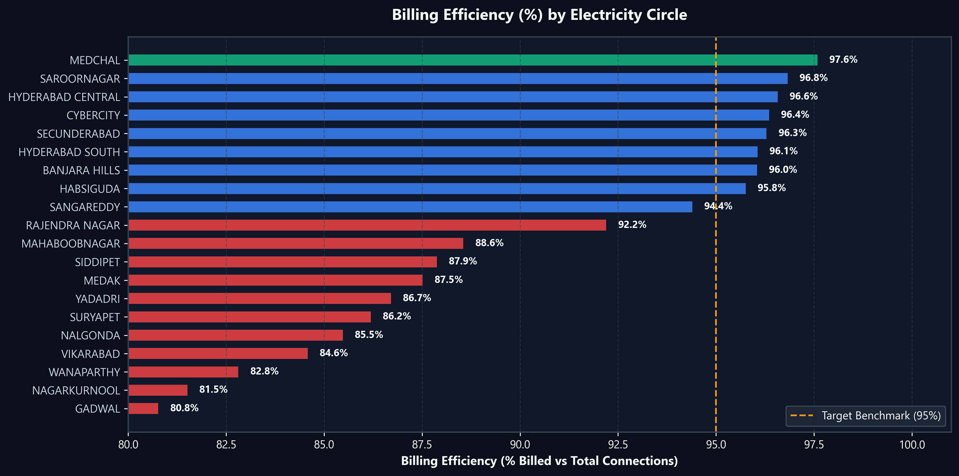
📈 Circle Billing Efficiency (%) vs 95% Benchmark
Seaborn palette — Amber dashed line = 95% target. Red/orange bars indicate circles needing attention.
10

Slide 11
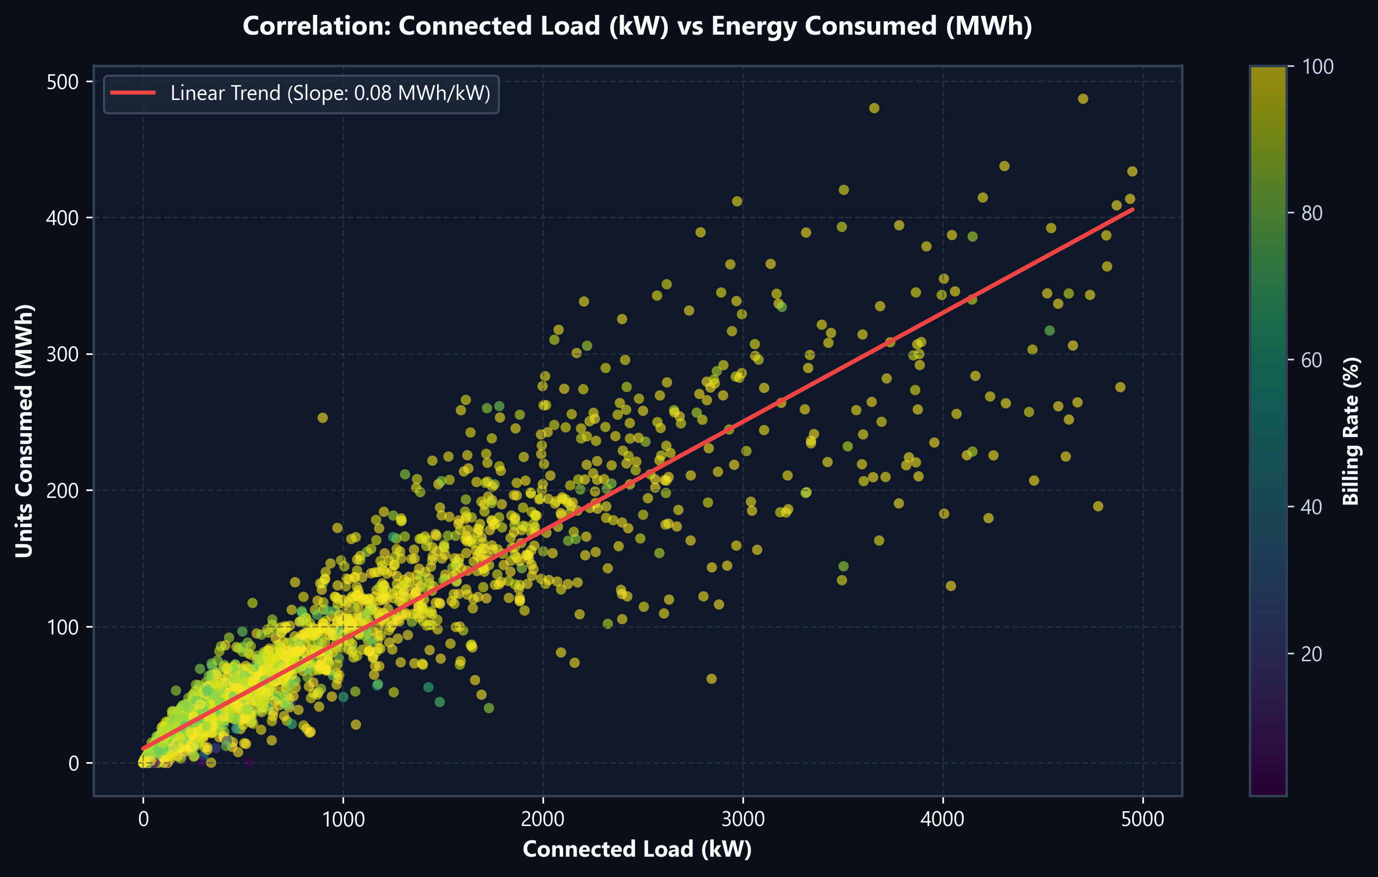
📈 Connected Load vs Units Consumed — Seaborn Regplot
Strong positive linear correlation (r ≈ 0.95) — Areas with higher load reliably show higher consumption
11

Slide 12
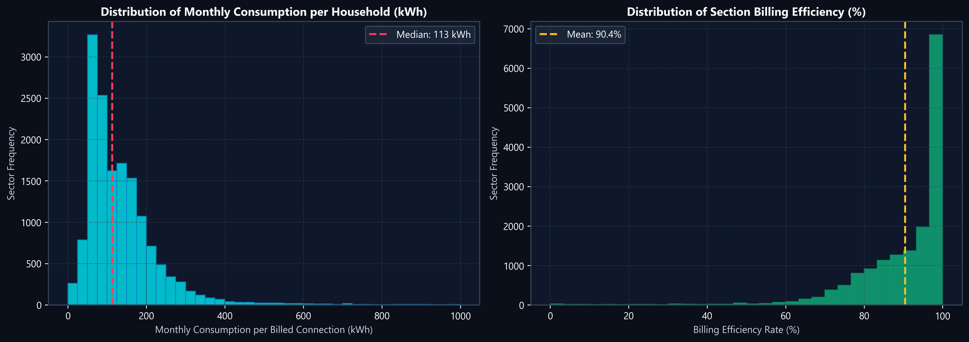
📈 Statistical Distributions — Seaborn Histplot + KDE
Left: Household consumption is right-skewed (median ~90 kWh) | Right: Billing efficiency peaks near 97–100%
12

Slide 13
Data Quality Issues & Outliers
⚠️ Data Issues Found
🔧 Cleaning Strategy
▸ 247 missing BILLDSERVICES — all have 0 UNITS (inactive areas)
▸ NaN BILLDSERVICES → imputed from TOTSERVICES
▸ 47 missing AREA names — filled as 'UNKNOWN AREA'
▸ Negative UNITS → clipped to 0 (treated as corrections)
▸ 15 rows with negative UNITS (billing corrections/adjustments)
▸ Outliers retained with flagging — valid high-consumption areas
▸ 1,999 duplicate AREA names across different sections
▸ Duplicates are geographic labels, NOT duplicate records
▸ Largest record: 2.32M units vs median 37,000 (extreme outlier)
▸ 1.5 × IQR outlier method used for identification
▸ Load range: 0 kW to 33,617 kW (household averages vary widely)
▸ Zero-consumption rows kept — may be seasonal / inactive
13

Slide 14
🔍 Key Patterns & Analytical Insights
Pattern: Consumption is concentrated — a small fraction of areas drives the majority of demand
▸ Consumption is strongly urban — top 10 Hyderabad circles = ~90% of all units
▸ Top 10% of areas by size = ~43% of total electricity consumed
▸ Areas labelled 'DOMESTIC HT', 'CT', 'HV' show 3,000–11,500 units/service (bulk connections)
▸ Several THANDA (tribal hamlet) areas in Nalgonda/Suryapet show near-zero consumption
▸ Units & Load are highly correlated (r ≈ 0.95) — load is a reliable predictor
▸ Billing efficiency gap: 92.68% vs 95% target → ~649,000 connections unbilled
▸ The 2,452 largest areas (~15% of all) account for 50.5% of total units
▸ Sort descending by per-service avg reveals 'HT/HV' bulk consumers billed as domestic
14

Slide 15
Technology Stack & Tools Used
🐍 Python Libraries
🌐 Web Dashboard
▸ Pandas — data loading, cleaning, aggregation
▸ HTML5 + CSS3 — dark-mode glassmorphism UI
▸ NumPy — vectorized feature engineering
▸ Chart.js — interactive bar, line, scatter charts
▸ Matplotlib — publication-quality static plots
▸ JavaScript — dynamic filtering & pagination
▸ Seaborn — statistical visualizations & KDE
▸ KPI Cards — real-time metric calculations
▸ python-pptx — automated PPT generation
▸ Anomaly Alerts — billing efficiency flags
▸ json — dashboard data export
▸ CSV Export — one-click filtered data download
15

Slide 16
⚠️ Dataset Limitations
Limitations define the boundary of conclusions — always qualify findings accordingly
▸ No time-series data — only July 2026 snapshot; cannot track trends over time
▸ Domestic only — commercial & industrial sectors excluded; total demand picture incomplete
▸ No weather/temperature data to explain seasonal consumption peaks
▸ No household-level info — income, family size, or appliance usage unknown
▸ No socioeconomic data — cannot correlate consumption with poverty/development level
▸ 1,999 repeated AREA names — geographic deduplication needed for spatial analysis
▸ Negative UNITS (~15 rows) — billing adjustments, not actual negative consumption
▸ HT/HV 'domestic' rows — bulk consumers may inflate domestic category averages
16

Slide 17
✅ Conclusion & Summary
✔ Urban concentration: Top 10 Hyderabad circles = 90% of total consumption
✔ Per-service average reveals Banjara Hills (240 kWh) is ~3× higher than district circles (~80 kWh)
✔ Billing efficiency at 92.68% — 649,000 unbilled connections represent revenue loss opportunity
✔ Load and consumption are strongly correlated (r ≈ 0.95) — load data is a reliable proxy
✔ Top 15% of areas (by size) consume over 50% of all electricity
🔗 GitHub Repository:
https://github.com/arjunkanukuntla/dav-project
Thank You • D.Chander • K.Arjun • P.Sachin
Roll No: 2503A52214 • 2503A52235 • 2503A52240
17

