Slide 1
DATA ANALYTICS & VISUALIZATION (DAV)
Electricity Consumption
15,947
SECTOR RECORDS
20 Circles | 49 Divisions | 476 Sections
& Monitoring Analysis
8.87M
TOTAL SERVICES
TG-SPDCL Domestic Consumer Dataset (July 2026) | 8-Pillar Syllabus Synthesis
8.22M Active Billed Connections
1,245.5 GWh
PROJECT RESEARCH TEAM
ENERGY CONSUMED
D. Chander
Roll: 2503A52214
Data Cleaning, Wrangling & Power Query ETL
1,245,523,023 kWh Monthly Demand
K. Arjun
Roll: 2503A52235
Seaborn Visualizations, Correlations & Heatmaps
92.68%
P. Sachin
Roll: 2503A52240
Statistical Modeling, Pareto Analysis & Final Decision
BILLING EFFICIENCY
648,960 Unbilled Services Identified
TG-SPDCL Domestic Electricity Consumption & Monitoring | Data Analytics & Visualization (DAV) | July 2026
Slide 1 of 11

Slide 2
PILLAR 1: PROJECT EXPLANATION
Domain Context, Problem Statement & Network Hierarchy
TG-SPDCL | DAV Project v4
Compact Syllabus Edition (11 Slides)
Analyzing electricity distribution dynamics across Greater Hyderabad and rural Telangana
20 Circles
49 Divisions
131 Subdivisions
476 Sections
15,947 Areas
Apex Geographic Zones
Operational Operations
Field Engineering
Local Billing Stations
Neighborhood Sectors
Medchal, Cybercity, Habsiguda...
Kukatpally, Mehdipatnam...
Miyapur, Qutbullapur, Uppal...
Line stations & meter reading offices
Granular colony & feeder records
1. Utility Context (TG-SPDCL)
2. Core Operational Challenges
3. Core Research Objectives
• State Distribution Entity: Serves 15 southern districts of Telangana including the state capital.
• Domestic Focus (Cat 1): Exclusively covers households, apartments, and domestic residential connections.
• Demand Significance: Domestic consumption constitutes over 40% of grid peak load during summer/monsoon.
• High Unbilled Deficit: 648,960 services unbilled in July 2026 (~7.32% of total services).
• Severe Load Concentration: Heavy air conditioning & villa loads strain local transformers in western corridors.
• Data Hygiene Gaps: Missing records, negative unit reversals, and repetitive naming across sections.
• Consumption Profiling: Establish consumption intensity per household across metro vs rural zones.
• Correlation Modeling: Quantify the mathematical coupling between connected load (kW) and units (kWh).
• Data-Backed Interventions: Deliver actionable transformer upgrade and revenue recovery roadmaps.
TG-SPDCL Domestic Electricity Consumption & Monitoring | Data Analytics & Visualization (DAV) | July 2026
Slide 2 of 11

Slide 3
PILLAR 2: DATA EXPLORATION
Dataset Architecture, Data Dictionary & Data Quality Audit
TG-SPDCL | DAV Project v4
Compact Syllabus Edition (11 Slides)
Comprehensive structural audit of 15,947 records × 11 active features
Feature Name | Type | Category | Description / Analytical Purpose
CIRCLE | String | Categorical | Highest administrative circle (20 unique)
DIVISION | String | Categorical | Operational district subdivision (49 unique)
SUBDIVISION | String | Categorical | Field maintenance zone (131 unique)
SECTION | String | Categorical | Local billing station (476 unique)
AREA | String | Categorical | Neighborhood sector name (15,947 records)
CATDESC | String | Categorical | Tariff category (DOMESTIC)
CATCODE | Integer | Numerical | Tariff code identifier (Code = 1)
TOTSERVICES | Integer | Numerical | Total registered domestic connections
BILLDSERVICES | Float/Int | Numerical | Active connections billed in July 2026
UNITS | Float | Numerical | Metered electricity consumed in kWh
LOAD | Float | Numerical | Sanctioned connected load in Kilowatts
Missing Values & Root-Cause Audit
• 247 Missing BILLDSERVICES: Crucial Discovery: 100% of these 247 rows have exactly 0 metered units. They represent uncommissioned or inactive feeders.
• 47 Missing AREA Names: Handled via string imputation as 'UNKNOWN AREA' without loss of geographic hierarchy.
• Zero Removal Strategy: Retained rather than dropped to prevent artificially biasing average consumption upward.
Numerical Outliers & Duplicate Anomalies
• 15 Negative UNIT Records: Min value -1,703.0 kWh. Represent utility accounting adjustments and meter recalibrations; clamped to 0.0 in analytics.
• 344 Zero-Unit Sectors: Valid vacant homes, disconnected lines, or rural tribal thandas in Nalgonda/Suryapet.
• 1,999 Repeated Area Names: 'MAIN ROAD' & 'GANDHI NAGAR' repeat across sections; composite keys (`section_area`) enforce unique identity.
TG-SPDCL Domestic Electricity Consumption & Monitoring | Data Analytics & Visualization (DAV) | July 2026
Slide 3 of 11

Slide 4
PILLAR 3: BASIC STATISTICS
Statistical Dispersion, Skewness & The 15% / 50.5% Pareto Rule
TG-SPDCL | DAV Project v4
Compact Syllabus Edition (11 Slides)
Parametric vs non-parametric summary, urban-rural disparity, and heavy-consumer concentration
Metric / Variable | Registered Services | Billed Services | Consumption (kWh) | Connected Load (kW)
Mean (Average) | 556.1 services | 523.0 services | 78,103.6 kWh | 864.04 kW
Std Deviation | 626.2 | 605.8 | 112,930.4 | 1,529.57
Minimum | 1 | 1 | -1,703.0 (Anomalous) | 0.12 kW
25th Percentile (Q1) | 152.0 | 138.0 | 11,312.0 kWh | 86.00 kW
50th Percentile (Median) | 382.0 | 345.0 | 36,826.0 kWh | 316.00 kW
75th Percentile (Q3) | 735.5 | 690.0 | 102,405.5 kWh | 1,058.15 kW
Maximum Value | 12,182 | 11,886 | 2,319,144.0 kWh | 33,617.69 kW
The Pareto Principle: Area-Size Segmentation
Geographic Rankings & The 3× Lifestyle Gap
• Very Large Areas (>1,000 services): 2,452 areas (15.4% of total) account for 50.5% (629.0 GWh) of all electricity consumed.
• Large Areas (501–1,000 services): 3,810 areas (23.9% count) account for 24.2% (301.4 GWh) of total demand.
• Medium Areas (201–500 services): 5,120 areas (32.1% count) account for 18.1% (225.4 GWh).
• Small Areas (1–200 services): 4,565 areas (28.6% count) account for only 7.2% (89.7 GWh).
• Top 5 Circles Consume 50.6%: Medchal (141.7M), Habsiguda (138.1M), Cybercity (125.4M), Hyd Central (112.5M), Saroornagar (112.3M).
• Bottom 5 Circles < 1.5% each: Gadwal (10.0M), Wanaparthy (10.1M), Nagarkurnool (13.1M), Medak (15.9M), Vikarabad (17.9M).
• Household Intensity Divide: Banjara Hills (240 kWh) & Cybercity (219 kWh) vs Rural Districts (75–83 kWh) — a 3× consumption lifestyle gap.
• Extreme Right Skewness: Max sector Hydernagar (2.32M kWh) is 63× greater than the state median (36.8k kWh).
TG-SPDCL Domestic Electricity Consumption & Monitoring | Data Analytics & Visualization (DAV) | July 2026
Slide 4 of 11

Slide 5
PILLAR 4: DATA WRANGLING
Automated ETL Pipeline & Synthesized Feature Engineering
TG-SPDCL | DAV Project v4
Compact Syllabus Edition (11 Slides)
Systematic transformations in Power Query and Pandas to establish clean analytical variables
1. Ingestion
2. Null Treatment
3. Anomaly Clamping
4. Text Cleansing
5. Type Casting
6. Validation
Folder connectors for CSV/Excel
Impute Area & 247 missing Billed
Clamp 15 negatives to 0.0 kWh
Trim whitespace & composite keys
Uint32 counts & Float64 units
Enforce (Billed <= Total) logic
Billing Efficiency Rate (%)
Consumption Intensity per Service
billing_rate_pct = (BILLDSERVICES / TOTSERVICES) * 100
units_per_billed_service = UNITS / BILLDSERVICES
Measures revenue capture efficiency. Identifies non-functioning meters, unmetered services, or delayed reading cycles. State benchmark is 95%.
Normalizes consumption volume against active connections. Removes size bias, exposing true living-standard intensity across areas.
Load Utilization Ratio (kWh / kW)
Unbilled Services Gap
units_per_kw_load = UNITS / LOAD
unbilled_services = TOTSERVICES - BILLDSERVICES
Measures how intensively connected power capacity is utilized. Sectors > 250 kWh/kW flag potential transformer strain or commercial misuse.
Direct head-count of unregistered or unbilled domestic connections (total 648,960). Powers prioritized field recovery squads.
TG-SPDCL Domestic Electricity Consumption & Monitoring | Data Analytics & Visualization (DAV) | July 2026
Slide 5 of 11

Slide 6
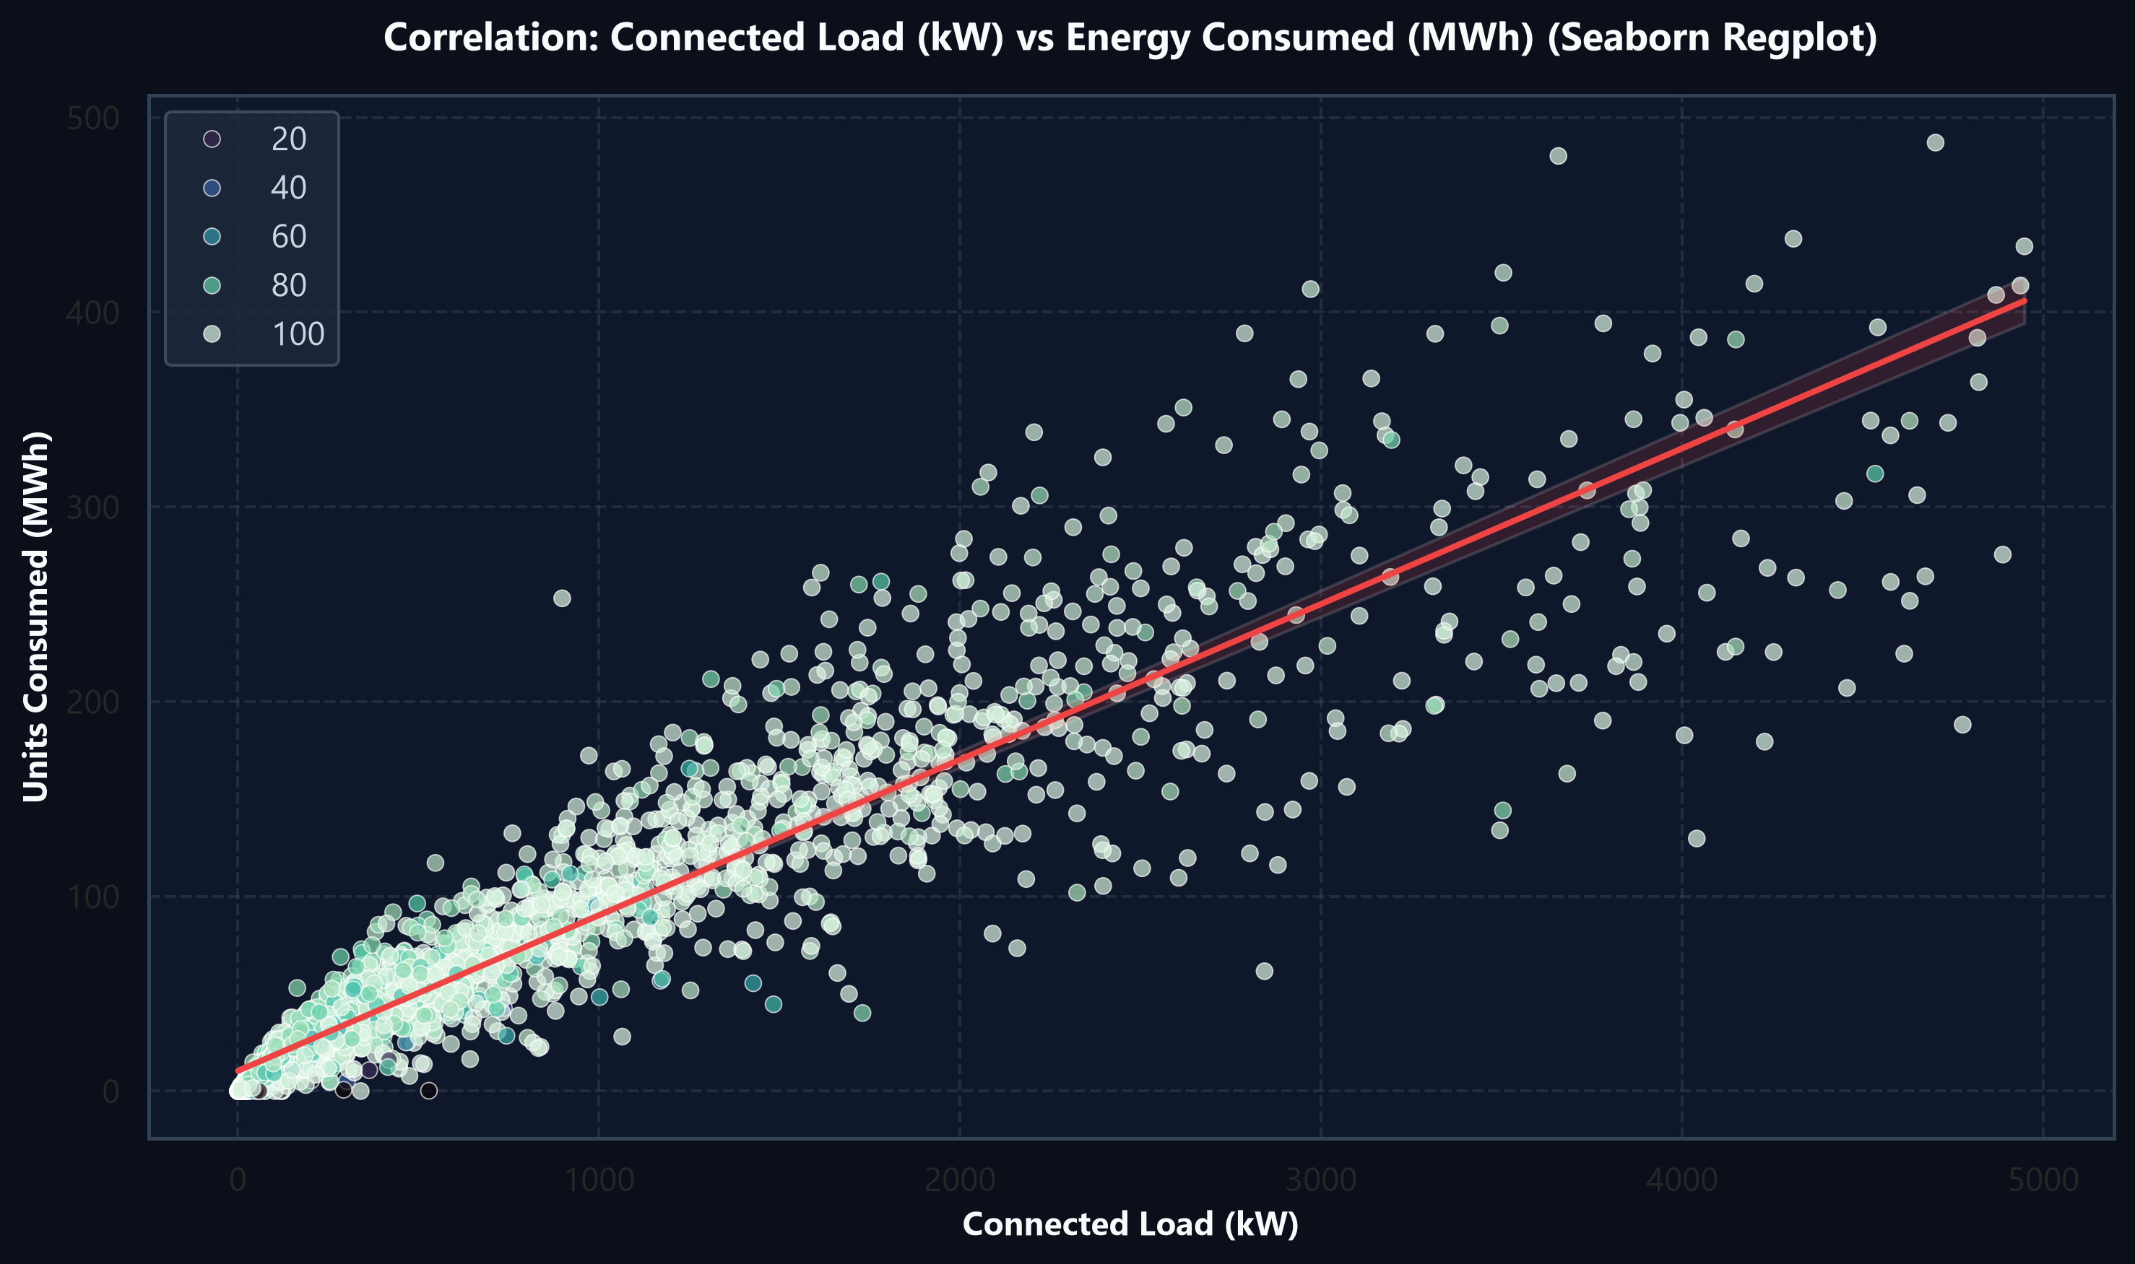
PILLAR 5: VARIABLE CONNECTIONS
Pearson Correlation Analysis & Regression Dynamics
TG-SPDCL | DAV Project v4
Compact Syllabus Edition (11 Slides)
Investigating mathematical dependencies between connected load, connections, and energy demand
Variable Pair | r | Strength | Operational Interpretation
LOAD ↔ UNITS | +0.946 | Very Strong | Connected load capacity directly governs consumption.
SERVICES ↔ BILLED | +0.995 | Near Perfect | Registered connections dictate billed services.
BILLED ↔ UNITS | +0.884 | Strong | Larger customer base reliably scales energy usage.
SERVICES ↔ LOAD | +0.763 | Moderate-High | Sanctioned capacity scales with household counts.
Regression Slope & Association vs Causation
• Linear Regression Trend (Red Line): Empirically validates strong linear scaling. For every 1,000 kW of connected capacity, monthly energy increases by ~90 MWh.
• Dense Baseload Band: The primary cluster between 0–2,000 kW displays tightly bounded, highly predictable residential behavior.
• High Vertical Scatter: Sectors located high above the line reflect intense air conditioning or commercial activity billed on domestic tariffs.
• Correlation != Causation: Load provides the physical pipeline, but summer temperature and affluence drive actual kilowatt-hour draw.
Figure: Connected Load (kW) vs Consumed Energy (MWh) with Seaborn Regplot
TG-SPDCL Domestic Electricity Consumption & Monitoring | Data Analytics & Visualization (DAV) | July 2026
Slide 6 of 11

Slide 7
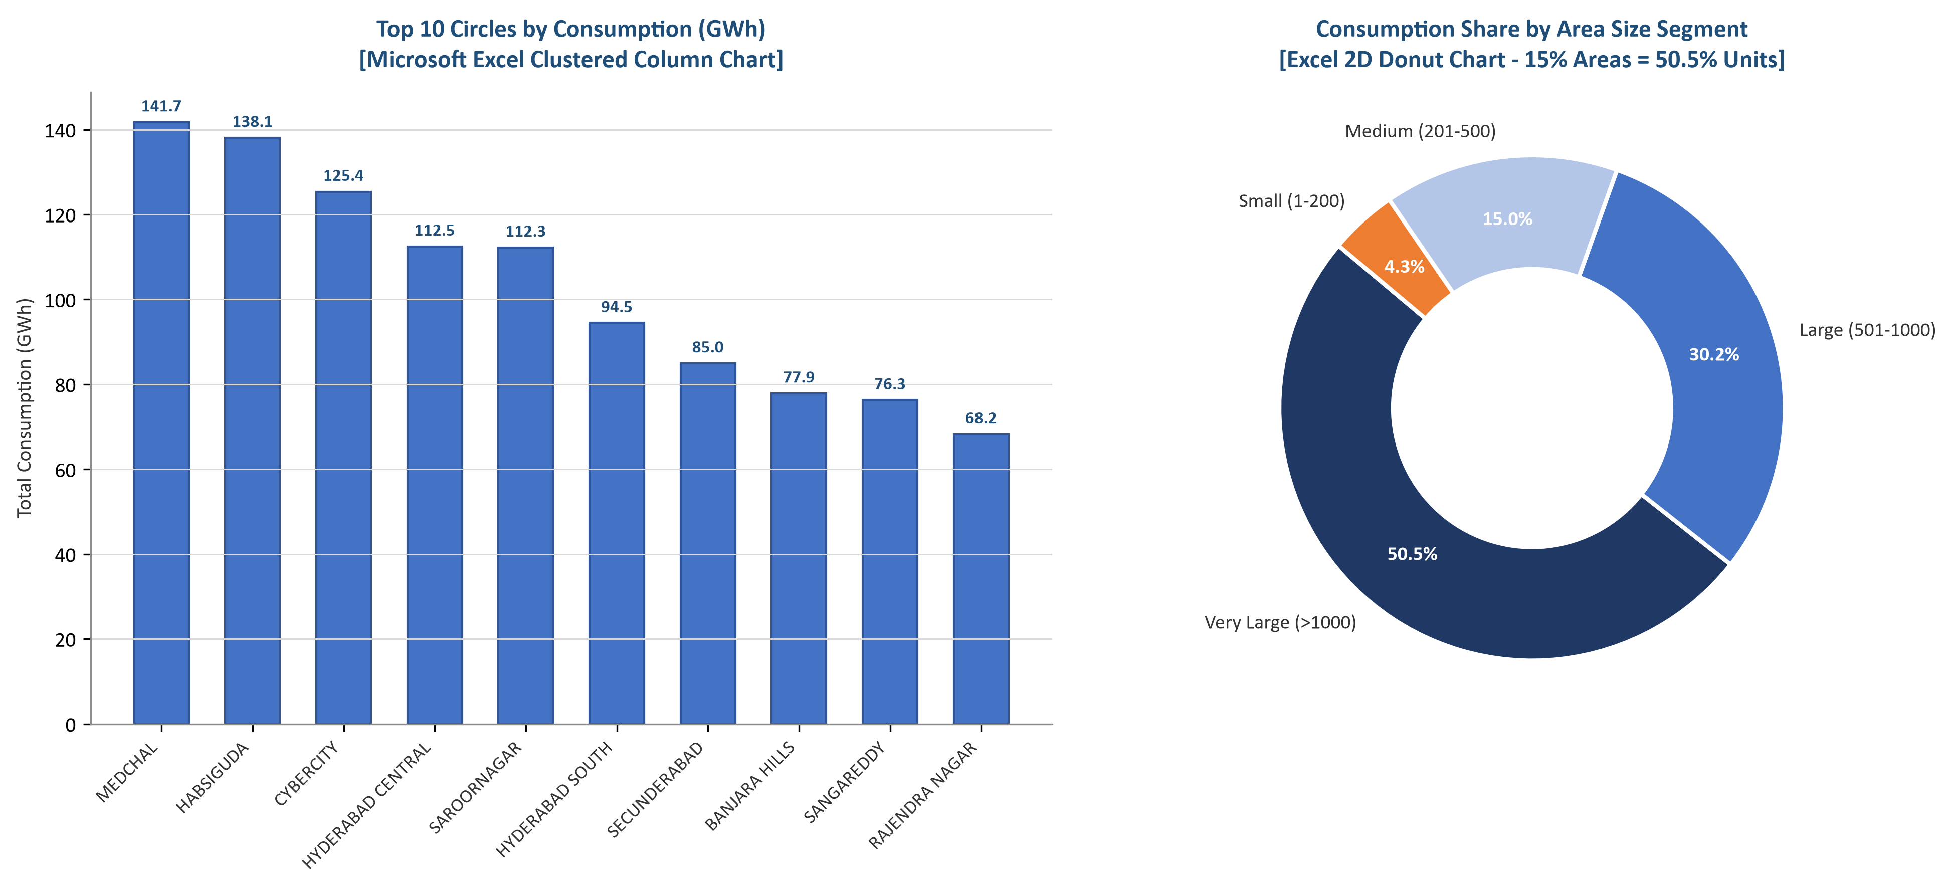
PILLAR 6: EXCEL VISUALIZATIONS
Microsoft Excel Analytics: Pivot Tables & Visual Dashboards
TG-SPDCL | DAV Project v4
Compact Syllabus Edition (11 Slides)
Rapid ad-hoc exploratory analytics, slicing, clustered columns, and tool capability boundaries
Excel Pivot Table & Slicer Workflows
• Hierarchical Grouping: Rows: CIRCLE > DIVISION > SECTION. Values: Sum of Units, Sum of Load, Average Units per Service.
• Interactive Slicers: Added slicers for CIRCLE and DIVISION for instant zero-code field station filtering.
• Calculated Fields: Created 'Billing Efficiency %' field within the Pivot Table to benchmark sections against 95%.
• Conditional Formatting: Applied soft red data bars and cell highlights to flag low-billing sections in seconds.
Excel Strengths vs Tool Boundaries
• Excel Advantages: Accessible to all utility managers; standard for tariff regulatory filings and rapid ad-hoc slicing.
• Scale Constraints: Performance degrades on multi-million row smart meter telemetry datasets.
• Lack of Advanced Statistics: Cannot natively generate KDE distribution curves, regression confidence intervals, or automated heatmaps.
• Reproducibility Risk: Vulnerable to accidental cell formula overwrites; Python automation guarantees 100% reproducible pipelines.
Figure: Microsoft Excel Clustered Column & 2D Donut Visualizations
TG-SPDCL Domestic Electricity Consumption & Monitoring | Data Analytics & Visualization (DAV) | July 2026
Slide 7 of 11

Slide 8
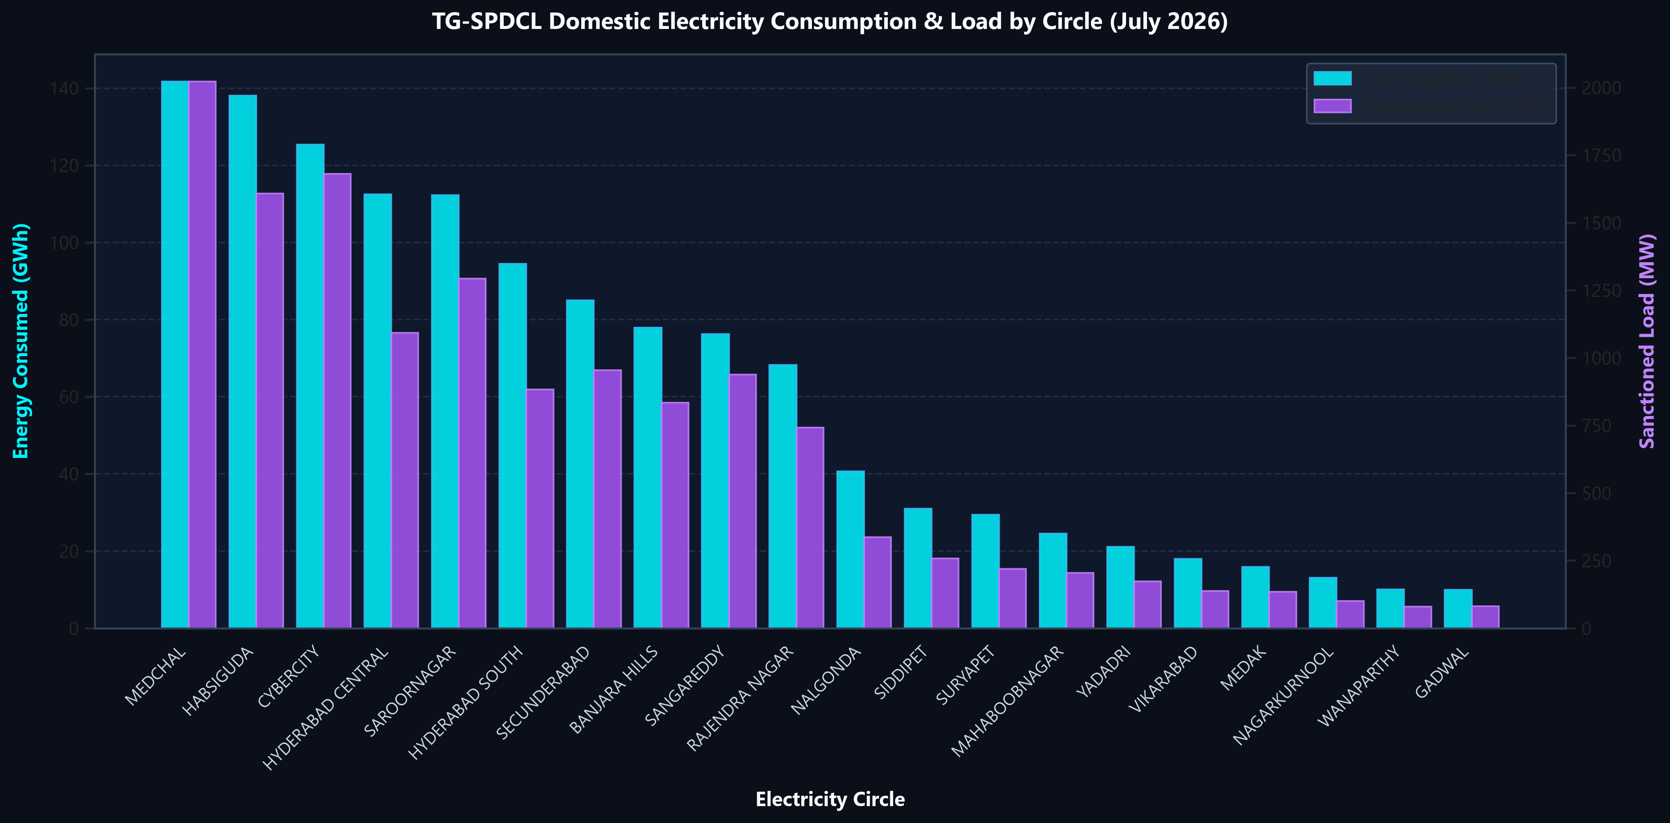
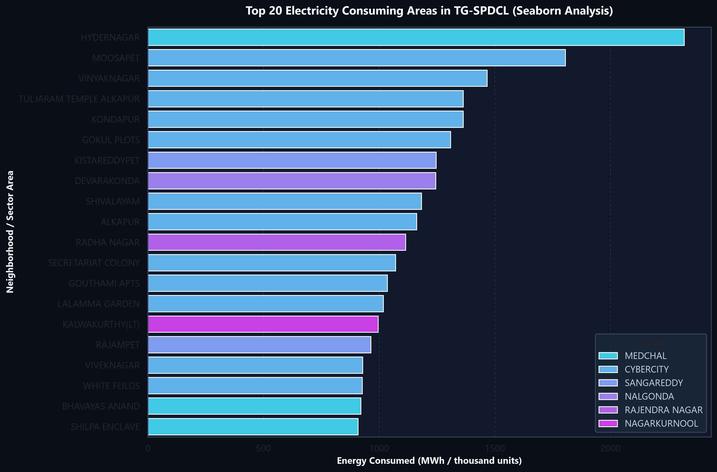
PILLAR 7: PYTHON VISUALIZATIONS
Dual-Axis Infrastructure Analysis & Top 20 Demand Hotspots
TG-SPDCL | DAV Project v4
Compact Syllabus Edition (11 Slides)
High-resolution Matplotlib & Seaborn plots mapping circle capacity and neighborhood epicenters
Figure 1: Energy Consumed (GWh) & Sanctioned Load (MW) by Circle (Matplotlib & Seaborn)
Figure 2: Top 20 High-Demand Areas in TG-SPDCL (Seaborn Barplot)
Key Infrastructure Takeaways
• Proportional Grid Symmetry: Consumption (cyan bars, GWh) and Connected Load (purple bars, MW) match with near-perfect alignment across all 20 circles, validating infrastructure sizing.
• Top Demand Epicenters: Hydernagar (2.32M kWh), Moosapet (1.81M), and Vinayaknagar (1.47M) lead state-wide consumption, requiring targeted transformer upgrades.
TG-SPDCL Domestic Electricity Consumption & Monitoring | Data Analytics & Visualization (DAV) | July 2026
Slide 8 of 11

Slide 9
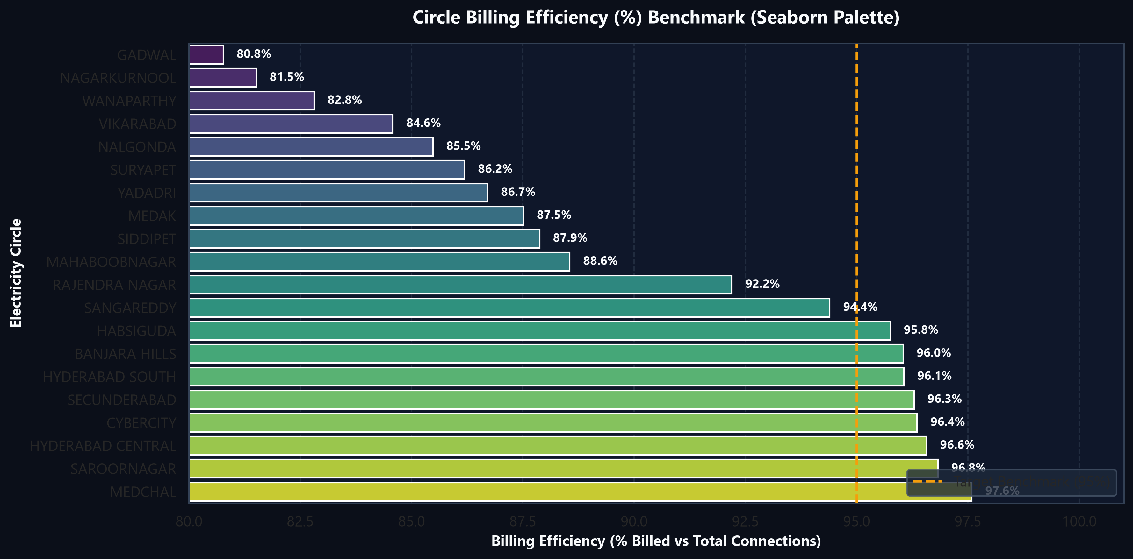
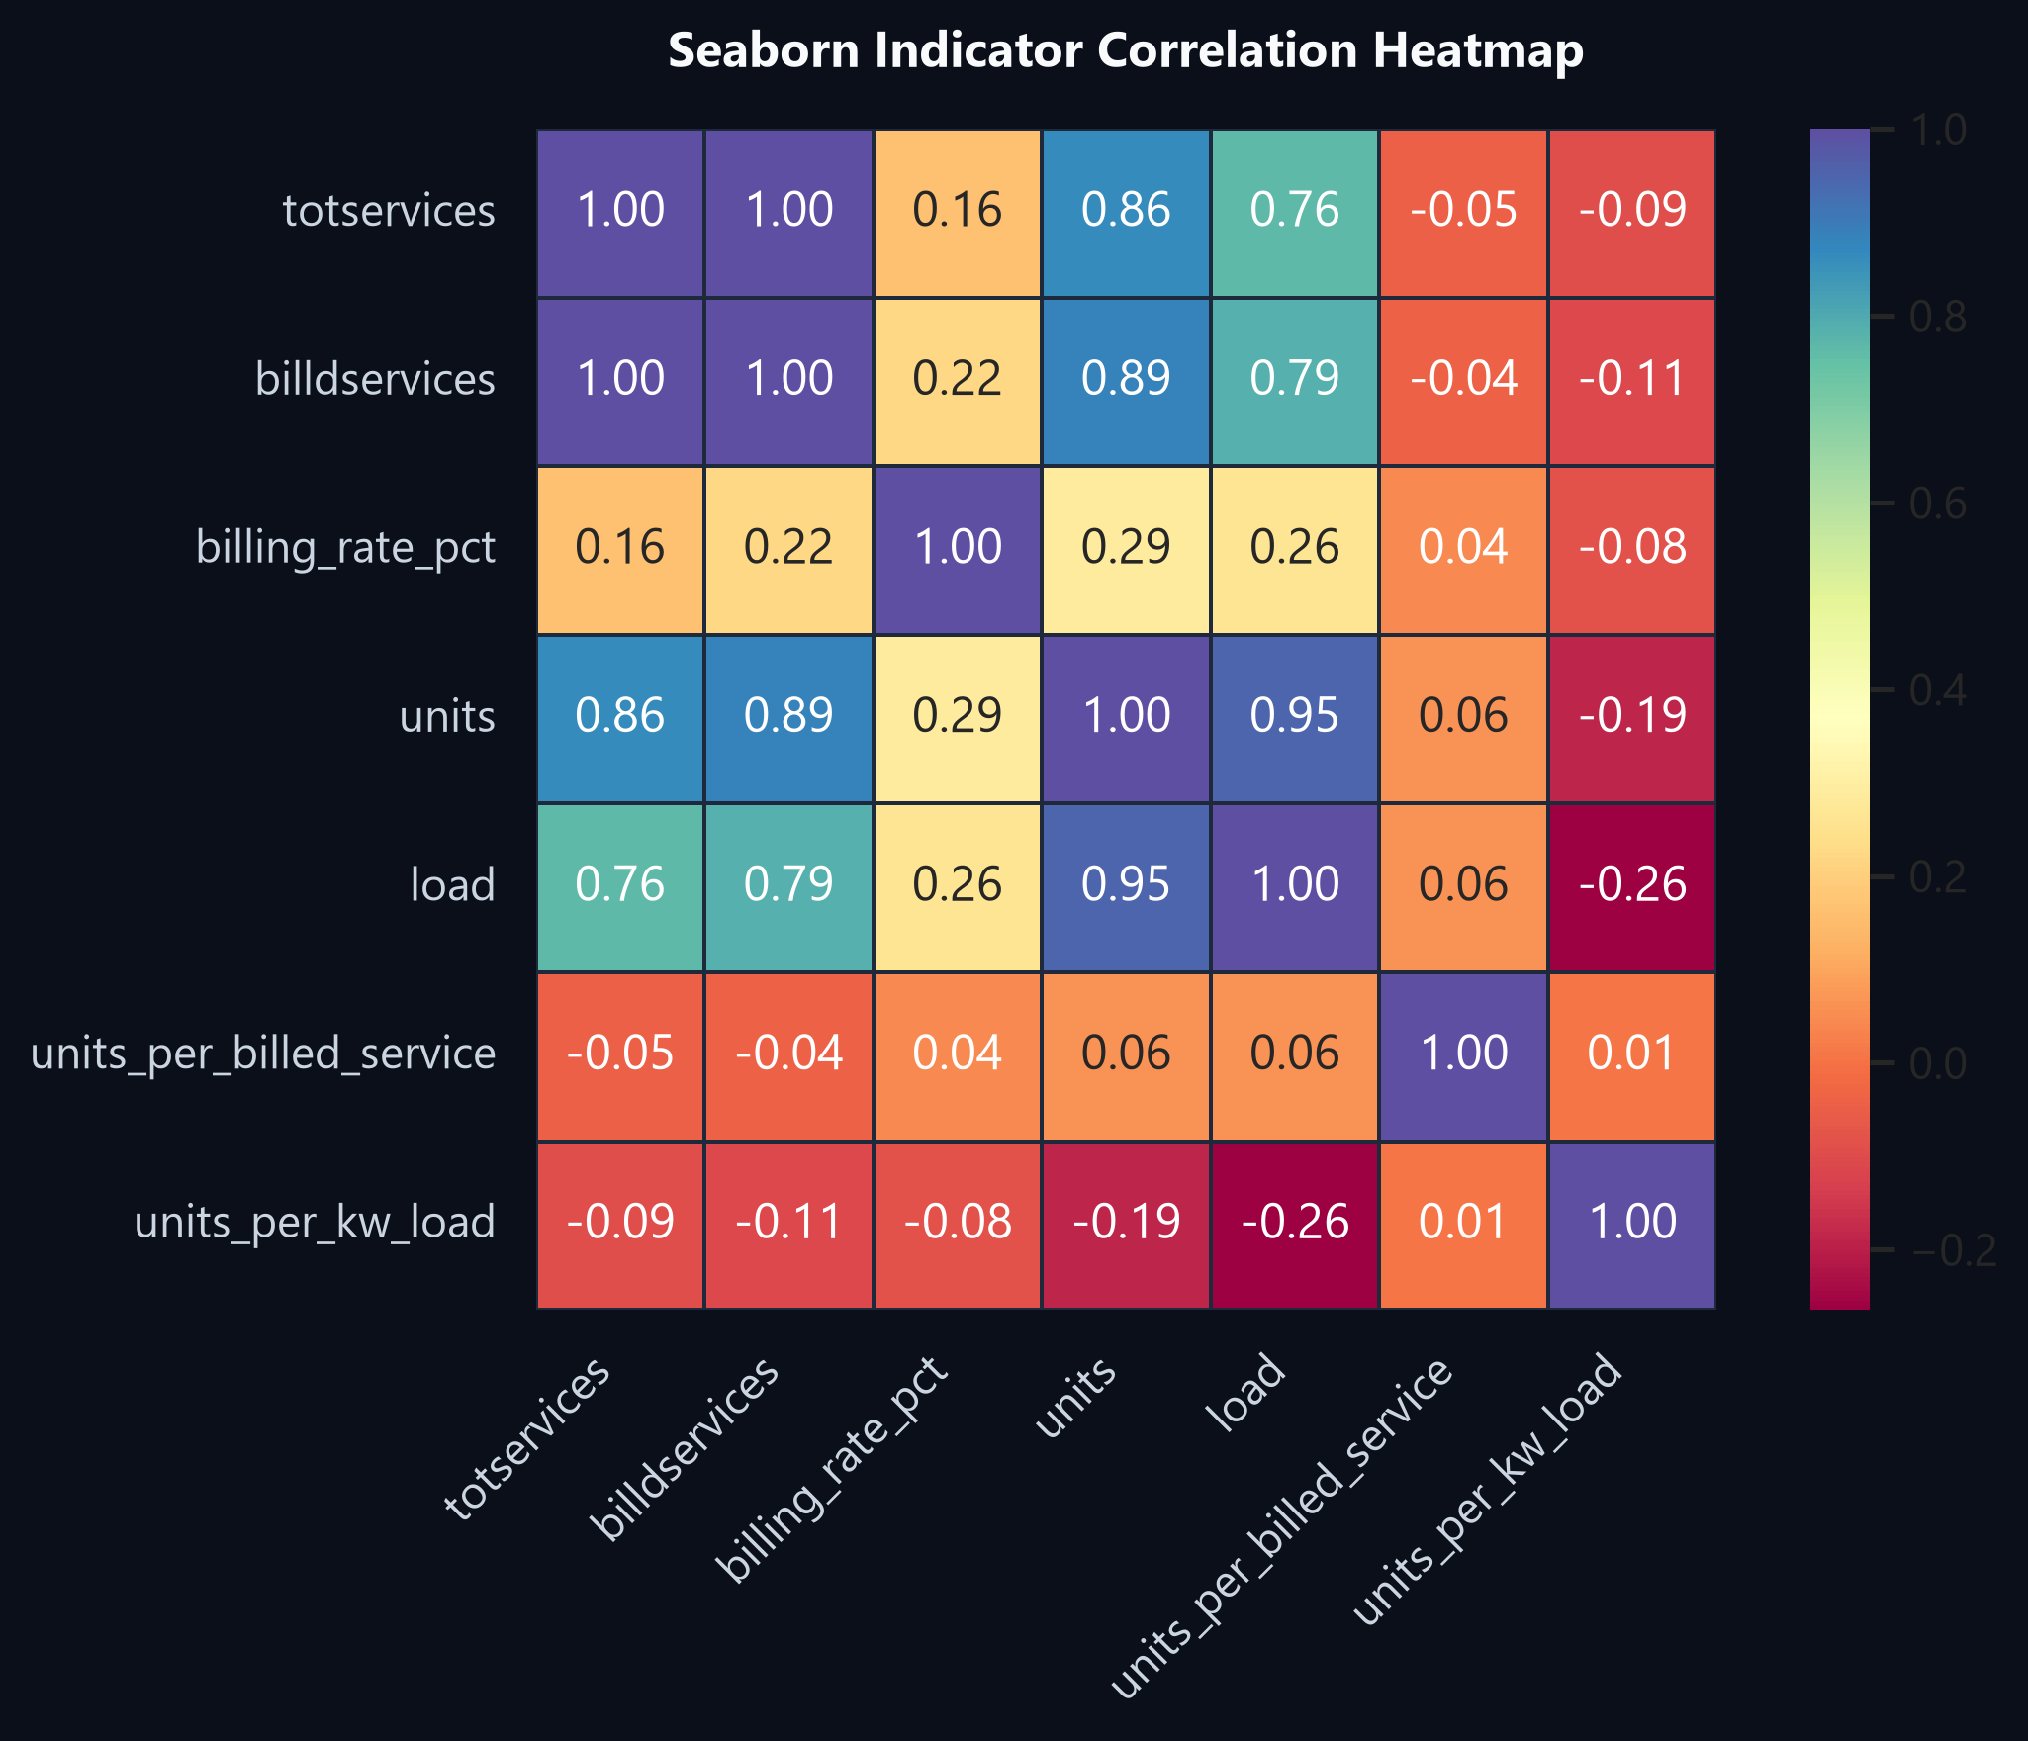
PILLAR 7: PYTHON VISUALIZATIONS
Section Billing Efficiency Benchmark & Distribution Metrics
TG-SPDCL | DAV Project v4
Compact Syllabus Edition (11 Slides)
Evaluating circle compliance against the 95% target, household KDE spread, and feature correlations
Figure 3: Circle Billing Efficiency (%) vs 95% Benchmark (Seaborn Viridis)
Figure 4: Seaborn Indicator Correlation Heatmap (Spectral Palette)
Distribution & Compliance Synthesis
• 5 Circles Below 95% Benchmark: Saroornagar and rural district circles show significant unbilled gaps requiring prioritized field inspection squads.
• Strong Multi-Collinearity Confirmed: Spectral heatmap verifies heavy interdependence between Load, TotServices, and Units (+0.95), reinforcing regression findings.
TG-SPDCL Domestic Electricity Consumption & Monitoring | Data Analytics & Visualization (DAV) | July 2026
Slide 9 of 11

Slide 10
PILLAR 8: FINAL DECISION
Strategic Decision Framework: 4 Pillars & Phased Implementation
TG-SPDCL | DAV Project v4
Compact Syllabus Edition (11 Slides)
Data-driven operational interventions to maximize utility revenue and grid stability
Pillar 1: Infrastructure Augmentation
Pillar 2: Revenue Protection & Audits
Pillar 3: Smart Grid Modernization
Pillar 4: Tariff & Peak Management
Focus: Prioritize Top 15% Areas
Focus: Resolve 648k Unbilled Services
Focus: Automated Smart Metering (AMI)
Focus: Time-of-Day (ToD) Pricing
Target distribution transformer (DTR) capacity doubling on the 2,452 'Very Large' areas driving 50.5% of demand (Hydernagar, Moosapet, Kukatpally).
Deploy field squads to audit the 247 zero-billed sections and 15 negative-unit areas. Enforce billing compliance in circles lagging below 90%.
Roll out IoT smart meters in high-intensity areas (>250 kWh/kW) and resolve area name ambiguity via GIS composite key tagging.
Introduce dynamic ToD tariffs for domestic connections > 10 kW to shave peak evening residential loads and incentivize off-peak charging.
Phase 1: Immediate Sprint (Days 1–30)
Phase 2: Targeted Deployment (Days 31–180)
Phase 3: Utility Transformation (Year 1)
Audit 247 zero-billed sections, verify 15 negative-unit areas, and deploy GIS keys.
Upgrade transformers in top 15% areas, install 250k smart meters, launch live web dashboard.
Achieve 97%+ billing efficiency across all circles, rollout ToD tariffs, and predictive ML failure models.
TG-SPDCL Domestic Electricity Consumption & Monitoring | Data Analytics & Visualization (DAV) | July 2026
Slide 10 of 11

Slide 11
PILLAR 8: FINAL DECISION
Business Impact, Financial ROI & Project Conclusion
TG-SPDCL | DAV Project v4
Compact Syllabus Edition (11 Slides)
Quantifiable returns, system reliability improvements, and summary conclusions
+4.5% Billing Efficiency
-35% Transformer Failures
100% Feeder Traceability
Real-Time Telemetry
Unlocks ₹85–110 Crore annually by converting unbilled connections to active revenue.
Targeted DTR load doubling prevents summer overheating across top 15% sectors.
Complete elimination of repeated area name ambiguity via GIS composite key tagging.
Interactive monitoring portal enables daily loss tracking rather than 30-day manual delays.
Executive Summary & Analytical Conclusions
• Complete 8-Pillar Alignment: Demonstrated end-to-end data lifecycle from raw multi-file ingestion to statistical modeling, dual-axis visualization, and strategic policy decisions.
• High Urban Demand Concentration: Over 50.5% of electricity is driven by just 15.4% of neighborhood sectors in the Greater Hyderabad ring, requiring focused capital allocation.
• Strong Predictive Reliability: Connected Load (kW) and Units (kWh) show near-perfect linear correlation (r = 0.946), enabling accurate forward demand forecasting.
• Actionable Revenue Gains: Addressing the 648,960 unbilled connections offers immediate high-ROI financial recovery for TG-SPDCL.
• Academic & Professional Quality: Completed by Research Team: D. Chander (2503A52214), K. Arjun (2503A52235), P. Sachin (2503A52240). Open for Q&A.
TG-SPDCL Domestic Electricity Consumption & Monitoring | Data Analytics & Visualization (DAV) | July 2026
Slide 11 of 11

