Slide 1

A Talk by Arjun Kathuria

Slide 2

How I hand-coded core Machine learning Algorithms from scratch in python, what i learned, and why you should too.

Slide 3

About the Speaker (Me)
Hi,
I am Arjun Kathuria, an independent software developer and hacker from New Delhi, India.
I was a Google summer of code student 2016 with jQuery Foundation.
I also held the position of the sole lead frontend software developer for a high growth startup in Bangalore from early 2017 to mid 2018, which i left to follow and pursue my other interests in computer science and music.
I am currently into python, machine learning, full-stack development projects, exploring lower level Kernel stuff and Rust.
Github: github/arjunkathuria
Twitter: @arjunslays
insta: @arjunslays
email: arjun.kathuria8@gmail.com

Slide 4
The premise / introduction

Slide 5
Chapter 1
Demystifying Machine learning.

Slide 6
WHAT is machine learning ?

Slide 7
I’ll do you one better
Who is machine learning ?

Slide 8
I’ll do you one even better
WHY is machine learning ?

Slide 9
What one extreme of the spectrum believes what Machine Learning is
…

Slide 10


Slide 11
What the other extreme of the spectrum believes what Machine Learning is
…

Slide 12
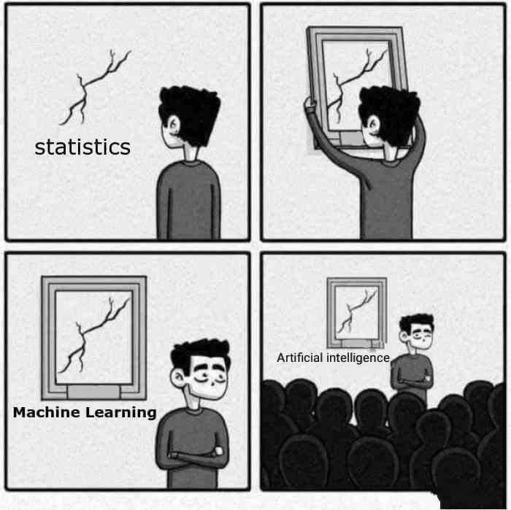

Slide 13
Well, Yes and No.
Its somewhere in the middle
The fundamentals of machine learning are still true to core statistics, but in practice, as of today, it has grown into something much bigger (as we will see).

Slide 14
When you zoom out and tune out the noise
Machine learning pertains to extraction of knowledge from data by building intelligent (often self-learning) agents / systems in order to make predictions.
In its simplest form -

Slide 15
Chapter 2 :
Machine Learning, The Big Picture.

Slide 16
All the cool stuff that you hear about. The wicked ML algorithms, the fancy sounding classifiers, the Neural Networks, They are just one part - The learning part - of a much larger picture of the ML field.
These different processes can broadly be classified into 4 sections
Data pre-processing.
Learning.
Evaluation.
Prediction.

Slide 17
Machine learning systems: The Big Picture

Slide 18
Machine Learning, a broad field.
Machine Learning
Supervised Learning
Unsupervised Learning
Reinforcement Learning
Labeled data
Predicts outcome
Eg: Classifiers like spam filters, text / character recognition
Unlabelled data
Finds hidden structure in data
Eg: Clustering, user segmentation etc.
Interacts with environment.
Decision process based on a reward system
Eg: Game playing agents.

Slide 19
Supervised learning in a nutshell
Labelled Training Data
Machine Learning Algorithm
New Data
Predictive Model
Prediction

Slide 20
Chapter 3: The Algorithms

Slide 21
The classification algorithms to be covered
The Perceptron classifier algorithm + The Adaline algorithm
Logistic Regression

Slide 22
Dataset
The ubiquitous Iris dataset is used for all code and examples in the talk
The dataset consists of 150 rows or measurements of the Iris flowers of 3 different species, namely - Virginica, Setosa and Versicolor - (50 of each) and it measures 4 of the flower features for each measurement.
The Sepal length
The Sepal Width
Petal Length
Petal Width

Slide 23
Data Shape
 | Sepal Length | Sepal Width | Petal length | petal width | Class Label
1 | 5.1 | 3.5 | 1.4 | 0.2 | Iris-setosa
2 | 4.9 | 3.0 | 1.4 | 0.2 | iris-setosa
. . . | . . . | . . . | . . . | . . . | . . .
149 | 6.2 | 3.4 | 5.4 | 2.3 | iris-virginica
150 | 5.9 | 3.0 | 5.1 | 1.8 | iris-virginica

Slide 24
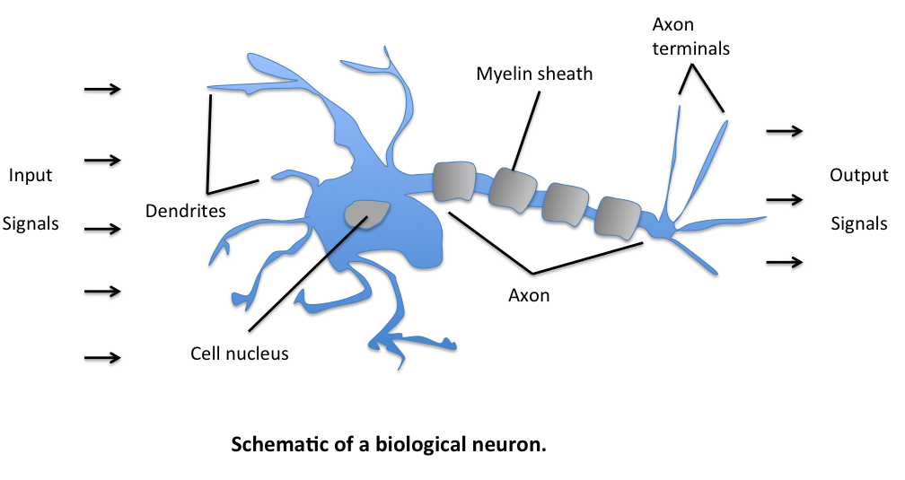
Modelling the artificial neuron
So, how a biological neuron works is, it receives multiple signals from the dendrites. Now if the total strength of signal exceeds a certain threshold, an output signal is generated and passed on by the axon terminals.
This, artificially can be modelled as a logic gate with a binary output, indicating if the input exceeds the given threshold. 1 if it does, 0 if it doesn’t.

Slide 25
Artificial neuron applied to a classification task.
WIP

Slide 26
The Perceptron Algorithm
One of the earliest classification algorithms known for binary classification.
Overview of How it works without getting into the math.
Initialise a set of weights (numbers, often random) equal to the number of features on the training set. i.e 1:1 mapping from a feature vector to a weight vector.
For each training sample
Calculate the net input by linear combination of the weight and feature vectors. net input is also sometimes known as weighted input.
If the net input is greater than a threshold, predict class A else predict class B (or not of class A), often numerically coded as 1 and -1. computationally, this is done by a decision function.
Update the weights based on the perceptron learning rule, so that it is more accurate the next time.
$$x^{(i)}$$

Slide 27
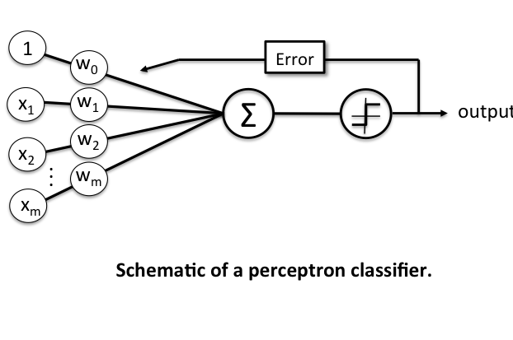
The Schematic
Net input /
weighted input
Decision
function

Slide 28
Terminology and Components of Perceptron Learning Rule.
Input Vector / Input matrix / Input values:- the data values as a vector/matrix/rows
Weight Vector:- a column vector containing weights for each dimension of input value.
Net input:- The linear combination of the input values (x) and the weight vector (w)
$$w=\left[\begin{aligned}w_{1} \\ . \\ . \\ . \\ w_{m}\end{aligned}\right]andx=\left[\begin{aligned}x_{1} \\ . \\ . \\ . \\ x_{m}\end{aligned}\right],$$
then the net input
$$z=w_{1}x_{1}+w_{2}x_{2}+...+w_{m}x_{m}$$
$$w^{T}=\left[\begin{aligned}w_{1}...w_{m}\end{aligned}\right]andx=\left[\begin{aligned}x_{1} \\ . \\ . \\ . \\ x_{m}\end{aligned}\right],$$
more concisely, we can say
$$z=w^{T}x$$
Where

Slide 29
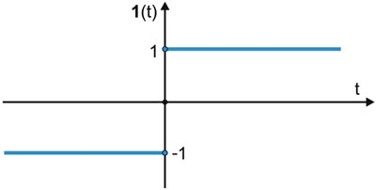
Now, in context of binary classification task, if the net input of a particular sample is greater than a defined threshold θ, we predict class 1, else class -1.
In case of perceptron, the decision function is a variant of the step function.
$$ϕ(z)=\{_{-1otherwise}^{1ifz≥θ}$$
Where
$$z=w^{T}x$$
The value for updating the weights at each increment is calculated by the learning rule

Slide 30
Perceptron learning rule
The value for updating the weights at each increment is calculated by the learning rule
$$Δw_{j}=η(target^{(i)}-output^{(i)})x_{j}^{(i)}$$
$$Δw_{j}$$
= Weight Update
$$η$$
= Learning Rate
, the learning rate (a constant between 0.0 and 1.0), “target” is the true class label, and the “output” is the predicted class label.
$$η$$
In the cases where the perceptron predicts the class label correctly, the weights remain unchanged:
$$Δw_{j}=η(1^{(i)}-1^{(i)})x_{j}^{(i)}=0$$
when true class label is 1 and the prediction is also 1
$$Δw_{j}=η(-1^{(i)}--1^{(i)})x_{j}^{(i)}=0$$
when true class label is -1 and the prediction is also -1

Slide 31
In the case of wrong prediction, the weights are “PUSHED” towards the direction of the positive or negative target class, respectively:
$$Δw_{j}=η(1^{(i)}--1^{(i)})x_{j}^{(i)}=η(2)x_{j}^{(i)}$$
when true class label is 1 and the prediction is -1
$$Δw_{j}=η(-1^{(i)}-1^{(i)})x_{j}^{(i)}=η(-2)x_{j}^{(i)}$$
when true class label is -1 and the prediction is 1
NOTE
it is important to note that all weights in the weight vector are being updated simultaneously. thus, for a 2-dimensional dataset, the updates would update each weight individually:
$$Δw_{1}=η(target^{(i)}-output^{(i)})x_{1}^{(i)}$$
$$Δw_{2}=η(target^{(i)}-output^{(i)})x_{2}^{(i)}$$

Slide 32
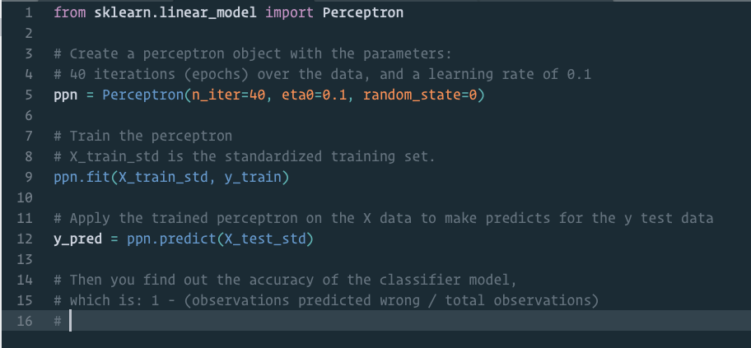
Python Code to train a perceptron model imported form sci-kit learn library

Slide 33
What we need:-
We need to initialize a Perceptron class instance with some given parameters
The learning rate.
The number of iterations after which to stop.
a random state as a seed to the random number generator for weights, for reproducibility.
That instance must contain:-
A Fit method :- which fits the model on training data
A Predict method :- which predicts the classification of new data.
some sort of metric to calculate efficiency of model

Slide 34
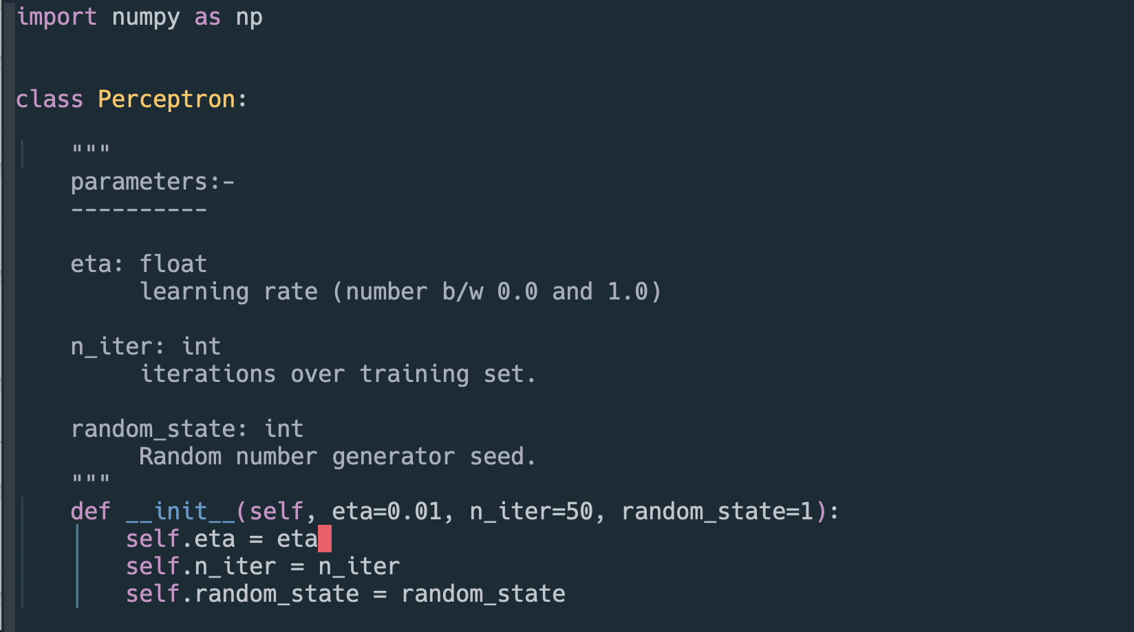
Writing your own Perceptron Classifier in Python
The init method

Slide 35
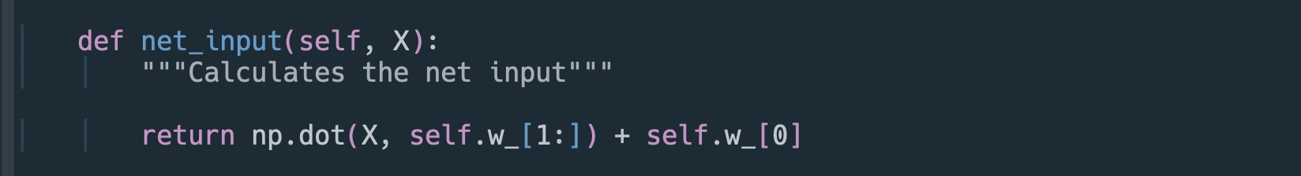
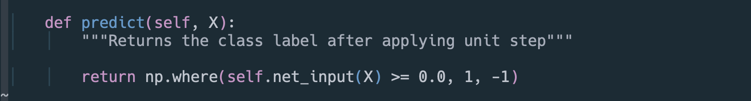
The net_input method
The predict method

Slide 36
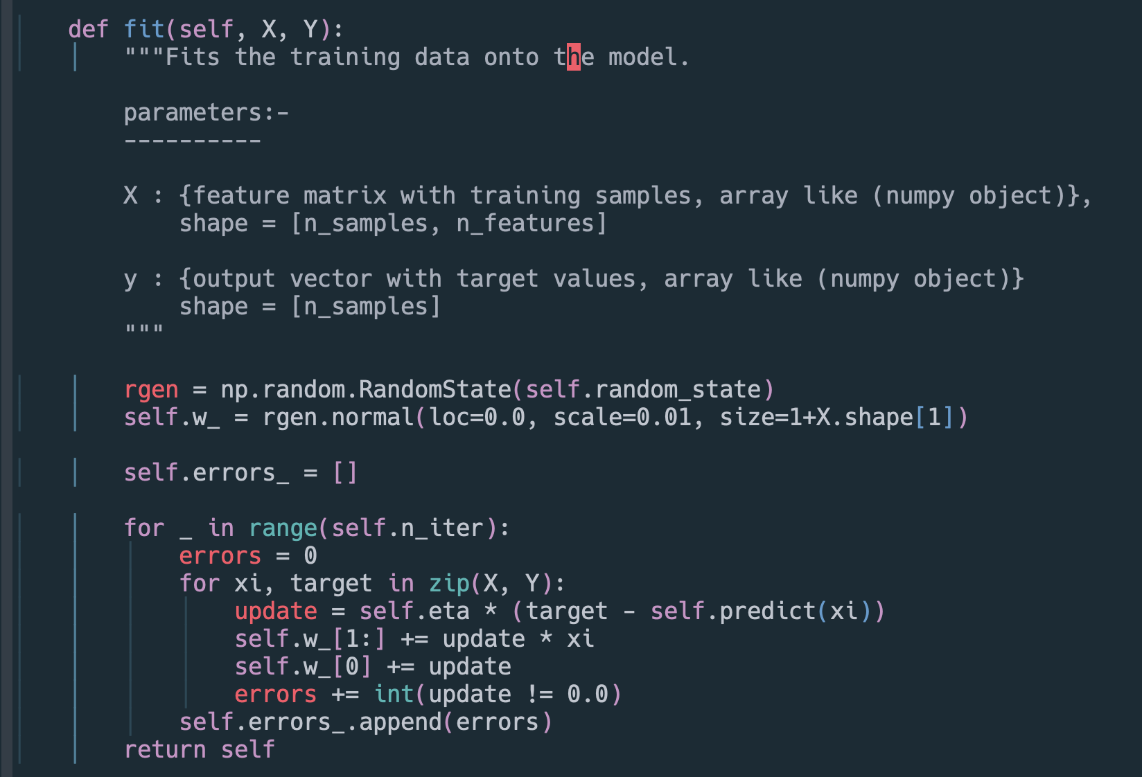
The fit method

Slide 37
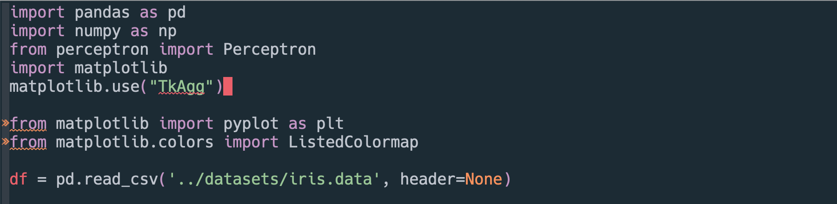
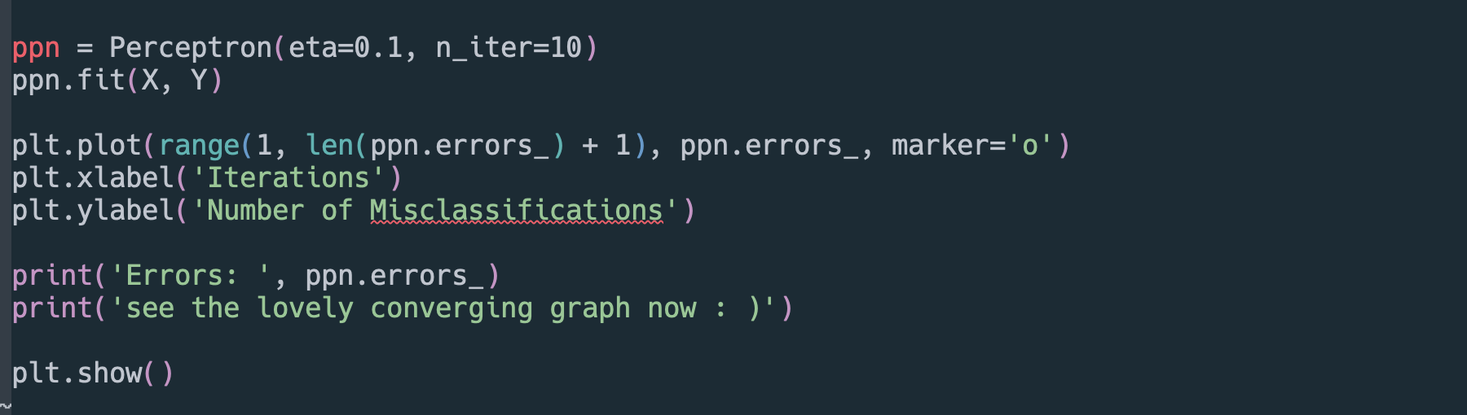
Training and plotting the Perceptron

Slide 38
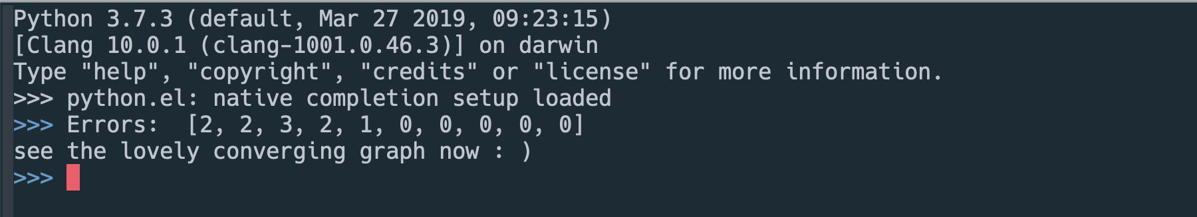
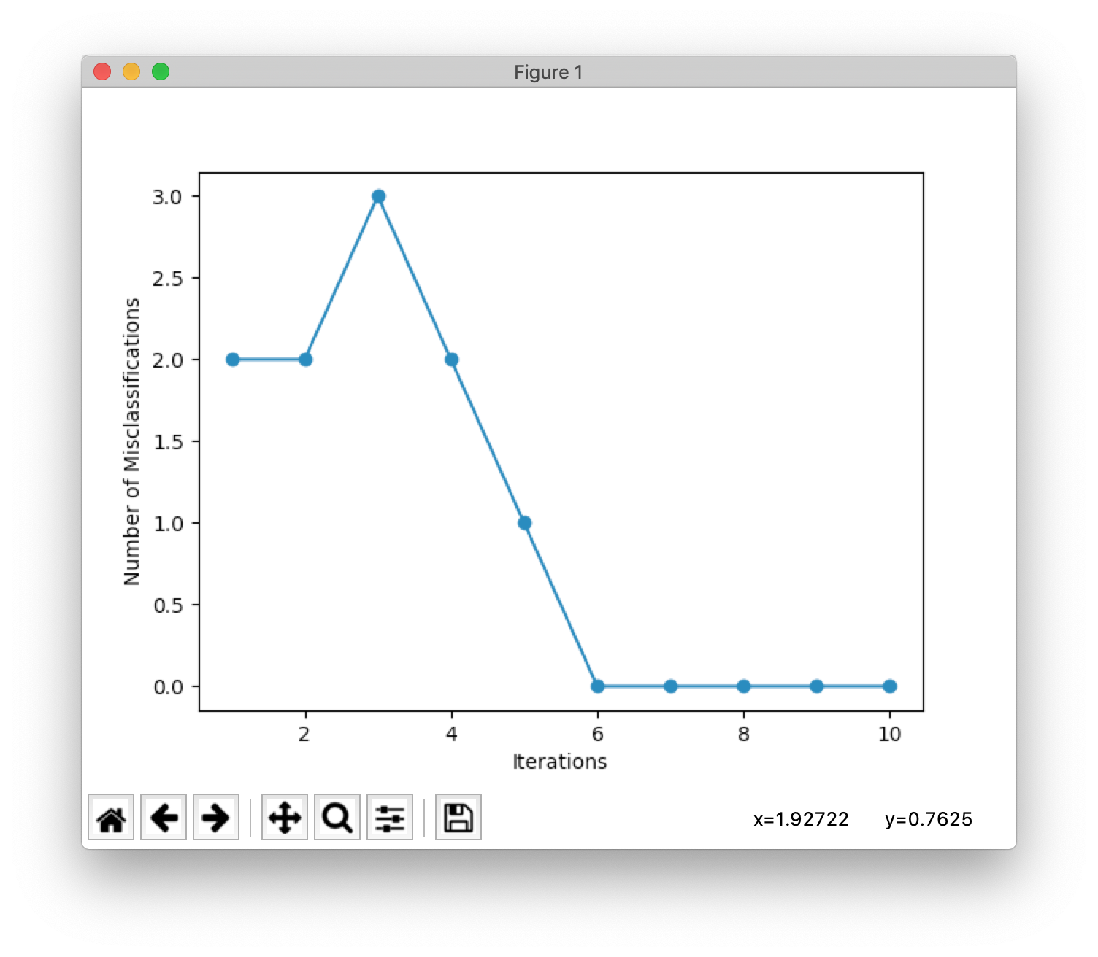

Slide 39
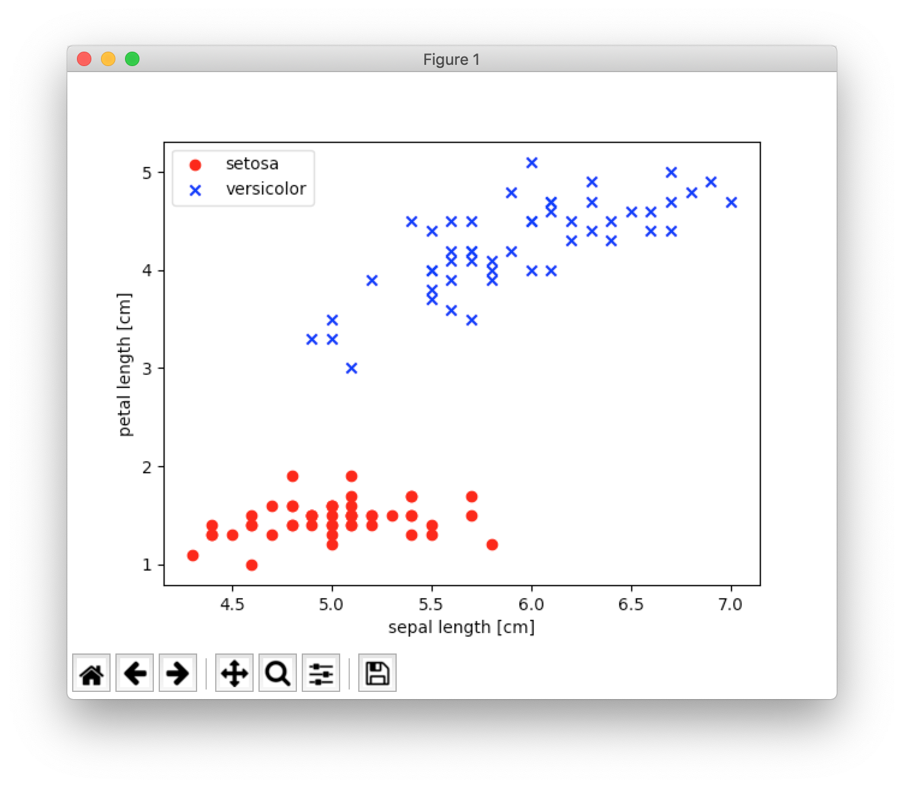

Slide 40
The Adaptive Linear Neuron or Adaline algorithm
Very similar to the perceptron algothim.
Work in progress [WIP]

Slide 41
The Logistic Regression Algorithm.
Work in progress [WIP]

Slide 42
Summary
WIP

Slide 43
Learnings and Outro
WIP

Slide 44
*Cue to Q/A session with the audience*

