Slide 1
Factors affecting on student's performance
<NSK>
Gayan moraliyage
Yeonho Lee
Seonbin Lee

Slide 2
Motivation and Background
Research Question
Results and interpretation
t. test
Regression analysis
Multiple regression analysis
4. Conclusion and future work

Slide 3
1. Motivation and back ground
• Many studies that focused on this issue and their findings revealed that many factors have a significant effect on the students performance in exams.
• The focus of this research is that student performance in examination is linked with students’ demographic, social and school related features.

Slide 4
2. Research Question
What are the factors that affect students performance?
List of hypothesis
H₁ : Gender is associated with students exam result
H_{2 :} Whether they paid for additional education is associated with students exam result
H_{3 :} Parents-education level is associated with students exam result
H₄ :Commute time to school is associated with students exam result.
H_{5 :} The number of going out is associated with students exam result.
H_{6 :} The number of absence in one semester is associated with students
exam result.

Slide 5
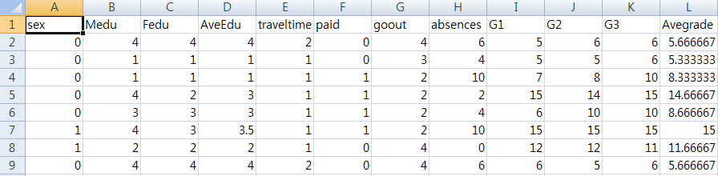
3. T-test

Slide 6
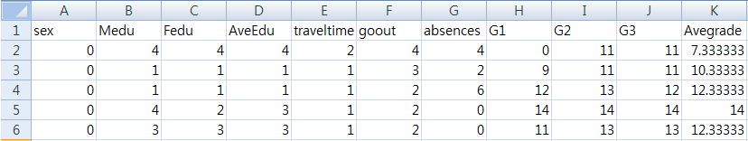
(Math score)
(Portuguese score)
H₁ : Gender is associated with students exam result
H_{2 :} Whether they paid for additional education is associated with students exam result

Slide 7
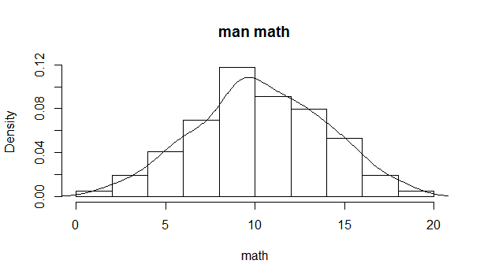
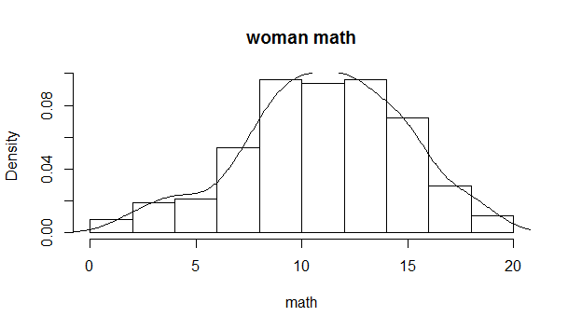
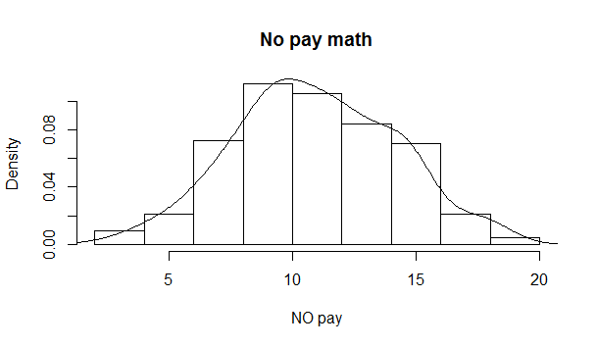
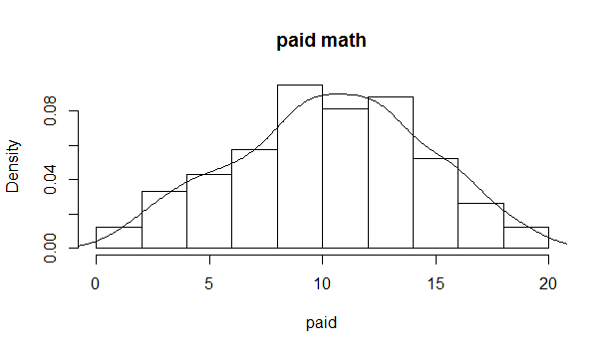
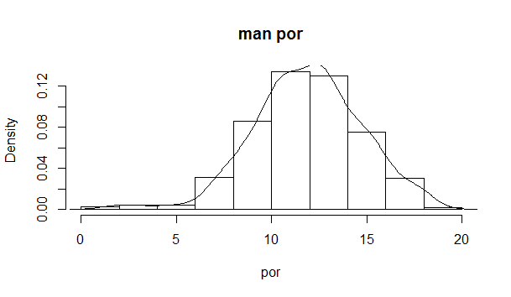
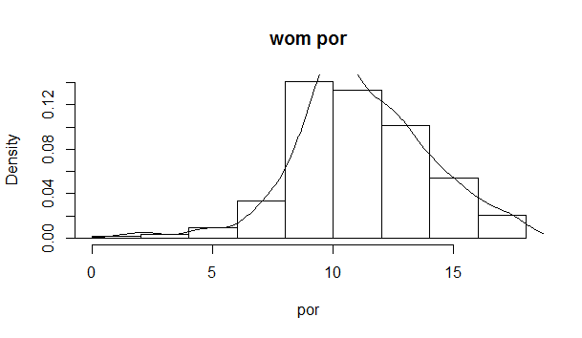

Slide 8
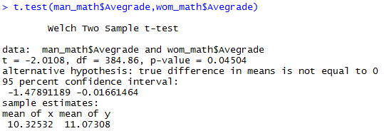
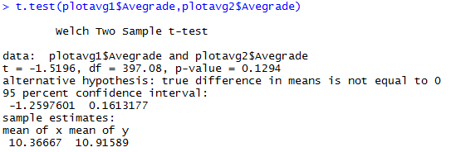

Slide 9
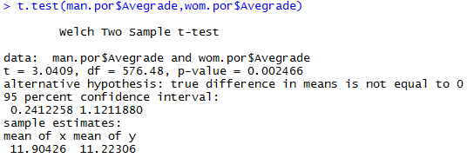
 | Math |  | Por
 | Gender | paid | Gender
p-value | 0.04504 | 0.1294 | 0.002466

Slide 10
Analyzing numeric variable by simple regression
H_{3 :} Parents-education level is associated with students exam result
H₄ :Commute time to school is associated with students exam result.
H_{5 :} The number of going out is associated with students exam result.
H_{6 :} The number of absence in one semester is associated with students
exam result.

Slide 11
Analysis of Math Grade
Math score | P-value | Coefficient | Correlation
Ave-Edu | 8.33E-0.6 | 0.835 | 0.222
Travel time | 0.0107 | -0.679 | -0.128
Going out | 0.0207 | -0.513 | -0.155
Absence | 0.906 | -0.003 | -0.0006
Education level, travel time, the number of going out can affect on student’s performance

Slide 12
Analysis of Portuguese Grade
Portuguese score | P-value | Coefficient | Correlation
Ave-Edu | 1.68E-12 | 0.761 | 0.272
Travel time | 0.0001 | -0.571 | -0.151
Going out | 0.031 | -0.203 | -0.084
Absence | 0.001 | -0.076 | -0.125
All of the factors can affect on student’s performance

Slide 13
Result of simple regression
Interpretation of simple regression
Same result on education level, commute time, going out
Different result on the number of absence with both score
2. Limitation of simple regression
Need to consider interaction between factors
--> Multiple Regression

Slide 14
Multiple Regression Analysis Results- Students Math score
Hypothesis |  | β | P-value | Results
H3 | Parents edu. Level → Students Exam Results | 0.82 | 1.42e-05 *** | Supported
H4 | Commute to school → Students Exam Results | -0.44 | 0.089864 | Not supported
H5 | Going out for fun → Students Exam Results | -0.54 | 0.000792 *** | Supported
H6 | Absences to school → Students Exam Results | -0.006 | 0.760869 | Not supported

Slide 15
Multiple Regression Analysis Results- Students
Portuguese score
Hypothesis |  | β | P-value | Results
H3 | Parents edu. Level → Students Exam Results | 0.71 | 1.07e-10 *** | Supported
H4 | Commute to school → Students Exam Results | -0.31 | 0.03600 * | Supported
H5 | Going out for fun → Students Exam Results | -0.18 | 0.04757 * | Supported
H6 | Absences to school → Students Exam Results | -0.07 | 0.00116 ** | Supported

Slide 16
5. Conclusion and Future Direction
In this direction, we can study how various factor affect the accomplishment of students. Here we consider only few factors and probably there are more factors that may affect for student’s performance. In order to further generalization of our study, we need to consider those factors in future studies.
Further research is needed to explore the problem on a large sample from more scattered geographical regions including other student factors, family factors, school factors and peer factors.
The study may helpful for both college’s policy makers and parents of the students. It helps the college administration to design and implement the policies to improve the students’ performance and the quality of education by changing the attitude of students towards learning, facilitating students and improving the teaching procedures.

Slide 17
Thank you

