Slide 1
Google mobility data An analysis

Slide 2
Systems , Tools and Techniques used for analysis
Built a GUI to display data by the year , GUI to plot data for 4 cites or four boroughs of London and desired category
Data visualization using Seaborn . Multi plot using sns.catplot for multiple category for selected cities or boroughs of London. Sns.relplot for visualizing time series
Bootstrapping to find the confidence intervals of point estimate
Analysis of trends across three UK lockdowns
Correlation between categories
Linear regression between categories and same category for two different cities or bourough
Timeseries analysis – Testing for stationary (ADF test) ,ACF and PCF plots , ARIMA models and forecasting

Slide 3
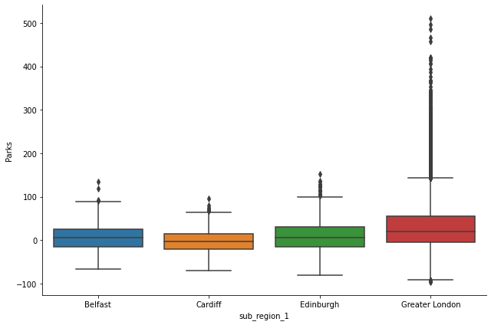
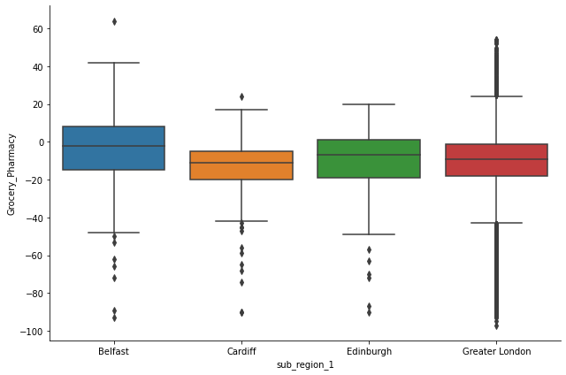
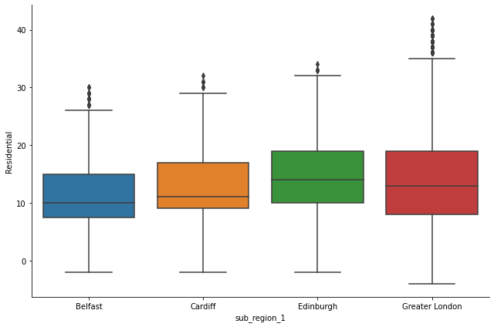
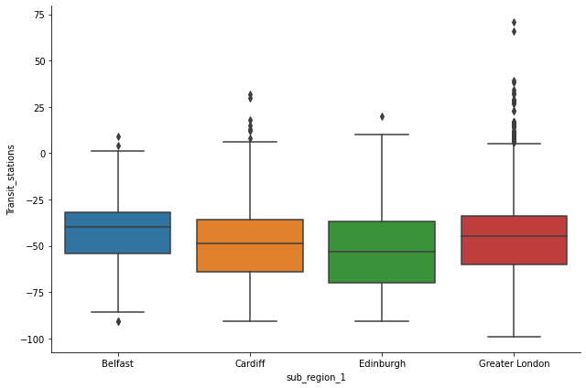
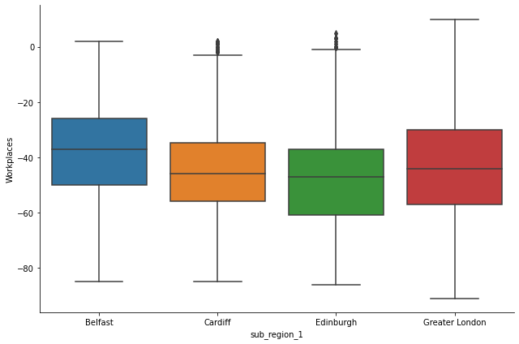
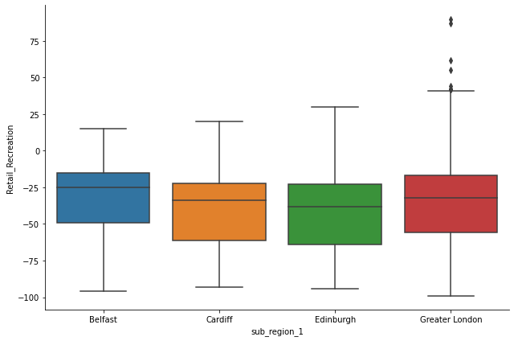
Initial analysis
For the whole period (feb 2020 to Apr 2022) transit has highest drop then workplace has the highest drop
Edinburg then London are cities with highest drop for transit and workplace

Slide 4
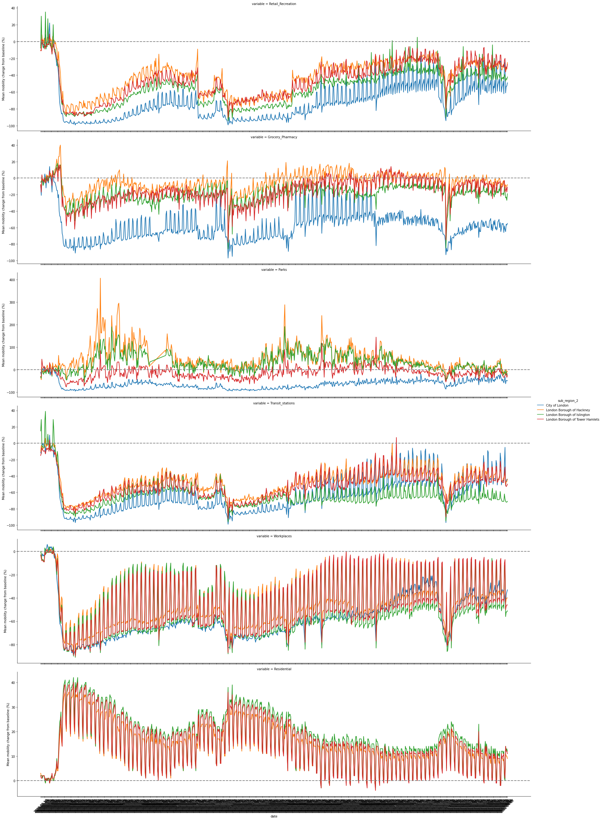
Time series plot of data for different cities
We can see three major drop for all the categories which corresponds to the three-lockdown imposed by the UK government

Slide 5
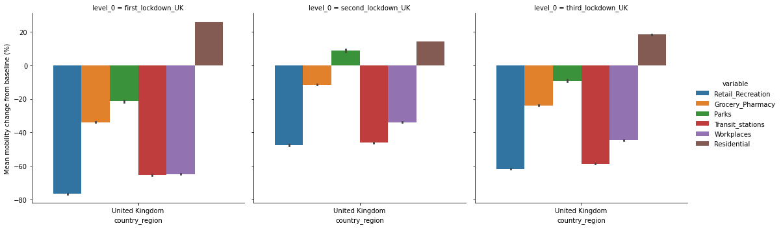
Uk lockdown analysis
First lockdown from 2020-03-24 to 2020-04-13
Second lockdown from 2020-11-05 to 2020-11-25
Third lockdown from 2021-01-06 2021-01-26
Retail has the highest decrease in whole uk then transit after the lockdown were announced . We can see increase in parks mobility after the second lockdown when meeting outdoors was allowed

Slide 6
Third lockdown analysis
Retail Recreation min change is East Renfrewshire Council with value of -46.1 max change is Bath and North East Somerset with value of -76.0
Grocery_Pharmacy min change is Neath Port Talbot Principle Area with value of -3.28 max change is Slough with value of -35.5
for Parks min change is for Parks is South Lanarkshire with value of 31.2 max change is Gwynedd with value of -59.7
Transit_stations min change is forNorth Lincolnshire with value of -33.25 max change is for Reading with value of -77.1
Workplaces min change is for Blaenau Gwent with value of -29.5 max change is for Edinburgh with value of -59.2
Residential min change is for Wokingham with value of 23.8 max change is is for North East Lincolnshire with value of 12.4

Slide 7
Second lockdown analysis
Retail_Recreation min change is Moray with value of -14.5 max change for Retail_Recreation is Bath and North East Somerset with value of -69.4
Grocery_Pharmacy is Neath Port Talbot Principle Area with value of 12.0 max change for Grocery_Pharmacy is Slough with value of -24.9
Parks is Bridgend County Borough with value of 46.8 max change for Parks is Rutland with value of -51.0
Transit_stations is East Lothian Council with value of -27.6 max change for Transit_stations is Luton with value of -73.2
Workplaces is Moray with value of -17.8 max change is for Workplaces Greater London with value of -46.7
Residential min change is Wokingham with value of 19.4 max change for Residential is Moray with value of 6.78

Slide 8
First lockdown
Retail_Recreation min change is East Renfrewshire Council with value of -64.4 max change is for Retail_Recreation is Bath and North East Somerset with value of -86.3
Grocery_Pharmacy is East Renfrewshire Council with value of -18.1 max change for Grocery_Pharmacy is Monmouthshire with value of -45.3
Parks is South Gloucestershire with value of 5.0 max change for Parks is Lisburn and Castlereagh with value of -75.3
Transit_stations min change is Scottish Borders with value of -44.1max change for Transit_stations is Luton with value of -86.0
Workplaces min change is North East Lincolnshire with value of -53.5 max change for Workplaces is Edinburgh with value of -76.7
Residential min change is Wokingham with value of 32.2 max change for Residential is Pembrokeshire with value of 18.0

Slide 9
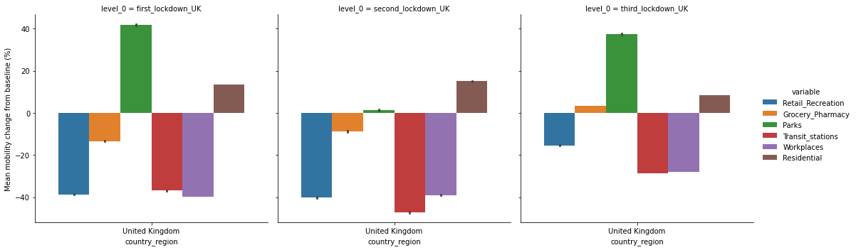
After lockdown improvements

Slide 10
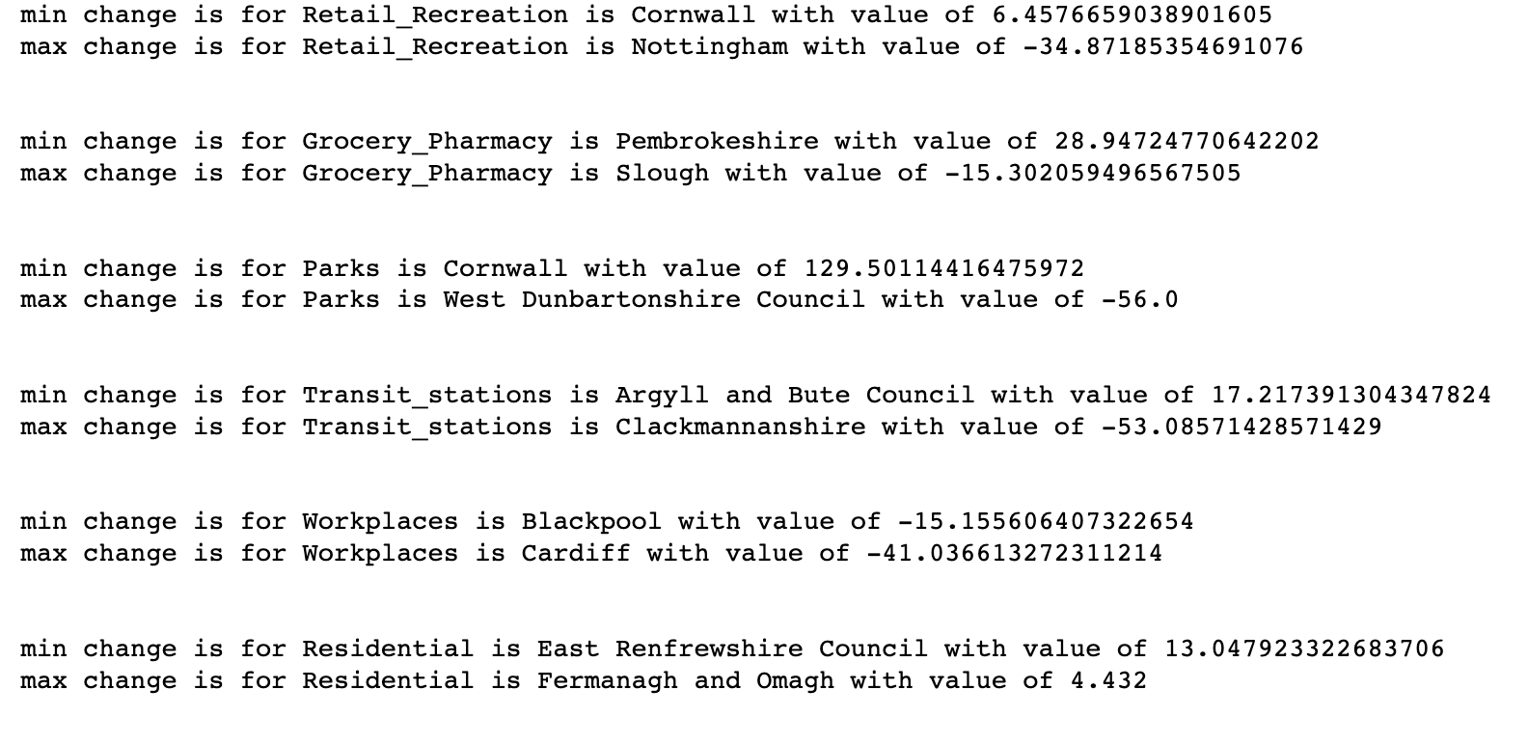
Third lockdown improvements

Slide 11
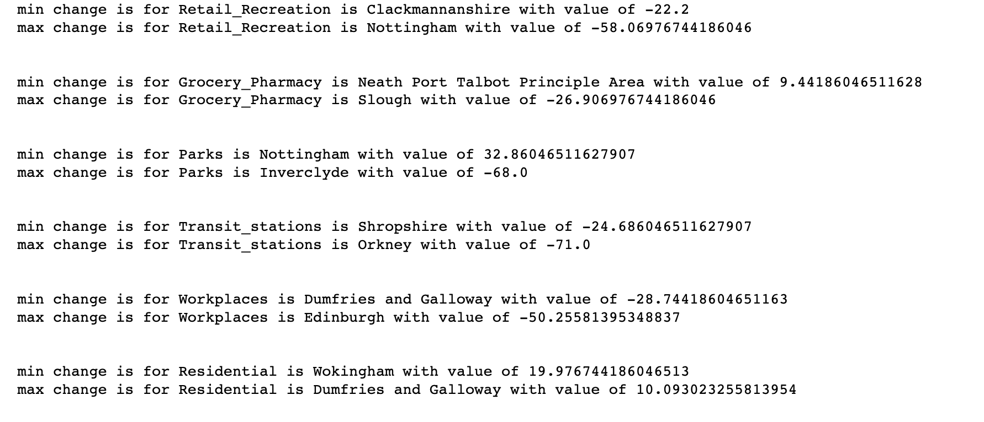
Second lockdown improvements

Slide 12
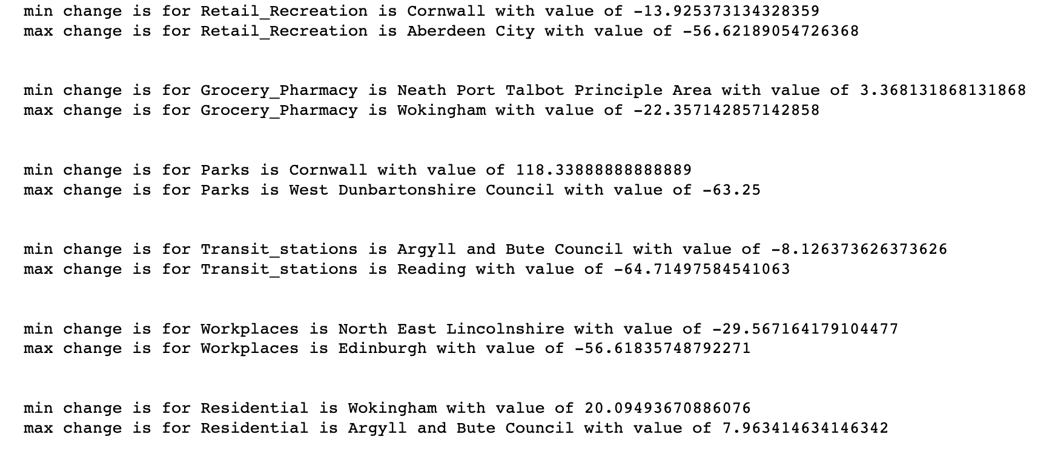
First lockdown improvements

Slide 13
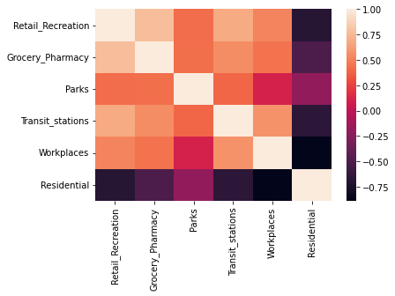
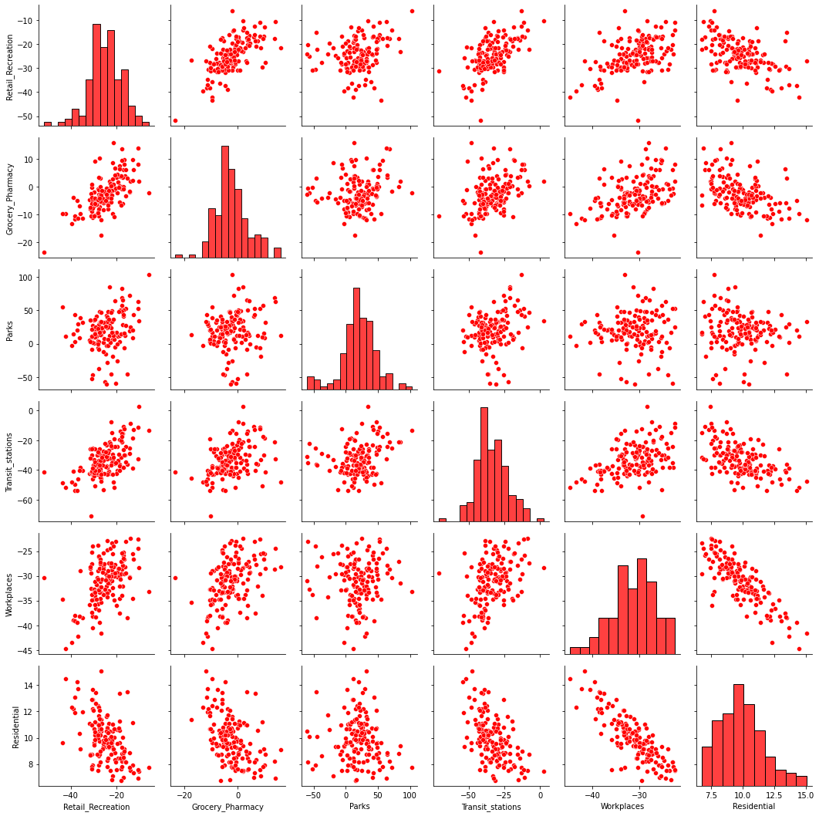
Scatter plots and Heat map

Slide 14
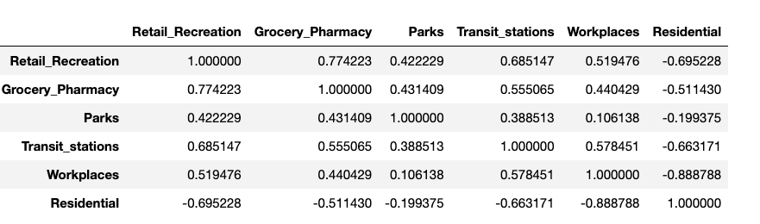
Correlation table for uk

Slide 15
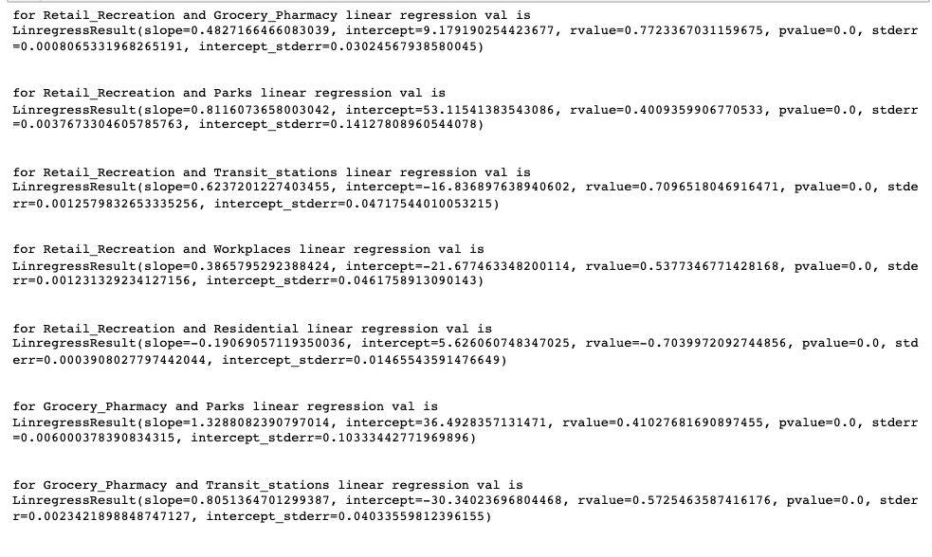
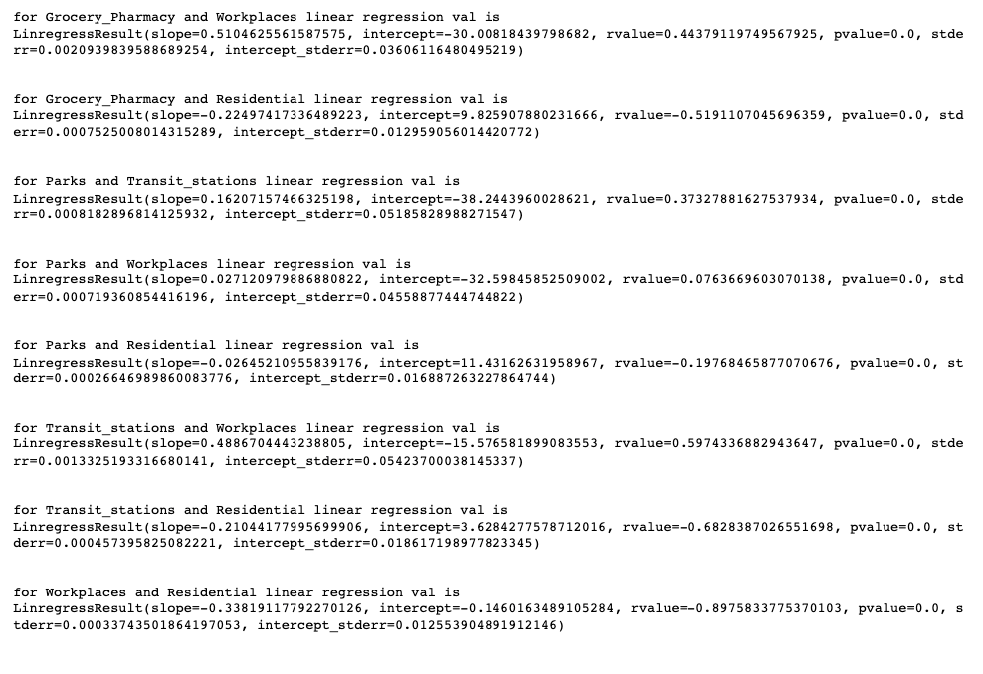
Linear regression

Slide 16
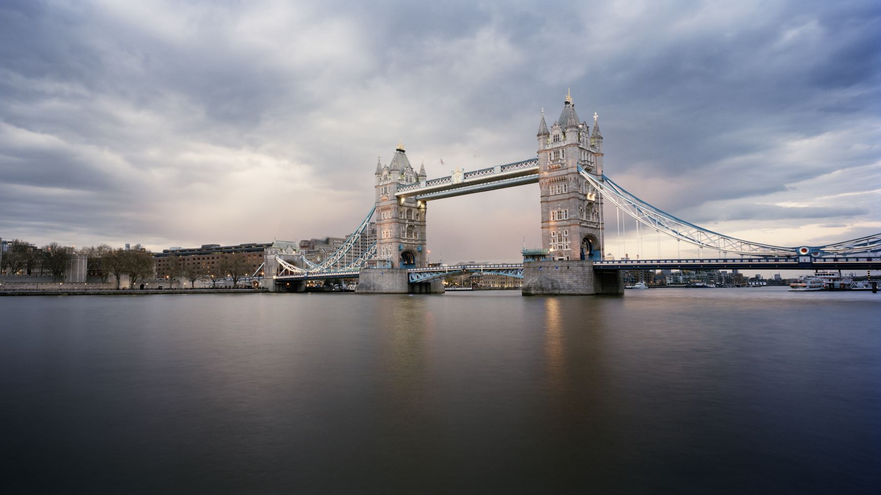
London borough Lockdown analysis

Slide 17
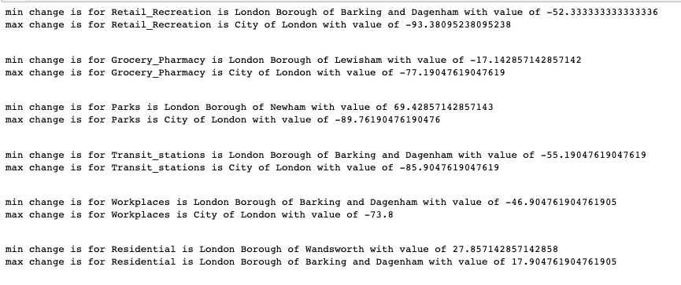
Third Lockdown

Slide 18
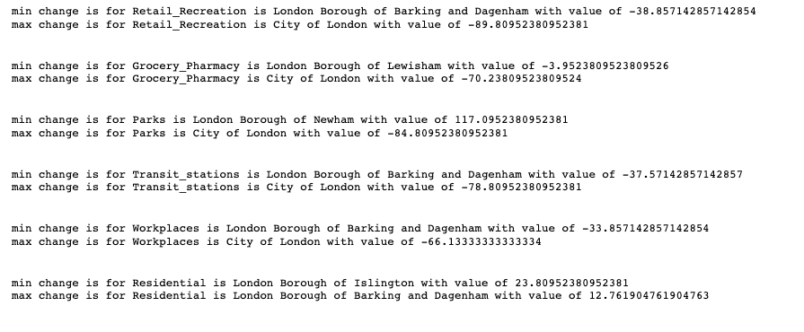
Sencond Lockdown

Slide 19
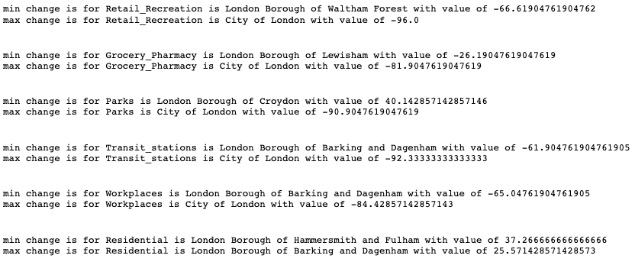
First Lockdown

Slide 20
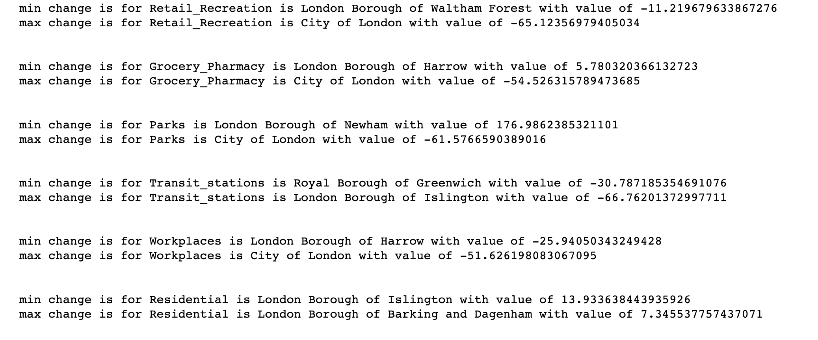
After Third lockdown improvements

Slide 21
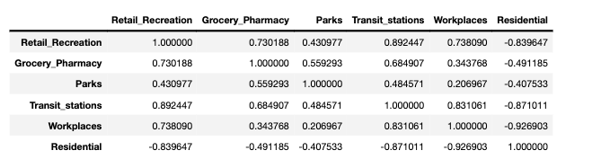
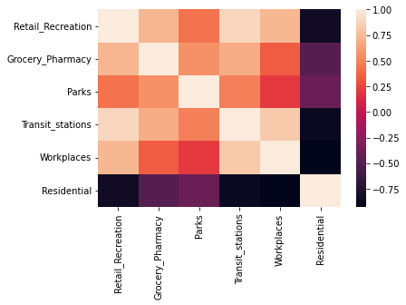
Tower Hamlets correlation and Heat map

Slide 22
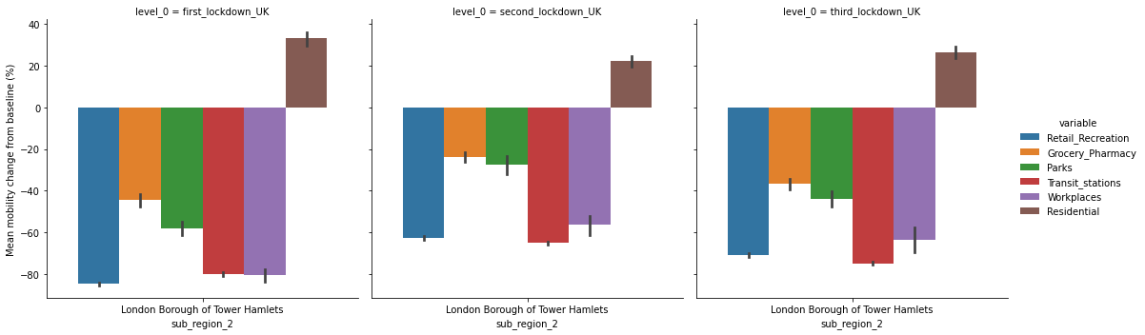
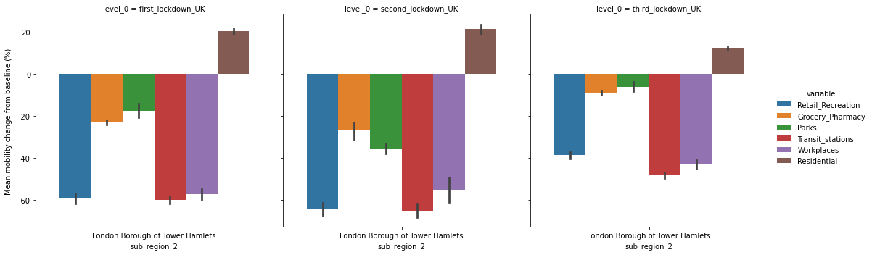
Tower Hamlets Lockdown and improvements after lockdown

Slide 23
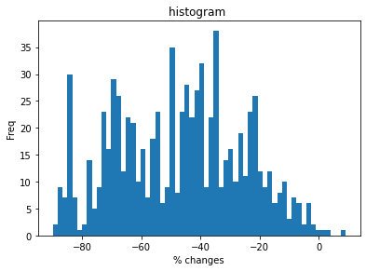
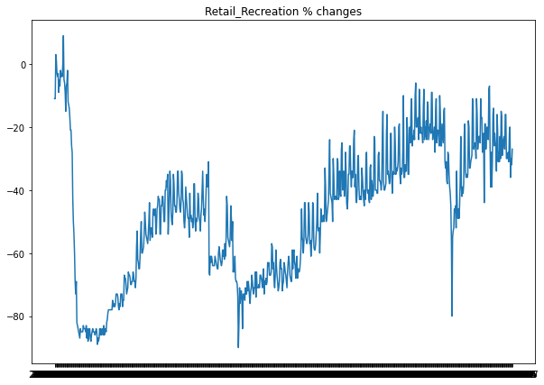
Time series forecasting of tower hamlets Retail Recreation percentage changes

Slide 24
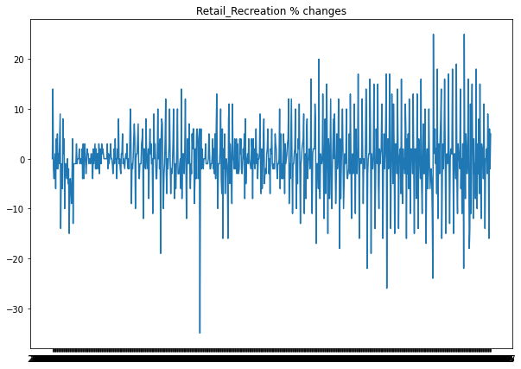
First difference, stationarity test
We cannot use the data to forecast the future since the data is specific to when the lockdown were imposed . I have used the data after the end of third lockdown to forecast
Form the time series data we can see that the data is not stationary . ADF test with high p-value of 0.07 suggest its not stationary . After first difference ADF test with small p- value suggest the time series is stationary
I have trained data from 2021-03-01 till 2022-02-01 and the remaining as test data
PACF is be used to figure out the best order of the AR modeACF is be used to figure out the best order of the MA model.

Slide 25
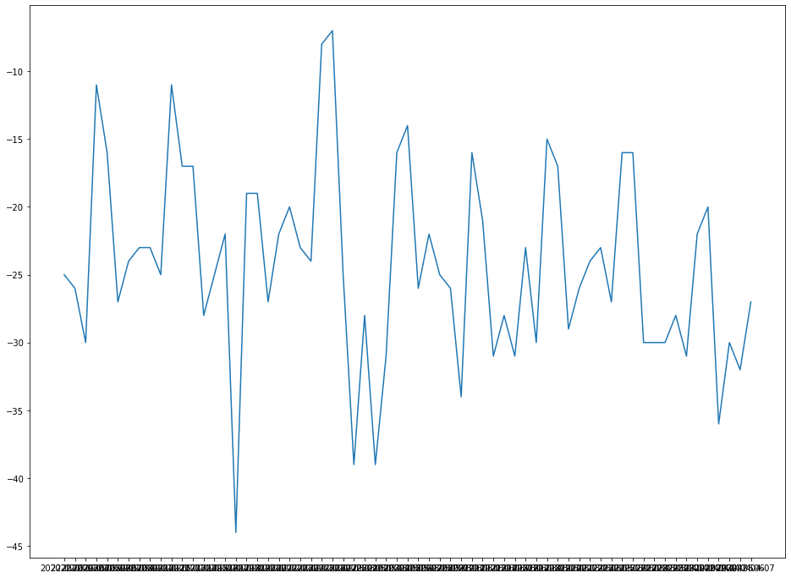
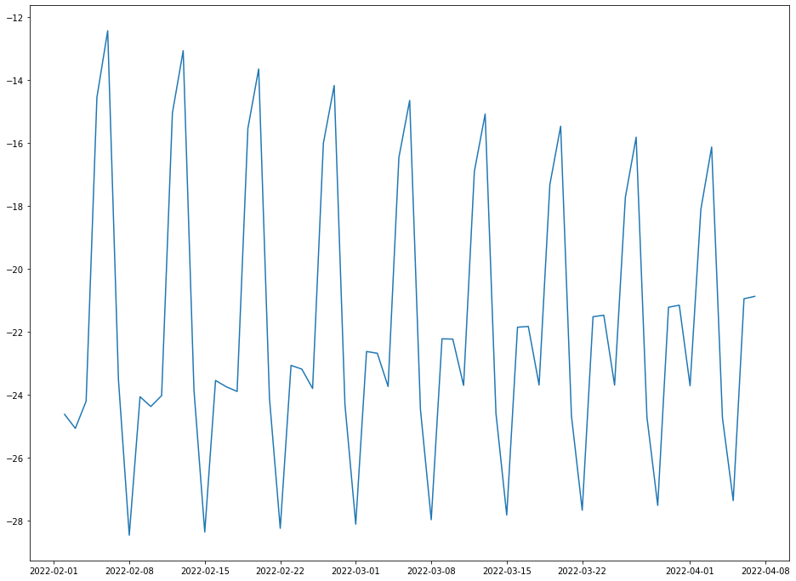
forecasting
Best model: ARIMA(4,1,5)(0,0,0)[0] intercept Total fit time: 8.141 seconds
MA-4 with first difference and AR-4 model
Top graph is the actual values for test data , bottom graph is the predicted values .
We can improve the model using Garch model since time series model has time varying volatility

