Slide 1
ASL Interpreter
Khoa Nguyen
Arjun Malik
Yashi Yadav
Fernando Merida

Slide 2
Overview
Objective: Create a user-friendly, accurate ASL recognition system using deep learning techniques. This project aims to enhance communication accessibility for the deaf and hard of hearing community.
Dataset: Microsoft's extensive ASL dataset, featuring diverse signers and a wide range of signs. It comes in the format of json files. The size is around 100,000 lines with 1000 labels.

Slide 3

Tech Stack
Web Development:
Frontend -> GUI by React, Vite.js
Backend -> Flask
Database -> SQLite3 (Non-production)
Model :
Pretrained CNN + LSTM
Sign-language-gesture-recognition
OpenVino asl-recogntition-004 and person-detection-001

Slide 4
Methodology
Development Approach:
Collaborative Development: Teamwork and collaborative decision-making were central to our process, utilizing tools and regular meetings for effective communication and progress tracking.
Deep Learning Techniques:
Data Preprocessing: Extensive preprocessing of the MSASL dataset to ensure optimal training conditions for our models.
Model Selection: Began with a Function API using a pre-trained VGG16 model, known for its efficiency in image recognition tasks.
Experimentation and Refinement: Progressed to experimenting with models pre-trained on ASL datasets to enhance gesture recognition accuracy.

Slide 5
Challenges & Development
Initially, we set up one model for both alphabet and word training. However, the training for words causes a lot of issues, so we have to resort to other models. This is our model for letter training.
First Model: CNN+LSTM with VGG16
Model: This is our proposed model by constructing a CNN+LSTM model, utilizing VGG16 as the pretrained CNN.
Problem: Overfitting - train accuray at 99% and validation is at 50~60%. We got correct responses for letter ‘M’, ‘L’, ‘Z’ but got wrong responses for ‘A’, ‘B’, ‘C’, ‘D’
We will demo this model later

Slide 6
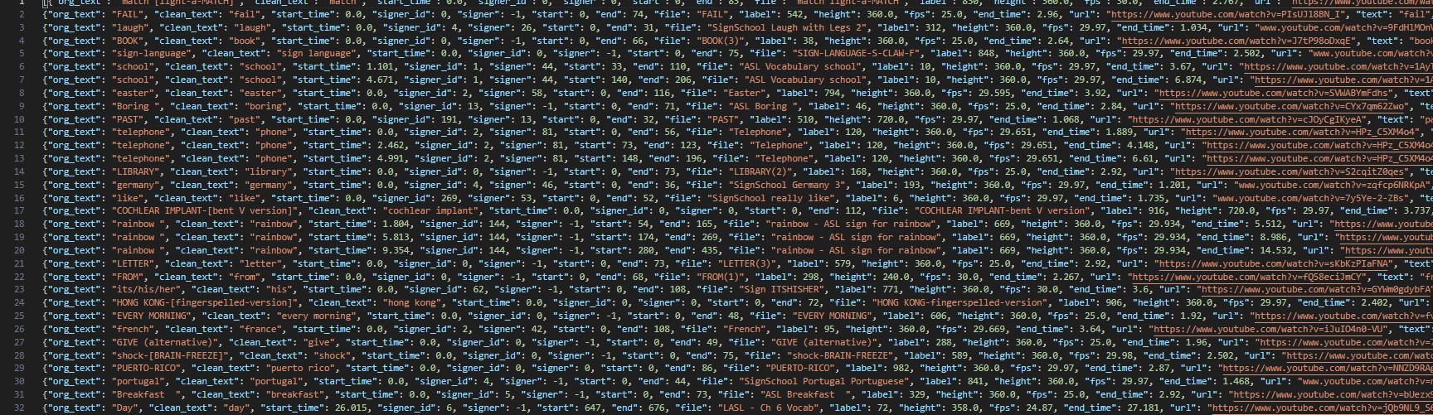
Challenges & Development
Now, it is the words/ phrases that caused a lot of issues, which is why we shifted our solutions many times. Here is a timeline of our models:
First Model & First Challenge: CNN+LSTM with VGG16
Model : Same model
Problem : Model returned low train and validation accuracy.
Causes : Improper label. Our data comes in JSON format (example below) and the naming was confusing. We have file, org_text, clean_text, label, text.
Solution: : Proper labelling and data organization.

Slide 7
Challenges & Development
First Model & Second Challenge:
Model : Same model
Problem : Model now returned high train, but still low validation accuracy.
Causes : It is due to inconsistent nature of dataset. Even though dataset is over 100k+ lines for 1000 labels, many of the videos are private or have been taken down. Because of that, some of the training labels have only no or only 1 training sample, at the same time, validation labels must also have at least one sample. We have narrowed down to 32 labels with 3-5 training samples for each.
Solution : Use other datasets or pre-trained models.

Slide 8
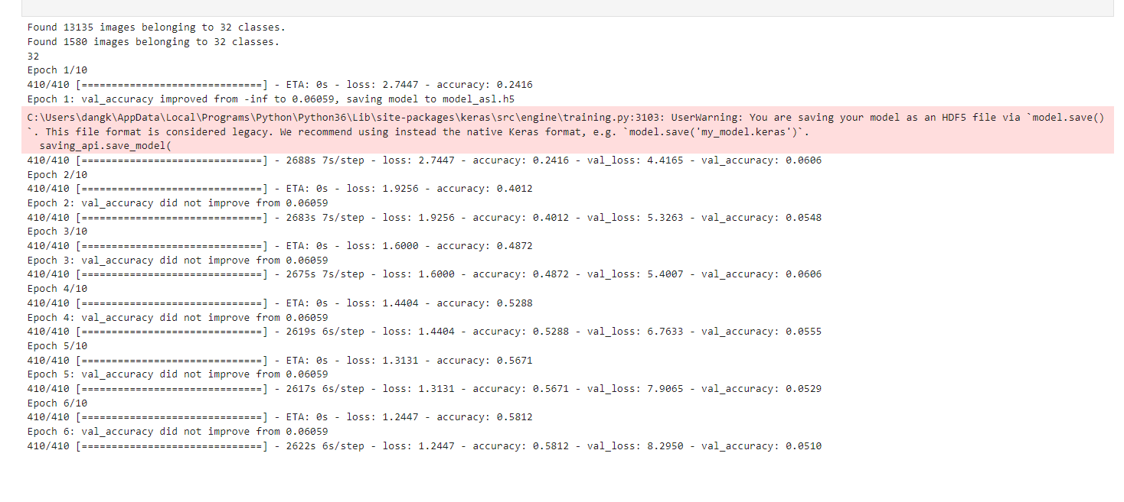
Challenges & Development
First Model &
Second Challenge:

Slide 9
Challenges & Development
Second Model :
Model : Inception V3 RNN (GitHub Reference) with 64-label datasets with 10 samples each.
Problem : Faced prolonged training times (over 48 hours for partial completion for training only, 27/64).
Solution : Explore alternative models for efficiency while training the model.

Slide 10
Challenges & Development
Third Model :
Model : Using OpenVino asl-recognition-004. OpenVino is an open-source toolkit developed by Intel and specifically made for computer vision and deep learning applications. It use S3D (Space Time Separable 3D Convolution) and MobileNetV3 (from lightweight CNN model). It is said the model has up to 83% accuracy.
Problem : Poor recognition performance
Causes : Model takes the whole picture and not important/ specific part of an image. This could add in a lot of noise. Moreover, this model has no parameters available for tuning
Solution : Add in movement capture.

Slide 11
Challenges & Development
Third Model & Motion Capture:
Model : OpenVino asl-recognition-004 & person-detection-asl-0001
Problem : Works with limited condition. It cannot take fast movement input since asl-recognition-004 is set to 15 fps for data processing.

Slide 12
Demo

Slide 13
Thank You For Listening!

