Slide 1

Strategic Exploration of Clinical Natural Language Processing for Healthcare: PII and PHI Redaction
Arjun Malik

Slide 2
Overview
Project Focus:
Automating PII and PHI redaction from medical records to ensure compliance with privacy regulations such as HIPAA.
Utilizing Clinical NLP combined with AWS cloud services for efficient, secure, and scalable processing.

Slide 3
Tech Stack
NLP and AI:
Amazon Textract: Extracts text and data from documents.
Amazon Comprehend: General entity detection in extracted text.
Amazon Comprehend Medical: Detects medical entities for specialized redaction.
Cloud Services:
AWS Lambda: Orchestrates the redaction process based on document upload triggers.
AWS Bedrock: Generates summaries of redacted information.
Amazon S3: Secure storage for input documents and redacted outputs.
User Interface:
Streamlit: Provides an easy-to-use web interface for document upload and download.

Slide 4
Solution Overview
Workflow Summary:
Upload: Streamlit interface allows users to upload PDF files to the Source S3 Bucket.
Processing:
AWS Lambda manages the process, invoking Textract and Comprehend services.
Bedrock provides a summary of the redacted information.
Output: Redacted documents are securely stored in the Output S3 Bucket and can be downloaded via Streamlit.
Key Advantages:
Accuracy: Leveraging specialized NLP models ensures precise redaction.
Scalability: The solution scales easily with AWS, handling large volumes of documents.
Security: End-to-end secure processing and storage within the AWS ecosystem.

Slide 5
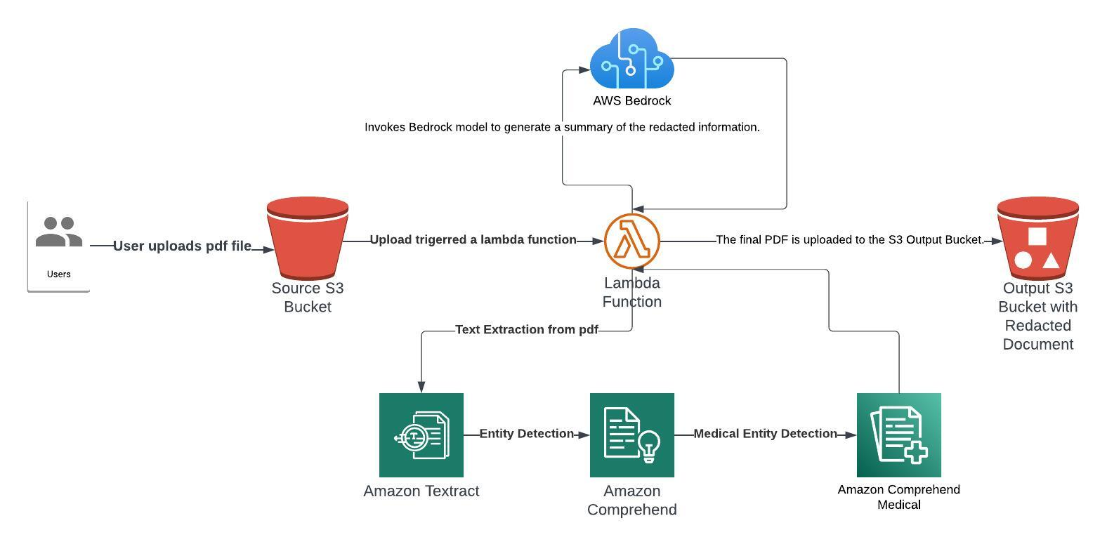
Architecture

Slide 6
DEMO

Slide 7
Strategic Impact
Business Value:
Compliance Assurance: Ensures compliance with data protection regulations like HIPAA.
Market Differentiation: Offers Cotiviti a leading edge in providing secure data management solutions in healthcare.
Efficiency Gains: Automating the redaction process reduces manual effort and error rates, leading to faster processing times.
Future Directions:
Broader Application: Potential to extend the solution to handle additional data formats, including audio and video.
Enhanced Security: Continuous improvement of security protocols to maintain data integrity and confidentiality.

