Slide 1
Software and Software Engineering
Module-1
(Source: Pressman, R. Software Engineering: A Practitioner’s Approach. McGraw-Hill, 2005)

Slide 2
Dual Role of Software
Both a product and a vehicle for delivering a product
Product
Delivers computing potential
Produces, manages, acquires, modifies, display, or transmits information
Vehicle
Supports or directly provides system functionality
Controls other programs (e.g., operating systems)
Effects communications (e.g., networking software)
Helps build other software (e.g., software tools)

Slide 3
Questions About Software Haven't Changed Over the Decades
Why does it take so long to get software finished?
Why are development costs so high?
Why can't we find all errors before we give the software to our customers?
Why do we spend so much time and effort maintaining existing programs?
Why do we continue to have difficulty in measuring progress as software is being developed and maintained?

Slide 4
A Definition of Software (all inclusive)
Instructions (computer programs) that when executed provide desired features, function, and performance
Data structures that enable the programs to adequately manipulate information
Documents that describe the operation and use of the programs

Slide 5
Differences between Software and Hardware
Software is developed or engineered; it is not manufactured in the classical sense
Impacts the management of software projects
Software doesn't wear out
Hardware bathtub curve compared to the software ascending spiked curve
Although the industry is moving toward component-based construction, most software continues to be custom built (it is still complex to build)

Slide 6

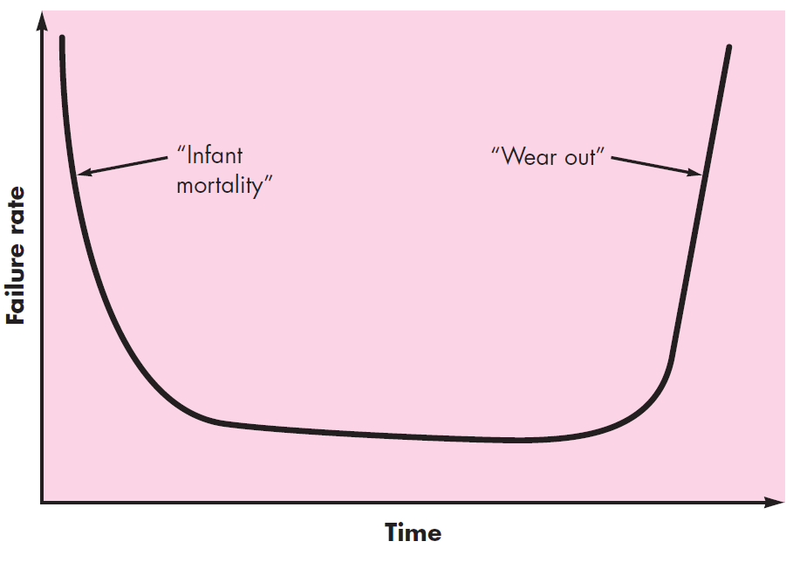

Slide 7
Software Failure Curve

Slide 8
Software Application Domains
System software: Software that helps the computer work. Examples: Operating systems (Windows, Linux), device drivers.
Application software: Software used by people for day-to-day tasks. Examples: MS Word, browsers, games, mobile apps.
Engineering/scientific software: Used for calculations, simulations, and technical problem-solving. Examples: MATLAB, AutoCAD.

Slide 9
Software Application Domains
Embedded software: Software inside machines or devices. Examples: Software in washing machines, microwaves, cars, ATMs.
Product-line software (e.g., inventory control, word processing, multimedia): Software used in companies to support business operations.
Examples: Inventory management, billing systems, multimedia suites.

Slide 10
Software Application Domains
Web applications: Software that runs on websites. Examples: Online banking, Gmail, Amazon, YouTube.
Artificial intelligence software: Software that learns, predicts, or acts smart.
Examples: Chatbots, recommendation systems, self-driving
car algorithms.

Slide 11
Legacy Software - Characteristics
Support core business functions
Have longevity and business criticality
Exhibit poor quality
Convoluted code, poor documentation, poor testing, poor change management

Slide 12
Reasons for Evolving the Legacy Software
(Adaptive) Must be adapted to meet the needs of new computing environments or more modern systems, databases, or networks
(Perfective) Must be enhanced to implement new business requirements
(Corrective) Must be changed because of errors found in the specification, design, or implementation
(Note: These are also the three major reasons for any software maintenance)

Slide 13
Software Engineering - Defined
In order to build software that is ready to meet the challenges of the twenty-first century, you must recognize a few simple realities:
It follows that a concerted effort should be made to understand the problem before a software solution is developed.
It follows that design becomes a pivotal activity.
It follows that software should exhibit high quality.
It follows that software should be maintainable.
These simple realities lead to one conclusion: software in all of its forms and across all of its application domains should be engineered. And that leads us to—software engineering.

Slide 14
Software Engineering - Defined
A definition proposed by Fritz Bauer at the seminal conference on the subject still serves as a basis for discussion:
(1969) Software engineering is the establishment and use of sound engineering principles in order to obtain economically software that is reliable and works efficiently on real machines
(IEEE) The application of a systematic, disciplined, quantifiable approach to the development, operation, and maintenance of software; that is, the application of engineering to software

Slide 15

Software Engineering is a Layered Technology

Slide 16
Process, Methods, and Tools
Process
Provides the glue that holds the layers together; enables rational and timely development; provides a framework for effective delivery of technology; forms the basis for management; provides the context for technical methods, work products, milestones, quality measures, and change management
Methods
Provide the technical "how to" for building software; rely on a set of basic principles; encompass a broad array of tasks; include modeling activities
Tools
Provide automated or semi-automated support for the process and methods (i.e., CASE tools)

Slide 17
Software Process
A process is a collection of activities, actions, and tasks that are performed when some work product is to be created.
Activity: An activity is a big step in the software process. It has a broad purpose that applies to any project.
Example: Communicating with customers

Slide 18
Software Process
Action: An action is a more specific part of an activity.
Example (inside Design Activity):
Architectural design
Interface design
Database design
These actions help achieve the big activity (designing the software).

Slide 19
Software Process
Task: A task is a small, well-defined piece of work that one person can complete at a time.
Example (inside Testing Activity):
Writing a unit test
Running a test case
Logging a bug

Slide 20
Software Process - Example
Imagine you are building a small mobile app.
Activity: Requirements gathering
Big goal: Understand what the client wants.
Actions inside this activity:
Conduct interviews
Review existing documents
Create requirement specification
Tasks inside one action: "Conduct interviews":
Schedule meeting with client
Ask pre-decided questions
Record the answers
Prepare summary notes

Slide 21
Generic Process Framework
A process framework establishes the foundation for a complete software engineering process by identifying a small number of framework activities that are applicable to all software projects, regardless of their size or complexity.
In addition, the process framework encompasses a set of umbrella activities that are applicable across the entire software process.

Slide 22
Generic Process Framework
A generic process framework for software engineering encompasses five activities:
Communication
Involves communication among the customer and other stake holders; encompasses requirements gathering
Planning
Establishes a plan for software engineering work; addresses technical tasks, resources, work products, and work schedule
Modeling (Analyze, Design)
Encompasses the creation of models to better understand the requirements and the design
Construction (Code, Test)
Combines code generation and testing to uncover errors
Deployment
Involves delivery of software to the customer for evaluation and feedback

Slide 23
Umbrella Activities
Software project tracking and control
Risk management
Software quality assurance
Software configuration management
Formal technical reviews
Measurement – process, project, product
Reusability management (component reuse)
Work product preparation and production

Slide 24
SOFTWARE ENGINEERING PRACTICE
A generic software process model composed of a set of activities that establish a framework for software engineering practice.
Generic framework activities— Communication, planning, modeling, construction, and deployment—and umbrella activities establish a skeleton architecture for software engineering work.
But how does the practice of software engineering fit in?

Slide 25
The Essence of Practice
Understand the problem (communication and analysis): Understanding isn’t always that easy. It’s worth spending a little time answering a few simple questions:
Who has a stake in the solution to the problem?
What are the unknowns (data, function, behavior)?
Can the problem be compartmentalized?
Can the problem be represented graphically?
Plan a solution (modeling and software design)
Have you seen similar problems before?
Has a similar problem been solved and is the solution reusable?
Can subproblems be defined and are solutions available for the subproblems?
Can you represent a solution in a manner that leads to effective implementation?

Slide 26
The Essence of Practice (continued)
Carry out the plan (code generation)
Does the solution conform to the plan? Is the source code traceable back to the design?
Is each component of the solution correct? Has the design and code been reviewed?
Examine the results for accuracy (testing and quality assurance)
Is it possible to test each component of the solution?
Does the solution produce results that conform to the data, function, and behavior that are required?

Slide 27
Seven Core Principles for Software Engineering
Remember the reason that the software exists
The software should provide value to its users and satisfy the requirements
Keep it simple, stupid (KISS)
All design and implementation should be as simple as possible
Maintain the vision of the project
A clear vision is essential to the project’s success
What you produce, Others will consume
Always specify, design, and implement knowing that someone else will later have to understand and modify what you did
Be open to the future
Never design yourself into a corner; build software that can be easily changed and adapted
Plan ahead for software reuse
Reuse of software reduces the long-term cost and increases the value of the program and the reusable components
Think, then act
Placing clear, complete thought before action will almost always produce better results

Slide 28
Generic Process Model
process flow—describes how the framework activities and the actions and tasks that occur within each framework activity are organized with respect to sequence and time and is illustrated in Figure 2.2.
28

Slide 29
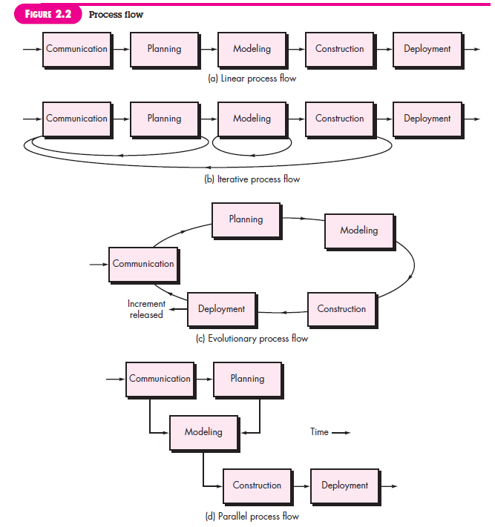

Slide 30
A linear process flow executes each of the five framework activities in sequence, beginning with communication and culminating with deployment (Figure 2.2a).
An iterative process flow repeats one or more of the activities before proceeding to the next (Figure 2.2b).
An evolutionary process flow executes the activities in a “circular” manner. Each circuit through the five activities leads to a more complete version of the software (Figure 2.2c).
A parallel process flow (Figure 2.2d) executes one or more activities in parallel with other activities (e.g., modeling for one aspect of the software might be executed in parallel with construction of another aspect of the software).

Slide 31
Prescriptive Process Model
Defines a distinct set of activities, actions, tasks, milestones, and work products that are required to engineer high-quality software
The activities may be linear, incremental, or evolutionary
31

Slide 32
Waterfall Model (Diagram)
Communication
Project initiation
Requirements gathering
Planning
Estimating
Scheduling
Tracking
Modeling
Analysis
Design
Construction
Code
Test
Deployment
Delivery
Support
Feedback
32

Slide 33
Waterfall Model (Description)
Oldest software lifecycle model and best understood by upper management
Used when requirements are well understood and risk is low
Work flow is in a linear (i.e., sequential) fashion
Used often with well-defined adaptations or enhancements to current software
33

Slide 34
Waterfall Model (Problems)
Doesn't support iteration, so changes can cause confusion
Difficult for customers to state all requirements explicitly and up front
Requires customer patience because a working version of the program doesn't occur until the final phase
Problems can be somewhat alleviated in the model through the addition of feedback loops (see the next slide)
34

Slide 35
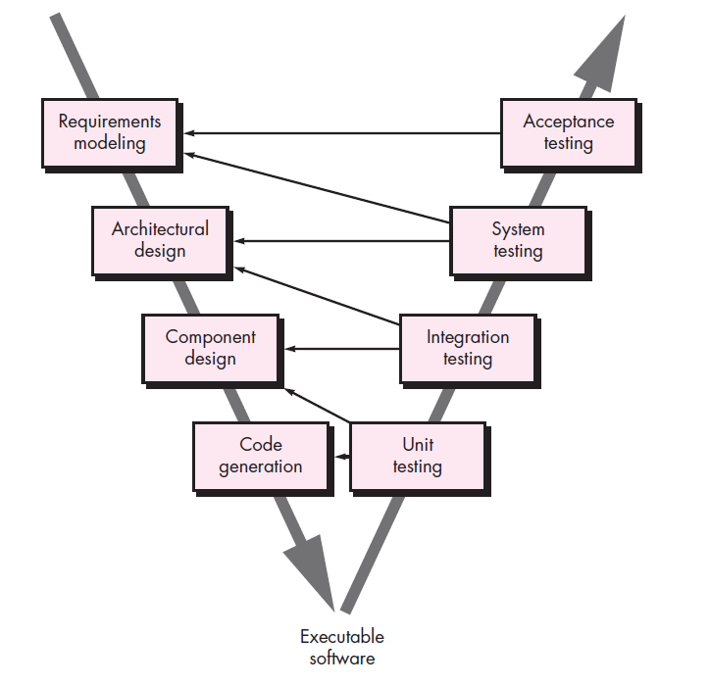
V - Model

Slide 36
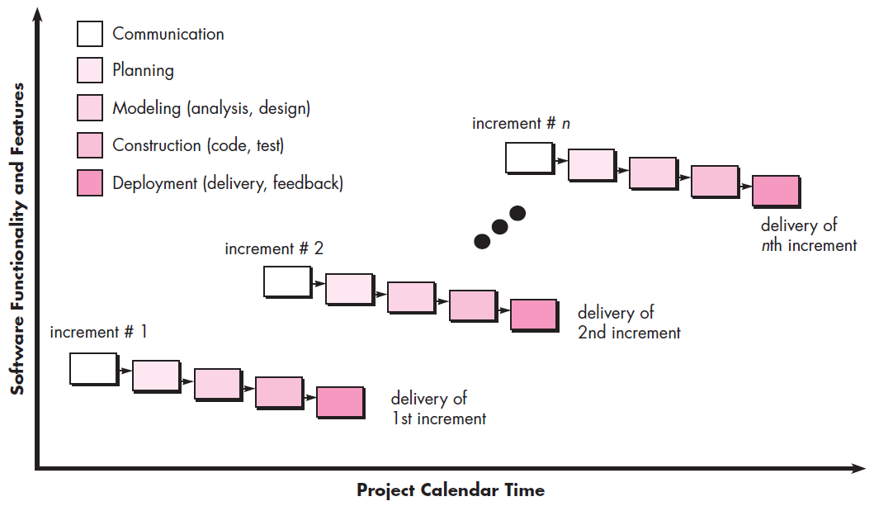
Incremental Model (Diagram)

