Slide 1
FEM Simulation before Fabrication
Arjun Narayanan
Lucas Smyk

Slide 2
Problem and Motivation
Problem
Simulate the behavior of elastic materials before fabrication
Motivation
Because 3D printing an object is costly in time and materials, we want our material to behave correctly prior to fabrication

Slide 3
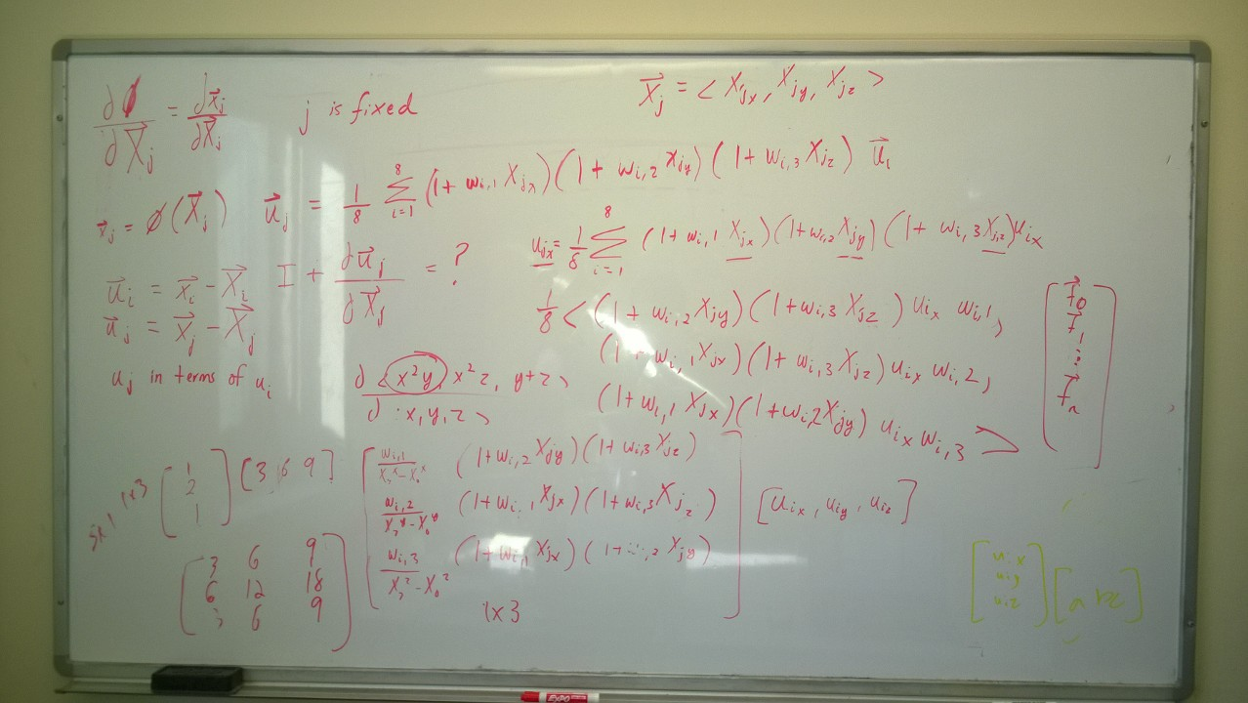
Derivation
Thanks to Desai Chen for resources on FEM theory
We took the derived all formulas ourselves

Slide 4
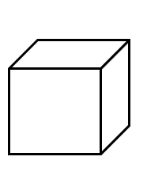
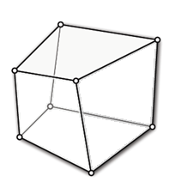
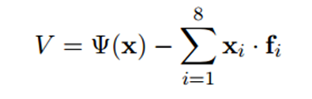
Technical Approach – Hexahedral Elements
x = deformed space, X = reference space
Indirect formulation with potential energy function
Minimize the energy in the presence of external forces
Strain Energy Function

Slide 5

Quadrature points
3D 2-point Gaussian Quadrature rule
8 quadrature points:

Slide 6
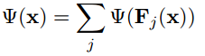
Technical Approach continued
Express strain energy in terms of deformation gradient. Sum strain energy at each quadrature point.
Derivation for F_{j}
Express shape function
Take the derivative with respect to reference space coordinates

Slide 7
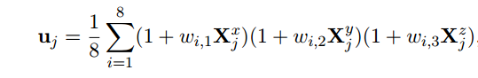
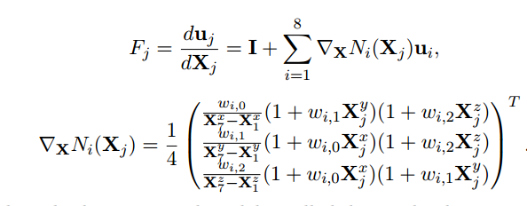
Derivation for F_{j}
Shape function expressed with tri-linear interpolation
(u_{j} expressed similarly)

Slide 8

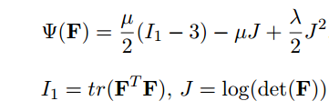
From F to : Material Model
Neohookean model:

Slide 9

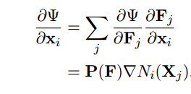
Energy Minimization
Gradient Descent
Move in direction of force
Newton’s method
Second derivative of V = stiffness matrix K
Solve K * deltaX = f

Slide 10
Newton’s Method
K is big – (3*numElements) x (3*numElements)
Need sparse matrix representation!
Solvers:
Eigen dense QR decomposition –TOO MUCH SPACE AND TOO SLOW
Eigen sparse conjugate gradient – TOO SLOW
CUSP GPU-Assisted sparse cg solver – WORKED WELL

Slide 11
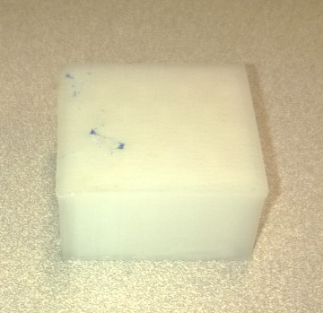
Makerbot Material Model
Didn’t have as much time to work on this
Measure Young’s Modulus of brick and convert to Neohookean parameters
Recreate cube experiment in simulation

Slide 12
FEM Results
Demo Video
https://www.youtube.com/watch?v=6-0ZNnHaVS8

Slide 13
Recreate cube experiment
Constructed material model: mu = 7.038*10^4, lambda = 1.056*10^5
Measured vs simulated data
(Simulation done with 1900 elements)
Error decreases with more force
FORCE (kg) | Measured Displacement of Cube (inches) | Simulated Displacement of Cube (inches) | Error (% of measured)
0.328 | 0.036 | 0.0236 | 34.4
0.72 | 0.061 | 0.0501 | 17.9
1.243 | 0.090 | 0.0800 | 11.1
1.78 | 0.099 | 0.105 | 6.06
Error decreases with more force

Slide 14
Conclusions
FEM Simulation behaves accurately
Constructed material model does approximate actual behavior

Slide 15
Future Work
Test more objects in reality vs simulation using constructed material model
Ran out of time to do this
Measure stress at which material breaks

Slide 16
Resources
As mentioned, thanks to Desai for some resources on Hexahedral elements
“Non-linear Continuum mechanics for finite element analysis” by Bonet and Woods
Class slides and notes for 6.S079
SIGRAPH 2012 course “FEM Simulation of 3D Deformable Solids: A practitioner's guide to theory, discretization and model reduction”

