Slide 1
Presented by : Arjun.N
Nan-Mudhalvan id :421221104003
college name: Karpaga vineyaga college of engineering and technology
Title:Colorizing Black and White Images using GANs
3/21/2024 Annual Review

Slide 2
PROJECT TITLE
Colorizing Black and White Images using GANs
3/21/2024 Annual Review

Slide 3


AGENDA
Introduction
Problem Statement
Project Overview
End Users
Solution and Value Proposition
The WOW in Your Solution
Modeling
Conclusion
3/21/2024 Annual Review

Slide 4

PROBLEM STATEMENT
Problem: Black and white photographs capture a timeless aesthetic, but often lack the vibrancy and emotional depth of color images. This project aims to leverage the power of Generative Adversarial Networks (GANs) to address this challenge and develop a robust system for colorizing black and white images.
Challenge: How can we automatically colorize black and white images to enhance their visual appeal and realism?
Objective: Develop a solution using Generative Adversarial Networks (GANs) to automatically colorize black and white images.
3/21/2024 Annual Review

Slide 5

PROJECT OVERVIEW
Approach: Utilize GAN architecture for image colorization.
Dataset: Collect a diverse dataset of black and white images paired with their corresponding color versions.
Training: Train the GAN model to generate realistic colorized versions of black and white input images.
Evaluation: Assess the quality of colorization using metrics such as color accuracy and visual inspection.
3/21/2024 Annual Review

Slide 6

WHO ARE THE END USERS?
Photographers: Enhance old black and white photographs with vibrant colors.
Artists: Transform sketches and line drawings into colorful artworks.
Historians: Revive historical images by adding color, providing a fresh perspective on the past.
3/21/2024 Annual Review

Slide 7

YOUR SOLUTION AND ITS VALUE PROPOSITION
Solution: Develop a GAN-based model that automatically colorizes black and white images.
Value Proposition:
Time-saving: Automates the labor-intensive process of manual image colorization.
Enhances creativity: Provides a tool for artistic expression and experimentation.
Preserves history: Restores and revives black and white photographs for future generations.
3/21/2024 Annual Review

Slide 8

THE WOW IN YOUR SOLUTION
Realism: Generated colorized images closely resemble the natural colors of the original scenes.
Versatility: Works with various types of black and white images, including photographs, sketches, and illustrations.
Customization: Allows users to adjust colorization parameters to achieve desired effects.
3/21/2024 Annual Review

Slide 9
MODELLING
Generative Adversarial Networks (GANs):
Generator: Produces colorized versions of black and white images.
Discriminator: Distinguishes between real color images and generated colorized images.
Training Process:
Adversarial training: Generator and discriminator networks compete to improve colorization quality.
Iterative refinement: Gradually improve the generator's ability to produce realistic colorizations.
3/21/2024 Annual Review

Slide 10
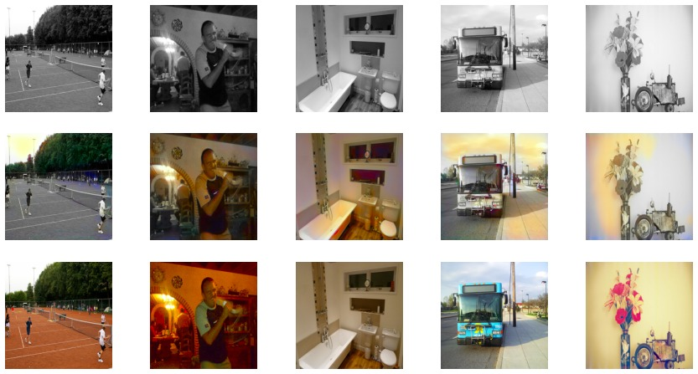
RESULTS
Generated Image For The Used Dataset
3/21/2024 Annual Review

Slide 11
CONCLUSION
Recap: Developed a GAN-based solution for automatic image colorization.
Impact: Empowers users to breathe new life into black and white images.
Future Directions: Explore advanced GAN architectures and techniques for further improving colorization quality.

