Slide 1
401K Fund Forecasting
Student: Arjun Panikar
Mentor: Neal Fultz

Slide 2
The Problem?
The 401K portfolio is an investment that any investor needs to be continuously monitoring to ensure that his/her hard earned money is being put to good use. Unfortunately, in many cases a lack of understanding on how to analyze fund data along with schedule constraints makes the management of this task cumbersome which results in missed opportunities and loss of money. In addition, the 401K management interface, does not have a robust suggestion feature that users can avail to make investment decisions.

Slide 3
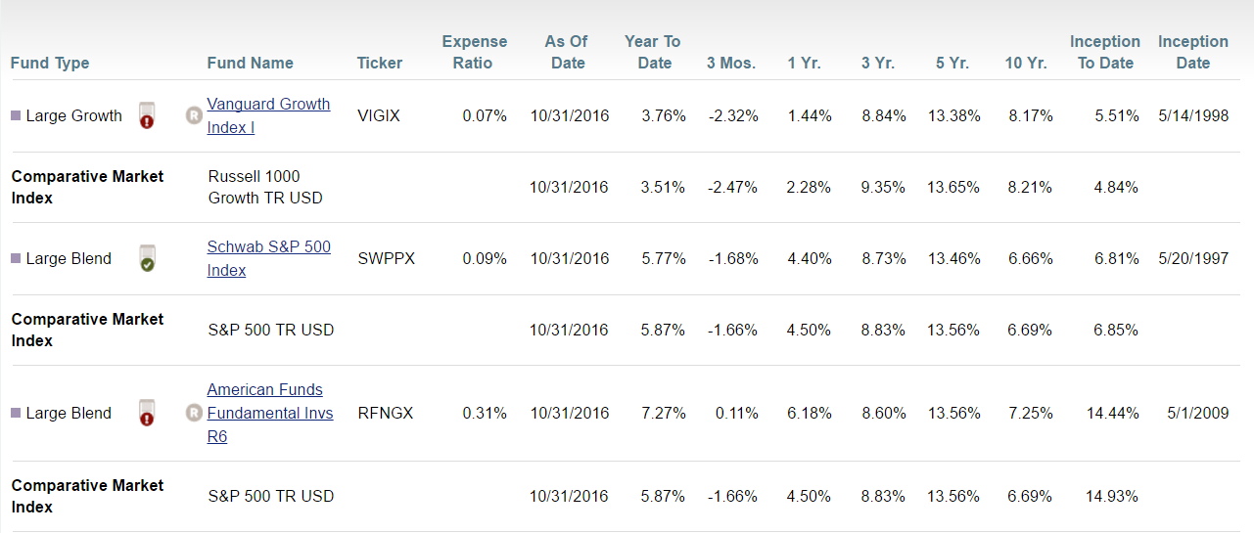
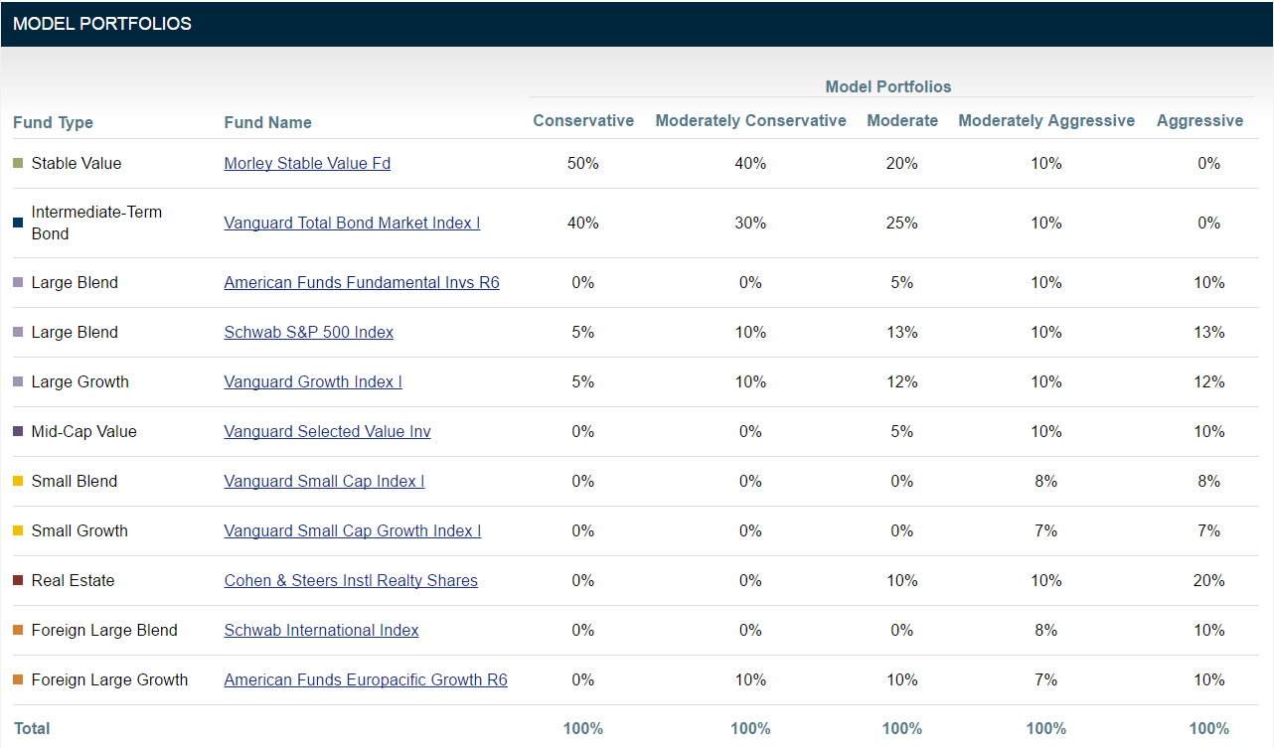
Available Options
1] Process data and pick for yourself
2] Trust model portfolio options

Slide 4
Fund Information
The funds available in the portfolio of interest are:

Slide 5
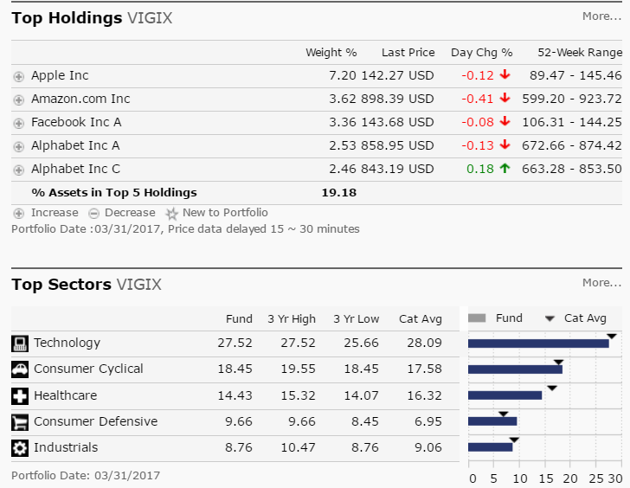
Vanguard Growth Index Institutional (VIGIX)
This fund invests in stocks of large U.S. companies in market sectors that tend to grow more quickly than the broad market. This low-cost index fund follows a buy-and-hold approach and invests in substantially all of the stocks represented in its broad benchmark. The fund’s primary risk, apart from general stock market volatility, comes from the fact that its focus on large-capitalization growth stocks may, at times, underperform the broader stock market.

Slide 6
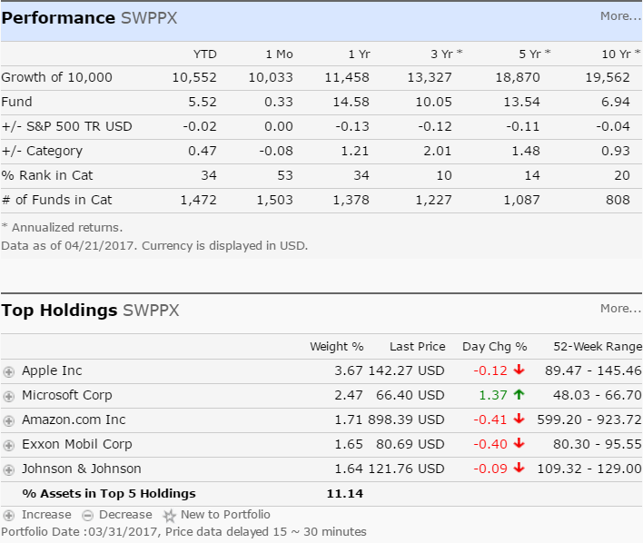
Schwab S&P 500 Index (SWPPX)
The Schwab S&P 500 Index tracks the Standard & Poor's 500 index, one of the most widely watched benchmarks for U.S. stocks. The index covers about 80 percent of the investable market capitalization of the U.S. equity market. The fund tracks the index very closely and generally. The only difference in the return of the fund and the index is the fund’s expense ratio.

Slide 7
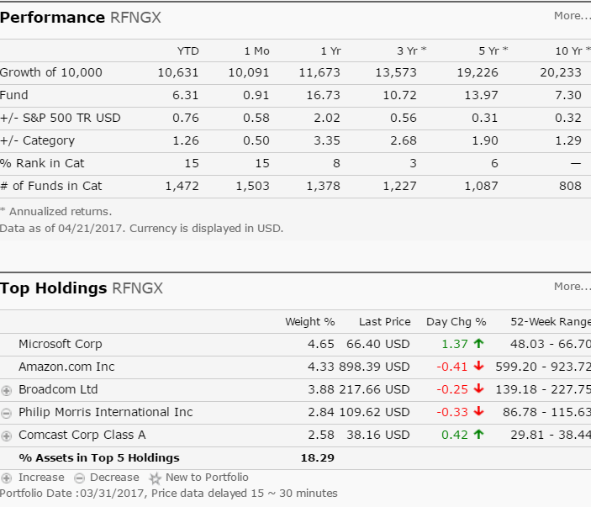
American Funds Fundamental Investors (RFNGX)
Of its large-blend funds, this is American Funds' most aggressive large-cap U.S. offering. With a diversified portfolio and low fees, the fund remains a solid option for investors seeking growth and diversification, according to Morningstar. As of April 07, 2017, the fund has assets totaling almost $84.95 billion invested in 211.00 different holdings. Its portfolio consists primarily of common stocks or securities convertible into common stocks, bonds, U.S. government securities and cash. Microsoft, Amazon, Comcast, Boeing and Apple make up some of the top assets in the fund.

Slide 8
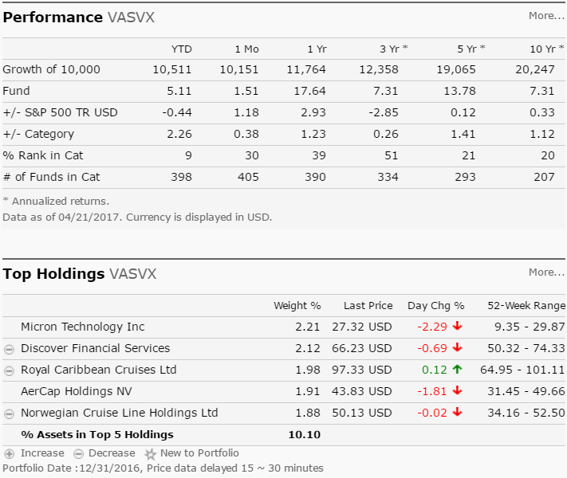
Vanguard Selected Value Fund Investor Shares (VASVX)
The Vanguard Selected Value Fund is designed to capture long-term gains by purchasing stock of currently undervalued companies. As of April 07, 2017, the fund has assets totaling almost $10.14 billion invested in 127.00 different holdings. Its portfolio consists primarily of mid-cap U.S. stocks trading at a bargain relative to future potential. The fund also holds a small number of non-U.S. stocks. It may invest up to 25 percent of assets outside the U.S. However, that non-U.S. stake currently represents less than 10 percent of total assets.

Slide 9
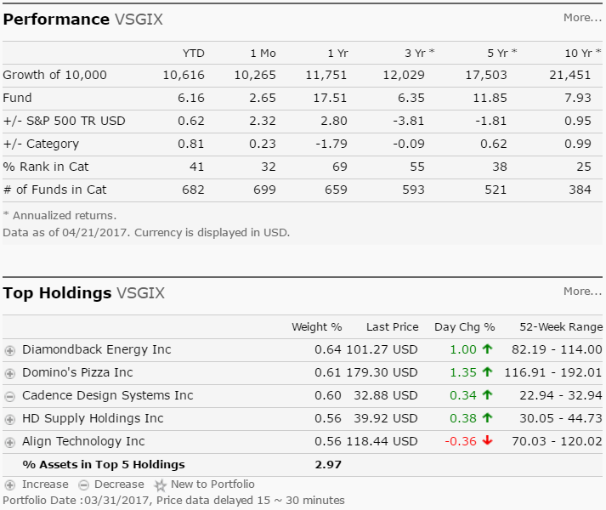
Vanguard Small-Cap Growth Index Fund Institutional Shares (VSGIX)
The Vanguard Small Cap Growth Index Fund has a very simple methodology: It tracks performance of the Center for Research in Security Prices' U.S. Small Cap Growth index. It may be an appropriate choice for investors who want to diversify from large-cap domestic stocks. As of April 07, 2017, the fund has assets totaling almost $18.25 billion invested in 683.00 different holdings. Its portfolio consists primarily of mid-cap and small-cap U.S. stocks. The median market capitalization of all holdings is $3.6 billion. That’s well below the $79.3 billion median market capitalization of the Vanguard 500 Index Fund. Top sectors represented in the fund are financials, industrials and technology.

Slide 10
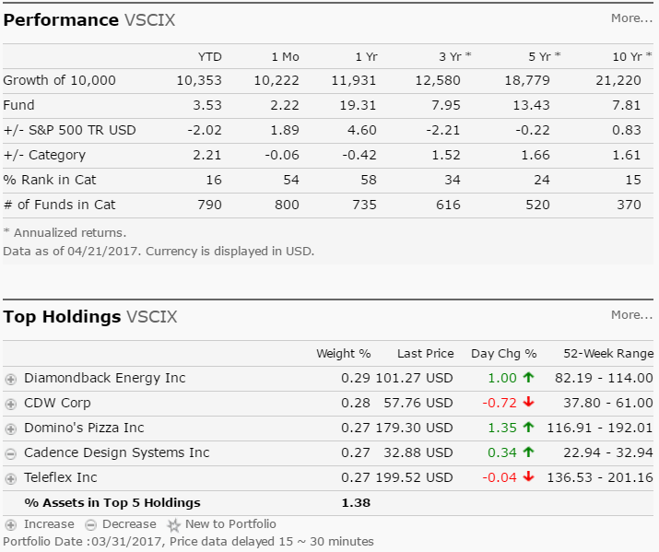
Vanguard Small-Cap Index Fund Institutional Shares (VSCIX)
With very low expenses and a focus on smaller companies, the Vanguard Small Cap Index fund is a great long-term building block for investor's portfolios. As of April 07, 2017, the Vanguard Small Cap Index fund has assets totaling almost $74.74 billion invested in 1,439.00 different holdings. Its portfolio consists primarily of small-sized companies and tracks the CRSP US Small Cap index, an index designed to include firms with market capitalizations in the bottom 2-15 percent of the overall market. Some of its largest holdings are in the financial, consumer goods and industrial sector. The fund’s top holdings include Salix Pharmaceuticals, Foot Locker, Harman International Industries, Cooper Cos. and Gannett Co.

Slide 11
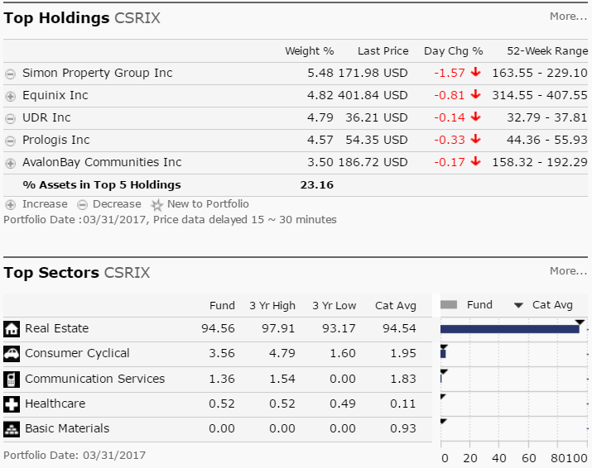
Cohen & Steers Institutional Realty Shares (CSRIX)
The investment seeks total return through investment in real estate securities. The fund invests at least 80%, and normally substantially all, of its total assets in common stocks and other equity securities issued by real estate companies. It may invest up to 20% of its total assets in securities of foreign issuers (including emerging market issuers) which meet the same criteria for investment as domestic companies, including investments in such companies in the form of American Depositary Receipts ("ADRs"), Global Depositary Receipts ("GDRs") and European Depositary Receipts ("EDRs"). The fund is non-diversified.

Slide 12
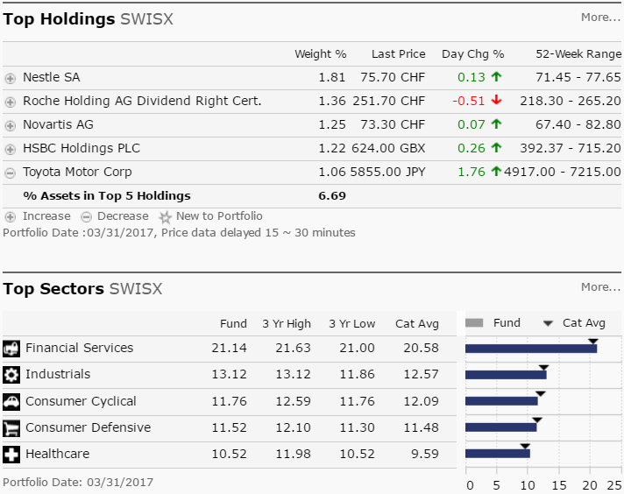
Schwab International Index Fund (SWISX)
The investment seeks to track the performance of a benchmark index that measures the total return of large, publicly traded non-U.S. companies from countries with developed equity markets outside of the United States. The fund generally invests at least 80% of its net assets in stocks that are included in the MSCI EAFE Index. It may invest in derivatives, principally futures contracts, and lend its securities to minimize the gap in performance that naturally exists between any index fund and its corresponding index. The fund may concentrate its investments in an industry or group of industries to the extent that its comparative index is also so concentrated.

Slide 13
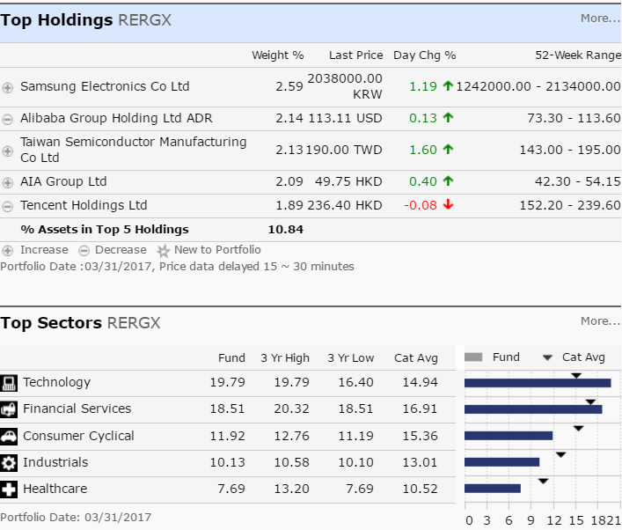
American Funds EuroPacific Growth Fund Class R-6 (RERGX)
The American Funds EuroPacific Growth Fund, the largest international fund, has a long history of investing in a diverse set of markets. As of April 07, 2017, the fund has assets totaling $132.31 billion. Its portfolio consists mostly of a blend of large-company growth and value stocks in Europe and the Pacific Basin. The fund had a banner year in 2009 but had a slow start in 2010. Emerging Markets make up about 20 percent of the portfolio as of the end of the first quarter. As the name suggests, the fund is well-diversified throughout Europe and Asia among developed and developing countries with more than 300 holdings. The fund has returned 13.10 percent over the past year and 2.17 percent over the past three years. Historically, the fund has a record of steady gains. Since its 1984 inception, the fund has weathered several overseas financial market storms. The fund has returned 6.64 percent over the past five years and 3.51 percent over the past decade.

Slide 14
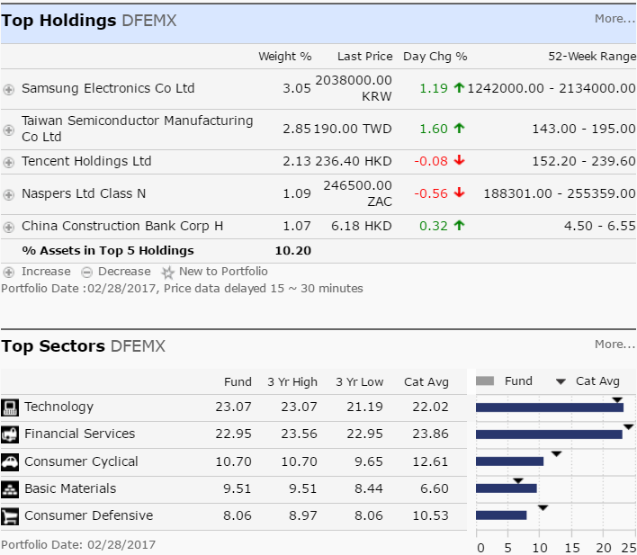
DFA Emerging Markets Portfolio Institutional Class (DFEMX)
DFA Emerging Markets I fund isn’t trying to beat the market. Like other funds offered by Dimensional Fund Advisors, this one seeks to instead provide investors with concentrated exposure to a particular area of the market—in this case large-cap emerging market stocks. As of April 07, 2017, the fund has assets totaling almost $5.58 billion invested in 1,099.00 different holdings. Its portfolio consists primarily of the largest companies in the emerging markets and is closely aligned with the MSCI Emerging Markets Index.

Slide 15
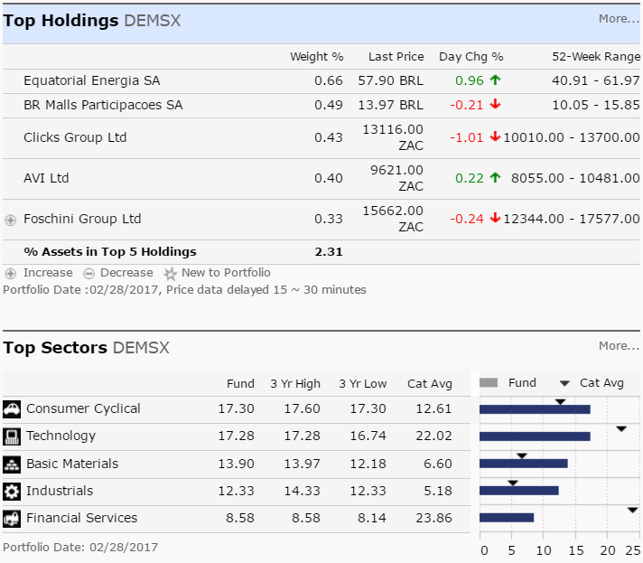
DFA Emerging Markets Small Cap Portfolio Institutional Class (DEMSX)
The investment seeks long-term capital appreciation. The Portfolio is a Feeder Portfolio and pursues its objective by investing substantially all of its assets in its corresponding master fund, the Emerging Markets Small Cap Series (the "Emerging Markets Small Cap Series") of the DFA Investment Trust Company (the "Trust"), which has the same investment objective and policies as the Portfolio. As a non-fundamental policy, under normal circumstances, the Emerging Markets Small Cap Series will invest at least 80% of its net assets in emerging market investments that are designated in the Prospectus as Approved Market securities of small companies.

Slide 16
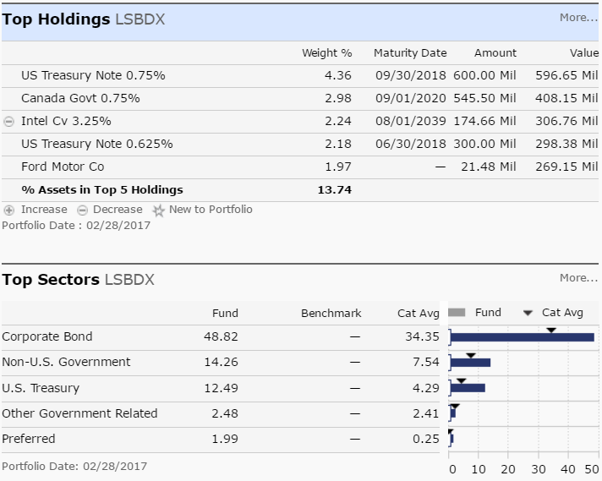
Loomis Sayles Bond Fund Institutional Class (LSBDX)
The Loomis Sayles Bond fund is heavy on the corporate bond side but offers some flexibility within lower grade names and even equities. As of April 07, 2017, the fund has assets totaling almost $13.82 billion invested in 458.00 different holdings. Its portfolio consists primarily of fixed income securities but also below-investment-grade bonds and stocks. Nearly 70 percent of the fund is invested in the U.S. and nearly 12 percent invested in Canada.

Slide 17
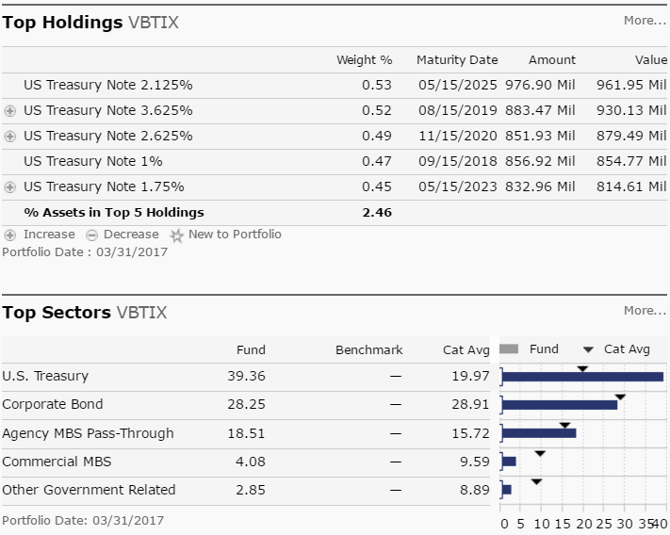
Vanguard Total Bond Market Index Fund Institutional Shares (VBTIX)
The Vanguard Total Bond Market Index fund holds higher quality investment-grade bonds, both corporate and government, with U.S. government debt making up the majority of assets in the portfolio. It's a broad-market bond fund and is used as a core fixed-income holding for a wide range of investors. Because the fund invests in all segments and maturities of the fixed income market, this is considered a core bond holding for investors.

Slide 18
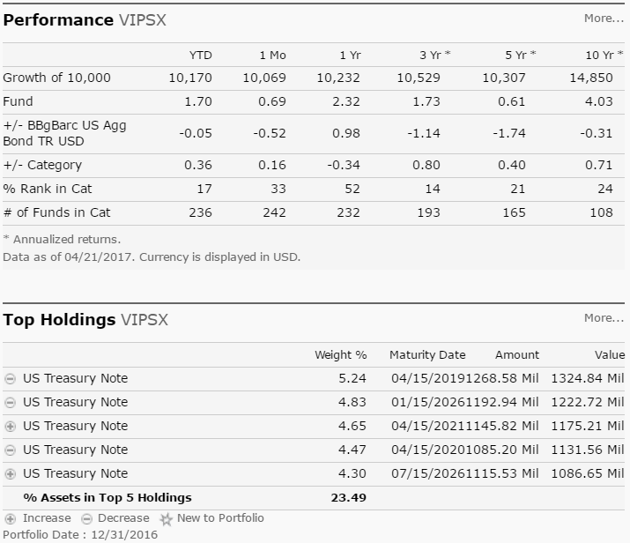
Vanguard Inflation-Protected Securities Fund Investor Shares (VIPSX)
A strict approach to inflation protection and low fees is a strategy that keeps this fund working well for investors, though interest rate changes remain this fund’s foil. As of April 07, 2017, the fund has assets totaling almost $26.83 billion invested in 37.00 different holdings. The fund exclusively invests in TIPS (Treasury-inflation protected securities), and doesn't veer into more credit-sensitive areas such as mortgage debt or emerging-market debt like some of its peers. This, of course can be beneficial when the markets don't favor those riskier sectors, but the fund can underperform its peers when assets outside its narrow focus perform well. The fund has returned 1.32 percent over the past year and 1.94 percent over the past three years.

Slide 19
Base Data Set
Quandl provided base data set with following data elements
Date – Date of record
Adjusted Close – Day end price of the 401K fund
Ticker – Ticker symbol
R Libraries used
Quandl
ggplot2
quantmod
lubridate
dplyr
data.table
forecast
ts

Slide 20
R was used to derive following variables
Index – Increase/decrease from previous day
Indicator – 1 if increase; 0 if decrease
Year – Year of Adjusted Close Date
Quarter – Quarter of Adjusted Close_Date
Month – Month of Adjusted Close Date
No_Growth_Days – Count of days with positive growth
No_No_Growth_Days – Count of days with negative growth
No_Positive_Runs – Highest continuous streak of positive growth
No_Negative_Runs – Highest continuous streak of negative growth
Month_Begin_Price – Ticker price at the beginning of the month
Month_End_Price – Ticker price at the end of the month
Range – Month end price – Month begin price
Growth_Ratio – Percentage of growth that was continuous
No_Growth_Ratio – Percentage of negative growth that was continuous

Slide 21
Preliminary Analysis
 | % Months Positive Growth | Ticker Price Improvement | Conservative | Moderately Conservative | Moderate | Moderately Aggressive | Aggressive
RFNGX | 68.75 | 19.35 |  |  | 5% | 10% | 10%
VSCIX | 64.58 | 25.02 |  |  |  | 8% | 8%
VSGIX | 64.58 | 13.00 |  |  |  | 7% | 7%
SWPPX | 62.50 | 12.44 | 5% | 10% | 13% | 10% | 13%
VASVX | 60.42 | 10.23 |  |  | 5% | 10% | 10%
VIGIX | 58.33 | 19.38 | 5% | 10% | 12% | 10% | 12%
CSRIX | 58.33 | 7.50 |  |  | 10% | 10% | 20%
VBTIX | 56.25 | 0.66 | 40% | 30% | 25% | 10%
SWISX | 54.17 | 1.90 |  |  |  | 8% | 10%
LSBDX | 54.17 | 1.32
RERGX | 50.00 | 6.00 |  | 10% | 10% | 7% | 10%
VIPSX | 50.00 | -0.52
DFEMX | 45.83 | -2.31
DEMSX | 41.67 | -1.02
Morley_Stable |  |  | 50% | 40% | 20% | 10%
Positive improvement for most tickers
Suggestions on model portfolios(on 401K website) pretty close to findings
Double-digit improvement in ticker performance between 2013-2016
Overall trend is positive for majority of tickers

Slide 22
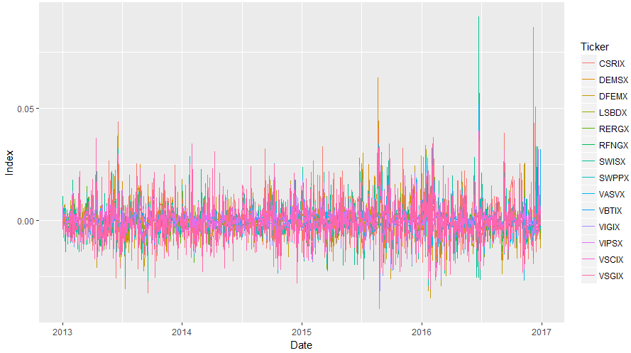
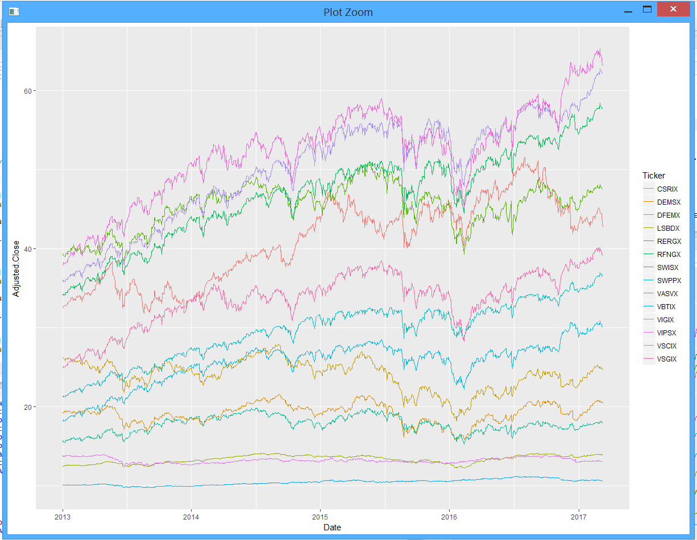
Preliminary Analysis
Tickers VASVX, VSCIX and VSGIX showed positive results in the month of February for all years
Tickers DEMSX, LSBDX, SWISX showed positive results in the month of February for all years
Tickers RFNGX, SWPPX, VIGIX, VSCIX, VSGIX showed positive results in the month of May for all years
Tickers VIPSX showed positive results in the month of July for all years
Tickers VSCIX, VSGIX showed positive results in the month of November for all years
Variance of the index variable is pretty close to zero

Slide 23
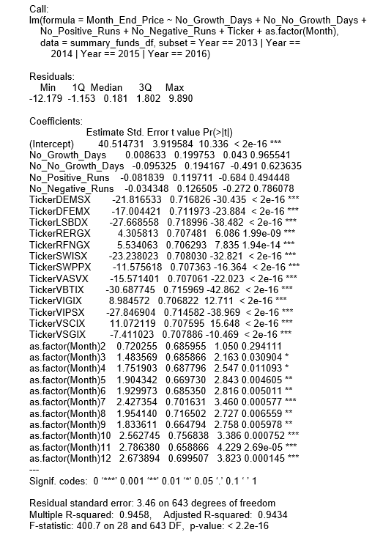
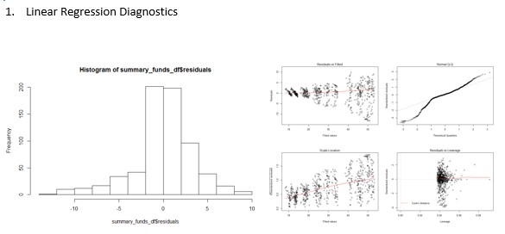
Linear Regression Analysis
Findings
Data is non-linear; Linear Regression is not the right approach to move forward.

Slide 24
Time Series Modelling
Ticker | (p, d, q) Model Selected | Model Formula
VIGIX | (0, 1, 0) | auto.arima(vigix_df[,2],seasonal=FALSE)
SWPPX | (1, 1, 1) | auto.arima(swppx_df[,2],seasonal=FALSE)
RFNGX | (0, 1, 0) | auto.arima(rfngx_df[,2],seasonal=FALSE)
VASVX | (1, 1, 0) | auto.arima(vasvx_df[,2],seasonal=FALSE)
VSGIX | (0, 1, 0) | auto.arima(vsgix_df[,2],seasonal=FALSE)
VSCIX | (0, 1, 0) | auto.arima(vscix_df[,2],seasonal=FALSE)
CSRIX | (0, 1, 0) | auto.arima(csrix_df[,2],seasonal=FALSE)
SWISX | (0, 1, 0) | auto.arima(swisx_df[,2],seasonal=FALSE)
RERGX | (0, 1, 1) | auto.arima(rergx_df[,2],seasonal=FALSE)
DFEMX | (0, 1, 1) | auto.arima(dfemx_df[,2],seasonal=FALSE)
DEMSX | (0, 1, 1) | auto.arima(demsx_df[,2],seasonal=FALSE)
LSBDX | (2, 1, 0) | auto.arima(lsbdx_df[,2],seasonal=FALSE)
VBTIX | (0, 1, 0) | auto.arima(vbtix_df[,2],seasonal=FALSE)
VIPSX | (2, 1, 2) | auto.arima(vipsx_df[,2],seasonal=FALSE)
After testing for autocorrelation and partial autocorrelation on the ticker price, it was found that the ACF is exponentially decaying and there is a significant spike at lag p in PACF, but none beyond that in most of the models. Therefore, the data may follow an ARIMA(p, d, 0) model.
Auto-arima on fund information was performed which resulted in the selection of following models as best suited for the data.

Slide 25
Forecasting Results
Negative outlook forecast matched actual performance for all funds for first quarter of 2017.
Best performing forecasts fitted by the ARIMA models were for funds VSCIX, VASVX, LSBDX and VIPSX.

Slide 26
Conclusion
Suggested portfolios analyzed between 2013 – 2016 resulted in positive growth as recommended by the 401K website.
Arima modelling was used to forecast fund performance for the first quarter of 2017 using data between 2013 – 2016.
Negative growth outlook predicted for all funds matched actual performance of all funds for the first quarter.
VSCIX, VASVX, LSBDX and VIPSX were best performing funds based on forecast.

