Slide 1
Facebook Mixer
Case study Presentation

Slide 2
Problem Statement
Problem Statement: From online sources, I found enrollment of University of Phoenix has been declining since 2010.University of Phoenix was looking to improve student engagement across the university.
Solution : University of Phoenix had started to do live student mixer events on facebook with the hope that Student’s issues are addressed and in turn retain more students.
Measure :No of students who start in a given week/Total No of students.University of Phoenix wants to see 3% YOY growth in terms of No of students.
Year | Enrollment
2010 | 470,000
2015 | 165,700
2016 | 142,500

Slide 3
Exploratory Data Analysis
Data Preconditioning: Extracted Datasets in jupyter, Converted Fields to required format, Replaced Nas with Zeroes to make it easy for analysis.
Merged Calendar table.
Univariate Analysis: Created Histograms and Boxplots for continous variables:
Insight
All the three continuous variables were right skewed and indicates there could be outliers. But I am ignoring outlier treatment as data is too small.

Slide 4
Exploratory Data Analysis
Binomial and Multinomial Analysis:
Insight
I checked the counts using cross tabulations to get an understanding of distribution on three important variables FB_Week_attnd, Attended_Online_School, Generation

Slide 5
Correlation
`
Pearson Correlation
Pair Plots :To get the best features in the dataset which could be correlated.
I checked for Pearson correlation between selected features.
Insight
Strong Linear relationships were found between crse_attmpt & crse_complt, FB_Week_attnd & curr_crse_engage , curr_crse_engage & curr_cres_Active_engage.
It makes sense that students who have attempted courses more have completed as well.

Slide 6
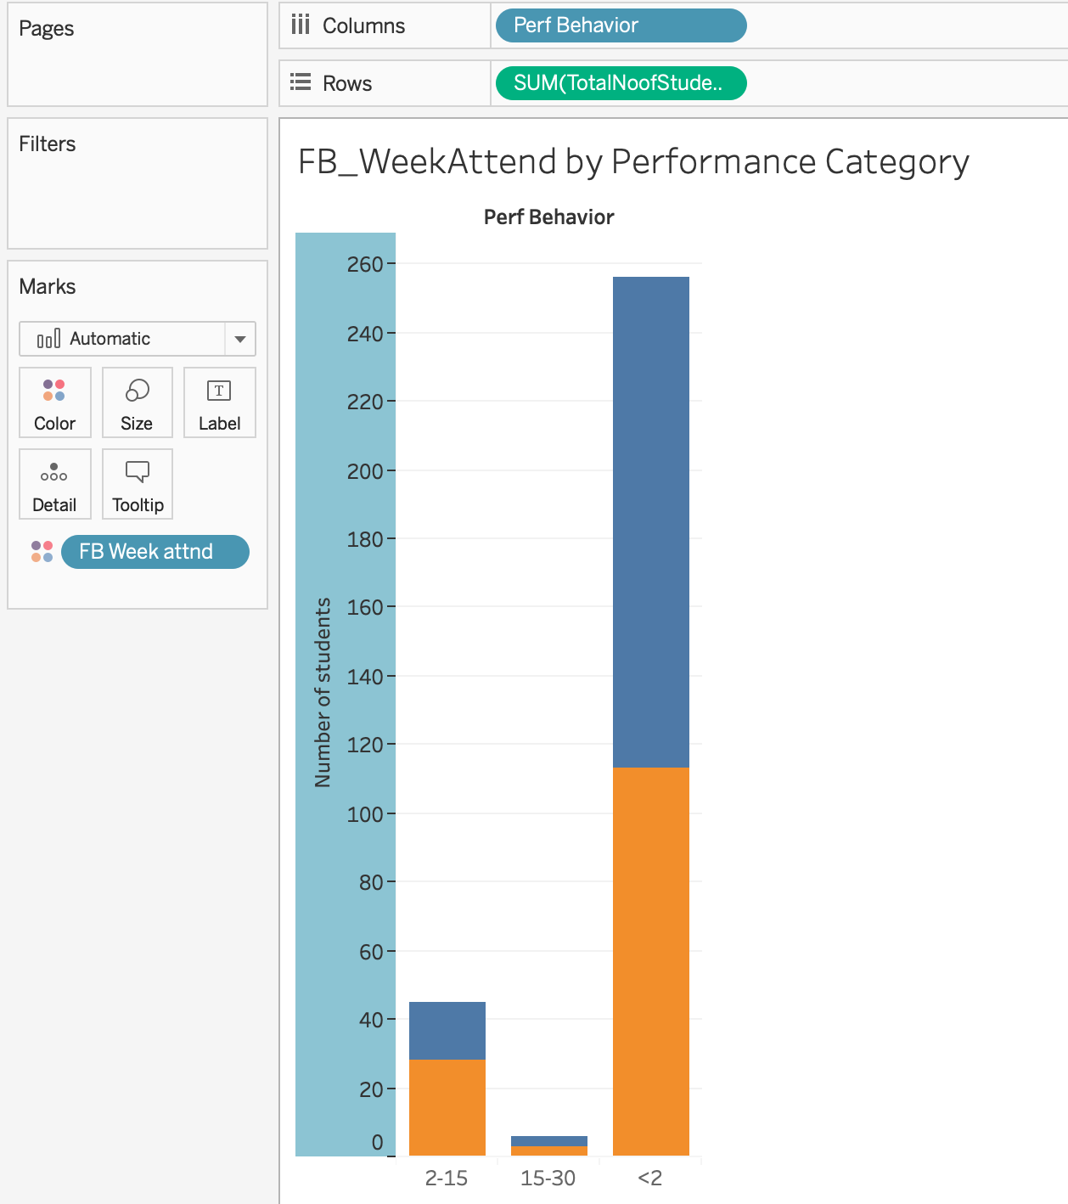
Data Visualization
Performance Bins
Based Performance on Crse_complt
One Hit Wonders: <2
Average Performers:2 -15
Top Performers :15-30
Insight
We are getting equal no people in all three groups in FB_WeekAttend Mixers.

Slide 7
Text Mining
Insight
Most of the top 10 words seem to have a negative sentiment with top frequency words being Time Management ,Work and Online. 91 students have spoken about Time Management and 84 students have spoken about Work.

Slide 8
Recommendations
Students in Average Performance Group need to be ensured that they go on to complete their course.These group of people are precious and KPI watch can help us track these guys.
One hit Wonders could be a lost cause.
From Text Mining , we noted Time Management , Work and Online to be the top most discussed comments.
These issues can be discussed with students and addressed effectively in FB_Mixers.
May be merging an external data source such Nielson TV data or Credit Scores on Student SSNs could provide more insight on if they are spending time other online resources such as Netflix or If they are unable to continue course due to unavailability of resources.

Slide 9
Cons/ Pros
Cons:
Dataset was too small to provide significant hypothesis.
Continuous variables were not normally distributed.
Dataset had lot of missing values.
Pros:
Text Mining provided good sentiment analysis.

