Slide 1
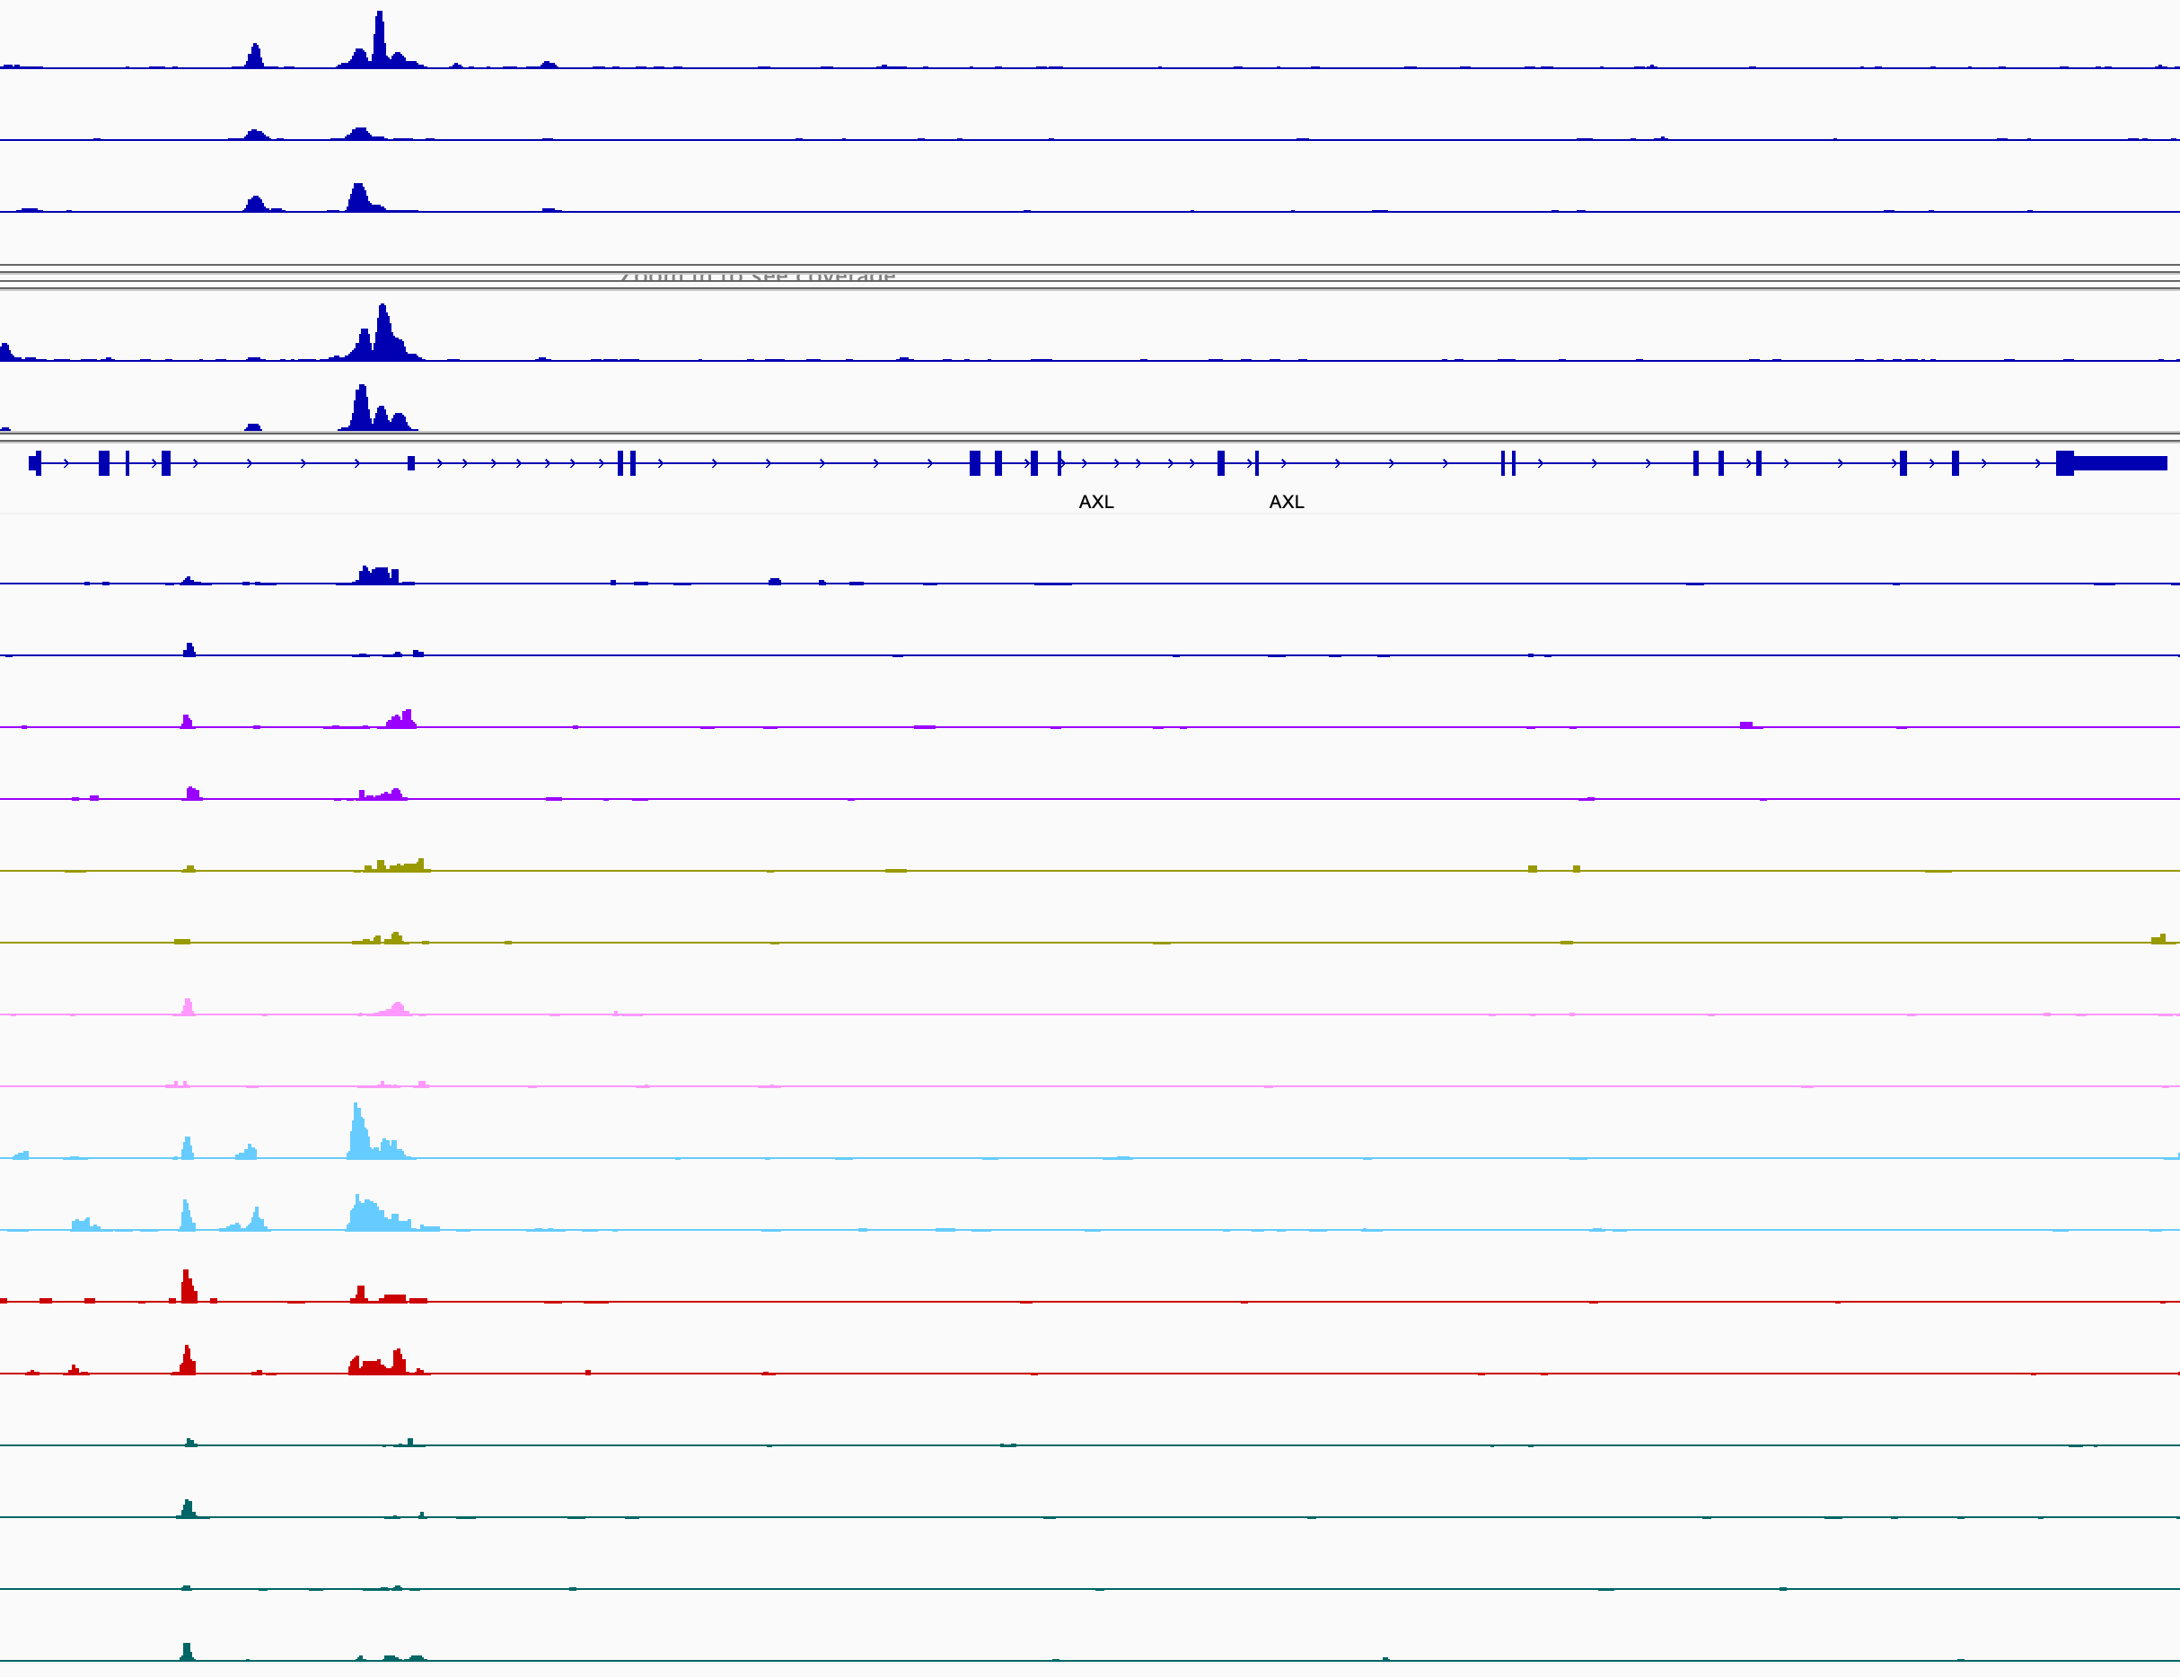
AXL
Jun/Fos
GR
dmso 3d
dex 3d
dex 3d + JNKin8 (1d)
dex 3d → dmso 11d
dmso 3d → trametinib 11d
dex 3d → trametinib 11d
dex 3d + JNKin8 (1d) → trametinib + JNKin8 11d
dex 3d → trametinib + JNKin8 11d

Slide 2
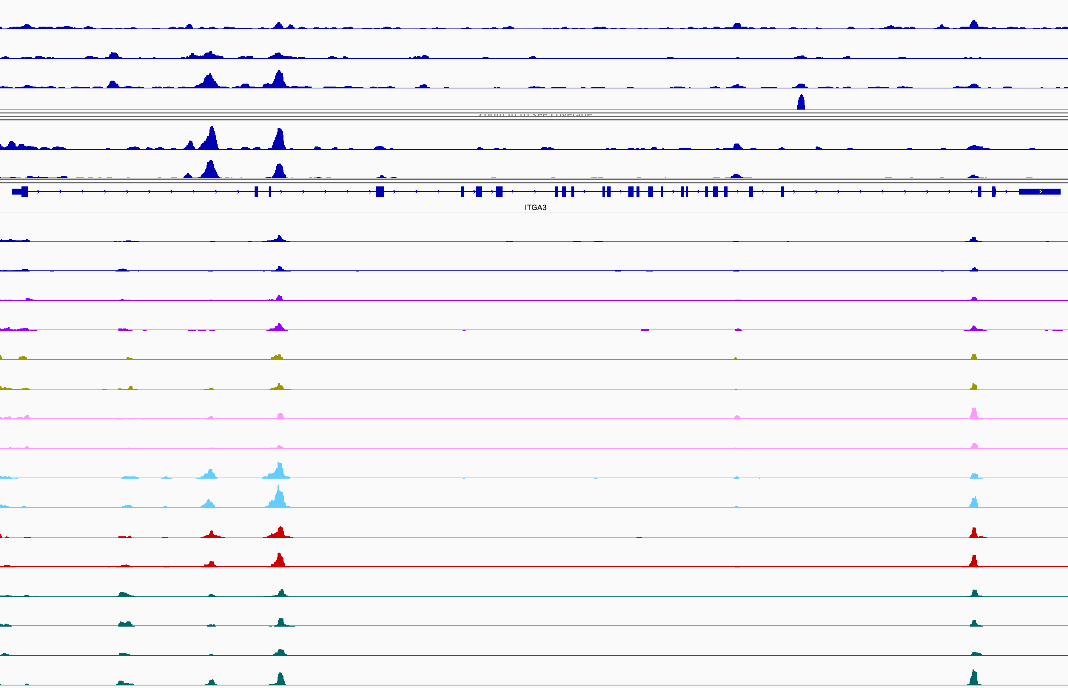
ITGA3
Jun/Fos
GR
dmso 3d
dex 3d
dex 3d + JNKin8 (1d)
dex 3d → dmso 11d
dmso 3d → trametinib 11d
dex 3d → trametinib 11d
dex 3d + JNKin8 (1d) → trametinib + JNKin8 11d
dex 3d → trametinib + JNKin8 11d

Slide 3
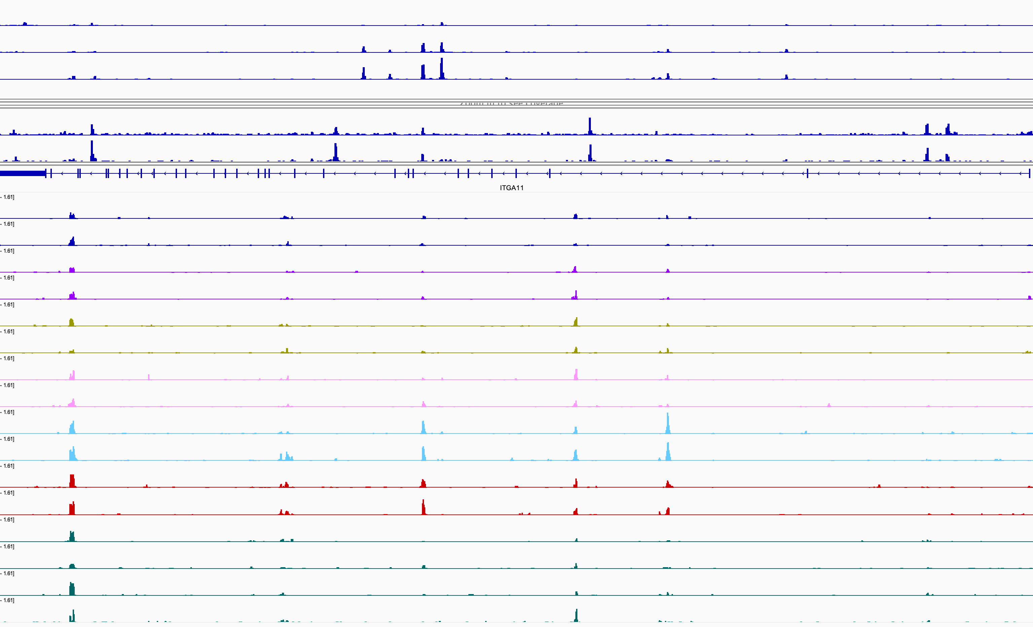
ITGA11
Jun/Fos
GR
dmso 3d
dex 3d
dex 3d + JNKin8 (1d)
dex 3d → dmso 11d
dmso 3d → trametinib 11d
dex 3d → trametinib 11d
dex 3d + JNKin8 (1d) → trametinib + JNKin8 11d
dex 3d → trametinib + JNKin8 11d

Slide 4
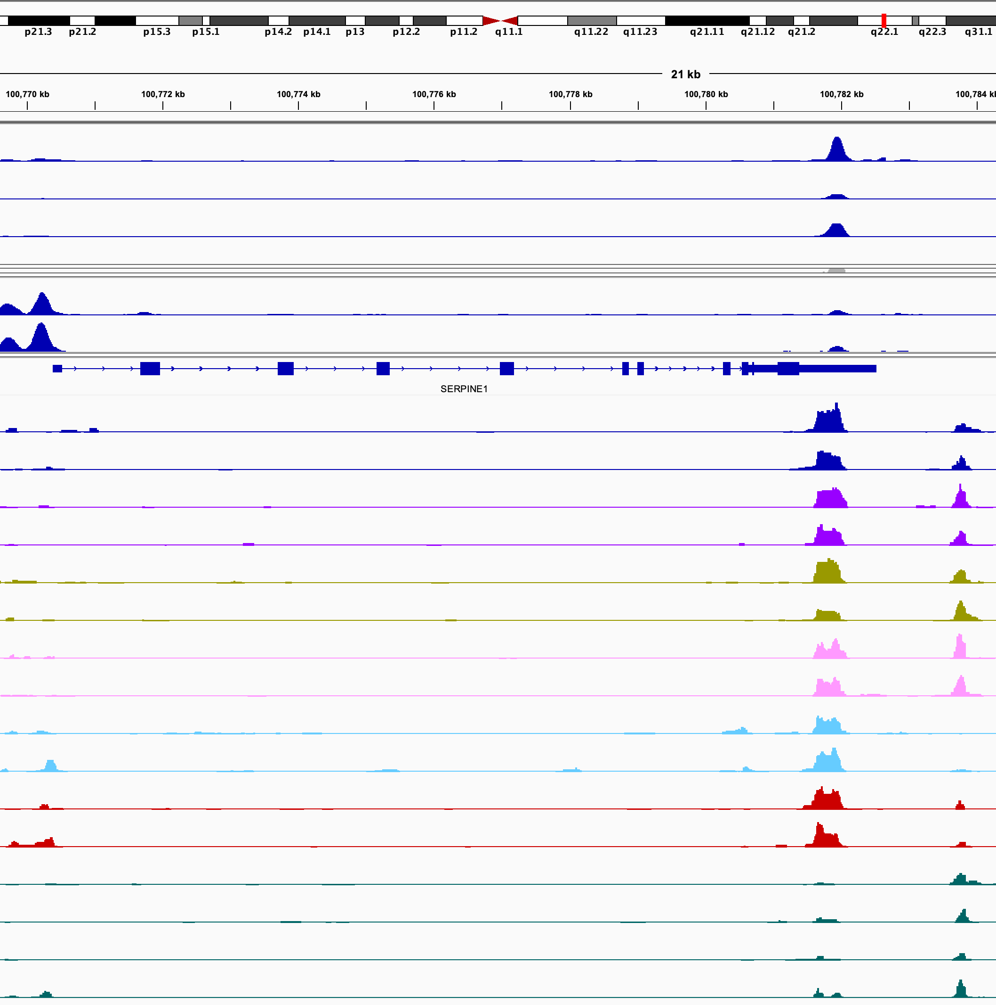
SERPINE1
Jun/Fos
GR
dmso 3d
dex 3d
dex 3d + JNKin8 (1d)
dex 3d → dmso 11d
dmso 3d → trametinib 11d
dex 3d → trametinib 11d
dex 3d + JNKin8 (1d) → trametinib + JNKin8 11d
dex 3d → trametinib + JNKin8 11d

Slide 5
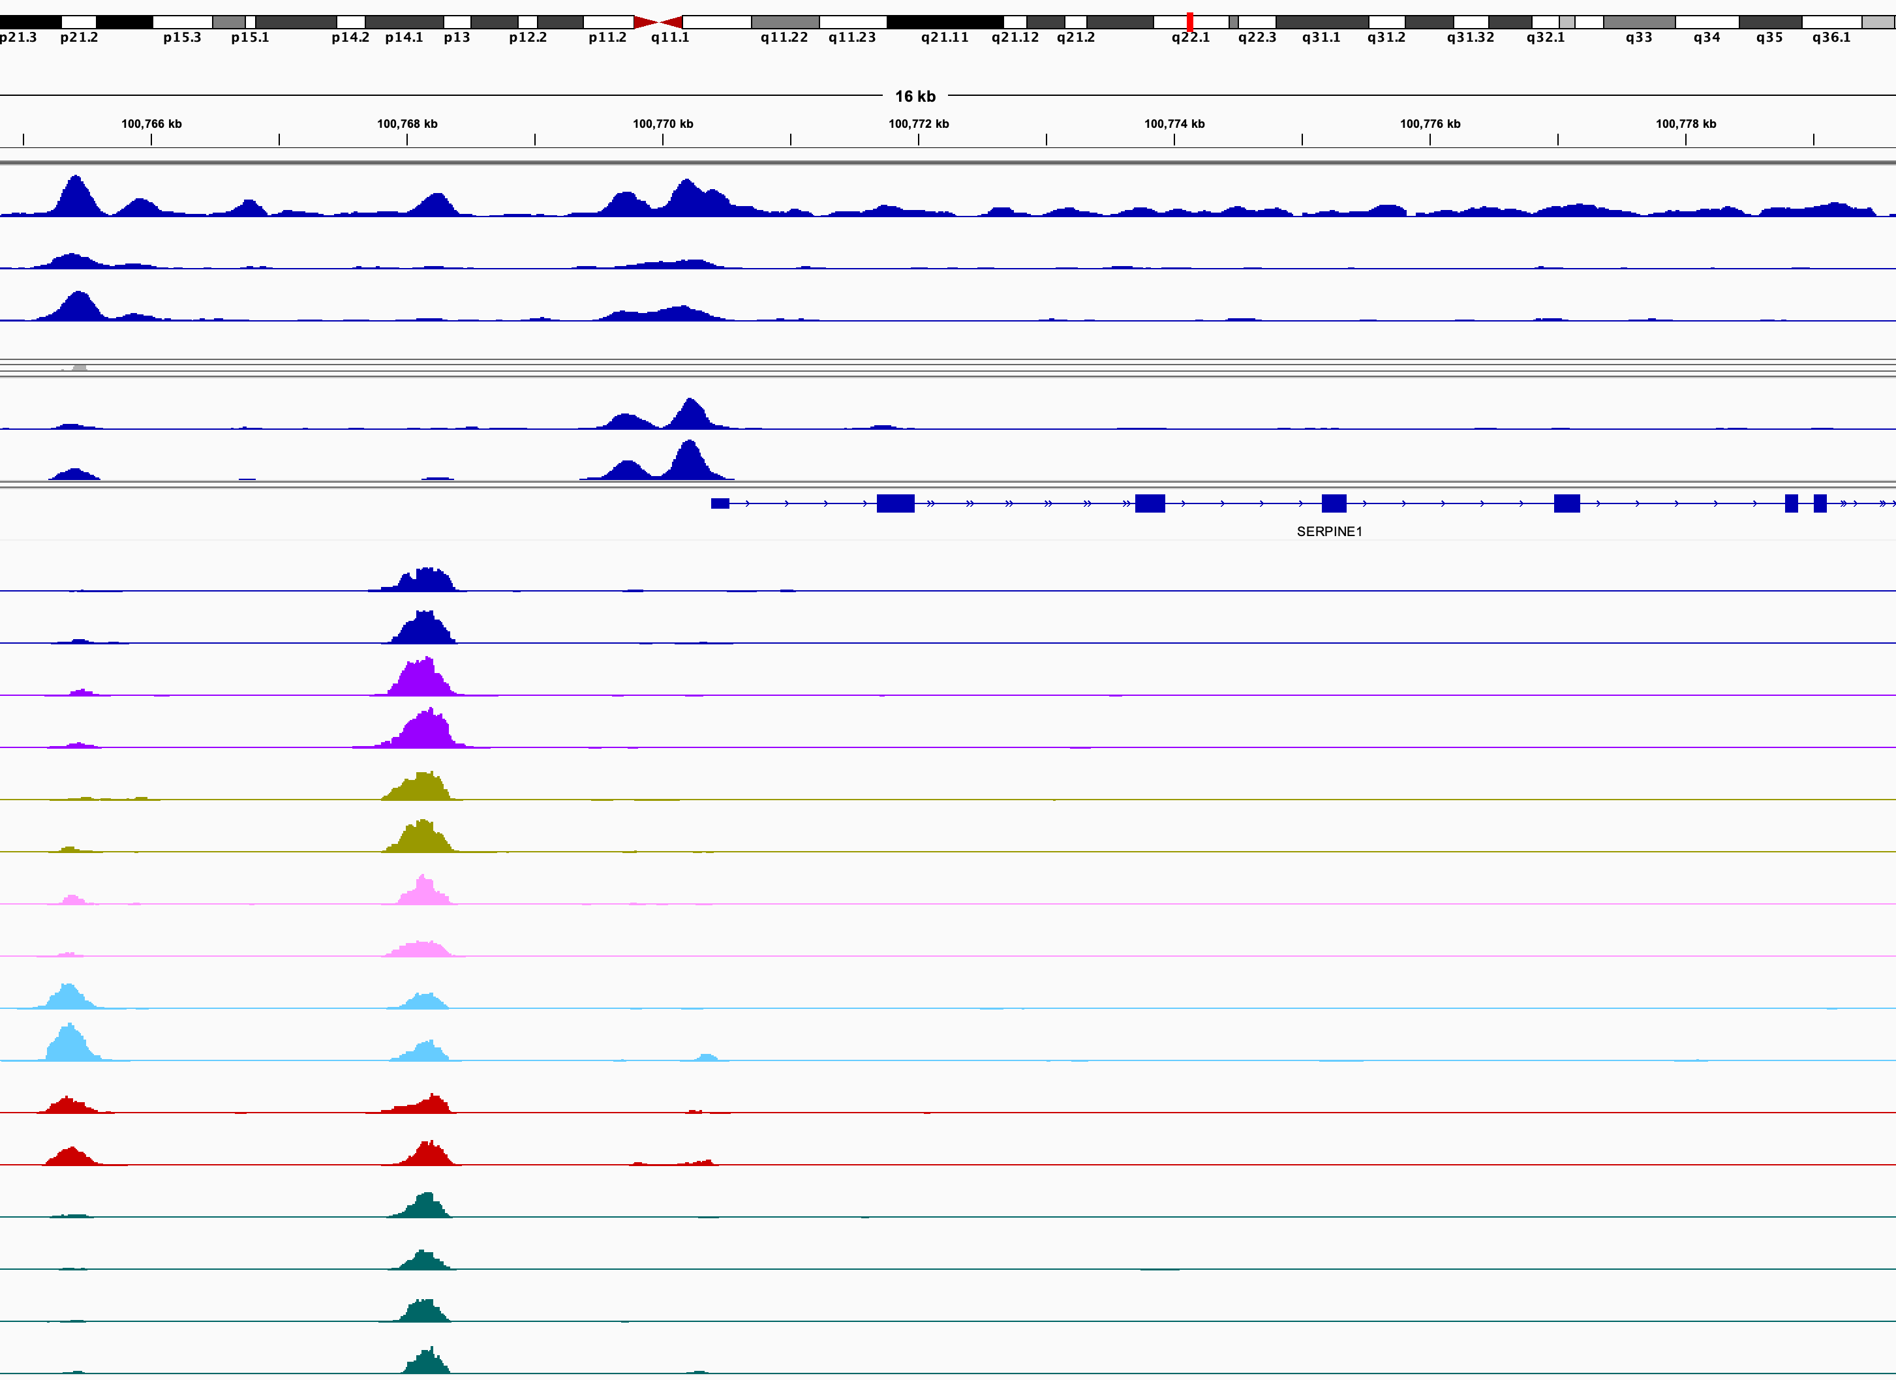
SERPINE1
Jun/Fos
GR
dmso 3d
dex 3d
dex 3d + JNKin8 (1d)
dex 3d → dmso 11d
dmso 3d → trametinib 11d
dex 3d → trametinib 11d
dex 3d + JNKin8 (1d) → trametinib + JNKin8 11d
dex 3d → trametinib + JNKin8 11d

Slide 6
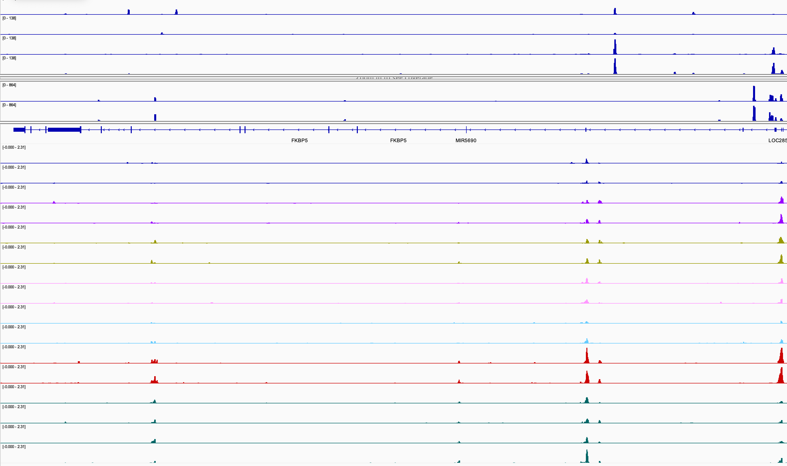
FKBP5
Jun/Fos
Jun/Fos
GR
GR
dmso 3d
dmso 3d
dex 3d
dex 3d
dex 3d + JNKin8 (1d)
dex 3d + JNKin8 (1d)
dex 3d → dmso 11d
dex 3d → dmso 11d
dmso 3d → trametinib 11d
dmso 3d → trametinib 11d
dex 3d → trametinib 11d
dex 3d → trametinib 11d
dex 3d + JNKin8 (1d) → trametinib + JNKin8 11d
dex 3d + JNKin8 (1d) → trametinib + JNKin8 11d
dex 3d → trametinib + JNKin8 11d
dex 3d → trametinib + JNKin8 11d

Slide 7
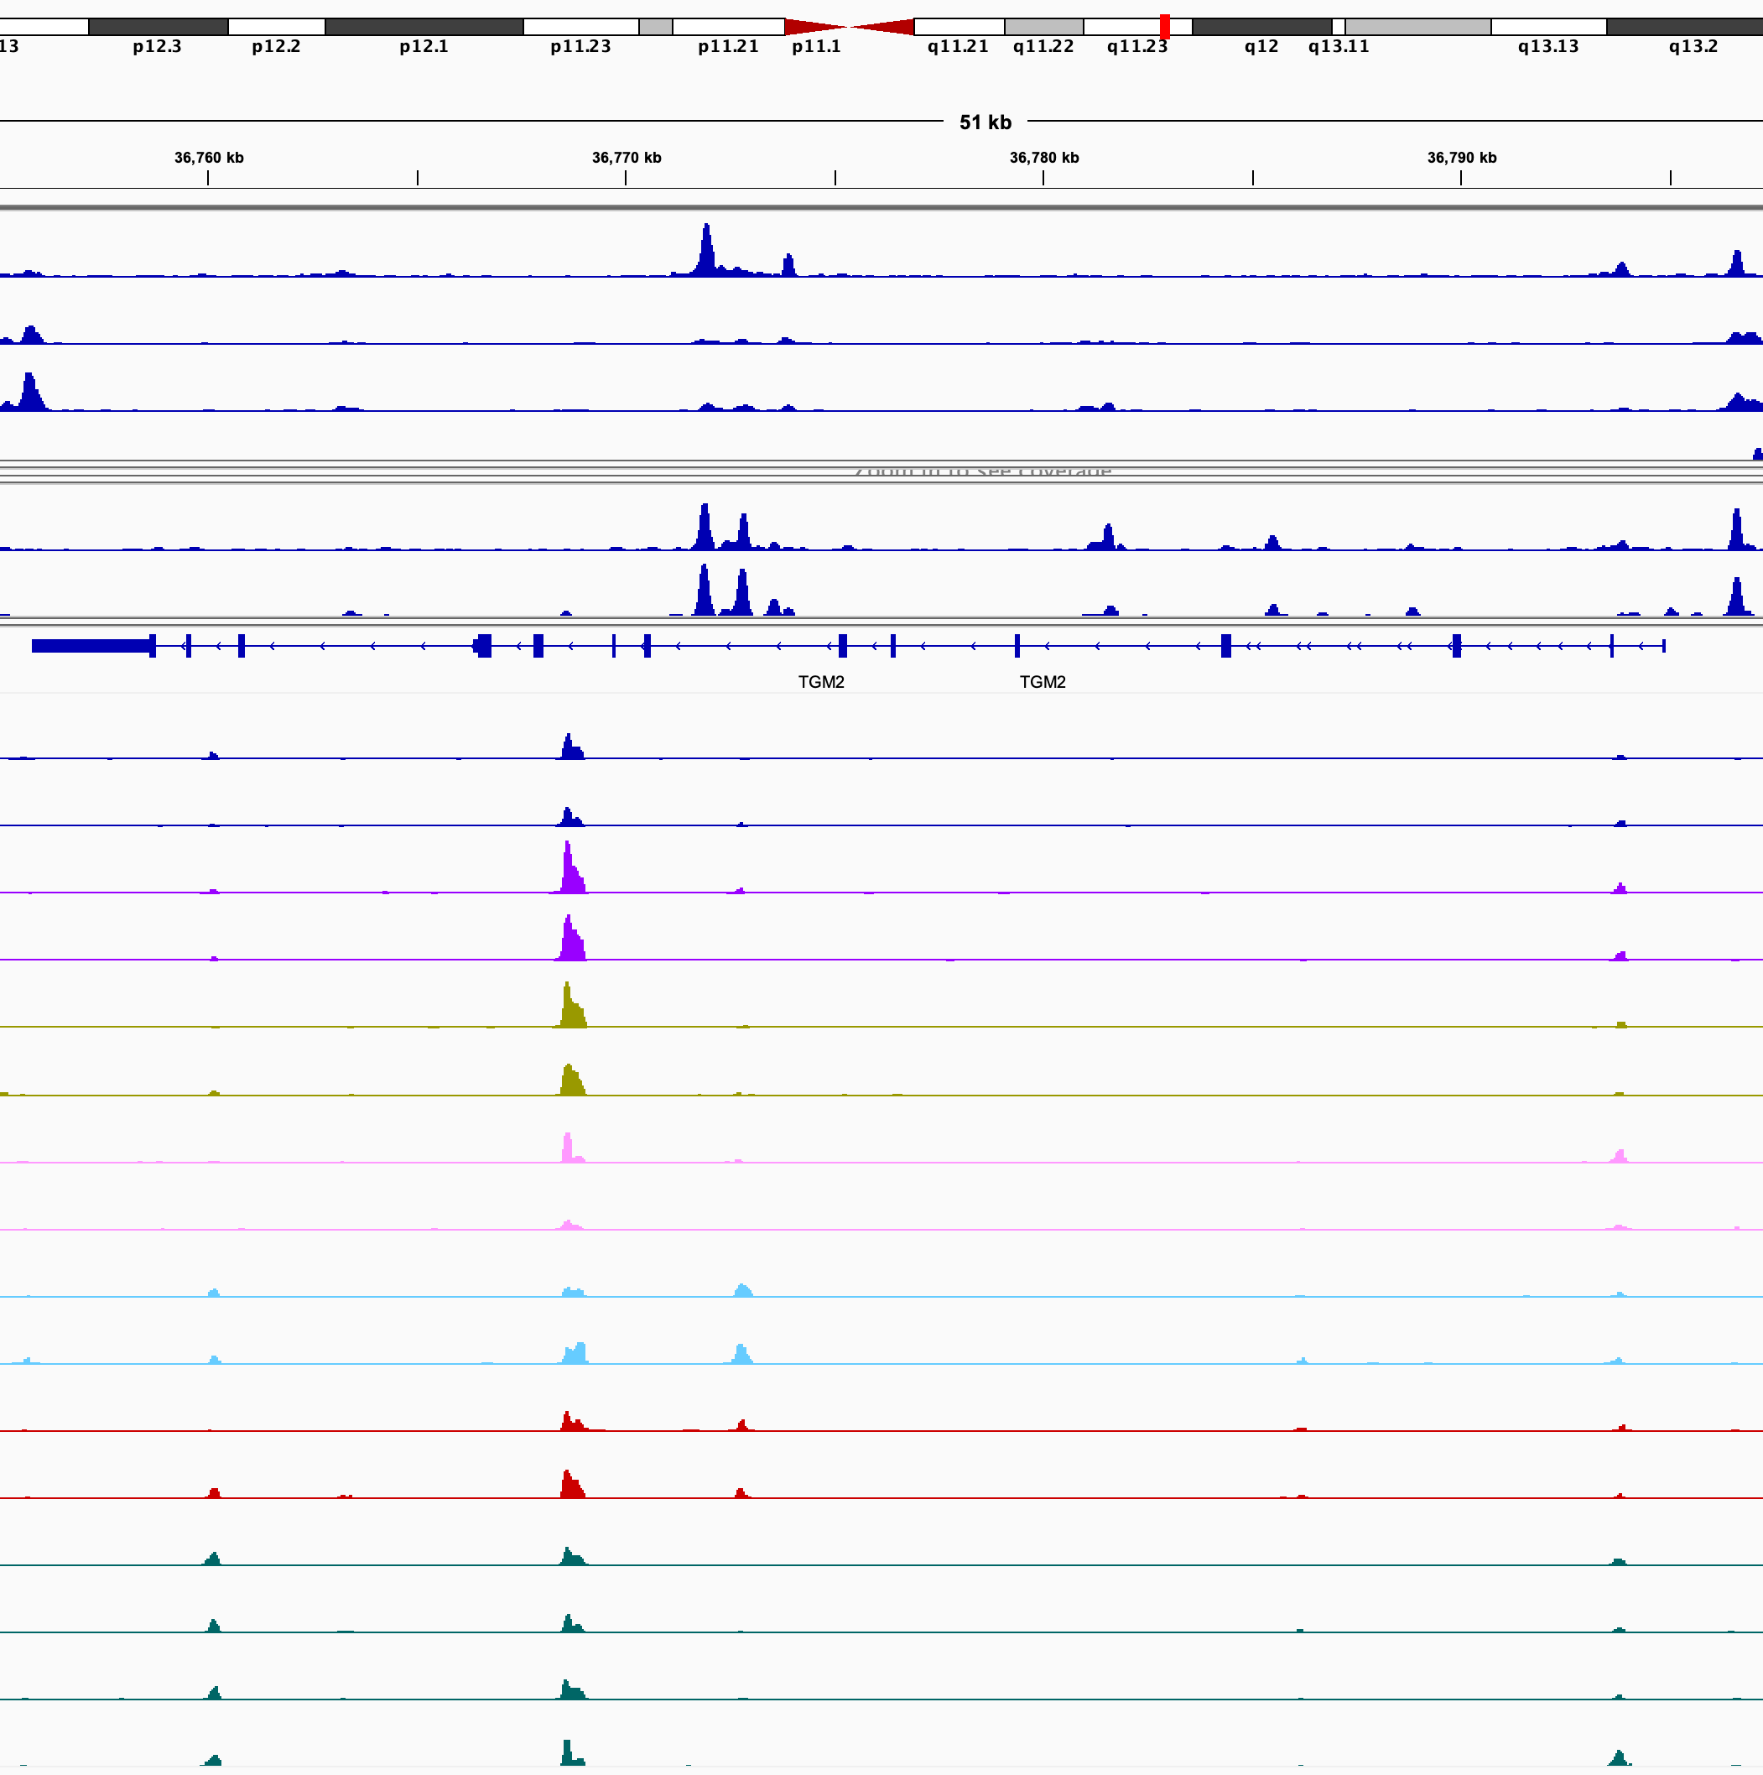
TGM2
Jun/Fos
GR
dmso 3d
dex 3d
dex 3d + JNKin8 (1d)
dex 3d → dmso 11d
dmso 3d → trametinib 11d
dex 3d → trametinib 11d
dex 3d + JNKin8 (1d) → trametinib + JNKin8 11d
dex 3d → trametinib + JNKin8 11d

Slide 8
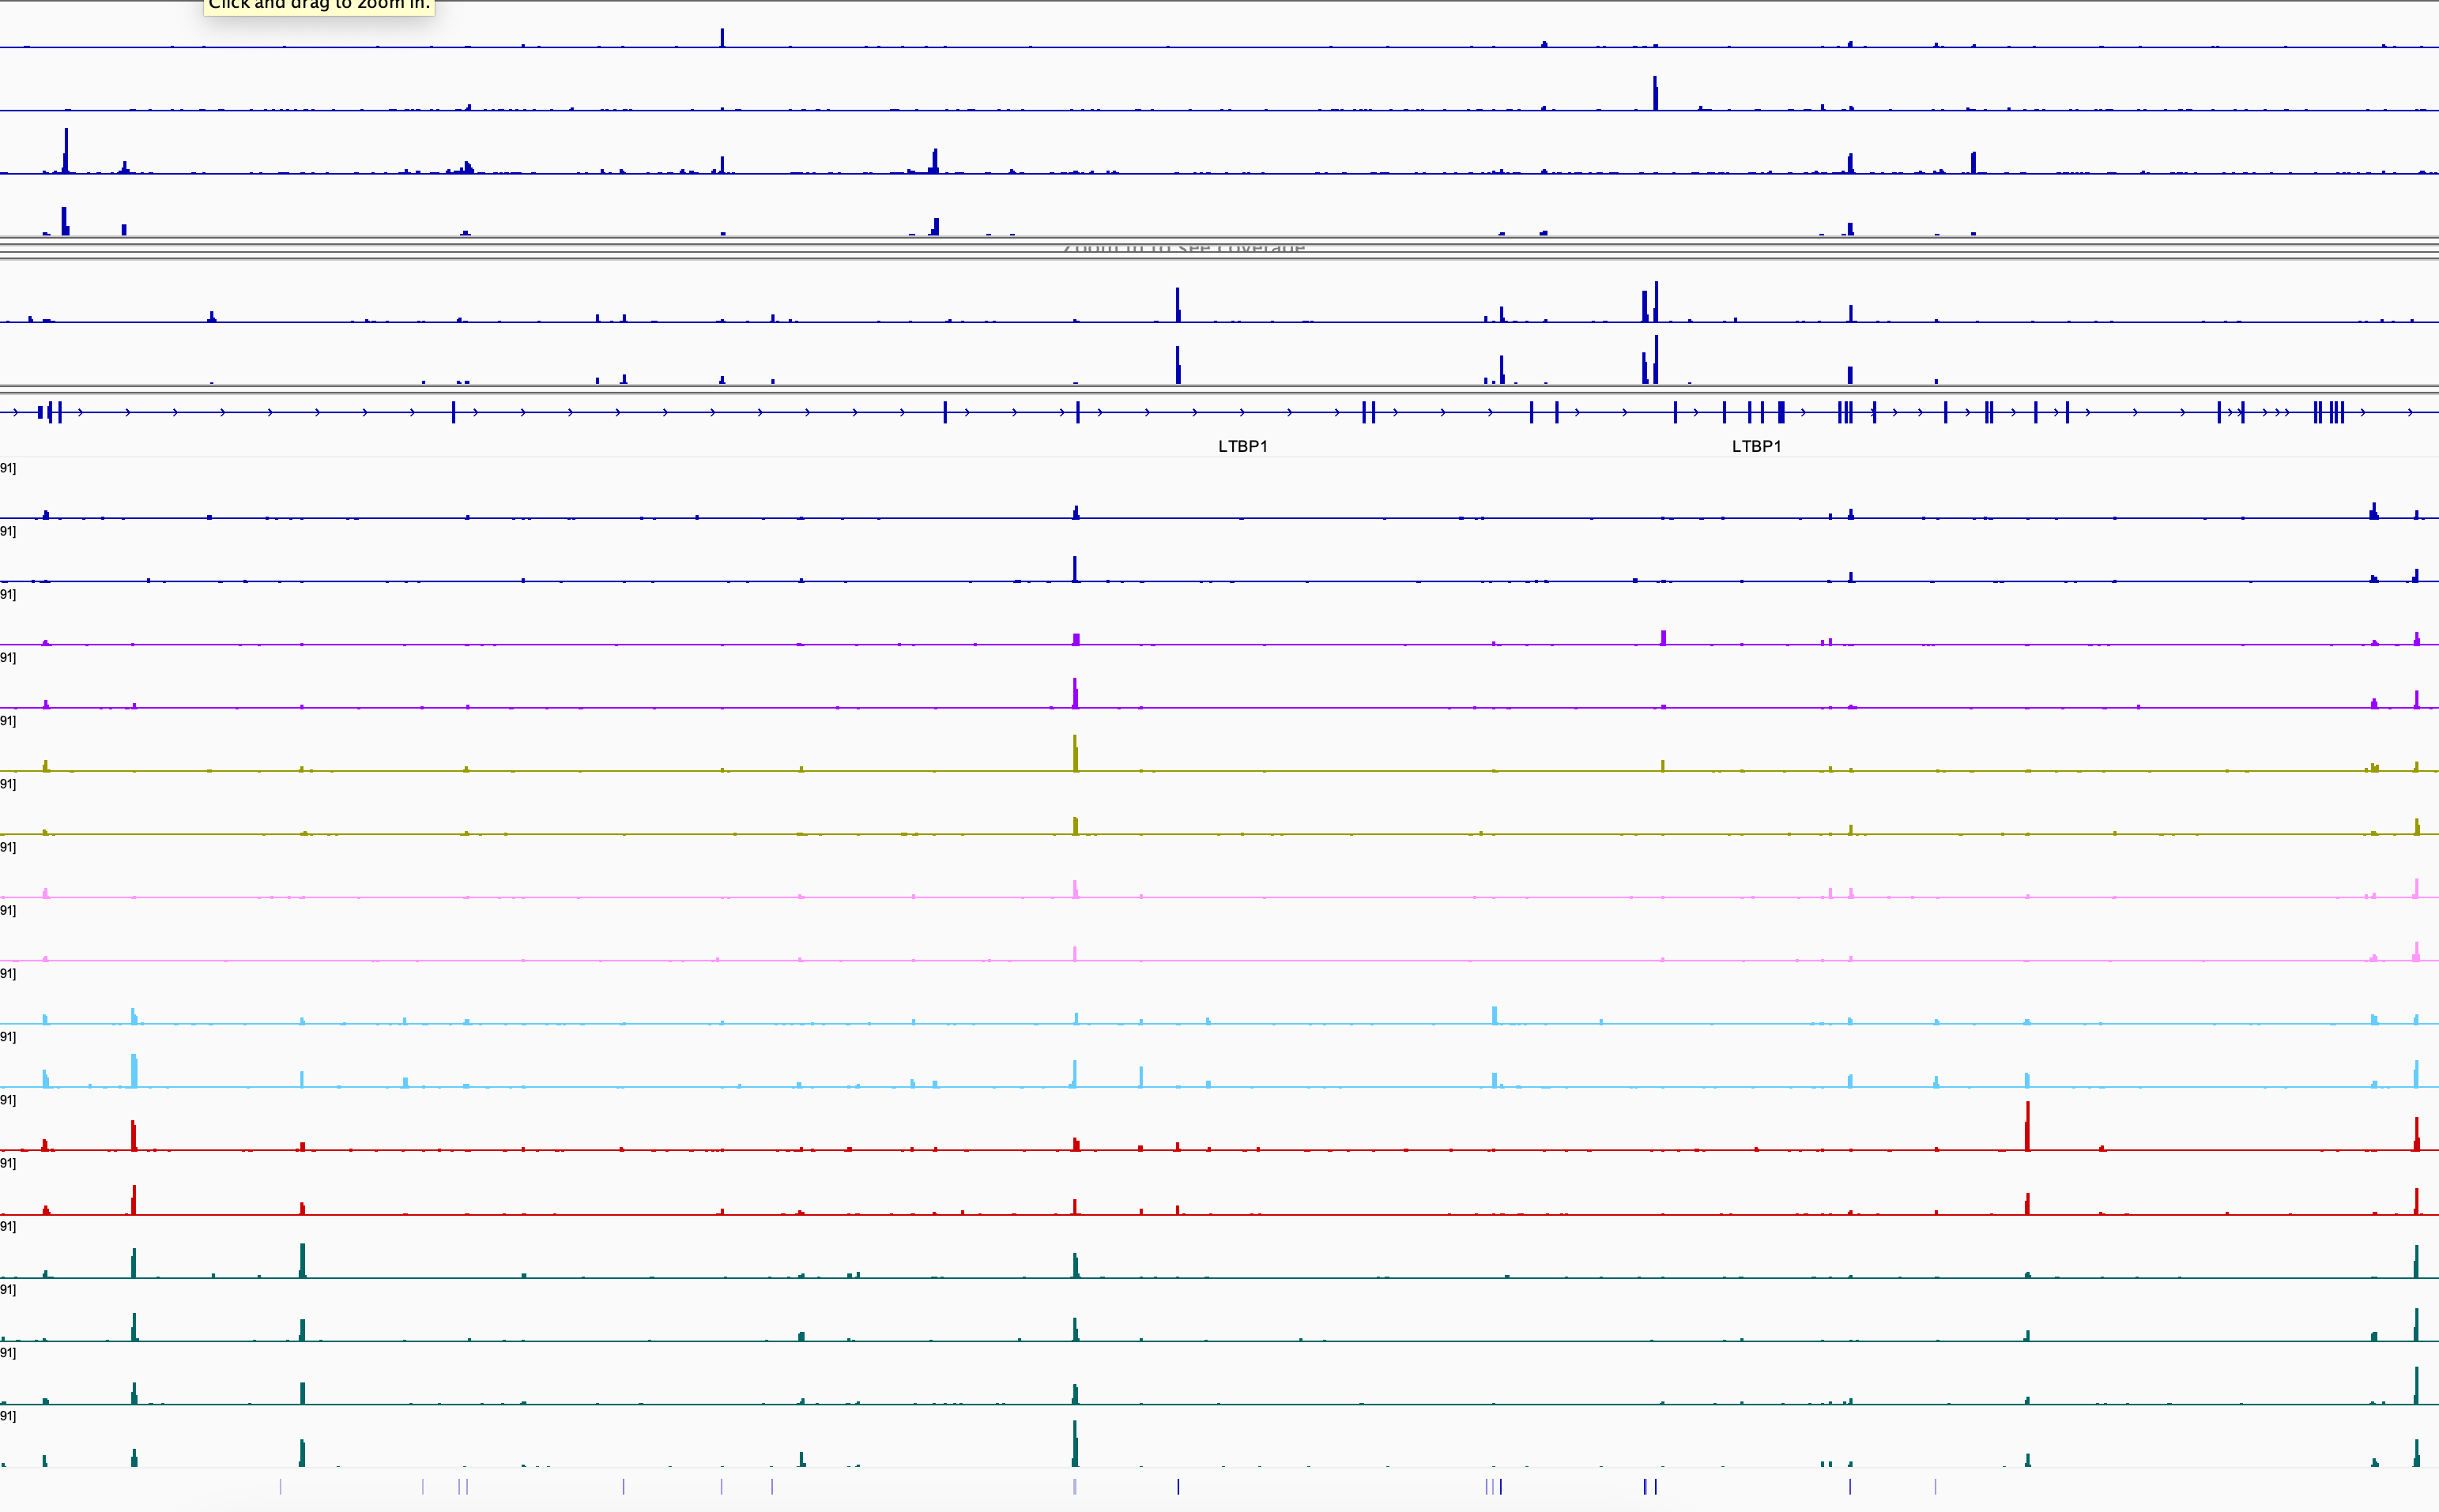
LTBP1
Jun/Fos
GR
dmso 3d
dex 3d
dex 3d + JNKin8 (1d)
dex 3d → dmso 11d
dmso 3d → trametinib 11d
dex 3d → trametinib 11d
dex 3d + JNKin8 (1d) → trametinib + JNKin8 11d
dex 3d → trametinib + JNKin8 11d

