Slide 1
Major Project
Comparison between Differential Evolution and Simulated Annealing for Parameter Tuning

Slide 2
Introduction
01

Slide 3
Problem Statement
The aim of the project is to ― Compare performance of Differential Evolution & Simulated Annealing in tuning parameters of different machine learning models.
We seek simple, automatic, and effective methods for finding tunings that give optimum value for the desired goal.

Slide 4
Data Set
02

Slide 5
Introduction
Our defect data comes from PROMISE repository . This data pertains to open source Java systems : ant, camel, ivy, jedit, log4j, lucene, poi, synapse, velocity and xerces.
We selected these data sets since they have at least three consecutive releases (where release i+1 was built after release i).
This will allow us to build defect predictors based on the past data and then predict (test) defects on future version projects, which will be a more practical scenario.

Slide 6
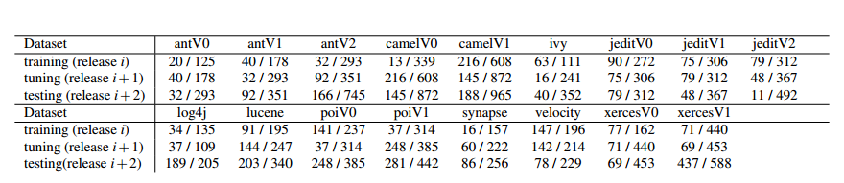
Dataset
Data used in this case study. Fractions denote defects I total. Eg: the top left dataset has 20 defective classes out of 125 total.

Slide 7
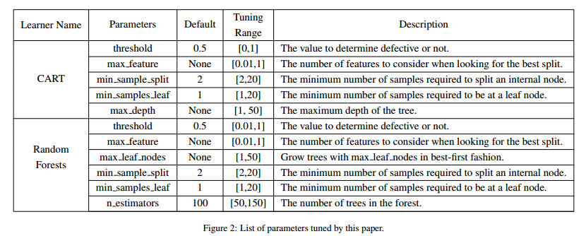
Parameters and Algorithms under consideration

Slide 8
Proposed Work and Algorithms used
03

Slide 9
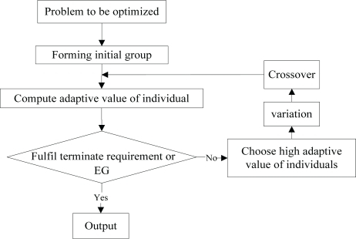
DE is an optimization technique which iteratively modifies a population of candidate solutions to make it converge to an optimum value of your function. First initialize candidate solutions randomly. Then at each iteration and for each candidate solution x, do the following:
Produce a trial vector: v = a + ( b - c ) / 2, where a, b, c are three distinct candidate solutions picked randomly among your population.
Randomly swap vector components between x and v to produce v'. At least one component from v must be swapped.
Replace x in your population with v' only if it is a better candidate (i.e. it better optimise your function).
Differential Evolution

Slide 10
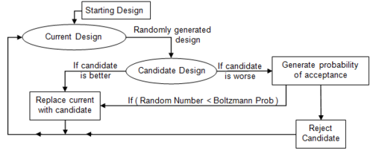
Simulated Annealing is a probabilistic technique for approximating the global optimum of a given function.
This algorithm is often used when the search space is discrete and it is important to find the global optimum than a local maxima in limited time.
It is based on annealing in metallurgy where there is heating and controlled cooling of a material to increase crystal size and decrease defects.
Heating and cooling affects the temperature and thermodynamic energy of the material.
This notion of slow cooling implemented in the Simulated Annealing algorithm is interpreted as a slow decrease in the probability of accepting worse solutions as the solution space is explored.
Simulated Annealing

Slide 11
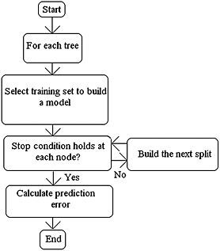
It is a classification and regression technique. It operates by constructing a multitude of decision trees at training time and outputting the mode or the mean of the classes.
Random forest is a collection of decision trees. Decision trees can overfit but random forest prevents it i.e. that is prevents overfitting.
The implementation of Random Forest as given in sklearn is as follows :
class sklearn.ensemble.RandomForestClassifier (n_estimators=10, criterion='gini', max_depth=None, min_samples_split=2, min_samples_leaf=1, min_weight_fraction_leaf=0.0, max_features='auto', max_leaf_nodes=None, min_impurity_split=1e-07, bootstrap=True, oob_score=False, n_jobs=1, random_state=None, verbose=0, warm_start=False, class_weight=None)
Random Forest

Slide 12
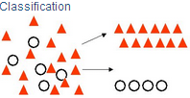
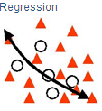
Decision Trees are commonly used in data mining with the objective of creating a model that predicts the value of a target (or dependent variable) based on the values of several input (or independent variables).
Classification Trees: Where the target variable is categorical and the tree is used to identify the "class" within which a target variable would likely fall into.
Regression Trees: Where the target variable is continuous and tree is used to predict it's value.
The implementation of CART as given in sklearn is as follows :
def cart(a, b, c, d, candidate):
ct = DecisionTreeClassifier(max_depth=candidate["tunings"][4], min_samples_split=candidate["tunings"][2], min_samples_leaf=candidate["tunings"][3], max_features=candidate["tunings"][1], min_impurity_split=candidate["tunings"][0])
ct.fit(a, b)
pred = ct.predict(c)
CART

Slide 13
Optimization Goals:
Our optimizers explore tuning improvements for precision and the F-measure, defined as follows. Let {A, B, C, D} denote the true negatives, false negatives, false positives, and true positives (respectively) found by a binary detector. Certain standard measures can be computed from A, B, C, D, as shown below.
pd = recall = D/(B+D)
pf = C/(A+C)
prec = precision = D/(D+C)
F = 2 ∗ pd ∗ prec/(pd + prec)

Slide 14
Results
04

Slide 15
Tuned vs Untuned Models
Each of the two algorithms - Random Forest and CART were applied on all the 17 datasets one by one by taking default values of their parameters. The Precision and F-measure were noted for each dataset.
Differential Evolution and Simulated Annealing were applied on Random Forest and CART one by one for each of the 17 datasets with the aim of optimising one of the performance parameters like Precision and F-measure. DE and SA, both were executed twice for each dataset in case of each algorithms by taking Precision as optimising goal in one case and F-measure in the other.

Slide 16
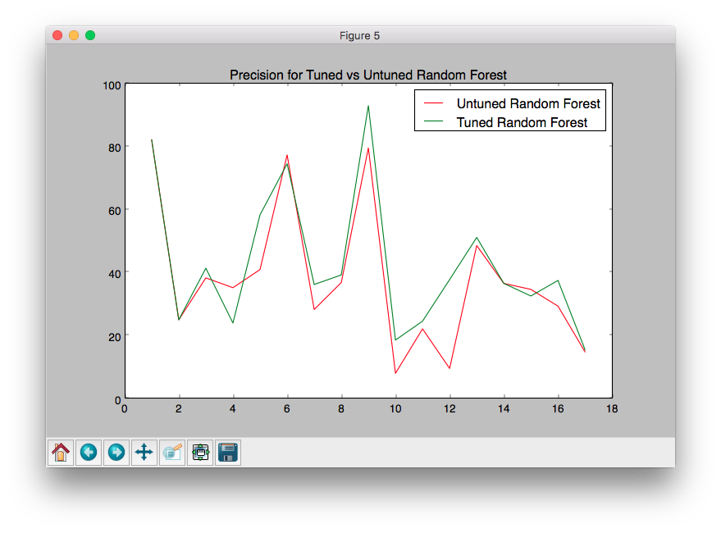
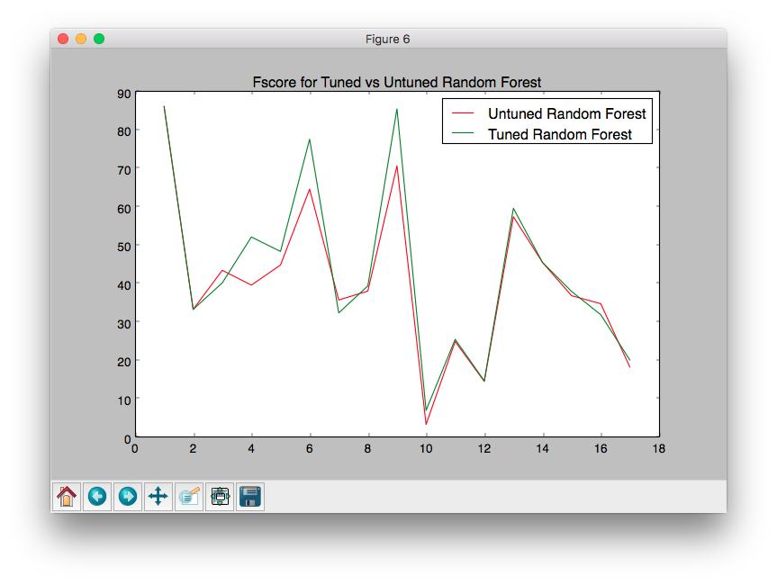
Tuned vs Untuned Models using Differential Evolution
Random Forest

Slide 17
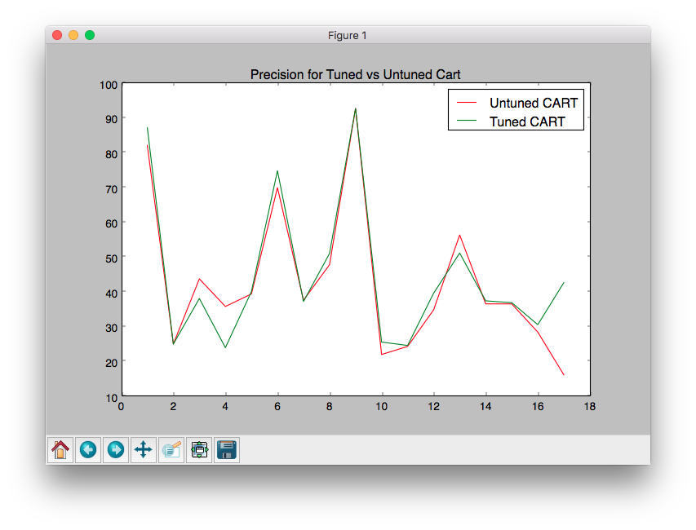
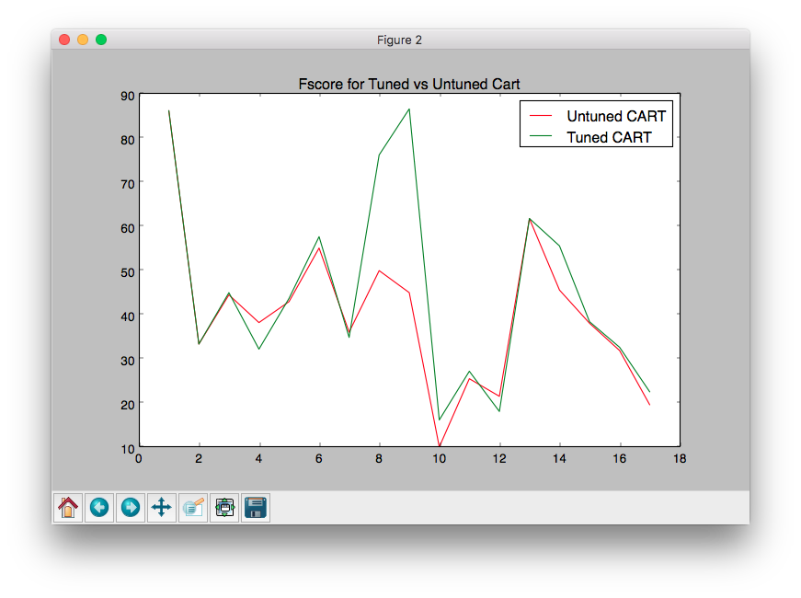
Tuned vs Untuned Models using Differential Evolution
CART

Slide 18
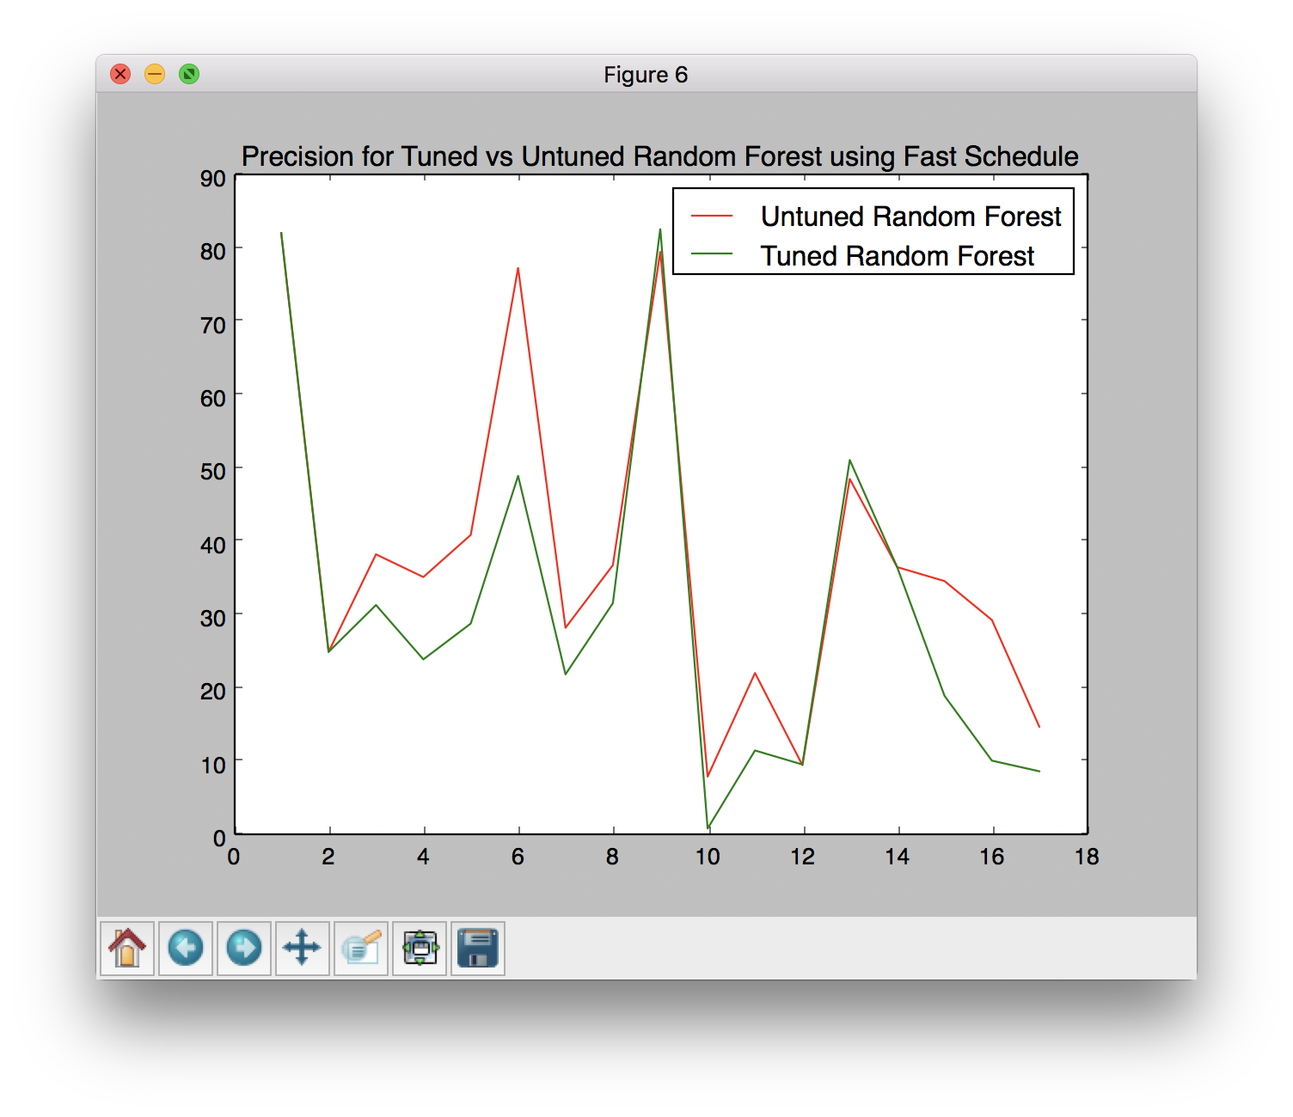
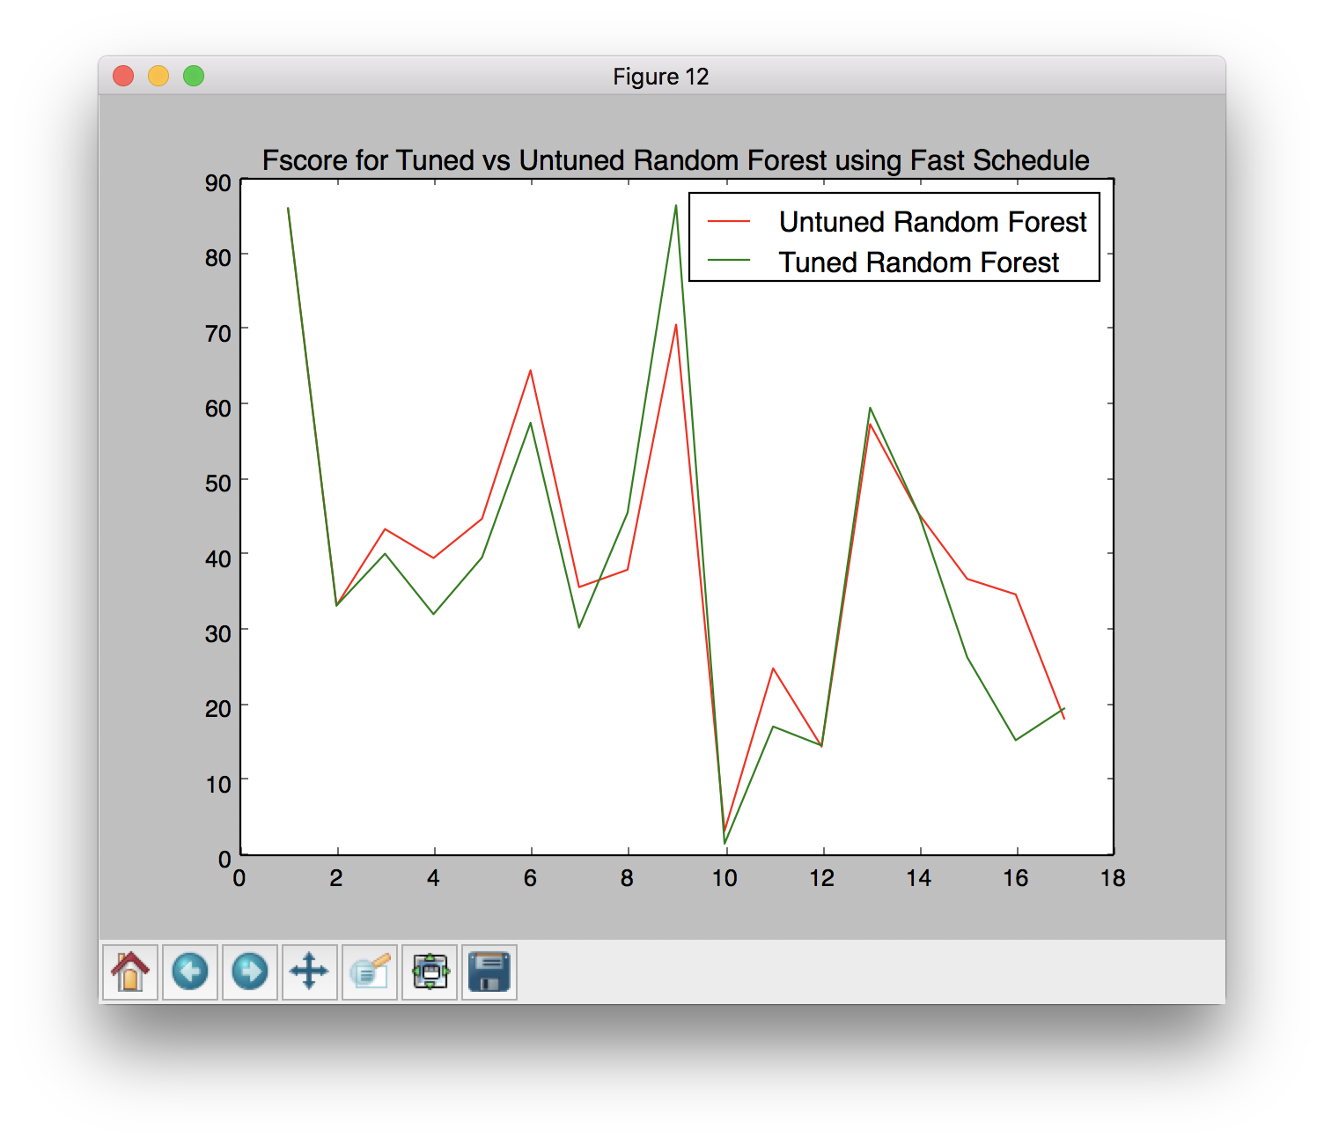
Tuned vs Untuned Models using Simulated Annealing
Random Forest

Slide 19
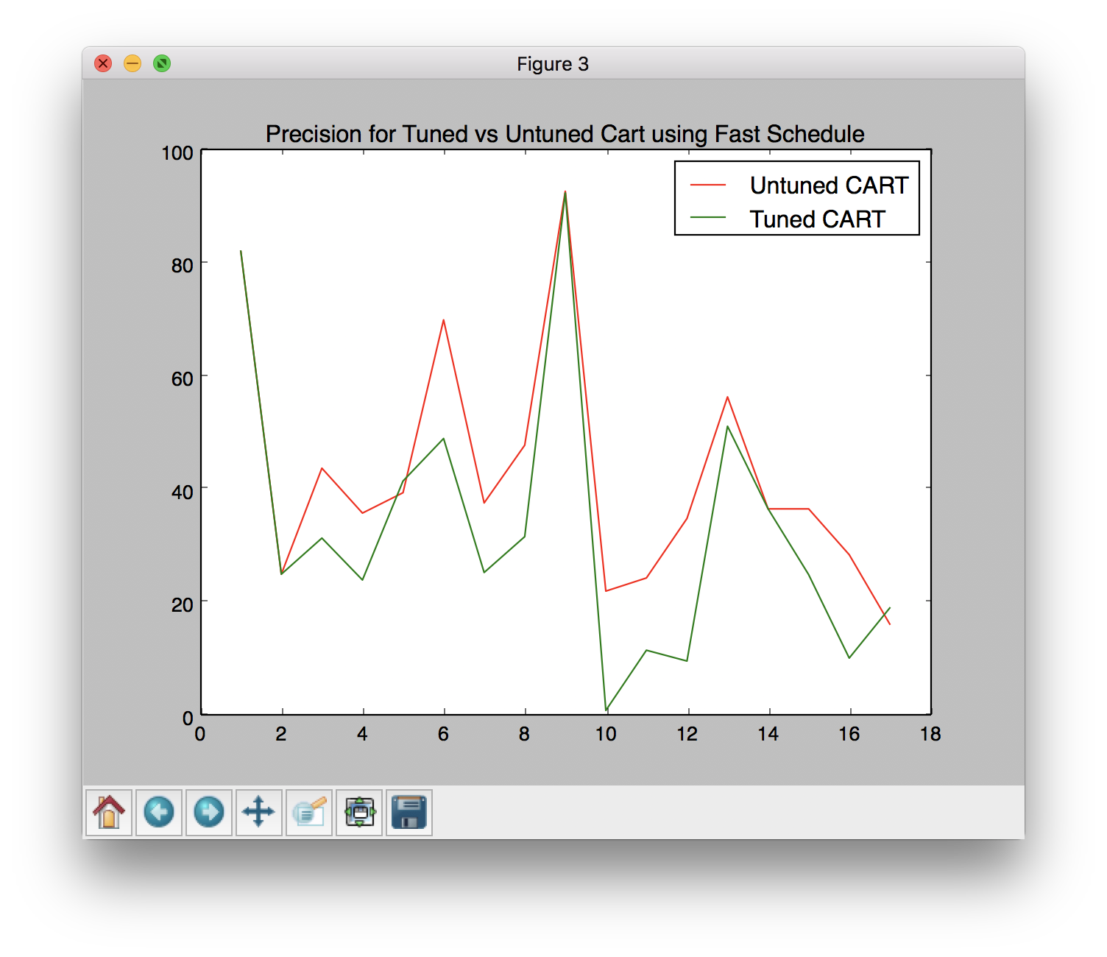
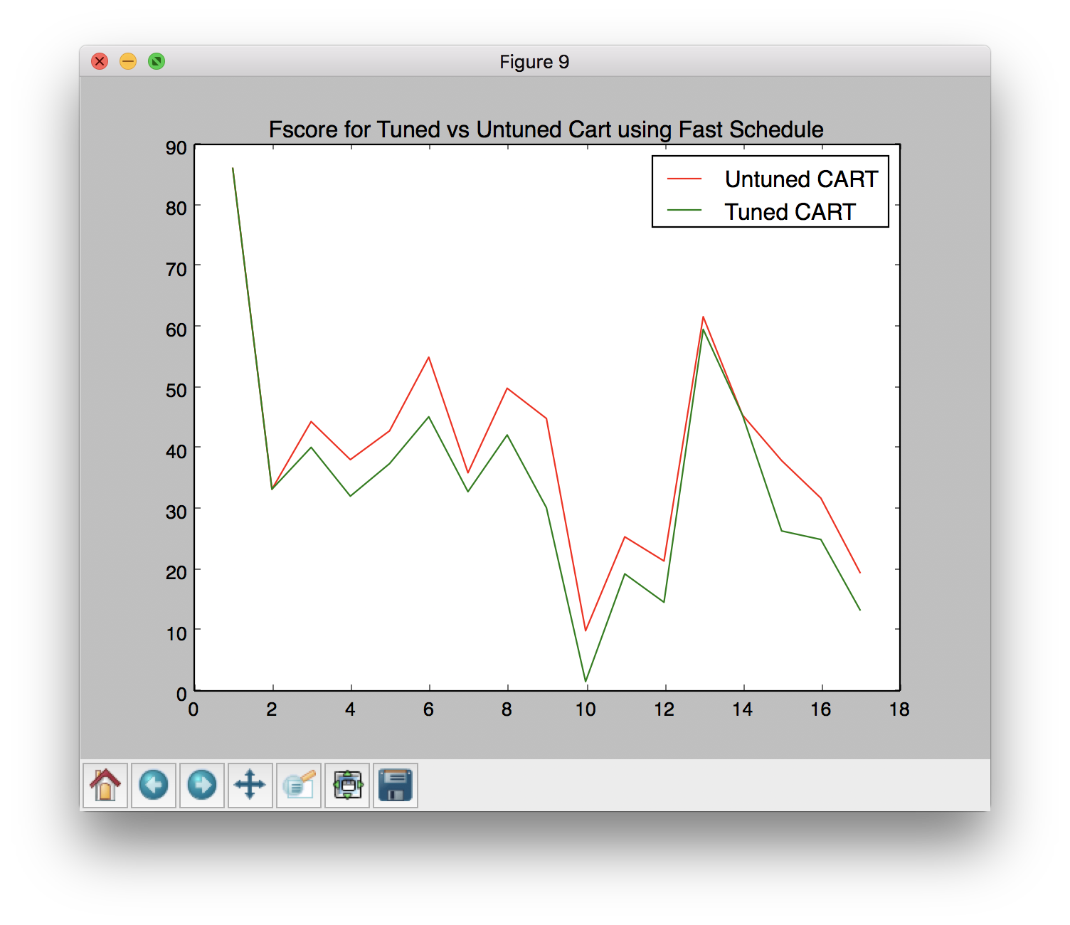
Tuned vs Untuned Models using Simulated Annealing
CART

Slide 20
Conclusion

Slide 21
Conclusion
In this project, we studied the impact of Parameter Tuning in the field of Software Defect Prediction. Differential Evolution and Simulated Annealing were applied on machine learning algorithms like Random Forest and Classification And Regression Trees (CART) with the aim of optimising Precision or F-Measure. It was found that tuning parameters improved both these performance measures substantially as compared to untuned parameters.
It was also observed that tuning the parameters of the learning algorithms were simple and that Differential Evolution showed greater improvement as compared to Simulated Annealing.
Our exploration in the field of Parameter Tuning showed that when learning defect predictors for static code attributes, analytics without tuning are considered harmful and misleading.
Notes:
Heba

Slide 22
Future Scope

Slide 23
Future Scope
It is now important to explore the implications of these conclusions to other kinds of software analytics.
This project has investigated some learners using one optimizer. Hence, we can make no claim that DE is the best optimizer for all learners.
Rather, our point is that there exists at least some learners whose performance can be dramatically improved by at least one simple optimization scheme.

Slide 24
THANK YOU!
PRESENTED BY
Arjun Rajpal (2K14/SE/021)
Dushyant Rathore (2K14/SE/029)
Manav Middha (2K14/SE/043)

