Slide 1
Paper Presentation
Comparison between Differential Evolution & Simulated Annealing for Parameter Tuning on Software Defect Prediction

Slide 2
Introduction
01

Slide 3
Problem Statement
The aim of the project is to ― Compare performance of Differential Evolution & Simulated Annealing in tuning parameters of different machine learning models in the field of Software Defect Prediction.
We try to find simple and easy to implement methods for tuning the defect predictors and also compare the performances of these methods.

Slide 4
Data Set
02

Slide 5
Introduction
Our defect data comes from PROMISE repository . This data pertains to open source Java systems : ant, camel, ivy, jedit, log4j, lucene, poi, synapse, velocity and xerces.
We selected these data sets since they have at least three consecutive releases (where release i+1 was built after release i).
This will allow us to build defect predictors based on the past data and then predict (test) defects on future version projects, which will be a more practical scenario.

Slide 6
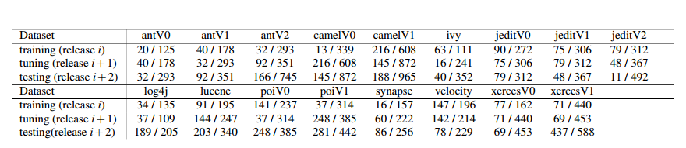
Dataset
Data used in this case study. Fractions denote defects I total. Eg: the top left dataset has 20 defective classes out of 125 total.

Slide 7
Attributes in dataset
ATTRIBUTES
SHORT FORM | FULL FORM | DESCRIPTION
amc | average method complexity | e.g. number of JAVA byte codes
avg_cc | average McCabe | average McCabe’s cyclomatic complexity seen in class
ca | afferent couplings | how many other classes use the specific class.
cam | cohesion among classes | summation of number of different types of method parameters in every method divided by a multiplication of number of different method parameter types in whole class and number of methods.
cbm | coupling between methods | total number of new/redefined methods to which all the inherited methods are coupled
cbo | coupling between objects | increased when the methods of one class access services of another.
ce | efferent couplings | how many other classes is used by the specific class.
dam | data access | ratio of the number of private (protected) attributes to the total number of attributes
dit | depth of inheritance tree
ic | inheritance coupling | number of parent classes to which a given class is coupled (includes counts of methods and variables inherited)

Slide 8
Attributes in dataset (Contd.)
lcom | lack of cohesion in methods | number of pairs of methods that do not share a reference to an instance variable.
locm3 | Another lack of cohesion measure | if m, a are the number of methods, attributes in a class number and μ(a) is the number of methods classes accessing an attribute, then lcom3 = (( 1 a μ(a )) − m)/(1 − m). ajj
loc | Lines of code
max_cc | Maximum McCabe | maximum McCabe’s cyclomatic complexity seen in class
mfa | Functional abstraction | number of methods inherited by a class plus number of methods accessible by member methods of the class
moa | aggregation | count of the number of data declarations (class fields) whose types are user defined classes
noc | Number of children
npm | Number of public methods
rfc | Response for a class | number of methods invoked in response to a message to the object.
wmc | Weighted methods per class
defect (Target Variable) | defect | Boolean: where defects found in post-release bug-tracking systems.

Slide 9
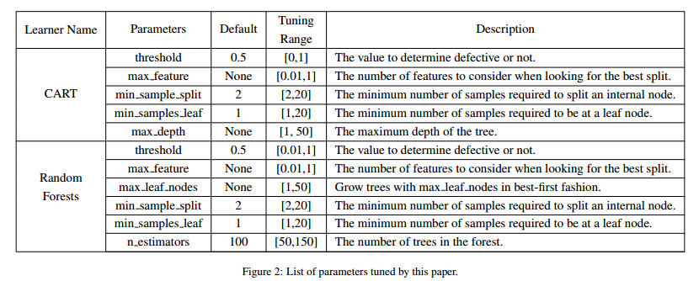
Parameters and Algorithms under consideration

Slide 10
Proposed Work and Algorithms used
03

Slide 11
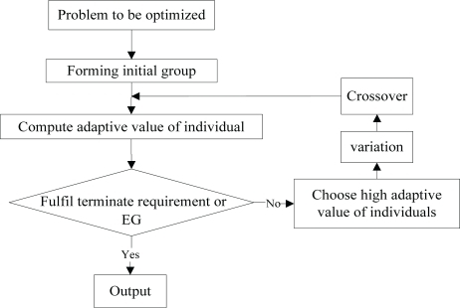
DE is an optimization technique which iteratively modifies a population of candidate solutions to make it converge to an optimum value of your function. First initialize candidate solutions randomly. Then at each iteration and for each candidate solution x, do the following:
Produce a trial vector: v = a + ( b - c ) / 2, where a, b, c are three distinct candidate solutions picked randomly among your population.
Randomly swap vector components between x and v to produce v'. At least one component from v must be swapped.
Replace x in your population with v' only if it is a better candidate (i.e. it better optimise your function).
Differential Evolution

Slide 12
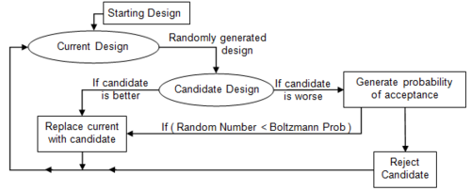
Simulated Annealing
Simulated Annealing is a probabilistic technique for approximating the global optimum of a given function.
This algorithm is often used when the search space is discrete and it is important to find the global optimum than a local maxima in limited time.
It is based on annealing in metallurgy where there is heating and controlled cooling of a material to increase crystal size and decrease defects.
Heating and cooling affects the temperature and thermodynamic energy of the material.
This notion of slow cooling implemented in the Simulated Annealing algorithm is interpreted as a slow decrease in the probability of accepting worse solutions as the solution space is explored.
There are different techniques which can be used to vary temperature and generate neighbours at each iteration. We have used
Cauchy, Fast and Random Neighbour schedule.

Slide 13
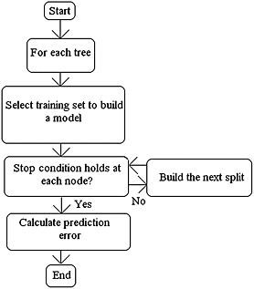
It is a classification and regression technique. It operates by constructing a multitude of decision trees at training time and outputting the mode or the mean of the classes.
Random forest is a collection of decision trees. Decision trees can overfit but random forest prevents it i.e. that is prevents overfitting.
The implementation of Random Forest as given in sklearn is as follows :
class sklearn.ensemble.RandomForestClassifier (n_estimators=10, criterion='gini', max_depth=None, min_samples_split=2, min_samples_leaf=1, min_weight_fraction_leaf=0.0, max_features='auto', max_leaf_nodes=None, min_impurity_split=1e-07, bootstrap=True, oob_score=False, n_jobs=1, random_state=None, verbose=0, warm_start=False, class_weight=None)
Random Forest

Slide 14
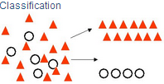
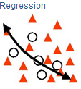
Decision Trees are commonly used in data mining with the objective of creating a model that predicts the value of a target (or dependent variable) based on the values of several input (or independent variables).
Classification Trees: Where the target variable is categorical and the tree is used to identify the "class" within which a target variable would likely fall into.
Regression Trees: Where the target variable is continuous and tree is used to predict it's value.
The implementation of CART as given in sklearn is as follows :
def cart(a, b, c, d, candidate):
ct = DecisionTreeClassifier(max_depth=candidate["tunings"][4], min_samples_split=candidate["tunings"][2], min_samples_leaf=candidate["tunings"][3], max_features=candidate["tunings"][1], min_impurity_split=candidate["tunings"][0])
ct.fit(a, b)
pred = ct.predict(c)
CART

Slide 15
Optimization Goals:
Our optimizers explore tuning improvements for precision and the F-score, defined as follows. Let {A, B, C, D} denote the true negatives, false negatives, false positives, and true positives (respectively) found by a binary detector. Certain standard measures can be computed from A, B, C, D, as shown below.
precision = D/(D+C)
recall = D/(B+D)
F = (2 ∗ precision ∗ recall)/(precision + recall)

Slide 16
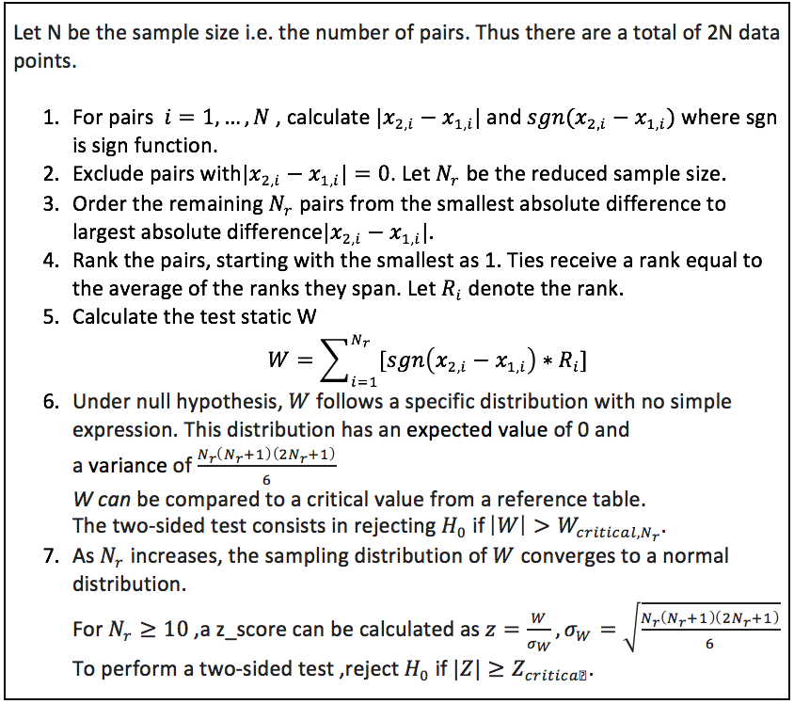
Wilcoxon Signed Rank Test
Wilcoxon Signed Rank Test has been used as a validation method to compare results of Differential Evolution and Simulated Annealing.
It is basically a non-parametric statistical hypothesis test used to compare two matched/related samples (in this case, precision/f-score of DE and SA) to assess the difference in their population mean rank.
It is a paired difference test.

Slide 17
Results
04

Slide 18
Tuned vs Untuned Models
Each of the two algorithms - Random Forest and CART were applied on all the 17 datasets one by one by taking default values of their parameters. The Precision and F-measure were noted for each dataset.
Differential Evolution and Simulated Annealing were applied on Random Forest and CART one by one for each of the 17 datasets with the aim of optimising one of the performance parameters like Precision and F-measure. DE and SA, both were executed twice for each dataset in case of each algorithms by taking Precision as optimising goal in one case and F-measure in the other.

Slide 19
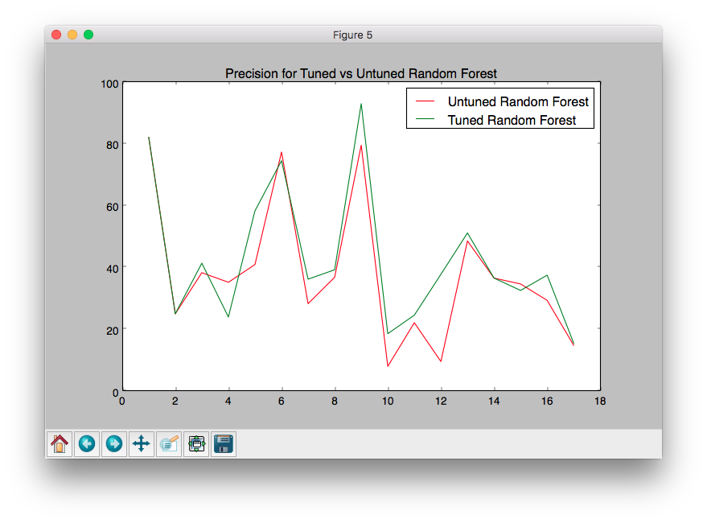
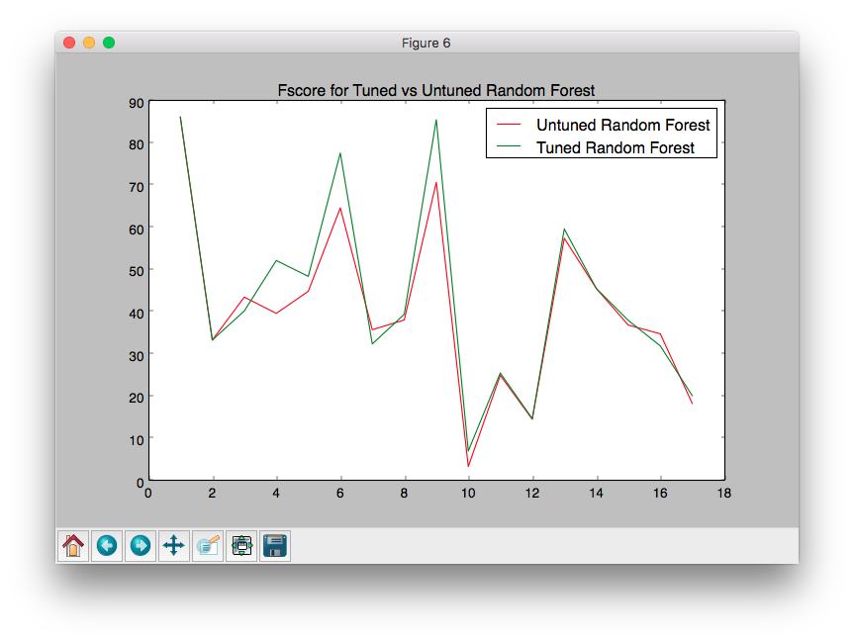
Tuned vs Untuned Models using Differential Evolution
Random Forest

Slide 20
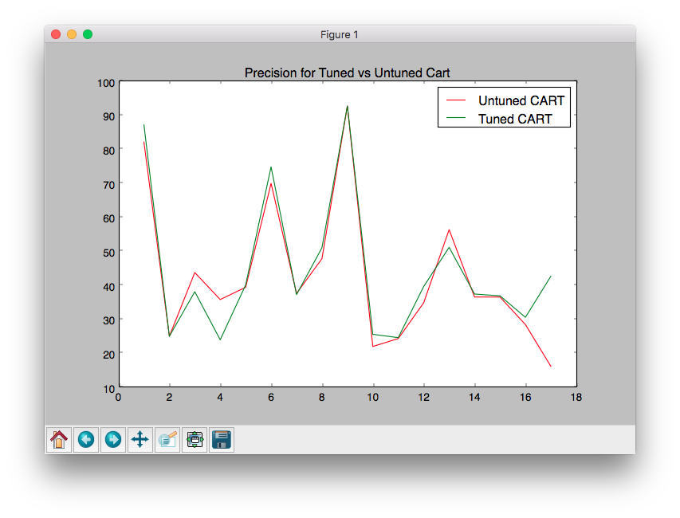
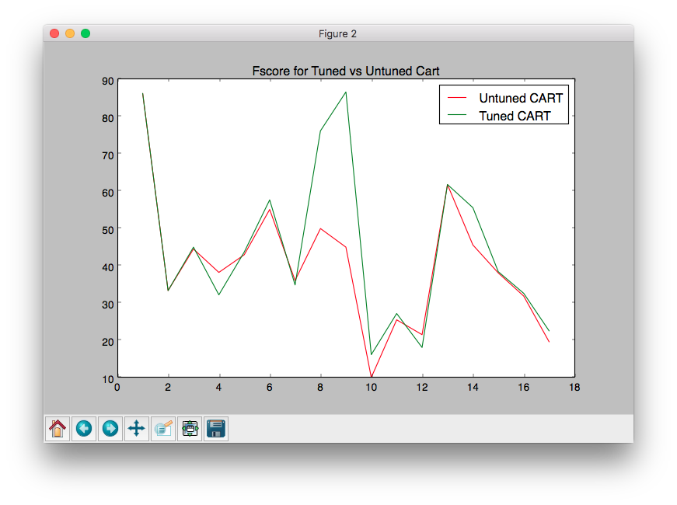
Tuned vs Untuned Models using Differential Evolution
CART

Slide 21
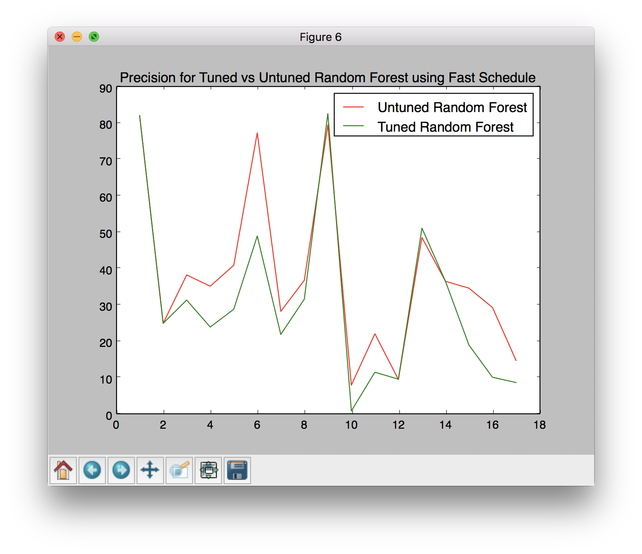
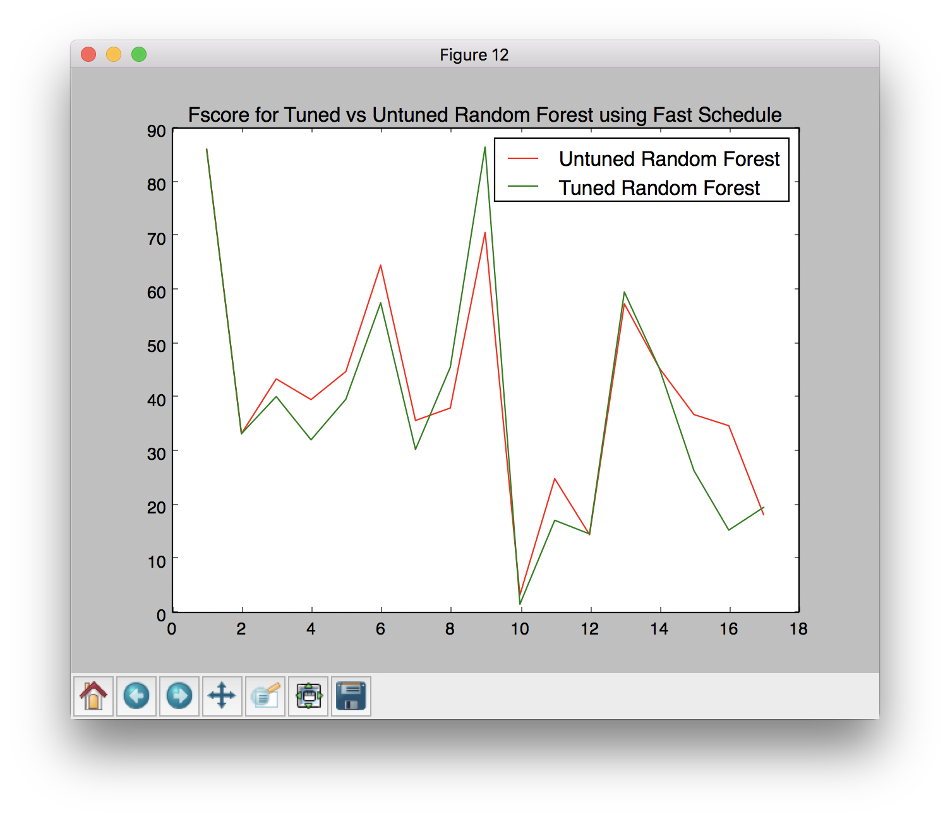
Tuned vs Untuned Models using Simulated Annealing
Random Forest

Slide 22
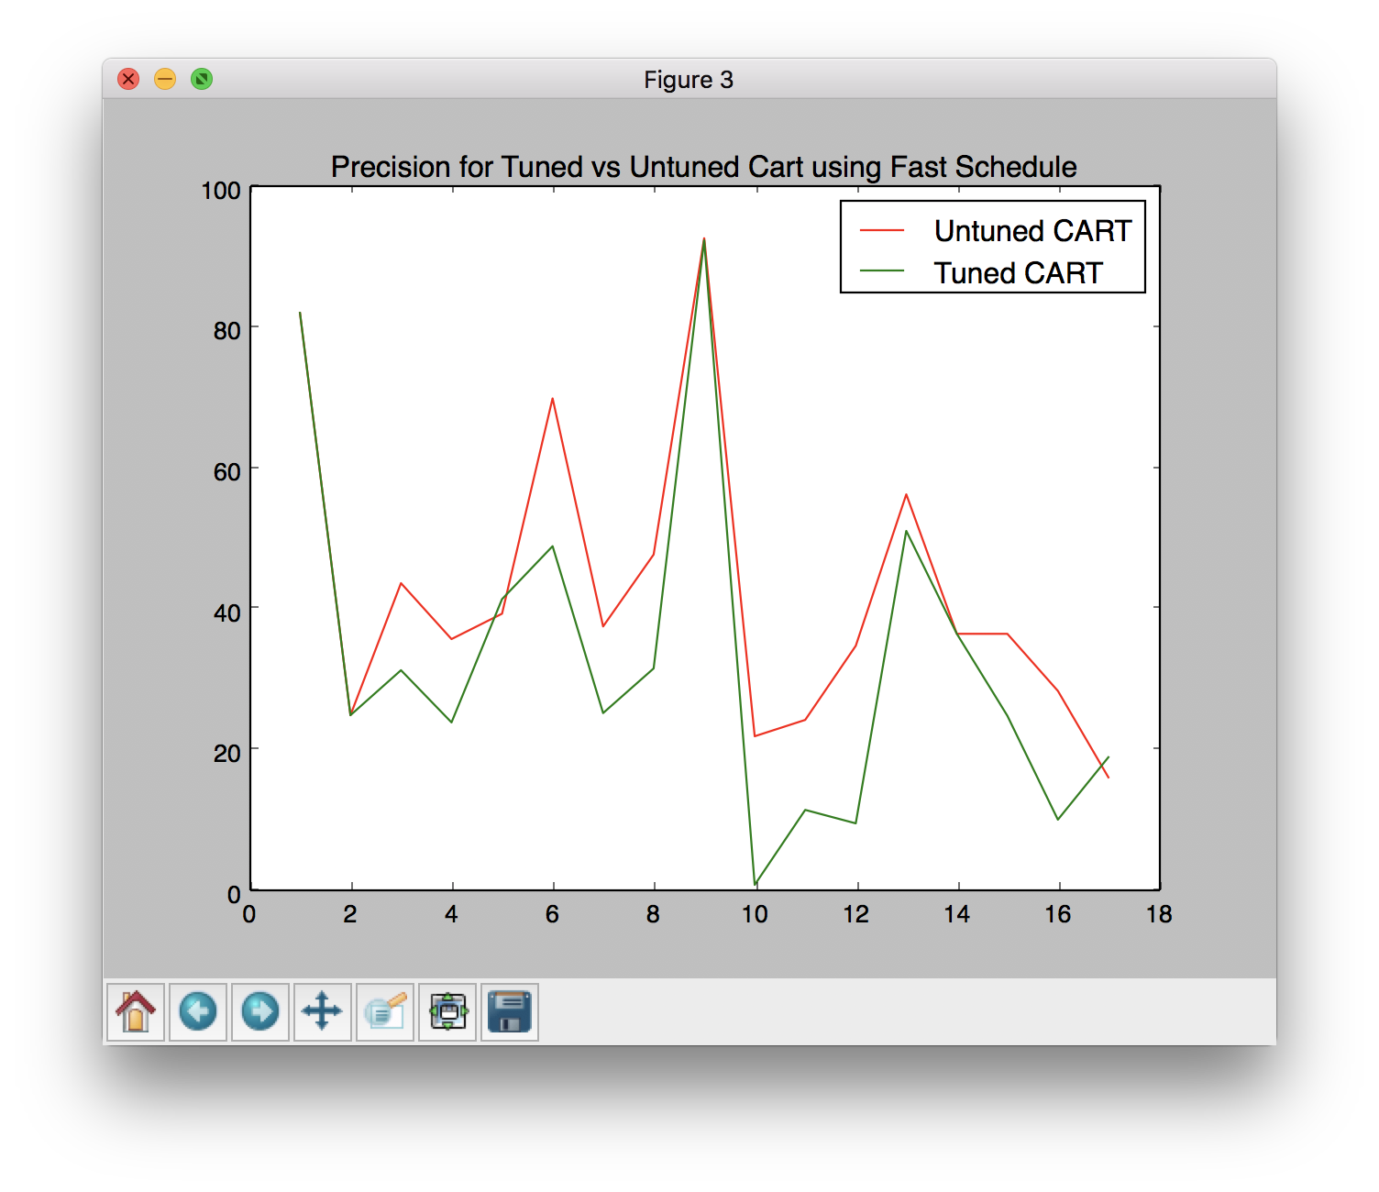
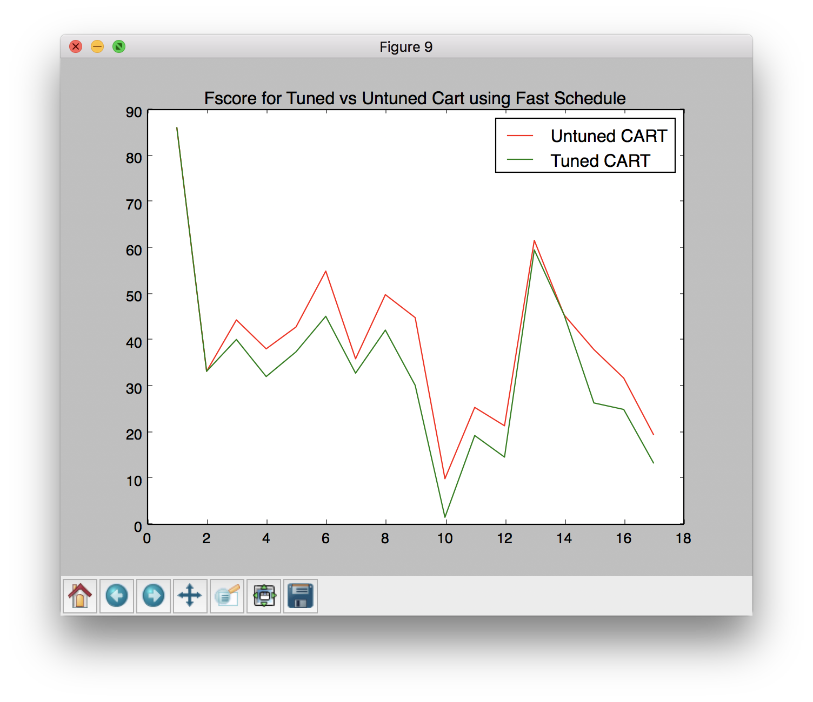
Tuned vs Untuned Models using Simulated Annealing
CART

Slide 23
Conclusion

Slide 24
Conclusion
While performing parameter tuning on defect predictors, we have learned that if defect prediction is performed on static code attributes without tuning, and even if tuning is performed but with a single tuning algorithm, it can be both harmful and misleading.
Performing tuning with just a single optimizer does not guarantee that we will get the best results. So, we recommend that whenever software analytics is performed, especially in case of defect prediction, parameter tuning should be taken into account and it should be treated as an important aspect of defect prediction.
In addition to this, we conclude that Differential Evolution usually outperforms Simulated Annealing due to its more robust principle.
Notes:
Heba

Slide 25
Future Scope

Slide 26
Future Scope
For future work, it is now essential to not only apply these optimizers in other software analytics fields but also compare their performances in those fields.

Slide 27
THANK YOU!
PRESENTED BY
Arjun Rajpal (2K14/SE/021)
Dushyant Rathore (2K14/SE/029)

