Slide 1
Minor Project
Parameter Tuning using
Differential Evolution

Slide 2
Introduction
01

Slide 3
Problem Statement
The aim of the project is to ― Tune the parameters of a Machine Learning Model using Differential Evolution which is
a form of a Genetic Algorithm.
We seek simple, automatic, and effective method for finding tunings that give optimum value for the desired goal.

Slide 4
Data Set
02

Slide 5
Introduction
Our defect data comes from PROMISE repository . This data pertains to open source Java systems : ant, camel, ivy, jedit, log4j, lucene, poi, synapse, velocity and xerces.
We selected these data sets since they have at least three consecutive releases (where release i+1 was built after release i).
This will allow us to build defect predictors based on the past data and then predict (test) defects on future version projects, which will be a more practical scenario.

Slide 6
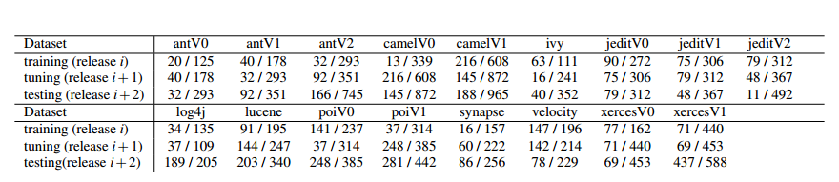
Dataset
Data used in this case study. Fractions denote defects I total. Eg: the top left dataset has 20 defective classes out of 125 total.

Slide 7
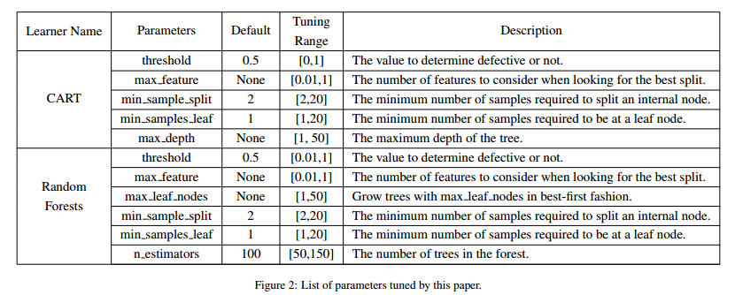
Parameters and Algorithms under consideration

Slide 8
Proposed Work and Algorithms used
03

Slide 9
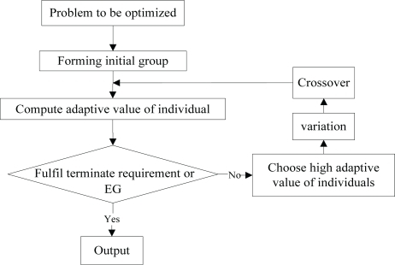
DE is an optimization technique which iteratively modifies a population of candidate solutions to make it converge to an optimum value of your function. First initialize candidate solutions randomly. Then at each iteration and for each candidate solution x, do the following:
Produce a trial vector: v = a + ( b - c ) / 2, where a, b, c are three distinct candidate solutions picked randomly among your population.
Randomly swap vector components between x and v to produce v'. At least one component from v must be swapped.
Replace x in your population with v' only if it is a better candidate (i.e. it better optimise your function).
Differential Evolution

Slide 10
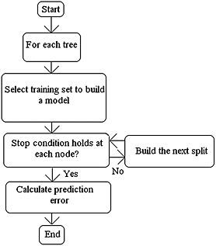
It is a classification and regression technique. It operates by constructing a multitude of decision trees at training time and outputting the mode or the mean of the classes.
Random forest is a collection of decision trees. Decision trees can overfit but random forest prevents it i.e. that is prevents overfitting.
The implementation of Random Forest as given in sklearn is as follows :
class sklearn.ensemble.RandomForestClassifier (n_estimators=10, criterion='gini', max_depth=None, min_samples_split=2, min_samples_leaf=1, min_weight_fraction_leaf=0.0, max_features='auto', max_leaf_nodes=None, min_impurity_split=1e-07, bootstrap=True, oob_score=False, n_jobs=1, random_state=None, verbose=0, warm_start=False, class_weight=None)
Random Forest

Slide 11
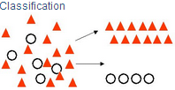
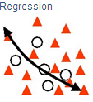
Decision Trees are commonly used in data mining with the objective of creating a model that predicts the value of a target (or dependent variable) based on the values of several input (or independent variables).
Classification Trees: Where the target variable is categorical and the tree is used to identify the "class" within which a target variable would likely fall into.
Regression Trees: Where the target variable is continuous and tree is used to predict it's value.
The implementation of CART as given in sklearn is as follows :
def cart(a, b, c, d, candidate):
ct = DecisionTreeClassifier(max_depth=candidate["tunings"][4], min_samples_split=candidate["tunings"][2], min_samples_leaf=candidate["tunings"][3], max_features=candidate["tunings"][1], min_impurity_split=candidate["tunings"][0])
ct.fit(a, b)
pred = ct.predict(c)
CART

Slide 12
Optimization Goals:
Our optimizers explore tuning improvements for precision and the F-measure, defined as follows. Let {A, B, C, D} denote the true negatives, false negatives, false positives, and true positives (respectively) found by a binary detector. Certain standard measures can be computed from A, B, C, D, as shown below. Note that for f-measure, the better scores are smaller while for all other scores, the better scores are larger.
pd = recall = D/(B+D)
pf = C/(A+C)
prec = precision = D/(D+C)
F = 2 ∗ pd ∗ prec/(pd + prec)

Slide 13
Results
04

Slide 14
Tuned vs Untuned Models
Each of the two algorithms - Random Forest and CART were applied on all the 17 datasets one by one by taking default values of their parameters. The Precision and F-measure were noted for each dataset.
Differential Evolution is applied on Random Forest and CART one by one for each of the 17 datasets with the aim of optimising one of the performance parameters like Precision and F-measure. DE is executed twice for each dataset in case of each algorithms by taking Precision as optimising goal in one case and F-measure in the other.

Slide 15
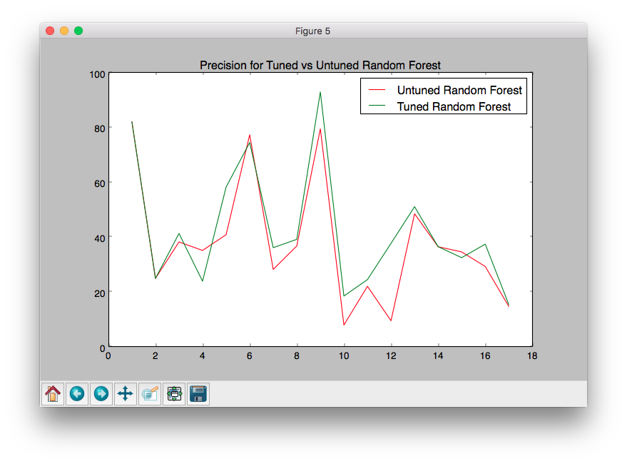
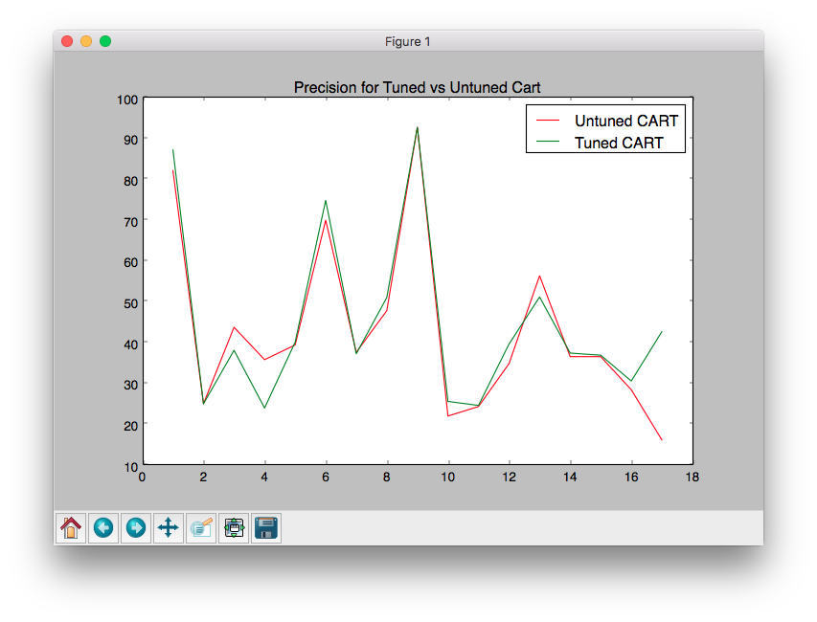
Tuned vs Untuned Models

Slide 16
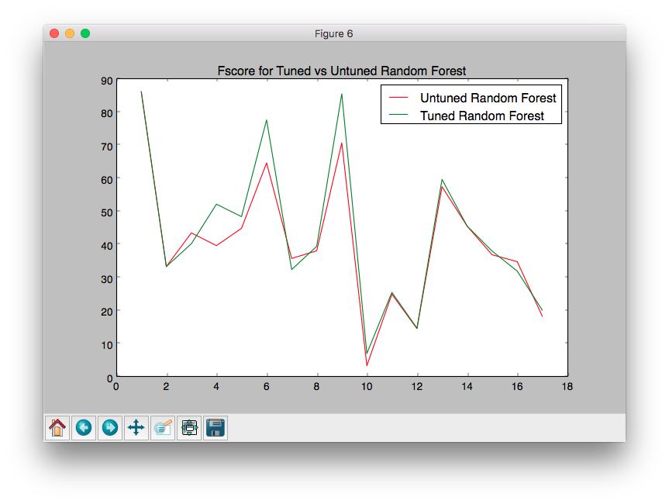
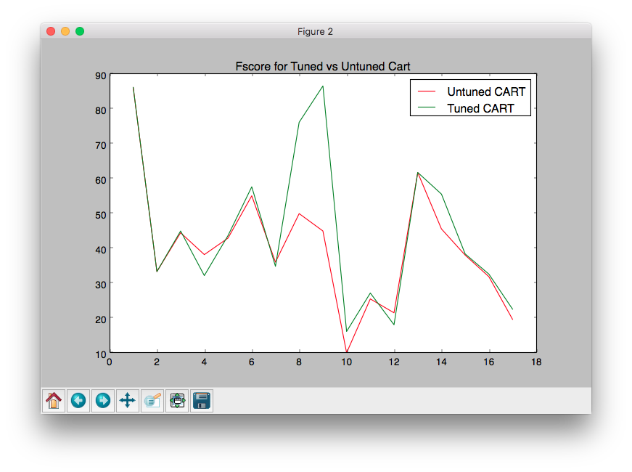
Tuned vs Untuned Models

Slide 17
Conclusion

Slide 18
Conclusion
In this project, we studied the impact of Parameter Tuning in the field of Software Defect Prediction. Differential Evolution, a tuning algorithm was applied on machine learning algorithms like Random Forest and Classification And Regression Trees (CART) with the aim of optimising Precision or F-Measure. It was found that tuning parameters improved both these performance measures substantially as compared to untuned parameters.
It was also observed that tuning the parameters of the learning algorithms was simple and that Differential Evolution showed greater improvement in CART as compared to Random Forest.
Our exploration in the field of Parameter Tuning showed that when learning defect predictors for static code attributes, analytics without tuning are considered harmful and misleading.
Notes:
Heba

Slide 19
Future Scope

Slide 20
Future Scope
It is now important to explore the implications of these conclusions to other kinds of software analytics.
This project has investigated some learners using one optimizer. Hence, we can make no claim that DE is the best optimizer for all learners.
Rather, our point is that there exists at least some learners whose performance can be dramatically improved by at least one simple optimization scheme.

Slide 21
THANK YOU!
PRESENTED BY
Arjun Rajpal (2K14/SE/021)
Dushyant Rathore (2K14/SE/029)
Manav Middha (2K14/SE/043)

