Slide 1
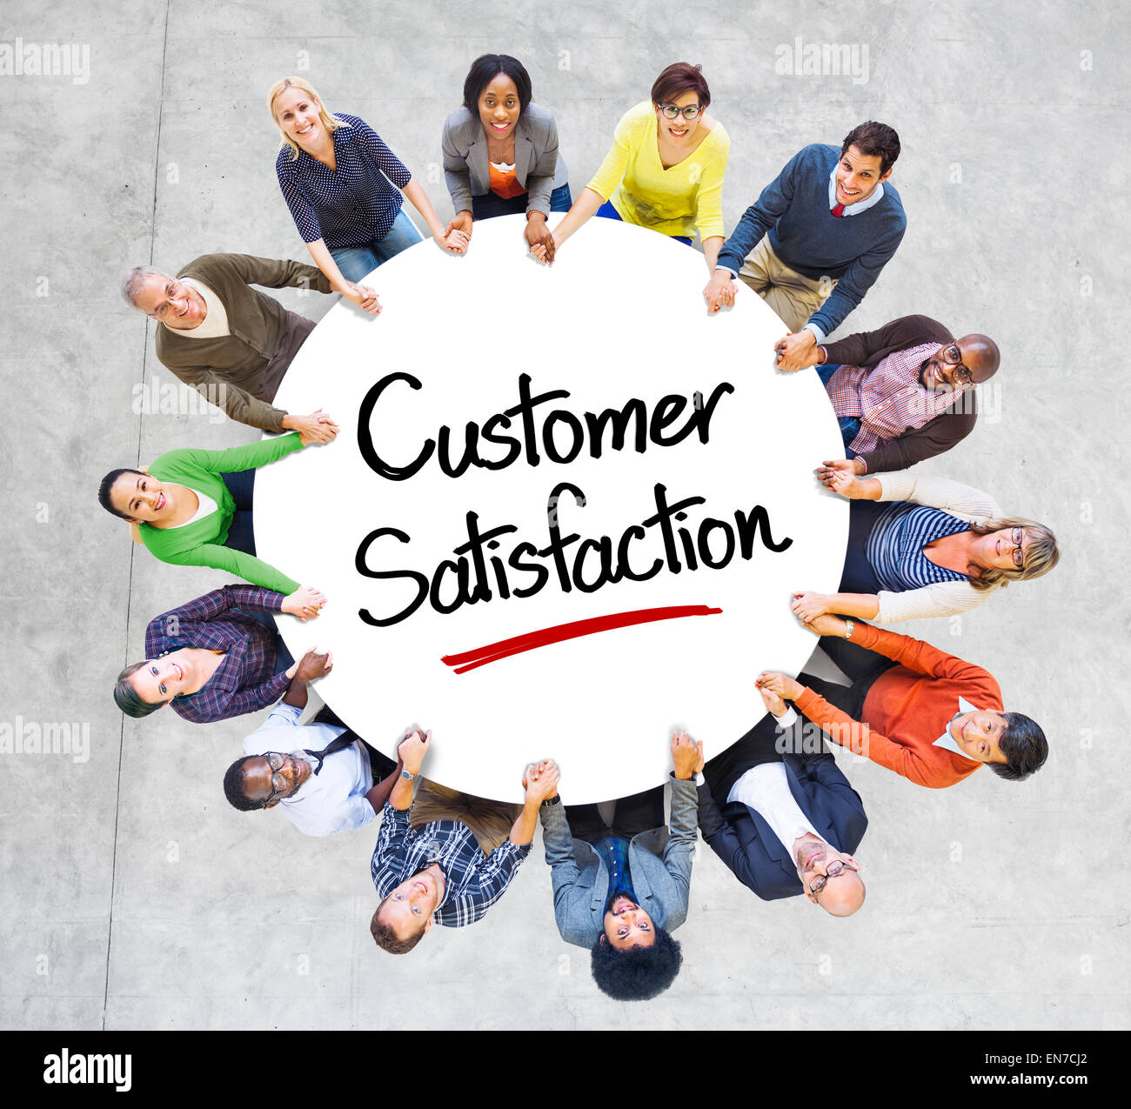


SUMMER INTERNSHIP PROGRAMME – 2024
MID- TERM PRESENTATION Presented by:- (Sakshi Pandita)
Roll no.: MB050 Faculty Guide: Prof.(Dr.) Naresh K.Patel
___________________
Company: Am Hyundai

Slide 2
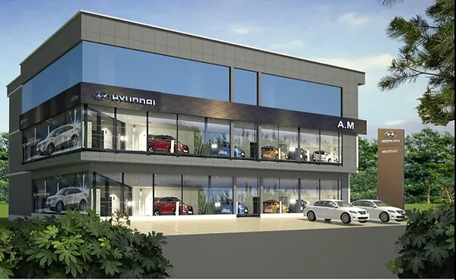
OVERVIEW
1. Company Overview
2. Brief Of Project
3. Objectives
4. Research Methodology
5. Weekly Tasks
6. Problem Faced
7. Thank You

Slide 3
COMPANY OVERVIEW
Founded in 1967 by Chung Ju-yung as a construction company.
Entered the automotive industry in 1968 with the Hyundai Motor Company.
Released its first car, the Pony, in 1975, developed with help from Mitsubishi.
Expanded globally in the 1980s, entering markets like the United States and Europe.
Established Hyundai Motor America in 1986, marking its entry into the U.S. market.
In the 1990s, Hyundai experienced rapid growth, becoming one of the world's largest automakers.
In 1996, Hyundai firstly entered in India at Chennai and setup Hyundai’s first plant their.
Launched luxury brand Genesis in 2015, targeting premium markets.
Invested heavily in eco-friendly vehicles, including hybrids, electric cars, and hydrogen fuel cell technology.

Slide 4
BRIEF OF SUMMER INTERNSHIP PROJECT “A STUDY OF CUSTOMER SATISFACTION AT AM HYUNDAI PVT. LIMITED”
As a Hyundai intern, I'm conducting research on "Enhancing Customer Satisfaction" to drive growth and competitiveness. In today's competitive landscape, customer experience is crucial for brand loyalty and success. This research explores customer satisfaction dimensions, including product quality, after-sales service, dealership experience, and digital engagement. By identifying key drivers and areas for improvement, Hyundai can refine its customer-centric strategies. With evolving consumer expectations and digital disruption, innovation is essential.
Through comprehensive analysis, including customer surveys, market research, and benchmarking, this study provides actionable insights to elevate customer satisfaction. By fostering emotional connections, enhancing service excellence, and leveraging digital technologies,
Hyundai can cultivate loyalty and drive sustainable growth in the automotive market. This research supports Hyundai's commitment to delivering exceptional value and experiences, ensuring long-term success. By understanding customer needs and preferences, Hyundai can stay ahead of the competition and achieve its vision of becoming a leader in the global automotive industry.

Slide 5
OBJECTIVES
1. To gain practical experience in HR functions such as recruitment and employee engagement.
2. To Acquire skills in HR tools and systems, such as HR software and analytics.
3. To network with professionals in the HR field and build relationships with colleagues and mentors.
4. To apply theoretical knowledge from academic studies to real-world HR challenges.
5. To develop soft skills like communication, teamwork, and problem-solving in a fast-paced corporate environment.
6. To enhance the understanding of organizational culture and diversity in a global company like Hyundai.

Slide 6

RESEARCH METHODOLOGY
Secondary data
1. Literature review
2. Company reports
3. Hyundai’s official website
4. Employee handbooks and policies
5. Online articles
Primary data
1. Observations
2. Data Collection through HR software and system
3. Employee’s feedback and suggestions
4. Performance data and metrics

Slide 7
WEEKLY TASKS

Slide 8

Week 1
I received training in recruitment best practices, enhancing my ability to attract and select top talent.
Through this training, I developed skills in fostering positive employee relationships, leading to improved employee engagement and retention.
I learned effective strategies for building strong relationships with employees, including communication, empathy, and conflict resolution.
As a result, I am now equipped to create a positive work environment, promoting employee satisfaction, productivity, and overall success.

Slide 9

Week 2
Conducted a survey as an HR trainee.
Focused on customer treatment and well-being.
Noted a well-equipped waiting room with air conditioning and drinks.
Observed a see-through glass for customers to watch car servicing.

Slide 10

Week 3
Learned about the leave system with specific guidelines.
Learned both manual and digital attendance methods.
Collected leave forms from employees.
Learned both manual and digital attendance methods.
Used the "Smart Office" app by the AM group for digital attendance.
Checked employee attendance on both software and manually

Slide 11

Week 4
Entered details of walk-in customers at the company's outlet.
Recorded names, contact numbers, locations, and interested car model
Gained insights into EVs, automatic, and manual cars.
Learned about car stocking and quick arrangement processes.
Acquired basic knowledge of car competitors (e.g., Hyundai Venue vs. Tata Nexon, Hyundai Verna vs. Honda City and Virtus).

Slide 12

Week 5

Slide 13
PROBLEMS
Finding data
Collection of data is sometimes very hectic because to find authenticated data is hard.
Time consuming
Sometimes to find the authentic data, it requires time to research properly.
Limited access to data
Difficulty obtaining necessary data or information due to confidentiality or restricted access.
Technical challenges
Difficulty with HR software, systems, or tools.
Maintaining confidentiality
Handling sensitive employee information and maintaining confidentiality.

Slide 14

Thanks

