Slide 1
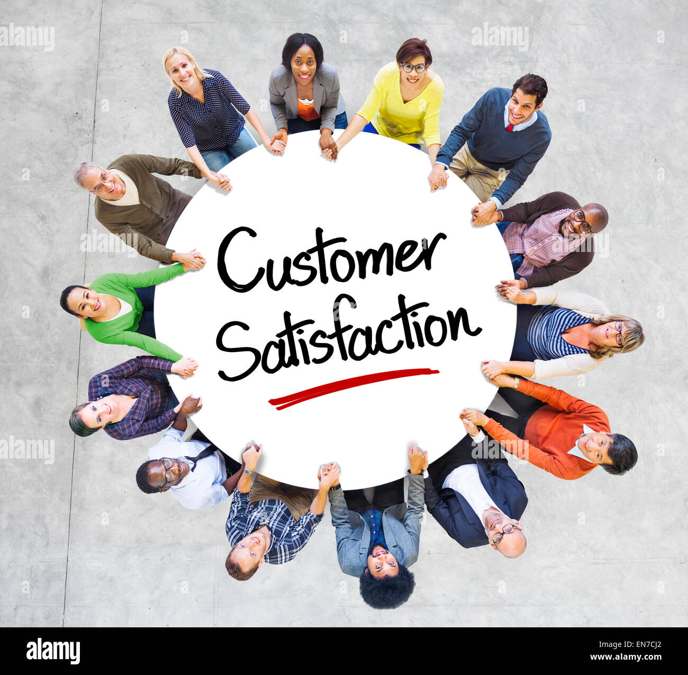



SUMMER INTERNSHIP PROGRAMME – 2024 MID- TERM PRESENTATION Presented by Sakshi Pandita Roll no.: MB050 Faculty Guide: Prof.(Dr.) Naresh K.Patel
Company: Am Hyundai

Slide 2
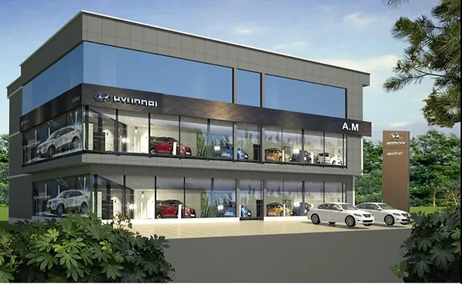
OVERVIEW
1. Company Overview
2. Brief Of Project
3. Objectives
4. Research Methodology
5. Weekly Tasks
6. Problem Faced
7. Thank You

Slide 3
COMPANY OVERVIEW
Founded in 1967 by Chung Ju-yung as a construction company.
Entered the automotive industry in 1968 with the Hyundai Motor Company.
Released its first car, the Pony, in 1975, developed with help from Mitsubishi.
Expanded globally in the 1980s, entering markets like the United States and Europe.
Established Hyundai Motor America in 1986, marking its entry into the U.S. market.
In the 1990s, Hyundai experienced rapid growth, becoming one of the world's largest automakers.
Introduced the Hyundai Sonata and Hyundai Elantra, which became popular models globally.
In 1996, Hyundai firstly entered in India at Chennai and setup Hyundai’s first plant their.
Launched luxury brand Genesis in 2015, targeting premium markets.
Invested heavily in eco-friendly vehicles, including hybrids, electric cars, and hydrogen fuel cell technology.
Present day, Hyundai is one of the world’s largest automakers, known for its innovative designs, technology, and sustainability efforts.

Slide 4
BRIEF OF SUMMER INTERNSHIP PROJECT “A STUDY OF CUSTOMER SATISFACTION AT AM HYUNDAI PVT. LIMITED”
As an intern at Hyundai, I am undertaking a research endeavor centered on "Enhancing Customer Satisfaction: A Strategic Imperative for Hyundai." In today's competitive automotive landscape, where customer experience plays a pivotal role in brand loyalty and market success, understanding and optimizing customer satisfaction is paramount for Hyundai's sustained growth and competitiveness.
This research aims to delve into the multifaceted dimensions of customer satisfaction within the context of Hyundai's operations. By examining factors such as product quality, after-sales service, dealership experience, and digital engagement, this study seeks to identify key drivers of customer satisfaction and areas for improvement.
Hyundai has long been committed to delivering exceptional value and experiences to its customers. However, in an era characterized by rapidly evolving consumer expectations and digital disruption, it is essential for Hyundai to continuously innovate and refine its customer-centric strategies.
Through comprehensive analysis, including customer surveys, market research, and benchmarking against industry best practices, this research endeavors to provide Hyundai with actionable insights and recommendations to elevate its customer satisfaction levels. By fostering stronger emotional connections, enhancing service excellence, and leveraging digital technologies, Hyundai can cultivate a loyal customer base and drive sustainable growth in the fiercely competitive automotive market.

Slide 5
OBJECTIVES
1. To gain practical experience in HR functions such as recruitment and employee engagement.
2. To Acquire skills in HR tools and systems, such as HR software and analytics.
3. To network with professionals in the HR field and build relationships with colleagues and mentors.
4. To apply theoretical knowledge from academic studies to real-world HR challenges.
5. To develop soft skills like communication, teamwork, and problem-solving in a fast-paced corporate environment.
6. To enhance the understanding of organizational culture and diversity in a global company like Hyundai.

Slide 6
RESEARCH METHODOLOGY
Secondary data
1. Literature review
2. Company reports
3. Hyundai’s official website
4. Employee handbooks and policies
5. Online articles
Primary data
1. Observations
2. Data Collection through HR software and system
3. Employee’s feedback and suggestions
4. Performance data and metrics

Slide 7
WEEKLY TASKS
Week 1
They give me training related to recruitment.
I gained skills in fostering positive employee relationships.
Week 2
Conducted a survey as an HR trainee.
Focused on customer treatment and well-being.
Noted a well-equipped waiting room with air conditioning and drinks.
Observed a see-through glass for customers to watch car servicing.

Slide 8
WEEKLY TASKS
Week 3
Learned about the leave system with specific guidelines.
Learned both manual and digital attendance methods.
Collected leave forms from employees.
Learned both manual and digital attendance methods.
Used the "Smart Office" app by the AM group for digital attendance.
Checked employee attendance on both software and manually.
Week 4
Entered details of walk-in customers at the company's outlet.
Recorded names, contact numbers, locations, and interested car models

Slide 9
WEEKLY TASKS
Gained insights into EVs, automatic, and manual cars.
Learned about car stocking and quick arrangement processes.
Acquired basic knowledge of car competitors (e.g., Hyundai Venue vs. Tata Nexon, Hyundai Verna vs. Honda City and Virtus).
Week 5

Slide 10
PROBLEMS
Finding data
Collection of data is sometimes very hectic because to find authenticated data is hard.
Time consuming
Sometimes to find the authentic data, it requires time to research properly.
Limited access to data
Difficulty obtaining necessary data or information due to confidentiality or restricted access.
Technical challenges
Difficulty with HR software, systems, or tools.
Maintaining confidentiality
Handling sensitive employee information and maintaining confidentiality.

Slide 11


