Slide 1
SSH
Basics, Master Control Sockets

Slide 2
SSH - Most Basic Syntax
Barest Bones SSH command:
ssh 12.34.56.78
SSH’s Home - Where this ssh instance will be executed
Calls ssh command binary to execute on the current host
Present Connection - Where we are pointing our connection attempt right now
IP - Where is our connection attempt going to right now? In this example, we are sending our connection to 12.34.56.78
But wait! Who am I logging in as? I should probably know that before I hit enter so I can know which password to use.
With SSH, any default value can be left out, and ssh will automatically insert its defaults. In this case, the default user is whoever you are currently logged in as. In that case...

Slide 3
SSH - Almost As Basic Syntax
Bare Bones SSH command:
ssh root@12.34.56.78
SSH’s Home - Where this ssh instance will be executed
Calls ssh command binary to execute on the current host
Present Connection - Where we are pointing our connection attempt right now
Username - What user do you intend to authenticate as when you land on target? Here, that’s root.
IP - Where is our connection attempt going to right now? In this example, we are sending our connection to 12.34.56.78
Yes, now I’m in! But wait! Where’s my port? How did this work without a port?
With SSH, any default value can be left out, and ssh will automatically insert its defaults. In this case, the default ssh port is 22, but this can be configured to something else for security purposes. In that case...

Slide 4
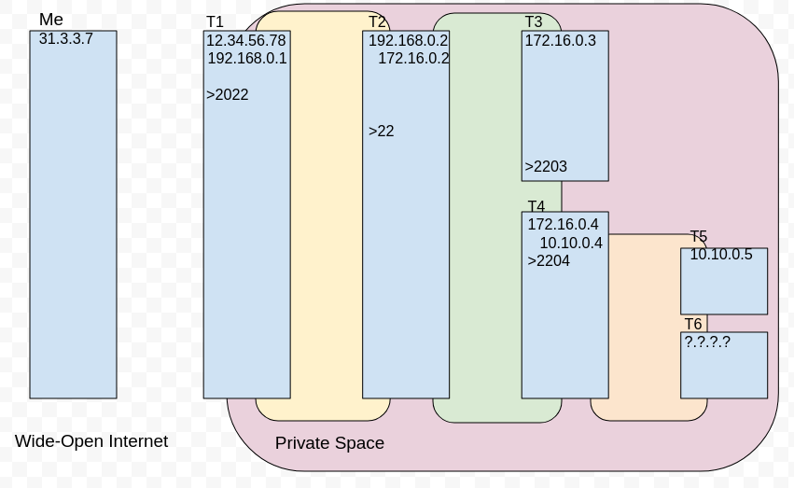
You want to be here
You are here

Slide 5
SSH - Basic Syntax
Basic SSH command:
ssh -p 2022 root@12.34.56.78
Here - The host where this ssh instance will be executed
Calls ssh command binary to execute on the current host
Present Connection - Where we are pointing our connection attempt right now
Port - The specific port listening for an ssh connection. Here, ssh is listening on port 2022
Username - What user do you intend to authenticate as when you land on target?
IP - Where are we sending our connection request to right now?
Awesome! Time to get all the windows on target! Let’s open up five windows!

Slide 6
log!
log!
log!
log!
You are here
log!
You are here

Slide 7
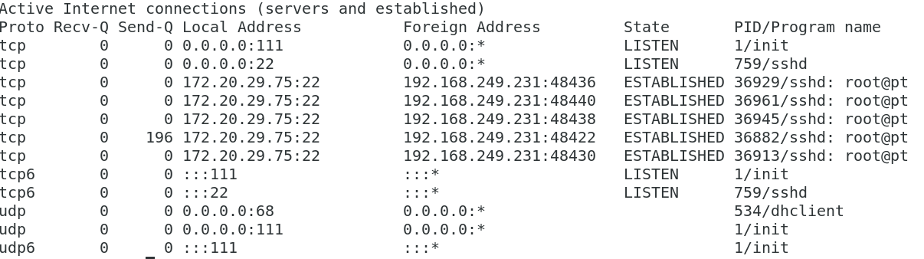
SSH - Basic Syntax
Now to take a look at our netstat…
12.34.56.78:2022 31.3.3.7:48436
12.34.56.78:2022 31.3.3.7:48440
12.34.56.78:2022 31.3.3.7:48438
12.34.56.78:2022 31.3.3.7:48422
12.34.56.78:2022 31.3.3.7:48430
Hmmm… That sticks that out a bit.

Slide 8
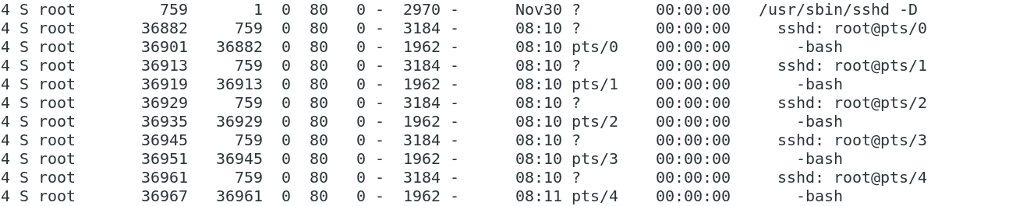
SSH - Basic Syntax
Now to take a look at our process list…
That doesn’t look better at all.

Slide 9
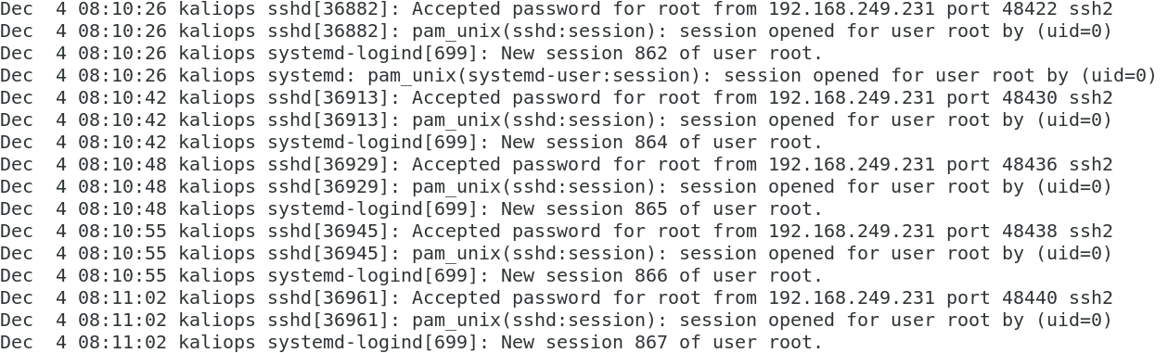
SSH - Basic Syntax
Maybe our authentication logs will be better…
Huh… five windows on target can be pretty noisy. What can I do?
You can… MULTIPLEX! Recycle that existing connection for additional windows!

Slide 10
SSH - Basic Multiplexed Syntax
Basic multiplexed SSH command:
ssh -M -S /tmp/T1 -p 2022 root@12.34.56.78
Here - The host where this ssh instance will be executed
Calls ssh command binary to execute on the current host
Multiplex Information - -M makes a new socket and -S saves the socket information for future use.
Present Connection - Where we are pointing our connection attempt right now
Port - The specific port listening for an ssh connection. Here, ssh is listening on port 2022
Username - What user do you intend to authenticate as when you land on target?
IP - Where are we sending our connection request to right now?
Awesome! Now it’s time to get all the windows on target! Let’s open up five windows!
Establish Secondary windows by running ssh -S /tmp/T1 -p 2022 root@192.168.0.1
Note: If you include the -M on your secondary, you will overwrite your original socket.

Slide 11
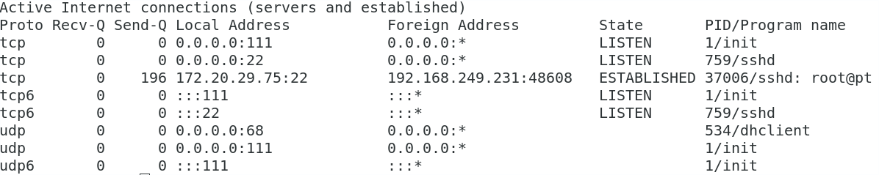
SSH - Basic Syntax
Now to take a look at our netstat…
And our authentication logs…
And our process list…
Well that looks better! Still shouldn’t open too many windows if I don’t need to, though. All those bash instances look pretty suspicious.

Slide 12
You are here
You are also here

Slide 13
SSH - Host Checking
Awesome! I’m on target and I can have all the windows I want (within reason). It’s asking if I want to save this host.
I’m just going to blindly accept “Yes” like I do with all of my End User License Agreements. I’m sure there will be no problems down the road.

Slide 14
Tunneling
SSH local and remote tunnels; Adding SSH Tunnels after connection
iptables/netsh

Slide 15
SSH - Tunneling
We’re on T1. Let’s take a look at our plan and see what comes next.
> T1: 12.34.56.78:2022 / 192.168.0.1
-> T2: 192.168.0.2:22 / 172.16.0.2
--> T3: 172.16.0.3:2203
--> T4: 172.16.0.4:2204 / 10.10.0.4
---< T5: 10.10.0.5 (beacon to TCP 12345)
---> T6: Suspected Mail Server
My next target is T2, but 192.168 is an internal IP. I can’t touch it directly from my external ops box. Because T2 is in an internal network, I need to connect through T1 if I want access it, but it’s bad practice to launch my ssh command in target space. It should only be launched from my opstation, which can’t touch it. What can I do?
I can… TUNNEL!

Slide 16
You are here
You are also here
You want to be here

Slide 17
SSH Tunnels - How Do They Work?
In a word, encapsulation. Does that help any?
No? Okay, how about a few more words.
SSH as a client/server system happens in the upper levels of the TCP/IP and OSI models. We create our ssh information (commands given or command output to be received) then send it down the network stack as payload with each layer–Transport, Network, Data Link, then physical.
What tunneling does is it sends our data down to the network layer where we’ve set up our local listener (127.0.0.1:2222) where our previous ssh T1 ssh session is listening. It then essentially takes that entire T2 session packet (transport header, network header, etc), swaps out IPs and ports from 127.0.0.1:2222 to whatever we specified) and runs it all the way back up our to our previous ssh session to act as the payload of the previous session’s ssh traffic so our packet looks a little something like this (overly simplified):
PACKET to A: [network header, transport header, encrypted payload to A (PACKET to B: [network header, transport header, encrypted payload to B])]
Packet is delivered to A. A finds a packet for B in its payload and forwards that packet to B.

Slide 18
SSH Tunnels - How Do They Work?
In a word, encapsulation. Does that help any?
No? Okay, how about a few more words and an analogy.
Imagine if you will that you and your best friends Harold and George are infamous trouble makers to the point that their mother has deemed you a Bad Influence™ and will not allow you to talk. But. Your friends’ big sister Erica is a Good Influence™ and is also tutoring you in Algebra, so you’re allowed to talk to her.
You need to get a message to Harold and George, but when you knock on the door, their mom always answers. Denied!
Back at home, you write a letter to Harold and George and put it in an envelope, then hide that envelope into a bigger envelope addressed to Erica. You give their mom a letter addressed to Erica. You are Erica can talk, so the letter is allowed in.
Erica opens the envelope and finds another envelope addressed to Harold and George, which she dutifully passes on. Mom sees Erica giving Harold and George a letter, but since Erica is allowed to talk to them, she allows it. As far as she knows, the two letters are unrelated because she only saw one letter come in, and it was addressed to Erica.

Slide 19
SSH Tunnel - Basic Syntax
Every ssh tunnel line has 5 parts, which always come in the same order.
-L 127.0.0.1:2222:192.168.0.2:22
The “direction” or “listening” end of the tunnel, -L or -R, indicating whether the packet initiating the connection will be received on your (L)ocal host or the (R)emote target you are connecting to, followed by...
The IP of the listening host, the very first host to receive the connection request packet, which controls where traffic will “enter” the ssh tunnel, followed by…
The open listening port on the listening host where you expect a connection. This can usually be any number you like so long as that port is not already bound by another process. However, some devices may have restrictions on available ports. This port is followed by…
The server IP or the IP of the remote host you want the connection packet to reach once it exits its ssh tunnel. This is usually, but not always, the target you are attempting to log into. Note this is not the IP of any target currently involved in your ssh connection. This is where you want to connect to next. This is followed by…
The service port. The service port is not created in your ssh connection, and the server IP needs to already be listening there via some other process or service.

Slide 20
SSH - Basic Multiplex Tunnel Syntax
Basic SSH command:
ssh -S /tmp/T1 dummy -O forward -L 127.0.0.1:2222:192.168.0.2:22
SSH’s Home - Where this ssh instance will be executed
Calls ssh command binary to execute on the current host
Multiplex Information - Define the connection information from our -S saved socket.
Present Connection - Where we are pointing our connection attempt right now
Connection Information - because we are using the existing session context stored in /tmp/T1 we don’t need to restate that information here. However, ssh requires we put SOMETHING here, so we’ll put ‘dummy’ so if something goes wrong, it’s unable to actually connect to anything.
Next Connection - Where am I going from here after I’m done on this target?
Options - What options do we want to modify about our existing ssh session. In this case, we want to add forwarding.
Tunnel Syntax - My tunnel information to connect me to the next target. Includes direction (-L), tunnel entrance IP (127.0.0.1), tunnel entrance port (2222), next hop IP (192.168.0.2), and next hop port (22).

Slide 21
-L 2222:192.168.0.2:22
You are here
You are also here
You want to be here

Slide 22
SSH - Connecting to a Multiplex Tunnel
Basic SSH command:
ssh -M -S /tmp/T2 -p 2222 student@127.0.0.1
SSH’s Home - Where this ssh instance will be executed
Calls ssh command binary to execute on the current host (Me, 31.3.3.7)
Multiplex Information - -M makes a new socket and -S saves the socket. We renamed this one T2 because we are creating a new socket and want it to be something easy to identify.
Present Connection - Where we are pointing our connection attempt right now
Port - The specific port listening for an ssh connection. When we connected to T1, we set our T2 port to 2222, so that is the port we will point our connection request at.
Username - What user do you intend to authenticate as when you land on target? We want to be “student” when we access T2.
IP - Where are we sending our connection request to right now? This is a (L)ocal tunnel, so we need to send it to our local loopback, which we established when we set up the tunnel.

Slide 23
-L 2222:192.168.0.2:22
lo:2222
You are here
You are here now

Slide 24
SSH - Connecting to a Multiplex Tunnel
I have to connect to T3 and T4 from here.
> T1: 12.34.56.78:2022 / 192.168.0.1
-> T2: 192.168.0.2:22 / 172.16.0.2
--> T3: 172.16.0.3:2203
--> T4: 172.16.0.4:2204 / 10.10.0.4
---< T5: 10.10.0.5 (beacon to TCP 12345)
---> T6: Suspected Mail Server
Can I run a tunnel through an existing tunnel? How about two?
Yes and yes! Just keep adding tunnel syntax to the end of your ssh command.

Slide 25
You want to be here
-L 2222:192.168.0.2:22
lo:2222
You are here
You are here
You want to be here

Slide 26
SSH - Tunneling through a Multiplex Tunnel
Basic SSH command:
ssh -S /tmp/T2 dummy -O forward -L3333:172.16.0.3:2203 -L4444:172.16.0.4:2204
SSH’s Home - Where this ssh instance will be executed
Calls ssh command binary to execute on the current host
Multiplex Information - Using session information we -S saved earlier in the socket.
Present Connection - Where we are pointing our connection attempt right now
Connection Information - Where are we sending our connection request to right now? Remember, because our session context is stored in /tmp/T2, we can put anything here, just so long as we have something here. We need to access T3 and T4 from T2, so we’re going to connect to T2 and tell it our forwarding rules.
Future Connection - Where are we going from here?
Session Options - Adding forwarding to the session
Tunnel syntax - My tunnel information to connect me to the next target. Includes direction, tunnel entrance IP, tunnel entrance port, next hop IP, and next hop port.
We can establish as many tunnels here as we could ever possibly need. The default listening/entrance IP for a -L tunnel is 127.0.0.1 so we can leave it off without issue.

Slide 27
You are here
You want to be here
-L 2222:192.168.0.2:22
lo:2222
-L 3333:172.16.0.3:2203
-L 4444:172.16.0.4:2204
You want to be here

Slide 28
SSH - Remote or “Reverse” Tunnel
> T1: 12.34.56.78:2022 / 192.168.0.1
-> T2: 192.168.0.2:22 / 172.16.0.2
--> T3: 172.16.0.3:2203
--> T4: 172.16.0.4:2204 / 10.10.0.4
---< T5: 10.10.0.5 (beacon to TCP 12345)
---> T6: Suspected Mail Server
Now that we have our tunnels in place, we can get to T3 like this:
ssh -M -S /tmp/T3 -p 3333 student@127.0.0.1
And T4 with this:
ssh -M -S /tmp/T4 -p 4444 student@127.0.0.1

Slide 29
You are here
You are here now
-L 2222:192.168.0.2:22
lo:2222
-L 3333:172.16.0.3:2203
-L 4444:172.16.0.4:2204
lo:3333
lo:4444
You are here too

Slide 30
SSH - Remote or “Reverse” Tunnel
> T1: 12.34.56.78:2022 / 192.168.0.1
-> T2: 192.168.0.2:22 / 172.16.0.2
--> T3: 172.16.0.3:2203
--> T4: 172.16.0.4:2204 / 10.10.0.4
---< T5: 10.10.0.5 (beacon to TCP 12345)
---> T6: Suspected Mail Server
Awesome! We made it to T3 and T4
But T5 has some weird backward pointing connection. What do I do?
In this case, it means, T5 is currently sending a connection to T4 on port 12345 (which is probably closed on T4). We want T4 to catch that connection and send it back to our host device.

Slide 31
-L 2222:192.168.0.2:22
lo:2222
-L 3333:172.16.0.3:2203
-L 4444:172.16.0.4:2204
lo:3333
lo:4444
Port Closed:
RST!
T4:12345
And send it back here
You want to catch it here

Slide 32
SSH Tunnel - Basic -R Syntax
The remote tunnel pieces are just the same. Like the -L tunnel, the listening tunnel entrance comes first, and the host that will likely actually process the connection request comes last.
-R 10.10.0.4:12345:127.0.0.1:5555
This tunnel opens remotely, so we put the remote information first...
The IP and port of our remote target serving as the entrance to our tunnel. This is where the beacon is currently sending its connection packets to. This tunnel will open a listener on the device you are currently connecting to (T4), but on the interface in T5’s network, the 10.10.0.0/24. Without the necessary config settings and permissions, it will only allow you to open your listener on 127.0.0.1.
The server IP and port for the host that will actually process this connection request. This is typically, but does no have to be, your local host. You will need to set up a listener on your local host, typically netcat, to receive this connection request.
Note 1: with both the -L and -R, the tunnel entrance socket always comes first.
Note 2: with both the -L and -R, you typically have no control over the remote host information, but can select whatever port you choose for the local side of your tunnel.

Slide 33
SSH - Using a -R Tunnel
SSH command:
ssh -S /tmp/T4 -p 4444 student@127.0.0.1 -O forward --R 10.10.0.4:12345:127.0.0.1:5555
SSH’s Home - Where this ssh instance will be executed
Calls ssh command binary to execute on the current host
Multiplex Information - -S accesses the stored socket when we connected to T4.
Present Connection - Where we are pointing our connection attempt right now
Port - The specific port listening for an ssh connection.
Username - What user do you intend to authenticate as when you land on target?
IP - Where are we sending our connection request to right now?
Future Connection - Where are we going from here?
Session Options - Adding forwarding to the session
Tunnel syntax - My tunnel information to connect me to the next target. Includes direction, tunnel entrance IP, tunnel entrance port, next hop IP, and next hop port. The default IP for a -R tunnel’s entrance is 127.0.0.1 if created without privileges.

Slide 34
-L 2222:192.168.0.2:22
lo:2222
-L 3333:172.16.0.3:2203
-L 4444:172.16.0.4:2204
lo:3333
lo:4444
-R 10.10.0.4:12345:127.0.0.1:5555
10.10.0.4:12345
T4:12345
T4:12345
Port Closed:
RST!
We want to listen here

Slide 35
SSH - Using a -R Tunnel
Boooooo!!! I set up my Remote tunnel but I’m not getting anything! What a scam!
Nope. Not a scam. Remember, just like with a -L tunnel, that last half is pointing traffic leaving our tunnel at a listening port or service, right? We told it to send the traffic to our own host’s loopback on 5555, but…
…we forgot to start a listener on our loopback. There are lots of listeners in the world, but for our purposes today, let’s use Good Old Netcat.
Receive your T5 callback by starting a listener on your local host on port 5555:
nc -nklvp 5555
This will open up a listening port on 5555 and keep it open even after the first connection. Great for communication, but if we just want to receive a single file, maybe ditch the -k and set it to output what it receives to file: nc -nlvp > myfile.
Note: Tunnels can be created on connection, but best practice is to wait until it’s needed, especially with -R. Otherwise, we are definitely receiving traffic from T5 before we’re ready for it and may even accidentally connect to it.

Slide 36
SSH - Dynamic Tunnels
> T1: 12.34.56.78:2022 / 192.168.0.1
-> T2: 192.168.0.2:22
--> T3: 192.168.0.3:2203
--> T4: 192.168.0.4:2204
---< T5: 192.168.0.5 (beacon to TCP 12345)
---> T6: Suspected Mail Server
We think there’s a mail server in here, but we don’t know where. I could maybe try to poke each IP in this 10.10.0.4/24 on common mail ports, but that’s 254 IPs and let’s see, SMTP is 25, POP3 is 110, IMAP is 143, and then there’s secure versions of all of them (465, 995, and 993 respectively). Two hundred fifty-four IPs times six possible ports. That’s over 1500 individual tunnels I’d need to set up if I want to scan for it! If only there were a better way!
There is, through the magic of… Dynamic Tunnels!

Slide 37
-L 2222:192.168.0.2:22
lo:2222
-L 3333:172.16.0.3:2203
-L 4444:172.16.0.4:2204
lo:3333
lo:4444
nc -lp
5555
-R 10.10.0.4:12345:127.0.0.1:5555
10.10.0.4:12345
T4:12345
T4:12345
Where am I???
Oh my goodness, so many tunnels, why so many tunnels? Don’t make me do it!

Slide 38
SSH Tunnel - Basic -D Syntax
Dynamic tunnels are excellent for when you don’t have a specific IP and port in mind. They allow you to set up your local listener and provide the remote forwarding later as needed.
ssh -S /tmp/T4 -p 4444 student@127.0.0.1 -O forward -D 9050
We use -D to tell our local device, the host on which we are typing this command, that we want to open a listener on our loopback.
The IP and port of our dynamic tunnel, opened up on our local device. The IP is going to be the loopback, so we can leave it off. The port can be anything we like, but we are going to use 9050 for reasons we’ll discuss in a minute.
And the server IP and port, which T4 will push our packets to, is… missing.
Hold on, what gives? You said the syntax always had a direction, a listener IP and port, and a server IP and port. There’s no second half! You’re a liar!
Not quite. It isn’t that our tunnel doesn’t have a server IP and port. It’s that it doesn’t have one yet. Anything we point at 127.0.0.1:9050 will assign a server IP and port on a case by case basis.

Slide 39
-L 2222:192.168.0.2:22
lo:2222
-L 3333:172.16.0.3:2203
-L 4444:172.16.0.4:2204
lo:3333
lo:4444
nc -lp
5555
-R 10.10.0.4:12345:127.0.0.1:5555
10.10.0.4:12345
T4:12345
T4:12345
-D 9050
Where am I???

Slide 40
SSH Tunnel - Using Dynamic Tunnels
Now that we have a dynamic tunnel listener on our local device, how do we specify the forwarder? If I try to send something through, how do I point it at the tunnel and also some random IP and port on the other side?
The answer is: Proxychains!
We’ll talk more about Proxychains later, but for now, just know that it creates a mini proxy server of sorts on your local host. Any network command you run with proxychains will send packets as though they were executed on the remote end of our dynamic tunnel. As such, we want to use network command syntax as though we were executing on the remove device. And guess what? Proxychains, by default sends traffic to 127.0.0.1:9050.
proxychains nmap -Pn -sT 192.168.0.1/24 -p 25,110,143,465,993,995
Calling the proxychains, which will send what follows to 127.0.0.1:9050 by default.
The command we want to execute. In this case, an nmap scan (we’ll cover this later)
And the server IP and ports, established on the fly as we scan, for T4 to send out.

Slide 41
-L 2222:192.168.0.2:22
lo:2222
-L 3333:172.16.0.3:2203
-L 4444:172.16.0.4:2204
lo:3333
lo:4444
nmap -Pn -sT
10.10.0.0/24
-p 25,110,143,465,993,995
nc -lp
5555
-R 10.10.0.4:12345:127.0.0.1:5555
10.10.0.4:12345
-D 9050
T4:12345
T4:12345
.5:465
proxychains
-D 9050
.99:110
.9:110
.12:993
.213:25
Where am I???

Slide 42
SSH - Modifying Existing Tunnels
> T1: 12.34.56.78:2022 / 192.168.0.1
-> T2: 192.168.0.2:22 / 172.16.0.2
--> T3: 172.16.0.3:2203
--> T4: 172.16.0.4:2204 / 10.10.0.4
---< T5: 10.10.0.5 (beacon to TCP 12345)
---> T6: 10.10.0.6:2206
Oh no! I don’t need these T3 and T5 connections, and I want to close them, but also I’ve identified the IP 10.10.0.6:2206 for T6 based on our scan results which connects from T4 so I can’t close T3 and T5 without closing T2 and T4! I want to connect, but I’ve already set up my tunnels for T3 and T5 and it’s bad to disconnect and reconnect because that’s making more logs and I need to add a tunnel to T6 and I’m in a panic and I don’t know what to do!
Sounds like you need… -O forward and -O cancel!

Slide 43
SSH - Modifying Existing Tunnels
SSH command:
ssh -S /tmp/T4 dummy -O cancel -D 9050
ssh -S /tmp/T4 dummy -O cancel -R12345:127.0.0.1:5555
ssh -S /tmp/T2 dummy -O cancel -L3333:192.168.0.3:2203
ssh -S /tmp/T4 dummy -O forward -L3333:192.168.0.6:2206
SSH’s Home - Where this ssh instance will be executed
Calls ssh command binary to execute on the current host
Multiplex Information - We want to modify the tunnel information on these sockets.
Present Connection - Where we are pointing our connection attempt right now
Username - Because it is referencing connection information stored in the socket file, we can put whatever we want here. This is just because basic ssh syntax demands SOMETHING here.
Future Connection - Where are we going from here?
Options: start with -O and either “cancel” to close or “forward” to open a tunnel
Tunnel syntax - What tunnel do we want to create or remove?
For the purposes of this class, all tunnels will be set-up as needed using the -O forward option, and torn down when no longer needed using the -O cancel option to prevent accidentally connecting [or receiving a connection] before you are ready to connect.

Slide 44
-L 2222:192.168.0.2:22
lo:2222
-L 3333:172.16.0.3:2203
-L 4444:172.16.0.4:2204
lo:4444
Port Closed:
RST!
-L 3333:10.10.0.6:2206
T4:12345
10.10.0.6
> 2205

Slide 45
SSH - Modifying Existing Tunnels
> T1: 12.34.56.78:2022 / 192.168.0.1
-> T2: 192.168.0.2:22 / 172.16.0.2
--> T3: 172.16.0.3:2203
--> T4: 172.16.0.4:2204 / 10.10.0.4
---< T5: 10.10.0.5 (beacon to TCP 12345)
---> T6: 10.10.0.6:2206
Sweet! My ss -tunap doesn’t show those 3333 or 9050 listeners anymore on my Ops box, and T4’s ss -tunap isn’t showing the 12345 listener anymore. And reduce, reuse, recycle, right? Now we have our ops box listening on 3333 ready to send stuff off to T6.
Life is good.

Slide 46
-L 2222:192.168.0.2:22
ssh user@lo:2222
-L 3333:172.16.0.3:2203
-L 4444:172.16.0.4:2204
ssh user@lo:4444
nc -lp
5555
-R 10.10.0.4:12345:127.0.0.1:5555
10.10.0.4:12345
-L 6666:10.10.0.6:2206
T4:12345
T4:12345
ssh user@lo:3333
10.10.0.6
>2206

Slide 47
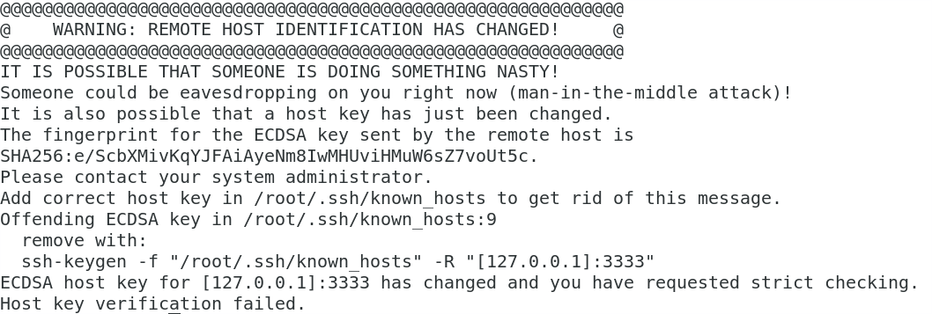
SSH - Host Checking Revisited
Now I can get to T6!
ssh -M -S /tmp/T6 -p 3333 student@127.0.0.1
And… Aww man. What’s this? This does NOT look good!

Slide 48
SSH - No Host Check Syntax
When you typed “yes” to that prompt earlier, you told it to store ssh connection information linking this username (student), this IP (127.0.0.1), and this port (3333). SSH, to make sure you are safe, checked its stored info and determined you weren’t safe because even though you’re really going to the .6 and not the .3, it still thinks you’re just going to 127.0.0.1. The records don’t match, so it’s “protecting” you. You’ll need to prevent it from checking your ~/.ssh/known_hosts file and to throw future known host information directly into /dev/null.
1 2 3 4 5 6 7
ssh -M -S /tmp/T6 -p 3333 -o StrictHostKeyChecking=no -o UserKnownHostsFile=/dev/null student@127.0.0.1
Calls ssh command binary
Creates the Master Control Socket {not used when using a secondary socket}
Declares where socket information is stored for Secondary socket use
Identifies the ssh port to connect to; if excluded, uses default port 22 {not used when using a secondary socket}
Prevents authentication failure due to conflicting stored ssh connection data
6. Username {any value can be used when using a secondary socket but there must be a value}
7. IP to which the ssh connection request is sent {not used when using a secondary socket}
You can also clear out your stored known host signatures on your local box with: cat /dev/null > ./.ssh/known_hosts
Notes:
“4” actually refers to the remote computer’s listening port in this example. However, when we start to tunnel, this becomes the port listening on local loopback.
You can also before your operation just to be safe run “cat /dev/null > ~/.ssh/known_hosts” to overwrite your existing known hosts file as an additional precaution.

Slide 49
Tunnel Syntax Review

Slide 50
SSH Tunnel - Tunnel Syntax Summary
Let’s review our tunnel syntax in general.
The five parts of every successful tunnel
-TunnelType Listen/BindAddress:Listen/BindPort:ServerAddress:ServerPort
-L = create the listener on the Local host I’m running the command from.
-R = create the listener on the Remote host I’m authenticating to right now.
-D = create the listener on the Local host I’m running the command from.
Listen Address = What IP on the device indicated above (local or remote) am I listening for connections on? Probably 127.0.0.1 unless another device needs to use this tunnel.
Listen Port = What port on the above device/IP will be listening for TCP connections?
Server Address = What IP will the other side of my current connection give tunnel contents to? Usually–but not always–the next hop for -L and 127.0.0.1 for -R
Server Port = What port on the target IP is waiting for my traffic? Usually a service port such as ssh or http, but could also be another tunnel entrance.

Slide 51
SSH Tunnel -L Tunnel Syntax Summary
The Local Listener Tunnel initiates locally and tells the remote side where to send traffic.
-TunnelType Listen/BindAddress:Listen/BindPort:ServerAddress:ServerPort
-L 127.0.0.1:2222:192.168.0.5:22
-L = I want to set up my listener Locally on my current device (probably your opstation).
127.0.0.1 = The IP on my local device I wish to listen on. I want to listen on my loopback, but you could also listen on an outward facing IP. Since 127.0.0.1 is the default, you can and often will leave this part off.
2222 = I chose to open port 2222 on my opstation’s loopback, but I could be any unbound port. Since it is on my optstation, no one will see this but me.
192.168.0.5 = I want the device I am connecting to right now to forward any tunnel traffic I receive to this IP, usually the device I want to access next.
22 = I want my forwarded traffic to go to this port on the above IP. We used 22/ssh here, but it could be any port that accepts TCP traffic. Note: I’m not creating a listener on the .5, nor have I touched it. I am pointing my tunnel at a port that is already listening for connections.
Local
Side
Remote
Side

Slide 52
SSH Tunnel -R Tunnel Syntax Summary
The Remote Listener Tunnel initiates remotely and tells the local device where to send traffic
-TunnelType Listen/BindAddress:Listen/BindPort:ServerAddress:ServerPort
-R 127.0.0.1:48907:127.0.0.1:22
-R = I want to set up my listener Remotely on the device I’m authenticating to right now.
127.0.0.1 = The IP on my remote device I wish to listen on. If you have permissions, you could set it up on an outward facing IP to receive a beacon coming to this device, or you could set it up on the loopback to create a tunnel internally for future use.
48907 = I chose to open port 48907 on the remote host, but I could use any unbound port. Admins can see this, so I should match the port to the port the beacon calls to, or if I’m setting up an internal tunnel, something that will blend in.
127.0.0.1 = When the remote device receives traffic and pushes it into our tunnel, I want my local device (probably the opstation) to send it to this IP, usually the loopback.
22 = Forwarded traffic should go to this port. In this case, I want to send traffic to my internal ssh port, but if it’s not pointing to a listening port, I will need to create a listener to catch it.
Remote
Side
Local
Side

Slide 53
SSH Tunnel -D Tunnel Syntax Summary
The Dynamic Listener Tunnel. Server Address and Port are not specified until connection.
-TunnelType Listen/BindAddress:Listen/BindPort:ServerAddress:ServerPort
-D 127.0.0.1:9050
proxychains nmap -Pn -sT 192.168.0.0/26 -p 21-23,80*
-D = I want to set up my listener Locally on my current device (probably your opstation).
127.0.0.1 = The IP on my local device I wish to listen on. Since 127.0.0.1 is the default, you can and often will leave this part off.
9050 = I chose to open port 9050 on my opstation’s loopback because it is the default specified in proxychains.conf, but I could be any unbound port. Since it is on my optstation, no one will see this but me.
192.168.0.0/26 = I want the device I am connecting to right now to forward any tunnel traffic I receive to these IPs, which are not provided until I actually use the tunnel.
21-23,80 = These are the ports I am dynamically declaring I want to connect to at the time of execution which are not provided until I actually use the tunnel.
*Doesn’t need to be nmap. Could be ‘proxychains wget 192.168.0.5:8080’ or telnet or nc any other TCP-based tool.
Local
Side
Remote
Side

Slide 54
SSH Tunnel - Helpful Hints
Your ssh connect lines from your Ops box should ONLY ever use your pivot IP or your localhost IP.
Every connection has a local/client side, where I’m running the command, and a remote/server side, the device I am connecting to right now.
If I want to go here, I need to point my ssh connection here.
  -L 127.0.0.1:4321:192.168.0.2:22
If you have a habit of trying to connect directly to a device after setting up a tunnel on your client’s localhost, specifying your listening IP may help you remember where your listening port is located.
  I.e. ssh user@1.2.3.4 -L 127.0.0.1:4321:192.168.0.2:22
  ssh user@127.0.0.1 -p 4321
127.0.0.1 and localhost are always relative to whoever is sending the packet.
  ssh user@localhost -L localhost:1234:localhost:22 -R localhost:4321:localhost:8765
  (Local) Client’s localhost (Remote) server’s localhost

Slide 55
SSH Tunnel - Troubleshooting
So you’ve set up a tunnel, but you’re still unable to reach the host you’re aiming for. Check for the following for common tunneling mistakes.
Is your ssh connection syntax pointing at your tunnel or someplace else?
Me > 10.50.100.200:22 > 192.168.0.3:22 – -L 127.0.0.1:3333:192.168.0.3:3333
  Correct: ssh user@127.0.0.1 -p 3333
  Incorrect: ssh user@10.50.100.200 -p 3333
  Incorrect: ssh user@192.168.0.3 -p 3333
  Incorrect: ssh user@192.168.0.3 -p 22
Did you establish the tunnel on the wrong device? Look at who you connected to when you established the tunnel. It should be the previous hop.
Was the port already bound? If you’ve used the same port number earlier on a previous tunnel and that session is still active, all traffic is being sent to that old session, not your new one. This is especially common when doing dynamic -D 9050
Are you running your ssh connection command from the same device you established the tunnel? If you built the tunnel from your opstation but are attempting to connect to the tunnel from your jump box, you’re gonna have problems.
Check credentials and tunnel IPs and ports very carefully for typoes. It happens. A lot.

Slide 56
BONUS TUNNELING!
The TELNET-SSH
-R Loop De Loop
Basics, Master Control Sockets

Slide 57
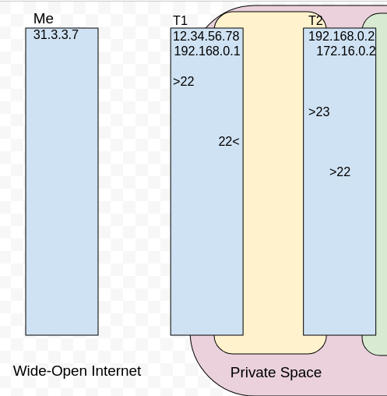
The Telnet -R Loop De Loop
I really want to ssh into T2 because I want to scan that 172.16.0.0/24 network, but darn the luck. T2 is in an internal network, and insult to injury, it looks like the ssh port on T2 is only listening internally on its loopback interface. I can’t access T2’s ssh from anywhere but inside T2, and I really need to set up that -D 9050 dynamic tunnel.
How can I get there? T1 has ssh open internally and externally, but what good does that do me?
Answer: Lots

Slide 58
The Telnet -R Loop De Loop
SSH from Me to T1’s ssh port, and while we’re at it, set up a tunnel to T2’s telnet port. I can’t ssh into T2, but I can telnet, so let me take what crumbs I can.
From Me:
ssh user@12.34.56.78 -L2323:192.168.0.2:23
ssh user@.78
-L 2323:192.168.0.2:23

Slide 59
The Telnet -R Loop De Loop
1. From Me:
ssh user@12.34.56.78 -L2323:192.168.0.2:23
Now we telnet to T2 via our tunnel
From Me:
telnet 127.0.0.1 2323
Cool. Now I’m on T2, but gross. I’m in an unencrypted telnet session. And I can still only SSH in locally. What to do?
ssh user@.78
-L 2323:192.168.0.2:23
Telnet 127.0.0.1 2323

Slide 60
The Telnet -R Loop De Loop
1. From Me:
ssh user@12.34.56.78 -L2323:192.168.0.2:23
2. From Me:
telnet 127.0.0.1 2323
T2 may be untrusting of inbound ssh, but it allows outbound, and T1 is a lot more receptive to my ssh requests, and is more than happy to forward traffic for me. Let’s take advantage of that.
I can ssh out to T1, and then tell T1 to listen on its loopback 12022 (or any port, really) and send it back to T2 to deliver to its own loopback on port 22!
From T2:
ssh user@192.168.0.1 -R 12022:127.0.0.1:22
ssh user@.78
-L 2323:192.168.0.2:23
Telnet 127.0.0.1 2323
ssh user@.1
-R 12022:lo:22
>12022

Slide 61
The Telnet -R Loop De Loop
1. From Me:
ssh user@12.34.56.78 -L2323:192.168.0.2:23
2. From Me:
telnet 127.0.0.1 2323
3. From T2:
ssh user@192.168.0.1 -R 12022:127.0.0.1:22
Cool. Now the inside of T1 can talk to the inside of T2. How does that help me?
We can set up a tunnel on T1 to point to that inside loopback port on T1, which is pointing back to that inside ssh port on T2
From Me:
ssh user@12.34.56.78 -L12322:127.0.0.1:12022
OR
-O forward -L12322:127.0.0.1:12022 (If I used master sockets)
ssh user@.78
-L 2323:192.168.0.2:23
-L 12322:localhost:12022
Telnet 127.0.0.1 2323
ssh user@.1
-R 12022:lo:22
>12022

Slide 62
The Telnet -R Loop De Loop
1. From Me:
ssh user@12.34.56.78 -L2323:192.168.0.2:23
2. From Me:
telnet 127.0.0.1 2323
3. From T2:
ssh user@192.168.0.1 -R 12022:127.0.0.1:22
4. From Me:
ssh user@12.34.56.78 -L12322:127.0.0.1:12022
Nice! Now I have a -L local listener on me (12322) pointing at a -R remote listener on T1 (12022) which is pointing back to a loopback ssh port on T2. And while I’m there, let’s throw my dynamic tunnel up, which will now come out T2
From Me:
ssh -p 12322 user@127.0.0.1 -D 9050
ssh user@.78
-L 2323:192.168.0.2:23
-L 12322:localhost:12022
Telnet 127.0.0.1 2323
ssh user@.1
-R 12022:lo:22
ssh -p 12322 user@127.1
> 12022
-D 9050

Slide 63
The Telnet -R Loop De Loop
1. From Me:
ssh user@12.34.56.78 -L2323:192.168.0.2:23
2. From Me:
telnet 127.0.0.1 2323
3. From T2:
ssh user@192.168.0.1 -R 12022:127.0.0.1:22
4. From Me:
ssh user@12.34.56.78 -L12322:127.0.0.1:12022
5. From Me:
ssh -p 12322 user@127.0.0.1 -D 9050
And now begins the scanning.
From me:
proxychains nmap -Pn -sT 172.16.0.0/24 -p 21,22,23,80
ssh user@.78
-L 2323:192.168.0.2:23
-L 12322:localhost:12022
Telnet 127.0.0.1 2323
ssh user@.1
-R 12022:lo:22
.10:21
ssh -p 12322 user@127.1
-D 9050
.5:22
.1:21
.116:22
.91:80
.7:80
.24:23
.5:22

Slide 64
netcat
Listener vs client; common syntax; Other uses

Slide 65
NC - As Client
The most common use of netcat is to act as a client for a server process. This is mostly used for troubleshooting network servers and network connections because you can see the raw data of the interaction. So, providing nc with just a hostname or IP address and a port number will make netcat act as the telnet utility:
nc localhost 22
In the given example, nc tries to connect to TCP port number 22 of the localhost
Notice that as the -u option is not used, nc will use the TCP protocol by default.
Notes:
Source: https://www.linode.com/docs/networking/diagnostics/netcat/netcat/

Slide 66
NC - As Server
nc will accept connections at a given port (-p) and act as a server when you execute it with the -l (listen) option:
nc -l -p 1234
In another terminal window, connect a client to the server with nc:
nc 127.0.01 1234
You can now send messages between the two machines with nc.
The first command tells netcat to listen on TCP port number 1234 for incoming connections - you can also see that netcat automatically reads data from the client and that you can send your response to the TCP client just by typing it.
Once again, as the -u option is not used, nc will use the TCP protocol.
Notes:
Source: https://www.linode.com/docs/networking/diagnostics/netcat/netcat/

Slide 67
netcat Exercise
On your Ops box, run
nc -nvlp 1980 -e /bin/bash
On you host box, run
nc <Ops_IP> 1980
Run
Ifconfig -a
and verify it is your Ops box
-n Skip all DNS or service lookups on addresses, hostnames or ports
-v Give more verbose output

