Slide 1
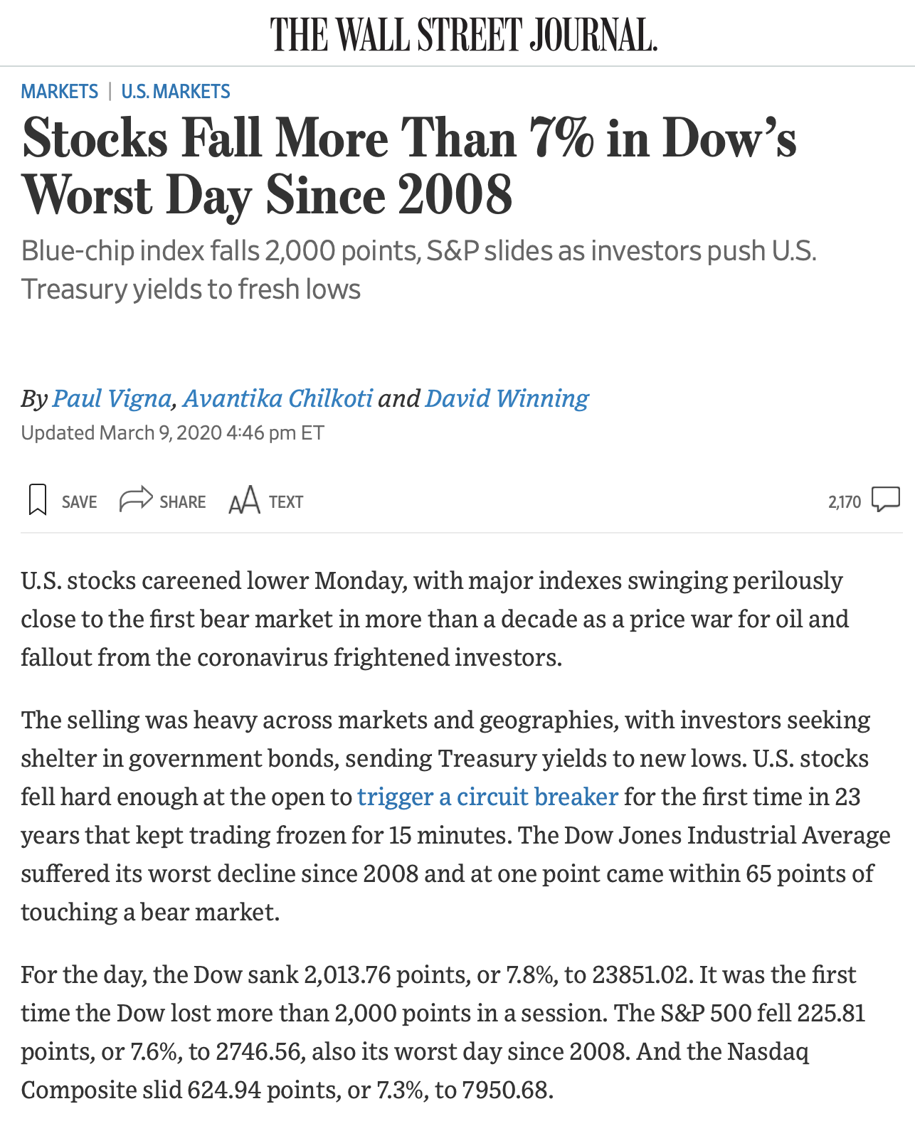

Input: Cleaned WSJ article
Pre-Trained BERT Model
Classifier
Output: Label
Corporate Earnings
Government Spending
Macro Outlook
Monetary Policy
Sovereign Military Conflict
Linear layer + softmax for classification
Notes:
BERT image credits: http://jalammar.github.io/illustrated-bert/

