Slide 1

Multilingual Translation Quality
Evaluation using NLP Tools
This project aims to develop a robust translation quality evaluation system that leverages advanced NLP models, to accurately assess the quality of multilingual text outputs. By addressing the limitations of existing translation metrics, this system will enable more reliable and scalable assessment of translation quality.
Team:
1.Mallikarjun Reddy
2.Manikeshwar Reddy
3.Leena Chekuri
4.Ankith Kumar Sara

Slide 2
Problem Statement
In many fields, such as legal, medical, and technical domains, accurate translations are crucial for ensuring clear and effective communication. However, assessing the quality of translations, especially those done by human translators, can be challenging and often subjective. Traditionally, translation quality assessment is done manually by experts, but this method has limitations, including high costs, time demands, and the inherent subjectivity of human judgment.
1
Powerful NLP Capabilities
The Helsinki-NLP model offers state-of- the-art natural language processing capabilities, including deep semantic understanding and contextual awareness.
2
Multilingual Support
This model is trained on data from over 100 languages, enabling comprehensive translation quality assessment across a wide range of language pairs.
3
Cutting-Edge Algorithms
Evaluate how well machine translations preserve meaning, context, and nuances compared to human translations using NLP metrics like semantic similarity and syntactic accuracy

Slide 3
Project Objective: Develop a robust translation quality evaluation system
Accurate Assessment
Provide precise and reliable evaluation of translation quality across a wide range of language pairs and domains.
Scalable Solution
Enable high-throughput translation quality assessment to support the needs of large- scale translation projects.
User-Friendly Interface
Develop a intuitive and easy-to- use platform for translation quality evaluation and analysis.
Continuous Improvement
Leverage the latest advancements in NLP and machine learning to continually enhance the system's performance.

Slide 4

Why Choose Helsinki-NLP Model?
1
State-of-the-Art Performance
The Helsinki-NLP model consistently outperforms other translation quality evaluation tools in benchmarks and real-world applications.
2
Comprehensive Multilingual Support
With coverage of over 100 languages, this model can assess the quality of translations across a vast linguistic spectrum.
3
Continuous Improvement
The Helsinki-NLP team regularly updates and fine-tunes the model, ensuring it remains at the forefront of translation quality assessment.

Slide 5

Challenges in Existing Translation Quality Metrics &
How Our Model Overcomes Them
Limited Language Coverage
The Helsinki-NLP model supports over 100 languages, enabling comprehensive evaluation of translations across a wide linguistic spectrum.
1
Lack of Semantic Understanding
The model's advanced natural language processing capabilities, including deep semantic analysis, allow for a more nuanced and contextual assessment of translation quality.
2
Subjective Evaluation
The model's objective, data-driven approach to translation quality assessment ensures consistent and reliable results, eliminating the need for manual, subjective evaluation.
3

Slide 6
Library used to train the model
Library
Functionality
Transformers (from Hugging Face)
These are tools provided by the Hugging Face Transformers library for handling Marian machine translation models.
NLTK (Natural Language Toolkit)
NLTK's BLEU score module is widely used for evaluating the quality of translations. BLEU (Bilingual Evaluation Understudy) compares the overlap of n-grams between the generated translation and the reference translation to quantify their similarity.
ROUGE Scorer
ROUGE measures the overlap of n-grams, word sequences, and word pairs between machine and human translations.
Levenshtein
This library calculates the Levenshtein distance, or edit distance, between two sequences.
scikit-learn
The cosine similarity function calculates the cosine of the angle between two vectors, measuring the text similarity based on word importance vectors.MinMaxScaler: This function scales numerical data to a given range, often between 0 and 1
Sentence Transformers
The Sentence Transformers library provides a way to generate sentence embeddings, which are dense vector representations of sentences using BERT-based models (like all-mpnet-base-v2).
Torch
The PyTorch library (torch) provides the underlying framework for training, deploying, and utilizing deep learning models, especially for GPU acceleration
Gradio
This is an interactive library for building user interfaces that allow users to input text and view translation quality results interactively.

Slide 7




Functionalities Used
The system employs various NLP functionalities to analyze and compare translations, including tokenization, stemming, and word embedding.
Tokenization
Breaking down text into individual words or units. Tokenization is a preliminary step that enables further text processing, such as vectorization or embedding generation, by creating these standardized units.
Sentence Embedding Similarity with SBERT (Sentence-BERT)
Sentence-BERT, or SBERT, is an adaptation of the original BERT model optimized to generate dense embeddings for entire sentences rather than individual tokens. SBERT transforms sentences into high-dimensional vector embeddings that capture the sentence's contextual meaning. It does so by learning to produce embeddings that are close in vector space for semantically similar sentences and far apart for dissimilar ones.
Weight Adjustment and Averaging in Translation Quality Evaluation
In translation quality assessment, multiple metrics (like BLEU, ROUGE, Levenshtein Distance, and sentence embeddings) are often combined. Each metric captures a different aspect of similarity—some focus on exact word overlap, while others capture semantic meaning. A weighted average of the similarity scores provides a balanced, comprehensive quality assessment.

Slide 8

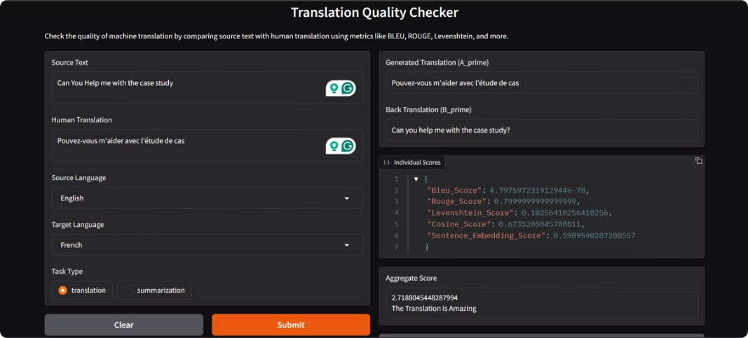
Interface
The interface is designed to be user-friendly and intuitive, allowing users to input the source text and human translation, then receive the quality assessment results.
The interface provides clear visualizations of the similarity scores and insights into the quality of the human translation.

Slide 9
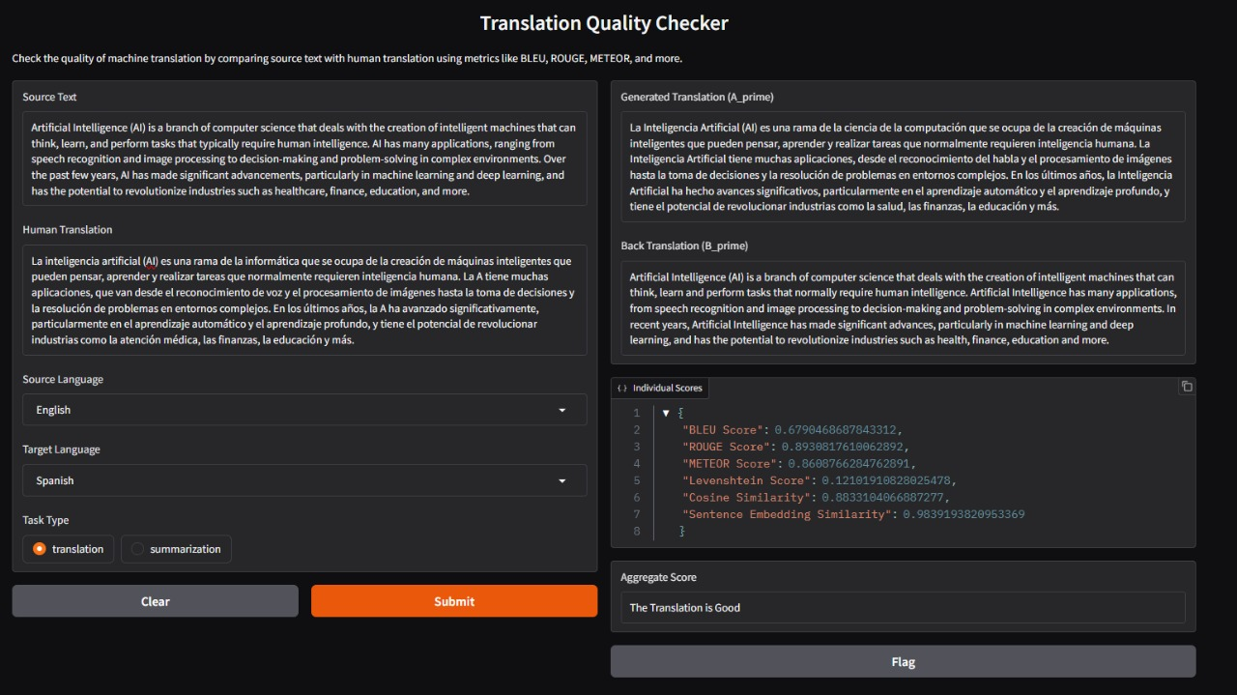

Slide 10
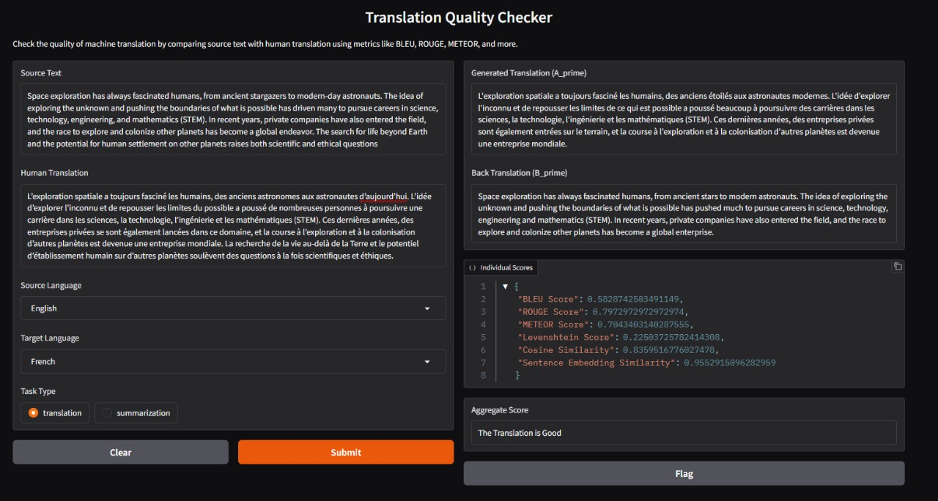

Slide 11


Future Use Cases for Companies and Future Directions
Localization
Ensures high-quality translations for international product and marketing content, driving global expansion and revenue growth.
Content Translation
Enables accurate and consistent translation of vital business documents, such as contracts, reports, and policies.
Customer Support
Improves the quality and consistency of multilingual customer service interactions, enhancing the overall customer experience.
Continuous Improvement
The Helsinki-NLP team will continuously update and enhance the model, ensuring it remains at the forefront of translation quality assessment.

Slide 12

Conclusion: Improved translation quality, scalability,
and future work
1
Improved Translation Quality
The Helsinki-NLP model's advanced NLP capabilities and comprehensive language support deliver more accurate and reliable translation quality assessments.
2
Scalable Solution
The system's high-throughput processing capabilities enable efficient and cost-effective translation quality evaluation for large-scale projects.
3
Future Advancements
The Helsinki-NLP team will continue to refine and expand the model, incorporating the latest breakthroughs in NLP and machine learning.

Slide 13
Reference Papers
Translation Techniques and Translation Competence in Translating Informative Text for Indonesian EFL Learners | Request PDF
(PDF) Research on the Application of Natural Language Processing Technology in English Translation Quality Control
(PDF) Translation Quality and Error Recognition in Professional Neural Machine Translation Post-Editing

Slide 14


