Slide 1


Introduction to PHP Programming
Unlocking the power of server-side web development.

Slide 2
What is PHP?
PHP = Power
Why Choose PHP?
Hypertext Preprocessor, server-side scripting language.
Free, open source, runs on all platforms, integrates with databases.

Slide 3
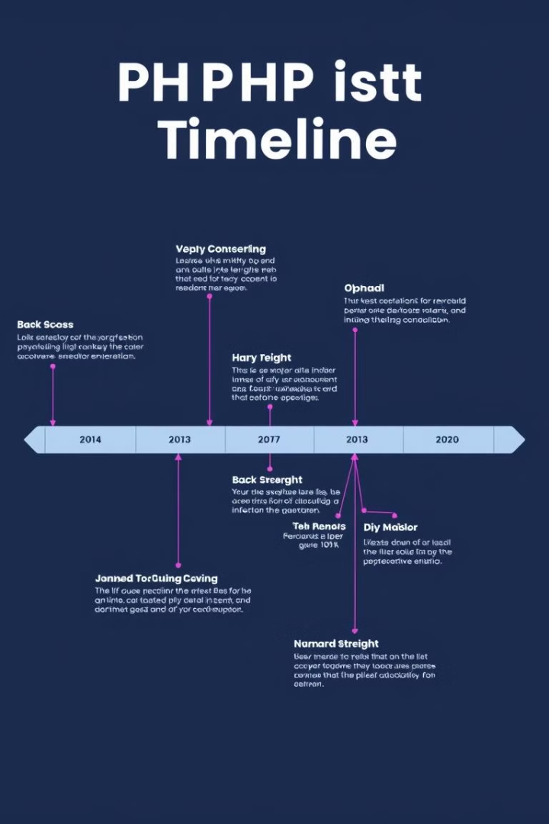

The Evolution of PHP
1
1993: Created by Rasmus Lerdorf as Personal Home Page.
2
1995: Released as PHP/FI (Forms Interpreter).
3
2004: Introduced Object-Oriented Programming (OOP) and PHP 5.

Slide 4
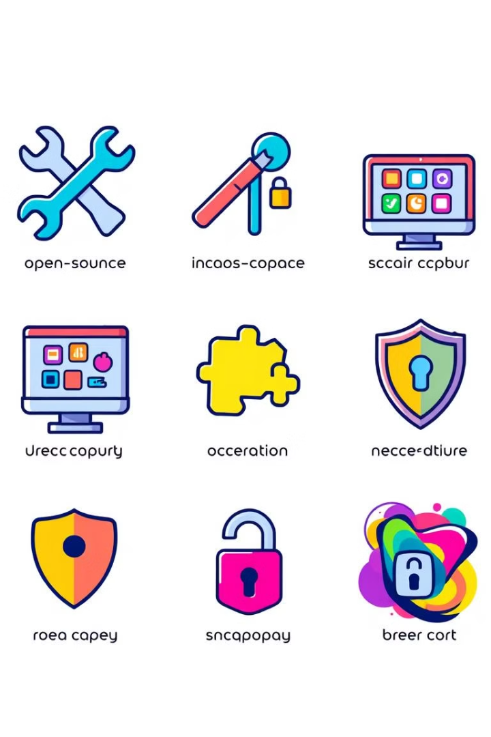
Why PHP? Key Features
Open Source
Cross-Platform
No cost, wide community support.
Works across Windows, Linux, and macOS.
Flexible Integration
Dynamic Content
Integrates with databases and services.
Interactive sites (blogs, e-commerce, forums).

Slide 5
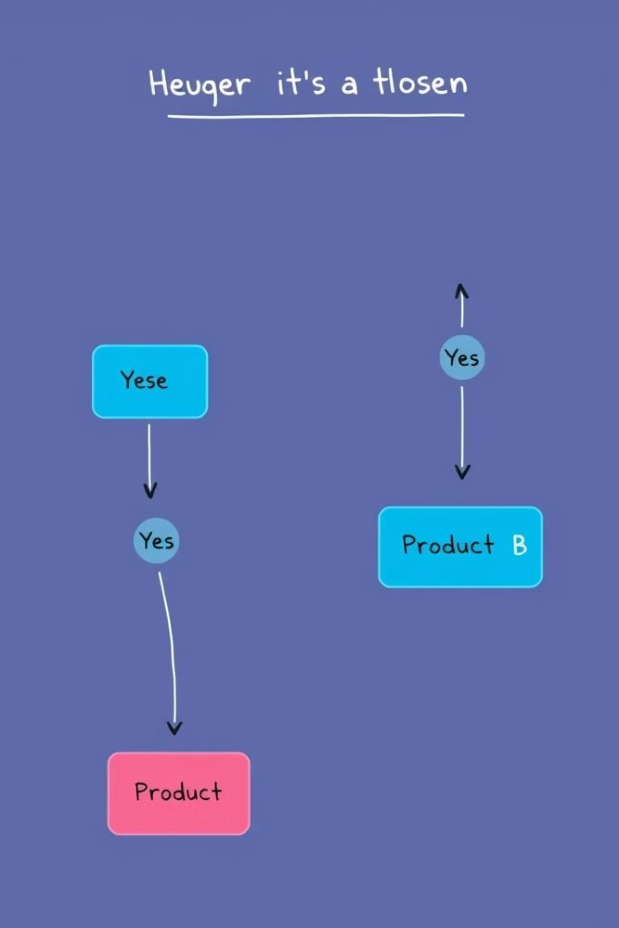


Control Structures in PHP
If Statements
Execute code based on conditions.
Loops
Repeat actions with for, while, and foreach.

Slide 6



Functions in PHP
Functions
1
Reusable blocks of code.
Built-in
2
strlen(), array_push().
Custom
3
Create your own functions.

Slide 7
PHP in Action: Forms & User Input
Working with Forms
PHP Handles the Backend
Handles form data submitted by the user.
Collects, validates, and processes user input.

Slide 8

Conclusion & Next Steps
1
2
PHP is Essential
Next Steps
Versatile language powering millions of websites.
Explore PHP frameworks, practice building dynamic websites, learn best practices for security and database integration.

