Slide 1

STEEL & STEAM · FOOD REDISTRIBUTION
Samaritan
Helping someone in need.
A nod to the Bill Emerson
Good Samaritan Food Donation Act.
+
A place at the table.
A community behind it.
Amrit
From Sanskrit amṛta: nectar.
Our interpretation: the essence
of nourishment and care.
Strict simplicity. Accountable food recovery.
SAMRIT / A PLACE AT THE TABLE
01
Notes:
Samrit brings together the everyday idea of a Good Samaritan—a person helping someone in need—and Amrit, from Sanskrit amṛta, nectar. Essence is our brand interpretation rather than a literal dictionary gloss. The Samaritan reference also evokes the Bill Emerson Good Samaritan Food Donation Act. We are not claiming that using Samrit automatically provides immunity: donation protections have conditions. Our promise is a welcoming route to food, supported by an accountable community.
Sources
S6 · https://www.usda.gov/about-food/food-safety/food-loss-and-waste/donating
S7 · https://dictionary.cambridge.org/us/dictionary/english/good-samaritan
S8 · https://api.pageplace.de/preview/DT0400.9788120837737_A24265371/preview-9788120837737_A24265371.pdf

Slide 2
THE THEME, REINTERPRETED
Steel & steam.
The kitchen is our starting point.
01
Steel is the structure.
Trucks, equipment, storage,
records and reliable handoffs.
02
Steam is the purpose.
A warm meal, a welcoming space,
and the dignity of being nourished.
LOGISTICS IN SERVICE OF A MEAL
SAMRIT / A PLACE AT THE TABLE
02
Notes:
The logistics interpretation of Steel and Steam is natural: vehicles, equipment and a chain of handoffs. Our twist is to start inside the kitchen. Steel is the physical and operational structure that makes a meal possible. Steam is the warm, human result. This is not a transport dashboard looking for a use case; it is a food-access experience with logistics behind it.

Slide 3
THE NEED AND THE OPPORTUNITY
Food exists. Need exists.
The connection is missing.
47.9M
30–40%
~800
80%
PEOPLE
OF U.S. FOOD SUPPLY
NYC NETWORK LOCATIONS
SMARTPHONE OWNERSHIP
Lived in food-insecure
U.S. households in 2024.
Estimated to go uneaten.
Pantries, soup kitchens
and mobile pantries.
Adults in households
below $30K income.
United States, 2026.
[S1] USDA ERS
[S2] EPA
[S3] Food Bank For NYC
[S4] Pew Research Center
Phone ownership is an access proxy, not a measurement of food-insecure people. NYC network count combines service types.
SAMRIT / A PLACE AT THE TABLE
03
Notes:
These figures describe different populations and should not be multiplied together. USDA reports 47.9 million people living in food-insecure U.S. households in 2024; this does not mean every person experienced hunger in the same way. EPA estimates 30–40% of the U.S. food supply goes uneaten. Food Bank For NYC describes a network of nearly 800 pantries, soup kitchens and mobile pantries; it is not a soup-kitchen-only census or a Samrit partner count. Pew’s 2026 survey found 80% smartphone ownership among adults in households earning under $30,000. That is a proxy for reach, not a food-insecurity-specific smartphone measure. Digital access still has gaps.
Sources
S1 · https://www.ers.usda.gov/topics/food-nutrition-assistance/food-security-in-the-us/key-statistics-graphics
S2 · https://www.epa.gov/sustainable-management-food/united-states-2030-food-loss-and-waste-reduction-goal
S3 · https://www.foodbanknyc.org/what-we-do/food-distribution/
S4 · https://www.pewresearch.org/internet/fact-sheet/mobile/

Slide 4
OUR DESIGN PRINCIPLES
Strict simplicity.
Accountable simplicity.
01
02
03
People seeking food first.
Accessible by intention.
Simple does not mean opaque.
No account required to find meals.
The primary action is easy to see.
Plain language, responsive screens,
visible choices and optional voice.
A clear next step for the person.
A clear record for the operator.
SAMRIT / A PLACE AT THE TABLE
04
Notes:
The person looking for food should not have to understand the logistics system. Our landing page prioritizes finding a meal. A person can browse without an account, choose visible allergen chips, write preferences in everyday language, or use the optional assistant. Staff workspaces are focused on their own jobs. Accountability lives in role permissions, verified menus, stage-ordered handoffs and evidence records. Simplicity is the front door; accountability supports it behind the scenes. These are design goals, not a claim of a completed formal accessibility audit.

Slide 5
WHAT MAKES SAMRIT DIFFERENT
Four capabilities. One coherent experience.
01
Dignified discovery
02
Menus into structured data
Allergen and preference filtering,
with optional voice assistance.
Gemini OCR creates editable dish
candidates for human confirmation.
03
Traceable handoffs
04
Private quality learning
QR events, photo hashes and
location provenance in one record.
Internal feedback helps the NGO
guide donors and venues.
SAMRIT / A PLACE AT THE TABLE
05
Notes:
The platform’s distinctive contribution is the combination: accessible discovery, human-verified menu extraction, accountable handoffs and private organizational learning. The AI is deliberately connected to concrete actions and structured records. It is not used as a replacement for food-handler judgment or as a public score that can shame a venue. The next slides show how these capabilities are distributed across the four faces.

Slide 6
THE PLATFORM STRUCTURE
Four faces. A shared responsibility.
01
02
03
04
People seeking
meals
Distribution
centers
Donors &
organizers
Central NGO
Discover, choose,
check in and review.
Profile capacity,
receive and verify.
Confirm menus,
offer leftovers.
Approve, dispatch,
review and guide.
The NGO face includes its driver mobile view. Drivers are provisioned by the NGO, not recruited through public signup.
SAMRIT / A PLACE AT THE TABLE
06
Notes:
We retain the original four-face structure. Face one is the public consumer experience; face two is the distribution center; face three is the event organizer or donor; and face four is the central NGO. The driver mobile view belongs to the NGO logistics face rather than becoming a fifth public signup category. The NGO already manages its people and fleet. Samrit coordinates those resources and records their handoffs.

Slide 7
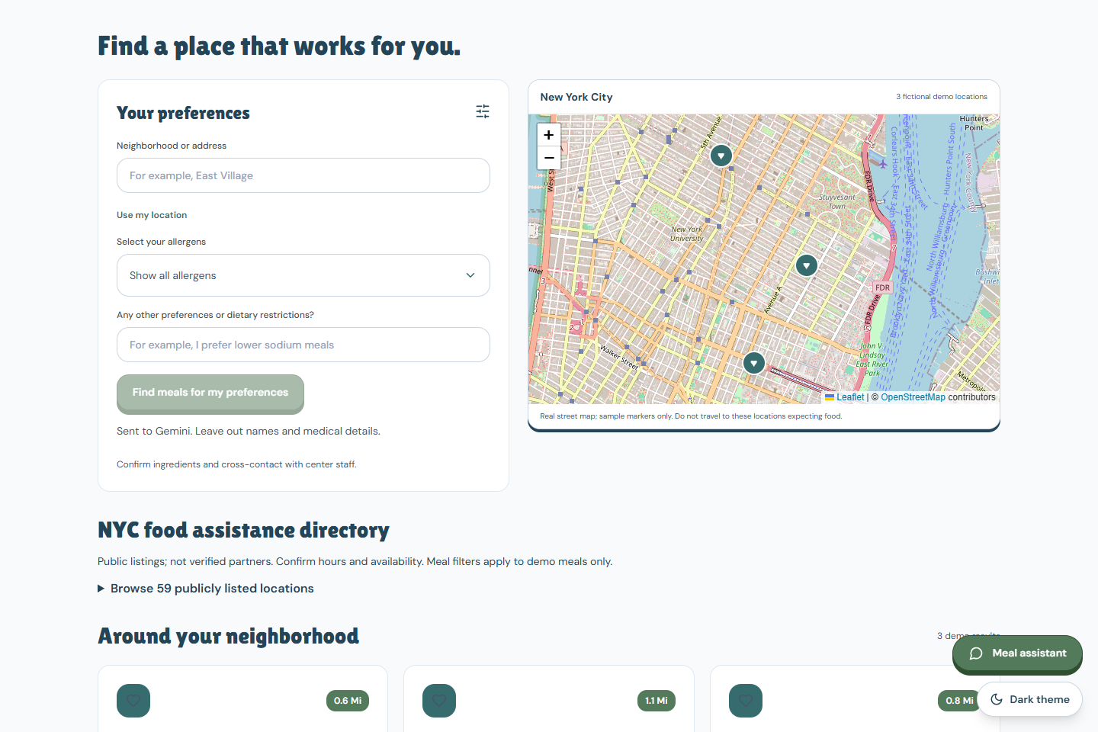
FACE 01 · PEOPLE SEEKING MEALS
Find a place that works for you.
01
Choose what fits.
Nine major-allergen categories
and natural-language preferences.
02
Stay in control.
Visible selections, optional voice
and no public account requirement.
03
Be heard privately.
One venue QR, finish the visit,
then leave private feedback.
SAMRIT / A PLACE AT THE TABLE
07
Notes:
The person seeking a meal is the priority, not a side link inside a staff portal. The interface uses FDA-recognized major-allergen categories: milk, eggs, fish, Crustacean shellfish, tree nuts, peanuts, wheat, soybeans and sesame. Gemini can interpret a preference such as avoiding cold food, while unknown nutritional properties are not invented. People should still confirm ingredients and cross-contact with staff. The sourced NYC directory and fictional demo meal catalog are distinct; this is not a live promise of meal availability. One shared venue QR starts the visit, and a finish button opens private feedback without an exit scan.
Sources
S5 · https://www.fda.gov/food/buy-store-serve-safe-food/food-allergies-what-you-need-know

Slide 8
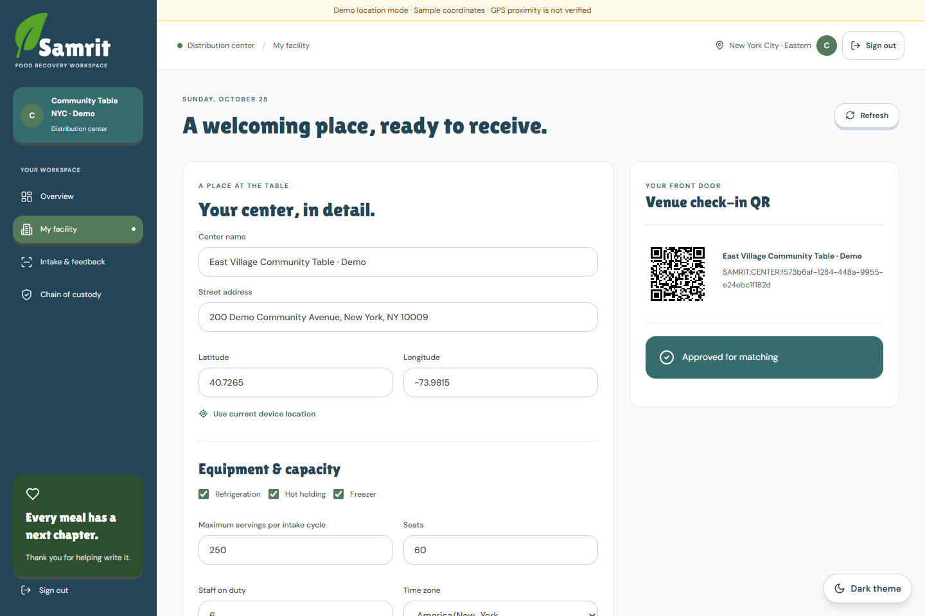
FACE 02 · DISTRIBUTION CENTERS
A welcoming place, ready to receive.
01
Capacity first.
Hours, seating, staffing and
hot / chilled / frozen capability.
02
NGO-approved.
The central NGO verifies
participating facilities.
03
Staff confirm intake.
A shared venue QR and staff
arrival-photo confirmation.
SAMRIT / A PLACE AT THE TABLE
08
Notes:
A center registers its facility, operating hours, equipment, seating, staffing and receiving capacity. Admin approval makes the center eligible for matching. Mixed batches require support for every included handling type. The driver scans the center’s shared venue code on arrival; center staff scan the tracking sticker and submit the receiving photograph. The same venue code supports consumer check-in, reducing signage and removing an unnecessary second entry code and exit code. A shared code does not merge delivery records with anonymous visit credentials.

Slide 9
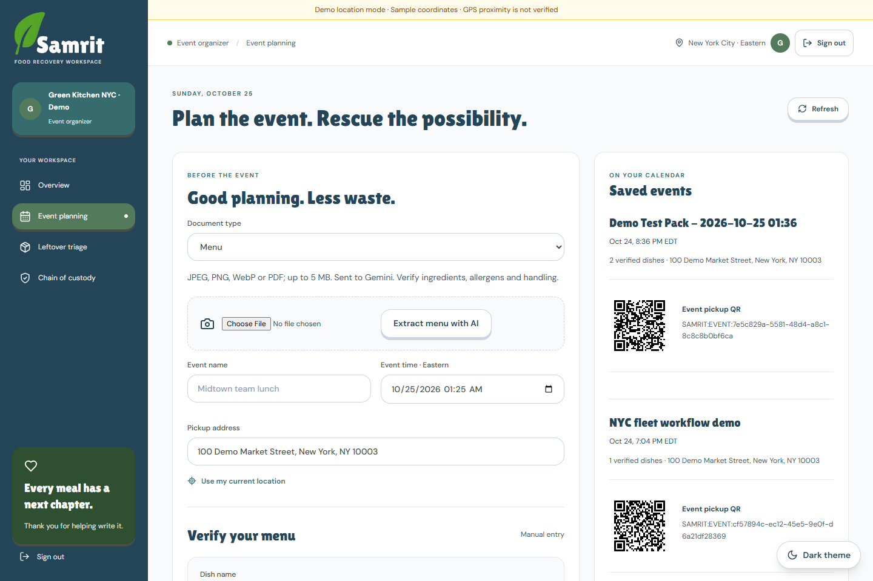
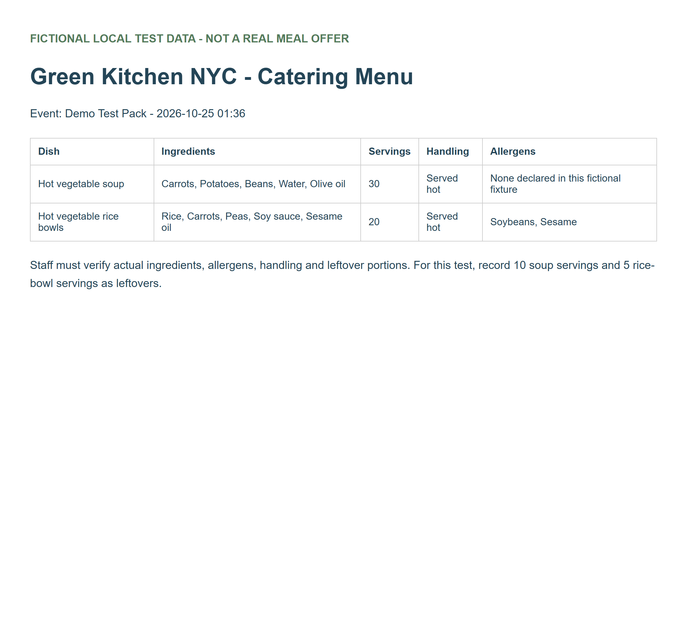
FACE 03 · EVENT ORGANIZERS & DONORS
From a menu photo to a rescue batch.
EXTRACT
CONFIRM
SELECT LEFTOVERS
Gemini reads the menu / invoice.
The donor verifies every dish.
Positive servings + handling types.
SAMRIT / A PLACE AT THE TABLE
09
Notes:
The donor can upload a menu or invoice for Gemini extraction. Dishes, ingredients, declared allergens, servings and handling requirements become editable candidates. The donor must confirm them; an invoice’s ingredients do not prove that a dish was served. After the event starts, the donor selects leftovers, enters positive whole-number servings, chooses all needed handling types and adds the Stage 1 photo. Clearing a servings field keeps its checkbox selected and blocks submission until corrected. Mixed handling is supported only when the assigned vehicle and destination can support every included requirement. The menu shown is a fictional test fixture.

Slide 10
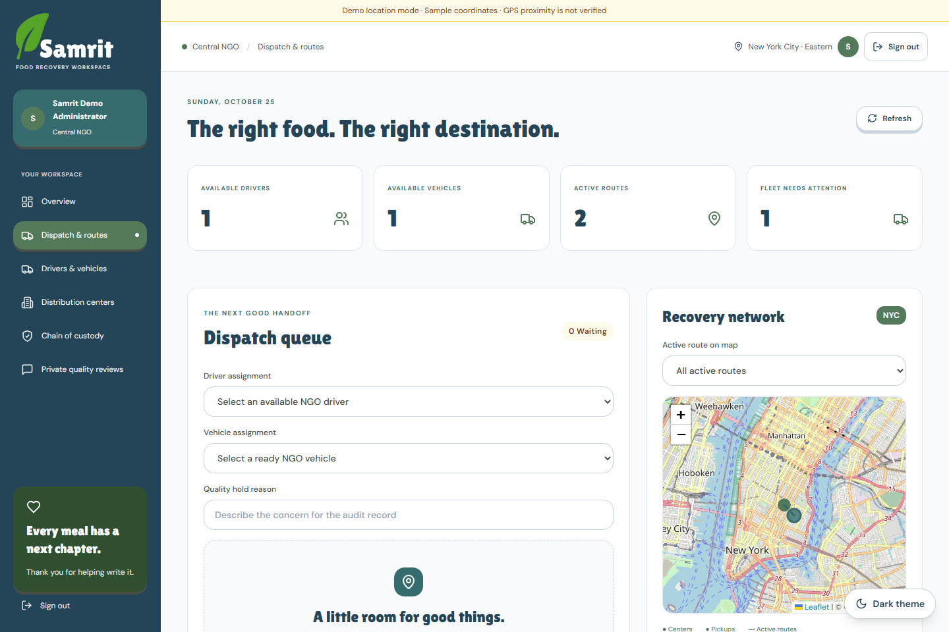
FACE 04 · CENTRAL NGO + DRIVER VIEW
The right food. The right destination.
01
Existing resources.
Approve venues; provision drivers;
maintain vehicles and equipment.
02
Compatible dispatch.
Match total capacity, handling,
opening hours and food expiry.
03
Clear driver steps.
Event QR → pickup photo → sticker
→ venue QR → staff receipt.
SAMRIT / A PLACE AT THE TABLE
10
Notes:
The central NGO uses its existing volunteer/driver operation and truck fleet. It provisions driver access, maintains equipment and availability, approves facilities and assigns resources. Vehicle capacity and every handling type must match the batch. A driver has one active assignment per resource, records pickup and arrival, and links a unique sticker to the batch. Center staff complete delivery. Map routes are planning visualizations, not live traffic optimization or continuous tracking. In presentation mode, distances and GPS verification are explicitly simulated so the demonstration works on a desktop.

Slide 11
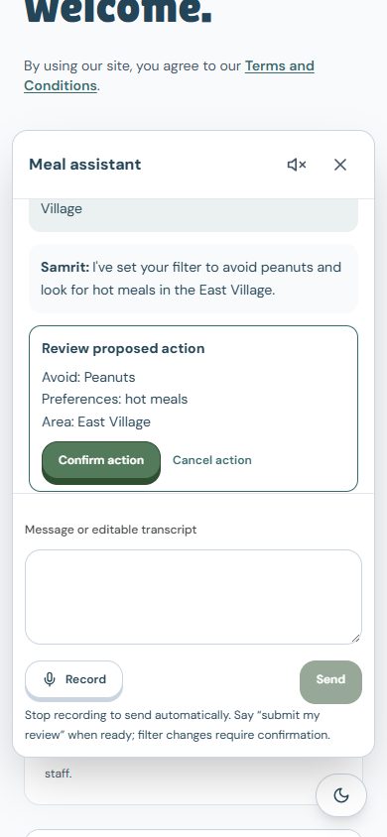
OPTIONAL, NATURAL-LANGUAGE OPERATION
Speak the intent.
Let the interface handle the steps.
“I can’t eat cold food. Avoid peanuts.”
ElevenLabs
Speech → text
Gemini
Correct → interpret → choose an action
ElevenLabs
Text → spoken reply
Optional alongside manual controls. “Leave a review” opens the sequence; “Submit my review” sends the ready draft once.
SAMRIT / A PLACE AT THE TABLE
11
Notes:
The assistant is an optional agentic layer, not a replacement for the existing interface. Stop recording to send automatically. ElevenLabs transcribes the audio; Gemini lightly corrects transcription errors while preserving intent and negation, then chooses a constrained page action. ElevenLabs speaks the result. A request to leave a review finishes the current visit and opens feedback; a ready review submits when explicitly requested, without repeated confirmation questions. Filters retain visible confirmation, permissions stay with the browser and unrelated requests receive a scoped refusal with available page actions. Audio and text go to their respective providers; keys remain server-side.

Slide 12
ACCOUNTABILITY AT EVERY HANDOFF
An append-style QR evidence trail.
1
2
3
4
5
6
Donor
photo
Event
QR
Pickup
photo
Container
sticker
Venue
QR
Receiving
photo
QR + timestamps
Photos + SHA-256
Location provenance
Stage order and ownership
Evidence linked to the batch
Device / simulated / unspecified
Traceability supports human review; it is not an immutable ledger or food-safety certificate. Demo GPS is clearly simulated.
SAMRIT / A PLACE AT THE TABLE
12
Notes:
Each valid handoff grows the custody record with a QR event, timestamp, actor and linked photo evidence. The workflow enforces stage order, event and destination identity, assigned-driver permissions, sticker uniqueness and center receipt. SHA-256 hashes identify the stored photo bytes; they do not prove the food is safe or make the whole database immutable. The accurate description is an append-style evidence trail rather than an independently tamper-proof append-only ledger. Live mode has proximity checks; the current desktop demo uses sample coordinates, skips proximity rejection and permanently marks location evidence simulated. AI uses this context for consistency review, not guaranteed fraud detection.

Slide 13
LEARNING WITHOUT PUBLIC SHAMING
Private feedback. Human guidance.
01
Gemini assists the review.
EXAMPLE FEEDBACK
Summarize concerns, flag patterns
and assess evidence consistency.
“I waited a long time
and did not receive
a meal.”
02
The central NGO sees it.
Private operational learning,
not public ratings or venue shaming.
A person’s experience matters.
03
People decide the response.
Follow up with donors and venues;
use uncertainty to guide investigation.
A finish-button interval is approximate. AI cannot verify truthfulness, actual queue time or food safety.
SAMRIT / A PLACE AT THE TABLE
13
Notes:
Consumer and staff feedback is private to the central NGO. Gemini can identify concerns such as a long wait, packaging problems or temperature worries, summarize them and assess consistency with available evidence. This is review verification in the limited sense of evidence consistency, not proof that a statement is true or false. A long interval between check-in and pressing Finish is not a measured queue duration. Simulated location provides no attendance corroboration. Staff make the judgment and guide donors or venues. Visitor AI results do not automatically impose public ratings or penalties.

Slide 14
FROM SURPLUS TO A SHARED TABLE
One coordinated operational journey.
PLAN
OFFER
DISPATCH
HAND OFF
RECEIVE
→
→
→
→
Verified event
and menu
Leftovers +
handling types
Driver, vehicle
and destination
QR + photo
custody stages
Venue staff
confirm intake
PUBLIC EXPERIENCE
Preferences → find a place → venue check-in → finish → private review
Current demo: fictional meal offers and simulated GPS. Automatically publishing delivered food to Find a Meal is the next integration.
SAMRIT / A PLACE AT THE TABLE
14
Notes:
The complete operational path has been exercised: register and approve a venue, confirm a donor event menu, create leftovers after the event starts, assign an eligible driver and vehicle, complete QR/photo handoffs and receive the food. The public visit and private review path also works. Be precise about the gap: delivered batches do not yet automatically publish live meal offers to Find a Meal. The public catalog uses fictional offers alongside a separate directory of sourced NYC locations. The current demo deliberately simulates geolocation. These are explicit prototype boundaries rather than claims of production availability or verified GPS.

Slide 15
EVIDENCE BEHIND THE STORY
Sources & scope
[S1] USDA ERS · Food security, 2024
[S6] USDA · Donating / Good Samaritan Act
47.9 million people lived in food-insecure U.S. households in 2024.
The Bill Emerson Good Samaritan Food Donation Act provides conditional protections for qualifying good-faith donations.
[S2] EPA · U.S. food loss and waste
[S7] Cambridge Dictionary · Good Samaritan
An estimated 30–40% of the U.S. food supply is never eaten.
A person who helps people in need; the name invokes this everyday meaning.
[S3] Food Bank For NYC · Distribution
[S8] A Practical Sanskrit Dictionary · amṛta
Nearly 800 pantries, soup kitchens and mobile pantries; a mixed network, not a soup-kitchen-only count.
Amrit derives from Sanskrit amṛta, including the sense nectar. Essence is the team’s brand interpretation.
[S4] Pew Research Center · Mobile, 2026
[S9] OHCHR / FAO · The Right to Food
80% smartphone ownership among U.S. adults in households earning below $30,000; survey Jan. 30–June 18, 2026.
The right to adequate food is recognized in international human-rights instruments.
[S5] FDA · Nine major food allergens
Major-allergen categories inform the interface; the platform is not FDA endorsed.
Sources checked 25 October 2026. Product screenshots: current local Samrit app; menu: fictional OCR test fixture.
SAMRIT / A PLACE AT THE TABLE
15
Notes:
Every source title on this slide is clickable. The statistics retain their original year, geography and denominator. The smartphone statistic is specifically a lower-income ownership measure; the kitchen-network count combines several provider types. The Sanskrit reference supports nectar; essence is the team’s interpretation. The Good Samaritan Act reference is inspiration and context, not a claim of blanket liability protection. The final statement is grounded in the international right to adequate food. Screenshots show the project itself, and the sample menu is fictional.
Sources
S1 · https://www.ers.usda.gov/topics/food-nutrition-assistance/food-security-in-the-us/key-statistics-graphics
S2 · https://www.epa.gov/sustainable-management-food/united-states-2030-food-loss-and-waste-reduction-goal
S3 · https://www.foodbanknyc.org/what-we-do/food-distribution/
S4 · https://www.pewresearch.org/internet/fact-sheet/mobile/
S5 · https://www.fda.gov/food/buy-store-serve-safe-food/food-allergies-what-you-need-know
S6 · https://www.usda.gov/about-food/food-safety/food-loss-and-waste/donating
S7 · https://dictionary.cambridge.org/us/dictionary/english/good-samaritan
S8 · https://api.pageplace.de/preview/DT0400.9788120837737_A24265371/preview-9788120837737_A24265371.pdf
S9 · https://www.ohchr.org/sites/default/files/Documents/Publications/FactSheet34en.pdf

Slide 16

OUR REASON FOR BUILDING
Access to food
is a basic
human right.
A place at the table.
A community behind it.
SAMRIT / A PLACE AT THE TABLE
16
Notes:
Close with the principle that unites the product: access to food is a basic human right. Samrit’s role is to make that access easier to navigate and the supporting operations easier to account for. The person seeking a meal comes first. A welcoming experience and a trustworthy organization belong together.
Sources
S9 · https://www.ohchr.org/sites/default/files/Documents/Publications/FactSheet34en.pdf

