Slide 1
HVAC · TAKE-HOME ASSESSMENT · 2026
Arjun Sarath
Ductline
SUBMISSION
Drawing in. Structured duct data out.
AUTHOR
Arjun Sarath
SCOPE
16-slide narrative · 5-drawing benchmark
V1
→
V2
→
V3
→
PRODUCTION
REPO
implementation/ · V1, V2, V3 all building

Slide 2
Ductline · Drawing in. Structured duct data out.
02 / 17
CONTENTS
I · THE PIVOT STORY
III · ROADMAP
02
Engineers re-key duct data by hand.
11
Defending the pivots.
03
One page in. Every duct out.
12
Production timeline.
04
Three architectures attempted.
13
Path to full automation.
05
V1 · One VLM call. Six deterministic stages.
14
Track 02 · Fine-tuned VLM.
06
Why V1 is parked.
IV · DEFENSIBILITY
07
V2 · Built. Iterated. Decline observed.
15
Three commitments behind the build.
II · V3 IN PRODUCTION
08
V3 · Replace the model with a click.
09
V3 results · 3 of 5 production-quality.
10
V3 · What the user sees.

Slide 3
Ductline · Drawing in. Structured duct data out.
02 / 16
01 · THE PROBLEM
Engineers re-key duct data by hand.
Every drawing. Every job. Across estimating, fab, and as-builts.
8–40
WHO PAYS FOR IT
Estimators
12h
~6–10 hours / project re-keying ducts into pricing sheets.
sheets per estimating set
Fabricators
2×
Each sheet re-typed downstream into pricing models, fabrication cut lists, and as-built records. No structured pass between formats.
Re-reading dimensions a second time to build cut lists.
Owners
0%
As-builts rebuilt from PDFs, then misplaced at audit.
The wedge — drawing → structured duct data.

Slide 4
Ductline · Drawing in. Structured duct data out.
03 / 16
02 · THE SOLUTION
One page in. Every duct out.
Color mask · skeleton · OCR attribution · SMACNA pressure class.
→
→
INPUT
PIPELINE
OUTPUT
HVAC drawing
Deterministic CV
Duct records
Single-page PDF or PNG. Plan view, title block, schedule, legend.
Color mask · skeleton · OCR token attribution. No LLM in the hot path.
Geometry · dim · pressure class · confidence · evidence. One JSON per segment.
PDF · PNG · JPG
REASONING TRACE PER DETECTION
COST · CUT LISTS · AS-BUILTS
Five benchmark drawings · color-coded outlines · parallel-wall plans.
NO LLM IN THE HOT PATH · FULLY ON-PREM

Slide 5
Ductline · Drawing in. Structured duct data out.
04 / 16
03 · ARCHITECTURE EVOLUTION
Three architectures attempted.
The order matters — V3 looks the way it does because of what V1 and V2 surfaced.
V1
PARKED
V2
PARKED
V3
SHIPPING
Hybrid VLM + CV
Reviewer + Tiled
Color-driven CV
VLM region detection + deterministic refinement. Seven stages.
Page categorizer, tiled VLM calls, neighbour context, reviewer loop.
User picks duct color. HSV mask → skeleton → OCR → SMACNA. No VLM.
BUILT
Yes — end to end
BUILT
Yes — full loop
BUILT
Live · iterative
BET
11B vision model
BET
Layers compensate
BET
Skip the model
RESULT
Structural failure
RESULT
Decline observed
RESULT
3 / 5 production

Slide 6
Ductline · Drawing in. Structured duct data out.
05 / 16
04 · V1 · HYBRID VLM + CV
One VLM call. Six deterministic stages.
The bet was a single agent stage gated by typed tool calls — everything else algorithmic.
01
02
03
04
05
06
07
Ingest
Quality
Region
Detect
Extract
Classify
Assemble
ALG
ALG
ALG
AGT
ALG
WF
ALG
Detect is the only agent stage.
ALG
algorithmic
AGT
agent · VLM tool call
WF
workflow
THE BET
WHAT SURVIVES
An open-source 11B vision model emits structured duct bboxes; OpenCV refines geometry. CV-only fallback if the call fails.
VLMClient Protocol + DetectDuctsTool typed schema. ADR-0002 — switching to a frontier model is a config flip.

Slide 7
Ductline · Drawing in. Structured duct data out.
06 / 16
05 · WHY V1 IS PARKED
The bet was the VLM. It didn’t pay off.
Five-drawing benchmark. Failure modes are structural, not bugs.
FAILURE MODE
FREQUENCY
ROOT CAUSE
11B vision models can’t reliably emit structured JSON.
Malformed JSON from VLM
4 / 5
Model parrots its training-distribution prior — web charts.
Hallucinated regular-grid bboxes
2 / 5
Vision pass exceeds soft latency budget on commodity hardware.
Ollama timeout (≥ 3 min)
1 / 5
HoughLinesP fires on walls, columns, gridlines without OCR gating.
CV fallback over-recalls
5 / 5
On-prem × open-source VLM = unwinnable today.
11B isn’t enough · 90B is too slow on commodity hardware · frontier proprietary can’t run on-prem.

Slide 8
Ductline · Drawing in. Structured duct data out.
07 / 16
06 · V2 · REVIEWER + TILED DETECTION
Built. Iterated. Decline observed.
V2 added the layers V1 was missing. Accuracy went down. Latency went up.
WHAT V2 ADDED
WHAT WE OBSERVED
Designed enhancements, fully built on V1.
Each new VLM call added new failure surface.
Page categorizer
Plan view · schedule · notes.
END-TO-END ATTRIBUTION
↓
Tiled detection
on 3 / 5 drawings vs V1
1100 px tiles · 15% overlap · trail context.
Reviewer agent
PER-DRAWING LATENCY
+8–14×
Second-pass critique on low-confidence segments.
30 s → 4–7 minutes (page-tiled)
Legend parser
Symbols + abbrevs grounded into the detector.
REVIEWER-LOOP VALUE
≈ 0
Smart per-tile DPI
no precision lift; oscillates
Re-render so dim text reaches OCR-readable size.

Slide 9
Ductline · Drawing in. Structured duct data out.
08 / 16
07 · V3 · COLOR-DRIVEN DETERMINISTIC
Replace the model with a click.
The user already knows which lines are ducts — they’re color-coded. Don’t ask the VLM to redo work the engineer already did.
01
02
03
04
05
06
07
Color pick
HSV mask
Skeleton + DT
OCR + regex
Attribution
Calibrate ppu
SMACNA class
Click duct color.
Flood-fill interior.
Centerline · half-width.
AxB · A″Ø · CFM.
Token → its duct.
Histogram of pix/in.
Pressure when flow present.
THE TRADE
THE WIN
One click per duct system.
Real results today.
Color-coded plans dominate commercial sets. Schedules cite the same legend.
3 of 5 benchmark drawings produce trustworthy widths in < 5 seconds per page.

Slide 10
Ductline · Drawing in. Structured duct data out.
09 / 16
08 · V3 RESULTS · 5-DRAWING BENCHMARK
3 of 5 production-quality. 2 of 5 partial.
Pixel-width accuracy split by drawing convention. Numbers are segments correctly attributed.
DRAWING
CONVENTION
MODE
SEGMENTS
WIDTH ACCURACY
01 · afdb-clean-cad
Saturated colored outlines
OUTLINE
25
100%
02 · newwest-mixed-trades
Black closed outlines + callouts
OUTLINE
20
90%
03 · caddsultants-shop
Saturated colored outlines
OUTLINE
35–60
85%
04 · asc2018-bid-set
Parallel-wall dark ducts
CENTERLINE
10
attr ok · width ✗
05 · federal-attachment
Parallel-wall dark ducts (dense)
CENTERLINE
58
attr ok · width ✗
Drawings 04 – 05 attribute correctly · pixel-width fails.
On parallel-wall plans, mask thickness is dilation, not duct gap. Closed by OCR-anchored Pattern A (M1–M2).

Slide 11
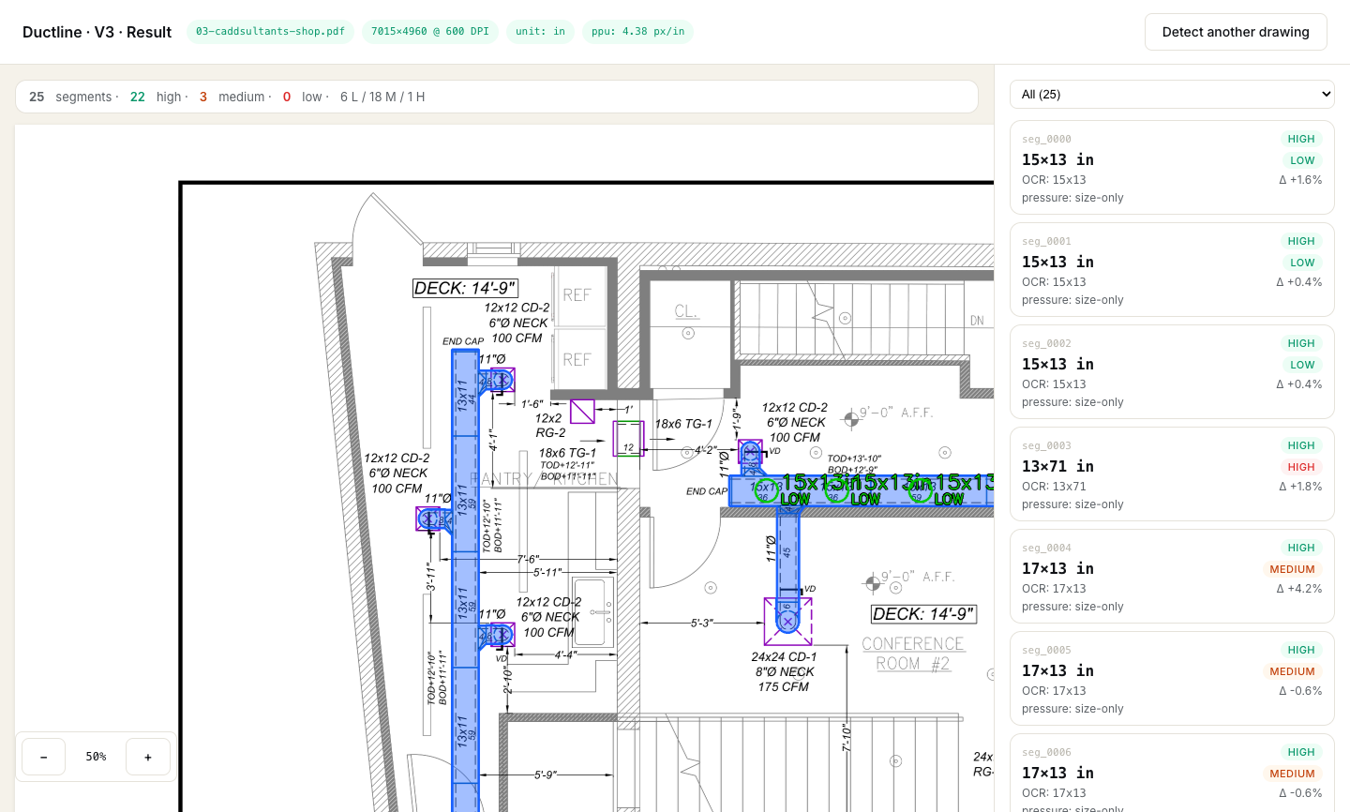
Ductline · Drawing in. Structured duct data out.
10 / 16
09 · V3 · WHAT THE USER SEES
Pick a color. Get a result. Click for the trace.
Reasoning surfaced in-line. Cursor magnifier · 140 px · 6× zoom. Per-segment cards: dim, pressure class, confidence.
LIVE INTERFACE
Color picker
User clicks a duct color in the legend or on the plan.
Overlay
Transparent PNG masks rendered over the page.
Segment cards
Dim · pressure class · confidence per duct.
Reasoning trace
Click any segment for attribution rule + ppu source.
Magnifier
140 px · 6× zoom on hover for pixel-level checks.

Slide 12
Ductline · Drawing in. Structured duct data out.
11 / 16
10 · DEFENDING THE PIVOTS
Why didn’t they just stay on V1?
Three load-bearing claims for future contributors.
01
02
03
V1 → V2 wasn’t enough.
V1 → V3 was correct.
V3 isn’t the final form.
V2 added the missing layers. Built end-to-end. Accuracy down. Latency up.
V3 removes the failure mode. The user names the color. Downstream is deterministic.
Doesn’t yet handle parallel-wall ducts. Requires manual color pick. Roadmap closes both.
Compounded an unreliable signal.
Trade: one click. Win: 3 / 5 today.
Custom model replaces the pick.

Slide 13
Ductline · Drawing in. Structured duct data out.
12 / 16
11 · PRODUCTION TIMELINE
Standards-based milestones.
Each milestone — handles drawings of standard X in Y months. Pace assumes V3’s shipping cadence.
V3 alpha · M0
Color-coded · 3 / 5
OCR-anchored Pattern A · M1–M2
Parallel-wall · 5 / 5 target
Schedules · M3–M4
Equipment + room
Multi-page · M5–M6
8 – 40 sheet sets
Auto-detect color · M7–M9
No manual pick
Confidence calibration · M10–M12
200–500 corpus
Custom model · YEAR 2
M0
M2
M4
M6
M8
M10
M12
Y2
CAVEATS
2–3 weeks build + 1 week iteration per milestone · one engineer FT on detection · part-time front-end + ops · customer-pilot drift can push by a multiple.

Slide 14
Ductline · Drawing in. Structured duct data out.
13 / 16
12 · PATH TO FULL AUTOMATION
Three improvement tracks.
Out-of-the-box VLMs already failed. Forward path is fine-tuning.
TRACK 01
M0 → M6
TRACK 02
YEAR 2
TRACK 03
YEAR 2 H2
V3 deterministic wins
Fine-tuned VLM, in parallel
Custom detection model
OCR-anchored Pattern A
Out-of-box Claude / GPT-4o failed
Faster R-CNN · FPN backbone
Pattern A auto-detection
Path A — fine-tune Claude / GPT-4o
1K–5K labeled drawings
Schedule + legend extraction
Path B — open-source LoRA
$30–80 / drawing labeled
Confidence calibration
Same eval, both paths
$5–10K compute · 3–4 mo
Multi-page topology
Migrate to OSS once it wins
Replaces the picker UX
1 engineer FT · 6 months
Shared corpus · ~$30–80K · 6–9 mo
Data-bound · 9–12 months

Slide 15
Ductline · Drawing in. Structured duct data out.
14 / 16
13 · TRACK 02 · FINE-TUNED VLM
Two fine-tune paths. One shared corpus.
Out-of-the-box Claude · GPT-4o · llama3.2-vision all failed on engineering drawings.
PATH A · PROPRIETARY FINE-TUNE
PATH B · OPEN-SOURCE LORA
Fine-tune Claude or GPT-4o vision.
Open-source vision + LoRA on same data.
VENDOR APIS
Anthropic / OpenAI vision fine-tune programs
BASE
Llama 3.2 Vision · Qwen2-VL · DeepSeek-VL
WHY FIRST
Highest-capacity base · fastest to clear the bar
ADAPTER
LoRA · 4-bit quant on 24 GB GPU
TRIGGER
Customer can ship drawings off-prem
WHY PARALLEL
Same training data — funding both is incremental
COST
Per-token API · ≈ $0.05 – $0.15 / page
ON-PREM
Defence, gov, AEC firms that can’t ship to a vendor
Convergence — when the OSS fine-tune outperforms on the same eval, migrate to OSS only. Lower cost · on-prem · no lock-in.

Slide 16
Ductline · Drawing in. Structured duct data out.
15 / 16
14 · TRACK 03 · CUSTOM MODEL
Purpose-trained detector replaces the picker.
Pressure class, dim attribution, and SMACNA logic stay downstream of detection — unchanged.
Faster R-CNN
5K
$30–80
$5–10K
ARCHITECTURE
LABELED DRAWINGS
PER DRAWING
TRAINING COMPUTE
FPN backbone · calibrated
Customer-contributed
Technical labelers
5K corpus · A100 hours
WHAT IT REPLACES
RISKS TO WATCH
Just the user’s color-pick step.
Distribution shift on new customers.
Upload → segments. No picker. Pressure class, dim attribution, SMACNA — unchanged. V3 deterministic stays as fallback.
Confidence calibration in detectors.
V3 must stay green for fallback.

Slide 17
Ductline · Drawing in. Structured duct data out.
16 / 16
15 · WHAT MAKES THIS DEFENSIBLE
Three commitments behind the build.
01
02
03
Algorithmic-first.
Honest confidence.
Reasoning surfaced.
Deterministic where possible. The VLM is one config flip away — the pipeline isn’t built around it.
Calibration cross-validates extracted dims against measured pixels. We never claim ‘high’ for a value we didn’t OCR.
Every detection carries its trace — attribution rule, ppu source, pressure source. The user sees what the system saw.
Ductline.
Drawing in. Structured duct data out.
V3 ALPHA SHIPPING · M0–M6 CLOSES THE DETERMINISTIC GAPS · YEAR 2 CLOSES THE MODEL GAP.

Slide 18
Ductline · Drawing in. Structured duct data out.
17 / 17
CONTACT
AUTHOR
Thank you
Arjun Sarath
REPO
implementation/ · V1, V2, V3
V3 ALPHA SHIPPING · ROADMAP DEFINED.

