Slide 1

Web Scraping British Airways Reviews to Uncover Insights
Arjun Sekhon

Slide 2
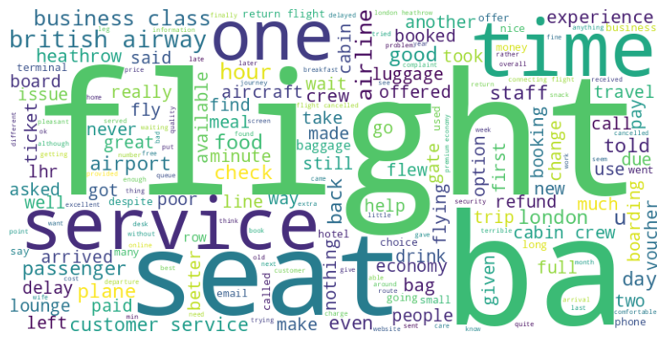
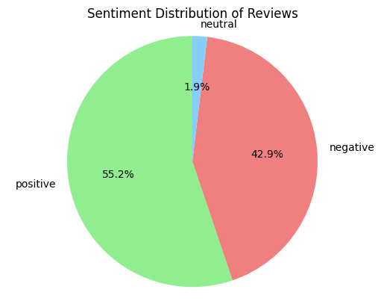
Key Insights
From 1000 Customer Reviews:
552 Positive Reviews: Focus on flight comfort and service
429 Negative Reviews: Frequently mention delays and customer service issues
19 Neutral Reviews

