Slide 1

Predictive Modelling of Customer Bookings
Arjun Sekhon

Slide 2
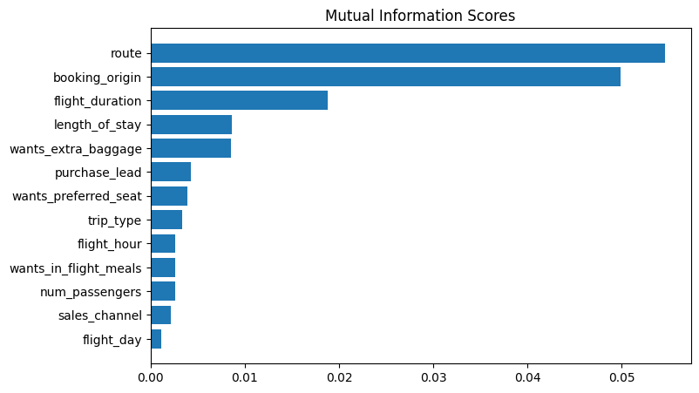
Predictive model to determine features that influence customer bookings
We trained the dataset with Random Forest Classifier and received:
ACCURACY: 85.37
AUC score: 0.568
Route
Booking Origin
Flight Duration
Wants Extra Baggage
Length of Stay
Number of Passengers
Are the 6 most important features that influence booking behaviour.

