Slide 1

BAGGING ~Random Forest
Presented by
Arjun Singh
Murali Krishna Mopidevi

Slide 2
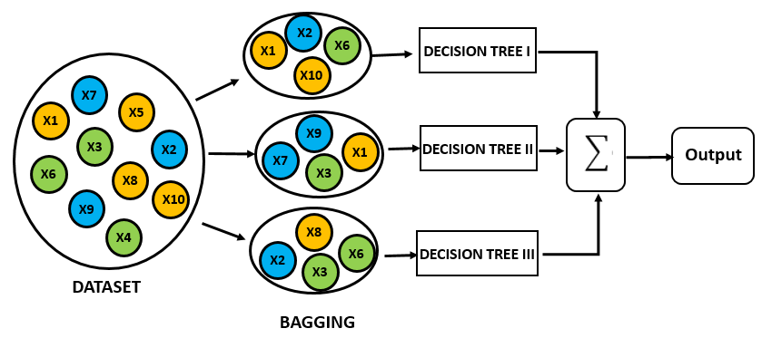
Bagging = Bootstrapping + Aggregation
Bootstrapping is a sampling technique in which we create subsets of observations from the original dataset, with replacement. The size of the subsets is the same as the size of the original set.
Bagging is an ensemble technique mainly used to reduce the variance of our predictions by combining the result of multiple classifiers modelled on different sub-samples of the same data set
Step1: Creating multiple datasets
Step2: Building multiple classifiers
Step3: Combining Classifiers

Slide 3
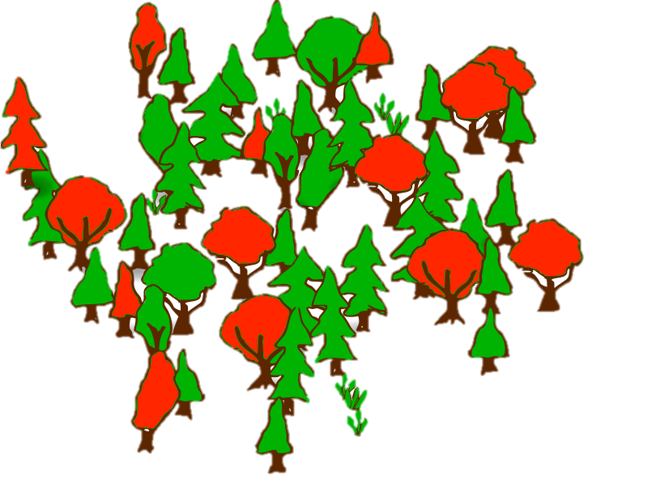
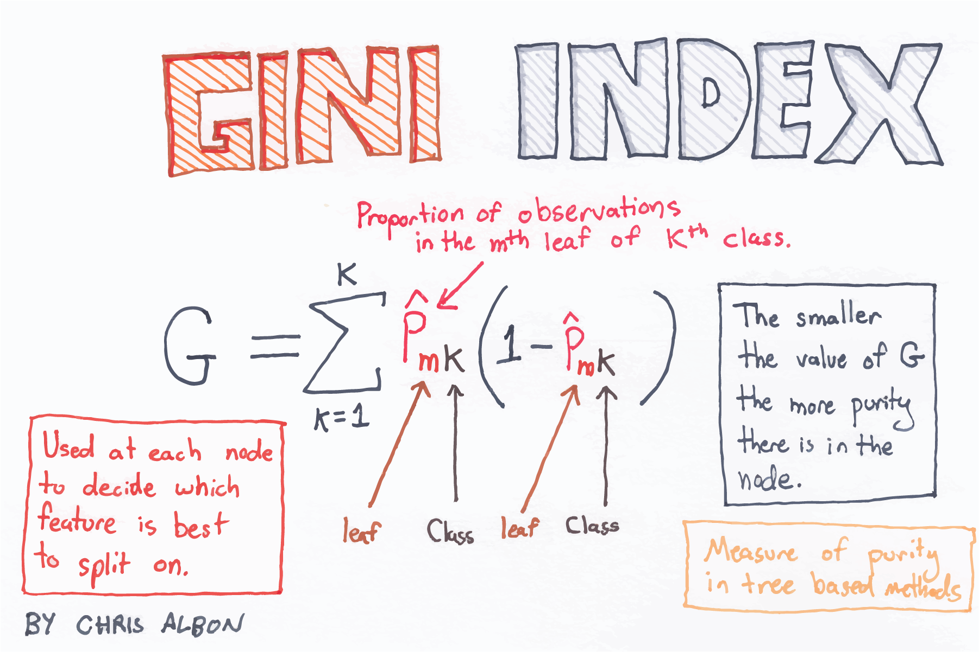
Random forest
Random Forest is an ensembling method and one of the most popular and powerful algorithm in Machine Learning.
The random forest is a model made up of many decision trees. Rather than just simply averaging the prediction of trees (which we could call a “forest”), this model uses two key concepts that gives it the name random:
Random sampling of training data points when building trees
Random subsets of features considered when splitting nodes
Gini Index to select the node

Slide 4
Advantages of Random Forest
Random Forest algorithm avoids overfitting
For both classification and regression task, the same random forest algorithm can be used
The Random Forest algorithm can be used for identifying the most important features from the training dataset. It helps in feature engineering.

Slide 5
Project(Census Dataset)
Description
48842 instances, mix of continuous and discrete
45222 if instances with unknown values are removed
Duplicate or conflicting instances : 6
Class probabilities for dataset.
Probability for the label '>50K' : 23.93% / 24.78% (without unknowns)
Probability for the label '<=50K' : 76.07% / 75.22% (without unknowns)
Attributes
age: continuous.
workclass: Private, Self-emp-not-inc, Self-emp-inc, Federal-gov, Local-gov, State-gov, Without-pay, Never-worked.
education: Bachelors, Some-college, 11th, HS-grad, Prof-school, Assoc-acdm, Assoc-voc, 9th, 7th-8th, 12th, Masters, 1st-4th, 10th, Doctorate, 5th-6th, Preschool.
marital-status: Married-civ-spouse, Divorced, Never-married, Separated, Widowed, Married-spouse-absent, Married-AF-spouse.
occupation: Tech-support, Craft-repair, Other-service, Sales, Exec-managerial, Prof-specialty, Handlers-cleaners, Machine-op-inspct, Adm-clerical, Farming-fishing, Transport-moving, Priv-house-serv, Protective-serv, Armed-Forces.
relationship: Wife, Own-child, Husband, Not-in-family, Other-relative, Unmarried.
race: White, Asian-Pac-Islander, Amer-Indian-Eskimo, Other, Black.
sex: Female, Male.
capital-gain: continuous.
capital-loss: continuous
hours-per-week: continuous.
native-country: United-States, Cambodia, England, Puerto-Rico, Canada, Germany, Outlying-US(Guam-USVI-etc), India, Japan, Greece, South, China, Cuba, Iran, Honduras, Philippines, Italy, Poland, Jamaica, Vietnam, Mexico, Portugal, Ireland, France, Dominican-Republic, Laos, Ecuador, Taiwan, Haiti, Columbia, Hungary, Guatemala, Nicaragua, Scotland, Thailand, Yugoslavia, El-Salvador, Trinadad&Tobago, Peru, Hong, Holand-Netherlands.

Slide 6
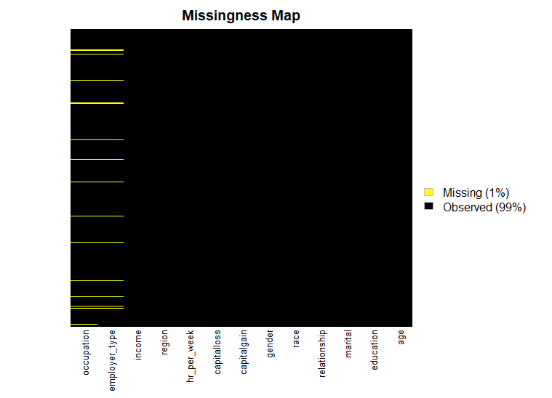
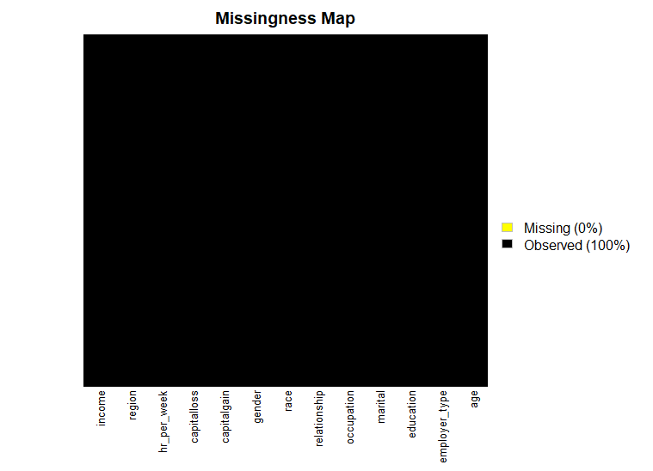
Data Cleaning
Cleaning the missing, NA values and changing the variable names for readability .
Before Cleaning
After Cleaning

Slide 7
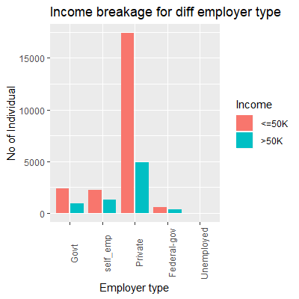
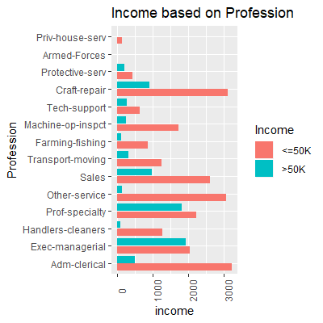
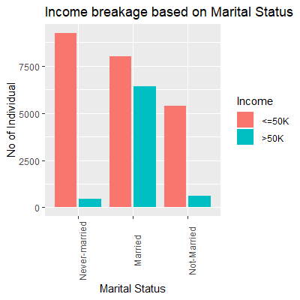
Data Visualization

Slide 8
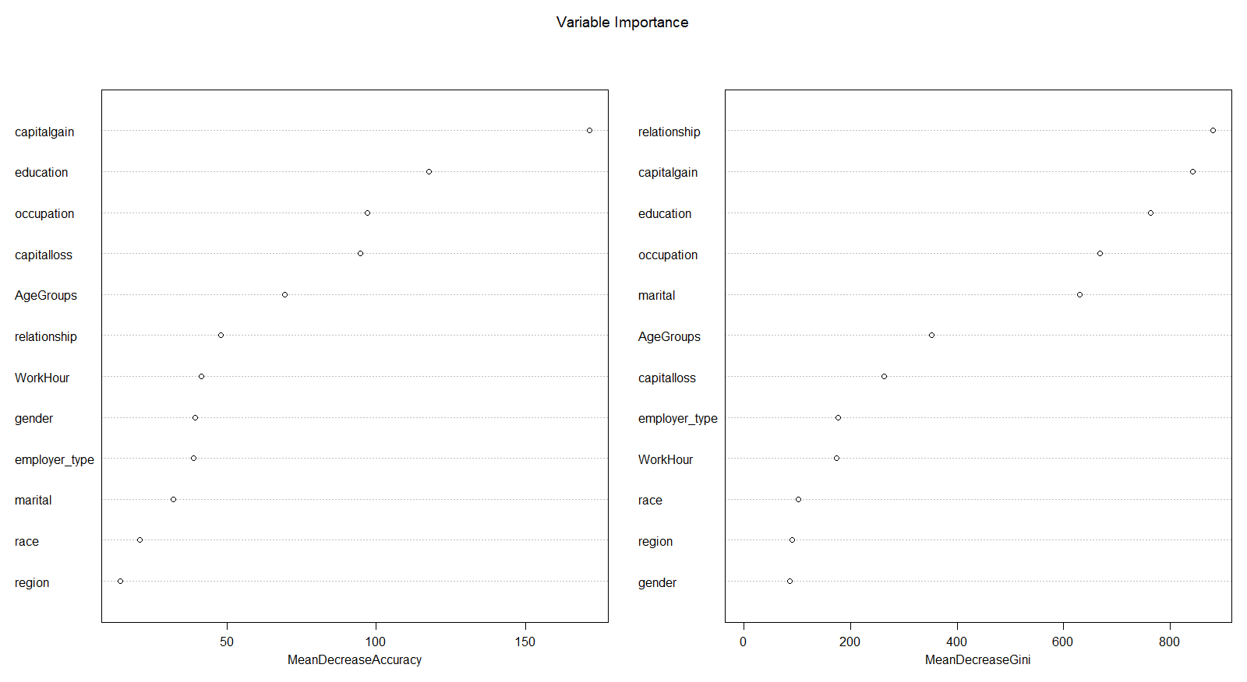
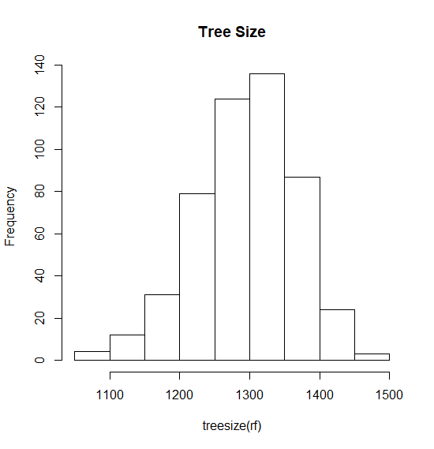
Model statistics
1 : education %in% c(' 10th',' 11th',' 12th',' 1st-4th',' 5th-6th',' 7th-8th',' 9th',' Assoc-acdm',' Assoc-voc',' Bachelors',' HS-grad',' Masters',' Preschool',' Some-college') & martialstatus %in% c('Never-married','Not-Married') & Occupation %in% c(' Adm-clerical',' Handlers-cleaners',' Other-service',' Sales',' Transport-moving',' Farming-fishing',' Machine-op-inspct',' Tech-support',' Craft-repair',' Armed-Forces',' Priv-house-serv') & relationship %in% c(' Not-in-family',' Other-relative',' Own-child',' Unmarried') & gender %in% c(' Female') & WorkHour %in% c('Full-time','Part-time') --> <=50K

Slide 9
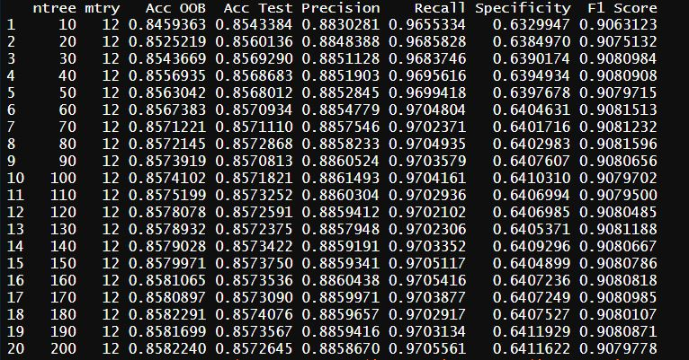
Model statistics
The Random Forest Algorithm
For ntrees 10,200 by of 10
{
for mtrys 1:7
{
for num in 1:20
{
setseed(num)
}
mean(accuracies of different setseed)
}
max(between all the 7 try’s
}
result

Slide 10
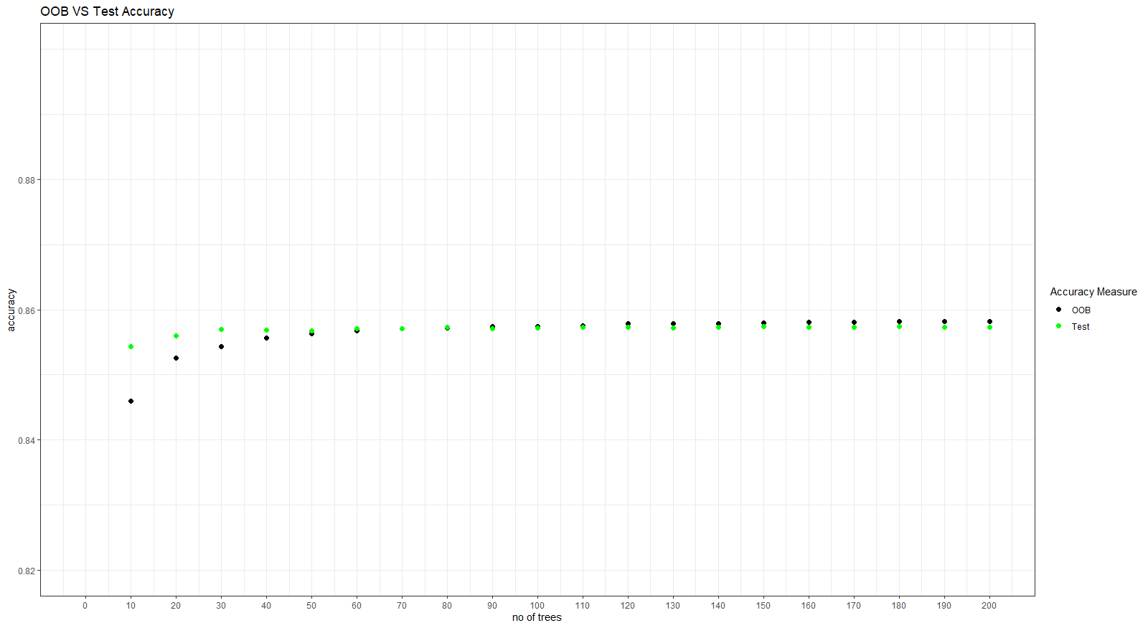
Accuracy Comaprison
OOB v/s Accuracy Test
The OOB and test accuracy start to converge when have high no of trees
Use of function tunerf() has revealed that for this algorithm we obtain best result for a particular tree size at 2 or 4 mtry(most of the time)
We have a good accuracy measure for the census dataset

Slide 11

THANK YOU!

