Slide 1
Optical Character Recognition
By: Sudhanshu S.
Arjun S.
Tejas B.

Slide 2
What Is OCR ?
Optical Character Recognition deals in recognition and classification of characters from an image.
For the accurate recognition, a character is classified and recognized based on calculated topological and geometrical properties.

Slide 3
PREPROCESSING
Image Acquisition
Binarization
Feature Extraction
Feature Comparison
Normalization
Character Recognition

Slide 4
Features
‘Character properties’.
Features are extracted from the image by means of spatial pixel-based calculation.
A collection of such features help in defining a character uniquely.

Slide 5
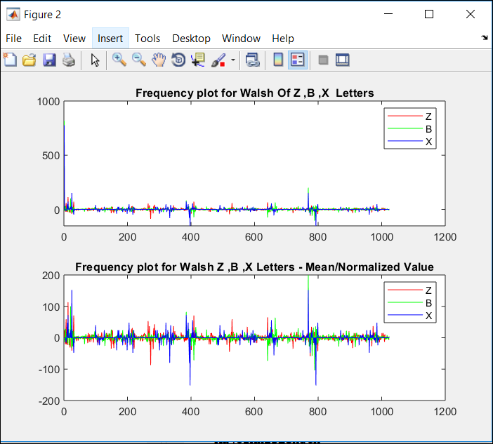
Walsh Comparison

Slide 6
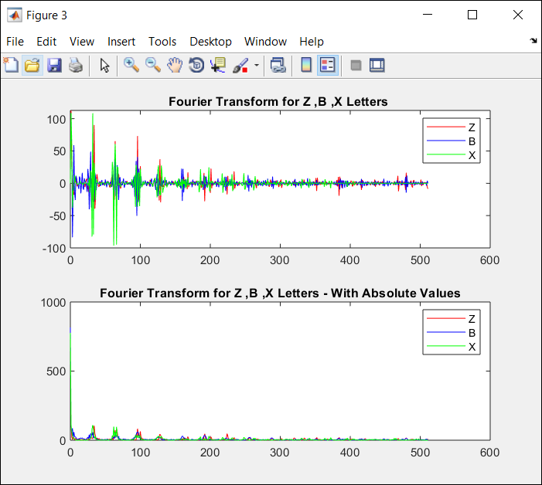
Fourier Comparison

Slide 7

Centroid

Slide 8
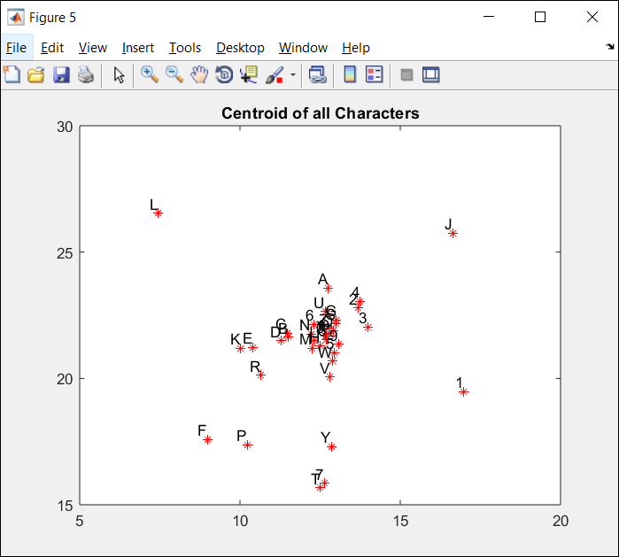
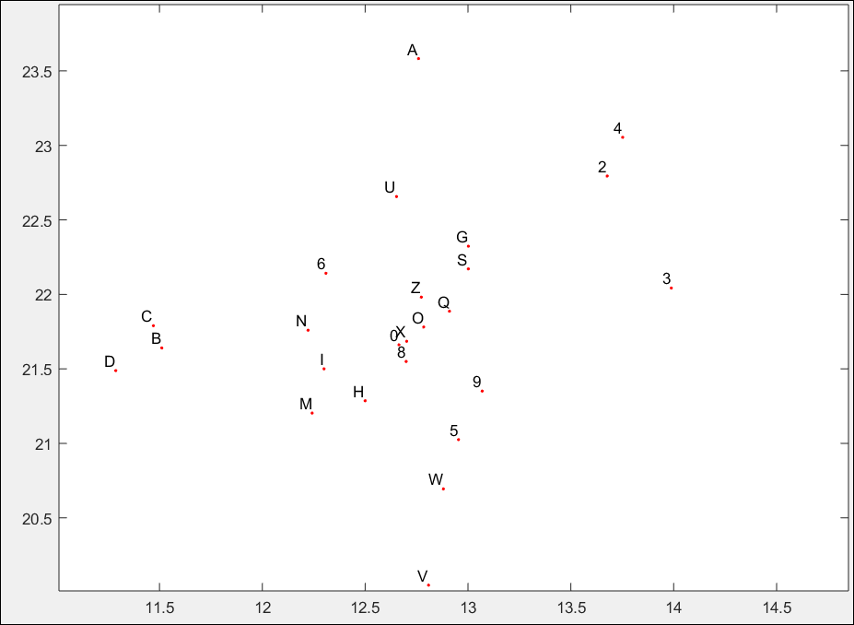
3.Centroid
. center of mass
.

Slide 9
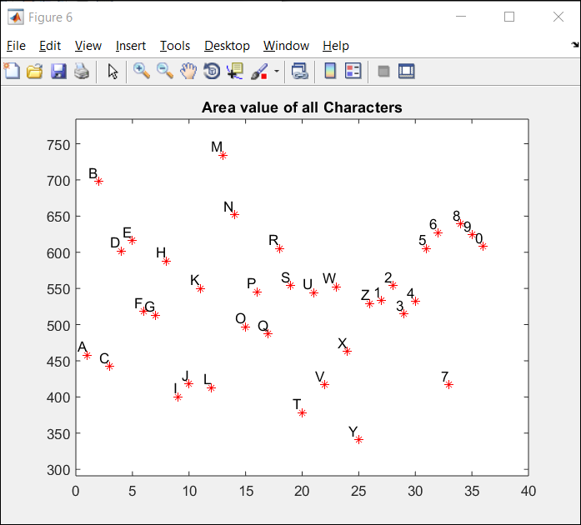
4. Area
Actual number of pixels in the region, returned as a scalar.

Slide 10
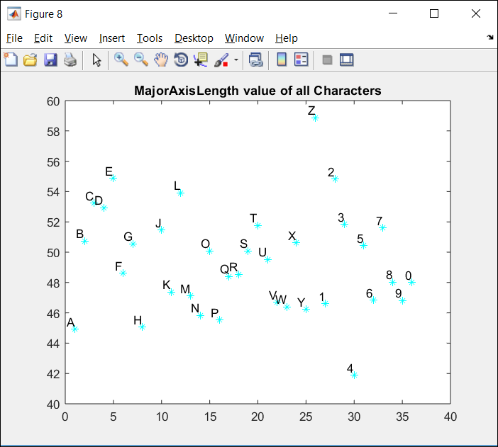
4. Major Axis Length
Length (in pixels) of the major axis of the ellipse that has the same normalized second central moments as the region, returned as a scalar.

Slide 11
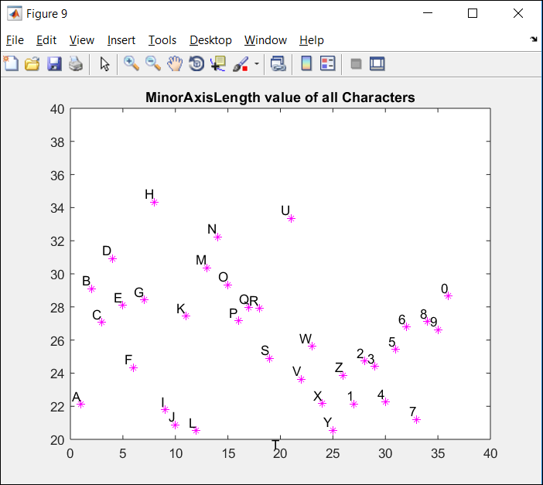
5. Minor Axis Length
Length (in pixels) of the minor axis of the ellipse that has the same normalized second central moments as the region, returned as a scalar.

Slide 12
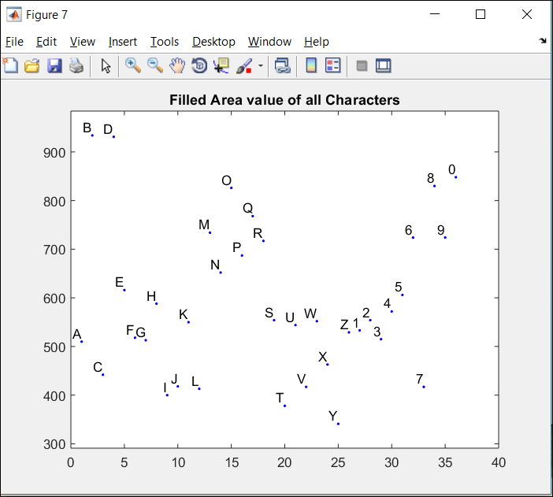
6. Filled Area
Number of on pixels in Filled Image, returned as a scalar.

Slide 13
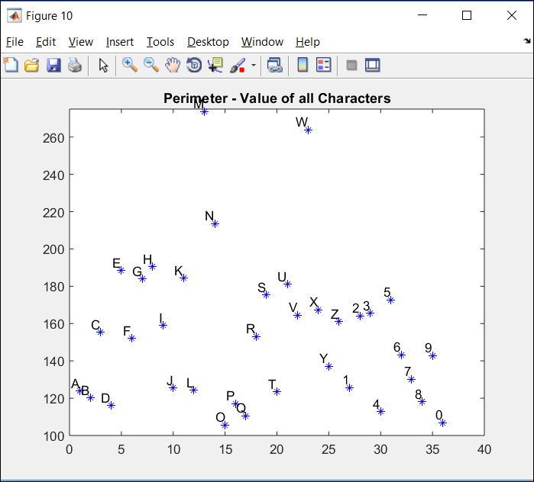
6. Perimeter
.Distance around the boundary of the region returned as a scalar.
. Computing perimeter by calculating the distance between each adjoining pair of pixels around the border of the region.

Slide 14
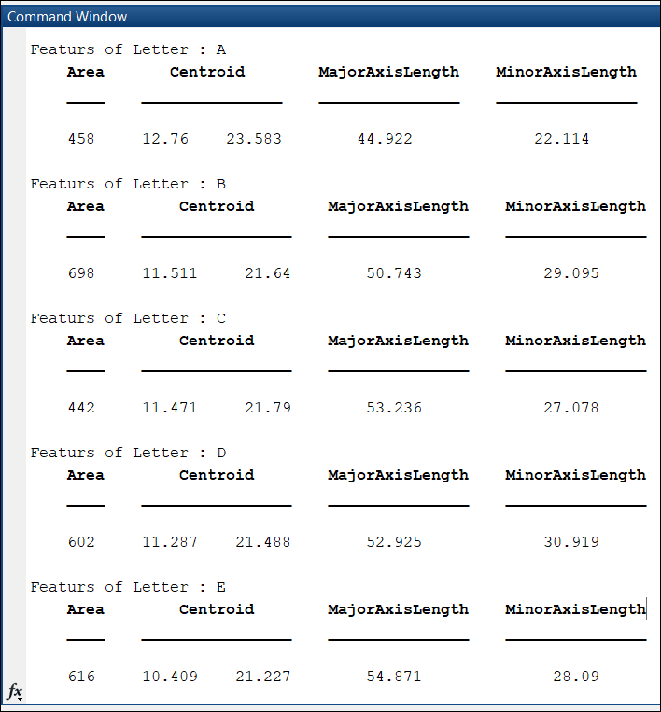
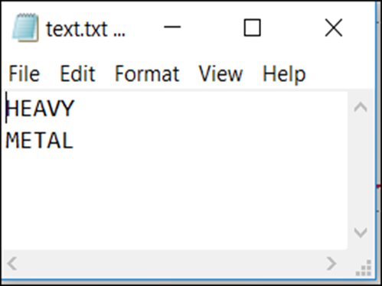

Slide 15
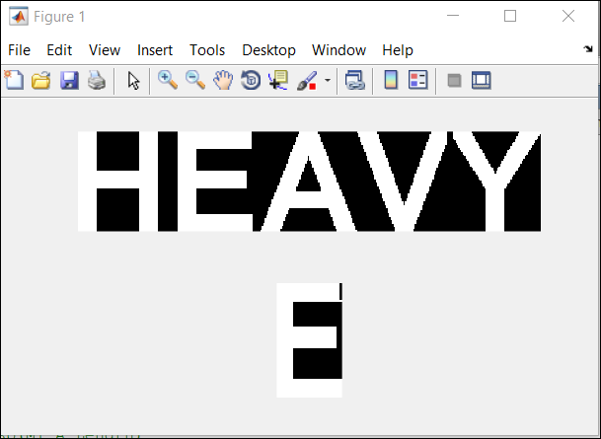
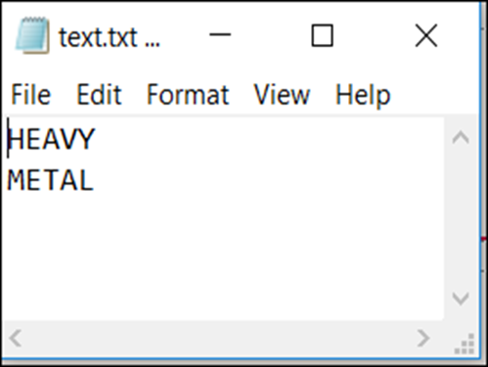
Output

