Slide 1
CREDIT RISK ANALYSIS
EDA CASE STUDY
:- PRESENTED BY
:- ARJUN SINGH BAGHEL

Slide 2
AGENDA
Applying EDA concepts in real business scenarios.
To develop basic understanding of “Risk Analytics” involved in “Banking”.
To build an understanding, how data is used to minimize the risk of losing while lending.

Slide 3
BUSINESS OBJECTIVES
To identify the patterns of “Client” with payment difficulties
To identify the trend of “Loan Default”.
To identify the driving factors leading to “Loan Default”

Slide 4
AIM OF CASE STUDY
This case study aims to make us understand how to apply concepts learnt in “Exploratory Data Analysis”( EDA) in a real business scenario.
To makes us familiar how datasets appears in “Banking Domain”.
To build a basic understanding of “Risk analytics” in “Banking & Financial Services”.
To understand how data is used to minimise the risk of losing money while lending to customers.

Slide 5
PROBLEM STATEMENT-I
If the applicant is likely to repay the loan, then not approving the loan results in a loss of business to the company
If the applicant is likely to repay the loan, then not approving the loan results in a loss of business to the company

Slide 6
PROBLEM STATEMENT-II
Present the overall approach of the analysis in a presentation. Mention the problem statement and the analysis approach briefly.
Identify the missing data and use appropriate method to deal with it. (Remove columns/or replace it with an appropriate value)
Identify if there are outliers in the dataset. Also, mention why do you think it is an outlier. Again, remember that for this exercise, it is not necessary to remove any data points.
Identify if there is data imbalance in the data. Find the ratio of data imbalance.
Explain the results of univariate, segmented univariate, bivariate analysis, etc. in business terms.
Find the top 10 correlation for the Client with payment difficulties and all other cases

Slide 7
What is Credit Risk Analysis?
In layman terms, Credit risk analysis is about identification of risks in situations where a potential for lending is observed by the Banks.
This helps to determine the entity’s debt servicing capacity, or its ability to repay.

Slide 8
APPROACH
Retrieve the Data
Separately study the each dataset
Glimpse of data
Check for missing data
Data Exploration:
Univariate Analysis
Bivariate Analysis
Segmentation & Correlation

Slide 9
APPROACH..
Conclusion
References

Slide 10
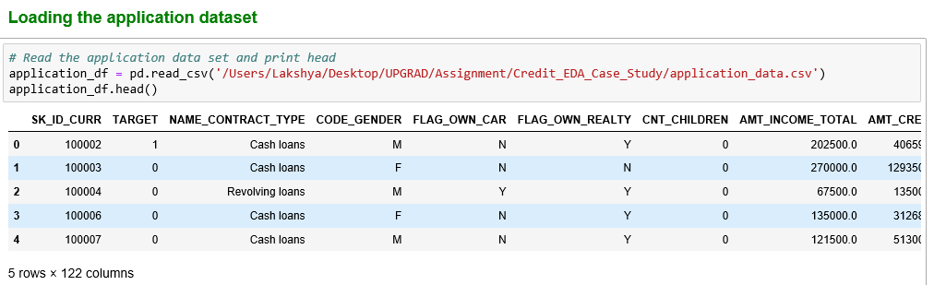
Retrieving Data:
Application Data:

Slide 11
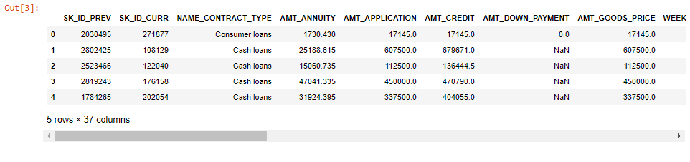
Retrieving Data:
Previous Application Data:

Slide 12
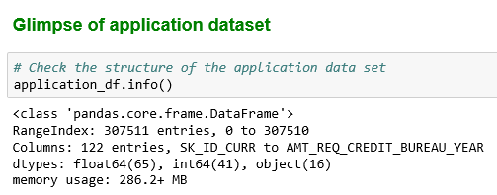
Glimpse of Data:
Application Data:

Slide 13
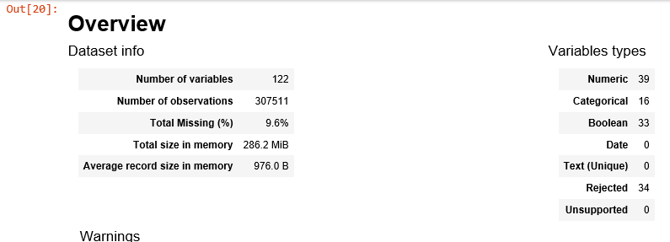
Glimpse of Data:
Application Data Profile:

Slide 14
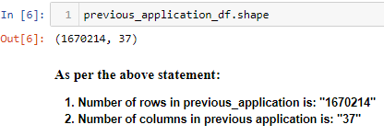
Glimpse of Data:
Previous Application Data:

Slide 15
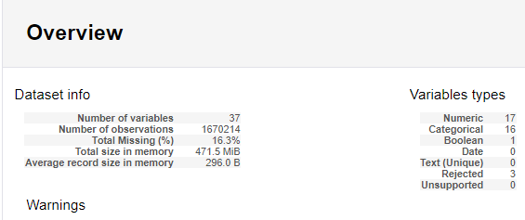
Glimpse of Data:
Previous Application Data:

Slide 16
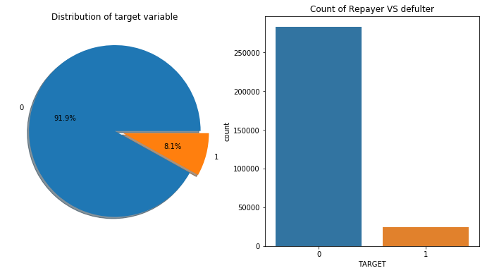
DATA IMBALANCE
Application Data:
Data imbalance ratio: 11.34%

Slide 17
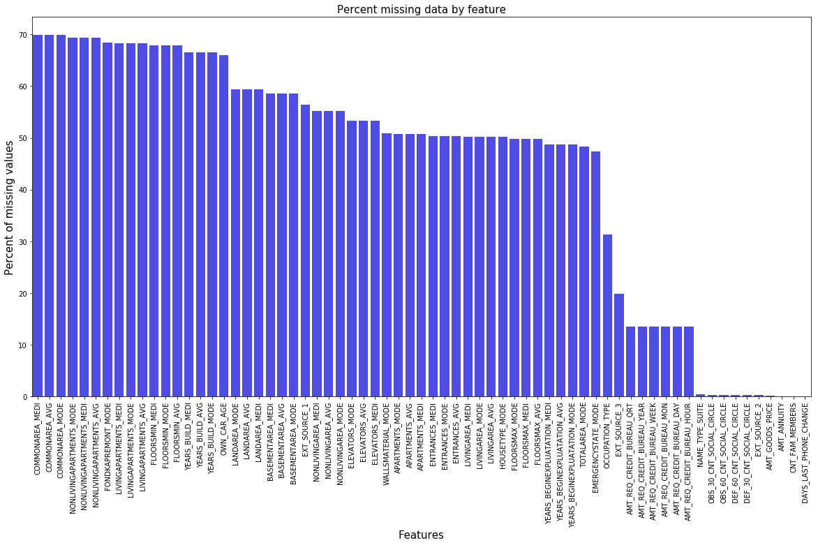
Missing Data:
Application data:

Slide 18
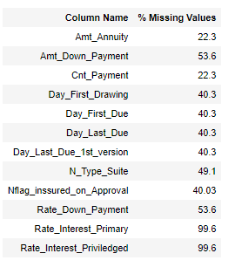
Missing Data:
Previous Application data:

Slide 19
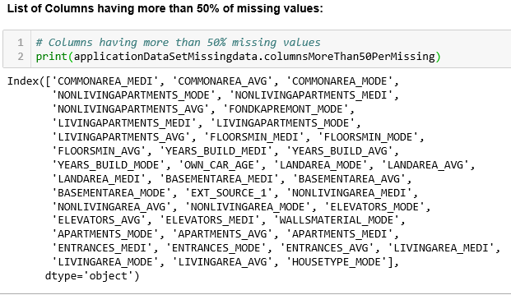
Missing Data : Treatment
Deleted the columns having more that 50% of missing data

Slide 20
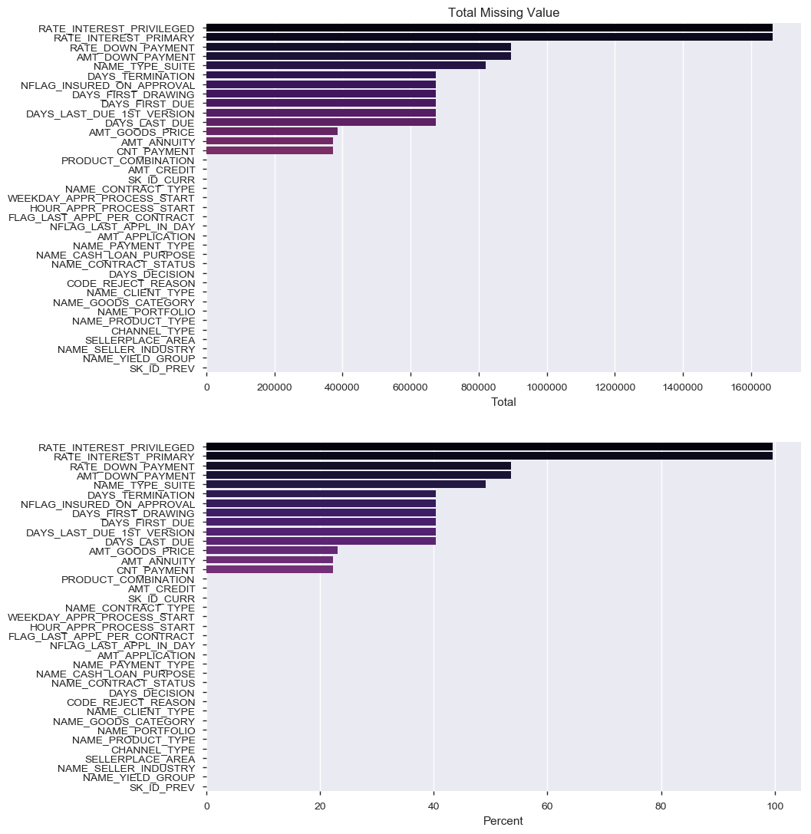
Missing Data:
Previous Application data:

Slide 21
Univariate Analysis
Considered random columns and performed analysis on
:- Categorical Columns
:- Numeric Columns
For both the dataset individually

Slide 22
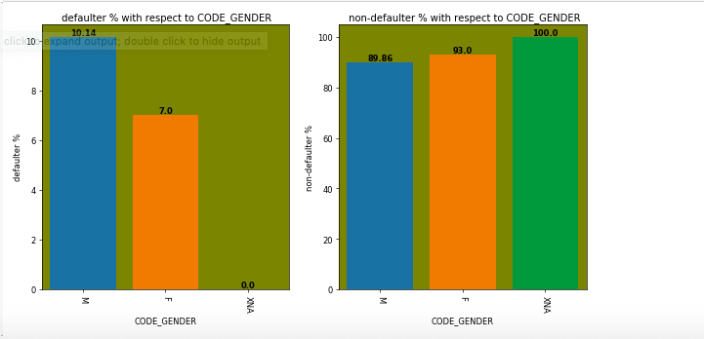
Univariate Analysis
CODE_GENDER ANALYSIS :

Slide 23
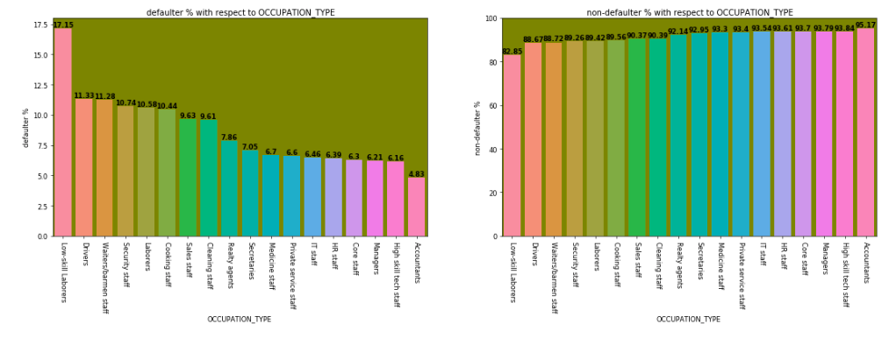
Univariate Analysis
Application Data: Occupation Type(Defaulter Vs Non Defaulter)

Slide 24
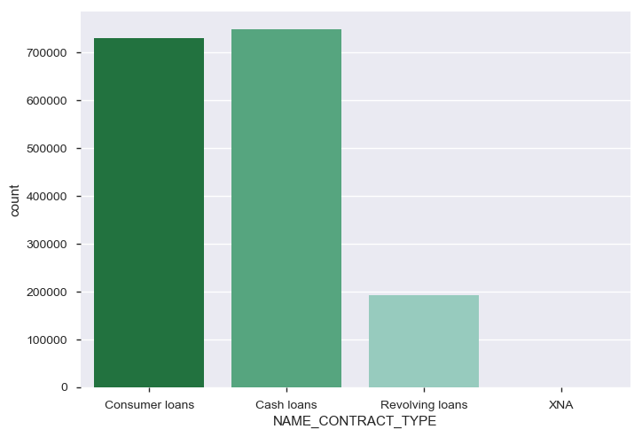
Univariate Analysis
Previous Application Data:
We have randomly chosen 10 variables to perform analysis.
Graphs are available in Python Note books

Slide 25
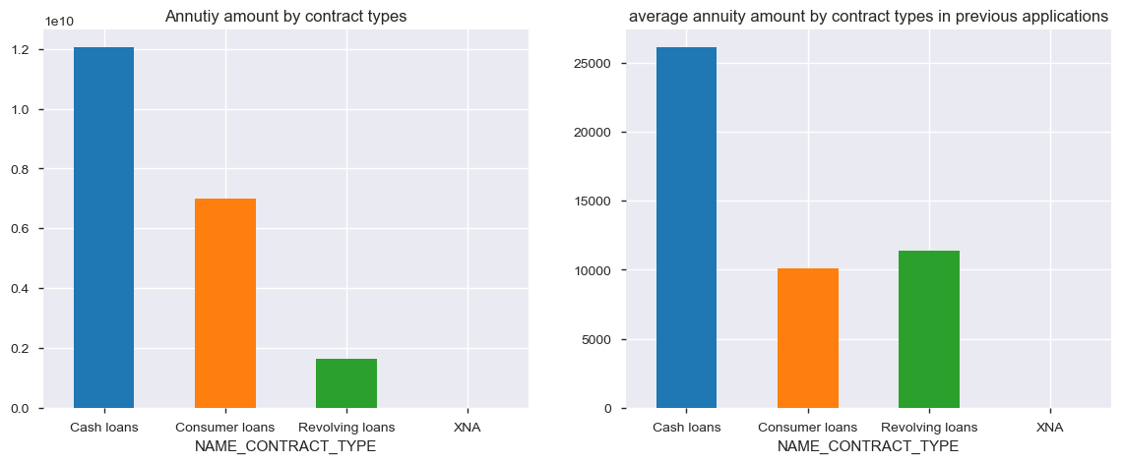
Bivariate & Multivariate Analysis
Considering Categorical and Numerical columns randomly tried to study the trends of different types of loans

Slide 26
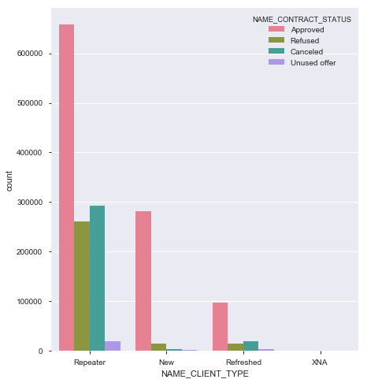
Bivariate & Multivariate Analysis
Previous Application

Slide 27
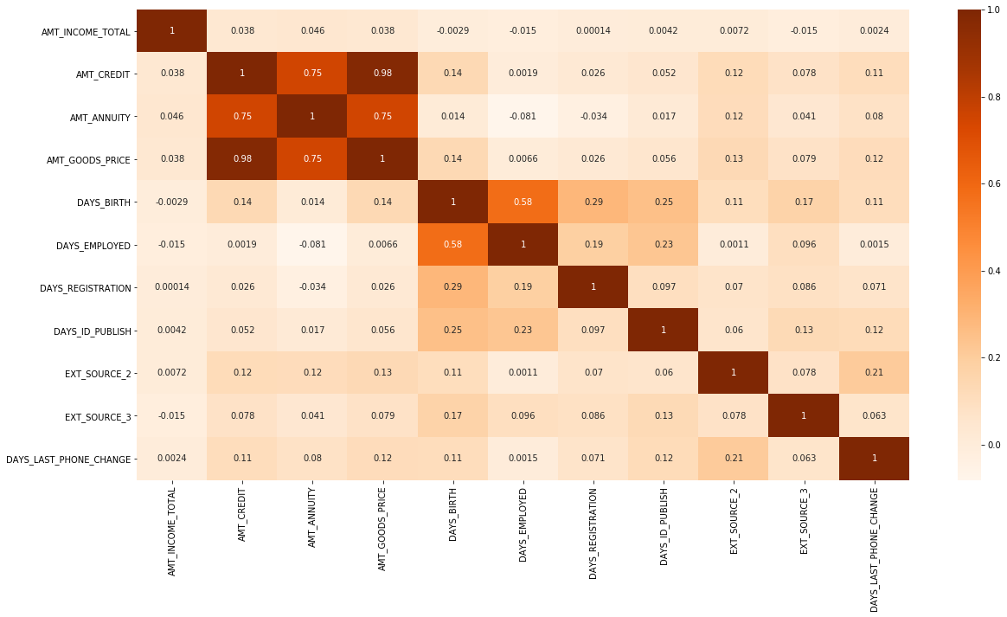
Correlation:
Application Data: Top Correlated variables:

Slide 28
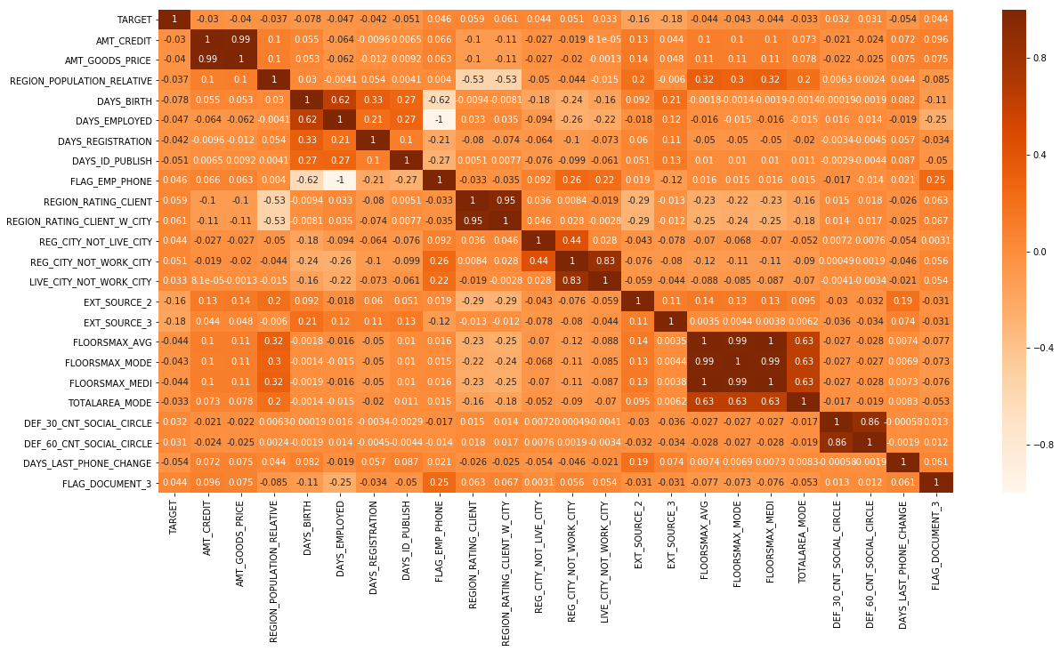
Correlation:
Application Data:

Slide 29
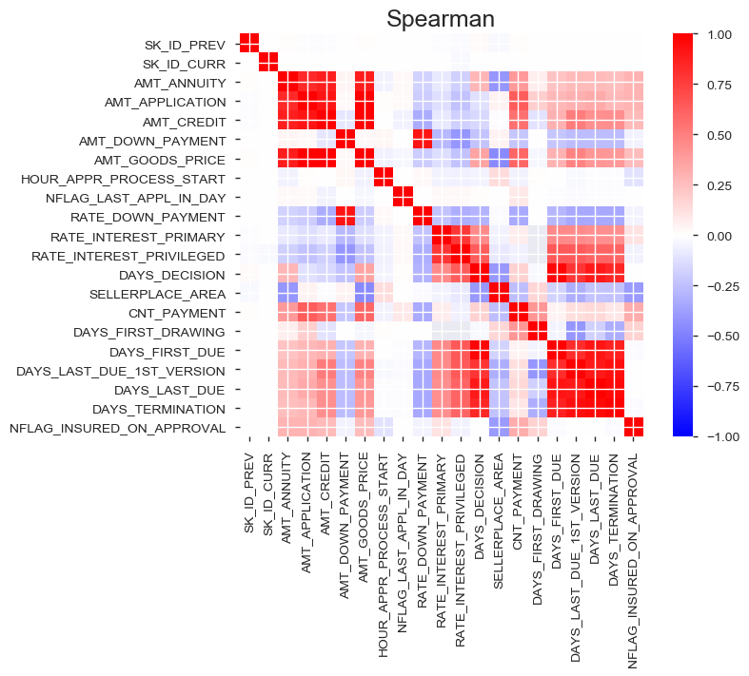

Slide 30
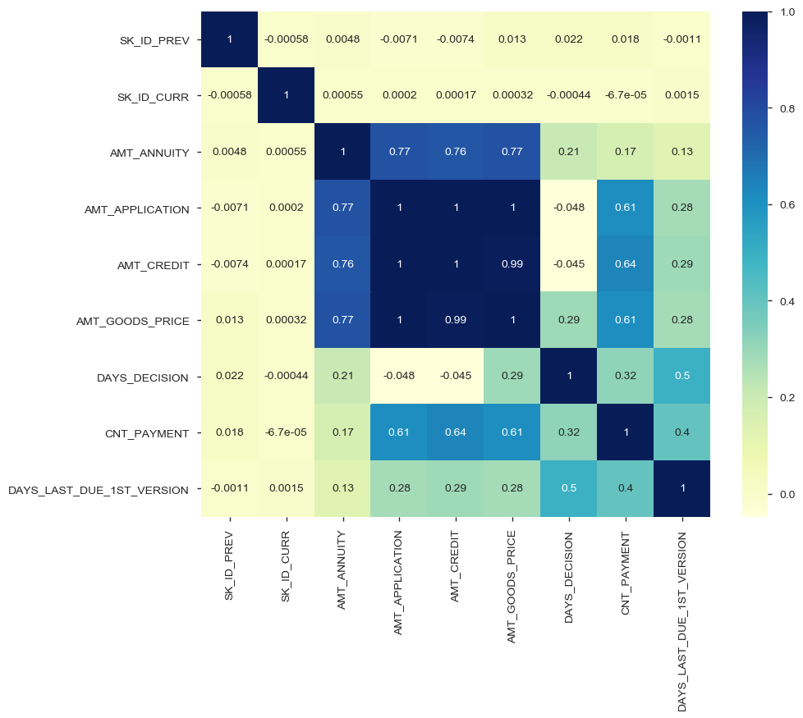
Correlation:
Previous Application data: Cash Loans

Slide 31
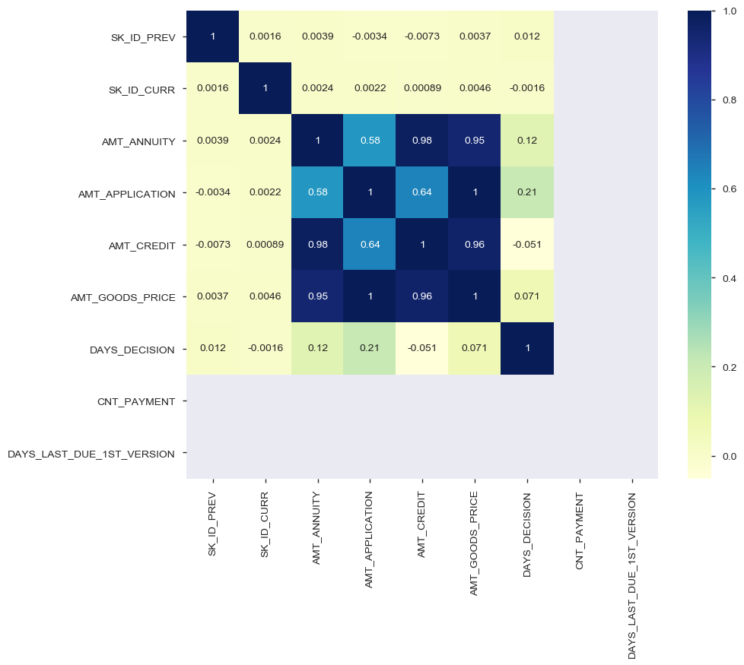
Correlation:
Previous Application Data: Revolving Loans

Slide 32
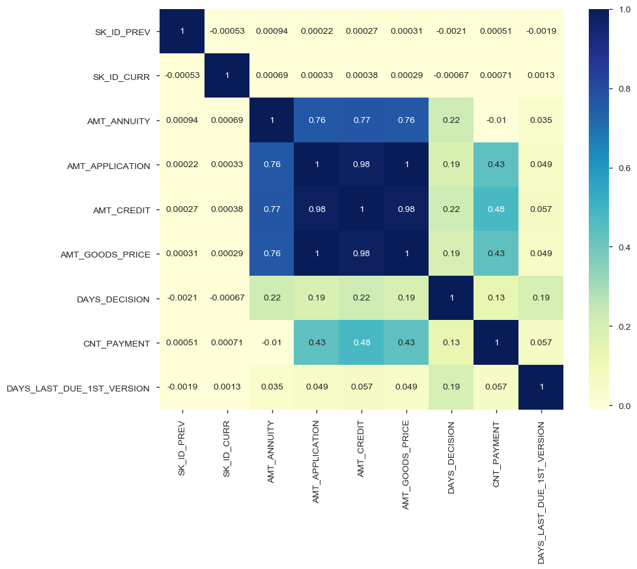
Correlation:
Previous Application Data: Consumer Loans

Slide 33
Conclusion:
Cash loans are tend to be defaulted as the datasets available
Driving Factors
Approved amount is higher than the requested amount
Longer tenured loan (Long duration of repayment)
Maternity of the client
Lower income and house type

Slide 34
Conclusion:
Loans being approved for Repeaters can involve risk
Major risk is involved with
Cash loans
Revolving loans

Slide 35
References
GitHub
Home Credit
Kaggle

