Slide 1

Drawing: A New
Way To Search
Doodle classification
Reproduction study and XGBoost extension
Recognizing objects in quick hand-drawn sketches
Arjun Srikanth / PES1UG24AM920
Nikhil Joshi / PES1UG24AM441
Notes:
**Arjun Srikanth (PES1UG24AM920)**
**Nikhil Joshi (PES1UG24AM441)**
- **Problem:** predict the object category represented by a quick hand-drawn sketch.
- **Reproduction:** reimplement the reference model families and compare their recorded results on 3, 10 and 50 classes.
- **Extension:** add XGBoost and compare boosted trees with the classical and neural models.
- **Reference:** Phu, Xiao and Muindi’s Stanford CS229 study. The project includes supplied source and historical experiments from supplied project materials.
- **Application:** drawing recognition could support visual search and communication. The implemented system returns a category label and model scores.
## Slide 1: Drawing: A New Way To Search
Reference study: Phu, Xiao and Muindi, *Drawing: A New Way To Search*, Stanford CS229, 2018. Source and historical experiment artifacts: supplied project materials. Credit supplied work separately from each presenter's own contribution.

Slide 2
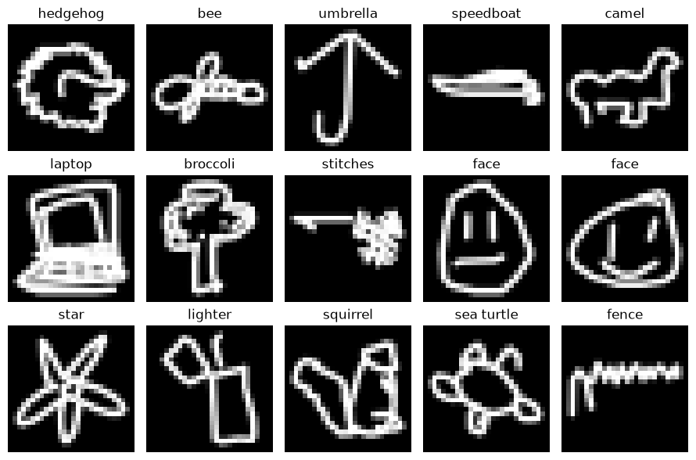
The QuickDraw dataset
28 × 28 grayscale images
784 pixel values per drawing
Raw pixel range: 0–255
20,000 drawings per class
The reference report’s stated dataset size
Classes | Selected drawings
3 | 60,000
10 | 200,000
50 | 1,000,000
Three-class vocabulary:
eraser, belt, banana
Notes:
- Google QuickDraw provides labeled doodles collected through a drawing game.
- We use the **NumPy bitmap format**: a **28 × 28 grayscale image**, represented by **784 pixel values** in the range **0–255**.
- We select the first **20,000 drawings per class**, following the reference report's stated dataset size.
- Experiments use three category sets to observe performance as the classification task grows.
| Class set | Selected drawings | Categories |
| --- | ---: | --- |
| 3 classes | 60,000 | Eraser, belt, banana |
| 10 classes | 200,000 | Laptop, rain, hockey stick, wristwatch, nose, pond, The Mona Lisa, banana, panda, paint can |
| 50 classes | 1,000,000 | A larger vocabulary that includes the 10-class categories and additional objects |
More competing categories create more opportunities for similar sketches to be confused. Uniform random guessing gives 33.3%, 10% and 2% accuracy for the three tasks.
SOURCE REFERENCES
## Slide 2: The QuickDraw dataset
Original slides: slide 1. Prep Guide: pages 2–3. Implementation: [data.py](/Users/arjun/Downloads/ML-MiniProject/src/data.py). Dataset: [Google QuickDraw](https://github.com/googlecreativelab/quickdraw-dataset).

Slide 3
Data split and evaluation
80% training 10% validation 10% test
Classes | Training | Validation | Test
3 | 48,000 | 6,000 | 6,000
10 | 160,000 | 20,000 | 20,000
50 | 800,000 | 100,000 | 100,000
Training learns parameters. Validation selects settings. Test evaluates selected configurations.
Fixed seed 42 and the same saved examples for each main class set.
We compare validation accuracy with the paper and label test results separately.
Notes:
Each class uses one fixed **80% training / 10% validation / 10% test** split with **random seed 42**.
| Classes | Training examples | Validation examples | Test examples |
| --- | ---: | ---: | ---: |
| 3 | 48,000 | 6,000 | 6,000 |
| 10 | 160,000 | 20,000 | 20,000 |
| 50 | 800,000 | 100,000 | 100,000 |
- **Training:** learns the model's parameters.
- **Validation:** compares settings and selects configurations.
- **Test:** evaluates selected configurations on held-out examples.
- Models for the same main class set reuse the same saved split. The separate 70k SVM investigation uses a larger dataset.
**Accuracy (%) = 100 × correct predictions / evaluated drawings**
We report validation accuracy for comparison with the paper and label test results separately. Selection uses validation, and the project evaluates separate stage finalists on test. We also record training time. A confusion matrix shows true categories in rows and predicted categories in columns.
SOURCE REFERENCES
## Slide 3: Data split and evaluation
Original slides: slides 1 and 3. Prep Guide: pages 3–4. Code: [data.py: `_split_class()`](/Users/arjun/Downloads/ML-MiniProject/src/data.py:76), [common.py: `Run`](/Users/arjun/Downloads/ML-MiniProject/src/common.py:81). Selection uses validation. The project evaluates separate stage finalists on test, so a project-wide “test used exactly once” claim would be inaccurate.

Slide 4
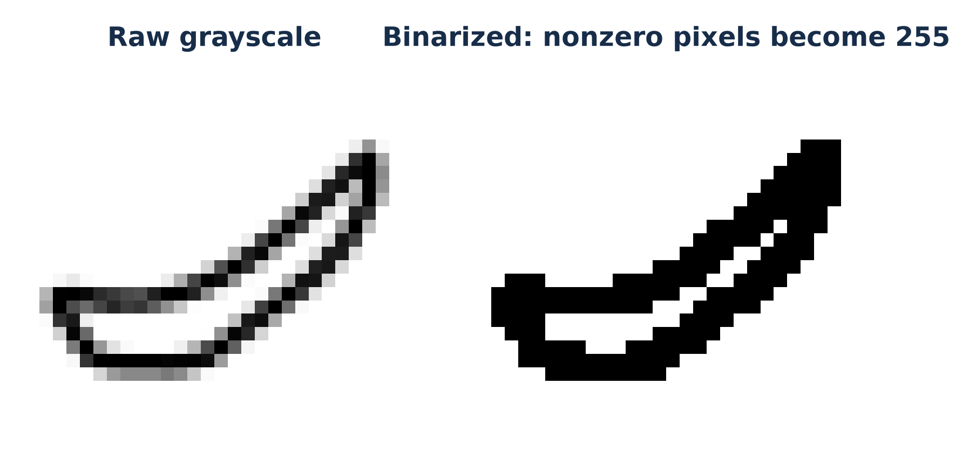
Input preparation by model
Family | Input transformation
Logistic regression | 784 raw pixels
SVM | Train-fitted scaling to [−1, +1]
CNN | 28 × 28 × 1, raw or binarized
Transfer learning | Resized image, three channels
XGBoost | 784 raw pixels
Binarization changes every nonzero pixel to 255.
The raw CNN experiments retain 0–255 values.
Notes:
The model families share the saved examples and labels, while their input transformations differ.
| Model family | Input representation | Preprocessing |
| --- | --- | --- |
| Logistic regression | A flat vector of 784 pixels | Raw pixel values in 0–255 |
| SVM | A flat vector of 784 pixels | MinMax scaling to −1 to +1, fitted on training data |
| CNN | A 28 × 28 × 1 image | Raw grayscale or binarized input |
| Transfer learning | A resized image with three channels | Resize for the selected pretrained network and repeat grayscale across channels |
| XGBoost | A flat vector of 784 pixels | Raw pixel values in 0–255 |
- **Binarization:** any nonzero pixel becomes 255, removing grayscale stroke intensity.
- **CNN input:** the raw-input experiments retain 0–255 values to follow the reference setup.
- **Transfer input sizes:** 224 × 224 for VGG19, MobileNet and ResNet50, and 299 × 299 for InceptionV3.
SOURCE REFERENCES
## Slide 4: Preprocessing for each model
Original slides: slides 2–3. Prep Guide: pages 4–8. Code: [data.py: `load()`](/Users/arjun/Downloads/ML-MiniProject/src/data.py:113), [data.py: `resized_batches()`](/Users/arjun/Downloads/ML-MiniProject/src/data.py:138), [train_transfer.py](/Users/arjun/Downloads/ML-MiniProject/src/train_transfer.py).

Slide 5
Implementation and code structure
Component | Location | Purpose
Data preparation | src/data.py | Fixed split and model-specific inputs
Model training | src/train_*.py | Definitions, fitting and evaluation
Experiment recorder | src/common.py | Settings, timing, scores and matrices
Training walkthrough | pipeline.ipynb | Main end-to-end workflow
Working demo | demo.ipynb | Small live fit and saved-model inference
Drawing interface | src/live_demo.py | Processed input and model predictions
46 recorded runs, with results and evidence preserved under results/.
Notes:
**Experiment workflow:** load the saved split, prepare the model's input, fit the model, evaluate it, and save the results and available checkpoints.
| Component | File or location | Role |
| --- | --- | --- |
| Dataset preparation | `src/data.py` | Download categories, create fixed splits and load transformed inputs |
| Model training | `src/train_lr.py`, `train_svm.py`, `train_cnn.py`, `train_transfer.py`, `train_xgboost.py` | Define and fit each model family |
| Shared experiment recording | `src/common.py` | Record settings, seeds, versions, timing, accuracy and confusion matrices |
| Training walkthrough | `demonstration/pipeline.ipynb` | Explain the main end-to-end training workflow |
| Working demonstration | `demonstration/demo.ipynb` | Train a small baseline and run inference with saved models |
| Drawing interface | `src/live_demo.py` | Prepare a drawing and compare model predictions |
| Experiment evidence | `results/` | CSV/JSON records, learning curves, confusion matrices and saved models |
The project ledger contains **46 recorded runs**, including the additional SVM data-size checks and XGBoost follow-ups. The pipeline notebook explains the main methods. Additional historical follow-ups remain separate recorded experiments.
SOURCE REFERENCES
## Slide 5: Implementation and code structure
Prep Guide: pages 7–10 and 19. Source root: [src/](/Users/arjun/Downloads/ML-MiniProject/src). Ledger: [all_results.csv](/Users/arjun/Downloads/ML-MiniProject/results/all_results.csv). Historical training used the supplied RTX 4070 laptop environment. The assembled Mac demo uses CPU inference.

Slide 6
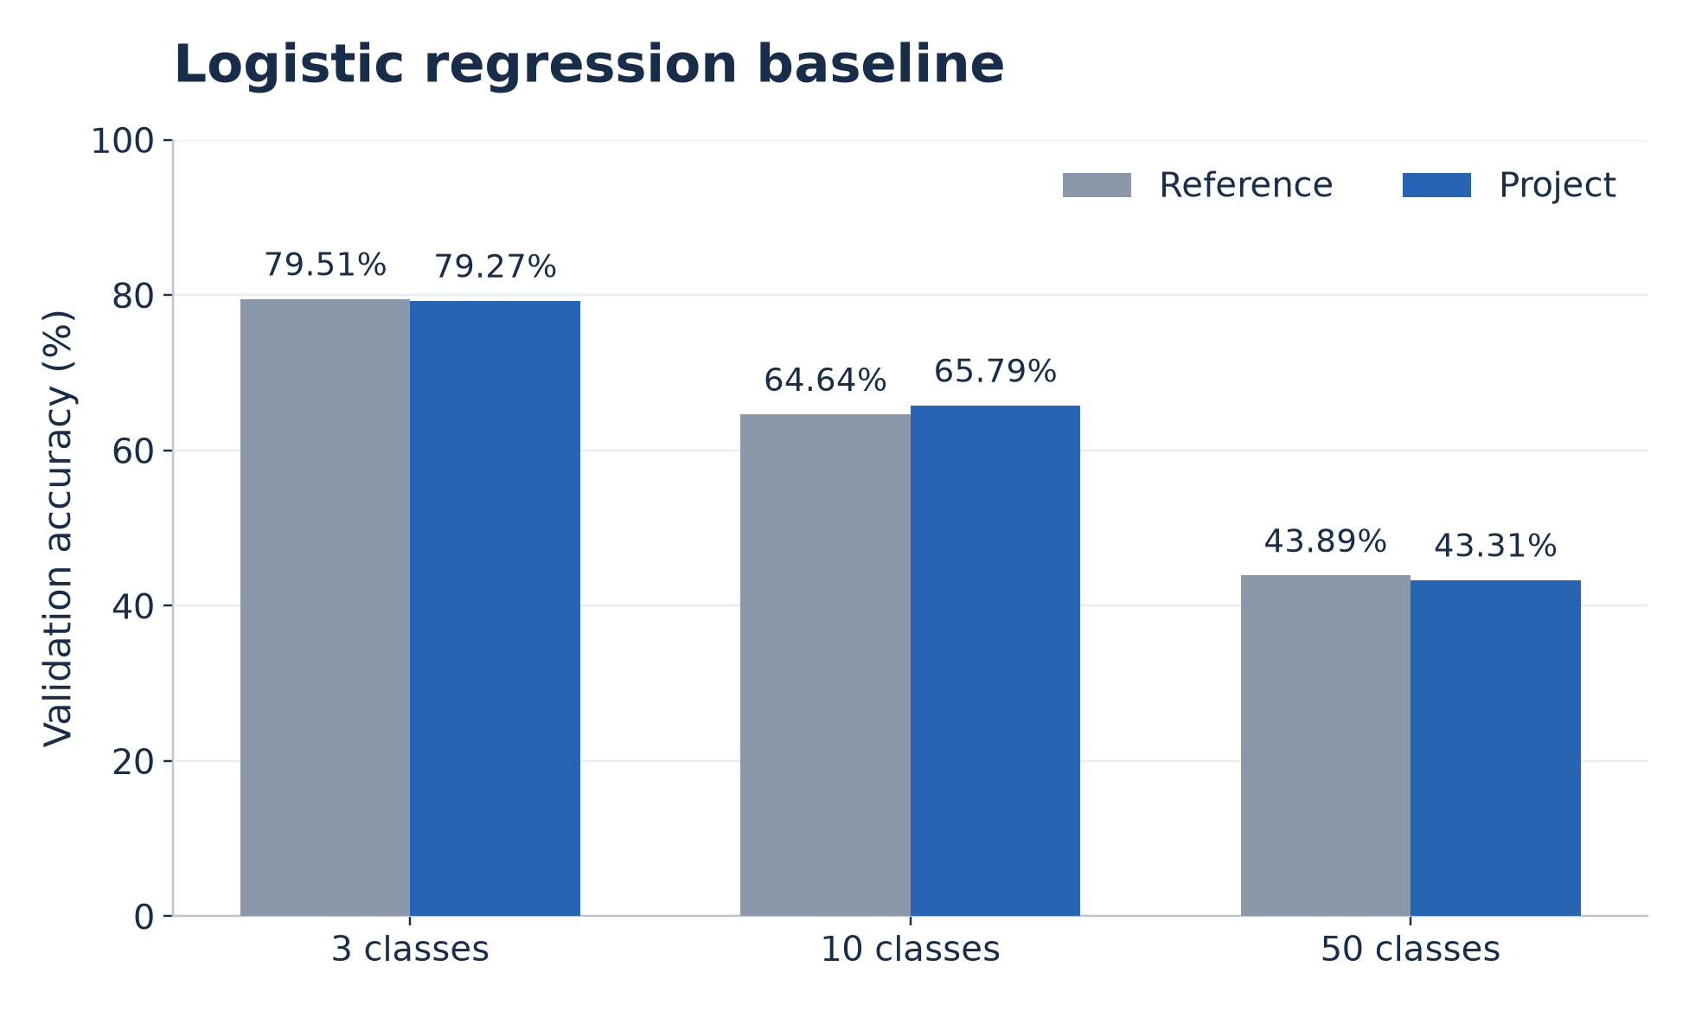
Logistic regression baseline
Linear classifier
Learns a weight for each pixel and category.
Reference settings
L-BFGS solver
100-iteration limit
Raw pixel input
Close to the reference. Accuracy falls as the category set grows.
Notes:
- Logistic regression provides a fast baseline on the **784 raw pixels**.
- For each category, it learns pixel weights and a bias. A weighted sum produces a class score, and softmax converts the scores into class probabilities.
- Its decision boundaries are linear, which limits the image patterns it can represent.
- Settings follow the reference: **L-BFGS solver**, **100-iteration limit**, and raw pixel inputs.
| Classes | Reference validation accuracy | Project validation accuracy | Historical fit time |
| --- | ---: | ---: | ---: |
| 3 | 79.51% | 79.27% | 19.92 s |
| 10 | 64.64% | 65.79% | 20.02 s |
| 50 | 43.89% | 43.31% | 85.98 s |
**Finding:** the results are close to the reference, while accuracy falls as the number of categories grows. The 100-iteration cap can leave optimization short of convergence.
SOURCE REFERENCES
## Slide 6: Logistic regression baseline
Original slides: slides 2 and 4. Prep Guide: page 4. Code: [train_lr.py: `main()`](/Users/arjun/Downloads/ML-MiniProject/src/train_lr.py:15). Exact values: `results/reported.csv` and `results/runs/LR_logreg_*_raw_s0.json`.

Slide 7
Support vector machines
Maximum-margin classification with scaled pixel inputs
Kernel | Key setting | 3 classes | 10 classes
Linear | Linear boundary | 43.28% | 23.35%
RBF | gamma = 1 | 84.00% | 74.62%
Polynomial | degree = 5, coef0 = 1 | 66.73% | 73.88%
Sigmoid | coef0 = 1 | 32.47% | 13.44%
C = 1 and max_iter = 500 for all four kernels.
RBF leads these capped configurations. The iteration limit can leave optimization incomplete.
Notes:
- An SVM learns a decision boundary that separates categories with a wide margin.
- Kernels allow nonlinear boundaries without explicitly constructing every transformed feature.
- Experiments use pixels scaled to **−1 to +1**, **C = 1**, and a **500-iteration cap**.
- We run the four reference kernels on **3 and 10 classes**.
| Kernel | Key setting | Validation accuracy, 3 classes | Validation accuracy, 10 classes |
| --- | --- | ---: | ---: |
| Linear | Linear kernel | 43.28% | 23.35% |
| RBF | Gamma = 1 | 84.00% | 74.62% |
| Polynomial | Degree = 5, coef0 = 1 | 66.73% | 73.88% |
| Sigmoid | Coef0 = 1 | 32.47% | 13.44% |
**Finding:** RBF performs best among these capped SVM configurations. The iteration limit affects how the results should be interpreted. These runs do not represent fully optimized SVM performance.
SOURCE REFERENCES
## Slide 7: Support vector machines
Original slides: slide 2. Prep Guide: pages 4–5. Code: [train_svm.py](/Users/arjun/Downloads/ML-MiniProject/src/train_svm.py). Values use the stored run-record rounding. The RBF 10-class matrix gives 74.625%, stored as 74.62%.

Slide 8
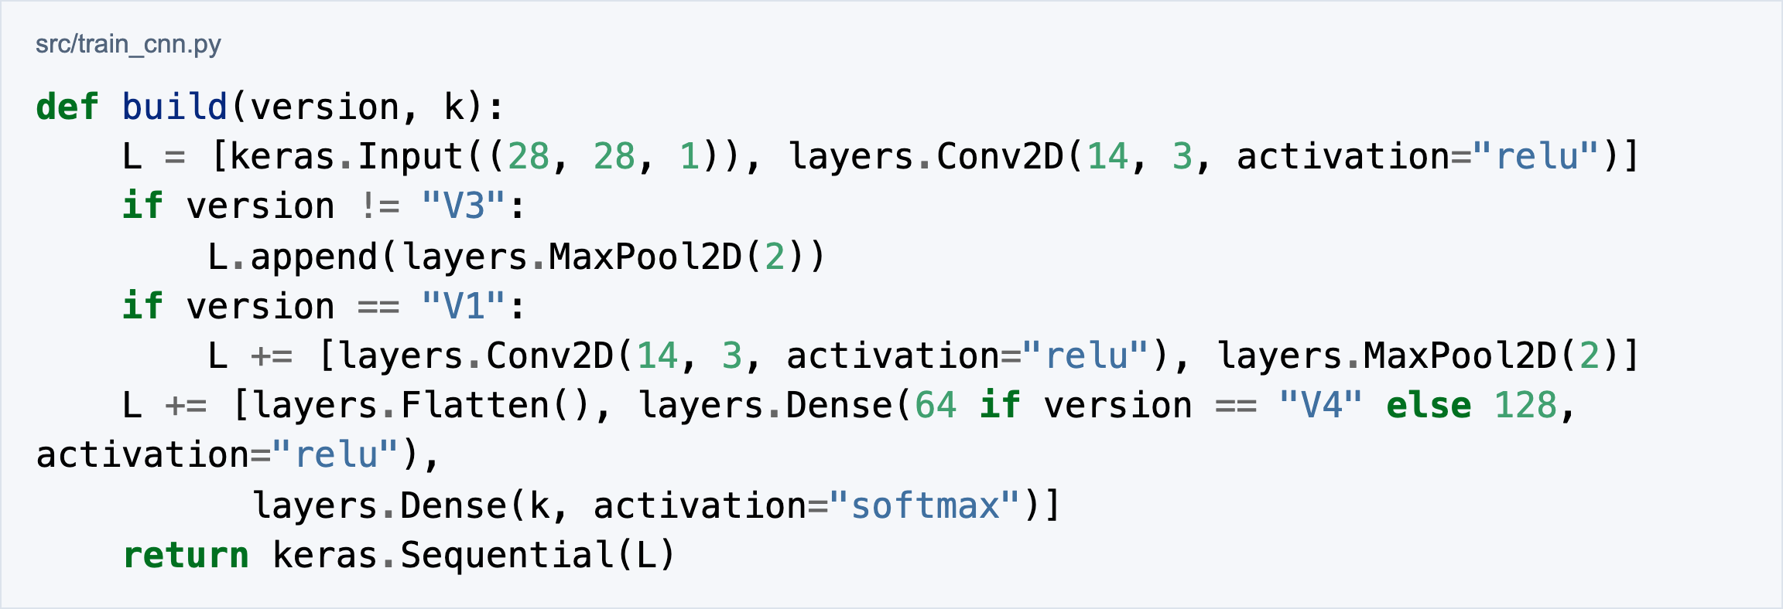
CNN architecture and variants
V1 uses two convolution/pooling blocks, Dense(128), and a class softmax.
Adam / batch 500 / 100 epochs / 18 raw and binarized configurations
50-class CNN V1: 81.21% validation and 81.071% test accuracy
Notes:
CNNs learn local stroke and shape patterns. The same convolution filter operates across different positions in the image, allowing the model to reuse learned detectors.
**CNN V1 architecture**
| Stage | Configuration | Output shape |
| --- | --- | --- |
| Input | Grayscale drawing | 28 × 28 × 1 |
| Convolution 1 | 14 filters, 3 × 3, ReLU | 26 × 26 × 14 |
| Max pooling 1 | 2 × 2 | 13 × 13 × 14 |
| Convolution 2 | 14 filters, 3 × 3, ReLU | 11 × 11 × 14 |
| Max pooling 2 | 2 × 2 | 5 × 5 × 14 |
| Classification | Flatten, Dense(128), ReLU, softmax output | One score per class |
**Variants:** V2 removes V1's second convolution/pooling block. V3 removes pooling from V2. V4 uses 64 dense units instead of V2's 128.
**Training:** Adam, learning rate 0.001, batch size 500, 100 epochs, and sparse categorical cross-entropy. Eighteen configurations cover the reference's raw/binarized variants and class sets.
**50-class CNN V1 raw result:** **81.21% validation** and **81.071% test**.
SOURCE REFERENCES
## Slide 8: CNN architecture and variants
Original slides: slide 2. Prep Guide: pages 5–6. Code: [train_cnn.py: `build()`](/Users/arjun/Downloads/ML-MiniProject/src/train_cnn.py:24), [train_cnn.py: `train()`](/Users/arjun/Downloads/ML-MiniProject/src/train_cnn.py:48). Test score: cached predictions in `analysis/error_analysis/20261022T113920Z/cnn_predictions.npz`.

Slide 9
Transfer learning
Reuse ImageNet features and train a new three-class classifier.
Pretrained network | Reference validation | Project validation
VGG19 | 95.58% | 95.35%
MobileNet | 75.40% | 94.58%
ResNet50 | 62.72% | 95.35%
InceptionV3 | 45.72% | 93.05%
Frozen feature extraction + Dense(128) + three-class softmax.
InceptionV3 also fine-tunes upper layers.
Caching avoids repeated feature extraction. It does not establish identical historical execution.
Notes:
Transfer learning reuses features from an ImageNet-pretrained network and learns a new classifier for the **three-class doodle task**.
1. Resize the grayscale image and repeat it across three channels.
2. Use the pretrained network as a frozen feature extractor.
3. Train a new head with global average pooling, Dense(128), and a three-class softmax.
4. For InceptionV3, also fine-tune upper network layers.
| Pretrained network | Reference validation accuracy | Project validation accuracy |
| --- | ---: | ---: |
| VGG19 | 95.58% | 95.35% |
| MobileNet | 75.40% | 94.58% |
| ResNet50 | 62.72% | 95.35% |
| InceptionV3 | 45.72% | 93.05% |
**Finding:** VGG19 is close to the reference. The other networks show large differences that require investigation.
The implementation caches frozen features to avoid recomputing them every epoch. The selected transfer-learning timings include feature extraction and head training. Numerical equivalence with the original software stack is not established.
SOURCE REFERENCES
## Slide 9: Transfer learning
Original slides: slides 2, 4 and 5. Prep Guide: pages 6–7 and 12–13. Code: [train_transfer.py: `extract()`](/Users/arjun/Downloads/ML-MiniProject/src/train_transfer.py:36), [train_transfer.py: `train()`](/Users/arjun/Downloads/ML-MiniProject/src/train_transfer.py:107). Results: `results/runs/TL_*_3_resized_s7.json`.

Slide 10
Reproduction results and discrepancies
Validation accuracy, compared with the final reference report
Experiment | Reference | Project | Assessment
LR, 50 classes | 43.89% | 43.31% | Close agreement
CNN V1 raw, 50 | 81.79% | 81.21% | Close agreement
VGG19, 3 | 95.58% | 95.35% | Close agreement
RBF SVM, 3 | 62.68% | 84.00% | Large difference
CNN V2 raw, 50 | 81.83% | 75.13% | Large difference
InceptionV3, 3 | 45.72% | 93.05% | Large difference
CNN V3 binarized remains unresolved: −2.48 points at 10 classes and −5.16 at 50.
Notes:
All scores below are **validation accuracy**. The comparison follows the final reference report, with documented implementation choices for the modern software environment.
| Experiment | Reference | Project | Interpretation |
| --- | ---: | ---: | --- |
| Logistic regression, 50 classes | 43.89% | 43.31% | Close numerical agreement |
| CNN V1 raw, 50 classes | 81.79% | 81.21% | Close numerical agreement |
| VGG19, 3 classes | 95.58% | 95.35% | Close numerical agreement |
| RBF SVM, 3 classes | 62.68% | 84.00% | Large improvement under the main 20k protocol |
| CNN V2 raw, 50 classes | 81.83% | 75.13% | Substantial difference |
| InceptionV3, 3 classes | 45.72% | 93.05% | Substantial difference |
- The released source and historical logs provide evidence for data-size and model-selection issues.
- Framework behavior is a possible contributor to the transfer-learning differences.
- CNN V3 binarized remains unresolved: **84.12% versus 86.60%** at 10 classes, and **65.14% versus 70.30%** at 50 classes.
**Conclusion:** this is a documented reproduction study. Similar scores support agreement on those measurements, while the remaining differences require bounded explanations.
SOURCE REFERENCES
## Slide 10: Reproduction results and discrepancies
Original slides: slide 4. Prep Guide: pages 10–13. Exact reference values: `results/reported.csv`. Project values: `results/all_results.csv`. Interpretation: [claim audit](/Users/arjun/Downloads/ML-MiniProject/analysis/claim_audit_20261026/CLAIM_AUDIT.md).

Slide 11
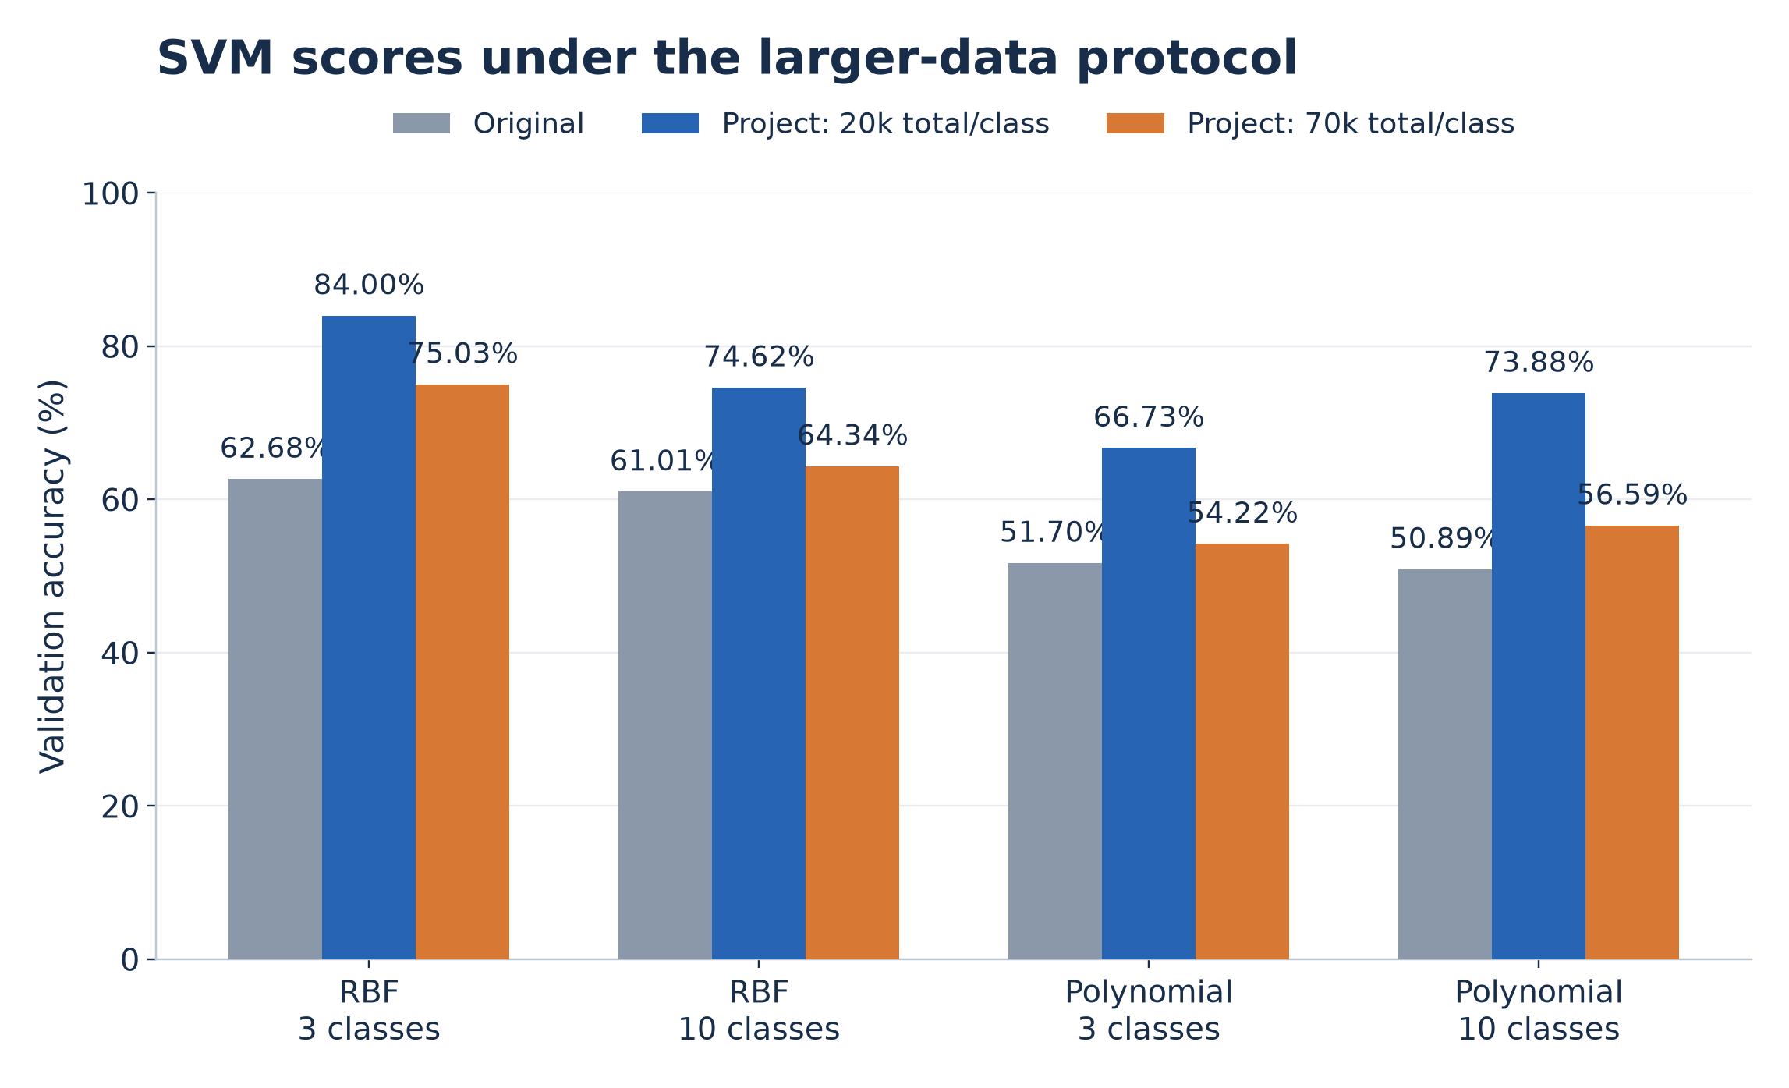
The 70,000-drawing SVM investigation
Historical evidence
7,000 validation drawings per class in all eight original SVM matrices.
Code history
An earlier loader selects 70,000 per class before a later reduction to 20,000.
70k total per class = 56k training + 7k validation + 7k test
The scores support data-size/iteration-budget effects. The remaining gaps are not fully explained.
Notes:
**Historical evidence:** all eight original SVM confusion matrices contain **7,000 validation drawings per class**. The authors' earlier loader explicitly selected **70,000 drawings per class**, before a later commit reduced the limit to 20,000.
Our diagnostic experiment keeps the kernel settings and **max_iter = 500**, while increasing the selected examples per class.
| Protocol | Training per class | Validation per class | Test per class |
| --- | ---: | ---: | ---: |
| Main 20k dataset | 16,000 | 2,000 | 2,000 |
| Diagnostic 70k dataset | 56,000 | 7,000 | 7,000 |
| Model | Original validation | Project at 20k | Project at 70k |
| --- | ---: | ---: | ---: |
| RBF, 3 classes | 62.68% | 84.00% | 75.03% |
| RBF, 10 classes | 61.01% | 74.62% | 64.34% |
| Polynomial, 3 classes | 51.70% | 66.73% | 54.22% |
| Polynomial, 10 classes | 50.89% | 73.88% | 56.59% |
**Finding:** larger-data scores move toward the original results. This supports a data-size/iteration-budget explanation, but does not explain the full gap. Changing dataset size also changes example membership, so these runs do not isolate solver convergence alone.
SOURCE REFERENCES
## Slide 11: The 70,000-drawing SVM investigation
Original slides: slide 5. Prep Guide: page 11. Code: [train_svm.py: `main()`](/Users/arjun/Downloads/ML-MiniProject/src/train_svm.py:23). Local evidence: `data/processed/qd70k_{3,10}.npz`, `results/runs/svm70k_*.json`, and saved confusion matrices. Primary sources: [historical 70k loader](https://github.com/jervisfm/cs229-project/blob/42e490e6ae4012f1a69558f487fb0fcbab1ef438/massageData.py), [change to 20k](https://github.com/jervisfm/cs229-project/commit/cfe4189a2bb11bc8db7a7e80d77bda81df38ecec).

Slide 12
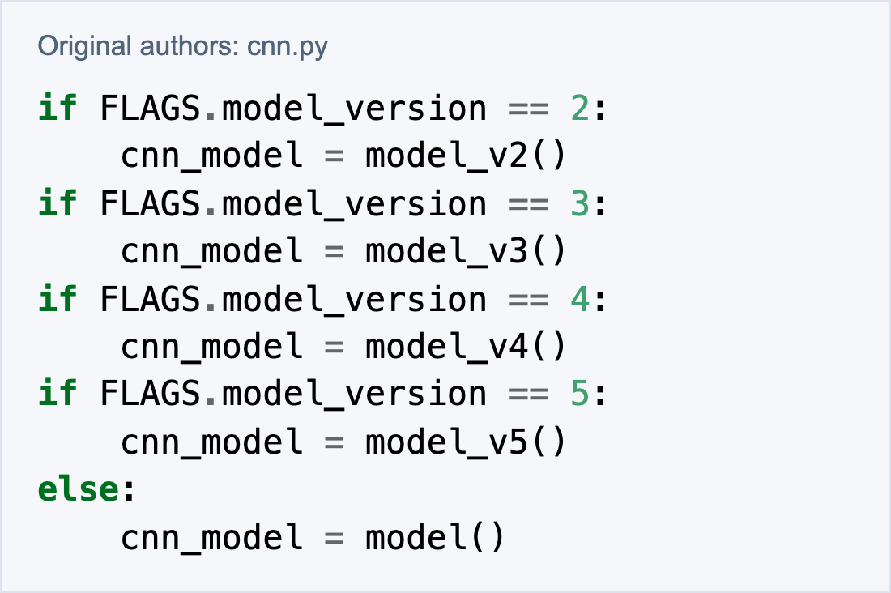
CNN source bug and BatchNorm hypothesis
Verified source behavior
Plausible framework explanation
VGG19 has no BatchNorm and closely matches the reference.
The three BatchNorm networks differ much more.
Modern Keras runs frozen BatchNorm in inference mode.
The final else overwrites versions 2–4 with V1.
The exact revision behind every published run remains uncertain.
No controlled replay established BatchNorm as the cause of the historical gap.
Notes:
**CNN version selection: verified source bug**
- The original code uses separate `if` statements to select versions 2–5.
- An `else` attached only to the version-5 check overwrites versions 2, 3 and 4 with V1.
- Executing that selection logic confirms the overwrite behavior.
- This could explain the V2 discrepancy. The exact source revision used for every published result remains uncertain.
**Transfer learning: plausible BatchNorm explanation**
- VGG19 has no BatchNorm and closely matches the reference.
- MobileNet, ResNet50 and InceptionV3 contain BatchNorm and show much larger differences.
- Modern Keras runs frozen BatchNorm layers in inference mode. Historical behavior can create a difference between training and inference features.
- The authors' Inception logs show about 99.99% training accuracy but about 45.7% validation accuracy.
**Evidence limit:** the code bug is observable. BatchNorm's contribution to the historical score gap remains a hypothesis because no controlled replay of the old environment was performed.
SOURCE REFERENCES
## Slide 12: CNN source bug and BatchNorm hypothesis
Original slides: slide 5. Prep Guide: pages 12–13. Sources: [original CNN selection](https://github.com/jervisfm/cs229-project/blob/03cd1a9280319ed08b3d70f3decd5a05155f8ed2/cnn.py#L329-L338), [original logs](https://github.com/jervisfm/cs229-project/blob/03cd1a9280319ed08b3d70f3decd5a05155f8ed2/README.md), [Keras BatchNormalization documentation](https://keras.io/api/layers/normalization_layers/batch_normalization/).

Slide 13
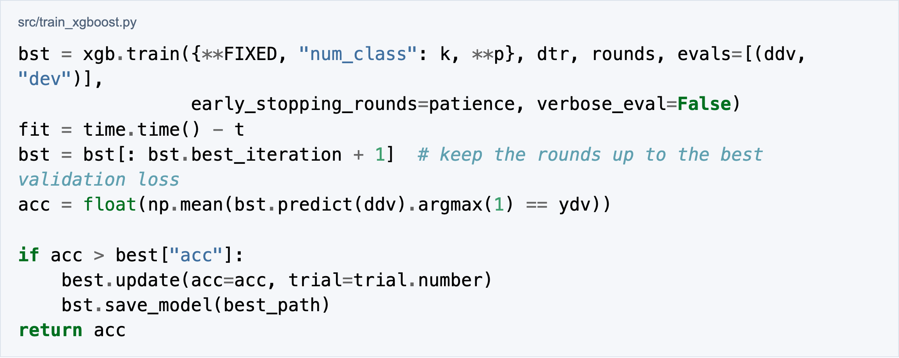
XGBoost extension and tuning
Boosted decision trees on 784 raw pixels
Optuna TPE selects settings using validation accuracy.
Early stopping monitors validation log-loss with patience of 50 rounds.
Seven tuned settings. Tree depth capped at 9 by the recorded GPU-memory constraint.
Notes:
XGBoost adds a model family that the reference did not test: **gradient-boosted decision trees** on the **784 raw pixel features**.
- A decision tree combines feature-based questions to produce an output.
- Boosting adds new trees that reduce the current prediction loss. The model combines their contributions using a learning rate.
- **Optuna's TPE sampler** selects hyperparameter settings using validation accuracy.
- **Early stopping** monitors validation log-loss with patience of **50 rounds**. The retained checkpoint corresponds to the best validation loss within a trial.
| Tuned setting | What it controls |
| --- | --- |
| `max_depth` | Maximum tree depth |
| `learning_rate` | Size of each boosting update |
| `min_child_weight` | Minimum Hessian-weight sum needed in a child |
| `subsample` | Fraction of training examples used |
| `colsample_bytree` | Fraction of pixel features used per tree |
| `gamma` | Minimum loss reduction required for a split |
| `reg_lambda` | L2 regularization on leaf weights |
Tree depth was limited to **9** by the recorded GPU-memory constraint. The 50-class candidate settings came from the 10-class search.
SOURCE REFERENCES
## Slide 13: XGBoost extension and hyperparameter tuning
Original slides: slide 6. Prep Guide: pages 14–15. Code: [train_xgboost.py: `space()`](/Users/arjun/Downloads/ML-MiniProject/src/train_xgboost.py:33), [train_xgboost.py: `search()`](/Users/arjun/Downloads/ML-MiniProject/src/train_xgboost.py:63), [train_xgboost.py: `boost()`](/Users/arjun/Downloads/ML-MiniProject/src/train_xgboost.py:111). Hyperparameter selection uses validation. The project reports test evaluations for separate stage finalists.

Slide 14
Extended XGBoost training
Classes | Initial val. / test | Extended val. / test
3 | 91.65 / 90.80 | 91.65 / 90.80
10 | 89.76 / 89.69 | 89.84 / 89.79
50 | 77.44 / 77.44 | 77.95 / 77.89
Selected 50-class model
Observed plateau
Continued from 1,168 rounds.
Retained checkpoint: 2,193 rounds.
Recorded fit time: 119.9 minutes.
Three converged settings: 77.95%, 77.95%, 77.77% validation.
A fourth stopped at the time budget.
The tested settings cluster near 78%. This does not establish a universal model-family ceiling.
Notes:
The initial 50-class candidates stopped under the training budget. The follow-up continued the best candidate and tested additional settings with more training time.
| Classes | Initial validation | Extended validation | Initial test | Extended test |
| --- | ---: | ---: | ---: | ---: |
| 3 | 91.65% | 91.65% | 90.80% | 90.80% |
| 10 | 89.76% | 89.84% | 89.69% | 89.79% |
| 50 | 77.44% | 77.95% | 77.44% | 77.89% |
- The selected 50-class model continued from **1,168 rounds** and retained its best checkpoint at **2,193 rounds**.
- Its recorded total fit time was **7,191.10 seconds**, approximately **119.9 minutes**.
- Three extended settings reached early stopping at **77.95%, 77.95% and 77.77% validation accuracy**.
- A fourth setting stopped at the overall time budget and did not converge.
**Finding:** the tested converged settings cluster around 78% validation accuracy. The 50-class test improvement is approximately **0.45 percentage points**. This is an observed plateau within the tested settings and budget, rather than an established limit of XGBoost.
SOURCE REFERENCES
## Slide 14: Extended XGBoost training
Original slides: slide 6. Prep Guide: pages 15–16. Records: `results/runs/XGB_*.json`, `results/xgb_extended/runs/{A1,A2-1,A2-2,A2-3}/result.json`. The 3-class result is unchanged. The stored 50-class test value rounds to 77.89%, with a previous checkpoint audit recording 77.886%.

Slide 15
Accuracy and training-time comparison
Best tested validation accuracy within each family
Family | 3 classes | 10 classes | 50 classes
Logistic regression | 79.27% | 65.79% | 43.31%
SVM | 84.00% | 74.62% | Not run
CNN | 91.72% | 88.77% | 81.21%
Transfer learning | 95.35% | Not run | Not run
Final XGBoost | 91.65% | 89.84% | 77.95%
50-class fit: CNN 7.2 min versus XGBoost 119.9 min
16.67× ratio for selected historical fits. Search cost is additional.
Unequal tuning budgets and mostly one seed limit broader conclusions.
Notes:
**Best tested validation accuracy within each model family**
| Model family | 3 classes | 10 classes | 50 classes |
| --- | ---: | ---: | ---: |
| Logistic regression | 79.27% | 65.79% | 43.31% |
| SVM | 84.00% | 74.62% | Not run |
| CNN | 91.72% | 88.77% | 81.21% |
| Transfer learning | 95.35% | Not run | Not run |
| Final XGBoost | 91.65% | 89.84% | 77.95% |
- **3 classes:** VGG19 and ResNet50 tie at the recorded 95.35% validation score.
- **10 classes:** final XGBoost reaches 89.84%, compared with the best CNN's 88.77%.
- **50 classes:** CNN V1 raw leads the tested configurations at 81.21%, compared with XGBoost's 77.95%.
**Selected 50-class historical fit times:** CNN V1 **431.43 s**, XGBoost **7,191.10 s**. Their ratio is **16.67**, favoring the CNN on this measurement.
Historical training used the supplied RTX 4070 laptop environment. The assembled Mac demo uses CPU inference. The timing comparison excludes total search cost. The models use different tuning budgets, and most configurations use one seed. The best CNN variant can differ between class sets.
SOURCE REFERENCES
## Slide 15: Accuracy and training-time comparison
Original slides: slides 7–8. Prep Guide: pages 16–17. Records: `results/all_results.csv`, `results/tables/cross_model_ours.csv`, `results/runs/CNN_V1_50_raw_s7.json`, `results/runs/XGB_xgb_extended_50_raw_s0.json`. These are historical training measurements, not current-Mac inference timings.

Slide 16
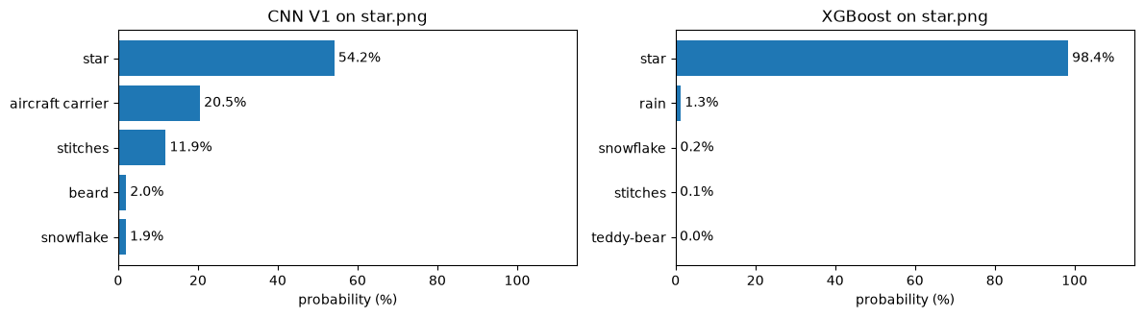
Working demonstration and conclusions
The same saved star drawing, compared by both trained models
CNN V1 leads the tested 50-class configurations.
XGBoost is competitive on the smaller class sets.
Next: new-user drawings, repeated seeds, stricter deduplication and pretrained features for XGBoost.
Notes:
**Working demonstration**
1. Display labeled QuickDraw examples.
2. Fit a small three-class logistic-regression model live.
3. Load the saved CNN and show correct and incorrect predictions.
4. Show a drawing, its processed 28 × 28 input, and the CNN/XGBoost category scores.
The drawing interface converts input to grayscale, adjusts background polarity, crops, pads and resizes it. Both models receive the same processed pixels. The CNN uses a 28 × 28 × 1 image and XGBoost uses the corresponding 784-value vector.
**Conclusions**
- CNN V1 gives the strongest measured 50-class validation result among the tested configurations.
- XGBoost provides a useful extension and achieves competitive results on the smaller class sets.
- The SVM data-size checks and original-source inspection help explain discrepancies, with remaining uncertainty stated explicitly.
**Limitations and next steps**
Fixed categories and drawing-style differences limit freehand performance. A high model score does not guarantee a correct prediction. Most experiments use one seed, and some historical discrepancies remain unresolved. Future work includes new-user drawings, repeated seeds, stricter deduplication, and XGBoost on pretrained image features.
SOURCE REFERENCES
## Slide 16: Working demonstration and conclusions
Code: [demo.ipynb](/Users/arjun/Downloads/ML-MiniProject/demonstration/demo.ipynb), [live_demo.py: `prepare_drawing()`](/Users/arjun/Downloads/ML-MiniProject/src/live_demo.py:22), [live_demo.py: `Classifiers`](/Users/arjun/Downloads/ML-MiniProject/src/live_demo.py:71). Reference: [Stanford report](https://cs229.stanford.edu/proj2018/report/33.pdf), [QuickDraw dataset](https://github.com/googlecreativelab/quickdraw-dataset), supplied project source. Saved-model inference reuses existing weights. Dataset accuracy does not establish accuracy on arbitrary new drawings, and high class scores do not guarantee correctness.

