Slide 1
Inception
Advanced Topics in Software Engineering
CSE 6324 - Section 001
Iteration 1
Team 4
Suvarna, Arjun - 1002024437
Sinari, Navina - 1002072310
Palnati, Netra - 1002030626
Waje, Sanjana - 1002069940

Slide 2
Background
The ecrecover() function is vulnerable to replay attacks if not used without proper checks, like adding nonces, chainId and certifying validity of the signature. (Github Issue #1950) ^{[1] [4]}.
Unencrypted data like keys and passwords on chain stored even in private variables are visible to a attacker ^{[2]}.
Hardcoded credentials make it easy for an attacker to use them for nefarious purposes ^{[3]}.

Slide 3
Detectors
New Slither detectors to detect:
Usage of the ecrecover() function without adequate protection and flag it as a security vulnerability. This detector is based on the pull request (#2015) ^{[5]}
API Keys stored as plain text.
Hard-coded passwords.

Slide 4
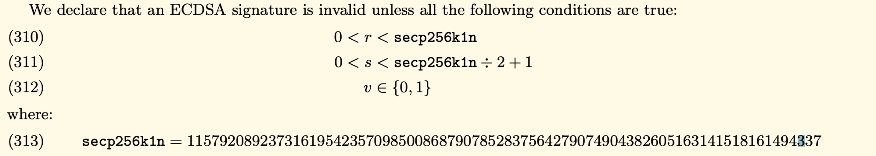
ECDSA Signature Validity
[Ethereum Yellow Paper]

Slide 5
Chain ID
Introduced in Ethereum Improvement Proposal #155 to uniquely identify Ethereum chains ^{[7]}.
Transactions signed with chain ID component would differ from other in the network ^{[7]}.
Replaying transactions from another chain would not be possible due to chain ID differing ^{[8]}.

Slide 6
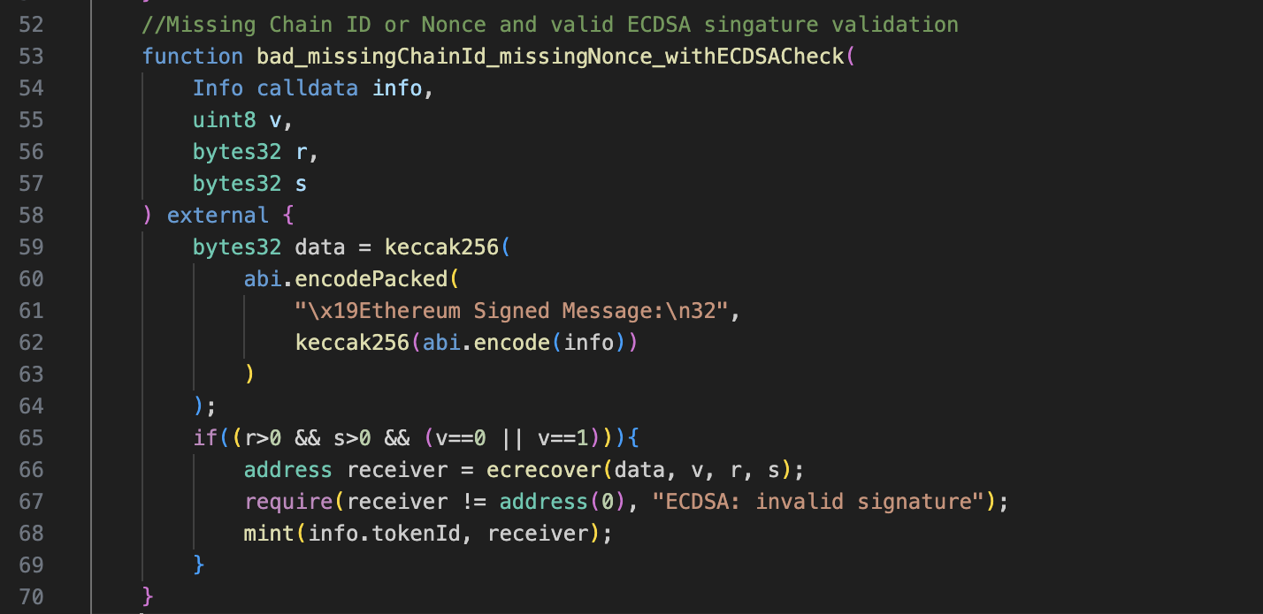
Detecting Improper Usage of ecrecover()
[Slither Pull Request #0215]

Slide 7
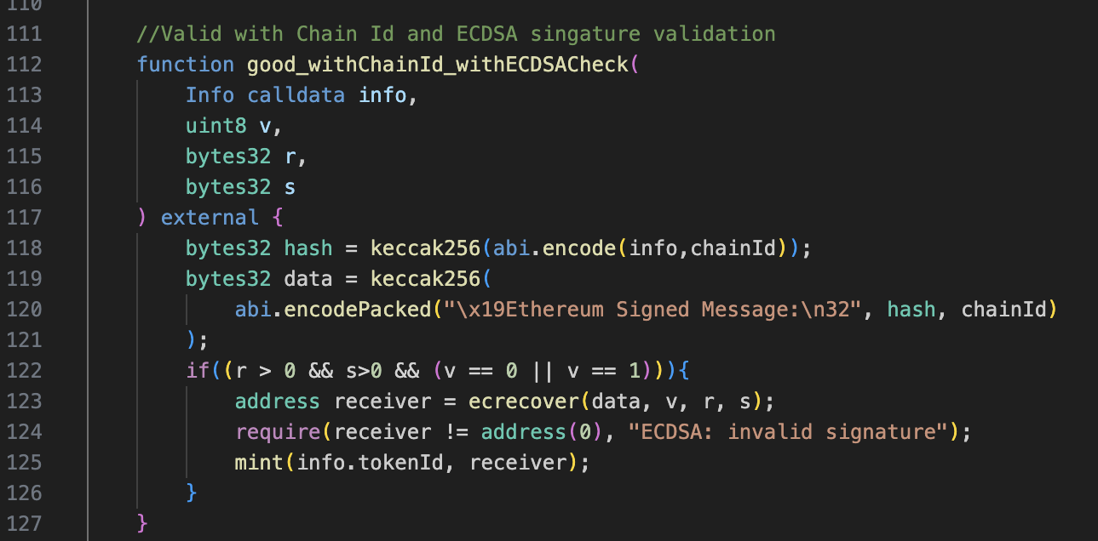
Detecting Improper Usage of ecrecover()
[Slither Pull Request #0215]

Slide 8
Demo

Slide 9
Planning
Define rules for ecrecover.
Build Detector on the rules.
Load the Smart Contract.
Iteration 1
Analyze smart contract with new detector.
Build detector for hardcoded sensitive data.
Improve through Iterative development and feedback.
Iteration 3
Iteration 2

Slide 10
Risks & Mitigations
Risk | Mitigation Plan
Incomplete rule definition | Iteratively build and test the detectors with rules defined
Changing Solidity Standards | Use the latest standards in solidity with long-term support like Ethereum Improvement Proposal #712
Missing Slither User’s needs from the detector’s | Thoroughly research the issue and interact with slither users
False Positive | Test with multiple negative scenarios
False Negatives | Test with multiple positive scenarios

Slide 11
Customers and Users
User | Role | Feedback
Mehul Hivlekar | New User to Smart Contracts and Solidity | The new detector covers many use cases.
Shruthaja Patali Rao | CSE-6324-001 Team 5 | SWC-121 has evolving standards to mitigate and must be monitored to keep the detector effective
Devyani Singh | CSE-6324-001 Team 8 | More cases can be explored by the detector to enhance coverage.

Slide 12
Github Repository
https://github.com/arjunsuvarna1/CSE6324_Team4_Fall23

Slide 13
References
[1] Improper usage of ecrecover - https://github.com/crytic/slither/issues/1950
[2] SWC-136 - https://swcregistry.io/docs/SWC-136/
[3] CWE-798 - https://cwe.mitre.org/data/definitions/798.html
[4] SWC-121- https://swcregistry.io/docs/SWC-121/
[5] Detector for ecrecover return value validation and use of nonces -
https://github.com/crytic/slither/pull/2015
[6] Ethereum: A Secure Decentralized Generalized Transaction Ledger -
https://ethereum.github.io/yellowpaper/paper.pdf
[7] EIP-155: https://github.com/ethereum/EIPs/blob/master/EIPS/eip-155.md
[8] Understanding Signature Replay Attack -
https://neptunemutual.com/blog/understanding-signature-replay-attack/

Slide 14
Thank you!
Questions?

