Slide 1
Inception
Advanced Topics in Software Engineering
CSE 6324 - Section 001
Iteration 2
Team 4
Suvarna, Arjun - 1002024437
Sinari, Navina - 1002072310
Palnati, Netra - 1002030626
Waje, Sanjana - 1002069940

Slide 2
Background
The ecrecover detector was built to detect improper use of ecrecover() in smart contracts. (Github Issue #1950) ^{[1] [5][4]}.
Due to the nature of Ethereum smart contracts private data like API Keys and passwords are not safe to be hardcoded into the code ^{[2][3]}.

Slide 3
API Key Detector
API key detector detects API keys hardcoded keys based on variable names using regular expressions.
The regular expression is built upon the regular expression used by sonar secrets to detect API Keys in Java code ^{[7]} .
The detector is based on the ecrecover detector which was built upon the slither pull request (#2015) ^{[5]}

Slide 4
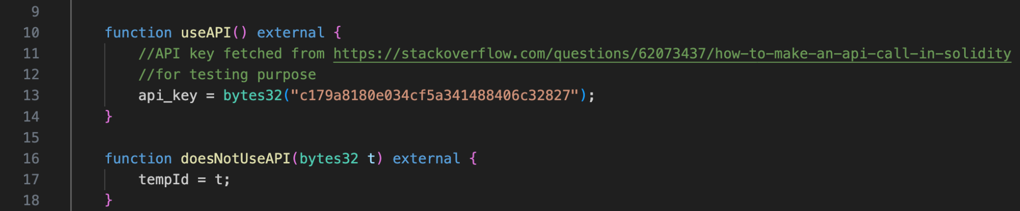
API Key Detector
[API key fetched from https://stackoverflow.com/questions/62073437/how-to-make-an-api-call-in-solidity]

Slide 5
Demo

Slide 6
Ecrecover() detector
The improper usage of ecrecover() function detector was enhanced to include additional checks described in the yellow paper^{[6]} based on open zeppelin implementation^{[8]}. This detector is based on the pull request (#2015) ^{[5]}.

Slide 7
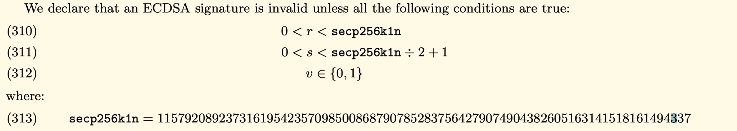
Ecrecover() detector
[Ethereum Yellow Paper]

Slide 8
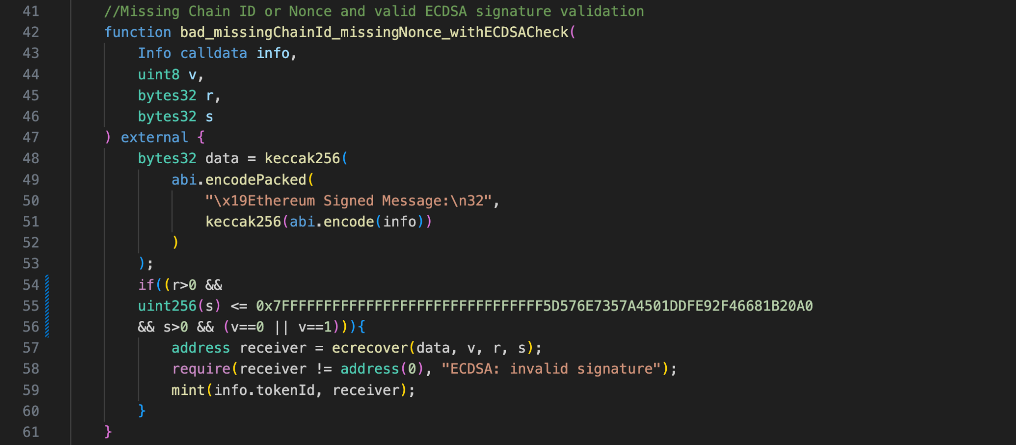
Improvements In Detecting Improper Usage of ecrecover()
[Slither Pull Request #2015]

Slide 9
Planning
Define rules for ecrecover.
Build Detector on the rules.
Load the Smart Contract.
Iteration 1
Analyze smart contract with new detector.
Build detector for hardcoded sensitive data.
Improve through Iterative development and feedback.
Iteration 3
Iteration 2

Slide 10
Risks & Mitigations
Risk | Mitigation Plan
Incomplete rule definition | Iteratively build and test the detectors with rules defined
Changing Solidity Standards | Fix Solidity version 0.8.18 as the target version
Missing Slither User’s needs from the detector’s | Thoroughly research the issue and interact with slither users
False Positive | Test with multiple negative scenarios
False Negatives | Test with multiple positive scenarios

Slide 11
Customers and Users
User | Role | Feedback
Mehul Hivlekar | New User to Smart Contracts and Solidity | The API key detector solves a very common developer error which can be a major issue.
Shruthaja Patali Rao | CSE-6324-001 Team 5 | More scenarios where the API key is exposed can be checked to improve the detector.
Devyani Singh | CSE-6324-001 Team 8 | The additional ecrecover detector changes make it very useful in preventing vulnerable code from being deployed.

Slide 12
Github Repository
https://github.com/arjunsuvarna1/CSE6324_Team4_Fall23

Slide 13
References
[1] Improper usage of ecrecover - https://github.com/crytic/slither/issues/1950
[2] SWC-136 - https://swcregistry.io/docs/SWC-136/
[3] CWE-798 - https://cwe.mitre.org/data/definitions/798.html
[4] SWC-121- https://swcregistry.io/docs/SWC-121/
[5] Detector for ecrecover return value validation and use of nonces -
https://github.com/crytic/slither/pull/2015
[6] Ethereum: A Secure Decentralized Generalized Transaction Ledger -
https://ethereum.github.io/yellowpaper/paper.pdf
[7] Sonar Secrets Github: https://github.com/Skyscanner/sonar-secrets/tree/master
[8] Openzeppelin ECDSA solidity implementation -
https://github.com/OpenZeppelin/openzeppelin-contracts

