Slide 1
Introduction to M365 Graph Connector - Get External Content to Microsoft 365
Arjun Menon
Microsoft MVP / Solution Architect

Slide 2
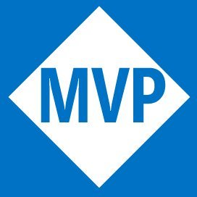








Who Am I
Microsoft MVP (M365 Development)
Co-maintainer – CLI for Microsoft 365
Core Team Member – Microsoft 365
& Power Platform Community (PnP)
Solution Architect with TCS
Arjun Menon
/in/
arjunumenon
arjunumenon.com
This Photo by Unknown Author is licensed under CC BY
This Photo by Unknown Author is licensed under CC BY

Slide 3
Graph Connectors aka Avengers
Notes:
Nick Fury -> Graph Connectors
Other avengers are like connections.
M365 Ecosystem is the world. Avengers face the evils, while the users of the system are trying to make their job easier

Slide 4
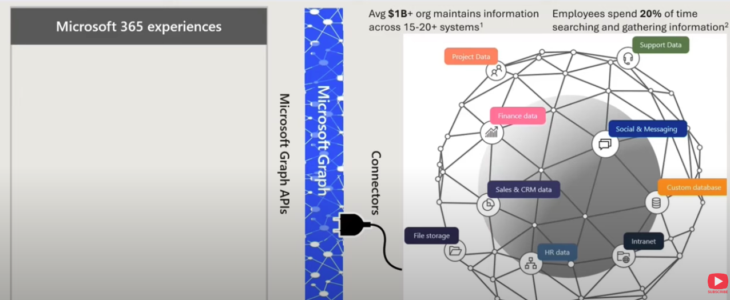

Graph Connector. What is that?

Slide 5
Graph Connectors Experiences
Microsoft Search
Context IQ on outlook
Microsoft 365 Copilot
Microsoft 365 App

Slide 6
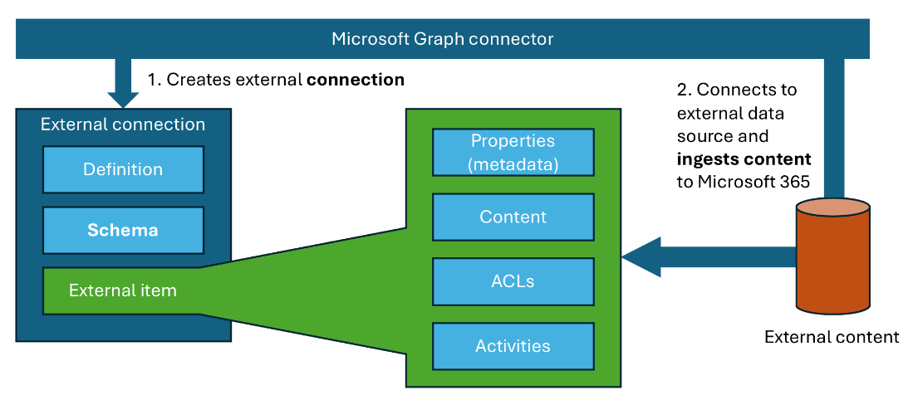
Graph Connector. Building blocks
Notes:
An external connection defines the source of external content that you’ll ingest into Microsoft 365. It contains information such as:
Name and description
Schema, which is a list of properties that are indexed for the external content
External content (referred to as external items) that are imported into Microsoft 365
Each external item contains:
Content that’s indexed
Metadata that describes the content as defined by the external connection schema (e.g., author of an item; when and by who it was last modified; where the content is located, etc.)
Access control list (ACL) that describes who is allowed to see the content
Optionally, activities on the content that support its discovery in the different Microsoft 365 experiences

Slide 7
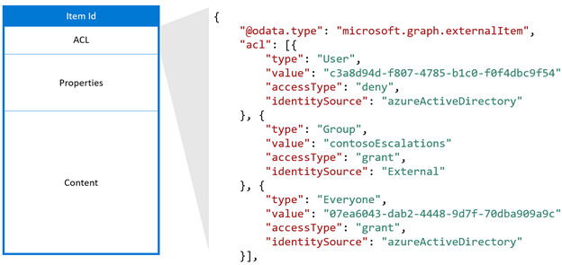
Access Control List – Breaking it down
Notes:
Using external groups in your connection
To use external groups in your connection, follow these steps:
For each non-Azure AD group, use the groups API to create an external group in Microsoft Graph.
Use the external group when defining the ACL for your external items as necessary.
Keep the membership of the external groups up to date and in sync.

Slide 8
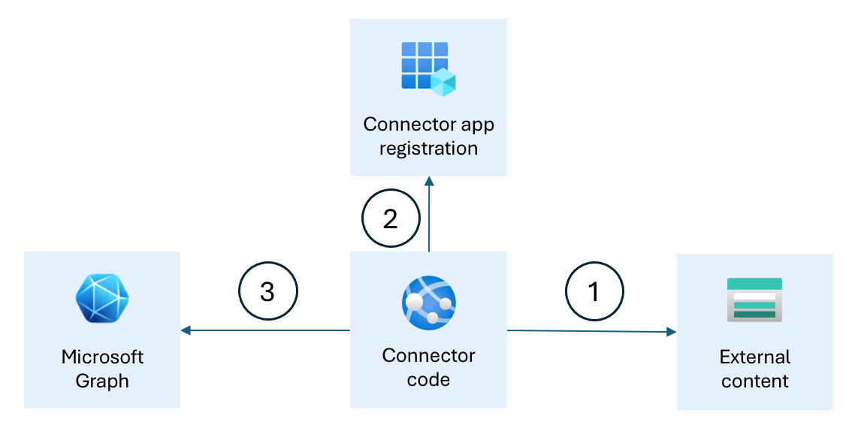
How they function together
Notes:
The Microsoft Entra app registration allows the Graph connector to authenticate with Microsoft 365 and call Microsoft Graph APIs.
The Graph connector code creates the external connection and configures the schema.
Then, regularly it connects to the external data source (1), authenticates with Microsoft Entra ID (2) and uses Microsoft Graph APIs to import the external content to Microsoft 365 (3).

Slide 9
Licensing and things to watch out for
Index Quotas
Each user license is entitled for 500 items of index quota.
IF a tenant has 50 licensed users, tenant is entitled for 25000 items
An item refers to a record which will be added to Microsoft Graph
Exceeding the quota could be achieved by further license purchases
Connection Limit : Total of 30 connections limit per tenant
Notes:
Cost of indexing connector content is $1000/month for every million items. This is assessed for items exceeding the entitled quota for each tenant (refer next section).

Slide 10
Let us see it in action!!!
Ingest Public API to Microsoft 365
Full blown API Integration Graph Connector

Slide 11

Feedback

Slide 12


References
Reference | Link / QR
Demo Artefacts
CLI for Microsoft 365

Slide 13
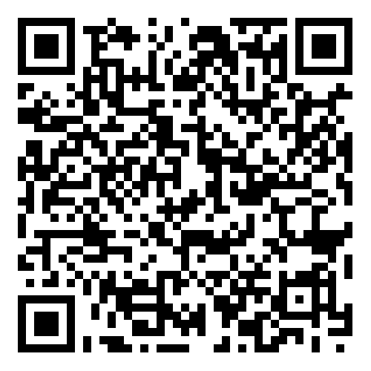

Future Demos and Sessions
Demo Details | Link / QR
Microsoft 365 Reactor Bootcamp
Poll for getting updates on the series

Slide 14




Thank You!

