Slide 1

Build a Microsoft 365 Copilot Extension to Bring External Data

Slide 2









WHO AM I?
Microsoft MVP (M365 Development)
Co-maintainer – CLI for Microsoft 365
Team Member – Microsoft 365
& Power Platform Community (PnP)
Solution Architect with TCS
Arjun Menon
/in/
arjunumenon
arjunumenon.com

Slide 3




Microsoft 365 Copilot
Unlock productivity and unleash creativity
Natural Language
Large Language Models
Microsoft Graph - Your Data -
Microsoft 365 Apps
The Internet

Slide 4
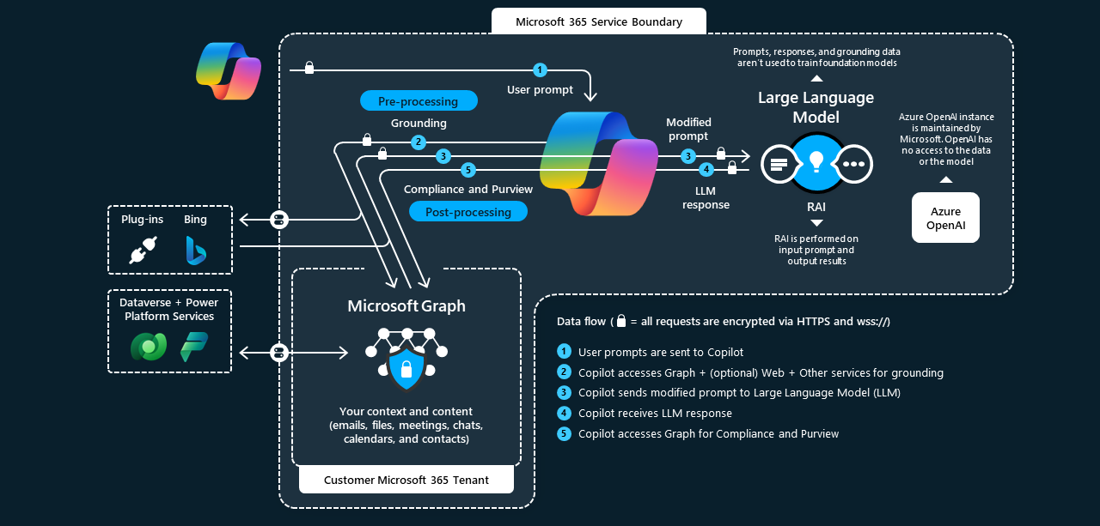
M365 Copilot Architecture

Slide 5
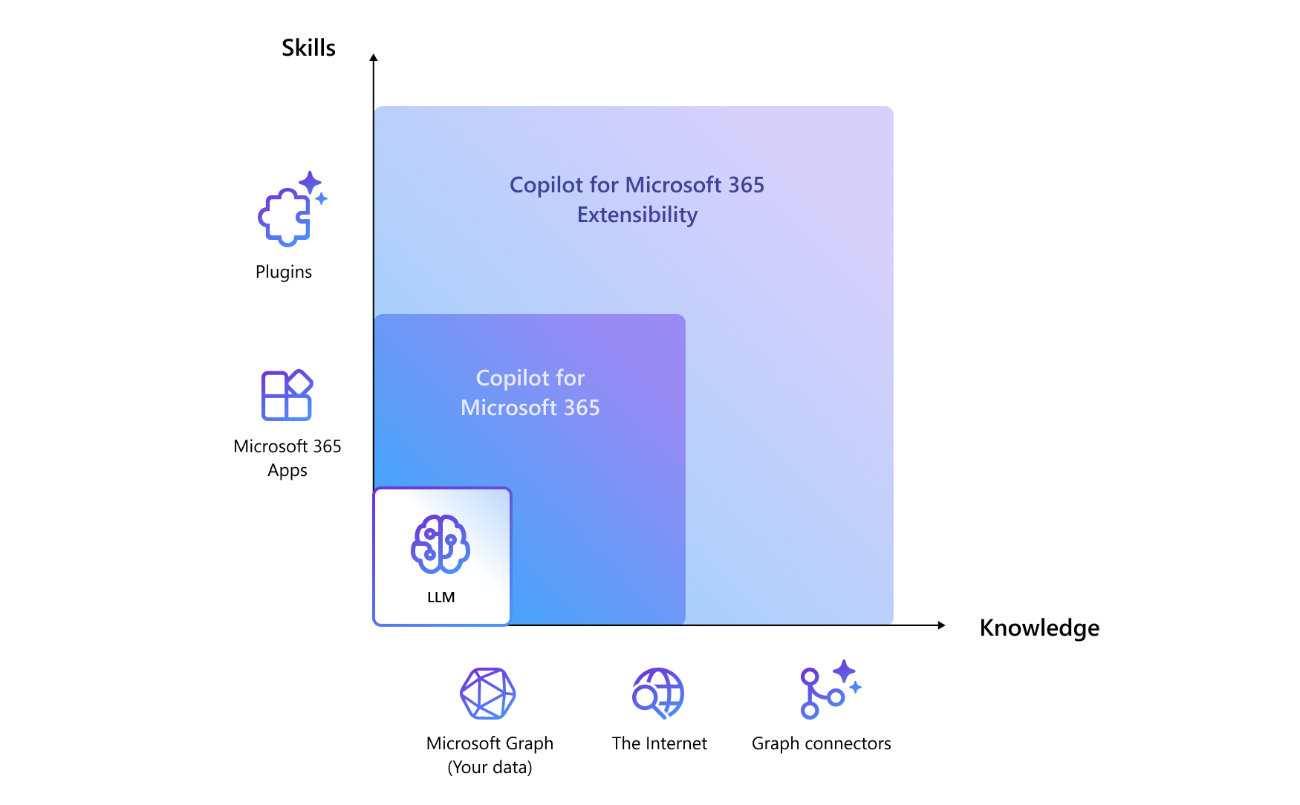
M365 Copilot – Extensibility Path

Slide 6
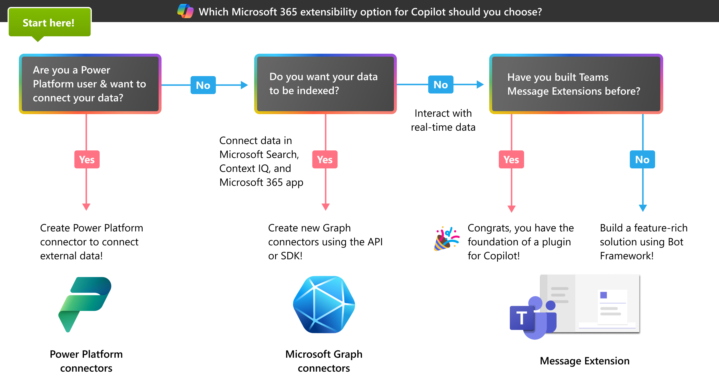
When to Use What?

Slide 7
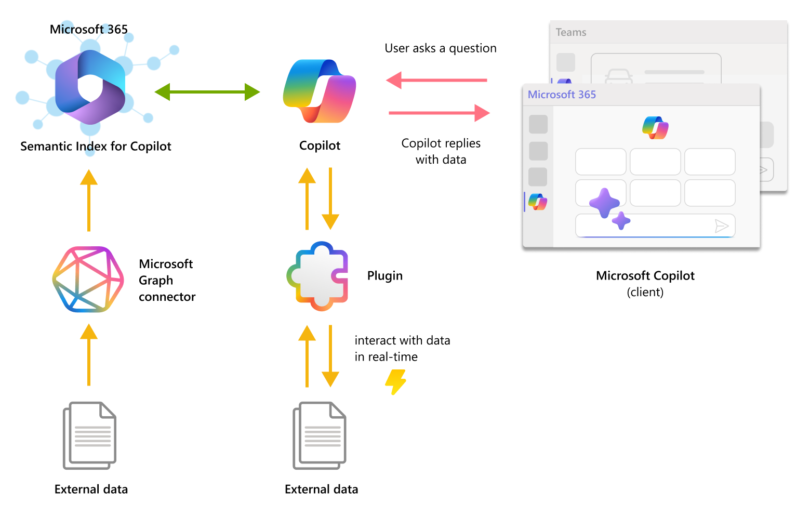
Plugins & Graph Connectors

Slide 8
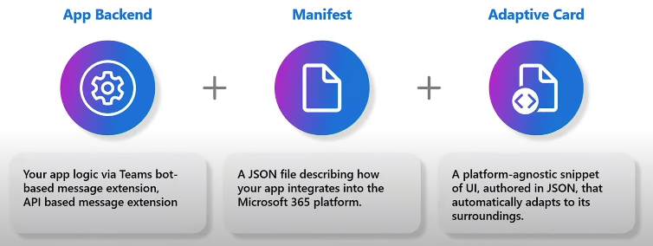
Teams Messaging Extension Plugin - Building Blocks

Slide 9
Pre-Requisites
VS Code
NodeJS 18.18
M365 License with Copilot
Teams Apps Sideloading

Slide 10
TODAY’s DEMO
Create Plugin from Scratch
Existing Plugin and integration

Slide 11
DEMO

Slide 12
CONCLUSIONS
Q&A?

Slide 13

THANK YOU

