Slide 1

Automating ITPs Using ATPs
Arjun Viswanathan
Advisor:
Cesare Tinelli

Slide 2
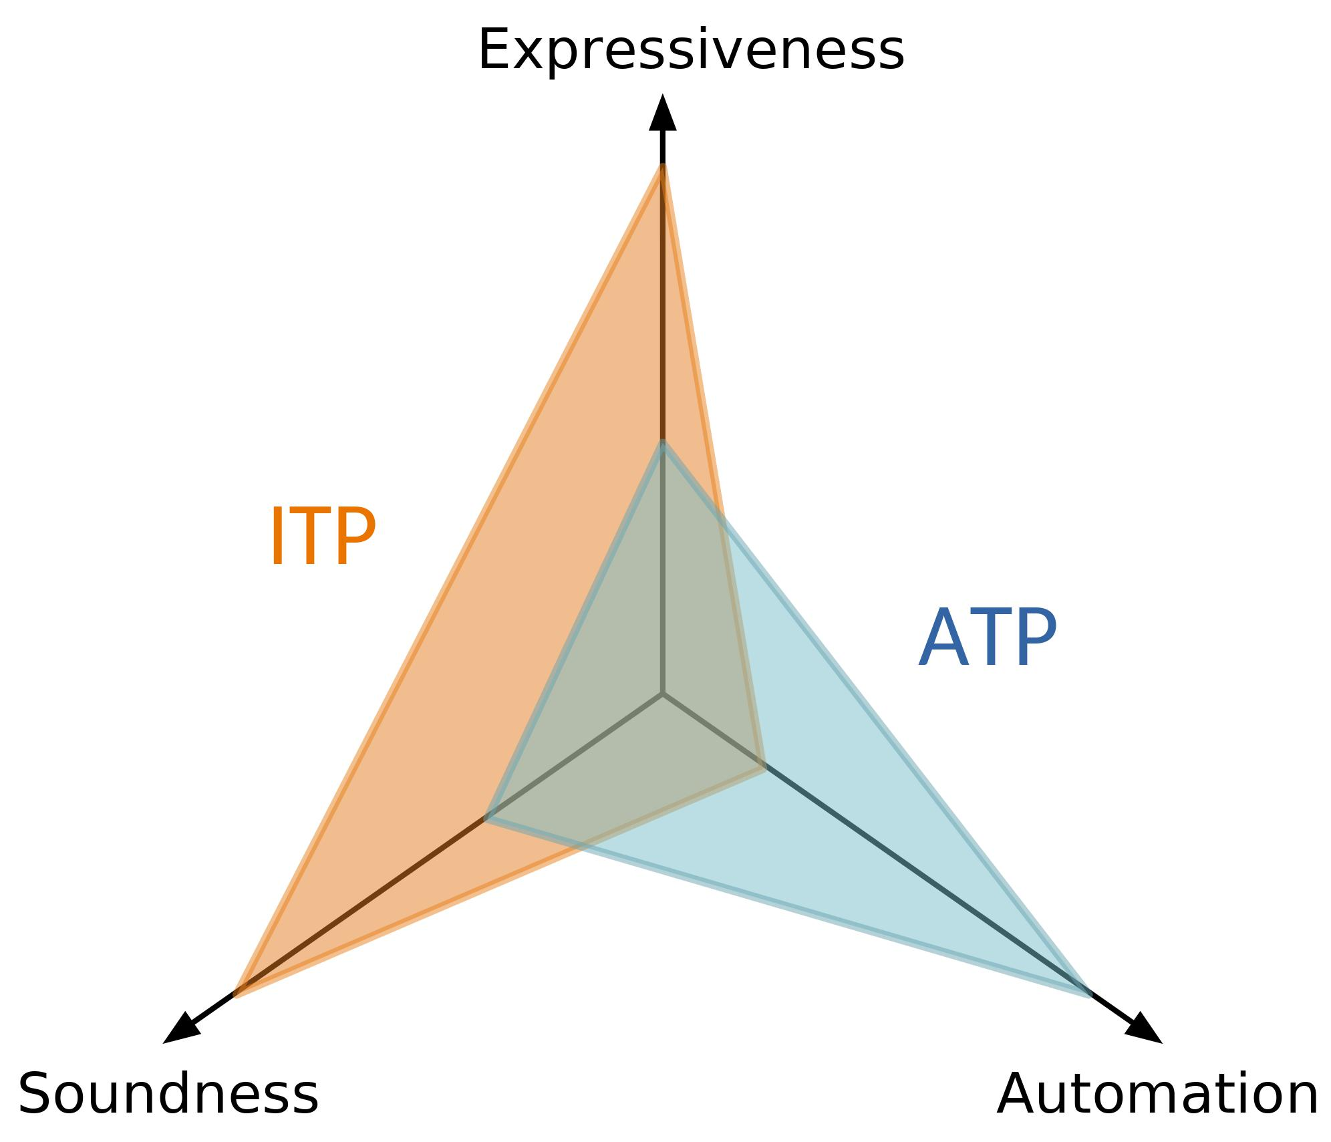
Introduction
Theorem provers prove logic properties
Used in hardware/software verification
Theorem Provers:
Interactive (ITPs)
Automatic (ATPs)
ITPs | ATPs
Small proof kernel | Large code base
User interaction | Highly automated
Reliable proofs | Susceptible to bugs
Expressive logics (HOL) | Less expressive logic (FOL)
Coq, Isabelle/HOL, Agda, Lean | Superposition Provers: Vampire, E, SPASS; SMT Solvers: CVC4, Z3, VeriT

Slide 3
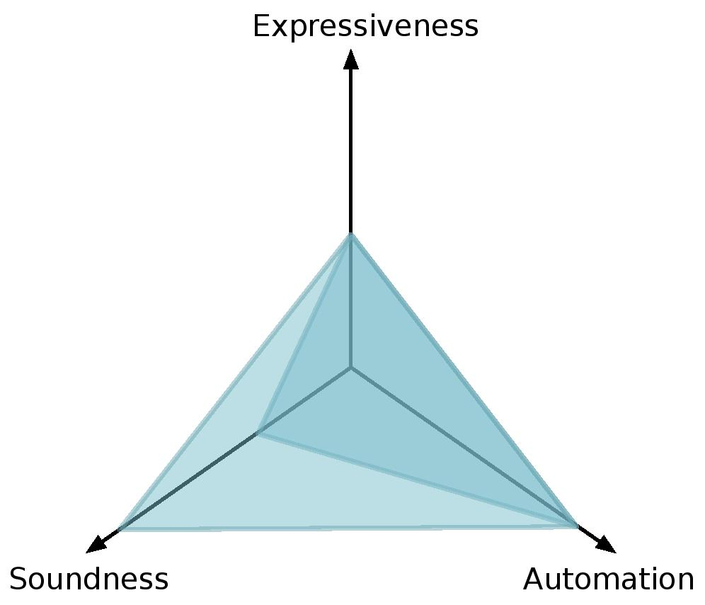
Motivation
Combine ITPs and ATPS to:
automate proofs in ITPs
certify results of ATPs
Autarkic approach – implement and prove correct ATP inside ITP
Skeptical approach – ATP outputs checkable certificate
Tools:
Hammers (e.g., Sledgehammer, CoqHammer)
Certified Checkers (e.g., SMTCoq)

Slide 4
Technical Preliminaries

Slide 5






Satisfiability
Propositional/Boolean Satisfiability (SAT) : Satisfy F by mapping variables to True/False
Satisfiability Modulo Theories (SMT) : Satisfy F by mapping variables to theory constants

Slide 6
Duality of Satisfiability and Validity
F is valid iff ¬F is unsatisfiable

Slide 7
SMT Solvers

Slide 8
ATPs – SMT Solvers
Is a given formula satisfiable or unsatisfiable?
DPLL(T) architecture – abstract theory literals and use SAT solver
SAT is NP-complete
Theories and quantification may make solving undecidable
SMT Solver
Arith Solver
SAT Solver
String
Solver
Bit-vector
Solver
. . .

Slide 9
Proof Producing SMT Solvers
Theory Proofs
Satisfiability – satisfying model
Unsatisfiability – resolution proof tree
Proof tree:
Input formulas – leaves
Theory lemmas – leaves
Empty clause – root
Node – rule applied to parents
Holes – unjustified simplifications
h₁
h₂
…
h_{n}
t₁
t₂
…
t_{n}
⊥

Slide 10
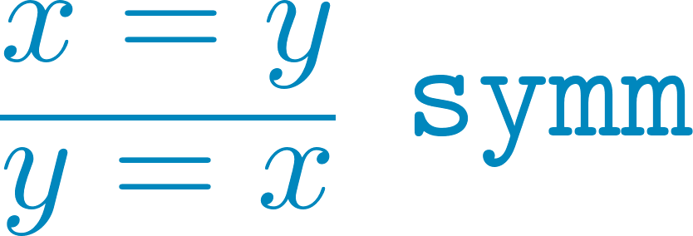
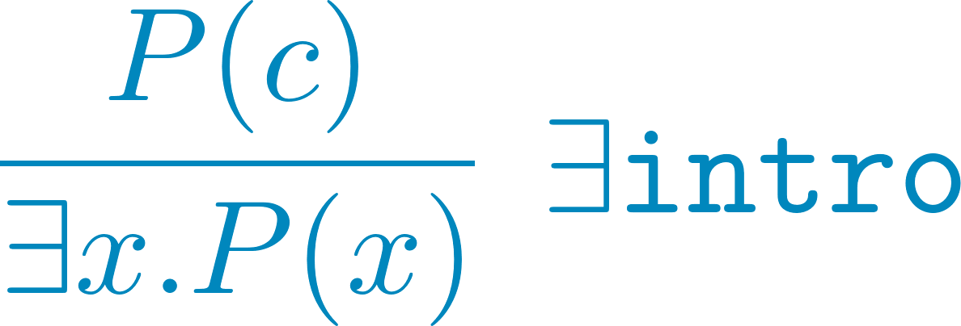

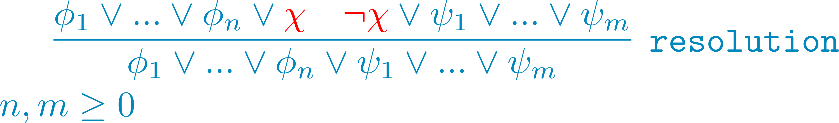
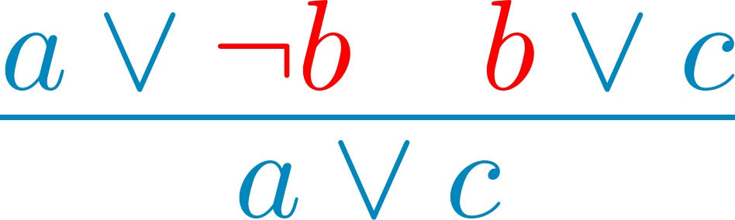
Proof Producing SMT Solvers
Proof rules:
CNF Conversion
Resolution
Theory-specific
Quantifier
Rewrites

Slide 11
Interactive Theorem Provers

Slide 12
ITPs
Small, trustable proof kernel
Human-machine collaboration
Tactics based on proof rules
LCF-Based | Automath-Based
Theorem is an ADT | Theorem statements - types
ADT provides functions to create theorems using inference rules of logic | Proofs – programs inhabiting types
HOL Light, HOL4, Isabelle | Coq, Agda, Lean
Sledgehammer – Isabelle/HOL | SMTCoq - Coq

Slide 13
Sledgehammer

Slide 14
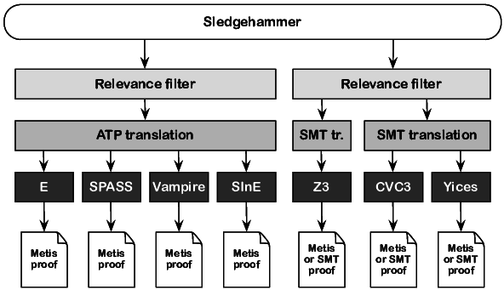
Sledgehammer
Automate proving within ITP using ATP
Premise Selection
Translation
Proof Reconstruction
Sledgehammer – Isabelle/HOL’s hammer
Metis – internal ATP
We focus on Sledgehammer’s SMT solver integration

Slide 15
Premise Selection
Given ITP goal:
G might depend on other facts
ITPs have large libraries of proven facts
Premise selection – filter out relevant facts to send with F
Delegate to user
Syntactic selection
Semantic selection
Hybrid
Notes:
Machine-learning based proof selection methods – learn from previous proofs using Bayesian statistics, nearest neighbor ranking functions, non-linear kernel methods. Semantic methods – find countermodels and select facts that exclude countermodels.

Slide 16
Premise Selection
Given ITP goal:
G might depend on other facts
ITPs have large libraries of proven facts
Premise selection – filter out relevant facts to send with G
Delegate to user
Syntactic selection – prioritize facts by common symbols with goal
Semantic selection
Hybrid
Notes:
Machine-learning based proof selection methods – learn from previous proofs using Bayesian statistics, nearest neighbor ranking functions, non-linear kernel methods. Semantic methods – find countermodels and select facts that exclude countermodels.

Slide 17
Translation
ATP – typed/untyped FOL
ITP – HOL
FOL is a subset of HOL
Translate non-FOL features of HOL such as anonymous functions, partial applications, etc.
Map types in Isabelle to types in theories
Notes:
Monomorphization can be non-terminating.

Slide 18
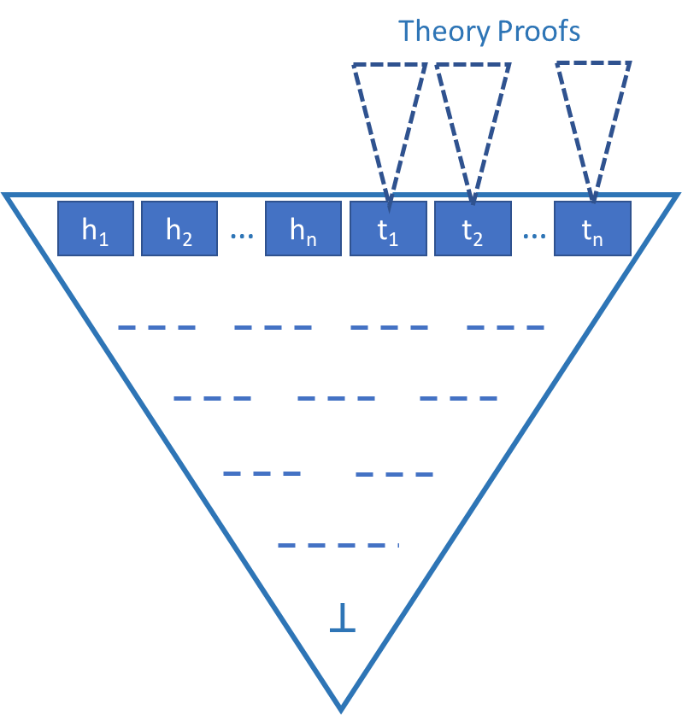
Proof Reconstruction
Sledgehammer with ATP
Trust as oracle – CVC4, Yices
Use as relevance filter – E, SPASS, Vampire
Reconstruct ATP proof – Z3
Reconstruction
Inference-by-inference
Depth-first post-order
Reconstruction of a node implies a proven theorem
Coarse-grained proofs necessitate proof search
Notes:
Isabelle receives a proof skeleton from Z3 that it has to fill using Metis or other methods. The coarser the Z3 proof, the more proof search Isabelle has to do.
Reconstructed proof nodes are reusable.
Sledgehammer checks that only the unsat core remains as leaves of the tree.

Slide 19
SMTCoq

Slide 20
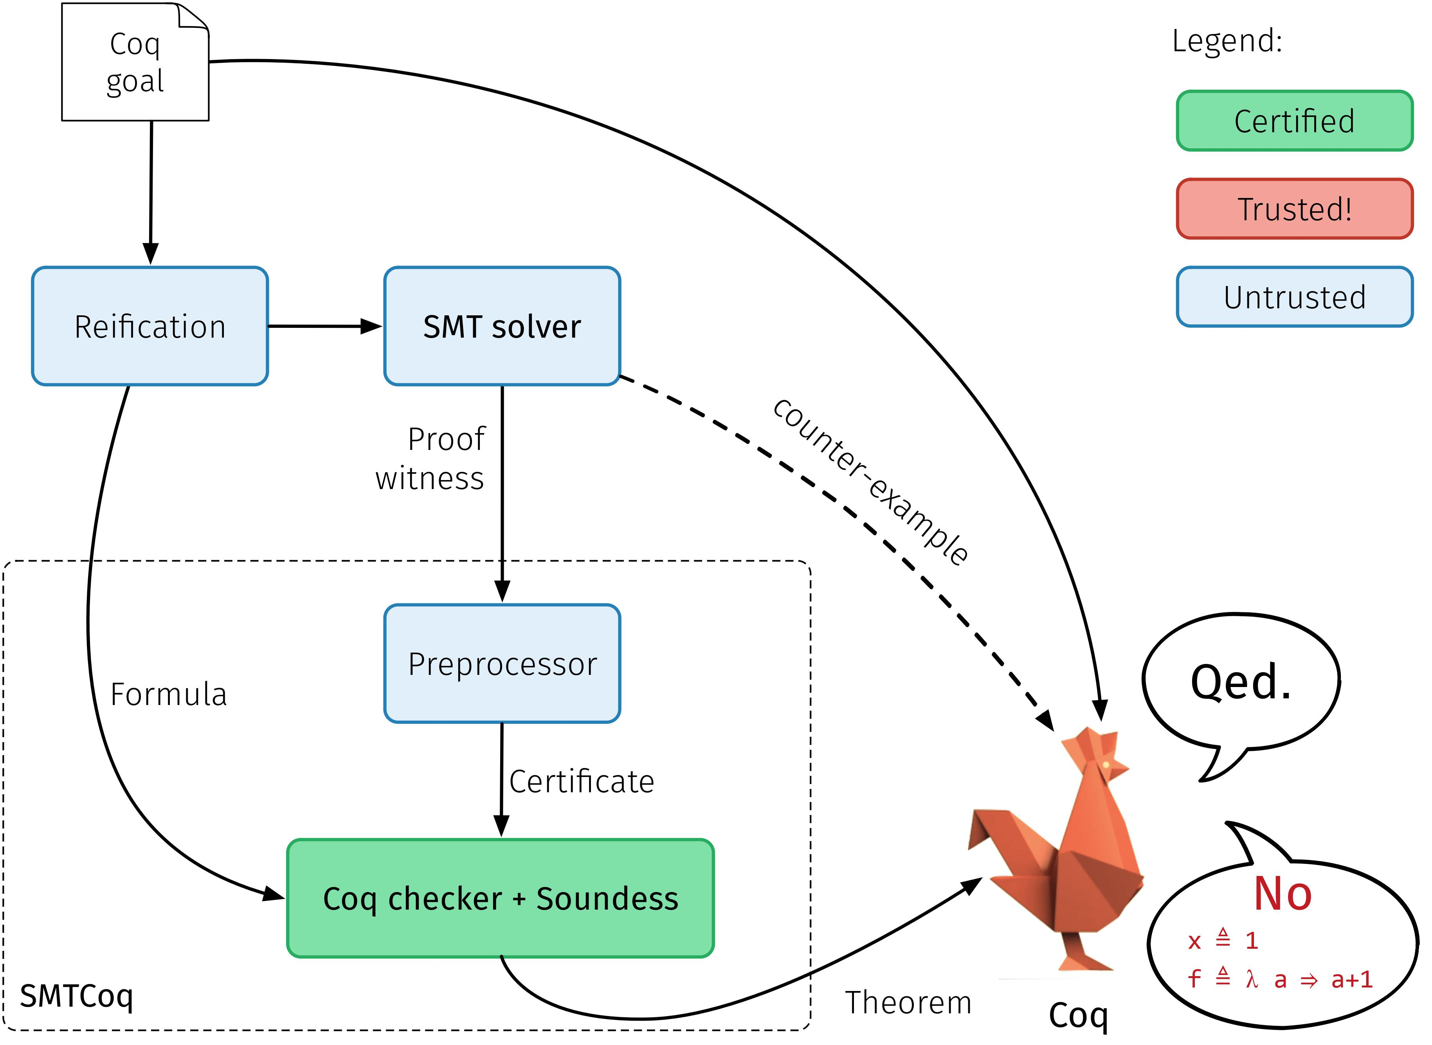

SMTCoq
Skeptical cooperation between Coq and SAT/SMT solvers
Coq data structures represent SMT terms (deep embedding)
Coq Props represent Coq theorems (shallow embedding)
SMT proofs Proof certificate
Boolean decision procedure checks proof certificate by computational reflection

Slide 21

Computational Reflection
Coq data structures represent SMT terms (deep embedding)
Coq Props represent Coq theorems (shallow embedding)
Reflect proofs from deep to shallow
Boolean decision procedure checks deep terms proof terms
Correctness of decision procedure
Reflection uses Coq’s computational capabilities

Slide 22
Computational Reflection
Reflection needs:
A Boolean decision procedure (check) that
takes a term s : S in the deep embedding,
a proof trace t : T from the ATP, and
checks that t justifies s
A proof of correctness of check (reflection principle)
p is a predicate on deep terms
check is largely computational
For a particular s and t, the proof of P s is:
Reflection principle relates
computational behavior of check
propositional meaning
Notes:
Most work goes into the correctness proof, and the computations within check.

Slide 23
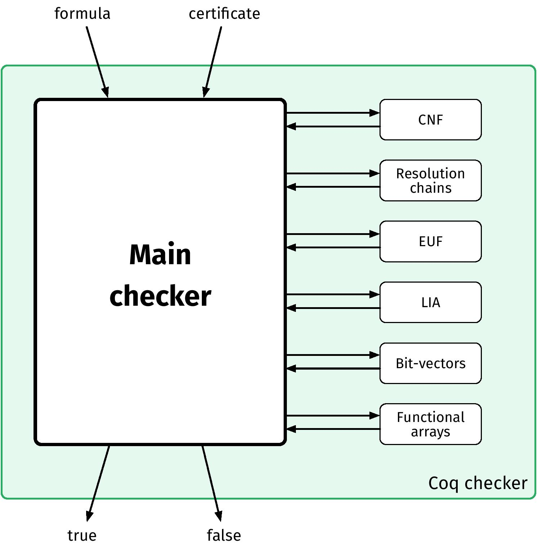
SMTCoq - Checker
Divide:
Proofs steps
Main checker small checkers
State : set of clauses
Each step modifies state while maintaining unsatisfiability
Main checker – is final state ⊥?
Notes:
Reconstructed proof nodes are reusable.
Sledgehammer checks that only the unsat core remains as leaves of the tree.

Slide 24
Sledgehammer vs SMTCoq

Slide 25
Comparison
 | Sledgehammer with Z3 | SMTCoq

Slide 26
Comparison
 | Sledgehammer with Z3 | SMTCoq
Operation | Trusts CVC3/4 and Yices as oracles Uses superposition provers as relevance filters Gets proof skeleton from Z3 and fills it using Metis | Converts proofs to a certificate format Uses reflection to reflect solver proofs

Slide 27
Comparison
 | Sledgehammer with Z3 | SMTCoq
Operation | Trusts CVC3/4 and Yices as oracles Uses superposition provers as relevance filters Gets proof skeleton from Z3 and fills it using Metis | Converts proofs to a certificate format Uses computational reflection to reconstruct solver proofs
Logic | Goals in FOL and a subset of HOL from Isabelle/HOL Quantified FOL with EUF, LIA, BV | Only FOL goals in Coq Quantifier-free FOL with EUF, LIA, BV, Arrays

Slide 28
Comparison
 | Sledgehammer with Z3 | SMTCoq
Operation | Trusts CVC3/4 and Yices as oracles Uses superposition provers as relevance filters Gets proof skeleton from Z3 and fills it using Metis | Converts proofs to a certificate format Uses computational reflection to reconstruct solver proofs
Logic | Goals in FOL and a subset of HOL from Isabelle/HOL Quantified FOL with EUF, LIA, BV | Only FOL goals in Coq Quantifier-free FOL with EUF, LIA, BV, Arrays
Extensibility | Specific integration with Z3 Trusts other solvers without proof reconstruction | Integration with CVC4, VeriT, Zchaff, Glucose Additional solvers can be added by adding a preprocessor

Slide 29
Comparison
 | Sledgehammer with Z3 | SMTCoq
Operation | Trusts CVC3/4 and Yices as oracles Uses superposition provers as relevance filters Gets proof skeleton from Z3 and fills it using Metis | Converts proofs to a certificate format Uses computational reflection to reflect solver proofs
Logic | Goals in FOL and a subset of HOL from Isabelle/HOL Quantified FOL with EUF, LIA, BV | Only FOL goals in Coq Quantifier-free FOL with EUF, LIA, BV, Arrays
Extensibility | Specific integration with Z3 Trusts other solvers without proof reconstruction | Integration with CVC4, VeriT, Zchaff, Glucose Additional solvers can be added by adding a preprocessor
Premise Selection | Uses various Sledgehammer premise selection techniques | Doesn’t consider facts outside a lemma

Slide 30

Future Work - Abduction
Given a set of axioms A, goal G, the abduct (if it exists) is a formula φ s.t.
Find formula φ that is consistent with the axioms and when added to them, allows the goal to be proven

Slide 31











Future Work - Abduction
SMTCoq

Slide 32
Questions?

Slide 33
Questions?

Slide 34
Questions?

Slide 35
DPLL(T) Architecture

Slide 36

ATPs – SMT Solvers
Is a given formula satisfiable or unsatisfiable?
DPLL(T) architecture – abstract theory literals and use SAT solver
SMT Solver
Arith Solver
SAT Solver
String
Solver
Bit-vector
Solver
. . .

Slide 37


ATPs – SMT Solvers
Is a given formula satisfiable or unsatisfiable?
DPLL(T) architecture – abstract theory literals and use SAT solver
SMT Solver
Arith Solver
SAT Solver
String
Solver
Bit-vector
Solver
. . .

Slide 38


ATPs – SMT Solvers
Is a given formula satisfiable or unsatisfiable?
DPLL(T) architecture – abstract theory literals and use SAT solver
SMT Solver
Arith Solver
SAT Solver
String
Solver
Bit-vector
Solver
. . .

Slide 39

ATPs – SMT Solvers
Is a given formula satisfiable or unsatisfiable?
DPLL(T) architecture – abstract theory literals and use SAT solver
SMT Solver
Arith Solver
SAT Solver
String
Solver
Bit-vector
Solver
. . .
Notes:
The model doesn’t satisfy the REFINEMENT

Slide 40

ATPs – SMT Solvers
Is a given formula satisfiable or unsatisfiable?
DPLL(T) architecture – abstract theory literals and use SAT solver
SMT Solver
Arith Solver
SAT Solver
String
Solver
Bit-vector
Solver
. . .

Slide 41
ATPs – SMT Solvers
Is a given formula satisfiable or unsatisfiable?
DPLL(T) architecture – abstract theory literals and use SAT solver
SMT Solver
Arith Solver
SAT Solver
String
Solver
Bit-vector
Solver
. . .

Slide 42
ATPs – SMT Solvers
Is a given formula satisfiable or unsatisfiable?
DPLL(T) architecture – abstract theory literals and use SAT solver
SAT is NP-complete
Theories and quantification may make solving undecidable
SMT Solver
Arith Solver
SAT Solver
String
Solver
Bit-vector
Solver
. . .

Slide 43
SMT Proof Rules

Slide 44





Proof Producing SMT Solvers
Proof rules:
CNF Conversion
CNF transformation algorithm by Tseitin
Transformed formula is linear in size
Procedure:
introduce new variable for each sub-term
unfold equivalences
Notes:
Equisatisfiable – both satisfiable or both unsatisfiable.
De Morgan’s Law and distribution might cause exponential blow-up in size.

Slide 45
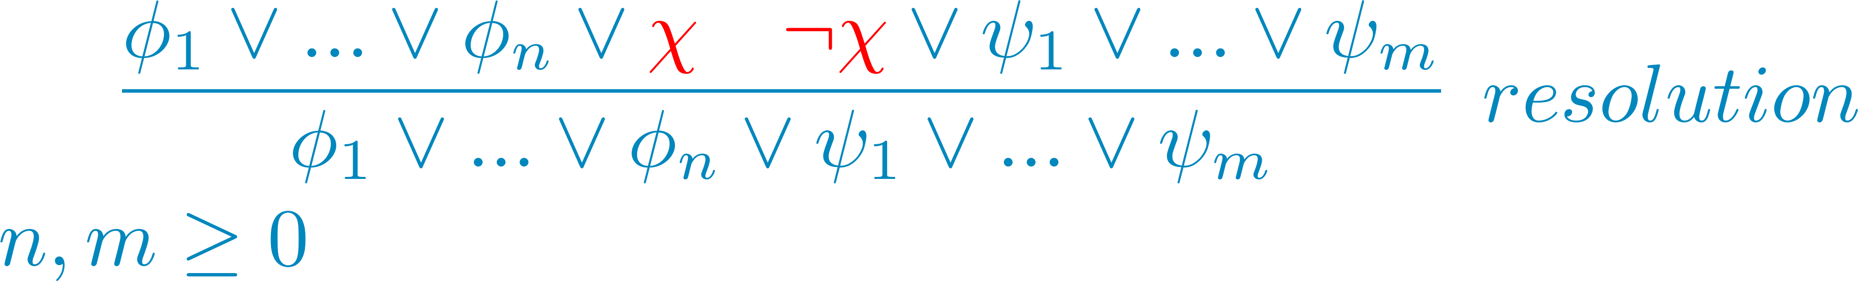
Proof Producing SMT Solvers
Proof rules:
CNF Conversion
Resolution

Slide 46
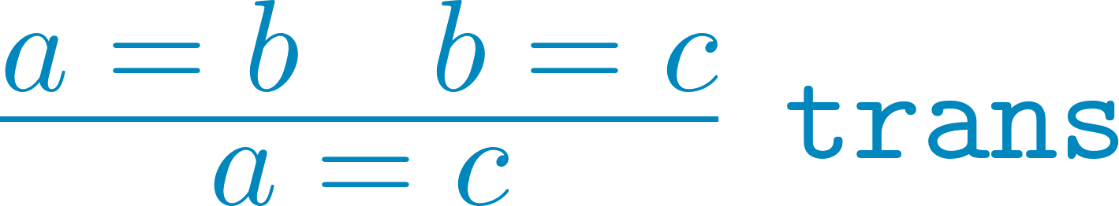

Proof Producing SMT Solvers
Proof rules:
CNF Conversion
Resolution
Theory-specific

Slide 47


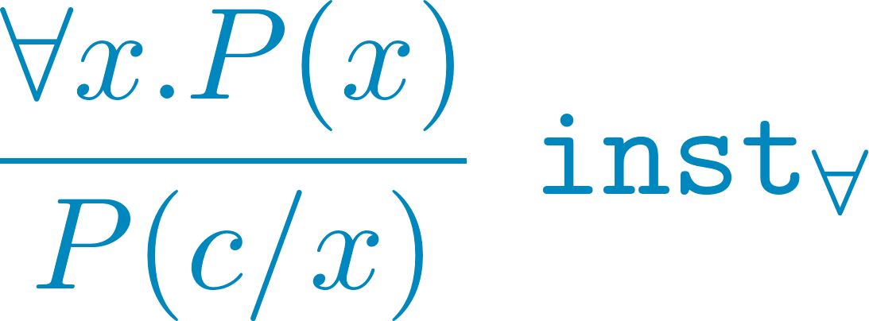
Proof Producing SMT Solvers
Proof rules:
CNF Conversion
Resolution
Theory-specific
Quantifier
Existential ( ) and universal ( ) quantifiers
Quantifier introduction rules
Instantiation rule to eliminate
Skolemization to eliminate

Slide 48


Proof Producing SMT Solvers
Proof rules:
CNF Conversion
Resolution
Theory-specific
Quantifier Elimination
Rewrites
Some rewrites are proven
Some are proof holes

Slide 49
HOL -> FOL Translation

Slide 50

Translation
ATP – typed/untyped FOL
ITP – HOL
FOL is a subset of HOL
Non-FOL features of HOL:
Type variables – monomorphization
Anonymous functions – named function + quantified constraint
Partial applications – explicit application
Compound types – new FO type
Types - sorts
Notes:
Monomorphization can be non-terminating.

Slide 51
Reflection

Slide 52
Computational Reflection
Reflect terms in the ITP’s language (shallow embedding) to terms in a datatype written in the ITP’s language (deep embedding)
Deep embedding represents terms from ATP
Use ATP methods over deep terms
Pattern matching is allowed over deep but not shallow terms
Prove correctness result for the transformation : theorems in deep embedding give theorems in shallow embedding

Slide 53
SMTCoq
Boolean decision procedure in Coq checks SMT proofs
Reflection in SMTCoq
Deep embedding – datatypes FOL terms
Shallow embedding – Coq terms FOL terms
Interpretation – deep shallow terms
Reification – shallow deep terms
Ssreflect: Bool Prop

Slide 54



Duality of Satisfiability and Validity
F is valid iff ¬F is unsatisfiable

