Slide 1



Verifying Bit-vector Invertibility Conditions in Coq (Extended Abstract)
Burak Ekici, Arjun Viswanathan, Yoni Zohar, Clark Barrett, Cesare Tinelli

Slide 2
Bit-vectors

Slide 3
Bit-vectors
Bit-vectors: Fixed-width bit sequences 10101 a ϵ BV₅

Slide 4
Bit-vectors
Bit-vectors: Fixed-width bit sequences 10101 a ϵ BV₅
Bit-vector operations a + b a <_{u} b …

Slide 5
Introduction
Bit-vectors have many applications:
Hardware circuit analysis [Gupta et al., 1993]
Bounded model checking [Armando et al., 2006]
Symbolic execution [Cadar et al., 2006 ]
...
Notes:
Bit-vectors have many applications in verification.

Slide 6
Introduction
Many applications require quantified bit-vector formulas
Some SMT solvers use quantifier-instantiation to solve quantified formulas
Invertibility conditions are a useful meta-construct for a quantifier-instantiation technique [Niemetz et al., CAV 2018]
Notes:
..and implemented in the CVC4 SMT solver

Slide 7


Invertibility Conditions
An invertibility condition for a variable x in a bit-vector literal
is a formula
s.t. the following invertibility equivalence is valid in the theory of bit-vectors:
where s, t, x : BV_{n}

Slide 8
Invertibility Conditions: Example
Notes:
Not being precise about the term inverse here.
For conjunction, the inverse is t.

Slide 9

Invertibility Conditions: Example
Inversion of bit-vector addition is unconditional The inverse is
Notes:
Not being precise about the term inverse here.
For conjunction, the inverse is t.

Slide 10
Invertibility Conditions: Example
Inversion of bit-vector addition is unconditional The inverse is
Inversion of bit-wise conjunction is conditional
Notes:
Not being precise about the term inverse here.
For conjunction, the inverse is t.

Slide 11
Motivation
This technique [Niemetz et al., CAV 2018] requires the equivalences to be true independent of bit-width
Proofs of these equivalences are required for the soundness of the technique
…and the solvers that use it
Notes:
For general correctness, the quantifier instantiation technique introduced by [Niemetz et al.] requires the equivalences to be true.

Slide 12
Previous Work
Notes:
But, CVC4 uses these invertibility conditions for arbitrary n.

Slide 13
Previous Work
[Niemetz et al., CAV 2018]
generated 162 invertibility equivalences
proved them using SMT-solvers for bit-widths up to 65
Notes:
But, CVC4 uses these invertibility conditions for arbitrary n.

Slide 14
Previous Work
[Niemetz et al., CAV 2018]
generated 162 invertibility equivalences
proved them using SMT-solvers for bit-widths up to 65
[Niemetz et al., CADE 2019]
encoded the equivalences in theories supported by SMT-solvers
verified equivalences for parametric bit-widths
approach succeeded on under 75% of the equivalences
Notes:
But, CVC4 uses these invertibility conditions for arbitrary n.

Slide 15
Contributions

Slide 16
Contributions
Formalized a representative subset of the 162 invertibility equivalences in Coq

Slide 17
Contributions
Formalized a representative subset of the 162 invertibility equivalences in Coq
Extended a Coq bit-vector library to support these equivalences

Slide 18
Contributions
Formalized a representative subset of the 162 invertibility equivalences in Coq
Extended a Coq bit-vector library to support these equivalences
Proved 18 of them for arbitrary bit-width

Slide 19
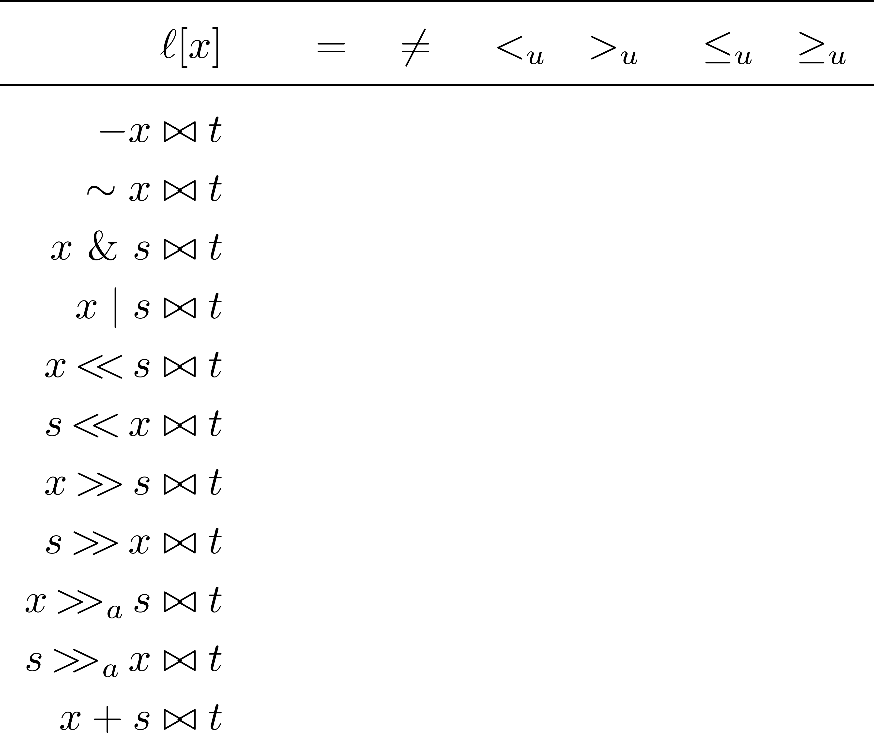
Result Summary
Notes:
The bowtie is a placeholder for the predicate.
Mention that SMT is CADE work, not CAV work.
We proved 18 equivalences in both directions, and one in one direction.

Slide 20
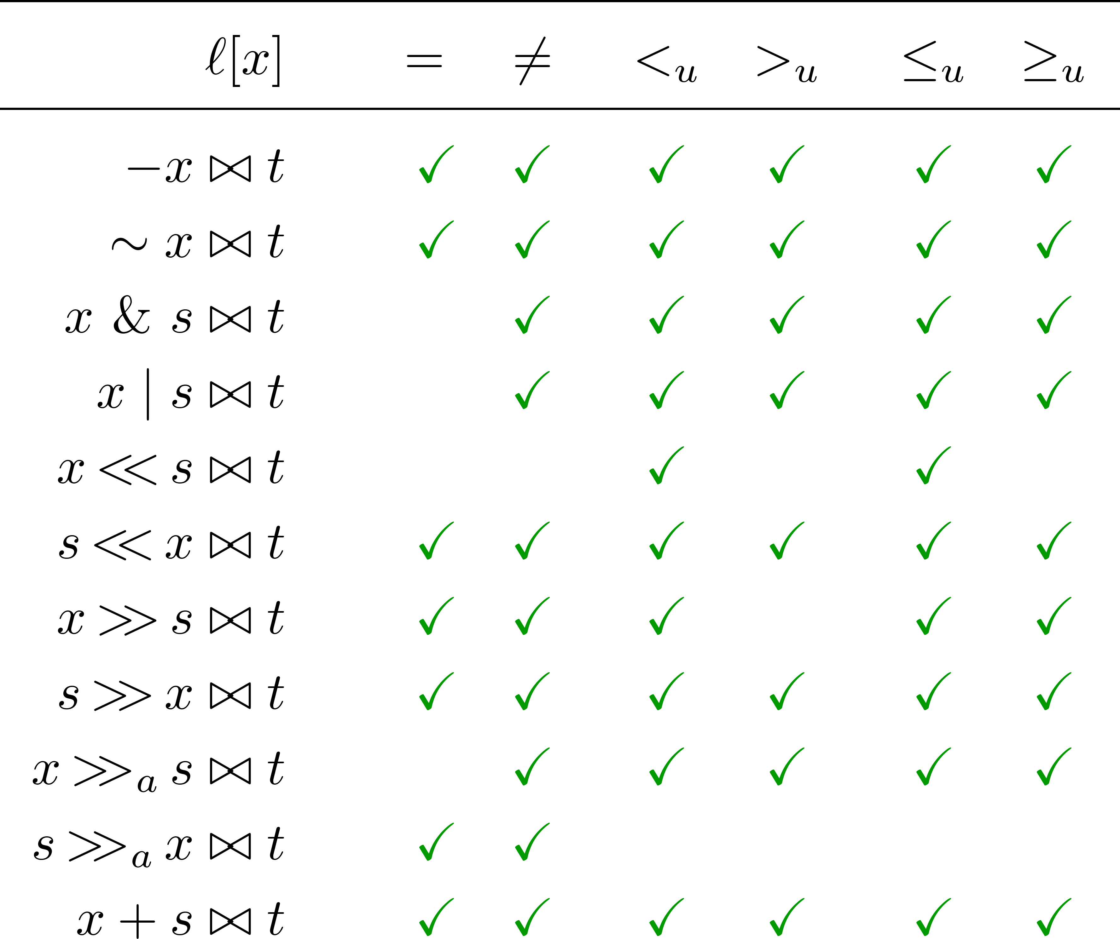
Result Summary (SMT)
Notes:
The bowtie is a placeholder for the predicate.
Mention that SMT is CADE work, not CAV work.
We proved 18 equivalences in both directions, and one in one direction.

Slide 21
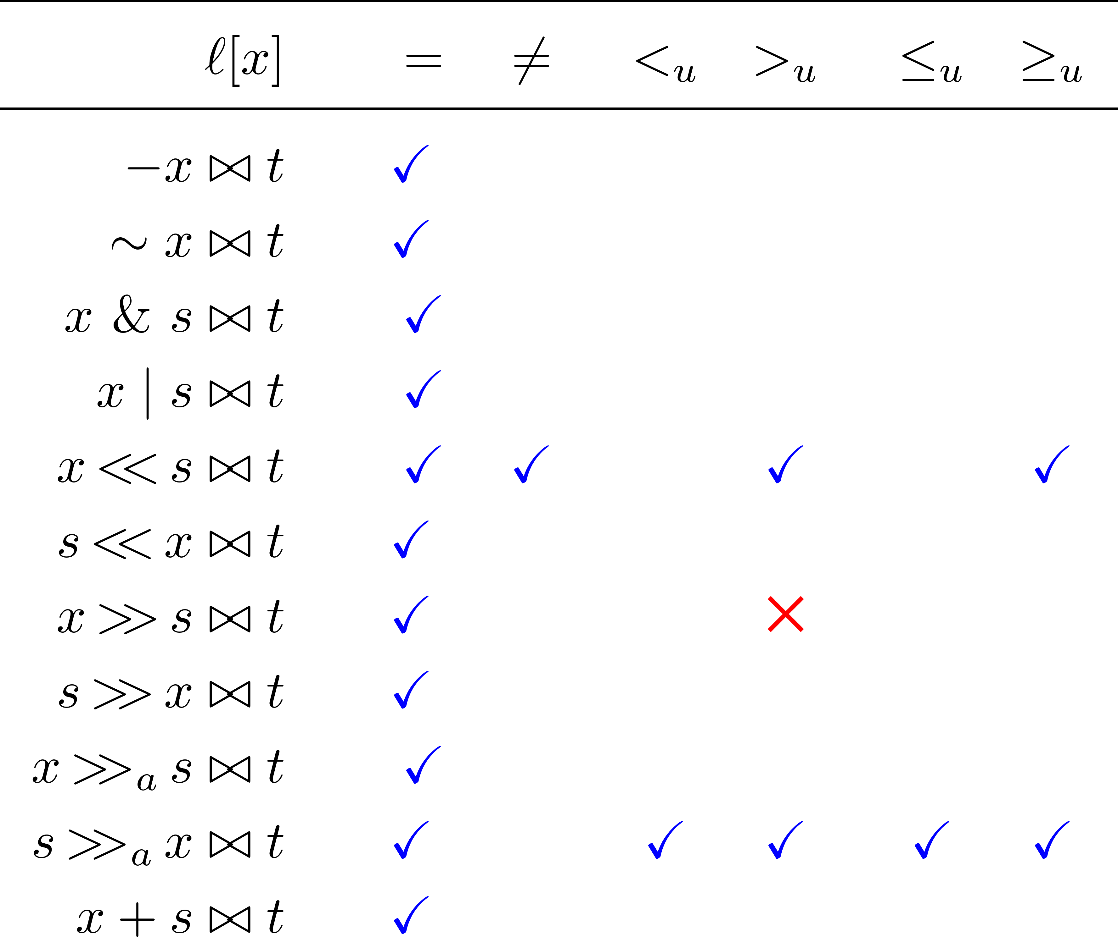
Result Summary (Coq)
Notes:
The bowtie is a placeholder for the predicate.
Mention that SMT is CADE work, not CAV work.
We proved 18 equivalences in both directions, and one in one direction.

Slide 22
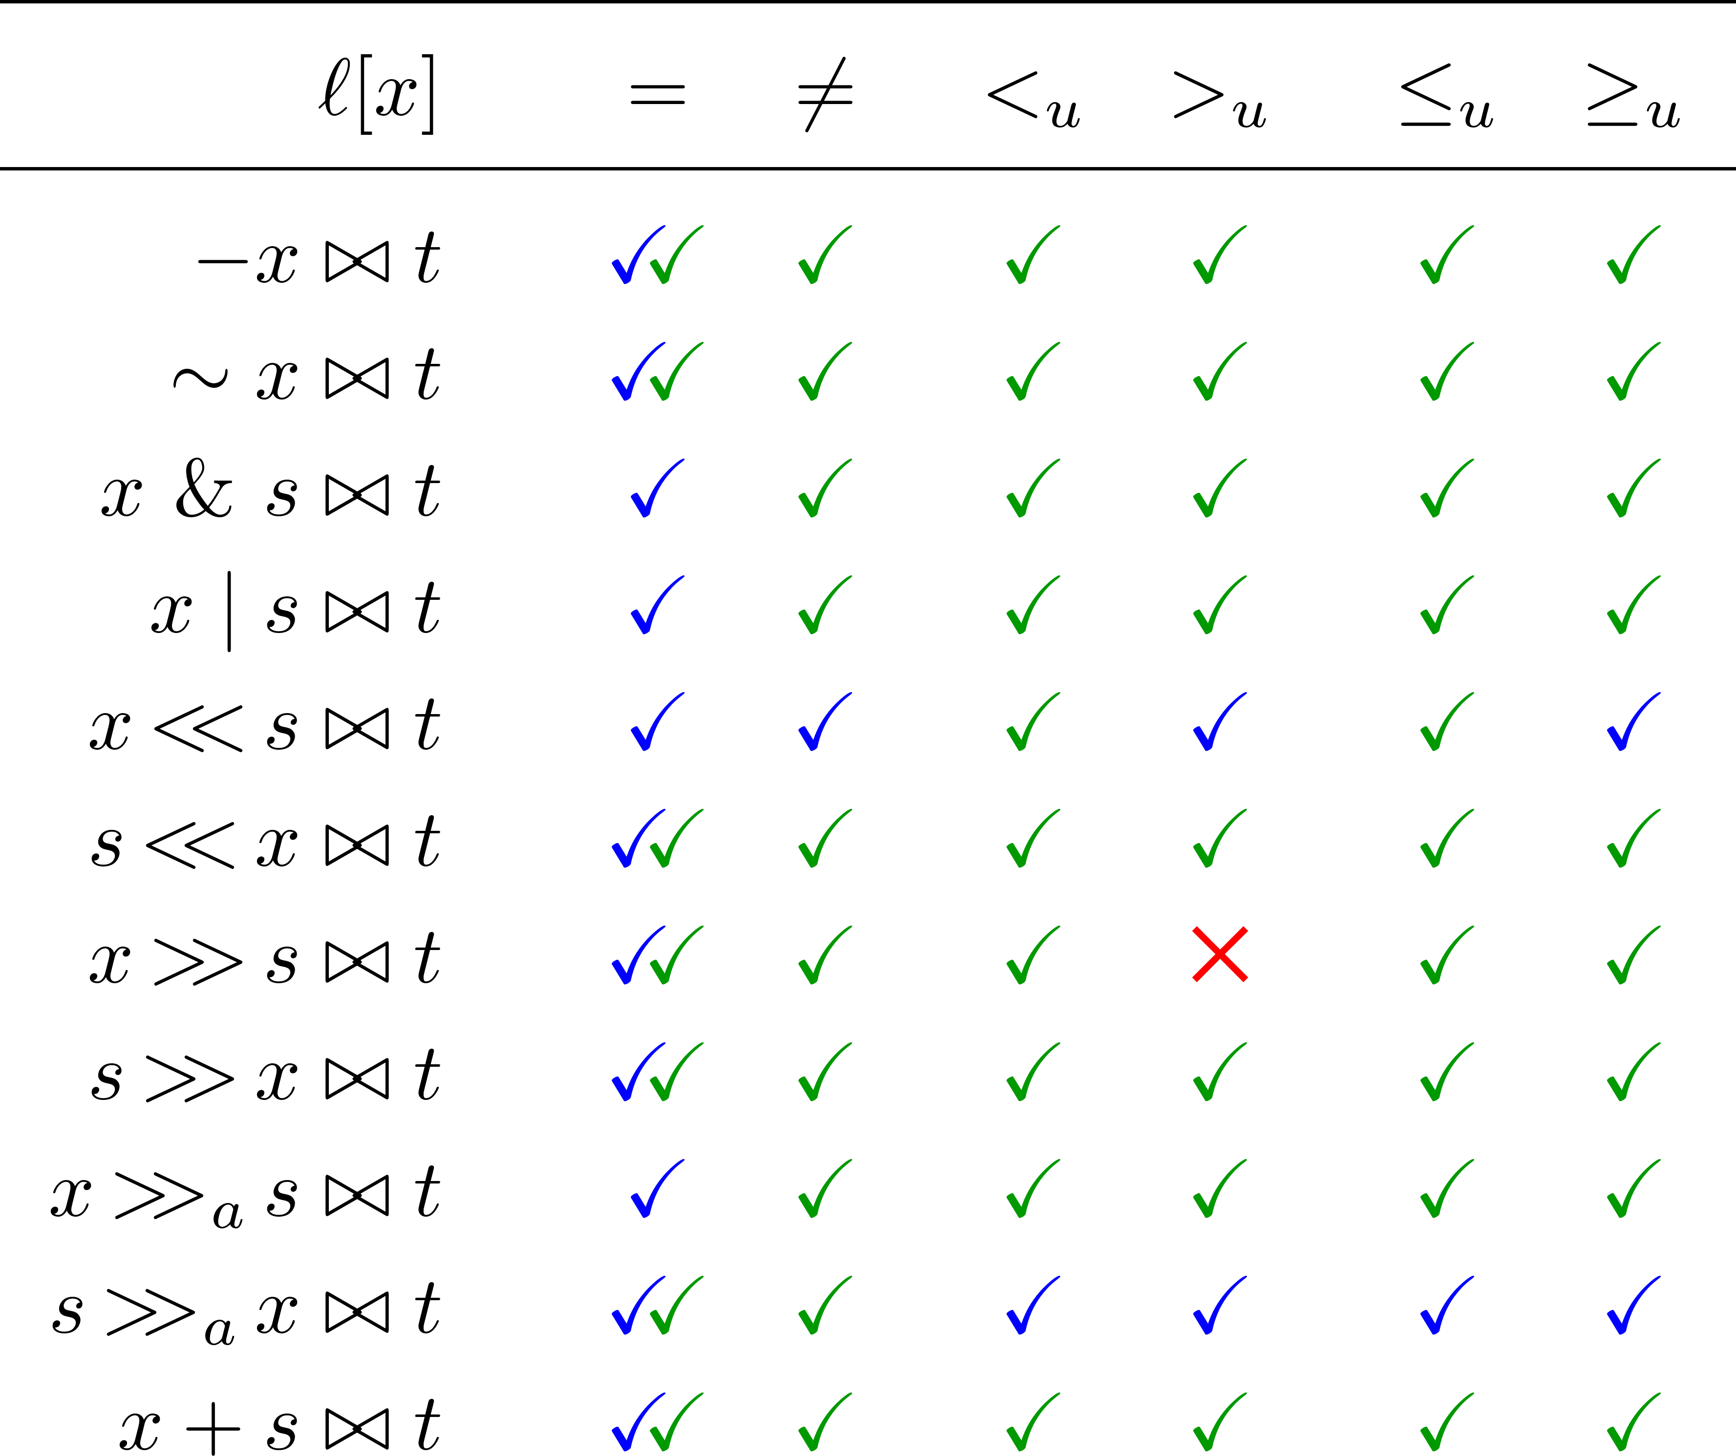
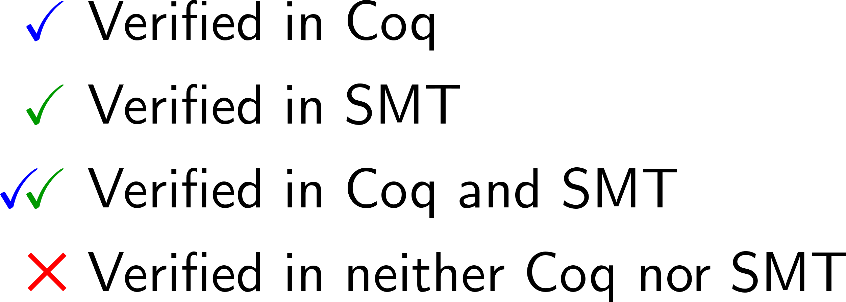
Result Summary (Both)
Notes:
The bowtie is a placeholder for the predicate.
Mention that SMT is CADE work, not CAV work.
We proved 18 equivalences in both directions, and one in one direction.

Slide 23
Bit-vector Library

Slide 24
Bit-vector Library
Used a bit-vector library originally developed for SMTCoq [Ekici et al., 2017]
SMTCoq is a Coq plugin that uses external SMT solvers to complete proof goals
Bit-vectors are represented as lists of Booleans
Notes:
Proof producing SMT solvers

Slide 25
Bit-vector Library
Used a bit-vector library originally developed for SMTCoq [Ekici et al., 2017]
SMTCoq is a Coq plugin that uses external SMT solvers to complete proof goals
Bit-vectors are represented as lists of Booleans
Modules
Types
Dependently Typed Bit-vector
bitvector : N -> Type
Functor: Raw2Bitvector
Raw (Non-dependent) Bit-vector
bitvector : Type size : bitvector -> N
Notes:
Proof producing SMT solvers

Slide 26
Bit-vector Representations
 | SMTLib [Niemetz et al. 18] | Encoding [Niemetz et al. 19] | Coq Library
Bit-vector Representation: | Bit-vector of width n One sort for each n | Bit-vector of width n Translated to NIA and UF | Bit-vector of width n List of Booleans over 2 layers
Expressivity: | n cannot be symbolic | Allows quantification over n | Bit-vectors dependent over n
Verification: | Automatic proofs using SMT solvers | Automatic proofs using SMT solvers | Manual proofs in Coq
Results | All equivalences for n = 1 to 65 | Verified ≈75% of equivalences | 18 equivalences
Notes:
Read column wise​

Slide 27
Bit-vector Library
Basic signature (previous work): + addition ₒ concatenation - negation = equality • multiplication ≠ disequality & bit-wise conjunction <_{u} unsigned less than | bit-wise disjunction >_{u} unsigned greater than ~ bit-wise negation <_{s} signed less than << logical left shift >_{s} signed greater than >> logical right shift
Extended signature (this work): ≤_{u} unsigned weak less than << logical left shift (alt. def.) ≥_{u} unsigned weak greater than >> logical right shift (alt. def.) >>_{a} arithmetic right shift >>_{a} arithmetic right shift (alt. def.)

Slide 28
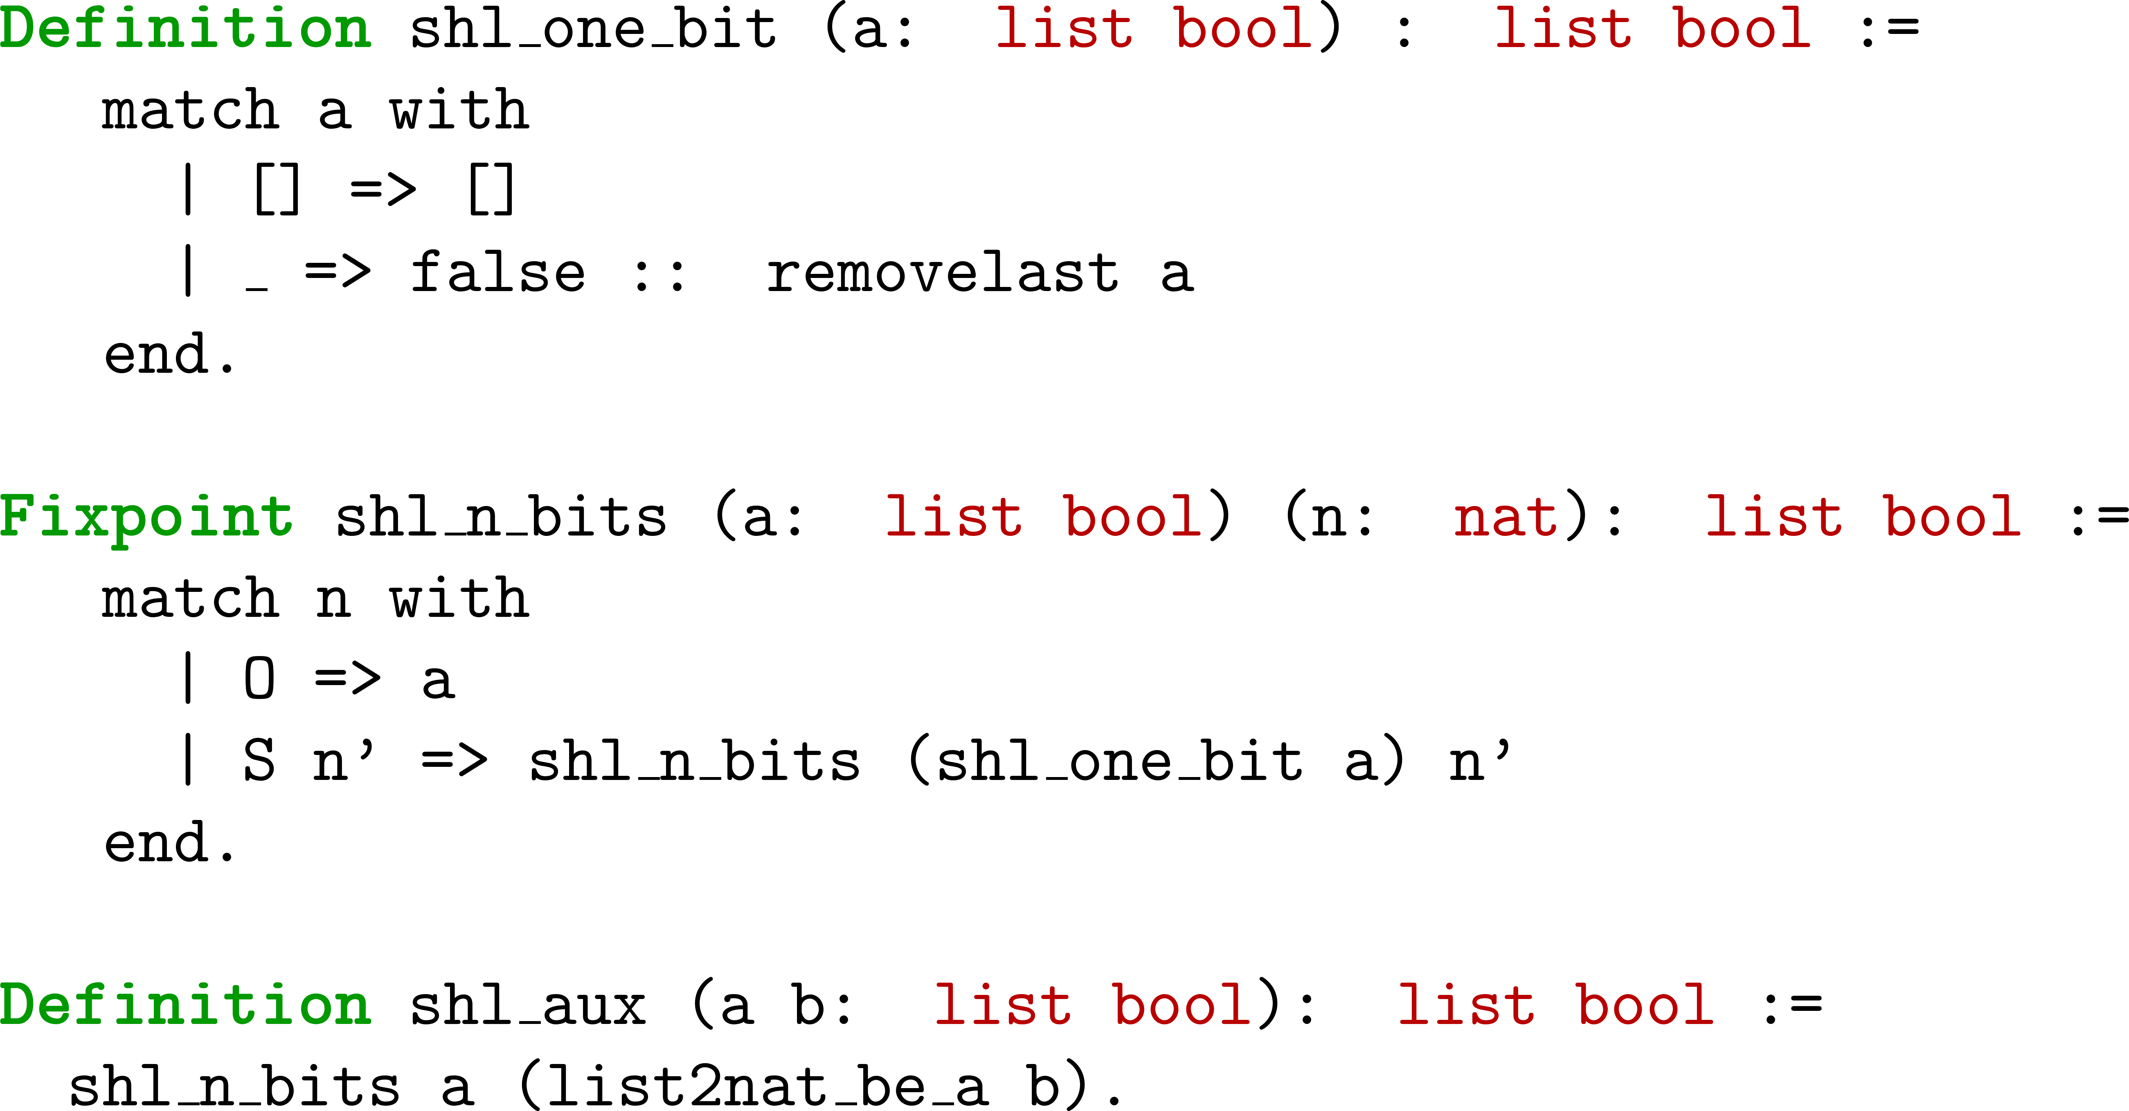
Original Shift Definition
Notes:
No need to mention: we represent bit-vectors with MSB on the right, so a left shift will look like a right shift.​

Slide 29
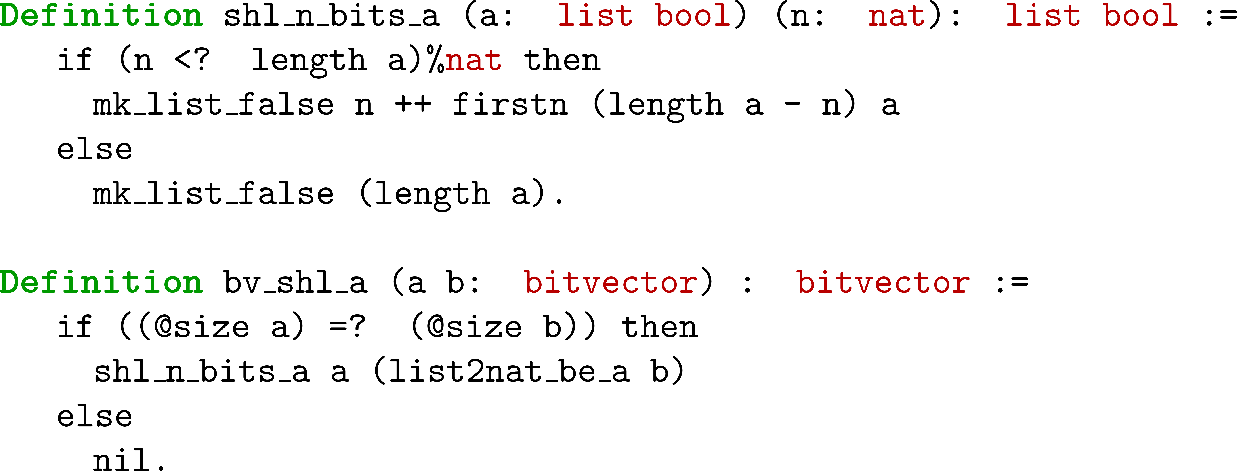
Shift Redefined
Notes:
The Coq standard list library consists of many lemmas about ++ and firstn that we found useful.
We use CoqHammer, a hammer tool that learns from previous proofs and using external solvers. ​
So CoqHammer also has these proofs at its disposal.​

Slide 30
Invertibility Conditions Proofs

Slide 31
Result Summary
Notes:
We proved 18 equivalences in both directions, and one in one direction, so far.
The proof sketch for the other direction is interesting.
In this direction of the equivalence existential becomes universal.
Left side is literal, right side is IC.

Slide 32
Result Summary
Notes:
We proved 18 equivalences in both directions, and one in one direction, so far.
The proof sketch for the other direction is interesting.
In this direction of the equivalence existential becomes universal.
Left side is literal, right side is IC.

Slide 33
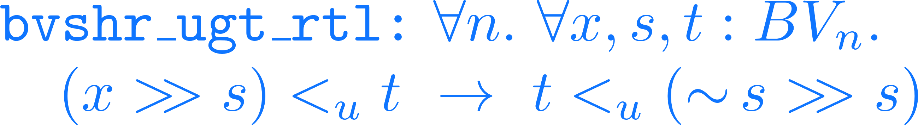
Result Summary
Notes:
We proved 18 equivalences in both directions, and one in one direction, so far.
The proof sketch for the other direction is interesting.
In this direction of the equivalence existential becomes universal.
Left side is literal, right side is IC.

Slide 34
Challenge
Notes:
In other words, msb_zero states that when k < l the most significant l - k bits of s are 0.
Consider quantification over l instead of n.
Consider removing sigma_n.

Slide 35
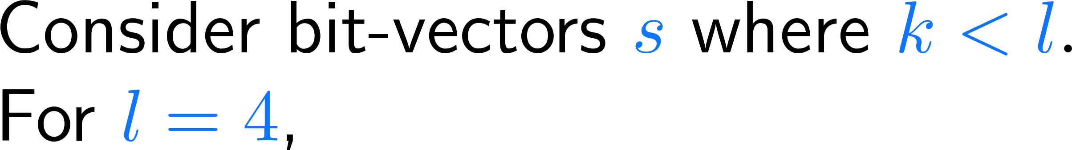
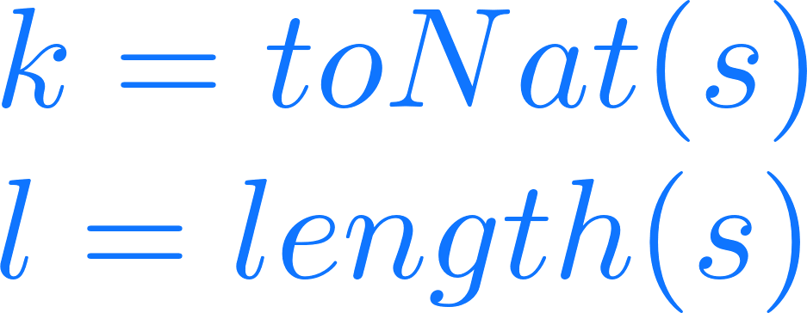
Challenge
s | k | l – k
0000 | 0 | 4
0001 | 1 | 3
0010 | 2 | 2
0011 | 3 | 1
Notes:
In other words, msb_zero states that when k < l the most significant l - k bits of s are 0.
Consider quantification over l instead of n.
Consider removing sigma_n.

Slide 36
Challenge
s | k | l – k
0000 | 0 | 4
0001 | 1 | 3
0010 | 2 | 2
0011 | 3 | 1
Notes:
In other words, msb_zero states that when k < l the most significant l - k bits of s are 0.
Consider quantification over l instead of n.
Consider removing sigma_n.

Slide 37
Challenge
s | k | l – k
0000 | 0 | 4
0001 | 1 | 3
0010 | 2 | 2
0011 | 3 | 1
Notes:
In other words, msb_zero states that when k < l the most significant l - k bits of s are 0.
Consider quantification over l instead of n.
Consider removing sigma_n.

Slide 38

Challenge
s | k | l – k
0000 | 0 | 4
0001 | 1 | 3
0010 | 2 | 2
0011 | 3 | 1
reduces to
Notes:
In other words, msb_zero states that when k < l the most significant l - k bits of s are 0.
Consider quantification over l instead of n.
Consider removing sigma_n.

Slide 39
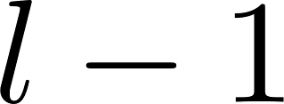




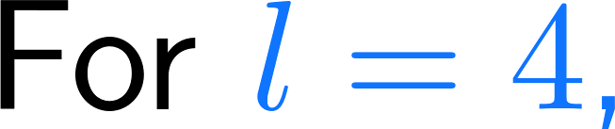
Proof Sketch of msb_zero
Proof Sketch:
s | k | l – k
0000 | 0 | 4
0001 | 1 | 3
0010 | 2 | 2
0011 | 3 | 1

Slide 40
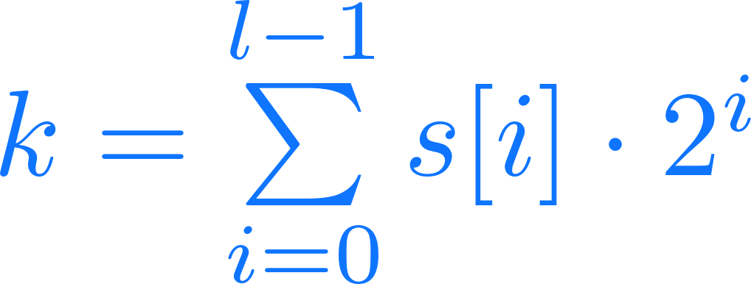
Proof Sketch of msb_zero
Proof Sketch:
s | k | l – k
0000 | 0 | 4
0001 | 1 | 3
0010 | 2 | 2
0011 | 3 | 1

Slide 41
Proof Sketch of msb_zero
Proof Sketch:
s | k | l – k
0000 | 0 | 4
0001 | 1 | 3
0010 | 2 | 2
0011 | 3 | 1

Slide 42

Proof Sketch of msb_zero
Proof Sketch:
s | k | l – k
0000 | 0 | 4
0001 | 1 | 3
0010 | 2 | 2
0011 | 3 | 1

Slide 43
Proof Sketch of msb_zero
Proof Sketch:
s | k | l – k
0000 | 0 | 4
0001 | 1 | 3
0010 | 2 | 2
0011 | 3 | 1

Slide 44
Proof Sketch of msb_zero
Proof Sketch:
s | k | l – k
0000 | 0 | 4
0001 | 1 | 3
0010 | 2 | 2
0011 | 3 | 1

Slide 45
Proof Sketch of msb_zero
Proof Sketch:
s | k | l – k
0000 | 0 | 4
0001 | 1 | 3
0010 | 2 | 2
0011 | 3 | 1

Slide 46
Conclusion
[Niemetz et al., CAV 2018] presented 162 invertibility conditions
[Niemetz et al., CADE 2019] verified ≈75% of the equivalences using an encoding
We complemented [Niemetz et al., CADE 2019] in proving all but one invertibility equivalences from 66 of them
We did this in the Coq proof assistant
We extended the Coq bit-vector library for SMTCoq to do this

Slide 47
Future Work
Integrate the extended bit-vector library into SMTCoq
Prove the remaining invertibility equivalences
Extend the library with / % ≤_{s} ≥_{s}
Refactor the library for improved readability and modularity
Consider using MathComp library for future proofs

Slide 48
References
[Gupta et al., 1993] Aarti Gupta, Allan L. Fisher. Representation and Symbolic Manipulation of Linearly Inductive Boolean Functions. In proceedings of ICCAD '93 of the 1993 IEEE/ACM international conference on Computer-aided design, pages 192-199.
[Armando et al., 2006] Alessandro Armando, Jacopo Mantovani, Lorenzo Platania. Bounded Model Checking of Software Using SMT Solvers Instead of SAT Solvers. In proceedings of International SPIN Workshop on Model Checking of Software. SPIN 2006: Model Checking Software, pages 146-162.
[Cadar et al., 2006] Cristian Cadar, Vijay Ganesh, Peter M. Pawlowski, David L. Dill, Dawson R. Engler. EXE: Automatically Generating Inputs of Death. In proceedings of CCS '06 Proceedings of the 13th ACM conference on Computer and communications security, pages 322-335.
[Niemetz et al., CAV 2018] Aina Niemetz, Mathias Preiner, Andrew Reynolds, Clark Barrett, Cesare Tinelli. Solving Quantified Bit-Vectors Using Invertibility Conditions. In proceedings of International Conference on Computer Aided Verification 2018, pages 236-255.
[Niemetz et al., CADE 2019] Aina Niemetz, Mathias Preiner, Andrew Reynolds, Yoni Zohar, Clark Barrett and Cesare Tinelli. Towards Bit Width Independent Proofs in SMT Solvers. To appear in proceedings of International Conference on Automated Deduction 2019.
[Ekici et al., 2017] Burak Ekici, Alain Mebsout, Cesare Tinelli, Chantal Keller, Guy Katz, Andrew Reynolds, Clark Barrett. SMTCoq: A Plug-in for Integrating SMT Solvers into Coq. In proceedings of 29th International Conference of Computer Aided Verification 2017.

Slide 49
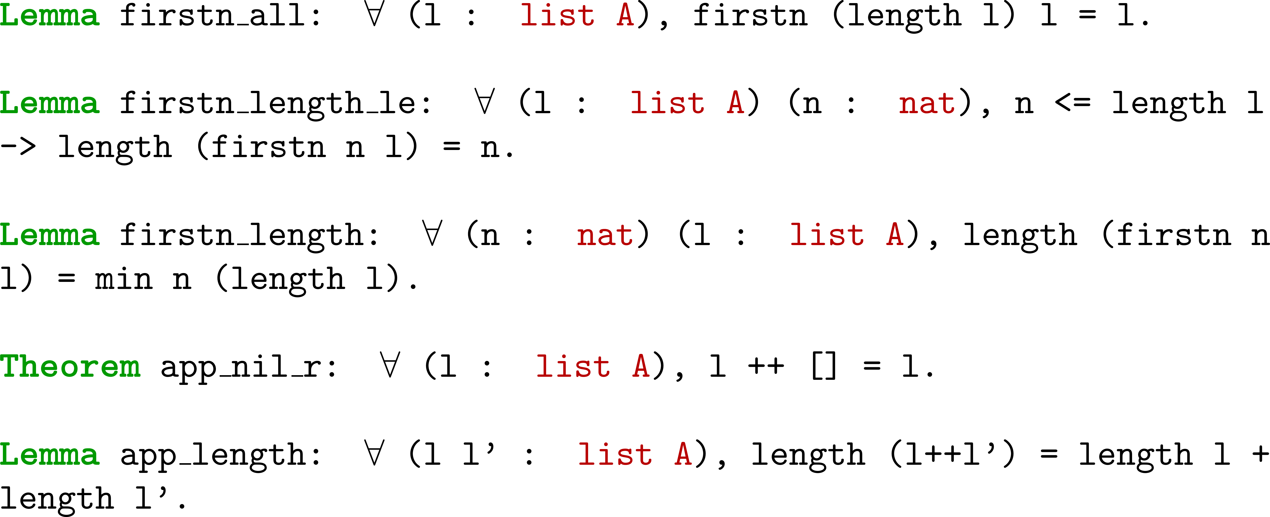
Useful Lemmas
Notes:
We use CoqHammer, a hammer tool that learns from previous proofs and using external solvers. ​
So CoqHammer also has these proofs at its disposal.​

