Slide 1



Verifying Bit-vector Invertibility Conditions in Coq
Burak Ekici, Arjun Viswanathan, Yoni Zohar, Clark Barrett, Cesare Tinelli

Slide 2
Introduction
Bit-vectors have many applications:
Hardware circuit analysis [Gupta et al., 1993]
Bounded model checking [Armando et al., 2006]
Symbolic execution [Cadar et al., 2006 ]
...

Slide 3
Introduction
Most applications use quantified bit-vector formulas
Some SMT-solvers use quantifier-instantiation to solve quantified formulas
Invertibility conditions are a useful meta-construct for a quantifier-instantiation technique [Niemetz et al., CAV 2018]
Invertibility conditions appear in invertibility equivalences

Slide 4


Invertibility Conditions
An invertibility condition (IC) for a variable x in a bit-vector literal
is a formula
s.t. this equivalence is valid (in the theory of bit-vectors):
We call this equivalence an invertibility equivalence

Slide 5
Invertibility Conditions: Example
Inversion of bit-vector addition is unconditional The inverse is x = t – s
Inversion of bit-vector multiplication is conditional

Slide 6
Motivation
[Niemetz et al., CAV 2018] requires these equivalences to be true independent of bit-width
Proofs of these equivalences parametric in bit-width are guarantees that bolster the results of the SMT-solvers that use them
Notes:
For general correctness, the quantifier instantiation technique introduced by [Niemetz et al.] requires the equivalences to be true.

Slide 7
Previous Work
[Niemetz et al., CAV 2018] generated 162 invertibility equivalences, and proved them using SMT-solvers for bit-widths up to 65
[Niemetz et al., CADE 2019] encoded the equivalences in theories supported by SMT-solvers to reason about parametric bit-widths
The approach by [Niemetz et al., CADE 2019] failed on over a quarter of the equivalences

Slide 8
Contributions
Represented a subset of the 162 invertibility equivalences in Coq, and proved them for arbitrary bit-width
Extended a Coq bit-vector library to support some of these equivalences

Slide 9
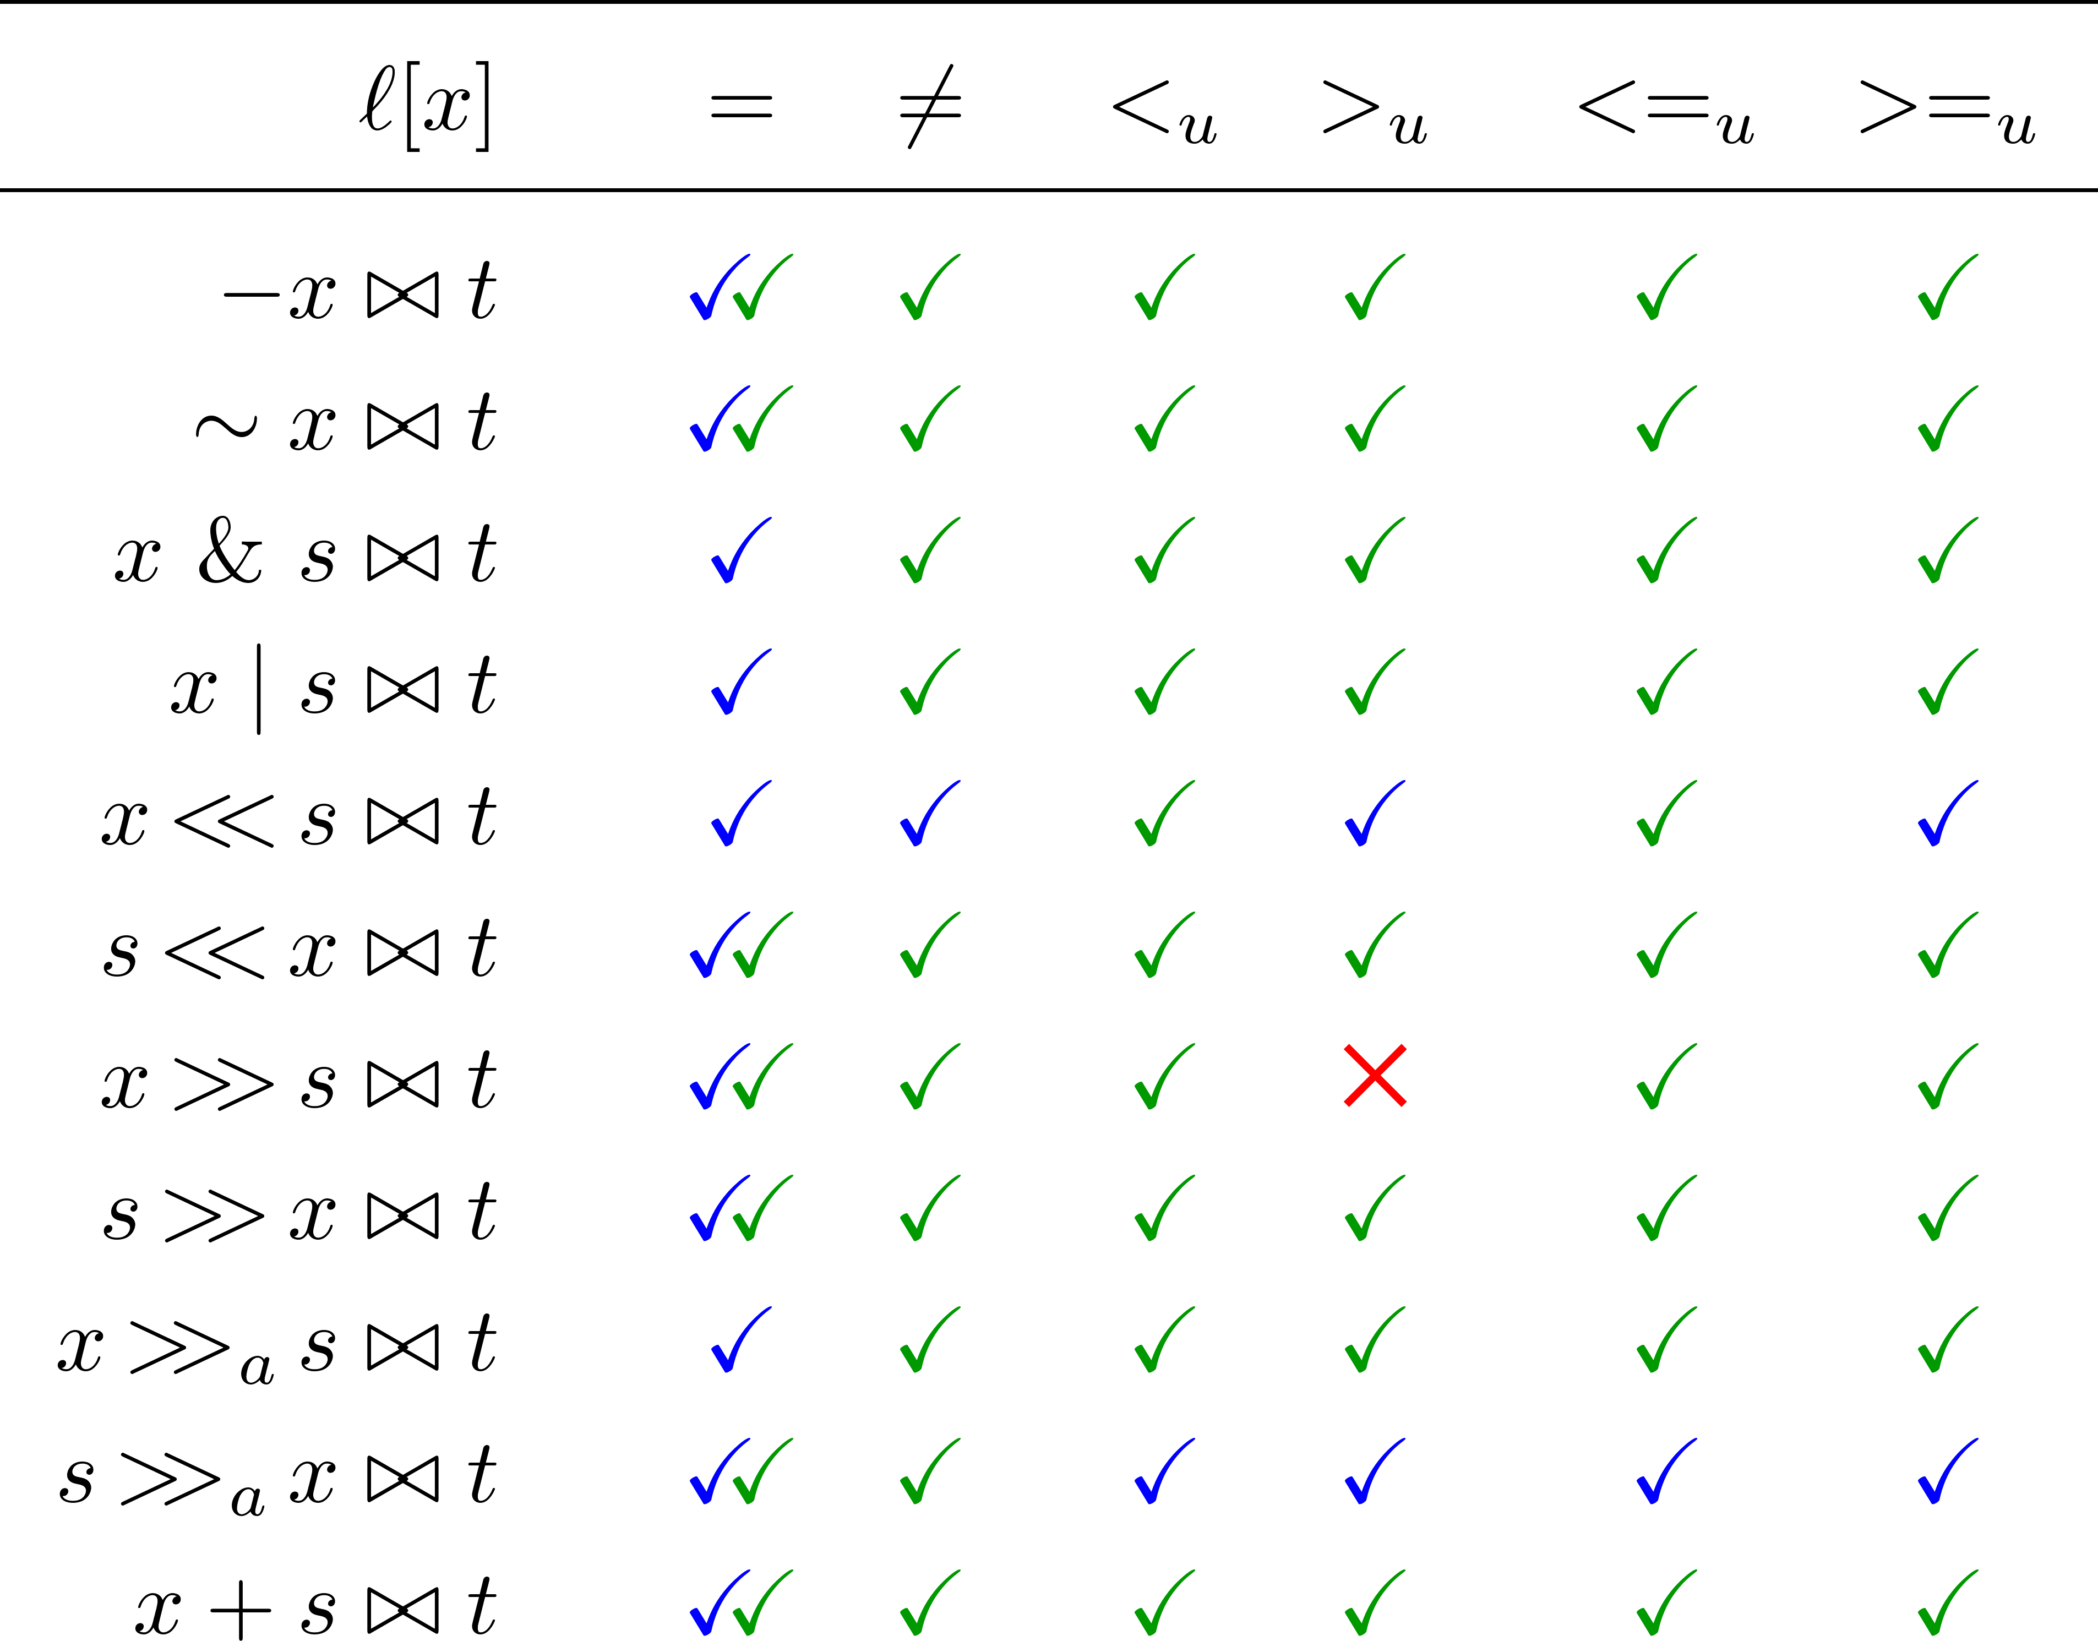
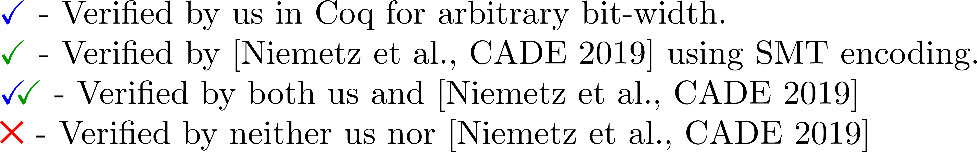
Result Summary

Slide 10
Bit-vector Library
We used a bit-vector library originally developed for SMTCoq [Ekici et al., 2017]
SMTCoq is a Coq plugin that uses external SMT solvers to complete proof goals
Bit-vectors are represented as lists of Booleans
Modules
Types
Raw (Non-dependent) Bit-vector
bitvector : Type size : bitvector -> N
Functor: Raw2Bitvector
Dependently Typed Bit-vector
bitvector : N -> Type

Slide 11
Bit-vector Representations
SMTLib [Niemetz et al., 2018] | [Niemetz et al., 2019] | Coq Library
Bit-vector n, one sort for each n No dependent types n can’t be symbolic Automatic proofs using SMT-solvers for n = 1 to 65 | Bit-vector n, translated to NIA and UF Allows quantification over n Automatic proofs using SMT-solvers for 75% of equivalences | Bit-vector n, represented as list of Booleans over 2 layers Raw bit-vectors have external size guarantees Dependent bit-vectors are built over raw-bitvectors. Manual proofs in Coq for a subset of the equivalences

Slide 12
Bit-vector Library
Basic signature: + (addition) ₒ (concatenation) - (negation) = (equality) • (multiplication) ≠ (unequality) & (bit-wise conjunction) <_{u} (unsigned less than) | (bit-wise disjunction) >_{u} (unsigned greater than) ~ (bit-wise negation) <_{s} (signed less than) << (logical left) >_{s} (signed greater than) >> (and right shift )
Extended signature: ≤_{u} (unsigned weak less than) new definitions of << and >> ≥_{u} (unsigned weak greater than) >>_{a} (arithmetic right shift)
Notes:
Organize into columns starting with symbols

Slide 13
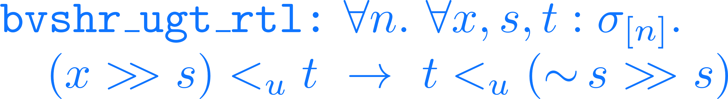
Result Summary

Slide 14
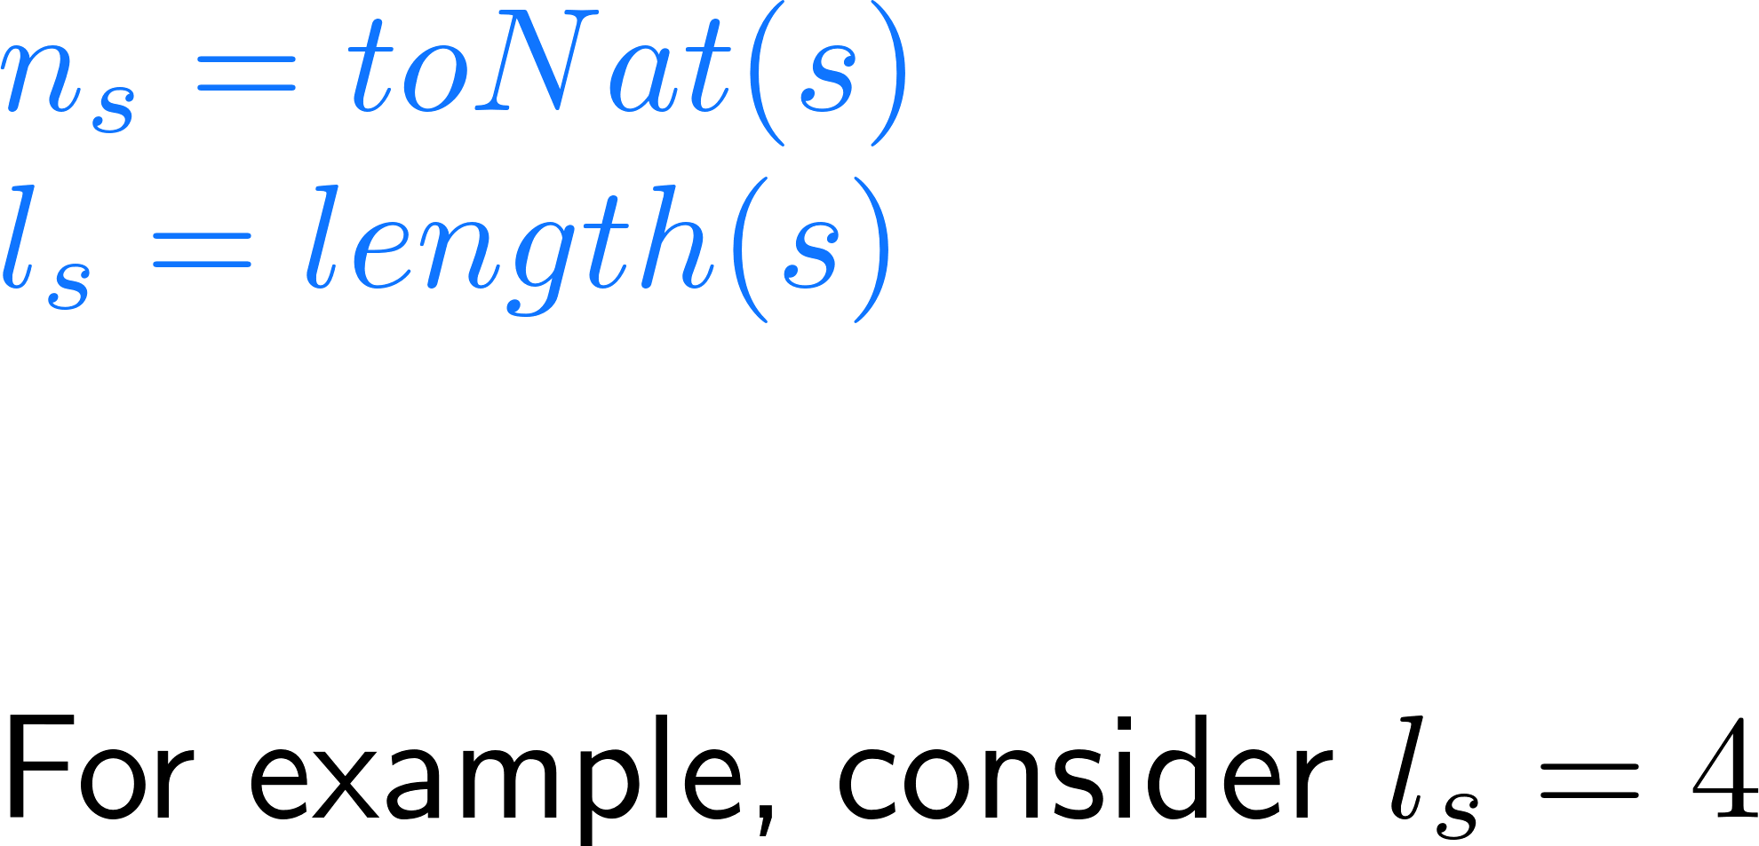
Challenge
reduces to
where
s | n_{s} | l_{s} – n_{s}
0000 | 0 | 4
0001 | 1 | 3
0010 | 2 | 2
0011 | 3 | 1
Notes:
In other words, msb_zero states that when n_s < l_s the most significant l_s – n_s bits of s are 0.

Slide 15
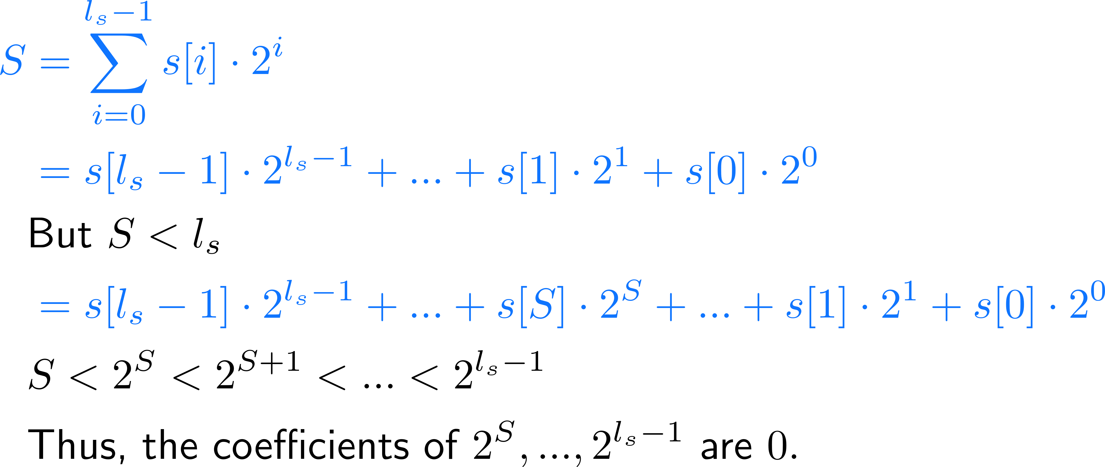
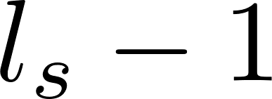




Proof of msb_zero
Proof:
Notes:
Change to texsf. To align, make separate aligns and add \phantom{S}

Slide 16
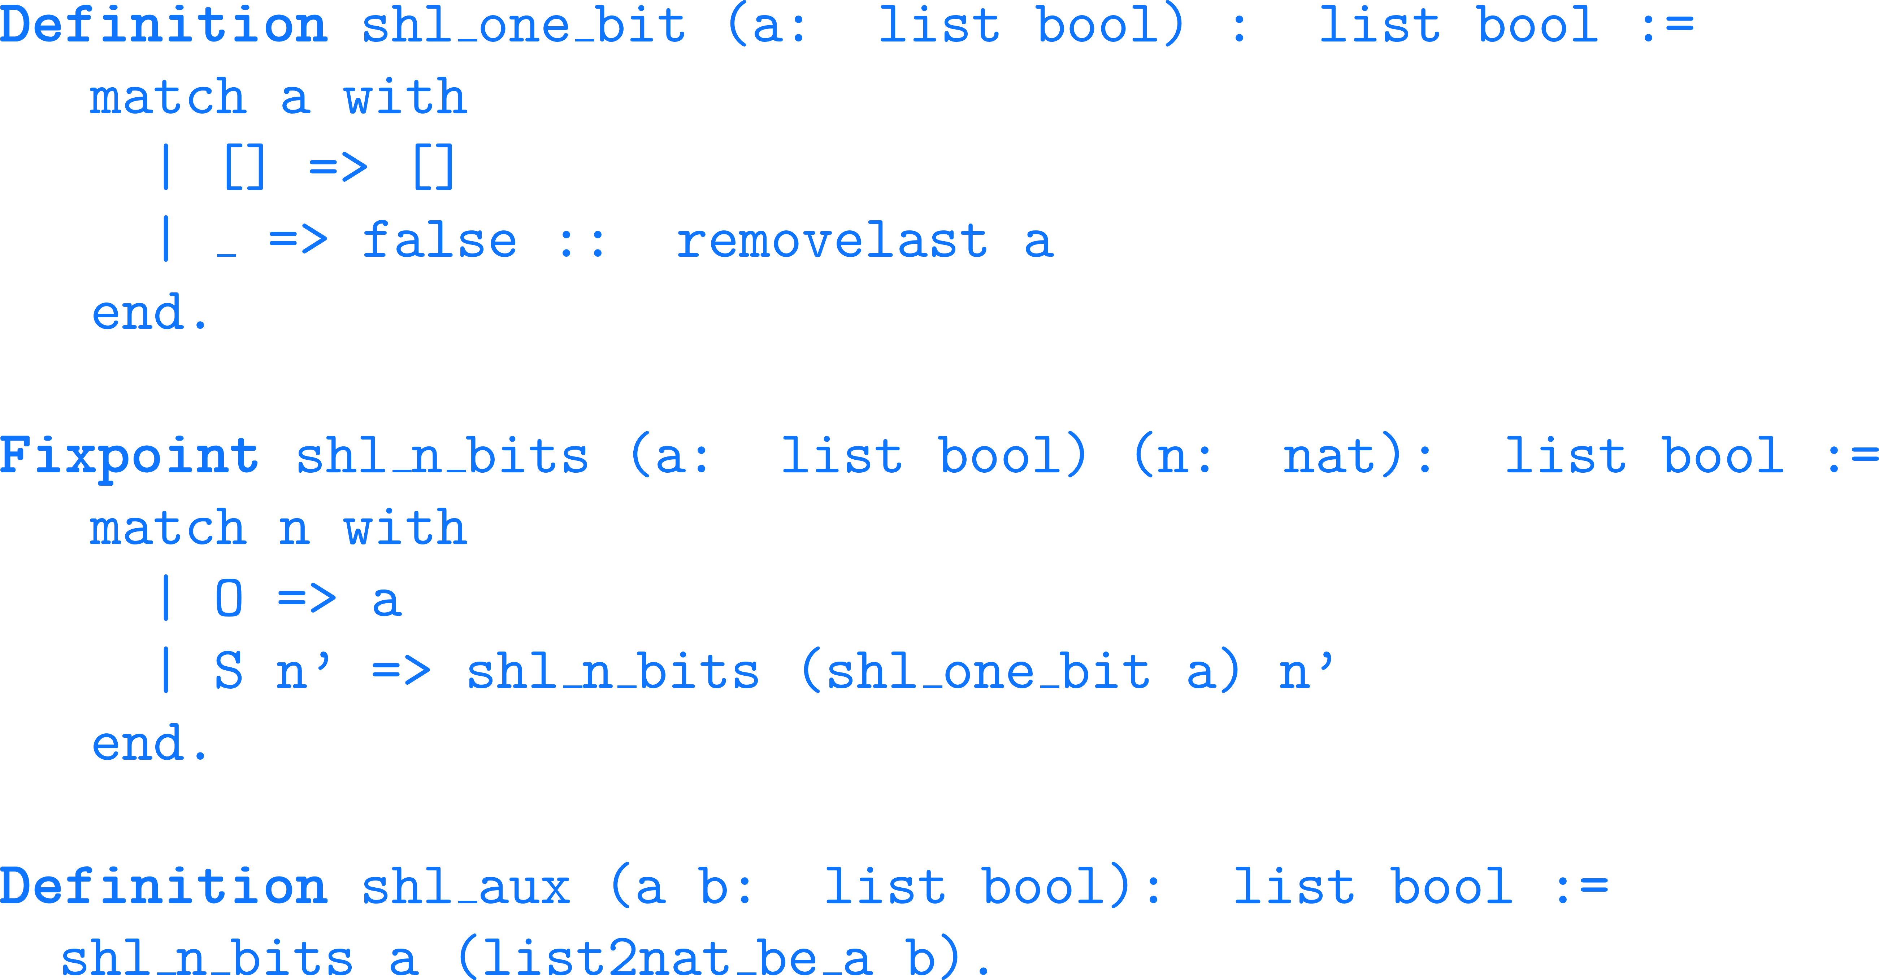
Definition of Shift

Slide 17
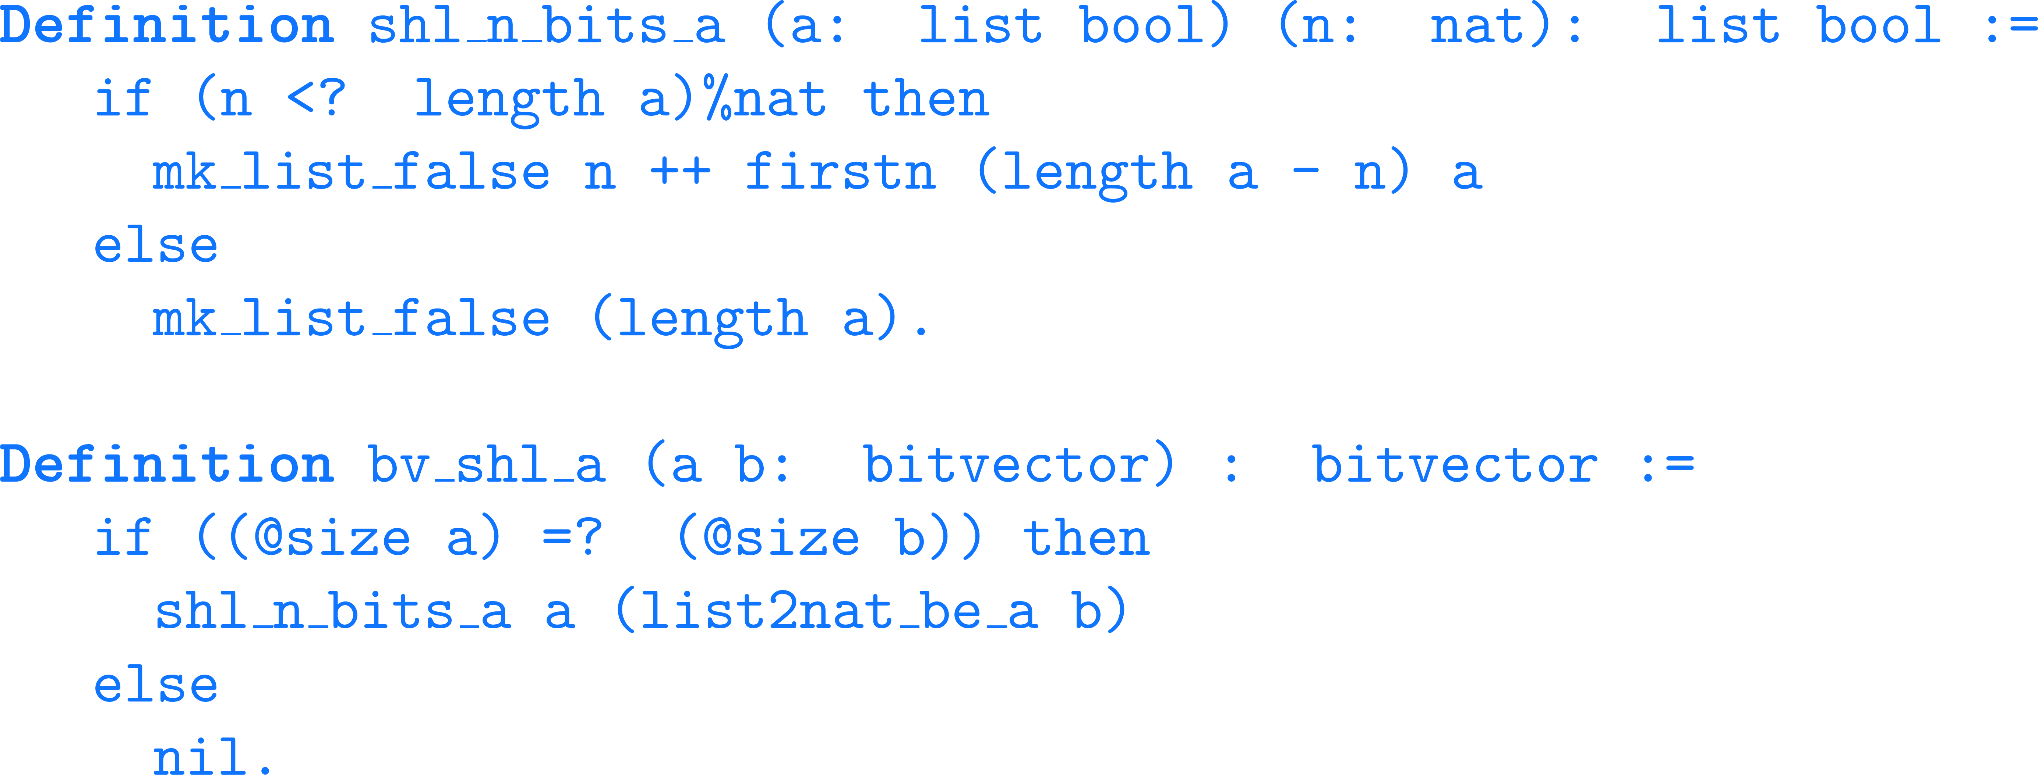
Shift Redefined

Slide 18
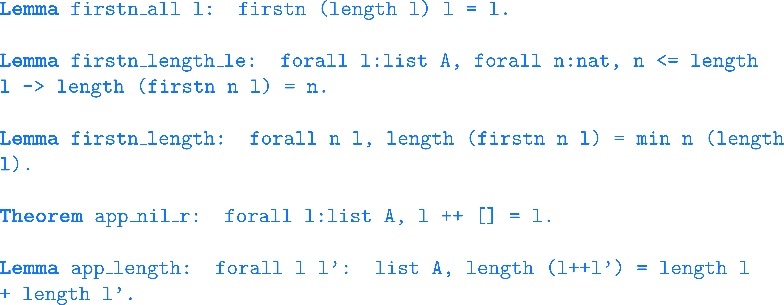
Useful Lemmas

Slide 19
Conclusion
We complemented [Niemetz et al., CADE 2019] in proving all but one invertibility equivalences from the 162 presented by [Niemetz et al., CAV 2018] We did this in the Coq proof assistant
We extended the Coq bit-vector library for SMTCoq to do this

Slide 20
Future Work
Make the extended bit-vector library compatible with SMTCoq
Extend the library with division (/), modulus (%), and weak signed comparison operators (≤_{s}, ≥_{s}) and prove equivalences over them
Organize the library as one for SMTLib2 bit-vectors

Slide 21
References
[Gupta et al., 1993] Aarti Gupta, Allan L. Fisher. Representation and Symbolic Manipulation of Linearly Inductive Boolean Functions. In proceedings of ICCAD '93 of the 1993 IEEE/ACM international conference on Computer-aided design, pages 192-199.
[Armando et al., 2006] Alessandro Armando, Jacopo Mantovani, Lorenzo Platania. Bounded Model Checking of Software Using SMT Solvers Instead of SAT Solvers. In proceedings of International SPIN Workshop on Model Checking of Software. SPIN 2006: Model Checking Software, pages 146-162.
[Cadar et al., 2006] Cristian Cadar, Vijay Ganesh, Peter M. Pawlowski, David L. Dill, Dawson R. Engler. EXE: Automatically Generating Inputs of Death. In proceedings of CCS '06 Proceedings of the 13th ACM conference on Computer and communications security, pages 322-335.
[Niemetz et al., CAV 2018] Aina Niemetz, Mathias Preiner, Andrew Reynolds, Clark Barrett, Cesare Tinelli. Solving Quantified Bit-Vectors Using Invertibility Conditions. In proceedings of International Conference on Computer Aided Verification 2018, pages 236-255.
[Niemetz et al., CADE 2019] Aina Niemetz, Mathias Preiner, Andrew Reynolds, Yoni Zohar, Clark Barrett and Cesare Tinelli. Towards Bit Width Independent Proofs in SMT Solvers. To appear in proceedings of International Conference on Automated Deduction 2019.
[Ekici et al., 2017] Burak Ekici, Alain Mebsout, Cesare Tinelli, Chantal Keller, Guy Katz, Andrew Reynolds, Clark Barrett. SMTCoq: A Plug-in for Integrating SMT Solvers into Coq. In proceedings of 29th International Conference of Computer Aided Verification 2017.

