Slide 1



Verifying Bit-vector Invertibility Conditions in Coq
Burak Ekici, Arjun Viswanathan, Yoni Zohar, Clark Barrett, Cesare Tinelli

Slide 2
Introduction
The theory of bit-vectors can be used to model problems in many applications:
Hardware circuit analysis
Bounded model checking
Symbolic execution
...

Slide 3
Introduction
It is useful to solve quantified bit-vector formulas, and to have guarantees about them
To solve quantified bit-vector formulas, some SMT-solvers use quantifier-instantiation.
Invertibility conditions appear in quantified bit-vector equivalences (invertibility equivalences), and are a useful meta-construct, for a quantifier-instantiation technique.

Slide 4
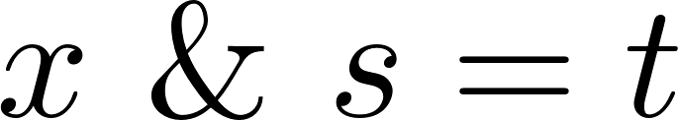
Invertibility Conditions: Example
Inversion of bit-vector addition is unconditional. (*x + s = t is always invertible for x*) The inverse is x = t – s (*and the invertibility condition is T.*)
(*The following equation is not always invertible: The conditions under which it is invertible for x are:*) Inversion of bit-vector multiplication is conditional

Slide 5
Motivation
This quantifier instantiation technique requires these invertibility equivalences to be true independent of their bit-width, for general correctness.
As a result, proofs of these equivalences parametric in bit-width are guarantees that bolster the results of the SMT-solvers that use them.

Slide 6
Previous Work
Previous work generated 162 of these invertibility equivalences, and proved them using SMT-solvers for bit-widths up to 65.
Another approach was to encode the equivalences in theories supported by SMT-solvers to reason about parametric bit-widths. However, this approach failed on over a quarter of the equivalences.

Slide 7
Contributions
Represented a subset of the 162 invertibility equivalences in Coq, and proved them for arbitrary bit-width.
Extended a Coq bit-vector library to support some of these equivalences.

Slide 8


Invertibility Conditions
An invertibility condition (IC) for a variable x in a bit-vector literal
is a formula
s.t. this equivalence is valid (in the theory of bit-vectors):
We call this equivalence an invertibility equivalence (IE).

Slide 9
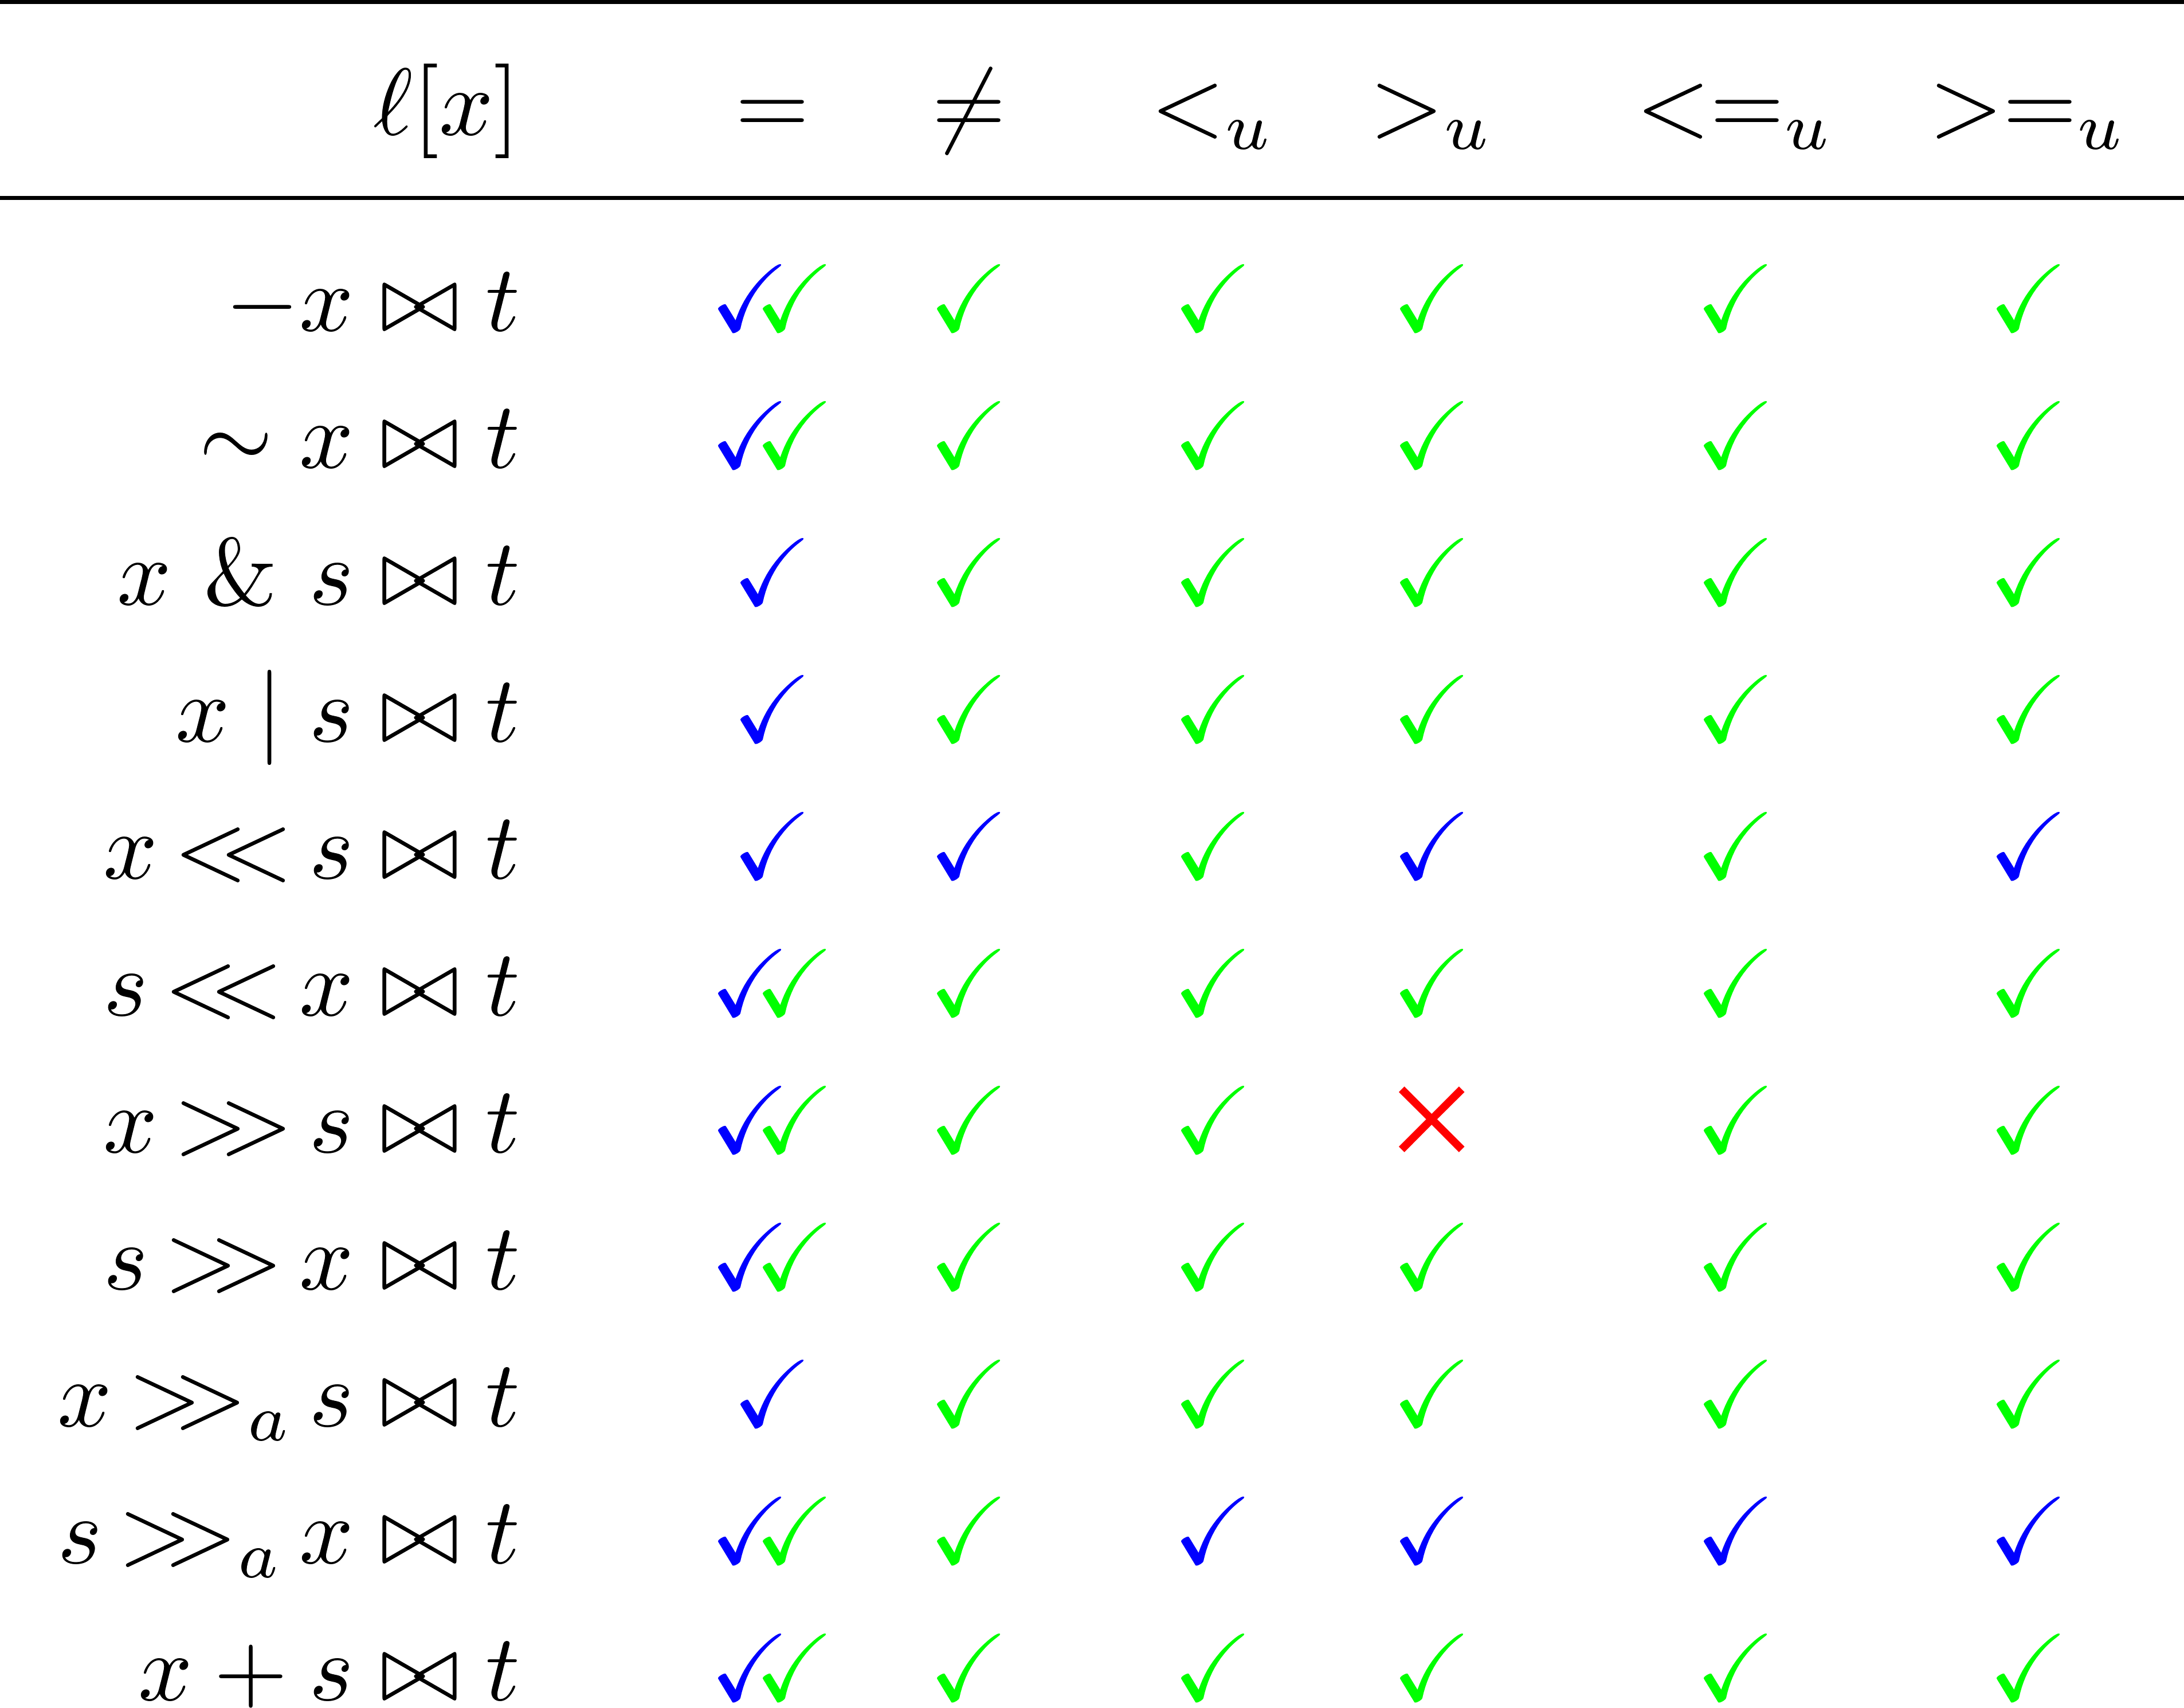
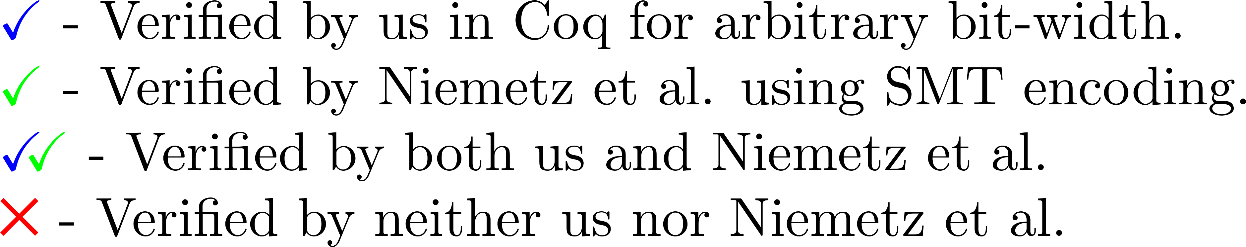
Result Summary

Slide 10
Bit-vector Library
We used a bit-vector library originally developed for SMTCoq – a Coq plugin that uses external SMT solvers to complete proof goals.
Bit-vectors are represented as lists of Booleans.
Modules
Types
Raw (Non-dependent) Bit-vector
bitvector : Type size : bitvector -> N
Functor: Raw2Bitvector
Dependently Typed Bit-vector
bitvector : N -> Type

Slide 11
Bit-vector Library
The library had support for the following operators and predicates:
Addition, negation, multiplication.
Bit-wise conjunction, disjunction, negation.
Logical left and right shift.
Concatenation.
Equality, unequality.
Signed and unsigned less than and greater than.
We extended the library with the following:
Unsigned weak inequalities.
Arithmetic right shift.
New definitions of all shift operators and a proof of equivalence between the two sets of definitions.

Slide 12
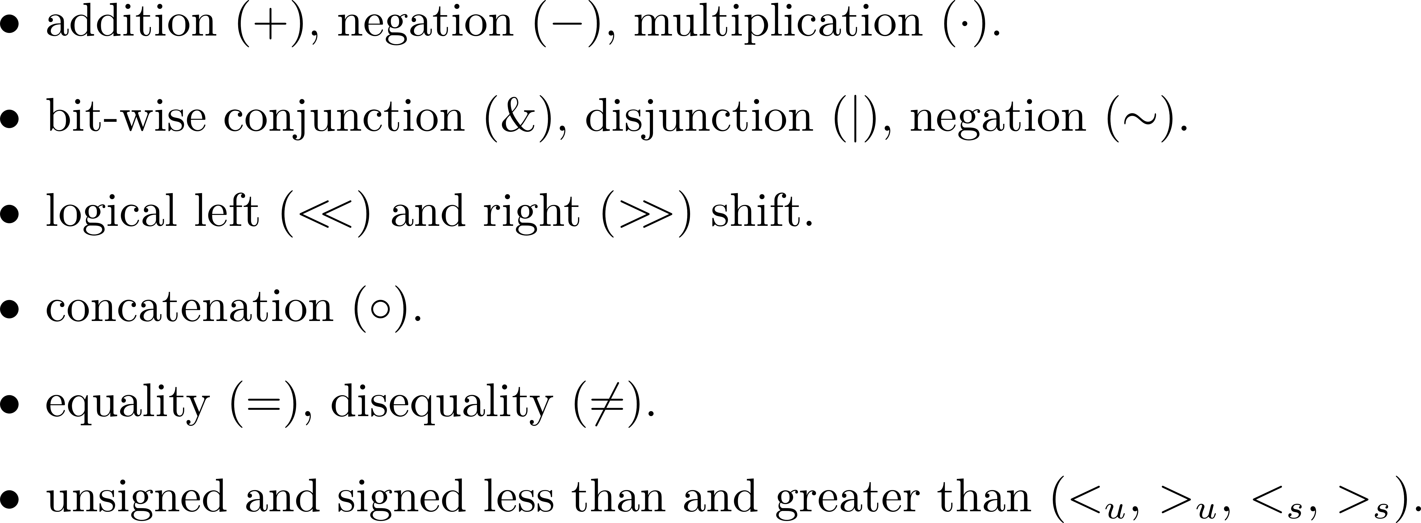
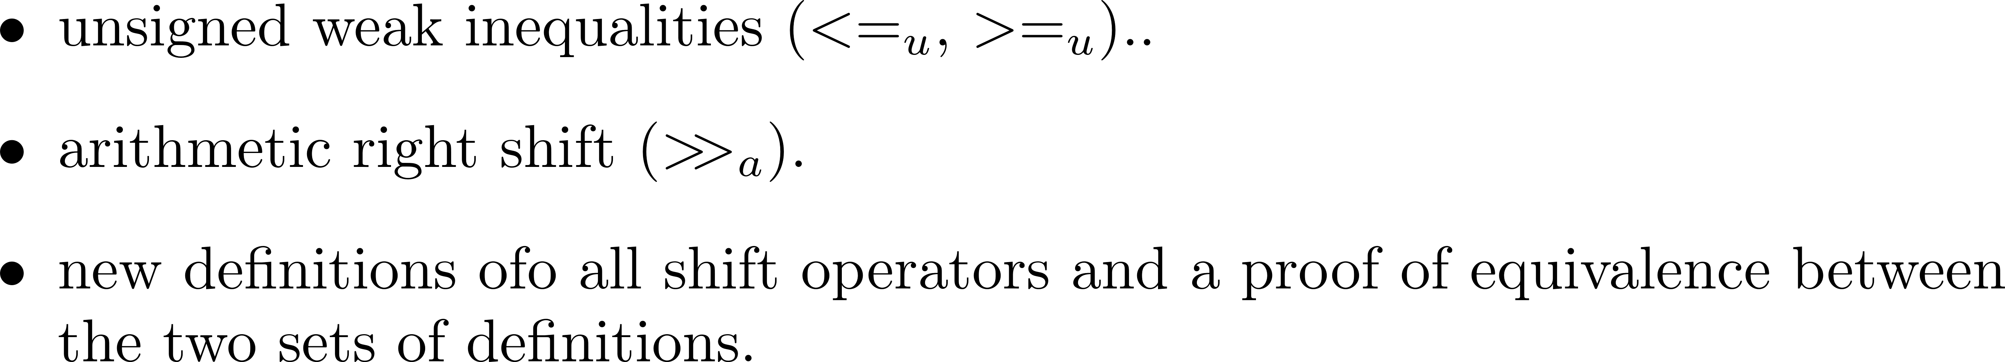

Slide 13
References
Aarti Gupta, Allan L. Fisher. Representation and Symbolic Manipulation of Linearly Inductive Boolean Functions. In proceedings of ICCAD '93 of the 1993 IEEE/ACM international conference on Computer-aided design, pages 192-199.
Alessandro Armando, Jacopo Mantovani, Lorenzo Platania. Bounded Model Checking of Software Using SMT Solvers Instead of SAT Solvers. In proceedings of International SPIN Workshop on Model Checking of Software. SPIN 2006: Model Checking Software, pages 146-162.
Cristian Cadar, Vijay Ganesh, Peter M. Pawlowski, David L. Dill, Dawson R. Engler. EXE: Automatically Generating Inputs of Death. In proceedings of CCS '06 Proceedings of the 13th ACM conference on Computer and communications security, pages 322-335.

