Slide 1
Content moderation using machine learning
Arjun Ajith B160140EC
Amal Surendran B160285EC

Slide 2
Introduction
Deep learning is probably one of the hottest tech topics right now. Large corporations and young startups alike are all gold-rushing this fancy field. Neural Networks have existed as far back as the 1960’s but with the advent of Deep Learning and increased processing power of the GPUs, it has yet again taken the spotlight revolutionizing the every field that has started to integrate AI.

Slide 3
Motivation
In the modern age of infinite data, the exchange of information happens quicker than the tick of the second hand of a clock. So vast is the amount of information that there is seldom any control over what is sent and received. The chaotic tendencies of consumed content demands moderation. The robustness and dependability of programming can provide a resolution.

Slide 4
Aim
The project inclusive of all its fragments aims to create a premise for large scale tool that can be upgraded into a fully fledged content moderation tool, beginning with the two most prominent parts of any internet site or plug in, which are text and image. By focusing on textual and imagery moderation, a base is set for a functioning tool that can be improved and innovated to be inclusive of more forms of media and content. The tool, in its essence, should be able to deduct whether a post on a website is appropriate or inappropriate for mass consumption.

Slide 5
The Overall Tool
The content moderation tool itself is divided into two parts that work in tandem to function properly. These are created separately, in order to assist the debugging process. They are, namely :
Text processing part
Image processing part
A major component of the tool is web scraping, which the process of extracting information from a website or a host of websites. Since each website is unique, coded with different graphics and set of tags (commands for creating an HTML file), the data collected for the implementation of the tool is scraped from a single website – Reddit. However, due to the voluminous amounts of posts (both text and images) uploaded to Reddit on a daily basis, it was more than sufficient to create machine learning models for each part of the tool.

Slide 6
Text Processing Tool – Web Scraping
For a Reddit post, the comments itself are highly reflective of the kind of post it is.
For an accurate estimation of the appropriateness of a comment, large amounts of comments need to be stored, pre-processed and analyzed to train the machine learning model.
Web scraping is used for this very purpose. A algorithm that obtains the post ID (a 5 character key) first, then obtains access to all the comments in the post is developed.
These comments, along the corresponding post ID, are then stored in a .csv file, from which the comments can be scanned one by one for the necessary pre-processing.

Slide 7
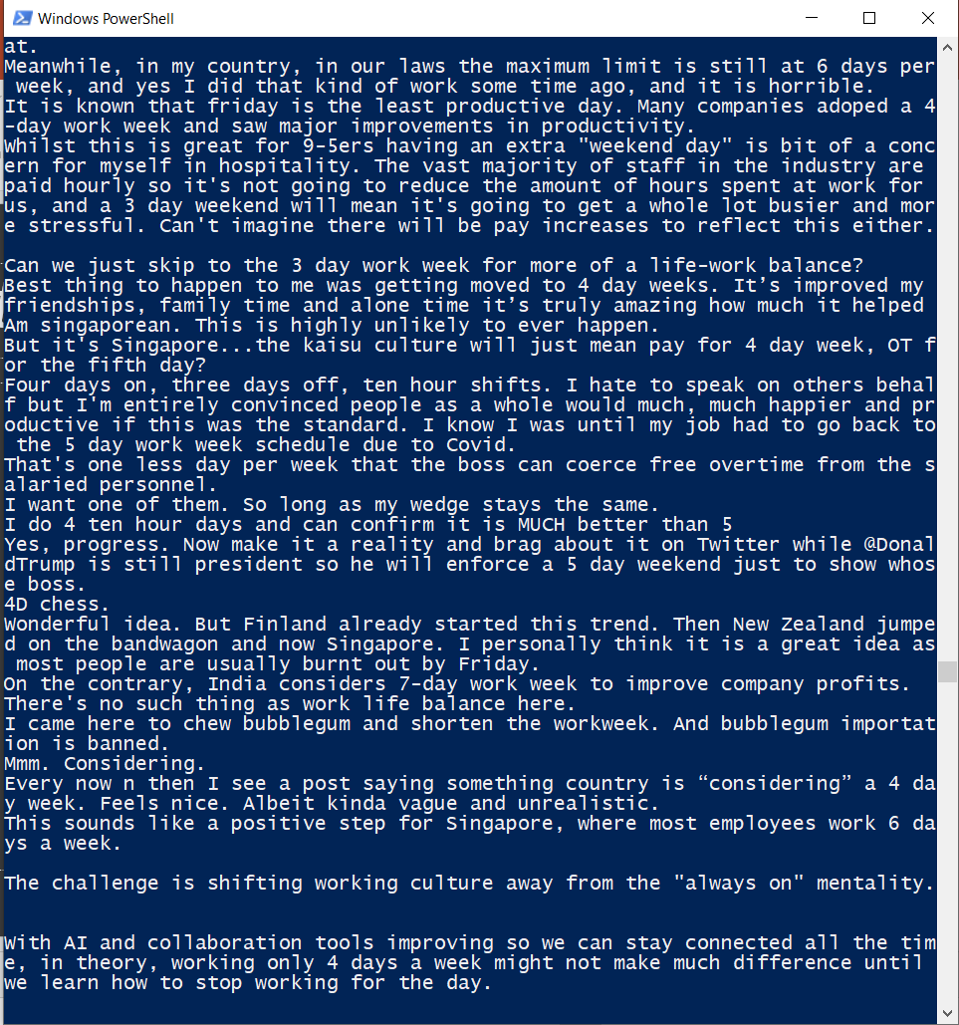
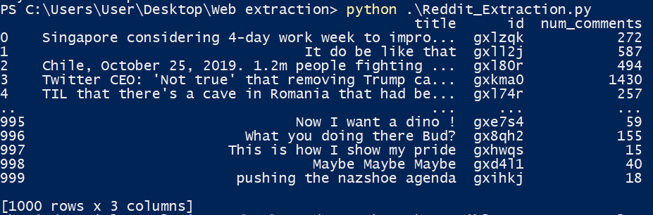
Fig. 2 – Parsed data, taken 1000 posts at a time. Each post may have between 50 to 1000 comments each.
Fig. 1 – Comments scraped from a single post.

Slide 8
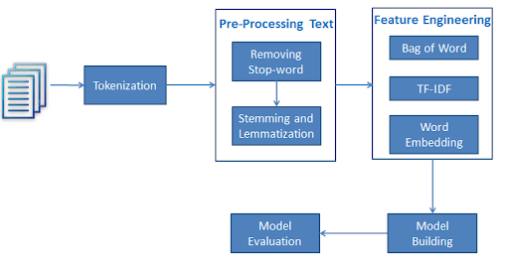
Text Processing Tool – Using NLTK
Natural Language Toolkit, or more commonly NLTK, is a suite of libraries and programs for symbolic and statistical natural language processing (NLP) for English written in the Python programming language.
It’s main features include tokenizers, stopwords and parts of speech (POS) tagging (also known as bag of words), etc.
Fig. 3 – Features of NLTK in comment analysis.

Slide 9
Text Processing Tool – Using NLTK
Splitting a sentence, i.e. the comment, into basic language elements using NLTK helps in easier training of the model, as the model can understand which segments in a sentence constitute appropriateness and inappropriateness. For this, however, negative and positive flagged comments must already be available for the model to study.
Hence, a manual dataset was created instead of accessing one of the many readily available ones on the internet, separating negative and positive comments with human judgment as the main decider. A preliminary model trained by this dataset was used for distinguishing future web scraping results, immediately able to classify them as positive and negative but at the expense of slower processing and data collection.
Since the latest dataset comes automatically classified, they can periodically be used to train the present model version into a better functioning one, marginally improving accuracy.

Slide 10
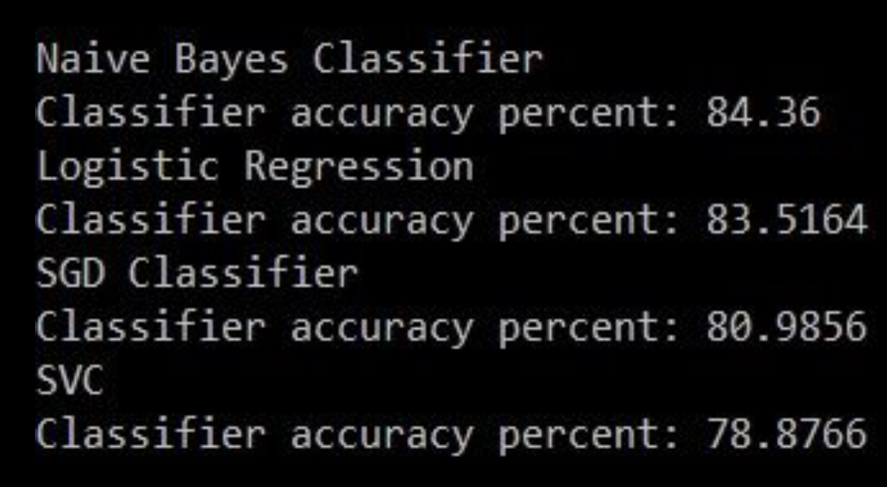
Text Processing Tool – Model Training
In machine learning, models need to be tested with various algorithms in order to find out the best algorithm for the dataset.
The tested algorithms and their respective accuracies are shown in figure.
As can be seen, Naïve Bayes classifier provides the better accuracy among simple classifiers, providing nearly 85%.
Fig. 4 – Tested algorithms and their accuracies.

Slide 11
Image Processing Tool – Web Scraping
Most posts on social media come with images as well as text, with images the crux of the message delivered to the viewers.
To set restrictions different kinds of images, there must first be a dataset of images so vast that it can be used to study and differentiate questionable images from the rest.
For web scraping and obtaining images, a special HTTP request must be sent to the website in focus (in this case, Reddit). This done using the python library ‘requests’ which helps in making the website more accessible. After the access is granted, the correct post can be found from the post ID stored in the corresponding ‘appropriate’ .csv file.
Using the post ID only from the ones deemed appropriate can prevent overlap between the post already considered inappropriate due to the comments of the post.

Slide 12
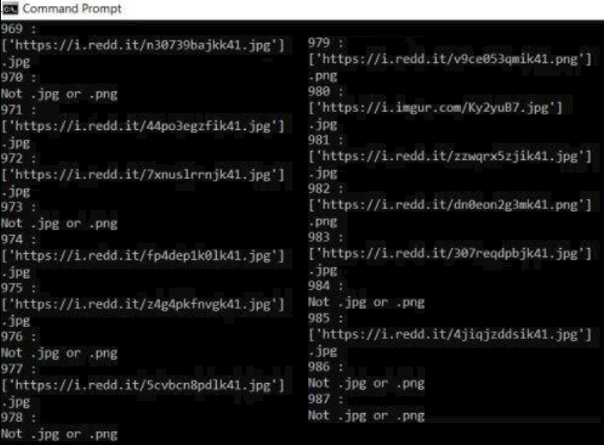
Fig. 6 – Scraping only images and rejecting other media forms.

Slide 13
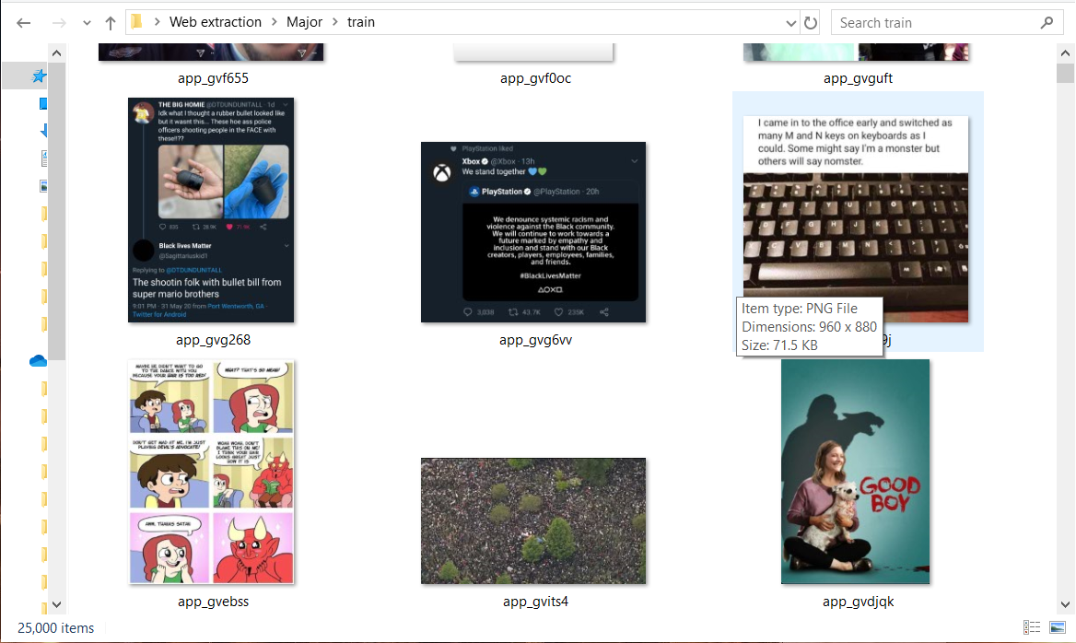
Image Processing Tool – The Dataset
Each image requested and located using post ID can be downloaded to a folder on a computer, each sized between 3-10 megabytes of data. All images are hence dumped into a single target folder.
Once again, like the initial text processing step, images need to be manually segregated into appropriate and inappropriate. This is for the model to recognize one form the other during training.
Fig. 7 – Dataset divided into appropriate (app) and inappropriate (ina).

Slide 14
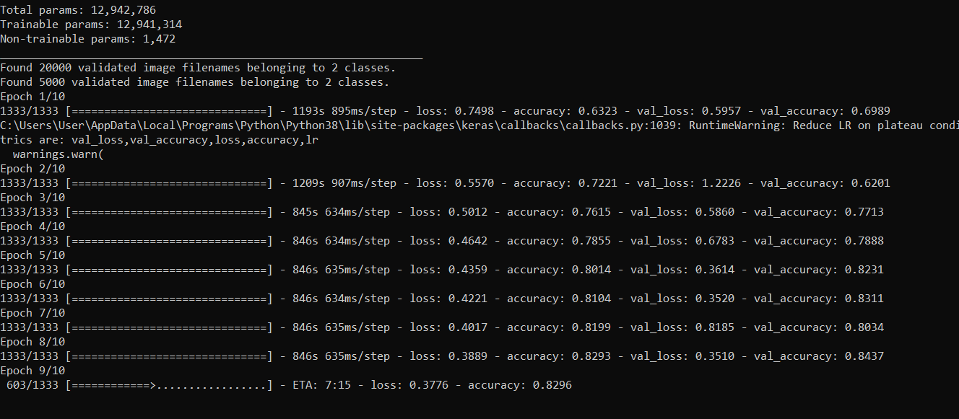
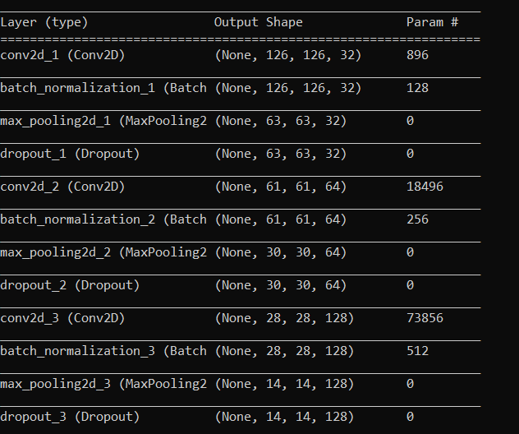
Image Processing Tool – The Dataset
Another extra measure for ease of training is pre-processing. Images need to be sized down and maybe cropped in order to remove unwanted distortions so that the training procedure can zone into specific features of the image. These features are what help in recognizing a particular class of image.
Pre-processing done well is important to use Convolutional Neural Network to train the model, which is known to give higher accuracy than other methods. TensorFlow also assists with classification.
Fig. 8 – Using TensorFlow and CNN requires pre-processing.

Slide 15
Image Processing Tool – CNN
To create a well functioning image distinguisher, it is better to peruse the parameters/features of an image through different layers. This can result in faster model training and better accuracy for the model. Convolutional Neural Network (CNN) is best used for this.
CNN is a hierarchically built network, developed in late 90’s and inspired by the human visual perception, renowned for its efficiency and accuracy in image classification and recognition.
TensorFlow used in a CNN model, builds layers for the network in stages. First, a filter is run through the image matrix along all pixels and pooled onto the next layer for further computation. The image size is paramount here, as the filter needs to capture all pixels of the image. The filter size and stride is decided based on this. Hence, pre-processing to give uniform image sizes can ensure the filter characteristics are uniform.

Slide 16
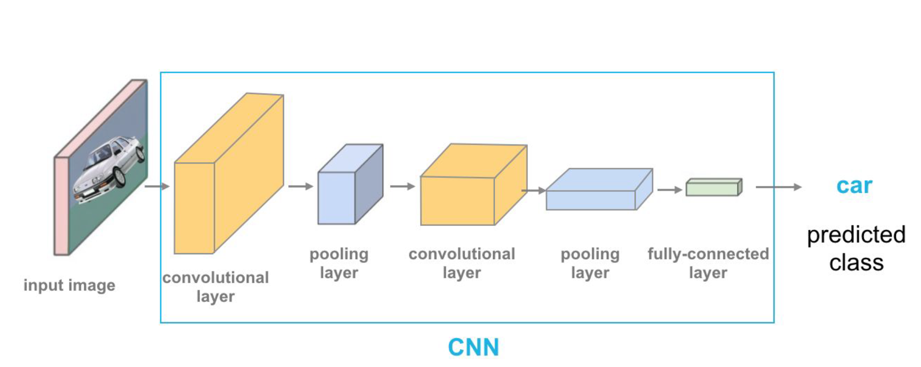
Fig. 9 – Example of a CNN process.

Slide 17
Image Processing Tool – CNN
After this, we pass this layer into the Rectified Linear Unit (ReLU) activation function. ReLU helps in determining interaction effect, i.e. how the presence of one variable affects the prediction of another variable.
This step includes encoding a convolutional layer to pass the pooling layer through. Finally, the convolutional results need to be flattened into an array. Padding of zeros is done according to each layer.
Conversely, the initial matrix can be tinkered such that padding will not be necessary. For instance, a 128x128 image, as the ones in the dataset, will no need any padding. This is more beneficial as the network does not have to learn that the padded areas are irrelevant to the classification.

Slide 18
Image Processing Tool – CNN
While presently we have few layers in the CNN, more layers can train the model better and improve accuracy, which is the main benefit of CNN. Therefore, before flattening, we pass through a few more layers of convolution and pooling.
Passing the final array through the softmax function creates a probability distribution, which forms the basis for the classification.
Hence, moving back and forth through this network and its layers, the trained model can classify images.

Slide 19
Image Processing Tool – Keras and Training
Keras is a neural network library that is made to run on top of the TensorFlow framework. TenssorFlow acts as the ‘backend’, enabling deep learning, and Keras functions as a high level Application Programming Interface (API) for defining layers and assisting with input and output.
Using Keras we can define the learning rate of the model, give cross-validation instructions that are important to check the learning model’s correctness and the data parallelism functionality helps train the model faster.
The dataset is subdivided in 10 epochs of training time. Roughly 25,000 samples form the dataset and using 80-20 cross-validation, the obtained size of samples amounts to 20,000 for immediate training and 5,000 for on-the-way validation of the model. Since the model follows convolutional neural networks (CNN), different layers to the model are established, learning hyperparameters that improve the accuracy as the number of layers increase.

Slide 20
Fig. 10 – Training the image processing model. An accuracy of roughly 84% is obtained after training and cross-validation.

Slide 21
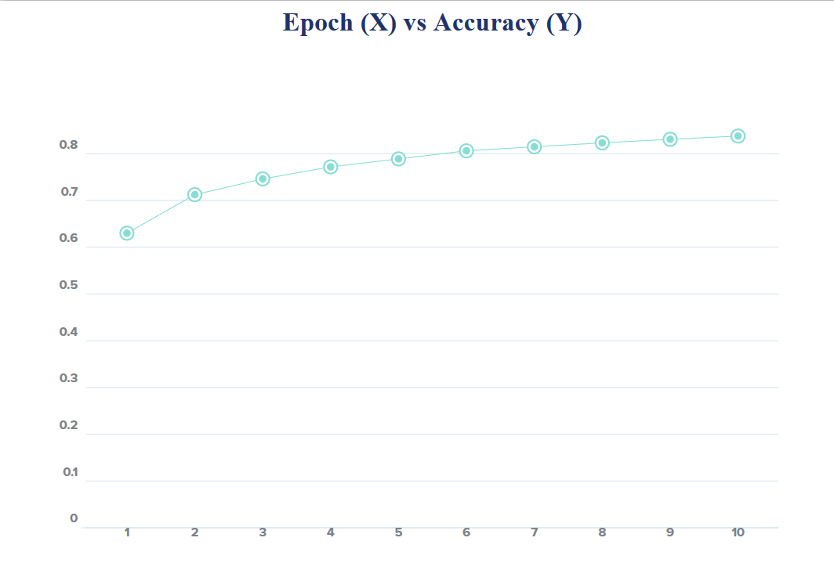
Fig. 11 – Epoch Vs Accuracy while training the model.

Slide 22
Image Processing Tool – The GUI
After a model is created and stored, this model needs to be accessed in order to give predictions. For this, a graphical user interface (GUI) using Tkinter is created atop the model file.
Tkinter is the standard GUI library for Python. Python when combined with Tkinter provides a fast and easy way to create GUI applications. Tkinter provides a powerful object-oriented interface to the Tk GUI toolkit.
The input to the model file to generate a prediction is directly interlaced with the GUI and through the GUI an image is tested with respect to the model and a prediction is demanded from the model. GUI uploads images and tests them individually via the model. Button widgets make the GUI appear more user friendly.

Slide 23
Results
A working content moderation tool was developed over the course of two semesters, that presently works on a single social media website, but with mindful alterations in web scraping and model parameters, can be applied to any website. The tool works on both text and image sequentially to provided satisfactory and instant output for a user using it.
The following figures show the tool working on images and classifying them

Slide 24
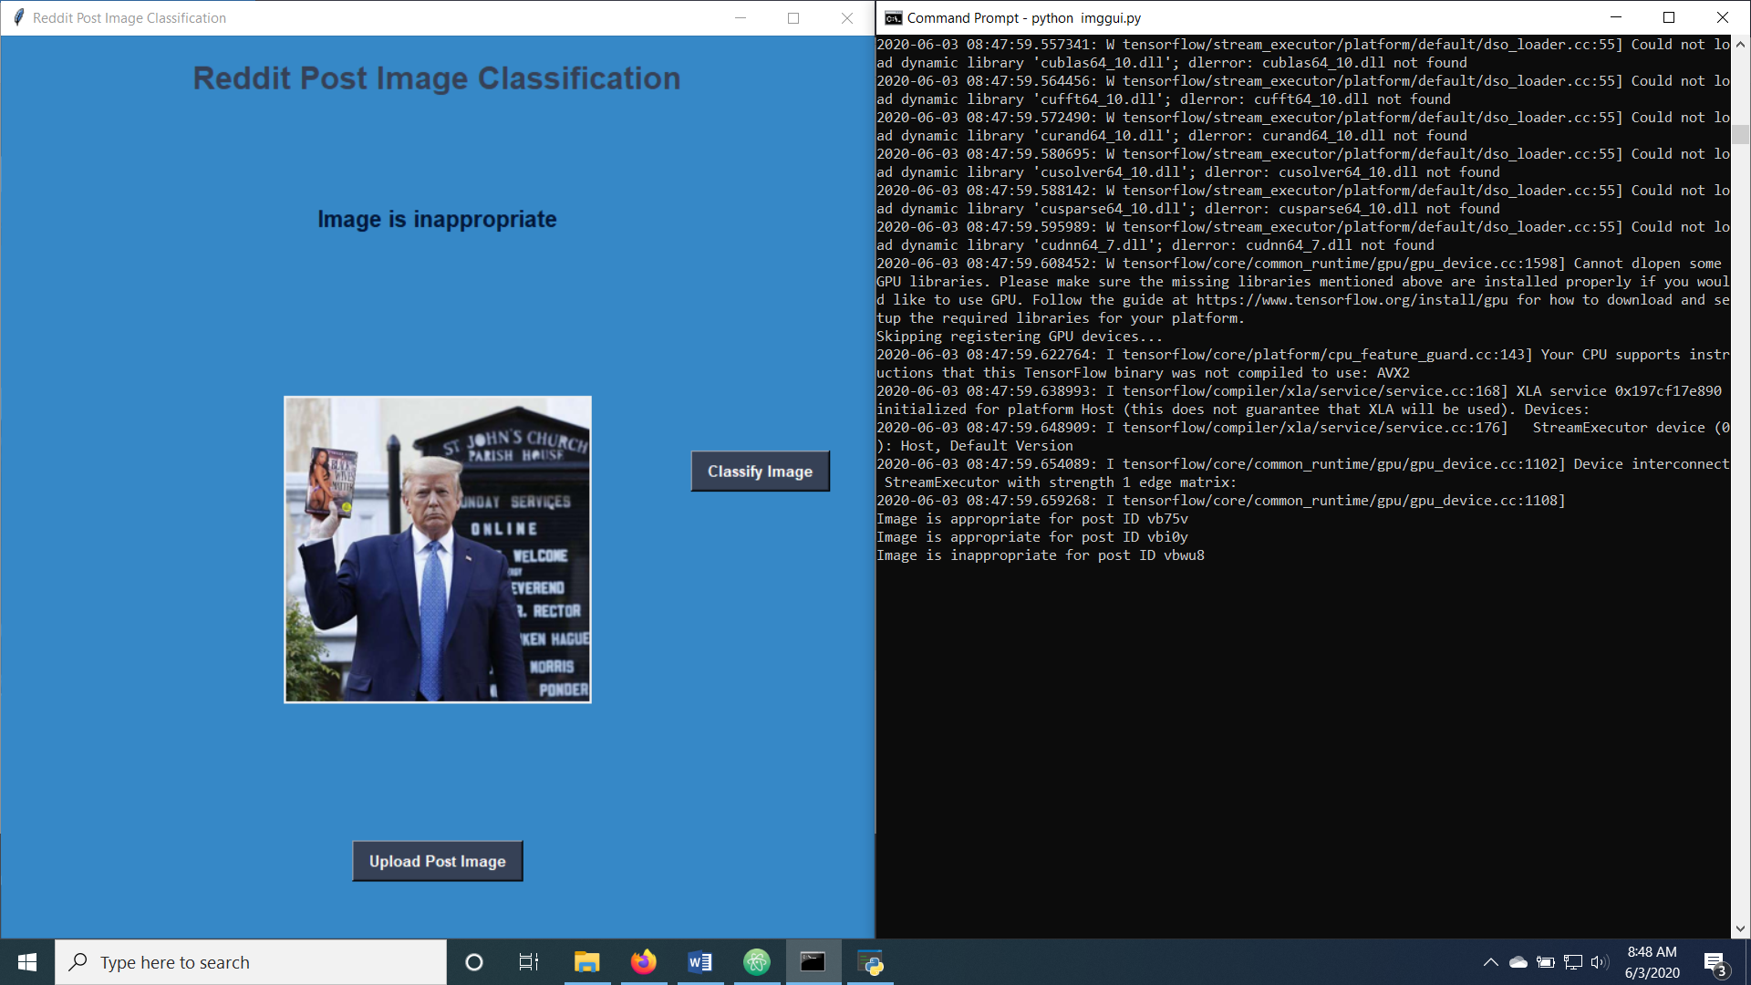
Fig. 13 – Inappropriate prediction 1.

Slide 25
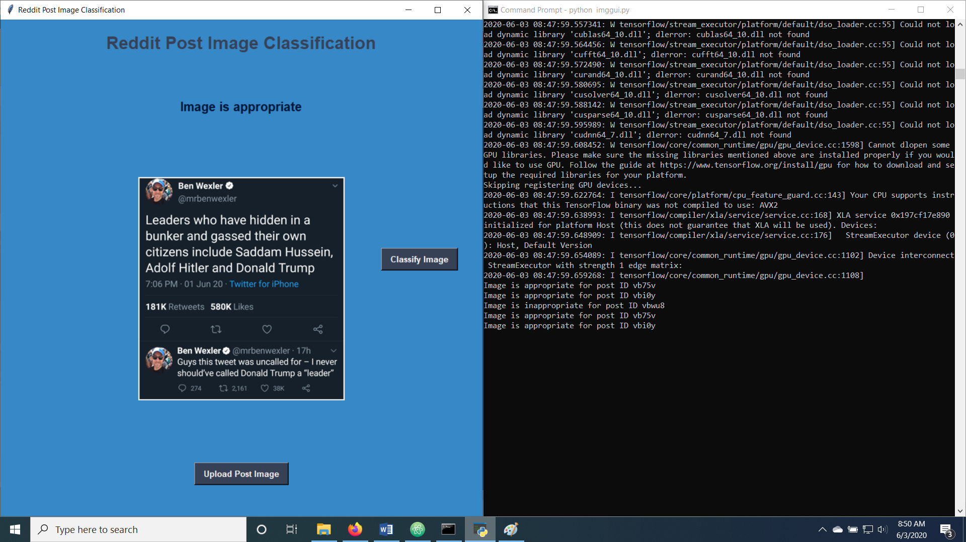
Fig. 14 – Appropriate prediction 2

Slide 26
Shortfalls
Due to lack of resources and weak processing power, the efficiency of the overall tool drops as instead of a hands-free tool, the user has to sit down to check individual appropriateness per post.
Lack of resources results in a model that needs proper pre-processing in order to reduce image file size for faster training and testing. With larger images (due to dimensions and quality), the system may not be able to take the load, resulting in hanging and in very rare cases, system crashes. Therefore, pre-processing becomes a very important part of the work.
Lower dataset samples availability, due to dearth of internet, means that the cross-validation accuracy itself ranges around 80-85%, which means that on a large testing data the accuracy of the image processing part may drop further

Slide 27
Conclusion
While creating a tool that operates on a single website itself many hurdles came up rather rapidly. From manually evaluating data to waiting for hours to train and re-train the model, it was important to be mindful and vigilant so that the tool could do justice to the purpose.
For the tool to be commercially viable, for example in schools and workplaces, a user may surf through numerous websites on the internet. Creating a common web scraping tool itself is a Herculean task due to each website needing specific, targeted scraping commands.
However, beyond web scraping, the task is relatively simpler and in the future, with faster processing computers, content moderation may become as simple as surfing the internet.

