Slide 1


Hazards Planning and Risk Management
LECTURES 3
Hazard and Disaster Information
Fall 2026
US – Pakistan Center for Advanced Studies in Water

Slide 2
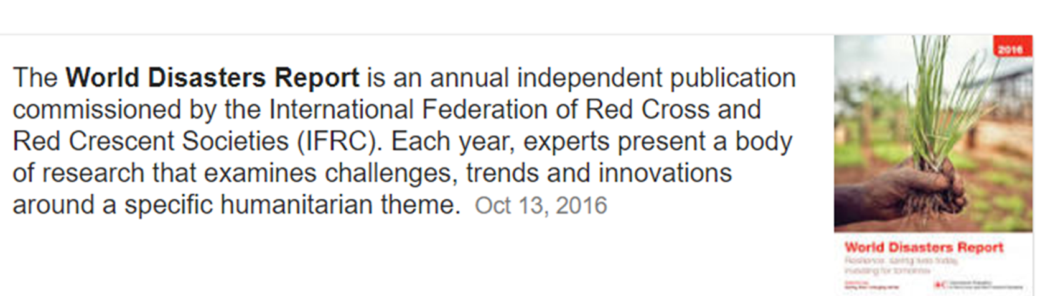

Slide 3
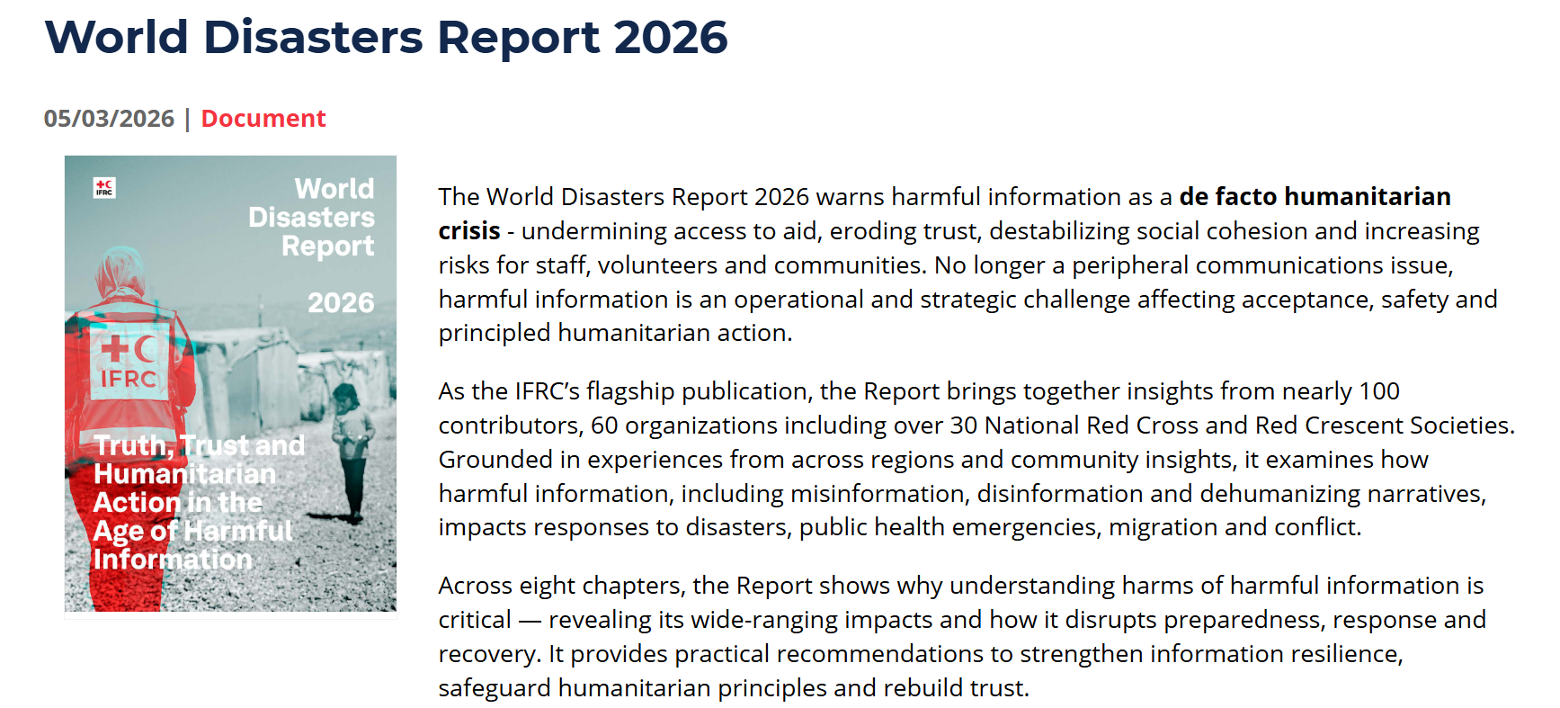
The IFRC World Disasters Report 2026 focuses on harmful information—misinformation, disinformation, hate speech, and other damaging narratives—as an emerging humanitarian challenge.
The 2026 report highlights that in modern disasters, reliable information and public trust are increasingly essential for effective, safe, and inclusive humanitarian response.

Slide 4


Slide 5
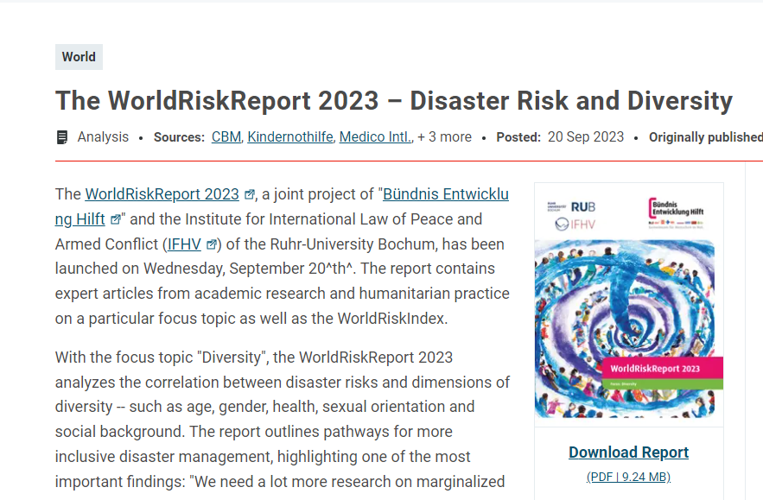

Slide 6


Slide 7
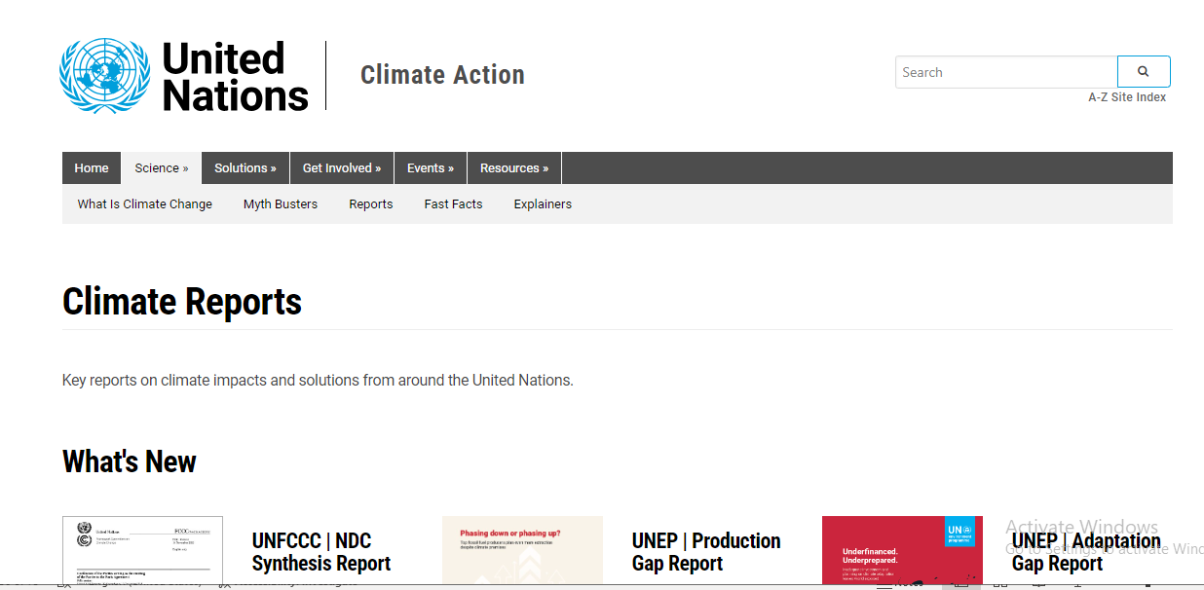
Climate Reports
Notes:
https://www.un.org/en/climatechange/reports?gclid=CjwKCAiAk9itBhASEiwA1my_6xOjvC4Q0OQ-Wy6koD-tSClDBvQfuyx-Rkt9XGeIoSS1pkXhNYIL1xoCpFgQAvD_BwE

Slide 8
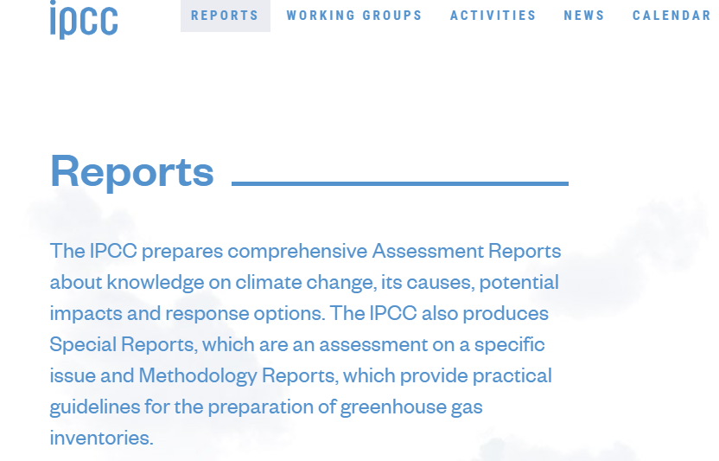
Notes:
Intergovernmental Panel on Climate Change

Slide 9
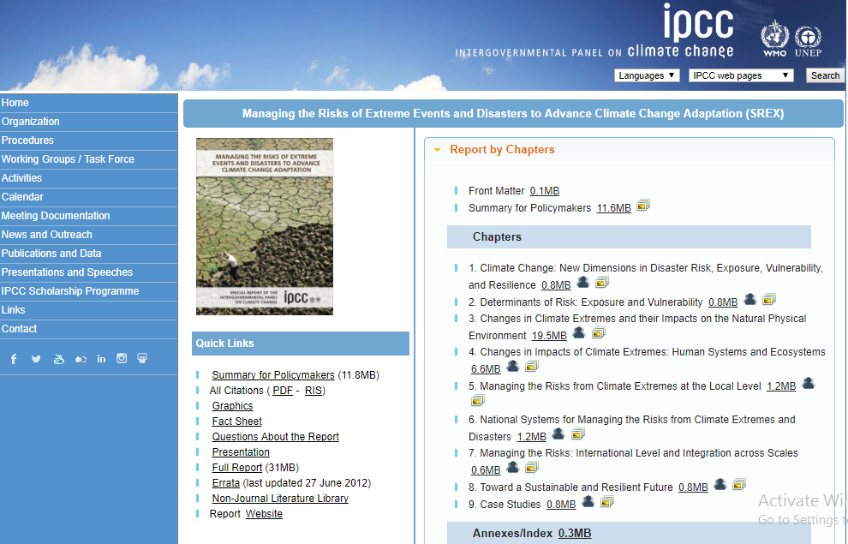

Slide 10
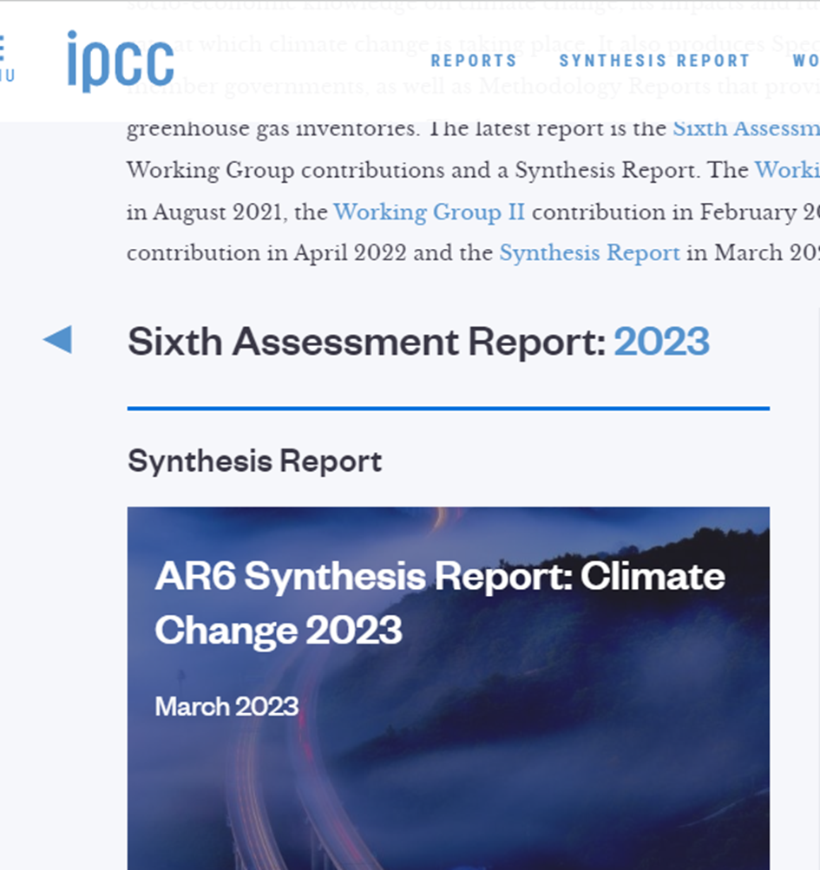
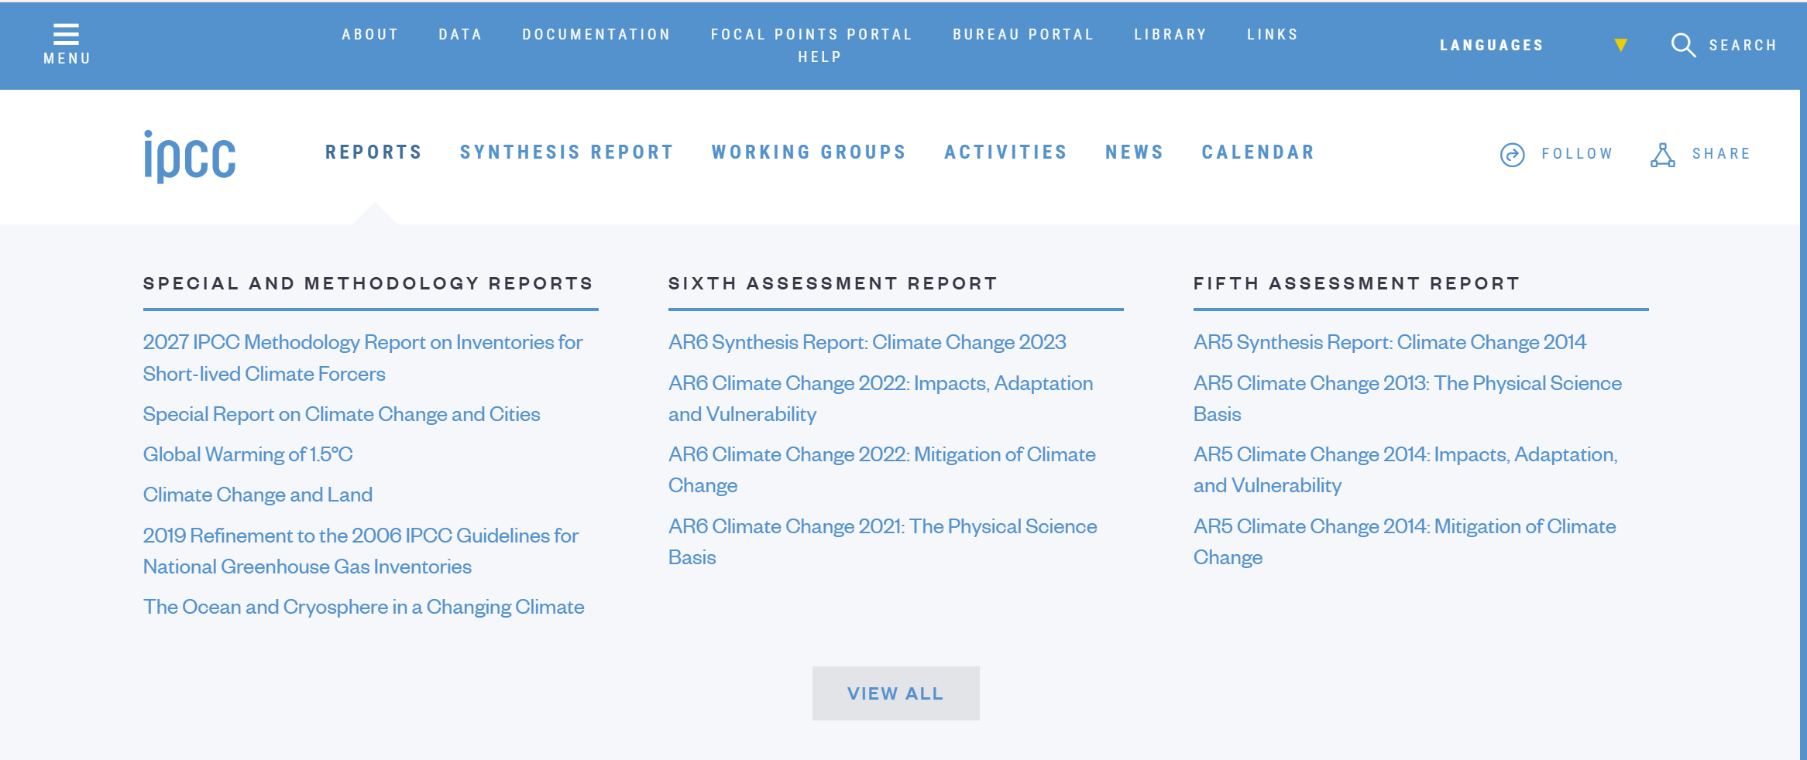

Slide 11
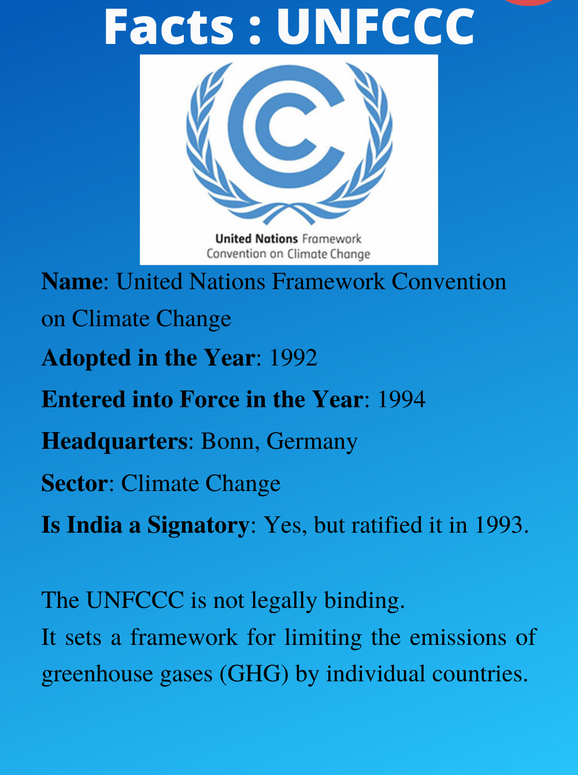

Slide 12
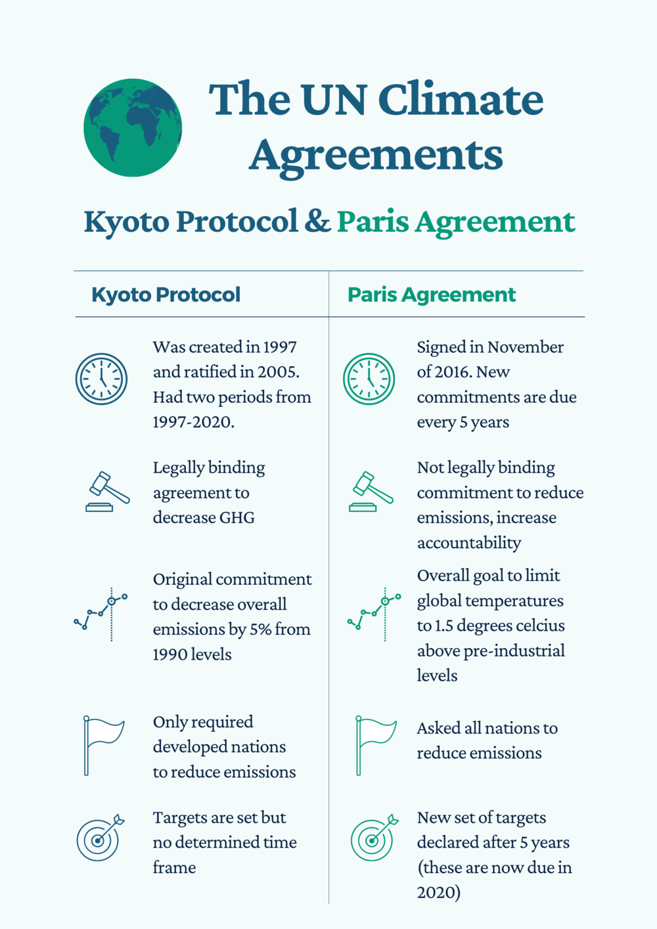
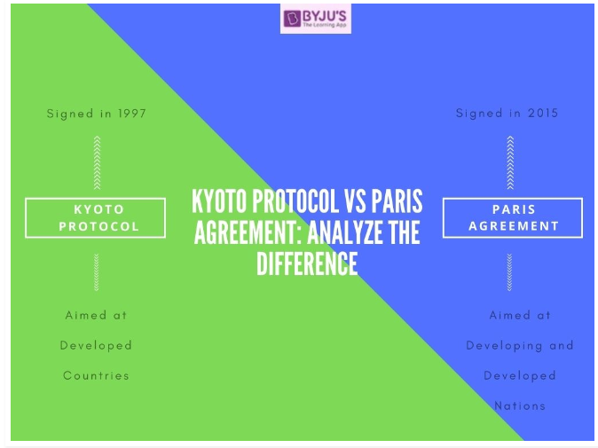

Slide 13
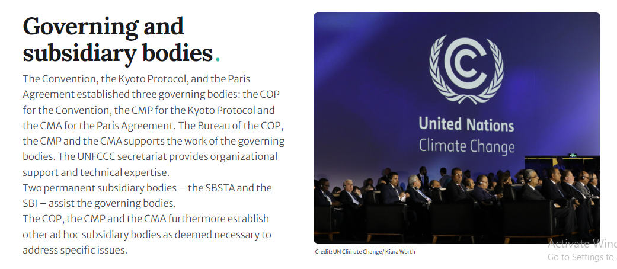
Notes:
COP, CMP, and CMA are distinct bodies within the United Nations Climate Change framework. COP oversees the main climate convention (Conference of the Parties).
CMA stands for the Conference of the Parties, serving as the meeting of the Parties to the Paris Agreement.
CMP (Conference of the Parties serving as the meeting of the Parties to the Kyoto Protocol)

Slide 14
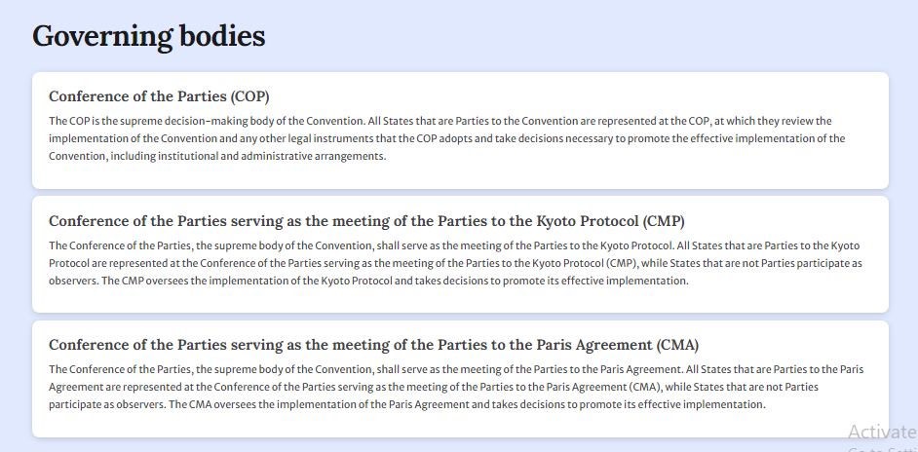

Slide 15
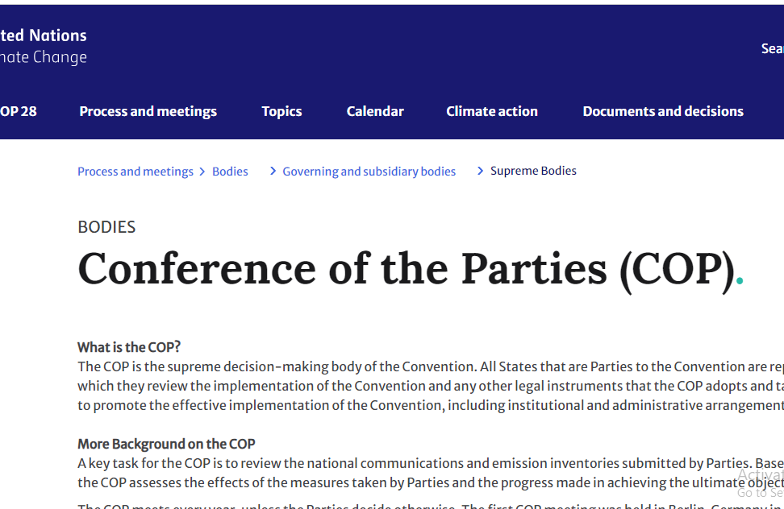
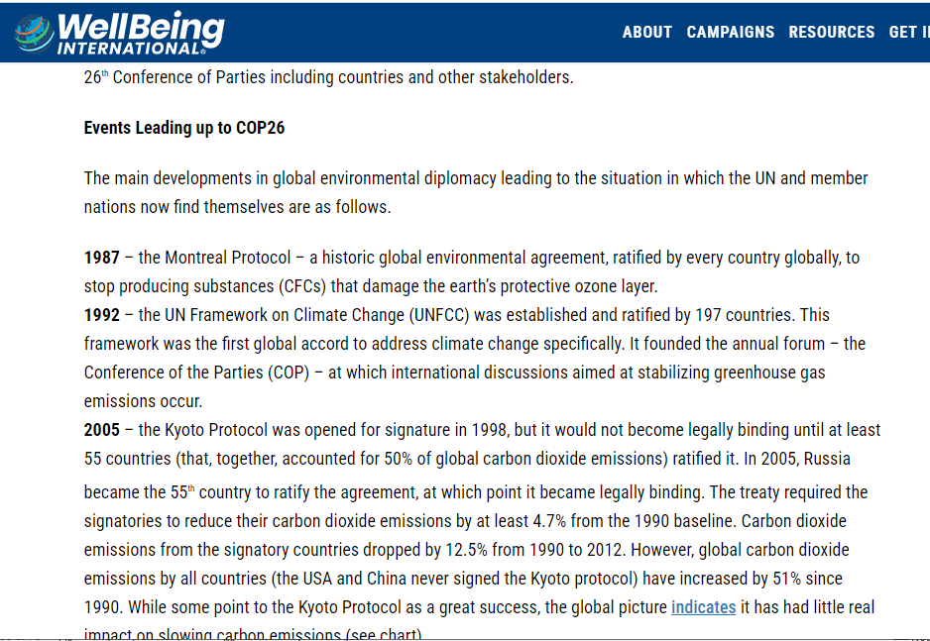

https://wellbeingintl.org/climate-change-and-cop26/?gclid=CjwKCAiAk9itBhASEiwA1my_6wlGaJQgxgoYP4Pbdij3Gz1rib2pijUJsxCaPV3sQYWOA2nXdPiBGRoC9wYQAvD_BwE

Slide 16
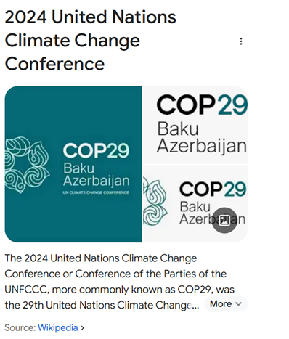
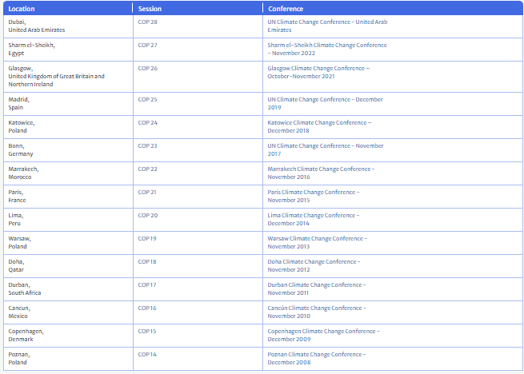
The next UN Climate Change Conference, COP31, will take place in Antalya, Türkiye, from November 9 to 20, 2026.

Slide 17
EM-DAT: The International Disaster Database
Centre for Research on the Epidemiology of Disasters (CRED)

Slide 18
EM-DAT
EM-DAT provides geographical, temporal, human and economic information on disasters at the country level.

Slide 19
EM-DAT Screenshots
https://www.emdat.be/
https://public.emdat.be/
Examples of database: Profiles and Trends

Slide 20
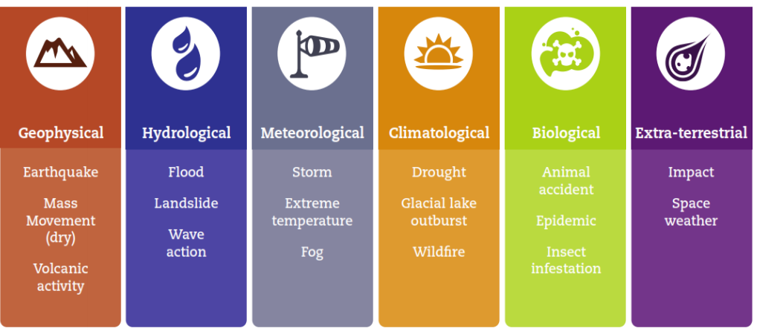

Slide 21
Notes:
http://www.emdat.be/classification

Slide 23
Glossary
http://www.emdat.be/Glossary

Slide 25
Any comment on these trends?

Slide 27
Any comment on these trends?

Slide 28
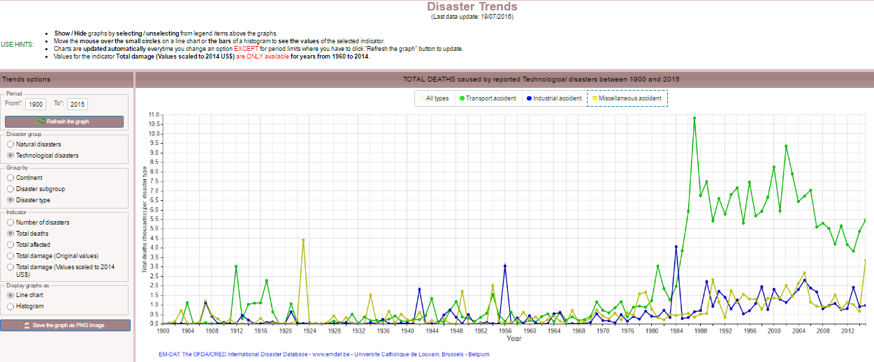

Slide 29
EM-DAT Criteria
EM-DAT includes all disasters from 1900 until the present, conforming to at least one of the following criteria:
10 or more people reported killed
100 people or more reported affected
declaration of a state of emergency
call for international assistance.
Notes:
The number of people killed includes people confirmed as dead and those missing and presumed dead. People affected are those requiring immediate assistance during a period of emergency (i.e., requiring basic survival needs such as food, water, shelter, sanitation and immediate medical assistance). People reported injured or homeless are aggregated with those reported affected to produce a ‘total number of people affected’.

Slide 30
How does Risk Develop?
Hazard is a danger that a disaster event may develop.
A hazard may cause a disaster to a vulnerable society.
A disaster is a function of the risk process.
Risk results from the combination of
exposure to a hazard,
conditions of vulnerability and
insufficient capacity or measures to reduce the potential negative consequences of risk.

Slide 31
A disaster happens when a hazard impacts on the vulnerable population and causes damages, casualties and disruptions.
A hazard is disastrous only when it affects people, their properties and activities.
For example; an earthquake in an uninhabited desert cannot be considered a disaster, no matter how strong the intensities produced
Disaster occurs only when hazards and vulnerability meet

Slide 32
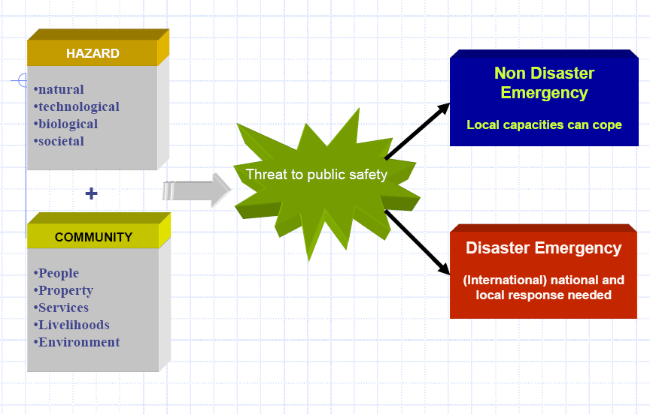
Notes:
Source: http://www.who.int/hac/techguidance/training/induction/wpro/Day1%20Concepts%20in%20Emergency%20Management.pdf

Slide 33
Reading Assignment
Explore further at http://www.emdat.be/database
Look at
http://unisdr.org/files/7817_UNISDRTerminologyEnglish.pdf
For subject related terminologies

Slide 34
Assignment
Go to the EM-DAT database and determine
Historically, which disaster type has more
Total number?
Total Deaths?
Total affected?
Total estimated damages?
You will find out that the answers to 1, 2, and 3 would not be the same.
Do you have any explanation for this difference?

Slide 35

Discussion/Comment/Question

