Slide 1


Artificial Intelligence
An Introduction to Artificial Intelligence, Machine Learning
and Deep Learning
Ms. Rubab (IWRM)
U.S.-Pakistan Center for Advanced Studies in Water
Mehran University of Engineering and Technology Jamshoro, Sindh, Pakistan
01

Slide 2
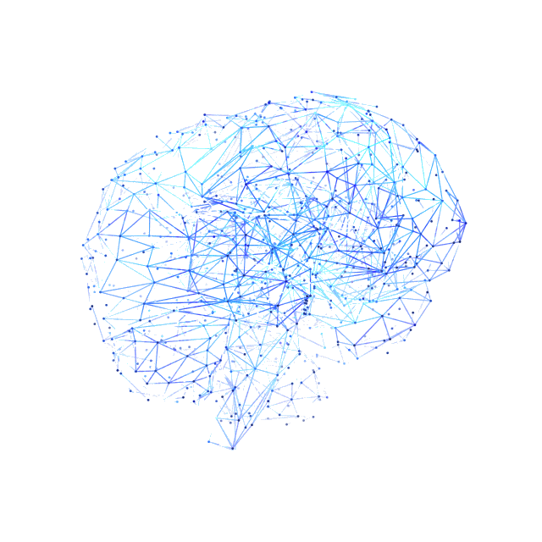
Learning Objectives
Machine Learning and its Types
Deep Learning and its Types
02

Slide 3

Artificial Intelligence
Artificial Intelligence is the field of creating computer systems that can perform tasks requiring human-like abilities such as learning, reasoning, perception, and decision-making.
1. 🗺️ Google Maps
AI → Traffic + Route Prediction → Best Route
2. 📱 Face Unlock
📷 Camera → AI/Face Recognition → 🔓 Phone Unlocked
03

Slide 4


Machine Learning
Machine Learning is a type of AI that allows computers to learn from data and make predictions or decisions without being directly programmed for every task.
🛒
Recommending
shows based on
what you watch.
Online shopping
sites showing you
products you might like.
04

Slide 5
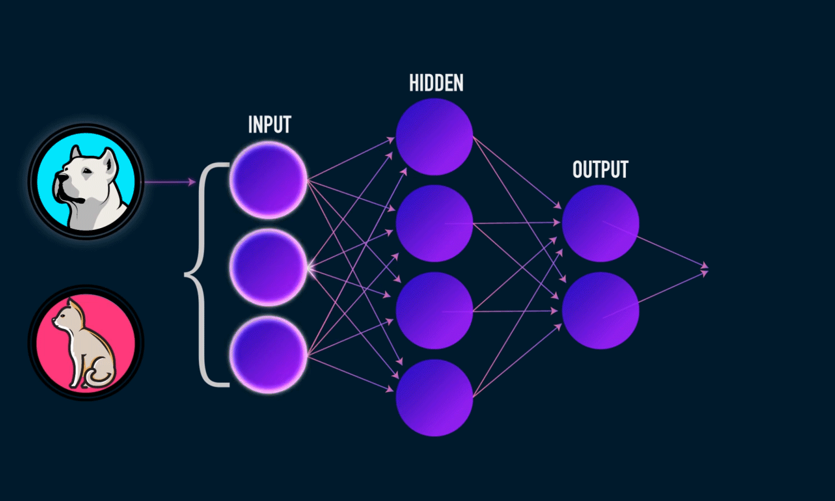
Deep Learning
Deep Learning is a type of Machine Learning that uses neural networks with multiple layers to learn complex patterns from large amounts of data.
📷 Image → 🧠 Deep Learning → 👤 Face Recognition
05

Slide 6
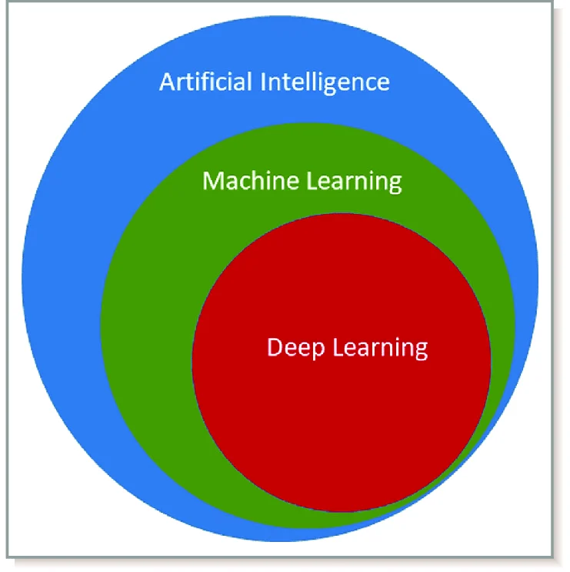
AI – Whole Brain
ML – Teaching the brain to learn from experience
DL – Teaching the brain by showing it lots and lots of examples
06

Slide 7
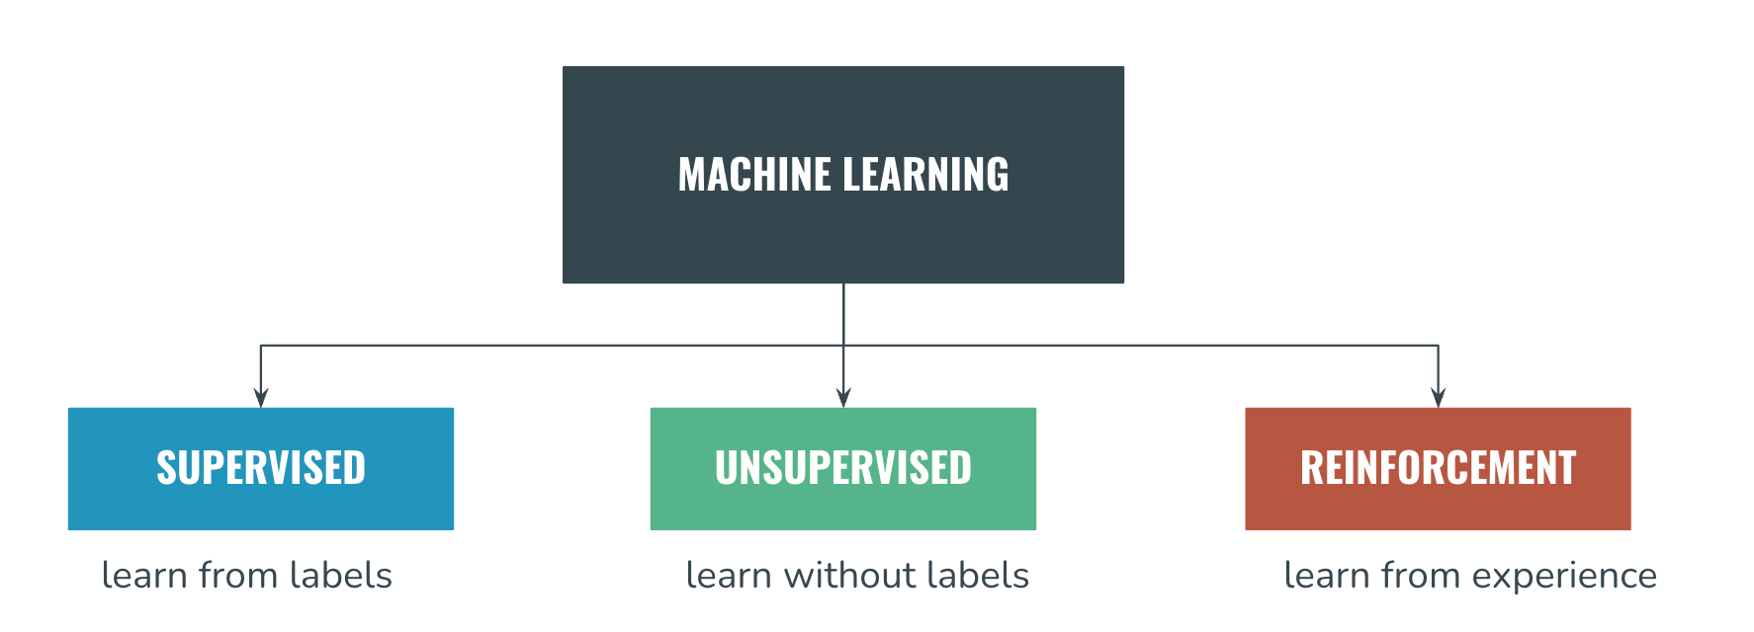
TYPES OF ML
07

Slide 8
TYPES OF ML
1. 🎓 Supervised Learning
Model learns from labeled data.
Example: Predicting river stage from temperature, rainfall, soil moisture, and evaporation.
ML Models: Regression, Classification
Regression: Predicts a continuous numerical value. 📈
Example: Predicting river stage = 5.8 m.
Classification: Predicts a category or class. 🏷️
Example: Flood risk = Low, Medium, or High.
08

Slide 9
Supervised Learning: Common Algorithms
TYPES OF ML
📈 Linear Regression → Predicts numerical values
🔢 Logistic Regression → Predicts categories
🌳 Decision Tree → Makes decisions using a tree structure
🌲 Random Forest → Uses many decision trees together
🎯 KNN (K-Nearest Neighbors) → Predicts using similar data points
📐 SVM (Support Vector Machine) → Separates data into classes
09

Slide 10
TYPES OF ML
2. 🔍 Unsupervised Learning
Model finds hidden patterns or groups in data.
Example: Grouping areas based on similar rainfall or temperature patterns.
ML Models: Clustering, Dimensionality Reduction
Clustering: Groups similar data points together without predefined labels. 🔍
Example: Grouping areas with similar rainfall patterns.
Dimensionality Reduction: Reduces the number of variables while keeping the most important information. 📉
Example: Reducing 20 climate variables to 3 important ones.
10

Slide 11
Unsupervised Learning: Common Algorithms
TYPES OF ML
🔵 K-Means Clustering → Groups similar data
🌳 Hierarchical Clustering → Creates groups in a hierarchy
🔎 DBSCAN → Finds natural groups and unusual points
📉 PCA (Principal Component Analysis) → Reduces many variables into fewer important variables
Example:
🌧️ Rainfall + 🌡️ Temperature + 💧 Soil Moisture → 🤖 ML → Similar Climate Groups
11

Slide 12
TYPES OF ML
3. 🎮 Reinforcement Learning
Reinforcement learning is a branch of machine learning in which an AI agent learns to make optimal decisions through trial and error to maximize cumulative reward.
Example:
🚗 Correctly stops at a red light → ✅ Reward
🚗 Makes a wrong move → ❌ Penalty
12

Slide 13
Reinforcement Learning: Common Algorithms
TYPES OF ML
🎯 Q-Learning → Learns the best action through rewards
🔄 SARSA → Learns from actions and their rewards
🧠 DQN (Deep Q-Network) → Uses deep learning for decision-making
Example:
🤖 Robot → 🚶 Action → ⭐ Reward / ❌ Penalty → 🧠 Learns the best action
13

Slide 14
TYPES OF DL
🧠 ANN – Artificial Neural Network
Learns patterns from data to make predictions.
Example: Predicting house prices from area, number of rooms, and location.
🖼 CNN – Convolutional Neural Network
Learns from images and recognizes objects or patterns.
Example: Identifying whether an image contains a cat 🐱 or a dog 🐶.
14

Slide 15
TYPES OF DL
🔄 RNN – Recurrent Neural Network
Learns from data that comes in sequence.
Example: Predicting tomorrow's temperature using previous days' temperatures.
⏳ LSTM – Long Short-Term Memory
Learns from sequences while remembering important past information.
Example: Predicting river stage using previous river stages, rainfall, temperature, and soil moisture.
15

Slide 16


