Slide 1
HYDROINFORMATICS DATA MANAGEMENT AND ANALYSIS
Graduate Course
Lecture 3: Introduction to the course

Slide 2
Learning Outcomes
By the end of the course, students will be able to
Explain the fundamental concepts, principles, and applications of Hydroinformatics in water resources management.
Acquire, manage, and preprocess hydrological and geospatial datasets from ground-based and Earth observation sources.
Analyze and visualize hydrological data using statistical methods and computational tools to identify trends, patterns, and anomalies.
Apply Python and cloud-based geospatial platforms to solve common water resources problems involving floods, droughts, and water quality.
Interpret and communicate analytical results to support evidence-based decision-making in water resources management.

Slide 3
Course Roadmap
Includes teaching, labs, assignments, projects, and a field visit
Informed and surprised quizzes
Mid-term exam (Theory)
Final Exam (Theory and Lab)
Refer to the course outline for the marks distribution.

Slide 4
Weekly Class Schedule
Every Tuesday
Theory Class 09:00 AM - 11:00 AM
Lab 11:00 AM - 02:00 PM
Office Hours: I do not have fixed office hours. Please check my availability before visiting.

Slide 5


Introduction
Hydroinformatics

Slide 6
HYDRO-INFORMATICS: An Applied Science
Hydro = Water
Informatics = Study of Computational Systems
Hydroinformatics is about information management to aid in understanding and managing water in the natural and built environments.
Data
Earth Observation
Models
Numerical Model
Hydrologic Models
Knowledge
Weather Patterns/ Predictions
Visualization
Maps, graphs showing relationships and trends, etc.
Decision Support
Environmental, economic, and social impacts of different scenarios
Hydraulic Models
Environmental condition
Climate change impact
AI Models
Ground Data
Computer Science
Hydrology
High End Computing
Geographic Information System
Engineering
Notes:
https://hydro-informatics.com/index.html
This entails issues related to data acquisition, archiving, representation, search, communication, visualization, and their use in modeling and knowledge discovery.
The cross roads of discipline.
And how these disciplines help us from data ==info==knowledge==wisdom
.

Slide 7
DEFINITION
Hydroinformatics encompasses the effective use of data for the characterization of the water cycle through natural and built environments.
It involves development of theories, methodologies, algorithms and tools, methods for testing the concepts, analysis and verifications, and knowledge representation and communication.
Notes:
Students might be thinking that till now they were here to study IWRM and HID, not computer Science or IT. But it looks like one. So as a manager we need to develop our abilities or skills. At the end of the degree some of you may have skills or programming, some may be pro in gathering remote sensing data, some may develop some sampling and field work skills.

Slide 8
🌍 WATER SYSTEM:
Rivers • Lakes • Groundwater • Watersheds
│
▼
📡 OBSERVE:
Monitor & Collect Data
(Sensors • Gauges • RS • GIS)
│
▼
💾 STORE:
Manage and Integrate Data.
(Databases • Cloud • QA/QC)
│
▼
📊 ANALYZE & MODEL:
Statistics • GIS • AI • Simulation
│
▼
🎯 DECIDE:
Decision Support.
(Risk Assessment • Planning)
│
▼
🌱 MANAGE:
Sustainable Water Resources.
(IWRM • Policy • Operations)
Why is Hydroinformatics considered an interdisciplinary field?
Hydroinformatics combines hydrology, data science, and computing to support integrated water resources management (IWRM).

Slide 9
Core Components
💧 Hydrology & Hydraulics 🛰️ Remote Sensing & GIS 📊 Data Science, Statistics, & Artificial Intelligence 🖥️ Numerical & Hydraulic Modeling 🌐 IoT, Sensors & Real-time Monitoring ☁️ Cloud Computing & Decision Support Systems

Slide 10
Why Hydroinformatics?
Integrates diverse water-related data.
Supports evidence-based decision making.
Improves monitoring, forecasting, and early warning
Enables sustainable water resources management
Helps address climate change and water security challenges

Slide 11
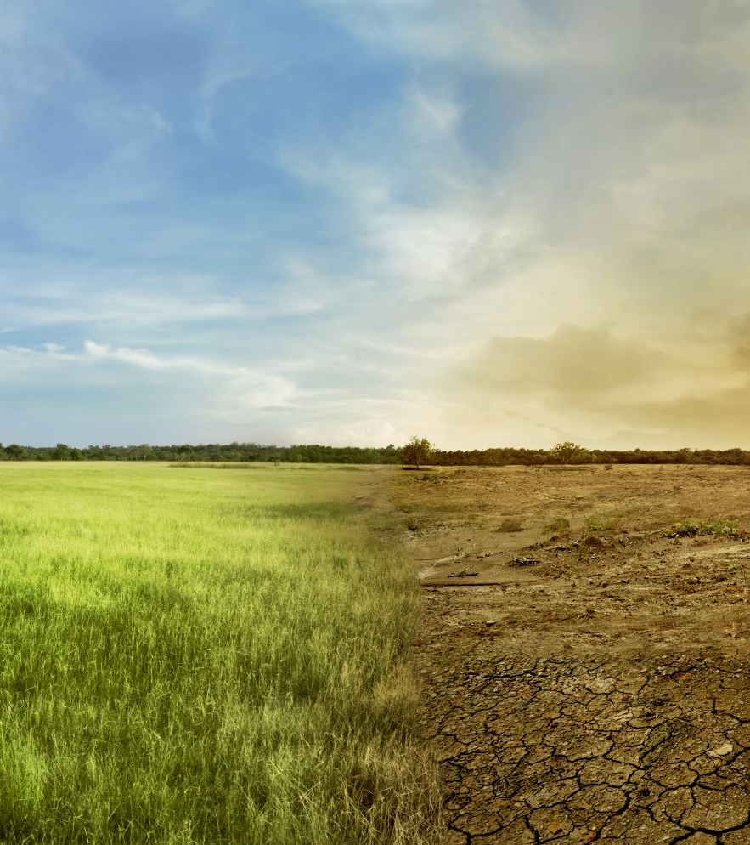

Applications
Flood forecasting and early warning
Drought monitoring
Water quality assessment
Irrigation and agriculture Urban water management
Groundwater monitoring
Climate change impact assessment
Notes:
Flood Forecasting: Real-time hydrographs, river gauge status, and GIS inundation maps.
Drought Monitoring: Satellite soil moisture index (SMI) and vegetation health maps (NDVI).
Water Quality: Contamination heatmaps and KPI (key performance indicators) testing parameter.
Irrigation & Agriculture: Crop water stress indexes and SCADA canal distribution schemes.
Urban Water Management: Smart-city AI sensor grids and pipe-network, digital twins.
Groundwater Monitoring: Borehole extraction vs. recharge graphs.
Climate Change Impact: Long-term multi-decadal trend lines and extreme-weather scenario projections

Slide 12
Some Examples

Slide 13

Digital Twin
A Digital Twin is a digital model of a real-world system that is continuously updated using real-time or near-real-time data to monitor, understand, and predict its behavior.
Example in Hydroinformatics:
A digital twin of a river system can combine river gauge data, satellite observations, rainfall, weather forecasts, and hydrological models to show the current river condition and predict future water levels or floods.

Slide 14

🌊 Flood Forecasting & Early Warning
Live Hydrograph Feeds: Stream tracking charts showing real-time water volume changes.
River Gauge Indicators: Color-coded alert bars changing from green to flashing red.
GIS Inundation Maps: Highlighted layout zones indicating active flood boundaries.

Slide 15
☀️ Drought Monitoring
Soil Moisture Mapping: High-contrast satellite layouts tracking ground dryness trends.
Vegetation Stress Indices: Color gradients charting declining crop health.
Precipitation Deficit Charts: Timeline bar graphs comparing current rainfall against averages.

Slide 16
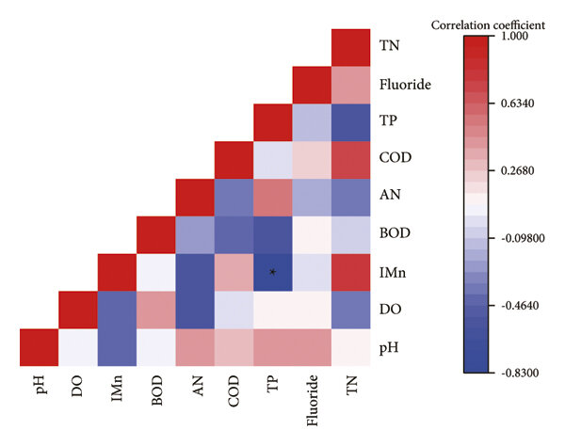
🧪 Water Quality Assessment
Contamination Heatmaps: Visual chemical dispersion models across active reservoirs.
KPI Matrix Dashboard: Ring meters tracking pH, dissolved oxygen, and turbidity.
Sensor Mesh Grids: Node layouts showing placement of live automated sampling sites.

Slide 17
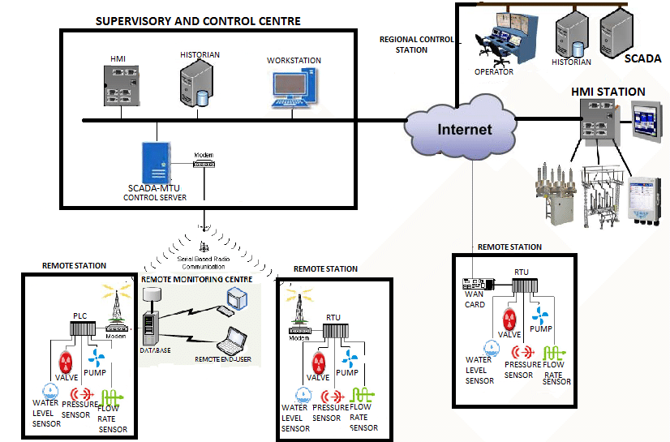
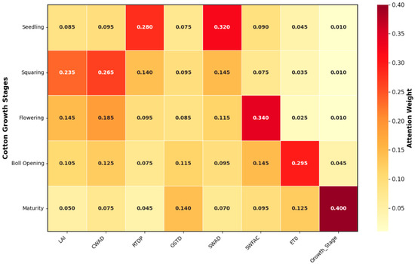
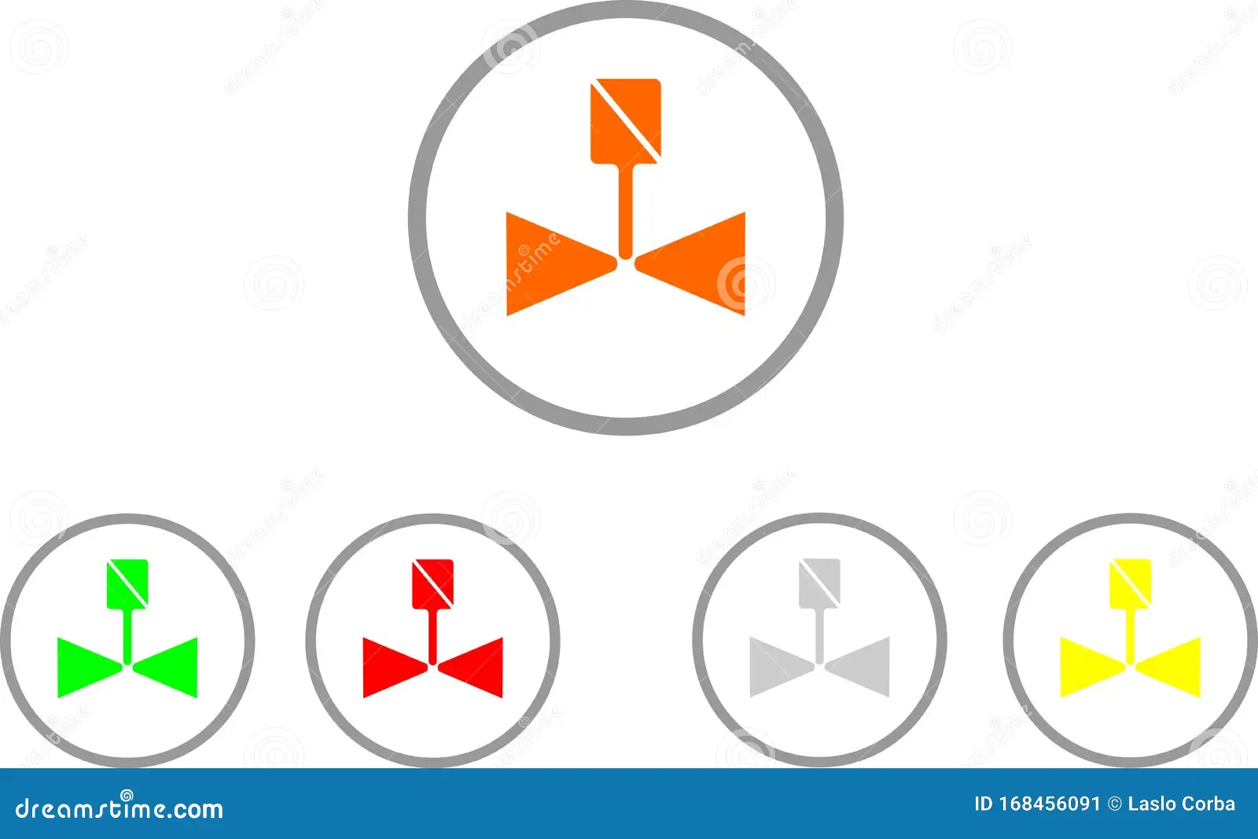
🚜 Irrigation & Agriculture
Crop Water Demand: Heatmaps tracking fields requiring immediate water delivery.
Automation Valve Status: Simple toggle icons showing active open or closed pipes.
SCADA Canal Schemes: Live flow schematics tracking primary distribution canals.
Notes:
Supervisory Control and Data Acquisition. It is a mix of software and hardware gathering live data from sensors.

Slide 18
🏢 Urban Water Management
Smart Utility Twin: A digital 3D model tracking the municipal pipe network.
Acoustic Leak Alerts: Pulsing radar symbols isolating pipeline structural breaks.
Demand Peak Gauges: Vertical bar charts monitoring city-wide water consumption.

Slide 19
🕳️ Groundwater Monitoring
Borehole Depth Status: Vertical cross-section graphics tracking aquifer levels.
Recharge vs. Drawdown: Split column charts displaying net water volume shifts.
Salinity Intrusion Vectors: Linear gradient arrows pointing out coastal seawater mixing.

Slide 20
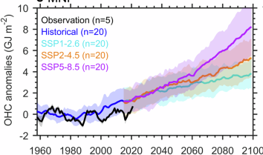

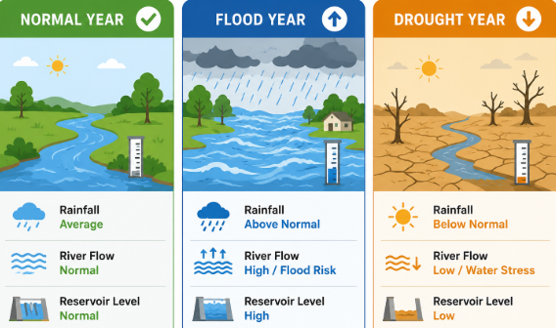
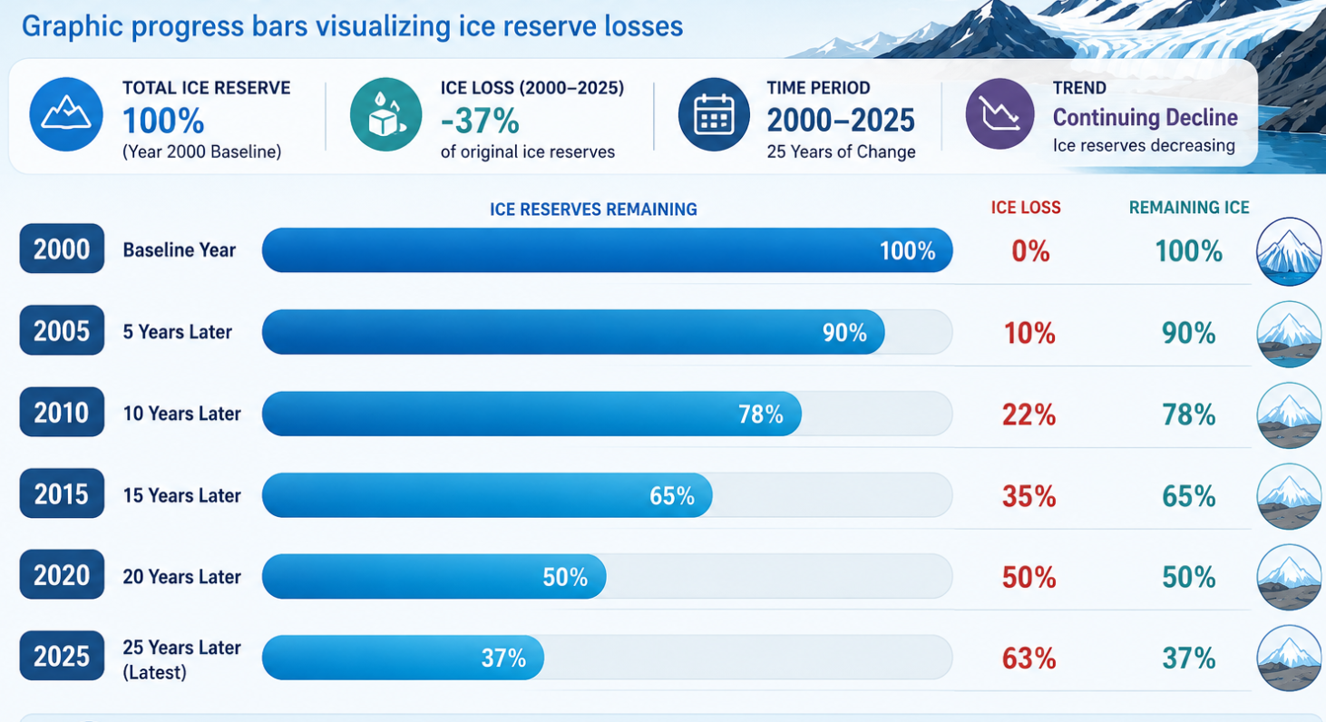
Climate Change Impact
Decadal Trend Lines: Multi-colored trajectory lines tracking long-term warming.
Scenario Matrix Blocks: Side-by-side comparison tiles simulating extreme weather.
Glacial Melt Timelines: Graphic progress bars visualizing ice reserve losses.

Slide 21
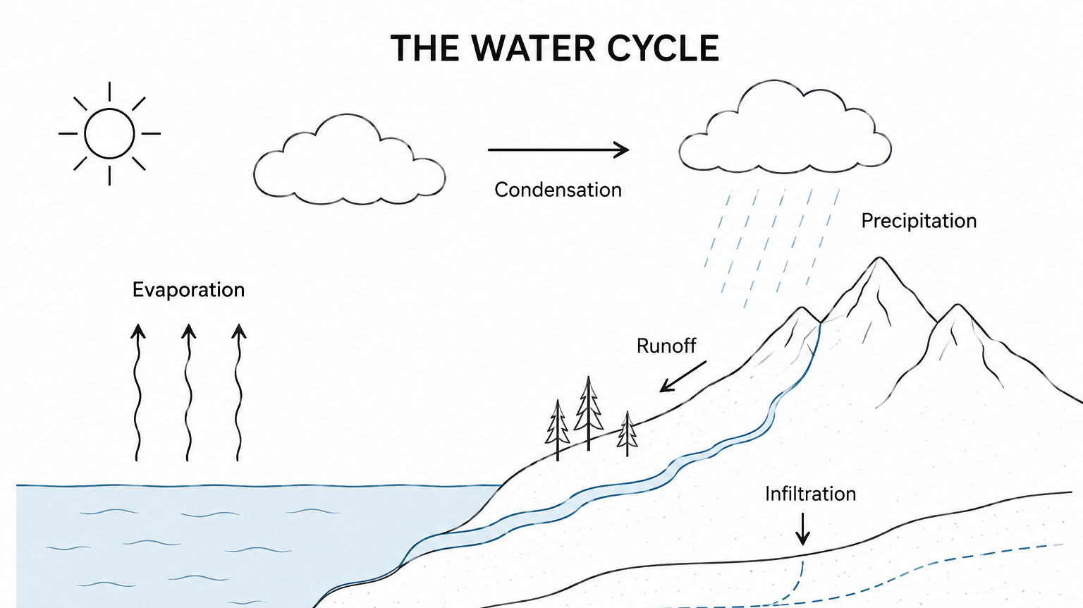

Understanding the water cycle is the first step toward sustainable water management
Transpiration

Slide 22
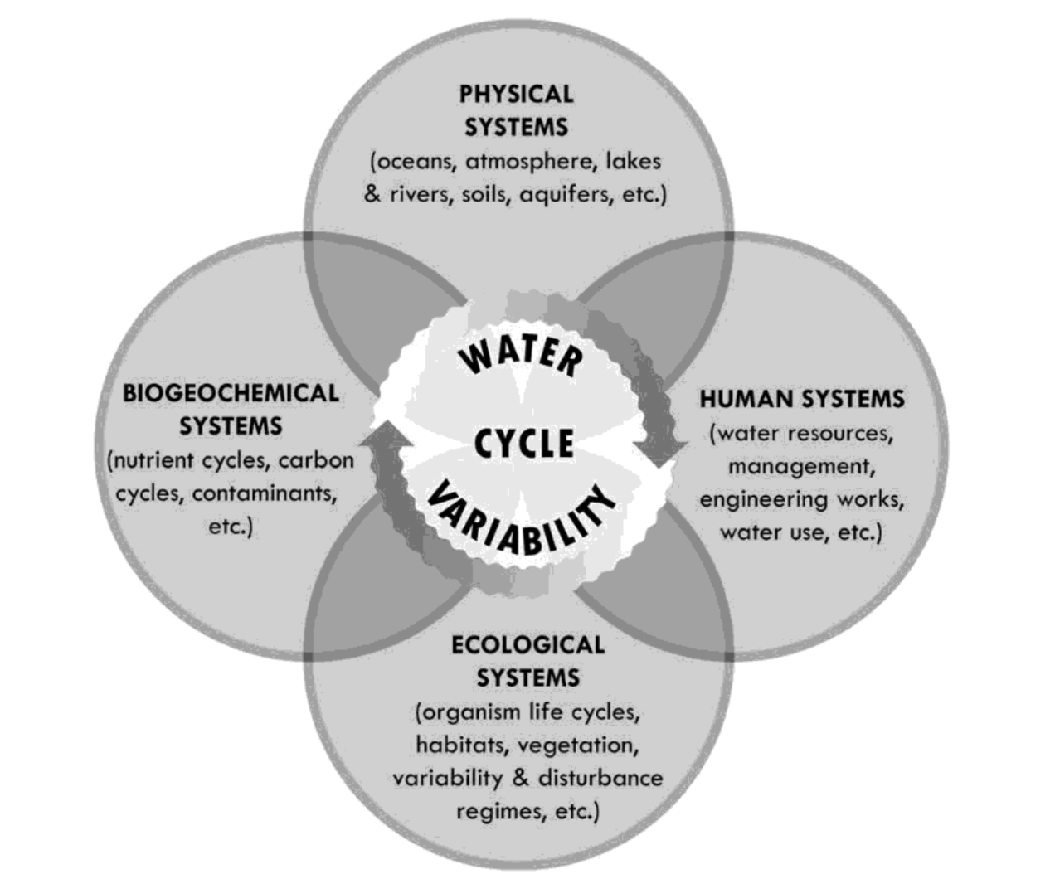
Global Water Cycle is a Complex System!!!

Slide 23
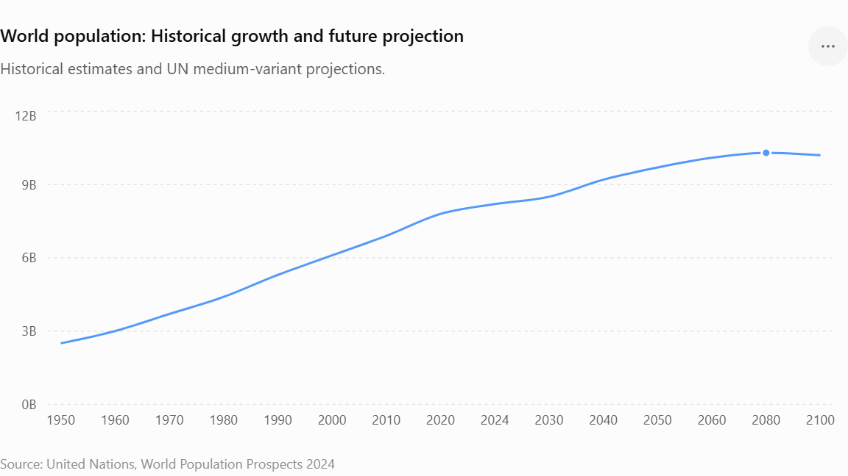
Water Management
Discuss!!!
What are the causes of water scarcity and their impacts?
How to optimize?
How to minimize uncertainty?
Notes:
1: Climate change, Urbanization, Population, Lifestyle, and technology advancement. Impacts: uncertainties, demand for more water (food production, daily demand, etc.), uncontrolled extraction of water, and wastages.
2. Allocation as per requirement

Slide 24
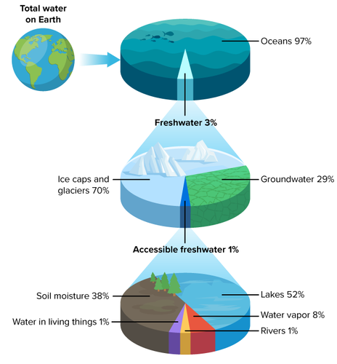
Global Water Distribution

Slide 25
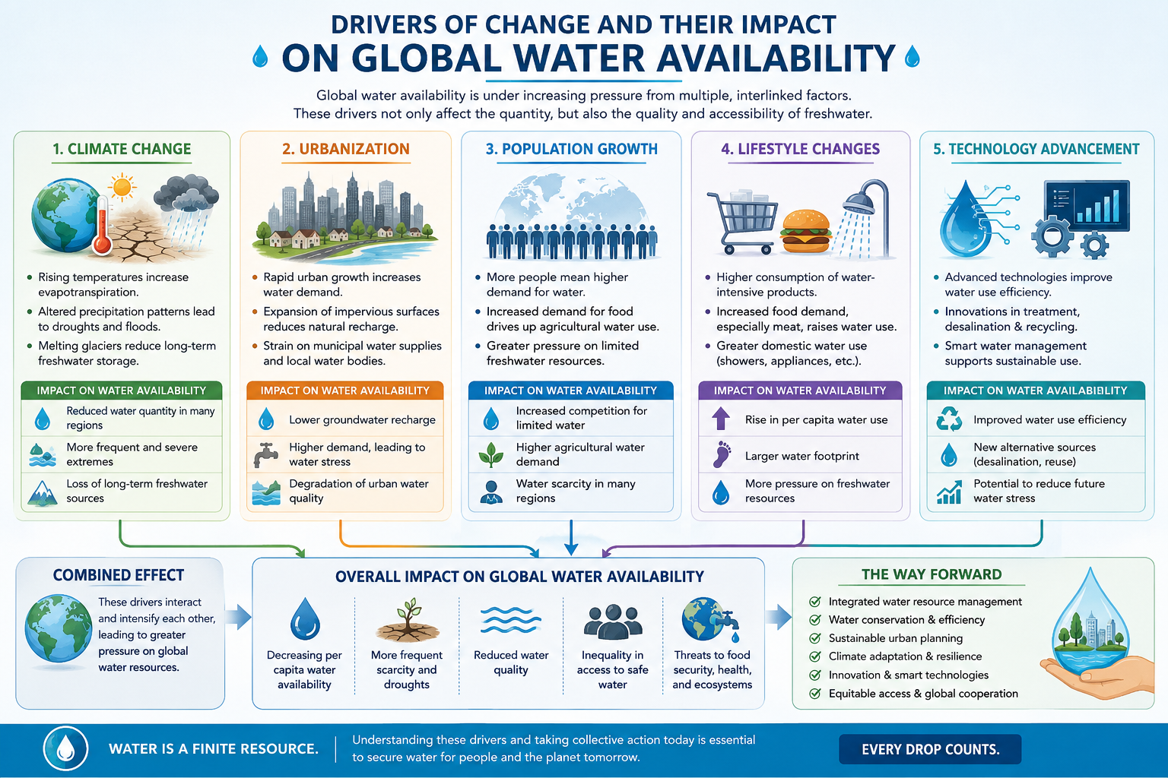



Slide 26
Data Requirement
Interactive classroom activity
Imagine you are responsible for managing a river basin. What data would you collect to make informed water management decisions? Classify your answers into:
Hydro-meteorological datasets
Geospatial datasets
Notes:
Hydro-meteorological and geospatial datasets

Slide 27
Data Sources
Interactive classroom activity
Can you identify some commonly used hydro-meteorological and geospatial datasets? Give a few examples.

Slide 28
Hydro-meteorological and Geospatial Data Sources
Ground-Based Observations
🌦️ Weather data: rainfall, temperature, humidity, wind speed, solar radiation (e.g., Pakistan Meteorological Department - PMD)(e.g., PMD)
🌊 Hydrological data: river discharge, water levels, canal flows, reservoir storage((e.g., Irrigation Department, WAPDA, IRSA)e.g., Irrigation Department, WAPDA, IRSA)
💧 Groundwater data: groundwater levels and well observations
🧪 Water quality data: pH, EC, TDS, dissolved oxygen, turbidity, etc.
Earth Observation (Satellite Data)
☔ Precipitation: CHIRPS, GPM, etc.
🌱 Vegetation: NDVI, EVI. Etc.
💦 Evapotranspiration: WaPOR, MODIS ET, etc.
🌍 Land Use/Land Cover: Sentinel-2, Landsat, ESRI Land Cover
🌊 Surface Water & Floods: Sentinel-1/2, Global Surface Water
🛰️ Water Levels: Satellite Altimetry (Sentinel-3, ICESat-2, Jason-3)
🌎 Groundwater Storage: GRACE

Slide 29
GIS & Remote Sensing
Applications in water resources

Slide 30
Hydrological Models
Conceptual, physical and data-driven

Slide 31
Decision Support
Forecasting, planning and management

Slide 32
Discussion Stop #1
Why is traditional hydrology alone no longer sufficient?

Slide 33
Before You Leave Today
One new thing learned?
What remains unclear?

