Slide 1


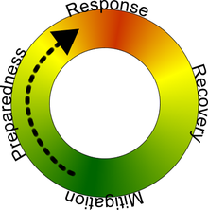
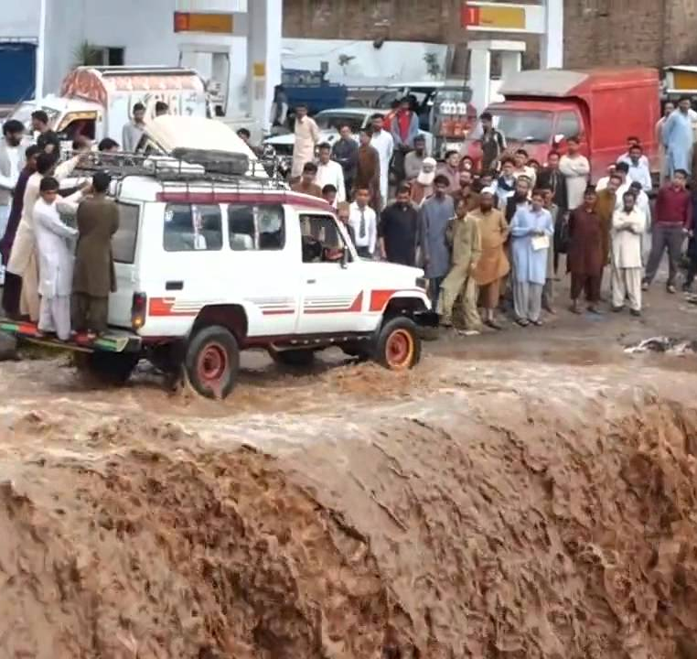



Hazards Planning and Risk Management
Disaster Management Cycle
Fall 2026
US – Pakistan Center for Advanced Studies in Water

Slide 2
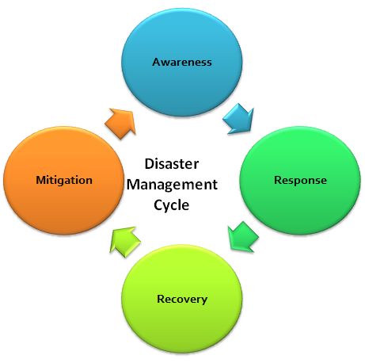
Learning Outcomes
After this lecture, the students will be able to;
Know – about the disaster risk management phases
Identify - suitable hazard risk mitigation and preparedness approaches and disaster response and recovery measures

Slide 3
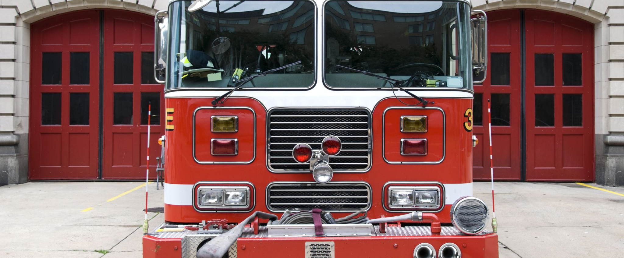
Disaster Mitigation & Preparedness

Slide 4
Reading Material
Introduction to Emergency Management By George Haddow, Jane Bullock, Damon P. Coppola
Chapters 3 & 6
Notes:
Concepts in Emergency Management (Pdf Notes will be provided)

Slide 5
DM Cycle
It is not a series of events which start and stop with each disaster occurrence.
Disaster and managing it is a continuum of interlinked activity.
Notes:
file:///D:/UU-MUET/Courses/DisasterManagmnt/2Fall2017/books/disaster-management-handbook.pdf

Slide 6
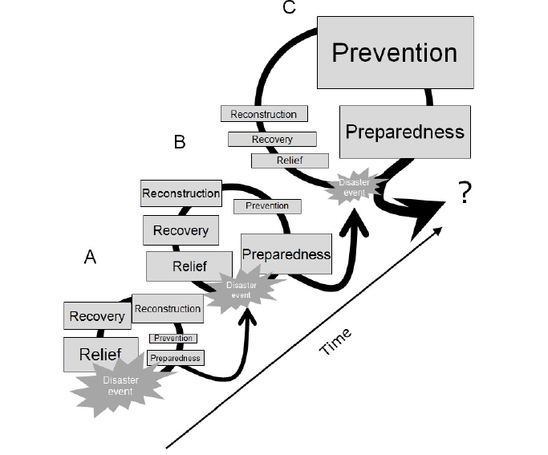
(Mitigation)
Disaster cycle (rather spiral) and its development through time
Notes:
Source: Dr. Cees Westen ITC

Slide 7
Mitigation
Attempt to prevent events from becoming disasters – How?
Sustained action to reduce or eliminate the risks to people and property from hazards and their effects.
Class Discussion: What is meant by the term sustained actions?
Measures taken to reduce both the effect of the hazard and the vulnerable conditions to it in order to reduce the scale of a future disaster
Examples?
Notes:
Source: CBSE, India
To become disaster resistant
Sustained: long-term solutions
Examples of mitigation measures which are hazard specific include water management in drought prone areas, relocating people away from the hazard prone areas and by strengthening structures to reduce damage when a hazard occurs. In addition to these physical measures, mitigation should also aim at reducing the economic and social vulnerabilities of potential disasters

Slide 8
Mitigation Activities
Mitigation activities can be focused on
Hazard itself
Example: water management in drought-prone areas.
Elements exposed to the threat
Examples:
strengthening structures to reduce damage when a hazard occurs.
reducing the economic and social vulnerabilities of potential disasters.
Notes:
Source: CBSE, India

Slide 9
Mitigation Alternatives
Prevent the creation of the hazard in the first place.
Change the nature or the size of the hazard.
Separate the hazard from that which it might affect
Modify the basic characteristics of a hazard.
Research what others are doing
For Examples, see https://www.iaem.org/portals/25/documents/is1_Unit3.pdf
Notes:
Source: FEMA –https://www.iaem.org/portals/25/documents/is1_Unit3.pdf
Modify: Dangerous chemicals are often packaged with a neutralizing agent right next to the chemicals. If the chemical container sustains damage, the neutralizing agent is automatically released, thus minimizing the toxic effects of the spilled chemical. In another case, a distinctive smell added to the odorless liquid propane gas warns people that propane is present.

Slide 10
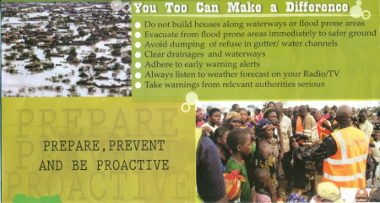
FEMA document More Examples of Mitigations
Public education and outreach activities designed to reduce loss of life and property destruction
Notes:
Taken from a FEMA document describing the National Incident Management System (NIMS)
http://www.memphis.edu/cait/pdfs/Phases_of_Emergency_Mngt_FINAL.pdf
Picture source: https://ugecviewpoints.wordpress.com/2015/10/19/the-effectiveness-of-early-warning-systems-in-the-management-of-urban-flooding-in-nigeria/

Slide 11
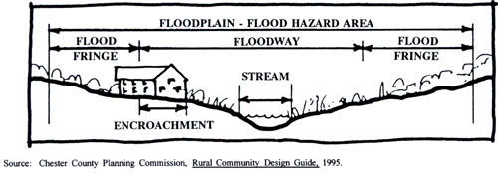
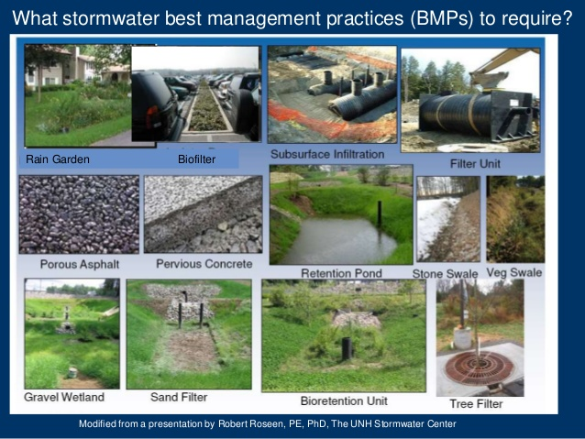
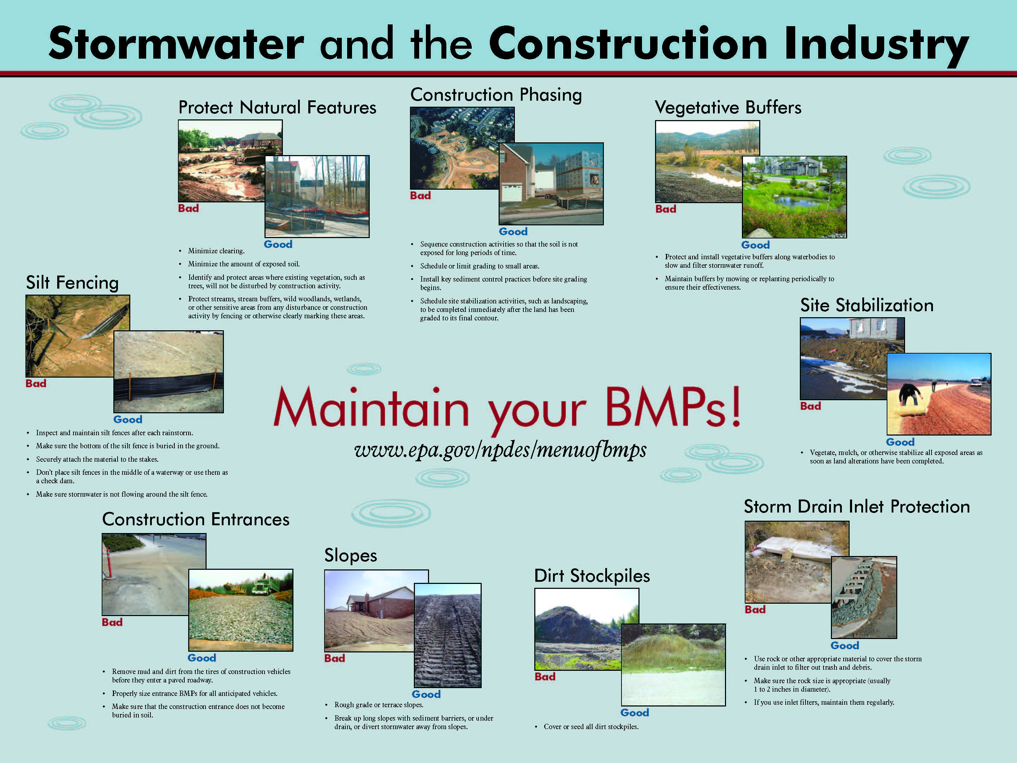
Examples conti…
FEMA document
Floodplain management and land-use regulations
Notes:
The area between the floodway boundary and limit of the 100 year floodplain is termed Flood Fringe.
Taken from a FEMA document describing the National Incident Management System (NIMS)
http://www.memphis.edu/cait/pdfs/Phases_of_Emergency_Mngt_FINAL.pdf
Pics sources:
http://www.landscapes2.org/ToolsElement/Pages/FloodProtect.cfm (accessed Sept 15, 2016)
http://cncsitedevelopment.com/common-pollutants-to-contain/
http://www.mpcnaturalresources.org/educational-programs/bmp-educational-seminars/

Slide 12
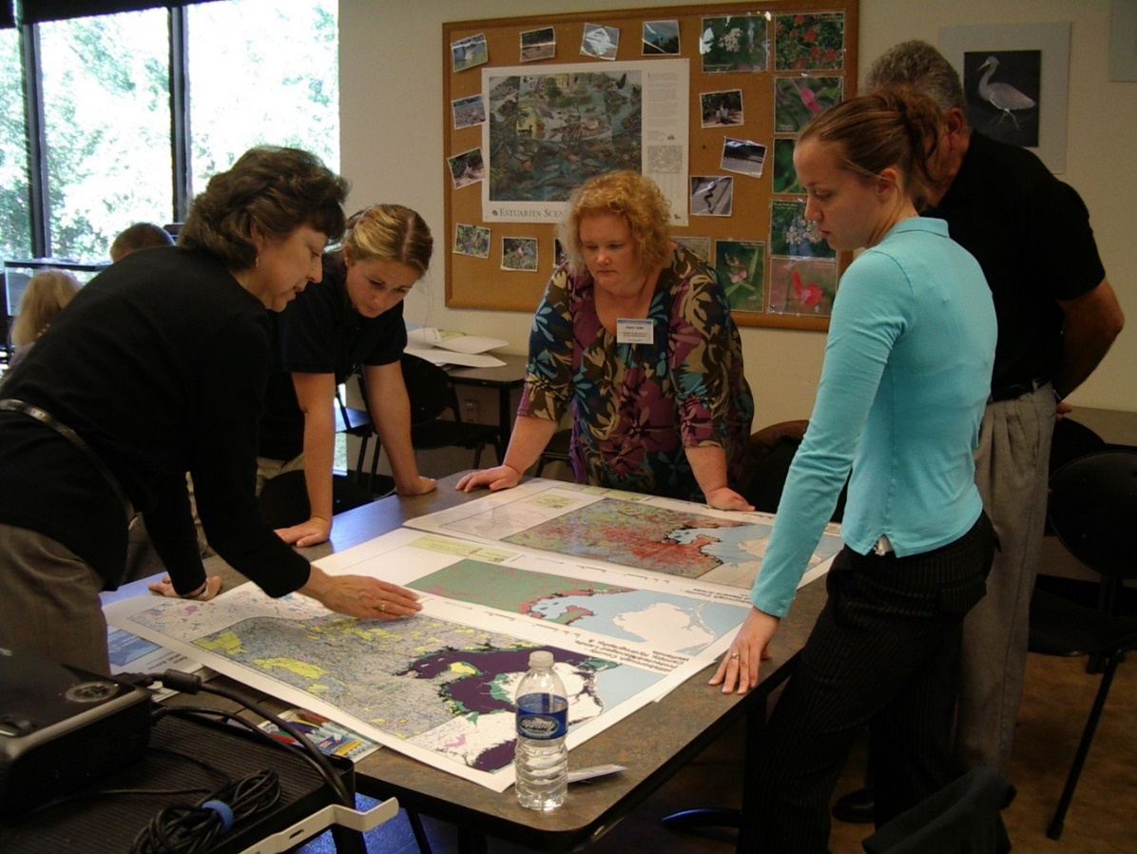
Examples conti…
FEMA document
Building codes, seismic design standards, and wind-bracing requirements for new construction, or repairing or retrofitting existing buildings
Notes:
Taken from a FEMA document describing the National Incident Management System (NIMS)
http://www.memphis.edu/cait/pdfs/Phases_of_Emergency_Mngt_FINAL.pdf
Pic Source: http://www.gulfalliancetraining.org/detail.aspx?Id=33

Slide 13
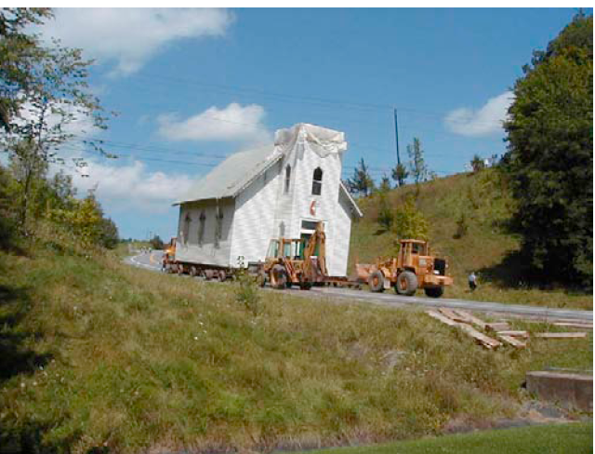
Structure Relocation: Most expensive but most effective Land use Planning tool
Examples conti…
FEMA document
Acquiring damaged homes or businesses in flood-prone areas, relocating the structures, and returning the property to open space, wetlands, or recreational uses
Notes:
Church is being moved half a mile to higher ground as part of the Stryker Road relocation project
Source: George D. Haddow, Jane A. Bullock and Damon P. Coppola

Slide 14
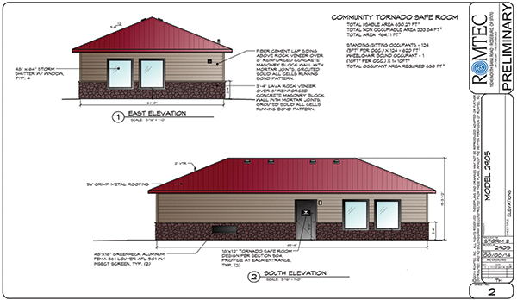
Examples of Mitigations: Conti…
Identifying, and refurbishing shelters and safe rooms to help protect people in their homes, public buildings, and schools in hurricane- and tornado-prone areas
Notes:
Taken from a FEMA document describing the National Incident Management System (NIMS)
Pic source: http://www.masonrymagazine.com/wp-content/uploads/2015/08/Safety-Shelter-Elevations.jpg

Slide 15
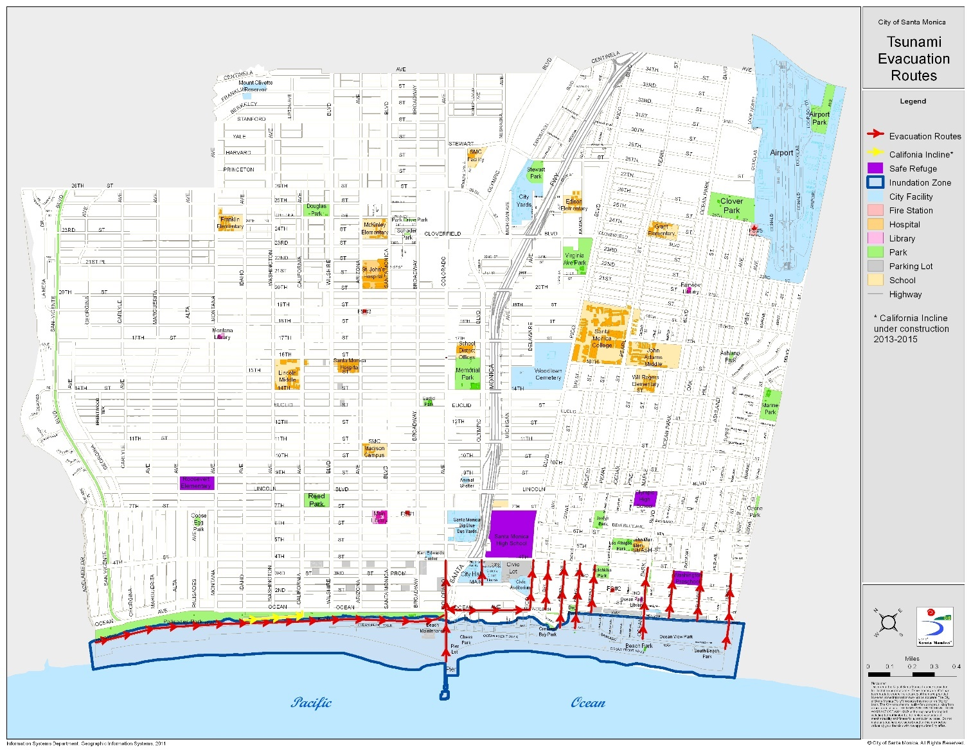
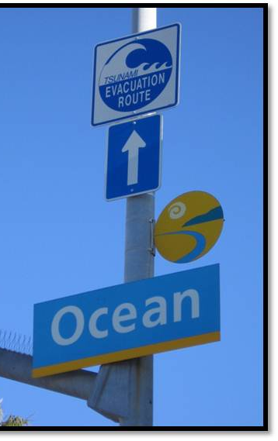
Examples of Mitigations: Conti…
Development of hazard-specific evacuation routes
Notes:
Taken from a FEMA document describing the National Incident Management System (NIMS)
Pic source: https://www.smgov.net/Departments/OEM/WhatToDo/Tsunami.aspx

Slide 16
Flood Hazard Maps
Maps that graphically provide information on inundation as well as on evacuation in an easy-to-understand format
Flood hazard mapping is an example of non-structural mitigation measures
Assist local residents in becoming aware of the
vulnerability of the area they live in,
the important roles that they play in disaster prevention activities and
proper evacuation in the event of floods.
Notes:
Inundation: predicted inundation areas, inundation depth, etc.),
Evacuation: (location of evacuation refuges, evacuation routes, dangerous spots on evacuation routes, etc.)
The goal is to quickly evacuate local residents in a safe and proper manner in the event of floods.

Slide 17
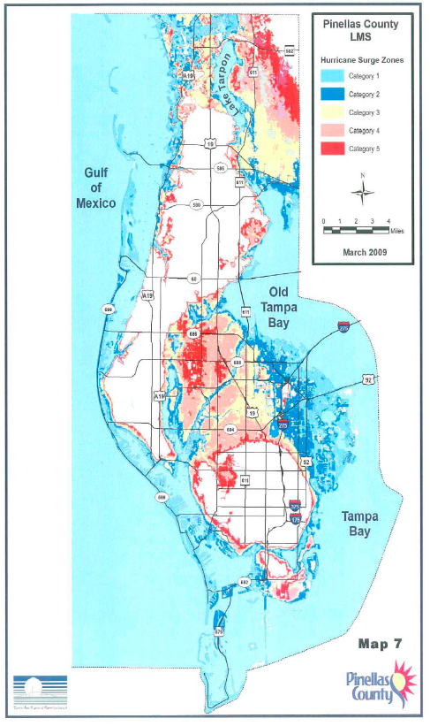
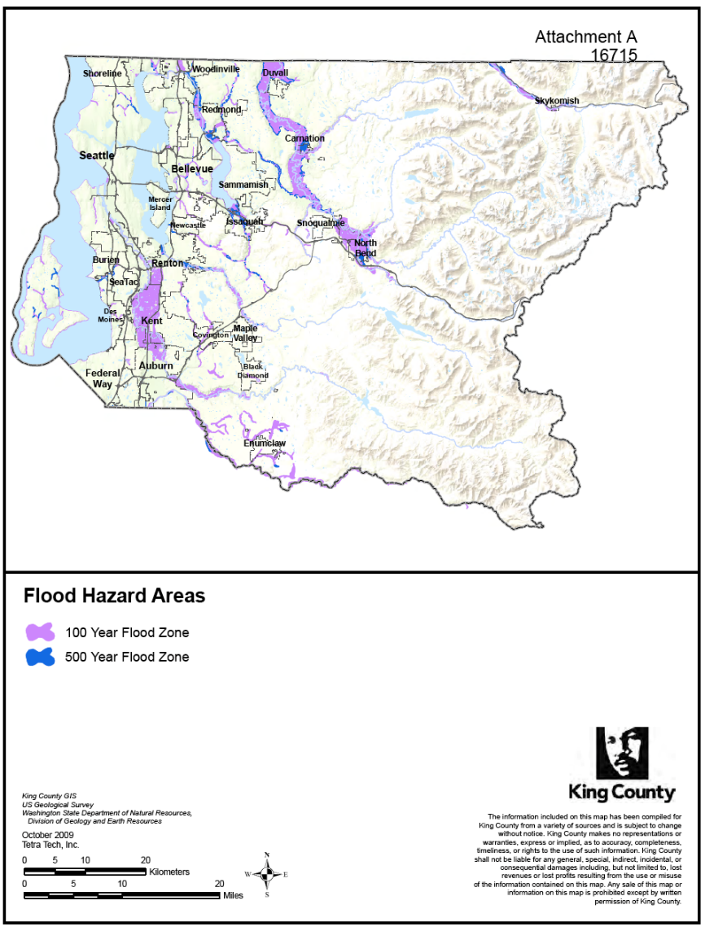
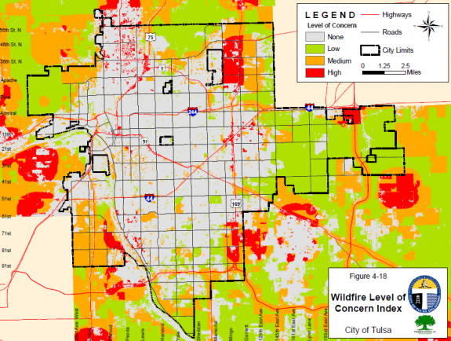
Examples of Mitigations: Conti…
Mapping of hazard or potential hazard zones, using geospatial techniques
Notes:
Taken from a FEMA document describing the National Incident Management System (NIMS)
Pinellas county in Florida
King County, Washington
Pic source: http://mitigationguide.org/task-5/steps-to-conduct-a-risk-assessment-2/1-describe-hazards/ (accessed September 2016)

Slide 18
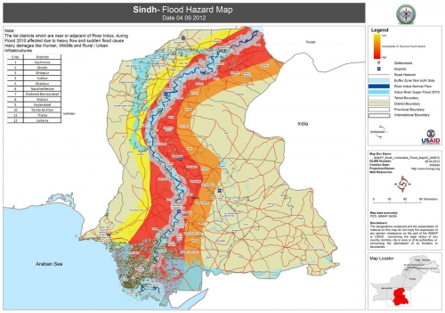
More about Flood Hazard Maps
Notes:
Pic source: http://www.immap.org/maps/index.php?do=map_view&id=929&cat=17

Slide 19
How to Represent Information on Flood Hazard Maps?
Should not convey a message that information shown on these maps is unchanged
Predicted inundation depths are usually shown in different colors
Flood danger level shown as the inundation depth
levee-break spots
Safe refuge and safe evacuation route
Non-colored areas on the hazard maps may be mistaken as non-inundation areas, whereas these are merely results from the flood simulation
In flash floods, how do you show the flow velocities on the map?
Notes:
Even though flow velocities can be shown on Flood Hazard Maps, it is difficult for residents to understand the actual danger of high-flow velocity.
Non colored area: The residents in those areas, however, believe that the areas will never be inundated during a flood occurrence

Slide 20
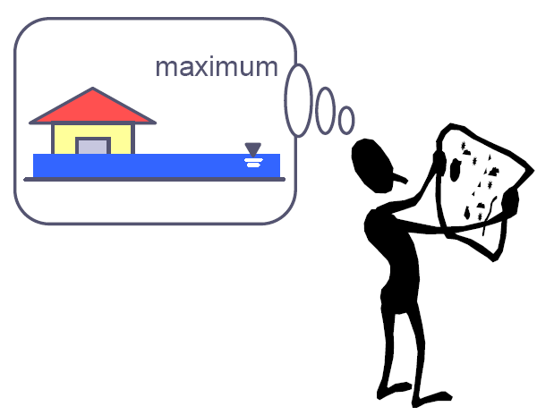
Hazard Maps
Have no value without any educational activities
Local residents should be encouraged to actively participate in the development of Flood Hazard Maps

Slide 21
Interesting Fact!
A study done for FEMA by the Multi-Hazard Mitigation Council (MMC) of the National Institute for Building Sciences (NIBS) found that for every $1 invested in mitigation, $4 would be saved in future losses
Notes:
Depending on the type of disaster and locale, this number was as high as $8.
Source: George D. Haddow, Jane A. Bullock and Damon P. Coppola

Slide 22

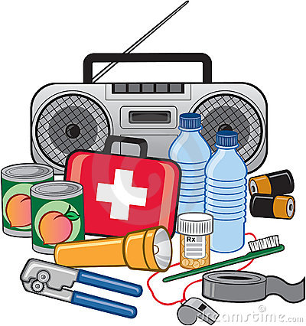

Preparedness Disaster Planning and Preparation
Better to be prepared a year early than a day late
Notes:
Source: http://www.authorstream.com/Presentation/Pravez-36117-IA-Emergency-Preparedness-PROTECTING-IRREPLACEABLE-DISASTER-PREPAREDNESSFOR-HISTORIC-PROPERTIES-Introduction-Report-as-Entertainment-ppt-powerpoint/
22

Slide 23
Disaster Preparedness
A state of readiness to respond to a disaster.
Protective process to respond rapidly to a disaster to cope with it.
Notes:
Source: http://www.who.int/hac/techguidance/training/induction/wpro/Day1%20Concepts%20in%20Emergency%20Management.pdf
http://www.authorstream.com/Presentation/Pravez-36117-IA-Emergency-Preparedness-PROTECTING-IRREPLACEABLE-DISASTER-PREPAREDNESSFOR-HISTORIC-PROPERTIES-Introduction-Report-as-Entertainment-ppt-
23

Slide 24
The capacity to respond and recover from emergencies and disasters is only developed through planning, training, and exercising —the heart of preparedness.
assess the exposure to risk
measures to build capacity and/or surge capacity
Notes:
Surge Capacity: Additional capacity to deal with sudden unexpected upturns in demand. Surge capacity is used when there are unforeseen emergencies and disasters
when a crisis deteriorates etc.
Source: Day1 Concepts in Emergency Management (Pdf in reading material)
http://www.authorstream.com/Presentation/Pravez-36117-IA-Emergency-Preparedness-PROTECTING-IRREPLACEABLE-DISASTER-PREPAREDNESSFOR-HISTORIC-PROPERTIES-Introduction-Report-as-Entertainment-ppt-
24

Slide 25
Whose Responsibility?
Expands beyond the boundaries of emergency management agencies.
Those susceptible to the consequences of disasters must ensure their preparedness.
All organizations: private, governmental, non-governmental

Slide 26
Scope?
Focus not only on the protection of citizens, property, and essential government services but also on ensuring the viability and sustainability of the community — including its
businesses and markets,
social services and character
Notes:
Introduction to Emergency Management By George Haddow, Jane Bullock, Damon P. Coppola

Slide 27
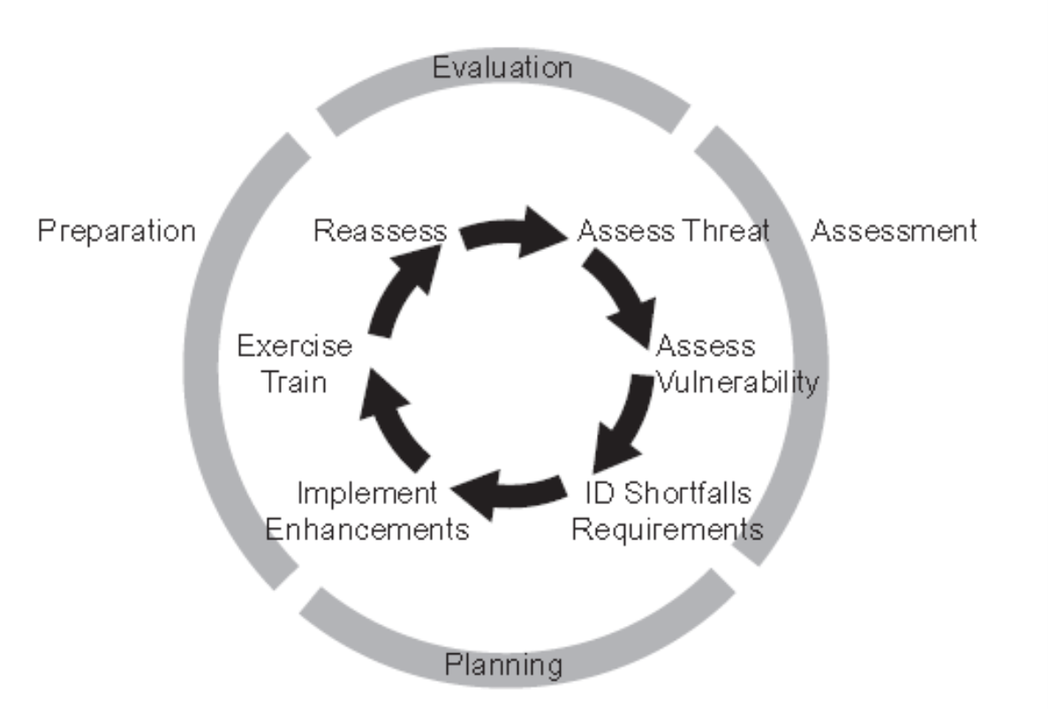
Preparedness: Activities
Identify areas of potential hazards.
Improve the abilities of agencies and individuals to respond to the consequences of a disaster event.
Develop plans to enhance disaster response operations.
methods for predicting the effectiveness of disaster response operations.
Emergency Plans
Pre disaster response
Post disaster recovery action
Installing early warning systems.
Training of personnel
Preparedness Planning Cycle
Notes:
Mitigation activities eliminate or reduce the effect of unavoidable disaster.
27

Slide 28
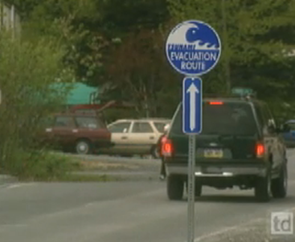
Evacuation Planning
How to evacuate citizens in the event of a major disaster in both warning and no warning situation?

Slide 29
Notes:
advisory evacuation warning and/or an imperative evacuation warning (the residents are, however, not charged a penalty if they do not follow the warnings).
Mind set: In case of flood hazard residents hardly realize that they are in serious danger and not recognize the strong power of stream flow if they never experience it, and believe that they can evacuate even after the onset of flooding.
Koriyama in Japan.

Slide 30
Evacuation Planning
Advanced planning for
Activation procedures,
Determination of adequate and effective routes,
Methods of transportation,
Destinations for those evacuated,
Security precautions for homes and belongings,
Adherence by citizens to evacuation orders, and
Facilitating the evacuation itself.
Full-scale test may give an accurate idea of how the plan will work in a real-life situation

Slide 31
Elements of Preparedness
National Level
Examples: Policies, procedures, guidelines
Local Level
Examples: Plans, resources, authority
Personal Level
Examples: Knowledge, Skills, and Attitude

Slide 32
Mitigation vs. Preparedness
Mitigation attempts to eliminate hazard risk by reducing either the likelihood or the consequences of the risk associated with the particular hazard
Preparedness, on the other hand, seeks to improve the abilities of agencies and individuals to respond to the consequences of a disaster event once the disaster event has occurred
Notes:
Source: George D. Haddow, Jane A. Bullock and Damon P. Coppola

Slide 33
Mitigation vs. Preparedness
Preparedness assumes the occurrence of an event, whereas mitigation attempts to prevent the event altogether
Mitigation focuses on activities taken prior to the instance of an emergency event
Preparedness: look for the activities needed once a disaster has occurred.
Notes:
Source: George D. Haddow, Jane A. Bullock and Damon P. Coppola

Slide 34
Response
RESPONSE
RESPONSE
RESPONSE
RESPONSE
RESPONSE

Slide 35
Response
Pre- and post-disaster activities to provide emergency assistance
For casualties
To reduce the probability of secondary damages
To speed up recovery operations
By the Local and Federal Government , Armed forces, and Volunteer humanitarian Groups
Notes:
Evacuation and sheltering of involved people.
35

Slide 36
Emergency Operations and Relief Activities
Evacuation & Temporary shelter
Search and rescue
Health care
Food and water distribution
Temporary sanitation
Restoration of access to transport
Preliminary damage assessment
Notes:
Evacuation: Relocate a population from zones at risk of an imminent disaster to a safer location. To move the population away from the hazard and its consequences.
The primary concern is protecting the life and treatment of the injured. Reduces the effect of disasters.
An Effective Evacuation Requires: A timely and accurate warning system. A clear identification of escape routes.
An established policy that requires everyone to evacuate when an order is given. A public education program to make the community aware of the plan.
SAR: The process of identifying the location of disaster victims who may be trapped or isolated and bringing them to safety and medical attention.
Time is critical – no delays!!!: Most effective in early min/hours/days.
Victims may be trapped under collapsed buildings, debris, moving water, etc. Half of those rescued are rescued in the first six hours.
Organized search and rescue activities are needed.
Locate by listening to their calls, looking for signs of life, or using information to estimate where the victims may be found.
Provide them with initial medical first aid. Transport them to hospitals/shelters or a safe location.

Slide 37
Class Activity/Homework
Keep in mind the 3 phases of DRM covered so far that are mitigation, preparedness, and response
Now consider our university premises as your study area and
Do the hazard profiling of the study area
Select the hazard with the highest probability of occurrence and with the highest impact (not necessarily the same hazard qualifying both criteria)
Suggest at least
Three (03) mitigation approaches
Three (03) preparedness activities
Three (03) response measures

Slide 38

DISASTER RECOVERY

Slide 39
UNISDR Terminologies
Recovery
The restoring or improving livelihoods and health, as well as economic, physical, social, cultural, and environmental assets, systems, and activities of a disaster-affected community or society, aligning with the principles of sustainable development and “build back better,” to avoid or reduce future disaster risk.
Rehabilitation
The restoration of basic services and facilities for the functioning of a community or a society affected by a disaster.
Notes:
https://www.unisdr.org/we/inform/terminology
Now called UNDDR Disaster Risk Reduction and Recovery
United Nations International Strategy for Disaster Reduction

Slide 40
Response vs. Recovery
There is usually an overlap of disaster response and recovery work.
Response is implemented during and in the immediate aftermath of a disaster to save lives and meet basic subsistence needs (immediate and short-term needs).
The main objective of the recovery phase is restoring and improving people’s former living conditions (in longer terms).
Also provides a ‘window of opportunity’. How???
Notes:
Early recovery, rehab and reconstruction
Source: Cities, Disaster Risk and Adaptation By Christine Wamsler

Slide 41
Recovery
Rebuilding, reconstruction, and repair of the damages
Function by which communities and individuals repair, reconstruct, or regain what has been lost as a result of a disaster.
Recovery measures should also reduce the risk in the future.
Requires special skills, equipment, resources, and personnel.
The recovery period follows the emergency phase of a disaster.
Notes:
Make things functional again.
The recovery process requires balancing the more immediate need to return the community to normalcy with the longer-term goal of reducing future vulnerability.

Slide 42
Recovery ---conti
Often begins in the initial hours and days following a disaster event and can continue for months or years, depending on the severity of the event.
Recovery function has such long-lasting effects and usually high costs.
Participants include all levels of government, the military, the business community, political leadership, community activists, and individuals.
Unique to each community and depends on the extent of the damages and available resources to cope.

Slide 43
Actions and Activities
Ongoing communication with the public.
Provision of temporary houses or long-term shelter.
Assessment of damages and needs.
Inspection of damaged structures.
Demolition of damaged structures.
Clearance, removal, and disposal of debris.
Repair of damaged structures.
Notes:
Source: Coppola

Slide 44
Actions and Activities
Rehabilitation of structures.
New construction.
Social rehabilitation programs.
Creation of employment opportunities.
Reimbursement for property losses.
Rehabilitation of the injured.
Reassessment of hazard risk.
Notes:
Source: Coppola

Slide 45
Pre-Disaster Recovery Actions
Hypothetical and focusing on broad goals rather than specific actions and procedures.
Sometimes referred to as “Pre-Event Planning for Post-Event Recovery (PEPPER).”
Can reduce the risk of haphazard rebuilding.
Notes:
Broad goal Example: Reduce vulnerability to electric transmission wires”

Slide 46
Pre-Disaster Recovery Actions
Examples:
Site selection for long-term temporary houses.
Site selection for temporary business activity.
Site selection for disposal of debris.
Emergency needs assessment.
Volunteers and donation management.
Mitigation measures and secondary hazard reduction measures.
Notes:
Name of contractors, coordination mechanisms,
Secondary hazards: These are hazards that follow as a result of other hazard events. (For EQ – building collapse, dam failure, fire, landslide, tsunami, water pollution. Etc.)

Slide 47
Short-Term Recovery
Restores vital services and systems.
Immediate and overlaps with response.
Actions
Restoring interrupted utility and other essential services (roads cleared).
Reestablishing transportation routes.
Providing food, shelter, and health care to those displaced by the incident.
Notes:
Although called “ short-term, ” some of these activities may last for weeks.
It may be considered as a transitional phase between (i) immediate relief and (ii) more major, long-term reconstruction and the pursuit of ongoing development.
Basic services and functions are restored,
Providing food and shelter to the effected people
Providing essential public health and safety services

Slide 48
Long-Term Recovery
Restores all services to normal or better conditions.
both the personal lives of individuals and the livelihood of the community.
It may involve some of the same actions as short-term ones.
Permanent construction or replacement of severely damaged physical structures.
Full restoration of all services and local infrastructure and the revitalization of the economy.
May continue for a number of months or years, depending upon the severity of the damages.
Example: Complete redevelopment of damaged areas
Notes:
Look for American Planning Association entitled Planning for Post-Disaster Recovery and Reconstruction .
Long-term recovery (replacement of homes, water systems, streets, hospitals, bridges, schools, etc.) can take
several years.

Slide 49
Post Disaster Long-Term Recovery Planning
Planning before the next disaster strikes.
It provides the following benefits;
Identifies the most vulnerable areas of the community.
Accelerates approval of federal funding for rebuilding in the post-disaster environment.
Anticipates/compensates for regulatory and environmental requirements for rebuilding.
Minimizes economic and social disruption to the community.
Maximizes post-disaster funding in the public and private sectors.
Notes:
Coppola
Promotes a favorable climate for municipal bond and insurance portfolios

Slide 50
Disasters as Opportunities for Development Initiatives
With a disaster comes disruption and tragedy, but in the aftermath comes opportunity!
Notes:
Disasters almost always present a window of opportunity to rebuild old, ineffective structures and develop policy and practice in a way that leaves behind a more empowered, resilient community.
This is an ideal time to implement new mitigation measures so that the community is better prepared to deal with future threats and does not leave itself vulnerable to the same setbacks as before.
Helping the community to take new mitigation steps is one of the most important roles during the recovery phase.
Reconstructions after a disaster should be carried out so that they are better than before a disaster

Slide 51
Disasters can highlight particular areas of vulnerability.
The political environment may favor a much higher rate of economic and social change than before in areas such as land reform, new job training, housing improvements, and restructuring of the economic base.
Emergency lending for post-disaster investment may be used to restructure the economy as a result of a disaster.
Notes:
Disasters can be a vehicle for major development programs. The political impact of damage and disruption can be a real catalyst for change.
The value of direct international assistance given after disasters may partially compensate for economic losses,
although the amounts are usually rather small in relation to the total loss.

Slide 52
Questions?

