Slide 1
GEE Lab - 1 WORKING WITH GOOGLE ERATH ENGINE
to search, find and visualize a broad range of remotely sensed datasets

Slide 2
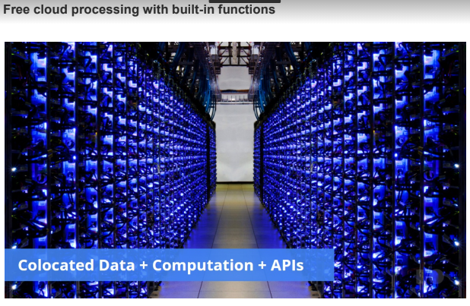
GOOGLE EARTH ENGINE
a cloud-based platform for planetary-scale geospatial analysis
No more downloading and analyzing individuals tiles at a time
Notes:
or stressing about your local storage.
application programming interface (API)

Slide 3
Sign up for a Google Earth Engine account
Earth Engine account registration: https://signup.earthengine.google.com/#!/
Once registered you can access the Earth Engine environment @: https://code.earthengine.google.com
Google Earth Engine Code Editor uses the JavaScript programming languages.
For JavaScript Background: https://developers.google.com/earth-engine/tutorial_js_01
Notes:
Source: https://www.geospatialecology.com/intro_rs_lab1/

Slide 4
Google Mission Statement
"To organize the world's information and make it universally accessible and useful."
Earth Engine provides an API to process, analyze, and visualize the data using Google machines.
Data storage and processing are all performed at Google.
Whatever USGS has, Earth Engine has.
All you need to use Earth Engine is an internet connection.
Notes:
Source: Dr. Hammad Gillani’s slides
Application Programming Interface

Slide 5

Earth Engine Data Catalog
No more downloading and analyzing individuals tiles at a time.
No more worry about your local storage.
As of 2020
Now
1000 of public datasets
Thousands of new images added every day
Total Stored Data: Over 90 petabytes (PB) and expanding rapidly.
Growth Rate: Grows by roughly 1 petabyte of new data every month.
Historical Span: Over 50 years of continuous global satellite records.
https://developers.google.com/earth-engine/datasets/catalog/?filter=SRTM
Notes:
As of 2020
In order to move the question to the data, Earth Engine hosts a petabyte-scale archive of satellite imagery and other geospatial data on Google infrastructure. At the same time, Earth Engine provides an API in order to perform processing, analysis, visualization of the data, also using Google machines. Data storage and processing are all performed at Google.
2024 Dr. Hammad Gillani presentation = 50 petabytes

Slide 6
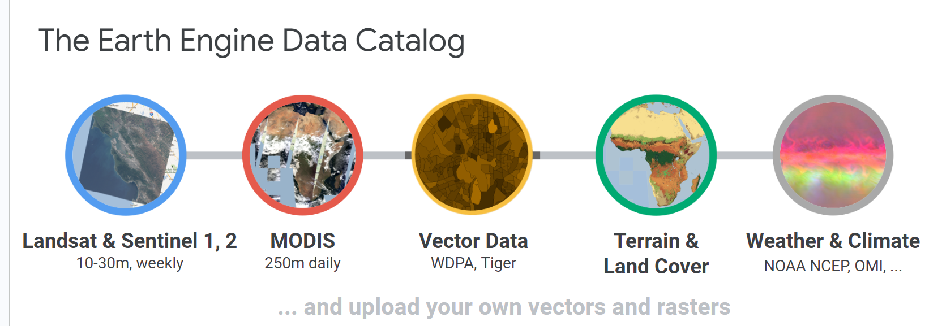
There is a one or two-day latency between scene acquisition and when it is ingested into the catalog.

Slide 7
33 years
Of satellite data
Over 5,000,000
Landsat and Sentinel scenes analyzed
3 Quadrillion Pixels
3,000,000,000,000,000
Notes:
Making Time Lapse used a huge amount of data, taking millions of hours of computation. However, when such a job is run in massive parallel on Google infrastructure, it just takes a few days.
Copied Dr. Gillani’s slide

Slide 8
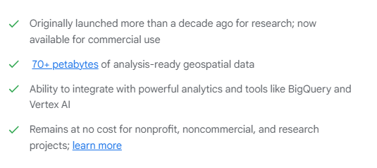
Notes:
As of Nov 2023

Slide 9
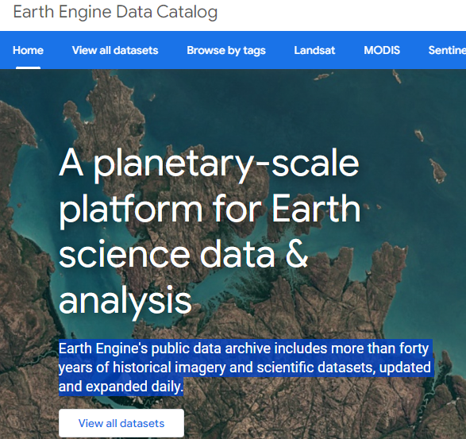
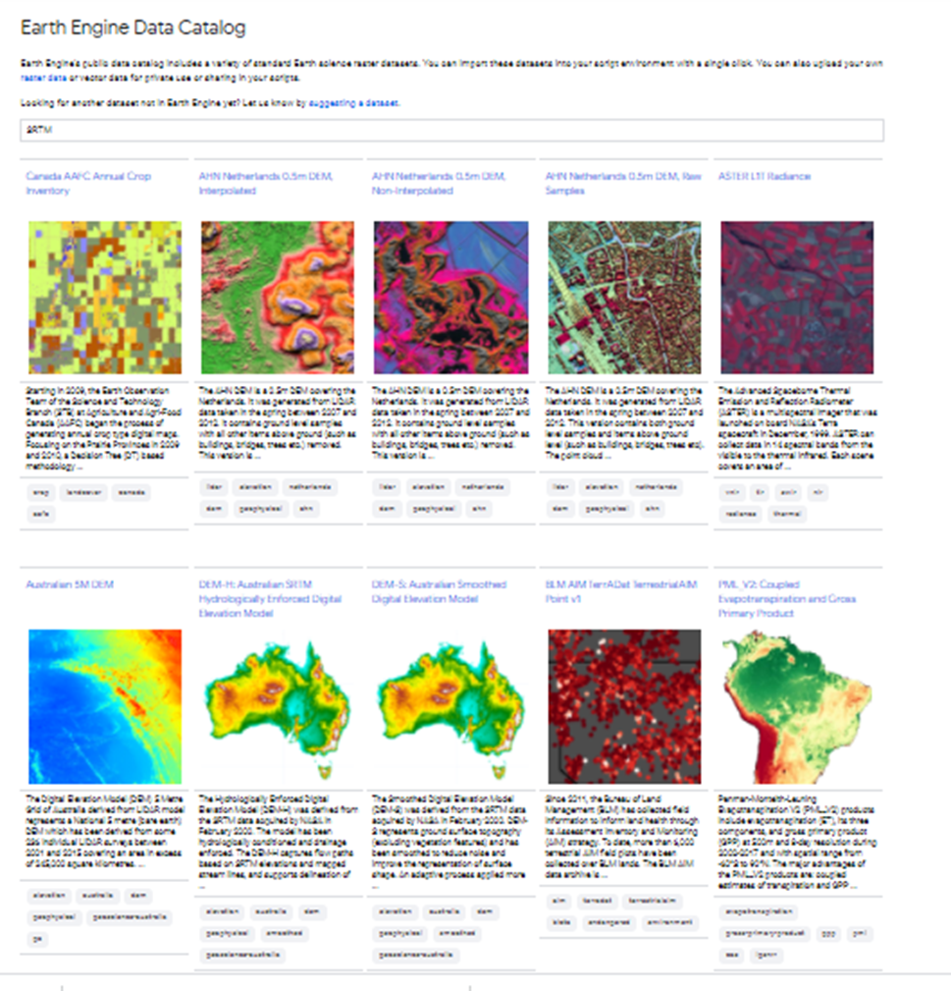

Slide 10
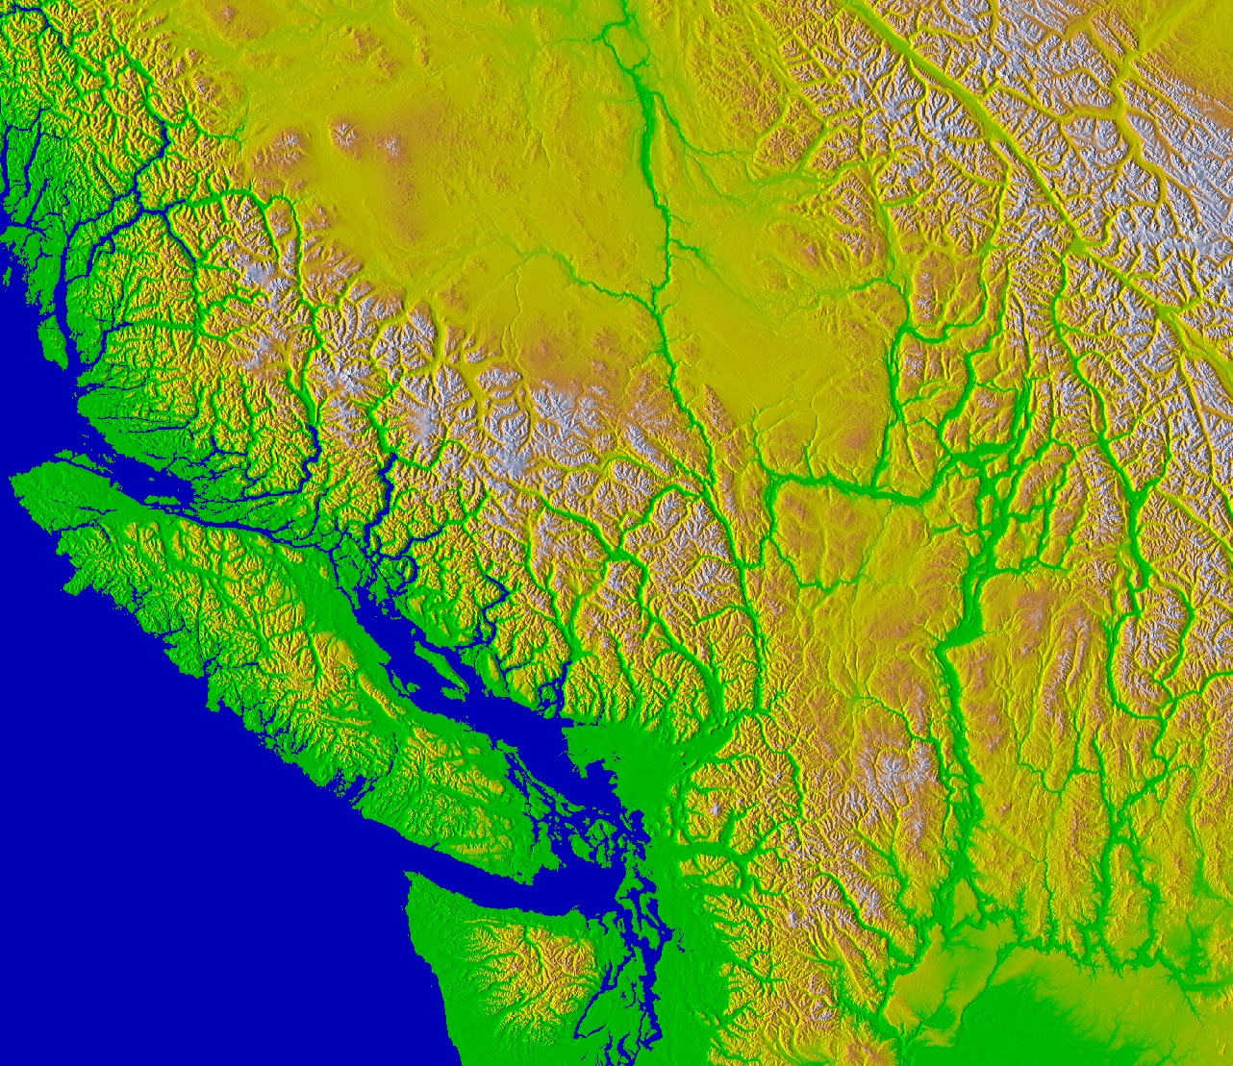
Terrain
Notes:
Terrain data. The purpose of this slide is to illustrate that compelling visualizations can be created and exported exactly as they appear on screen. You have control over scale, projection and rendering.

Slide 11
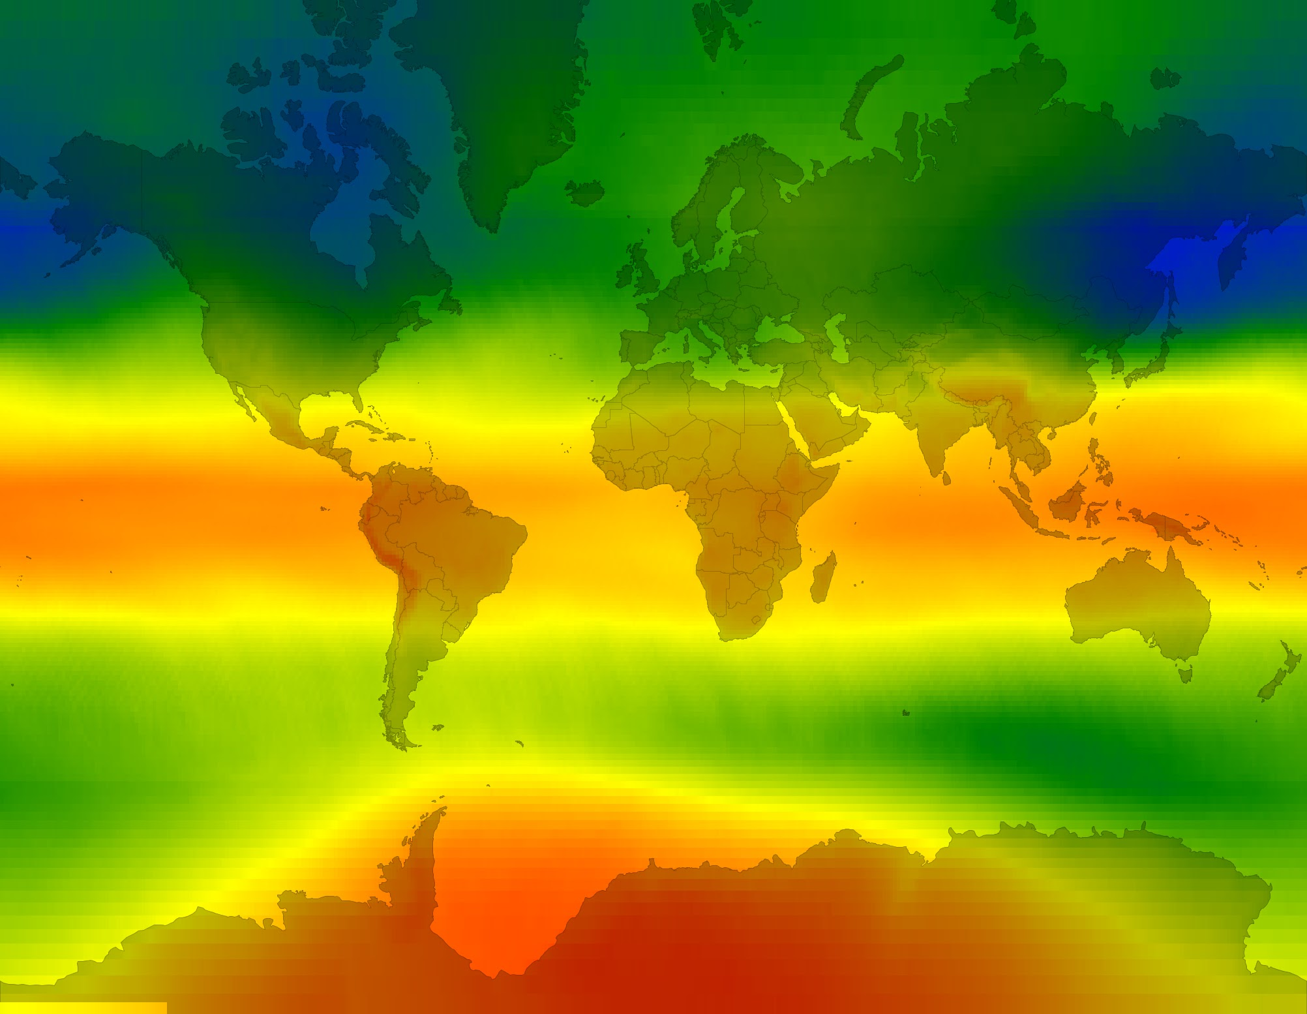
Atmosphere
Notes:
This image is mean annual ozone from the merged OMI/TOMS dataset. Red is less ozone, blue is more ozone. There are lots of other climate and atmosphere data in the catalog. Use the search tool to explore the catalog.

Slide 12
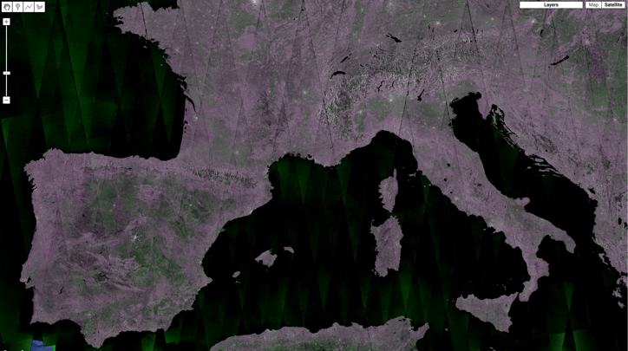
Sentinel
Sentinel-1
Notes:
A composite of Sentinel-1 backscattering coefficients.

Slide 13
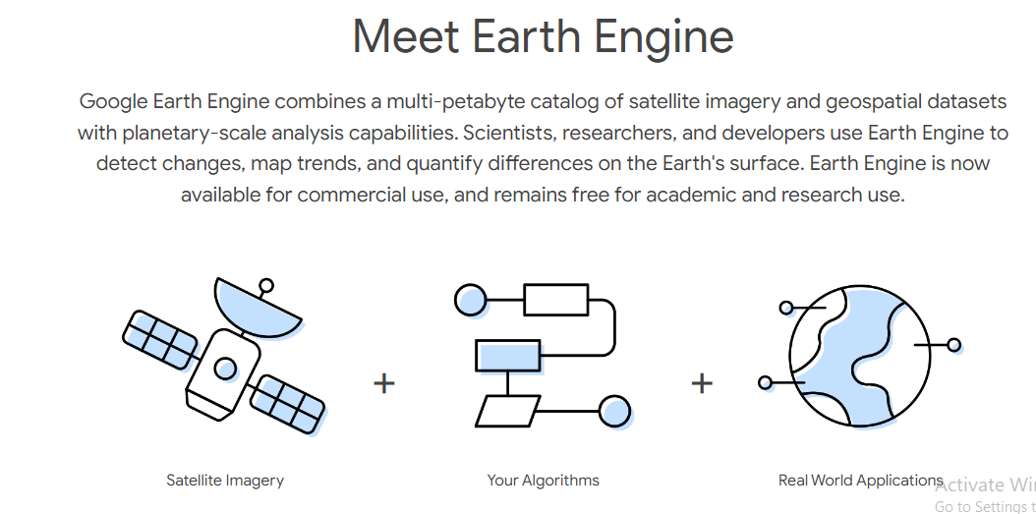

Slide 14
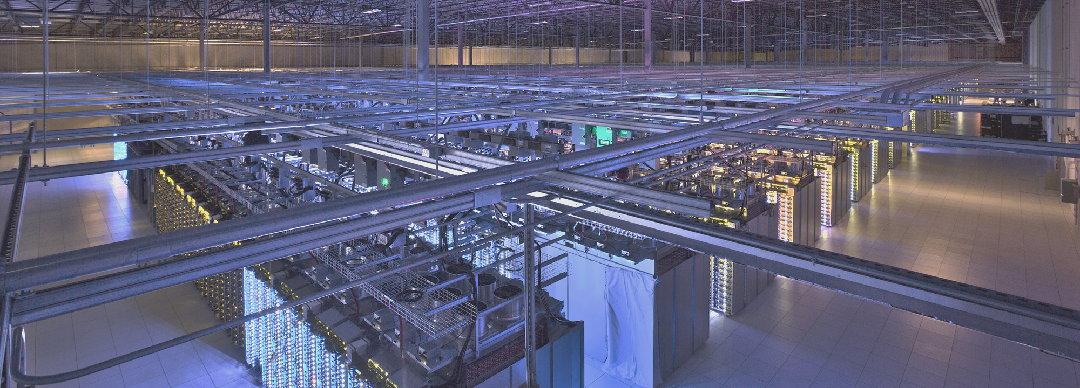
Computation Platform
On-the-Fly Computation
Interactively visualize data, serve queries, and preview analysis results.
Batch Computation
Large-scale parallel computation at the click of a button.
Notes:
Interactive mode is the Code Editor. To run big jobs at arbitrary scale and scope, use batch mode.

Slide 15
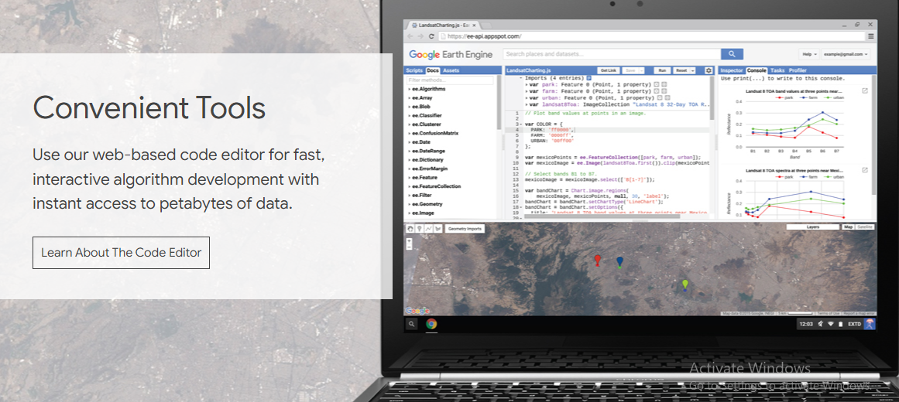
Powerful JavaScript* API
Notes:
Python too

Slide 16
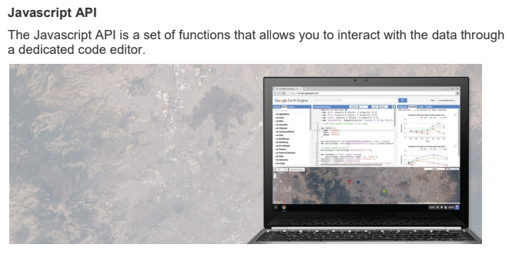

Slide 17
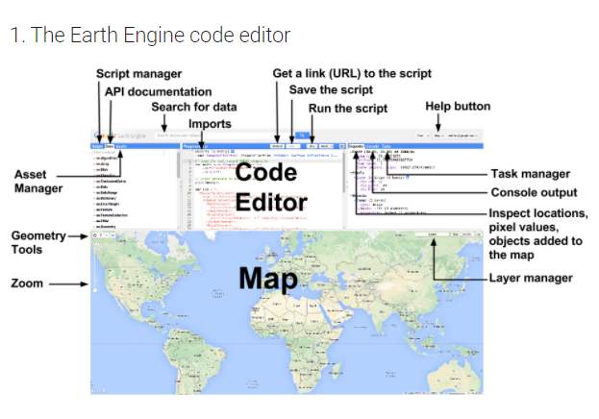
Notes:
Source: https://www.geospatialecology.com/intro_rs_lab1/
An application programming interface

Slide 18
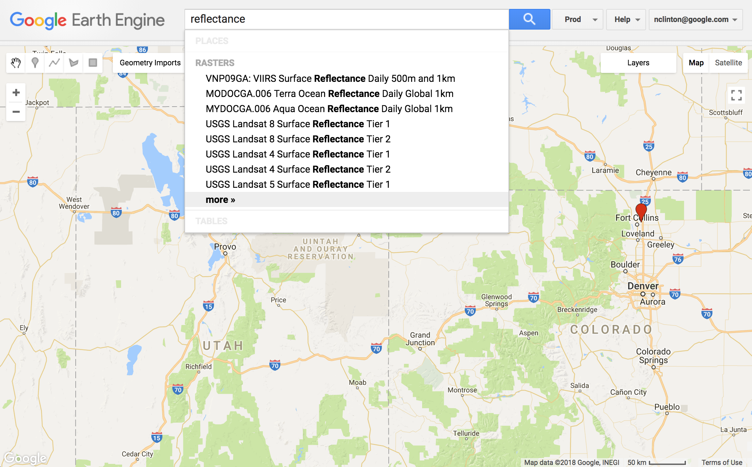
Search!

Slide 19
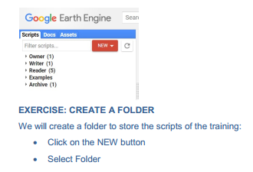
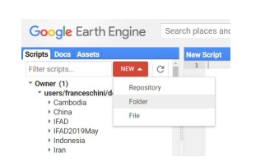
1
2
3 – Type name of the folder

Slide 20

Your first Script: Hello, I am ‘your name’

Slide 21
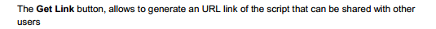
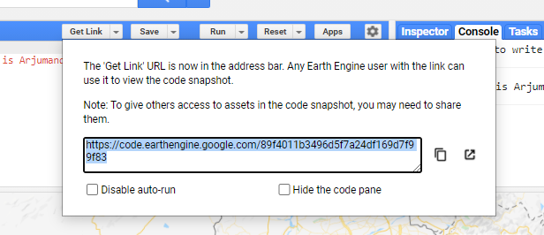

Slide 22
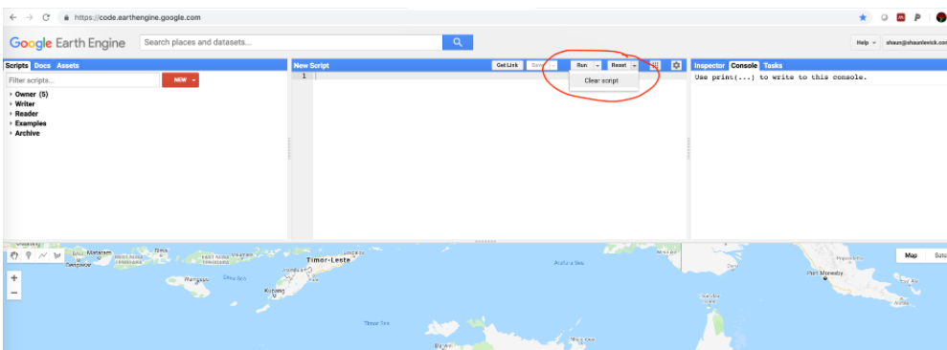
Clear Script

Slide 23
Data Types and Geospatial Processing Functions
Image - band math, clip, convolution, neighborhood, selection ...
Image Collection - map, aggregate, filter, mosaic, sort ...
Feature - buffer, centroid, intersection, union, transform ...
Feature Collection - aggregate, filter, flatten, merge, sort …
Filter - by bounds, within distance, date, day-of-year, metadata ...
Reducer - mean, linearRegression, percentile, histogram ….
Join - simple, inner, outer, inverted ...
Kernel - square, circle, gaussian, sobel, kirsch …
Machine Learning - CART, random forests, bayes, SVM, kmeans, cobweb …
Projection - transform, translate, scale …
over 1000 data types and operators, and growing!
Notes:
Image is the fundamental raster data structure in Earth Engine. Bands. Pixels. Metadata.
ImaeCollection is stack or time series of images.
Feature is the fundamental vector structure in Earth Engine. Geometry and metadata.
FeatureCollection is a collection of Features (surprise).
Filter is how to limit the scope of analysis temporally, spatially or by metadata.
Reducer is the way to aggregate data. Statistics such as min, max, mean, SD, variance, covariance, linear regression, etc.
Joins are the way to combine different data sets.
Kernel facilitates image processing operations, for example convolution.
Machine Learning algorithms support supervised and unsupervised classification.
Projection is the way to control scale and appearance of data outputs.
And growing in response to user requests.

Slide 24
Global composites with a few lines of code
var composite = ee.Algorithms.Landsat.simpleComposite({
collection: ee.ImageCollection('LANDSAT/LC08/C01/T1'),
asFloat: true
});
Map.addLayer(composite,
{bands: ['B4', 'B3', 'B2'], max: 0.3},
'composite');
https://code.earthengine.google.com/05d2e23206b329dfe696e5ba8e232c3f
Notes:
Concept: reduce a stack of images to one image. The inputs are the images. The output is the median. Map is just for review.
The reducer is repeated. It is evaluated separately for each band. Come to the arrays session to learn another way.

Slide 25
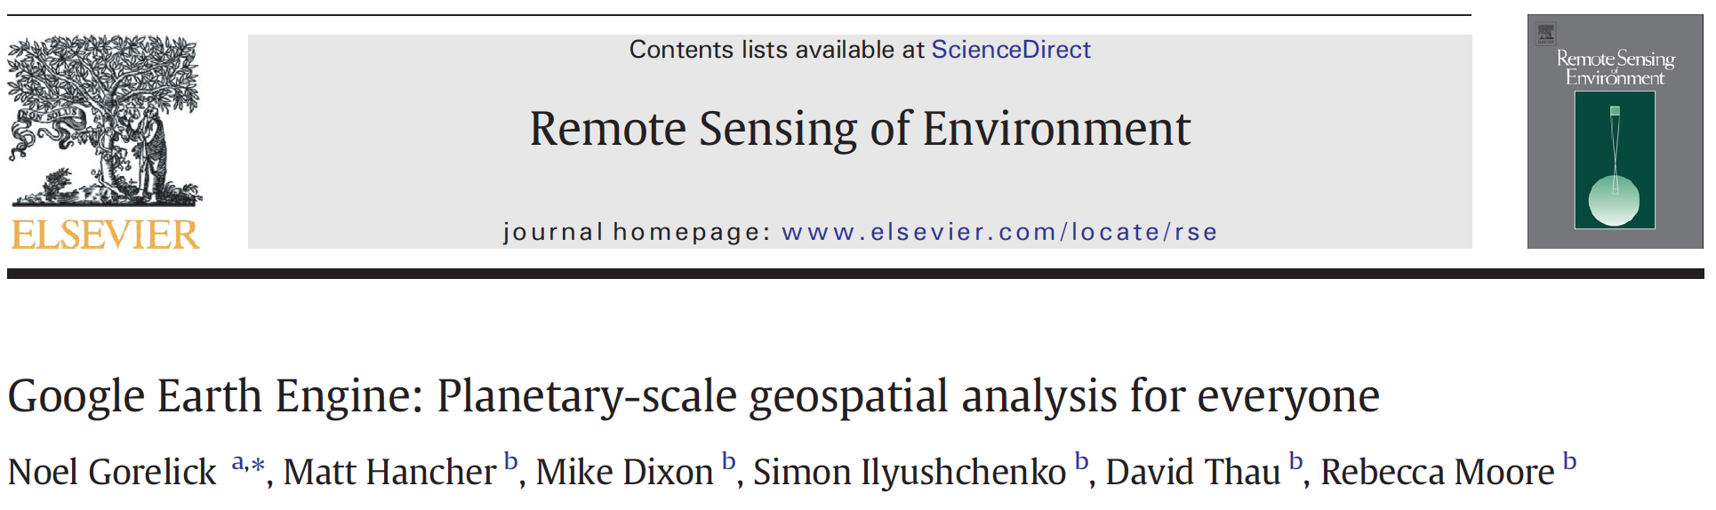
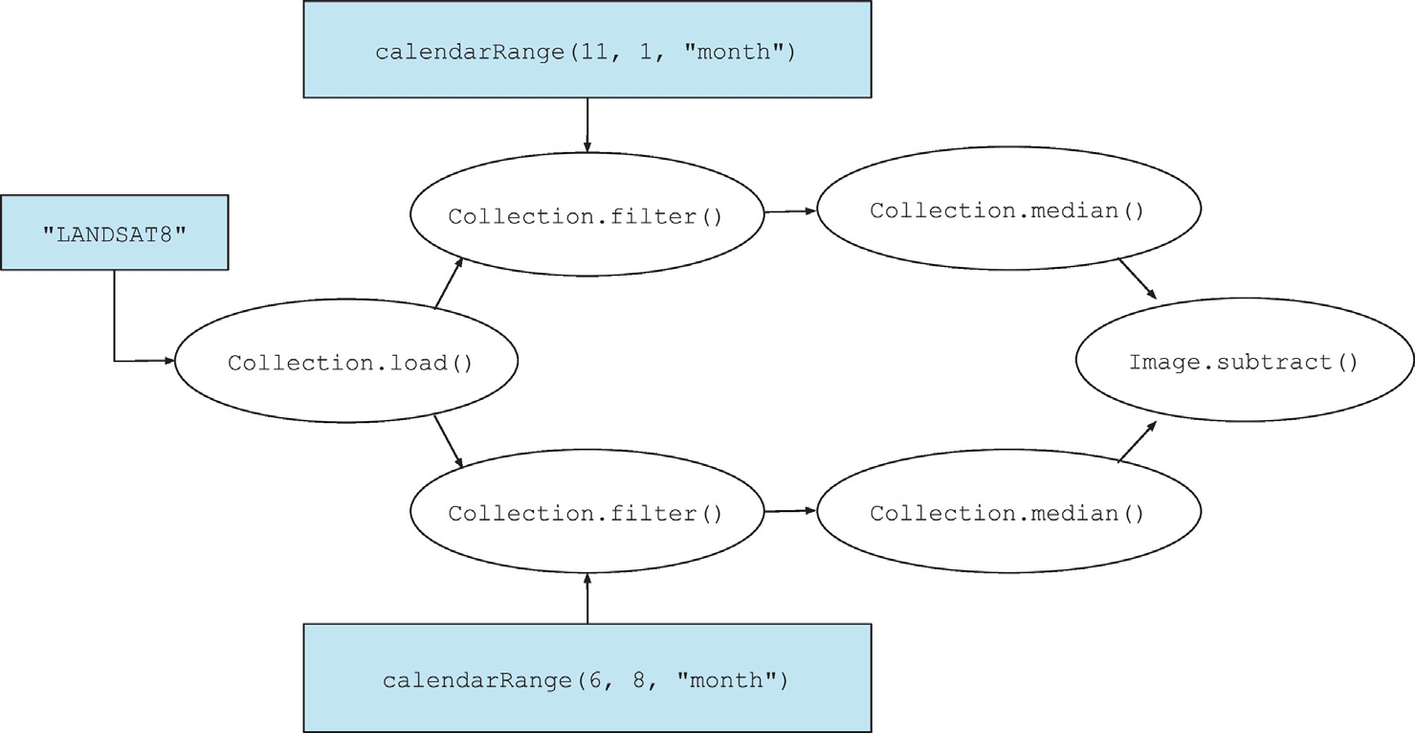

https://www.sciencedirect.com/science/article/pii/S0034425717302900
Notes:
See this paper for more details. Segue to publications.

Slide 26
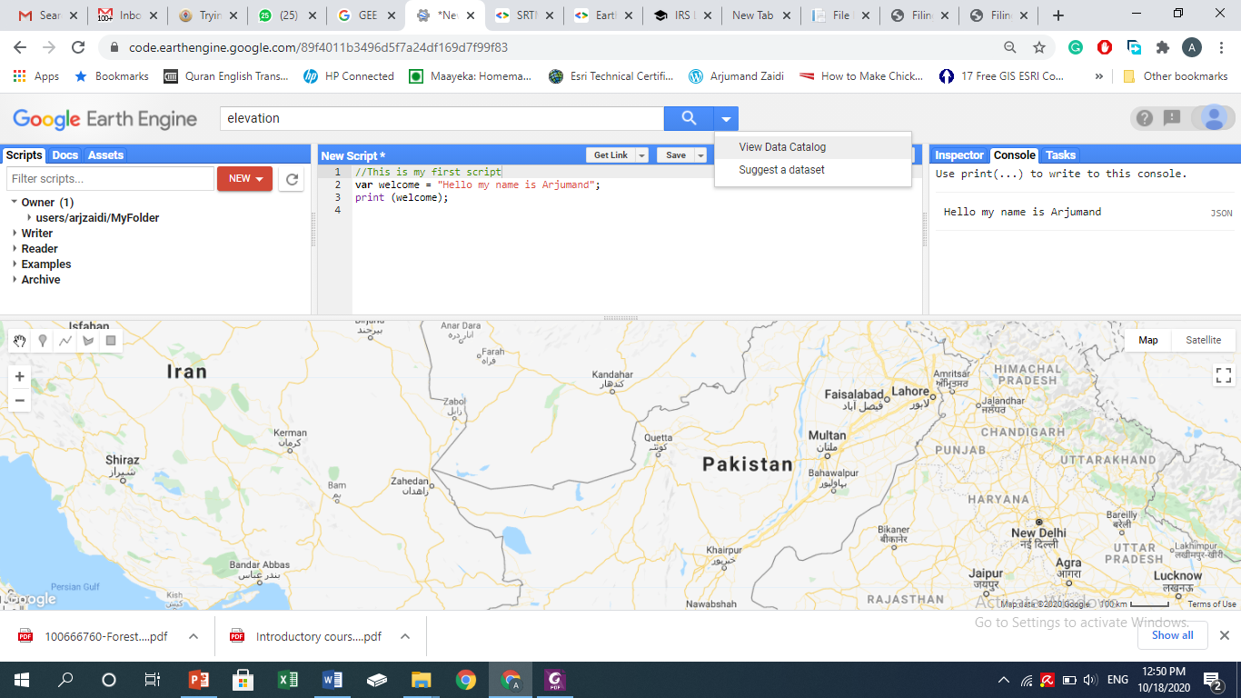
Data Catalog
Or Search Keywords
View

Slide 27
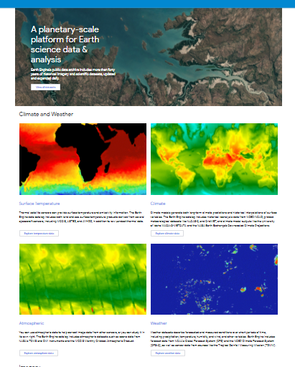
Data catalog contains a description of the available datasets by theme
https://developers.google.com/earth-engine/datasets/
Search or directly select data from the catalog to import

Slide 28
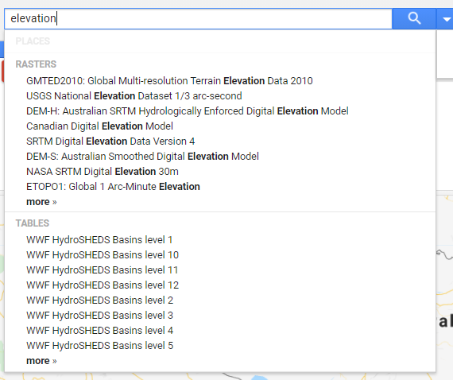
Search Data - Elevation
Write key words in search window.
Select data

Slide 29
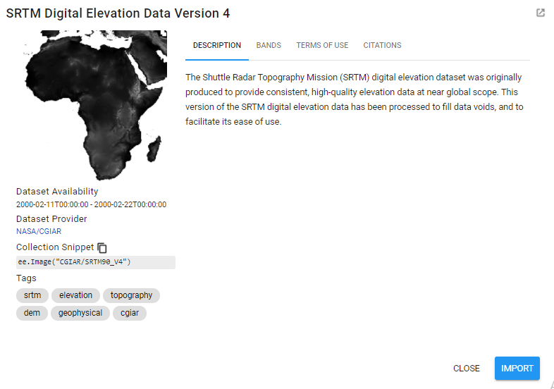
Or- View Dataset in Catalog Page

Slide 30
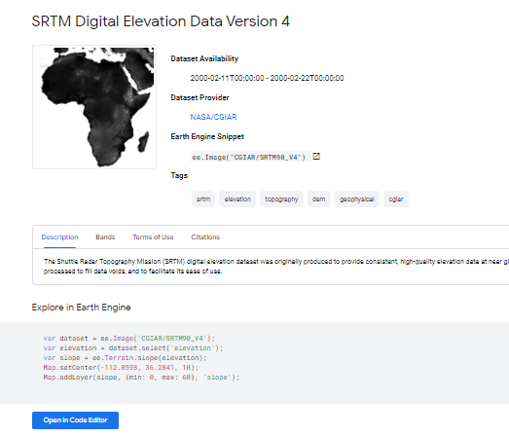
View Dataset in Catalog Page
(long, lat, zoom level)

Slide 31
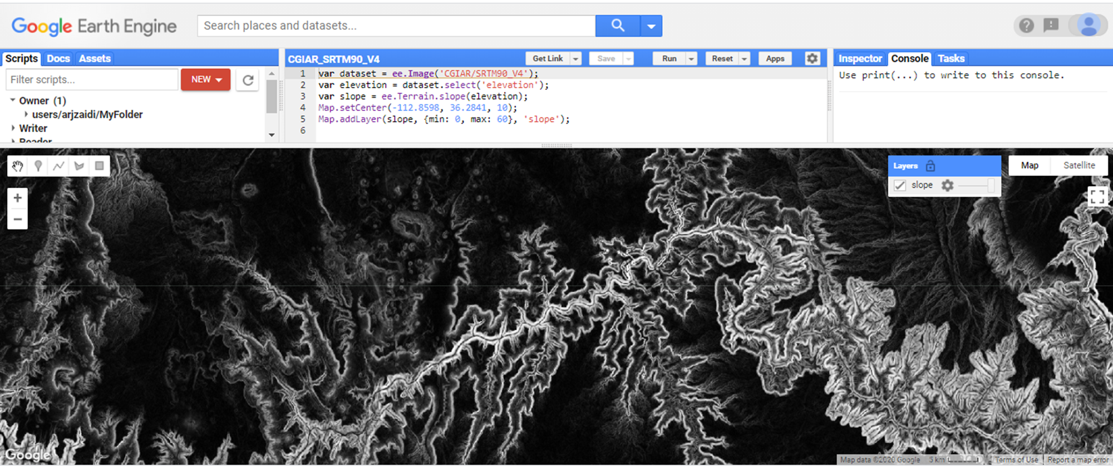
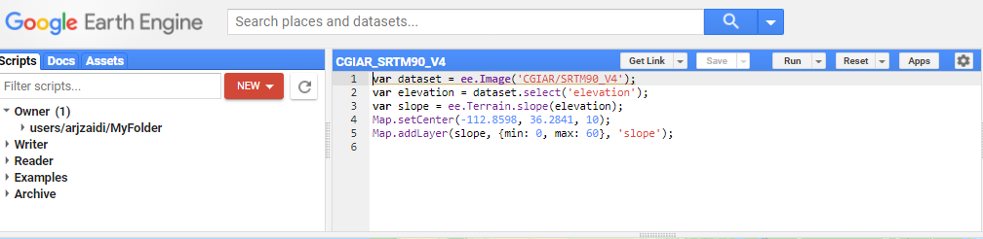
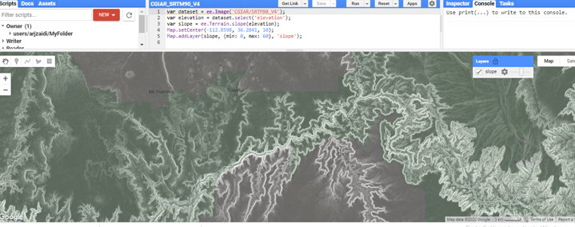
Open Code Editor
Change Layer Transparency

Slide 33
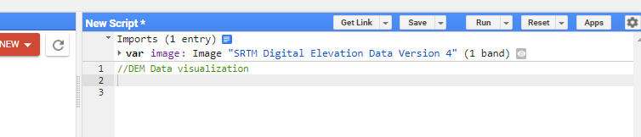
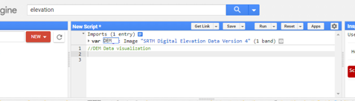
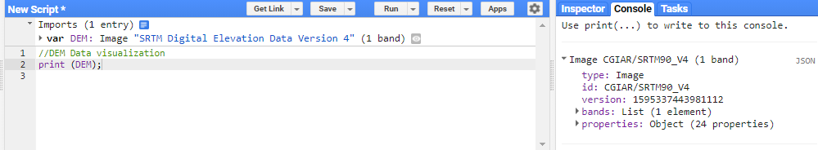

Slide 34
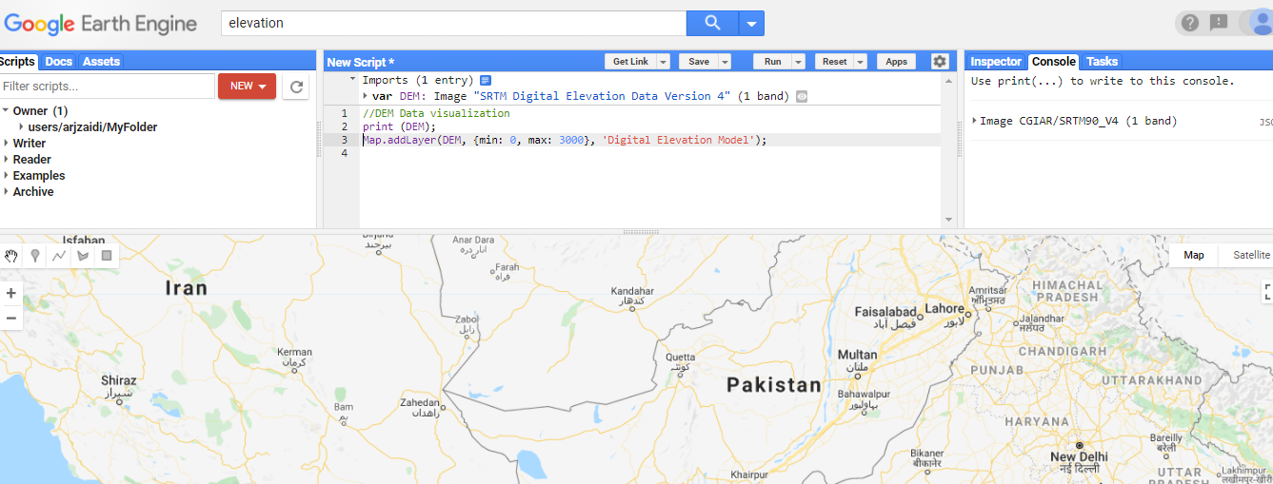
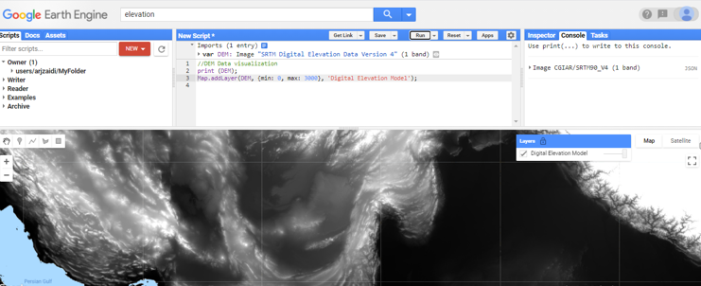

Slide 35
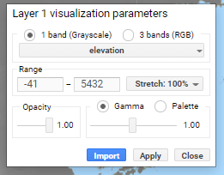
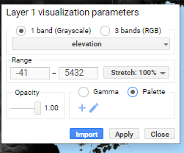
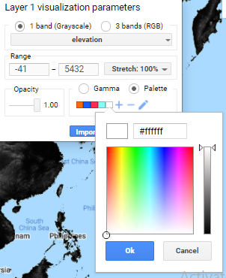

Slide 36
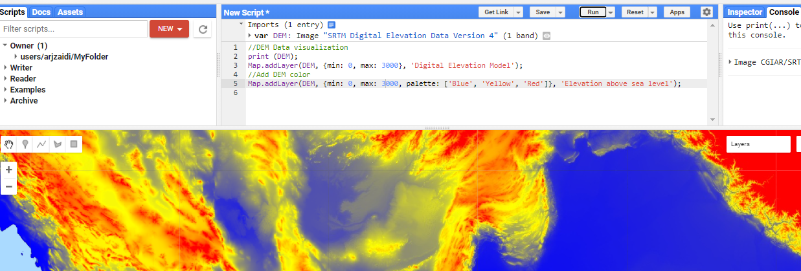
Change Symbology Color

Slide 37
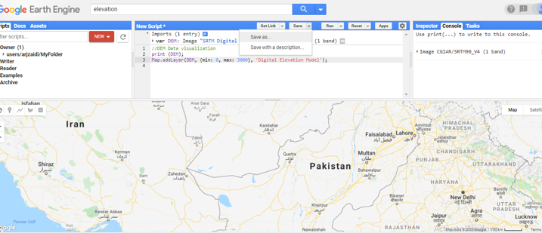
Saving your Script

Slide 38
THANK YOU

