Slide 1
WORKING WITH GOOGLE ERATH ENGINE 2
to search, find and visualize a broad range of remotely sensed datasets

Slide 2
Adding Multi-Image Data
Sentinel 2 imageries

Slide 3
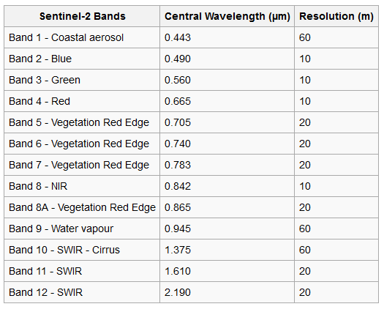
Key characteristics:
2 Satellites (S2A, S2B)
Multi-spectral data with 13 bands
Spatial resolution up to 10 m
Revisit around five days from two-satellite A & B (at equator)
Swath width = 290 km

Slide 4
Sentinel 2
Sentinel-2 MSI: MultiSpectral Instrument, Level-IC: COPERNICUS/S2
Earth Engine Snippet: ee.ImageCollection("COPERNICUS/S2")
The Sentinel-2 data contain 13 UINT16 (Unsigned Integer 16 bit ) spectral bands representing TOA reflectance scaled by 10000.
Sentinel-2 MSI: MultiSpectral Instrument, Level-2A: COPERNICUS/S2_SR
Earth Engine Snippet: ee.ImageCollection("COPERNICUS/S2_SR")
The assets contain 12 UINT16 spectral bands representing SR scaled by 10000 (unlike in L1 data, there is no B10).
Notes:
In laymen's terms an unsigned int is an integer that can not be negative and thus has a higher range of positive values that it can assume. A signed int is an integer that can be negative but has a lower positive range in exchange for more negative values it can assume.

Slide 5
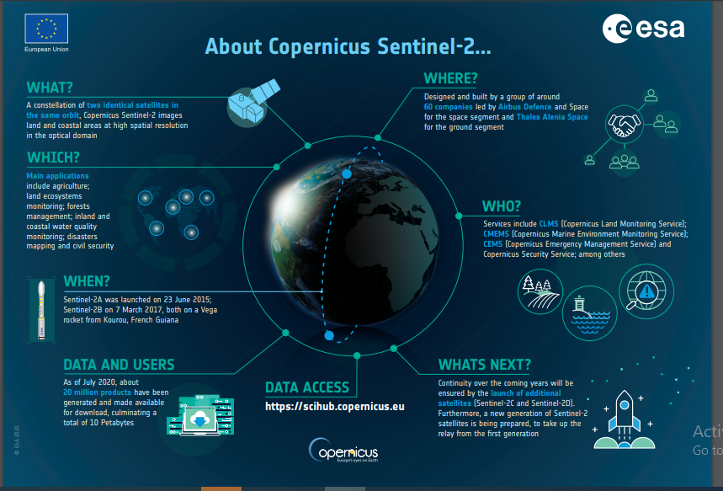
Notes:
2C = in 2024
2D = in 2025

Slide 6
Image Collection
While working with DEM we dealt with mapping an ‘Image’
Now we will move to ‘Image Collection’ or collection of images as multi-band, multi temporal images.
We will filter our required images based on their attributes- such as bands, dates, cloud cover, etc.

Slide 7
Importing Sentinel 2 Image Collection
Open a new code window to create a script
Find Sentinel-2 from the ‘Data Catalogue’
Click on the surface reflectance datasets
Import using import button or copy the code and paste it in the code window.
var S2 = ee.ImageCollection("COPERNICUS/S2_SR");
var S2 will contain the entire archive of images acquired from the beginning

Slide 8
Filter data for a specific period, or location, or quality
From the entire set of the image collection we need to limit the number of images according to some criteria
Filter by a period
Filter by a location
Filter by a metadata

Slide 9
FILTER IMAGE COLLECTION
Selection FROM AN IMAGE COLLECTION based on certain criteria

Slide 10
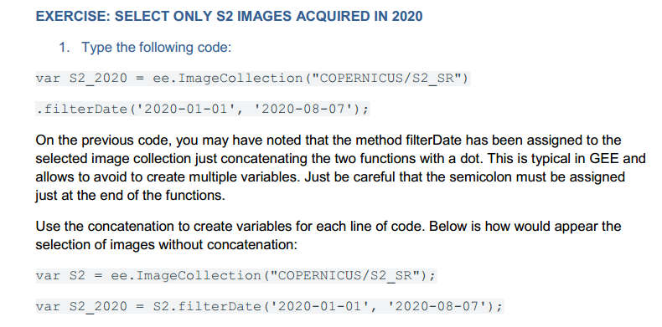
Filter by a Period
imageCollection.filterDate()

Slide 11
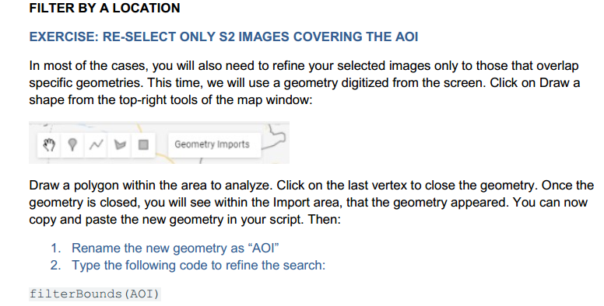
Filter by a Location
imageCollection.filterBounds()

Slide 12
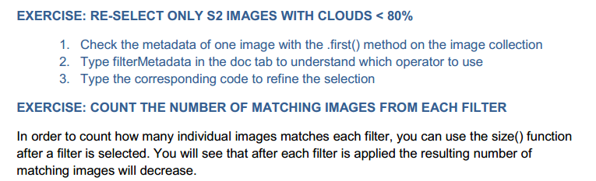
Filter by a Metadata
imageCollection.filterMetadata()

Slide 13
Filter Image Collection
SELECT ONE IMAGE FROM AN IMAGE COLLECTION

Slide 14
Is mapping entire image collection possible?
Yes, theoretically possible but,
Adding an image collection to the map layer may end-up showing an error due to exceeding the computation time

Slide 15
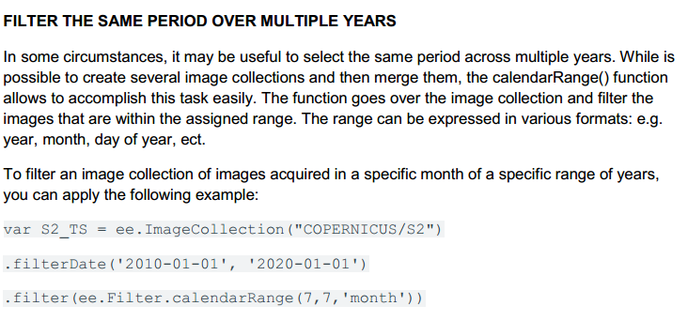

Slide 16
SELECT ONE IMAGE FROM AN IMAGE COLLECTION
Each image has its unique ID that can be used to access and display the specific image
Other options are:
The first() function, returns the first image from the image collection.
The sort() function returns the images in ascending or descending order, based on a property.
Combining sort and first, you can return the most recent image matching your filters.
var mostRecent = S2_2020.sort('system:time_start', false).first();
//False is in descending order

Slide 17
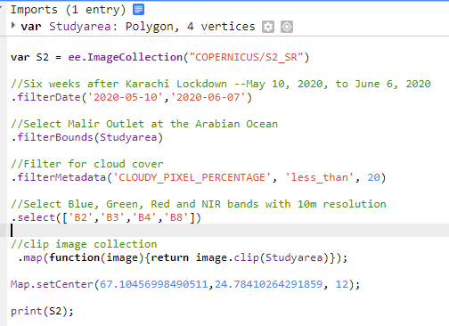
Example

Slide 18
Loading a Specific Sentinel-2 image
Assets format: COPERNICUS/S2_SR/20151128T002653_20151128T102149_T56MNN.
Here
the first numeric part represents the sensing date and time
second numeric part represents the product generation date and time, and
the final 6-character string is a unique granule identifier indicating its UTM grid reference

Slide 19
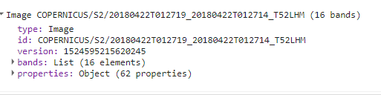
Use this link
https://code.earthengine.google.com/baeed711e6960beb8cf691c8e81bb6ec
https://code.earthengine.google.com/2970513a29120fb7b6347ae3a9b2b07a
https://code.earthengine.google.com/4380b36d27ef37ed3b6060ad36567370
Notes:
Reflectance values for Sentinel-2 products range from 0 to 3000.

Slide 20
Spectral Indices
image. normalizedDifference([‘BANDx’, ‘BAND’])
var NDVI = image.normalizedDifference(['B8','B4']);
Notes:
NDVI: https://code.earthengine.google.com/b0167f59887fd0b46c2f8c5dc88cd5d8

Slide 21
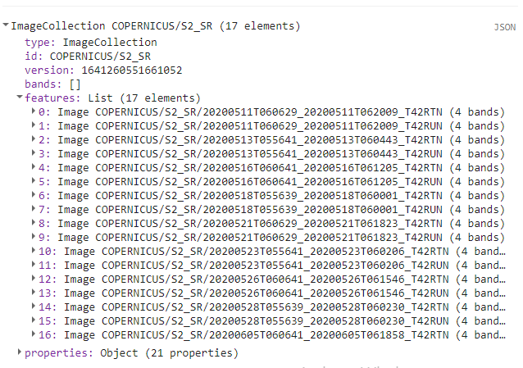
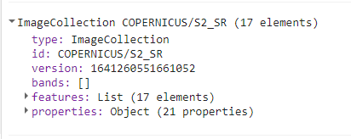

Slide 22
Applying reducers - applying stats
Mean = ImageCollection.reduce(ee.Reducer.mean())
OR ImageCollection.mean()
Median .median()
Minimum .min()
Maximum .max()

Slide 23
Lab work
Prepare a GEE code and follow these steps:
Select Sentinel 2 images. Use all THREE filters (select the metadata filter of your choice).
Select only one Sentinel 2 image from its image collection.
Map Individual Bands (B2, B3, B4, and B8)
Map True color combination
Map B8, B4, B3 combination
Map Index NDVI and use different color palette.

Slide 24
Coding Indices
// 1- Define variable NDSI from equation
var NDVI = image. expression(
"(NIR - RED ) / ( NIR + RED)",
{
RED: image.select("B4"), // RED
NIR: image.select("B8"), // NIR
}).rename('NDVI');
Map.addLayer(NDVI, {min: -1, max: 1}, "NDVI");

Slide 25
Quiz
Add in the code (sentinel 2) you were writing the following spectral indices (search internet to get the formula) and add the indices layers in the map with appropriate visualization parameters (use import);
Normalized Difference Water Index (NWDI). + 1, -1
Normalized Difference Salinity Index (NDSI). +1, -1
Soil Adjusted Vegetation Index (SAVI). -1, +1
Advanced Vegetation Index (AVI). 0.00 to 114.98
Enhanced Vegetation Index (EVI). -1, +1
Difference Vegetation-Index (DVI). -1, +1
Import your shapefile and clip with all layers with it before adding the map layer.
Notes:
NDWI = (Green – NIR)/(Green + NIR)
SAVI = ( NIR − Red ) ( 1 + L ) / ( NIR + Red + L ) take L=0.5
AVI = [NIR * (1-Red) * (NIR-Red)] 1/3, AVI (Sentinel 2) = [B8 * (1 – B4)*(B8 – B4)]1/3, AVI (Sentinel 2) = [B8 * (1 – B4)*(B8 – B4)]^{1/3}
EVI = G * ((NIR – R) / (NIR + C1 * R – C2 * B + L)), EVI (Sentinel 2) = 2.5 * ((B8 – B4) / (B8 + 6 * B4 – 7.5 * B2 + 1))
DVI= NIR - R

Slide 26
Useful website
https://www.geospatialecology.com/intro_rs_lab2/

Slide 27
THANK YOU

