Slide 1
WORKING WITH GOOGLE ERATH ENGINE 3
to search, find and visualize a broad range of remotely sensed datasets

Slide 2
Overview of the Quiz
Search the internet and find out the range of each indices and then check your results.

Slide 3
More Examples
Sentinel 2 imageries

Slide 4
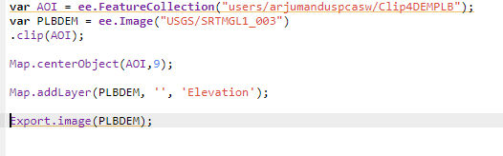
Exporting Single Image

Slide 5
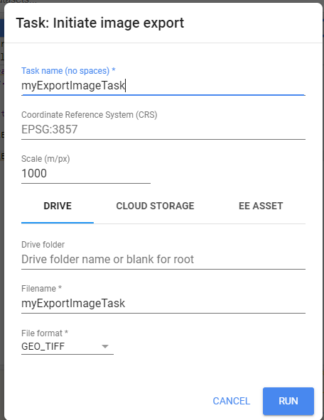
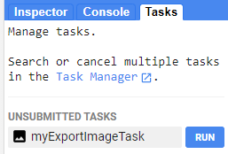

Slide 6
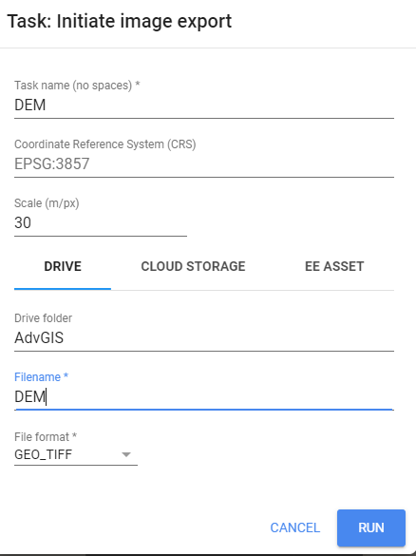
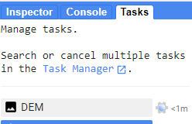


Slide 7
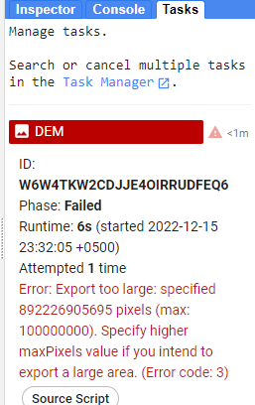
Error Message

Slide 8
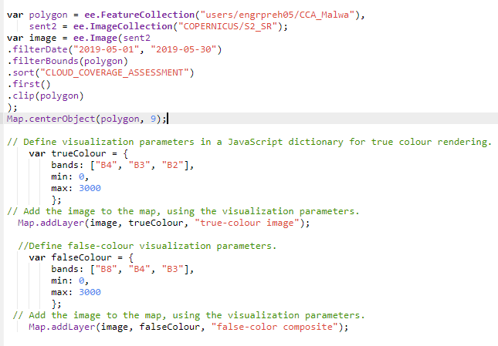
Viewing Band Combination

Slide 9
Mosaicing All indices in a single image
Shared in class.
Check the following link for your reference
https://code.earthengine.google.com/3e52b95027575ac70fb57335004d1fcc

Slide 10
Extracting indices values at GPS points
Downloading these values as CSV file.
Check the same link for your reference
https://code.earthengine.google.com/3e52b95027575ac70fb57335004d1fcc

Slide 11
Reducers (mean, median, max, min)
https://code.earthengine.google.com/758875b1fdc1ef962ca297121de5c699
Ground Water Storage (zonal stats and Chart)
https://code.earthengine.google.com/ae2abb568b09aa830c13438fa6273e1f

Slide 12
THANK YOU

