Slide 1


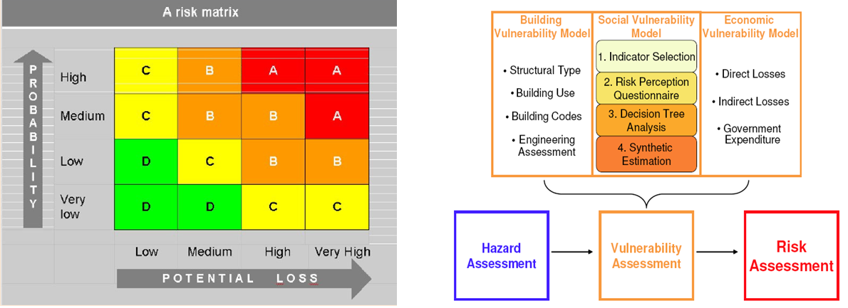



Hazards Planning and Risk Management
Risk Analysis and Assessment
Fall 2026
US – Pakistan Center for Advanced Studies in Water

Slide 2
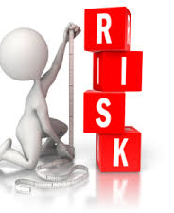
Learning Outcome
Students will Learn how to analyze and assess disaster related risks
Notes:
Picture from Internet.

Slide 3
Reading Material
Dr. Cees Westen (ITC) Guide Book 01 (pdf provided)

Slide 4
Recap - Risk?
Probability that loss will occur as the result of an adverse event, given the hazard and the vulnerability
What is at Risk? – consequence of Hazards
  Personal Injury
  Destruction of property
    Poor building material and maintenance
  Damage to local economy
  Opportunity Loss:
    diversion of economic resources to recovery efforts
Notes:
Definition Source: Disaster Management Version 1.
Probability or likelihood of a hazard event of a certain magnitude occurring.
“measure of the expected losses due to a hazard event occurring in a given area over a specific time period.”
Risk (R) can be determined as a product of hazard (H) and vulnerability (V). i.e. R = H x V

Slide 5
Risks can also be prioritized according to the acceptability of the population at risk.
How?
Notes:
For instance, despite the fact that more people are exposed to a particular risk or that it causes more fatalities or damages each year, it might still be more palatable to the exposed population than another much less dangerous or damaging risk due to the benefits that would be lost if the risk was partially or fully mitigated. For example, transportation accidents have caused more fatalities in the United States and worldwide than nuclear power accidents. Yet, most people are much more willing to accept the risk of transportation accidents than nuclear accidents because the loss of automobiles would have a much more personal and profound impact. (Coppola Emergency-Management)

Slide 6
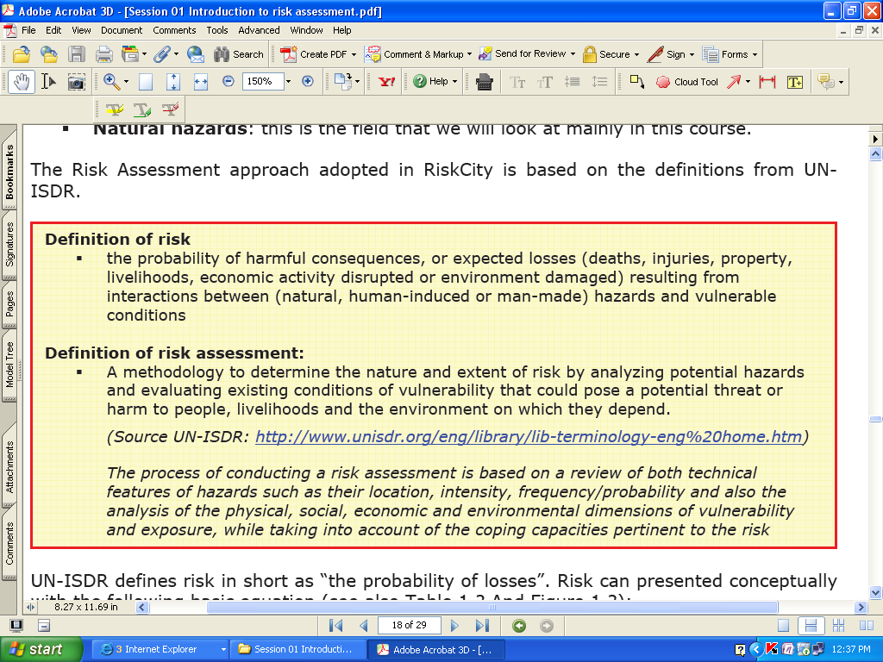
Risk and Risk Assessment
Dr. Cees Westen (ITC) slides
Notes:
Source: Westen Guidebook 01
Essentially, a natural hazard risk assessment is a study undertaken to determine the range of possible consequences from a natural hazard.
UN-ISDR: United Nations International Strategy for Disaster Reduction
6

Slide 7
Notes:
Source: Westen Guidebook 01

Slide 8
Risk = Probability of Losses
Risk = Hazard * Vulnerability * Amount of elements-at-risk
Or
Risk = Hazard * Vulnerability / Capacity
Capacity = Expresses the positive managerial and operational resources and procedures for reducing risk factors
  Examples:
  awareness raising
  early warning
  preparedness planning
Notes:
Equation 2 is said to be a conceptual equation.
Equation [1], given above, is not only a conceptual one, but can also be actually calculated with spatial data in a GIS to quantify risk, with a focus on (direct) physical, population and economic losses.
Source: ITC
Summation for all possible risks.
8

Slide 9
Hazard Risk Assessment
Process by which threat posed by each identified hazard is investigated.
Risk depends on Hazard likelihood and hazard consequences.
The above two (02) factors are constantly changing as a result of changing environment.
High-likelihood/high-consequence hazards are of special consideration.
A comprehensive Risk Management Program can greatly reduce life and property losses.
Notes:
low-likelihood/low-consequence hazards are of least concern. And all fall in between.
The above 2 factors are constantly changing as a result of increased development, access to new information, changes in climate and community characteristics, etc.
9

Slide 10
RISK = HAZARD * VULNERABILITY * AMOUNT
Hazard = Probability of an event with a certain magnitude
  Triggering mechanism
  Type of event
  Magnitude: Volume, distance, duration, speed, etc
Vulnerability = Degree of damage. Function of:
  Magnitude of event, and
  Type of elements at risk
Amount = Quantification of the elements at risk, e.g.
  Replacement costs of buildings, infrastructure, etc.
  Loss of function or economic activities
  Number of people
Notes:
Source: Cees van Westen

Slide 11
Hazard Identification
Identify all hazards that have affected or could affect the area of focus through
  Historical data
  Brainstorming
  Scientific analysis
  Subject matter expertise
Hazard Profiling is a component of hazard identification where all hazards in a study area are defined
  General description of hazard
  Location of hazard and spatial extent of its affects
  Duration of an event caused by hazard
  Seasonal or time based patterns followed by the hazard
  Speed of onset of an actual hazard event
  Availability of warning for the hazard
Notes:
Source: Cappola
For rare yet real hazards only knowledge or opinion of experts can provide an insight (e.g. technological hazards)
11

Slide 12
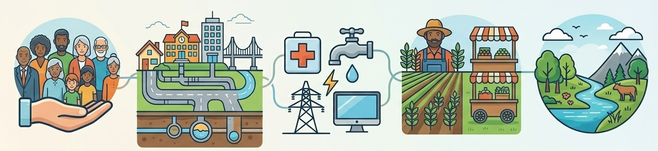
Vulnerability of five (05) elements of a community
Each of those elements has a specific vulnerability to a specific hazard
Notes:
Source: http://ebookbrowse.com/day1-concepts-in-emergency-management-pdf-d116896500
vulnerability to natural hazards generally refer to the characteristics of an element exposed to a hazard.
Extent to which a community’s structure, service or environment is likely to be damaged or disrupted by the impact of a hazard
Definition Source: Disaster Management Version 1.
Risk vulnerability looks at four factors, including social vulnerability, environmental vulnerability, physical vulnerability, and economic vulnerability.
The expected degree of loss of the element at risk
12

Slide 13
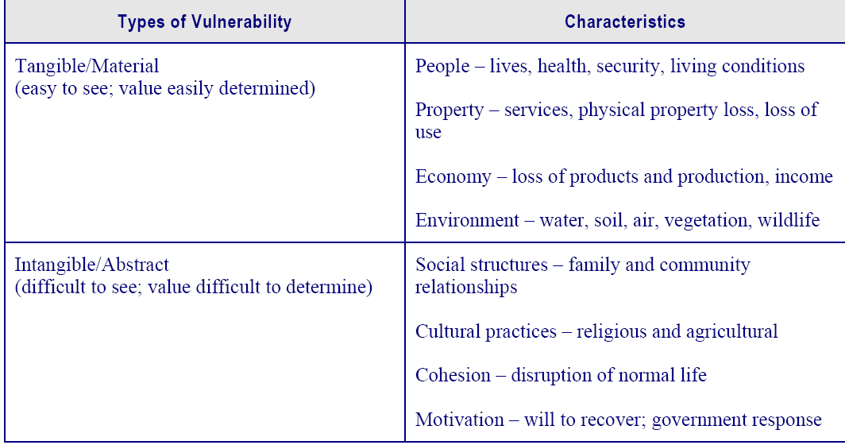
Notes:
Source: Disaster Management Version 1.

Slide 14
Vulnerability Assessment
The process of estimating the vulnerability to potential disaster hazards of specified elements at risk.
A process to determine the nature and extent of vulnerability by analyzing existing conditions and characteristics of an element or system exposed to a particular type of natural hazard event.
Notes:
Source: Dr. Cees Westen ITC

Slide 15
Vulnerability Assessment
Vulnerability assessment identifies the relationship between the hazard and the element at risk.
Vulnerability is evaluated as the interaction between the intensity of the hazard and the type of element at-risk, making use of so-called vulnerability curves
Notes:
Source: Dr. Cees Westen ITC

Slide 16
How to do Vulnerability Assessment?
  Which are the most important elements at risk?
  Which methods for vulnerability assessment could be used?
  What are the data requirements?
  Aggravating factors of vulnerability? Examples?
Notes:
Source: ITC
Aggravating factors: Degraded Environment, urbanization, population explosion, etc.

Slide 17
Risk Assessment
For different hazards there are different
  Methods for loss estimation
  Data requirements
Risk Assessment = Risk Estimation + Risk Evaluation
Notes:
Cees Van Westen
Data: (base data from which information related to risk can be derived e.g. soil data, DEM, landuse/land cover, social/economical, hydrological conditions, building footprints, building heights, road networks, etc.)
Lack of base data may impose problem in modeling risk.

Slide 18
Risk Analysis Methodology
Both Qualitative and Quantitative.
Various computer based models.
Risk assessment outcomes depend on quality and availability of data.

Slide 19
Qualitative Risk Analysis
An analysis which uses word form, descriptive or numeric rating scales to describe the magnitude of potential consequences and the likelihood that those consequences will occur
Resulting in a qualitative value of the risk. e.g. High Risk, Moderate Risk, Low Risk etc.
Notes:
ITC

Slide 20
Quantitative Risk Analysis
An analysis which is based on numerical values of the probability, vulnerability, and consequences
Resulting in a numerical value of the risk. e.g.
Risk = $ 5,000, etc.
Notes:
ITC

Slide 21
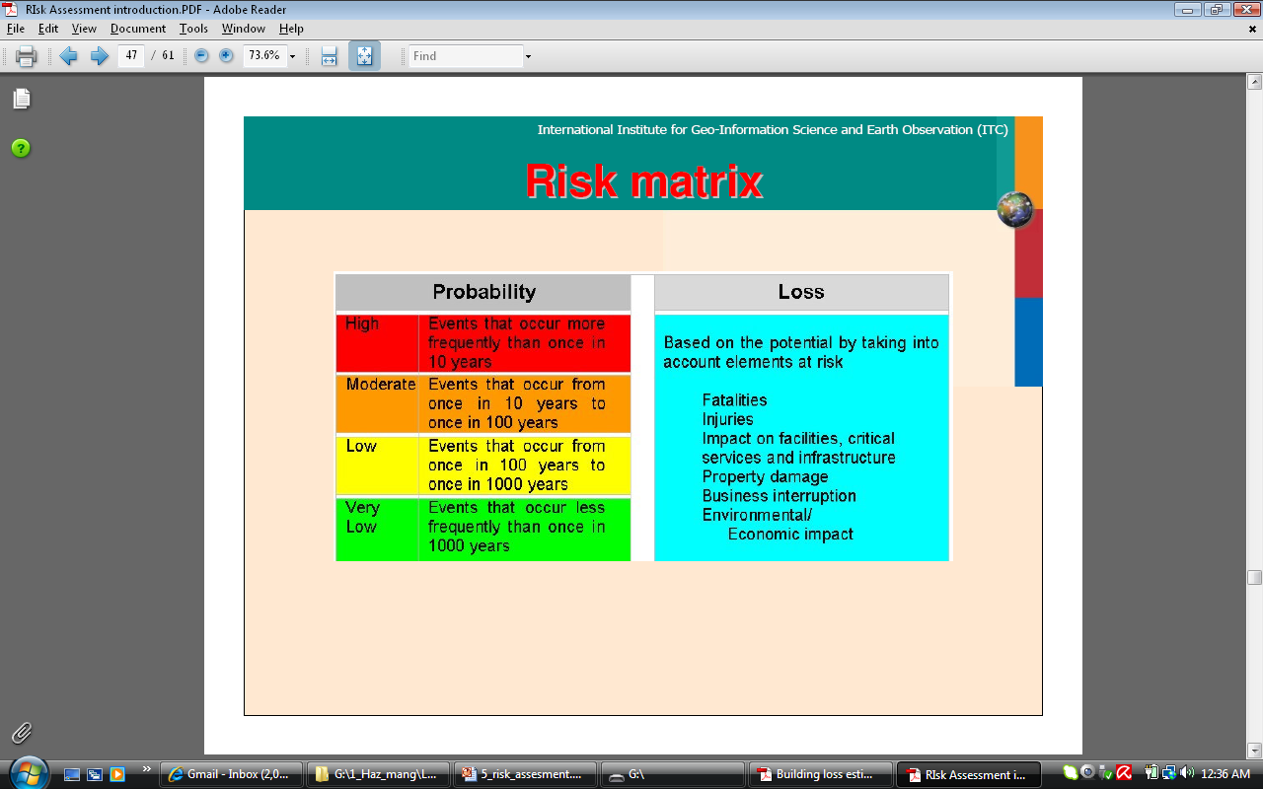
Notes:
ITC

Slide 22
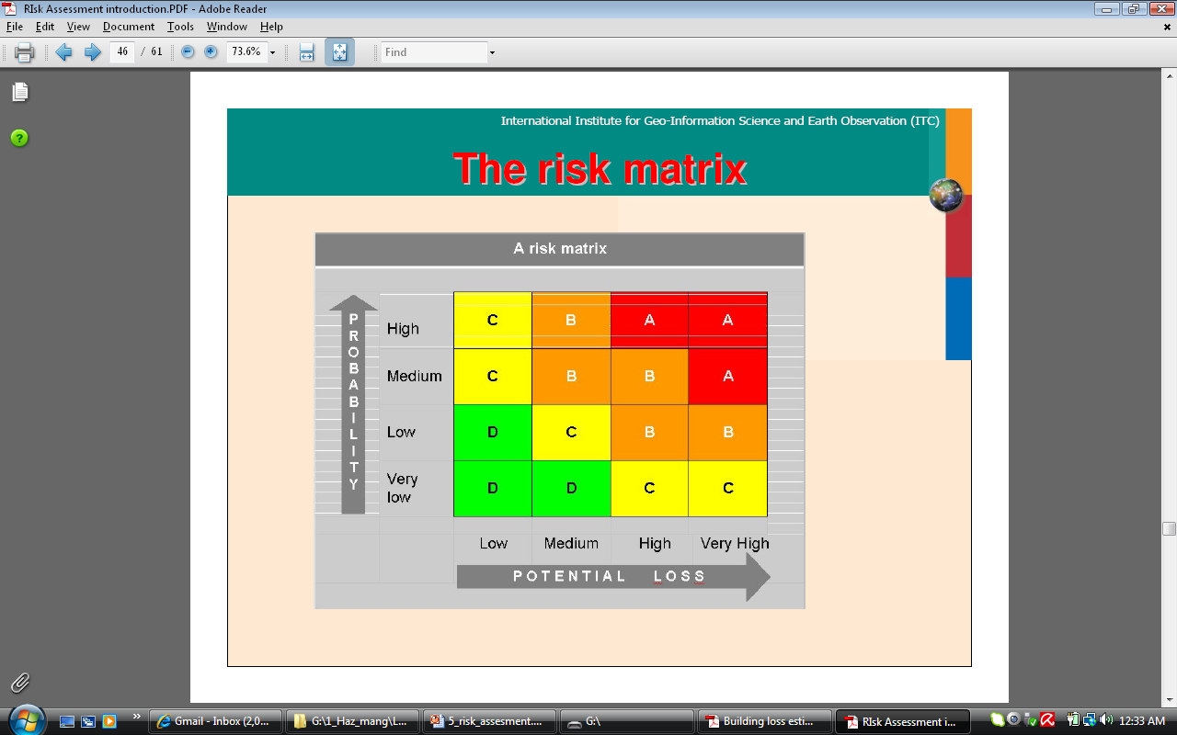
Notes:
ITC
A = Very High Risk
B= High
C = Medium
D = Low Risk

Slide 23
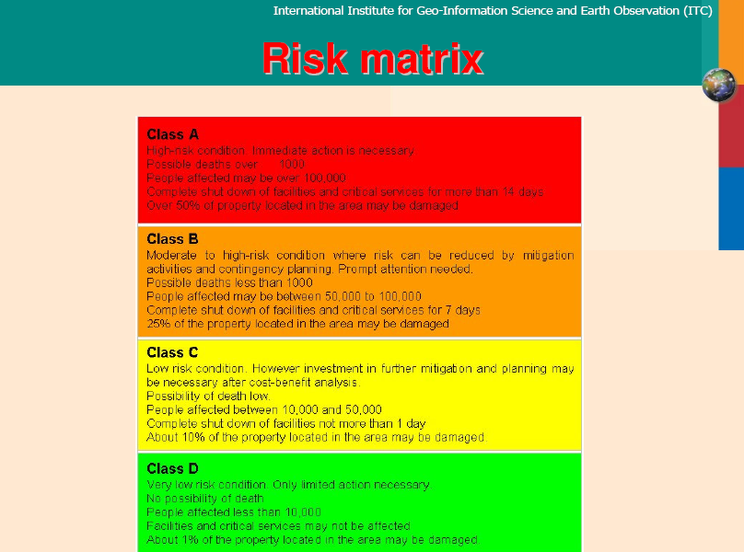

Slide 24
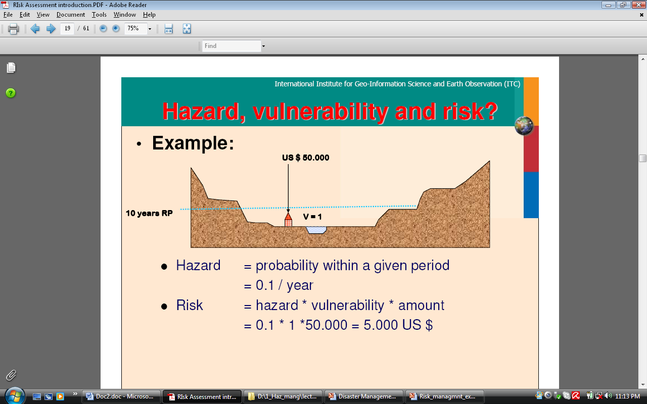
Notes:
RP = Return Period

Slide 25
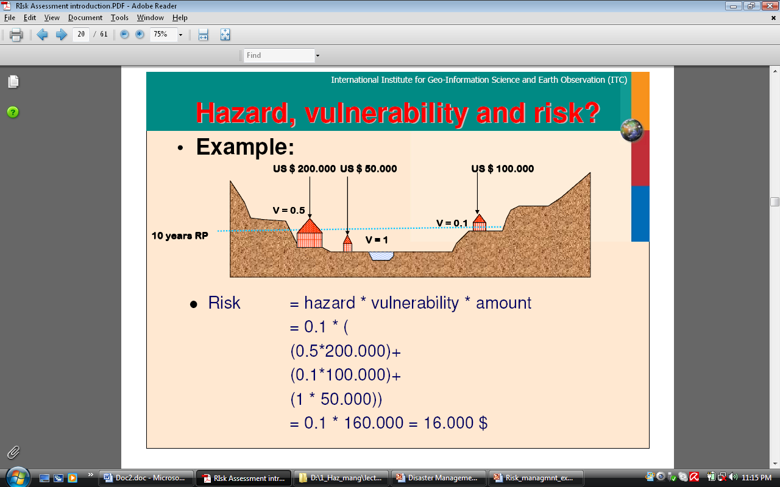

Slide 26
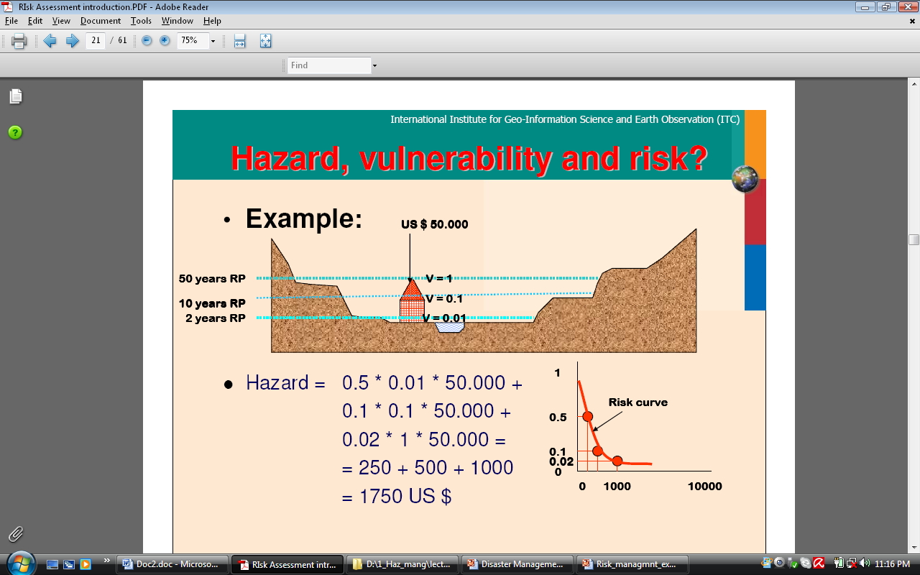

Risk Curve
Notes:
Expected degree of loss = risk
2 years RP – prob or hazard = ½ = 0.5
10 years RP – prob = 1/10 = 0.1
50 years RP – prob = 1/50 = 0.02

Slide 27
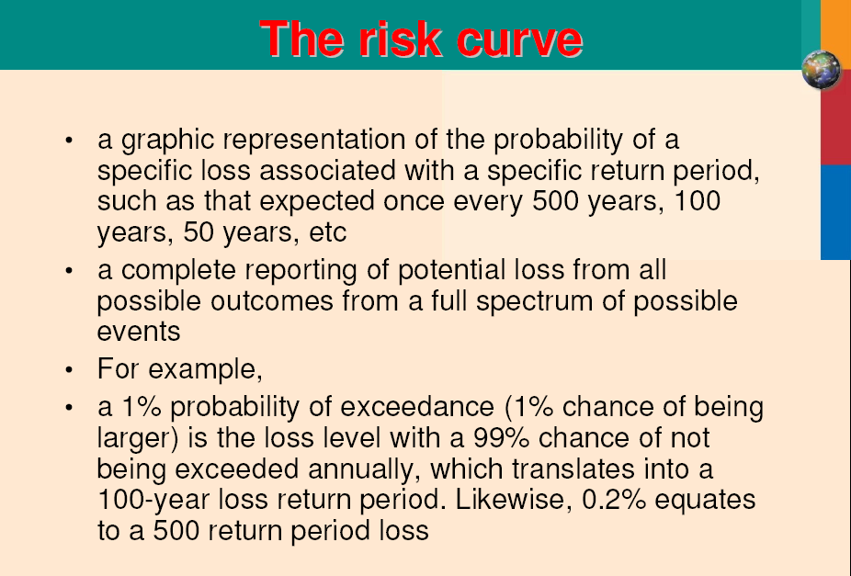

Slide 28
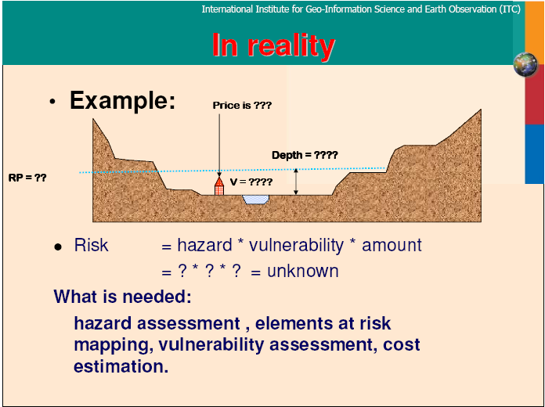
Notes:
Multi-Hazard Risk Assessment is very complicated

Slide 29
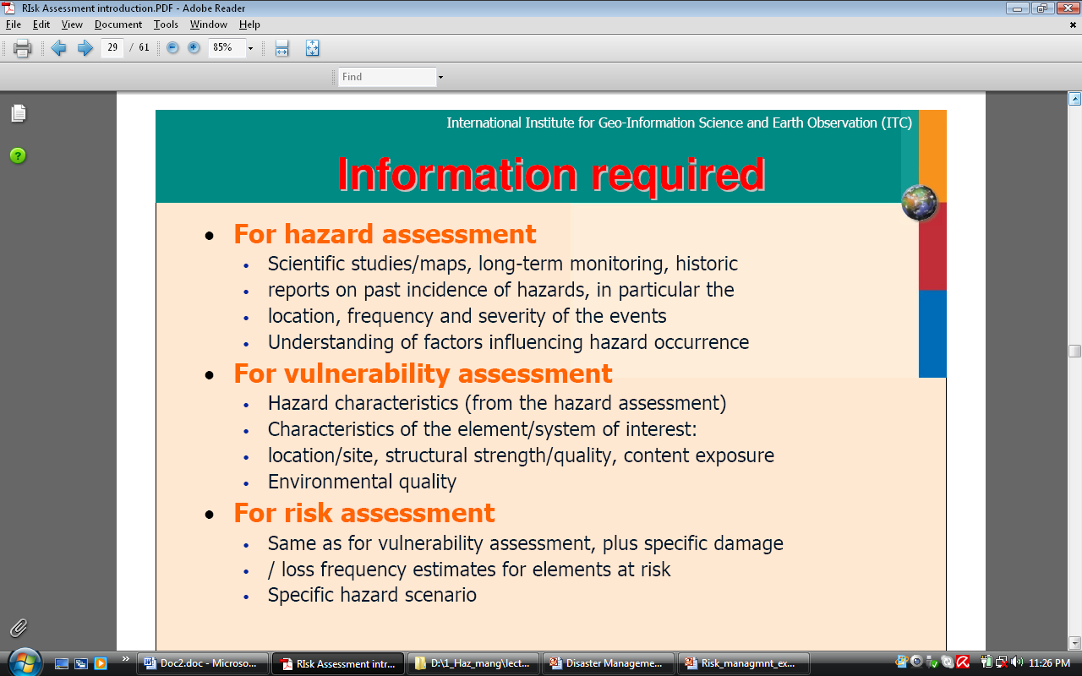

Slide 30
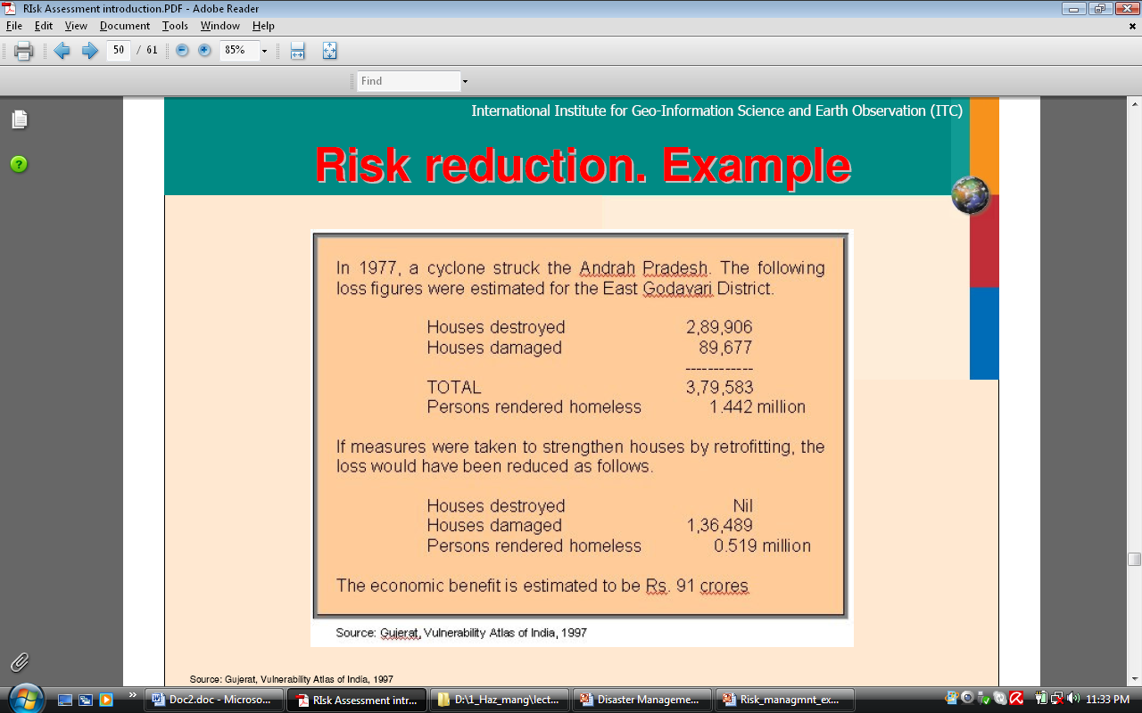

Slide 31
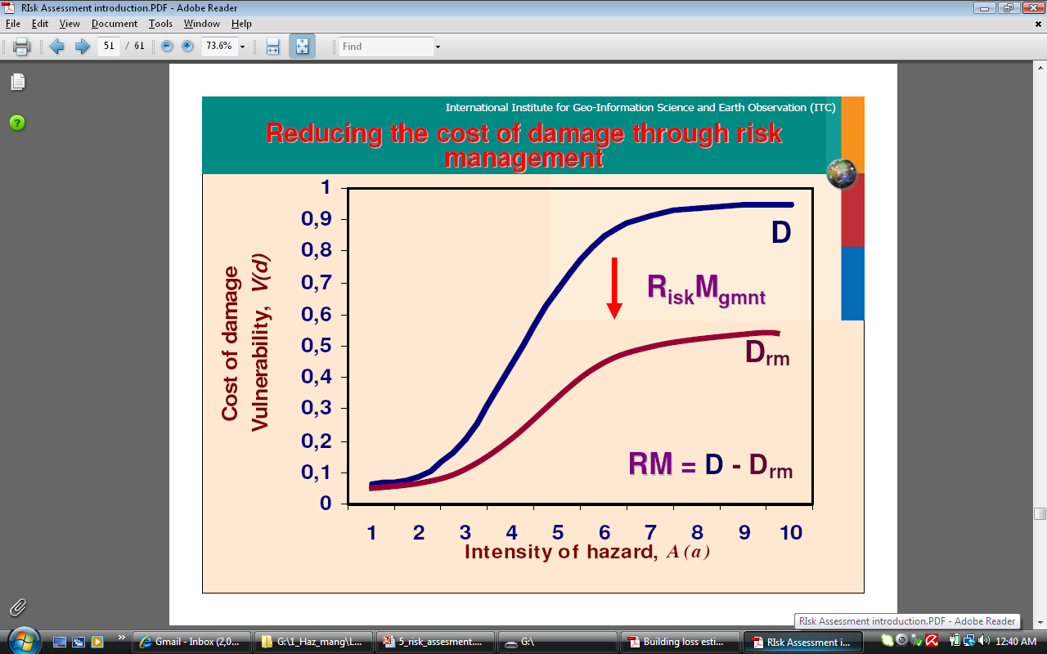

Slide 32
Elements at Risk
All objects, persons, animals, activities and processes that may be adversely affected by hazardous phenomena, in a particular area, either directly or indirectly.
This includes: buildings, facilities, population, livestock, economic activities, public services, environment.

Slide 33
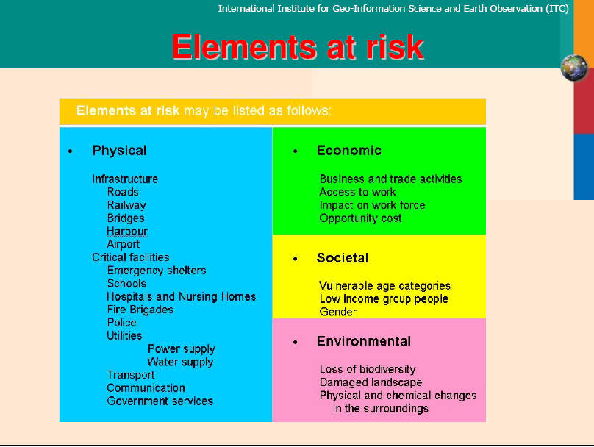

Slide 34
Elements of Risk Matrix
Hazard Type | Element at Risk |  | Sources (bold = primary source)
 |  |  | Register | Map | Field | Image
Earthquake | Buildings | Building type | √ | √ | √ | √
 |  | Structure type
 |  | Material
 |  | Height
 |  | Use
 |  | Shape
 |  | age
 | Lifelines
 | Population
 | Essential facilities
Flood

Slide 35
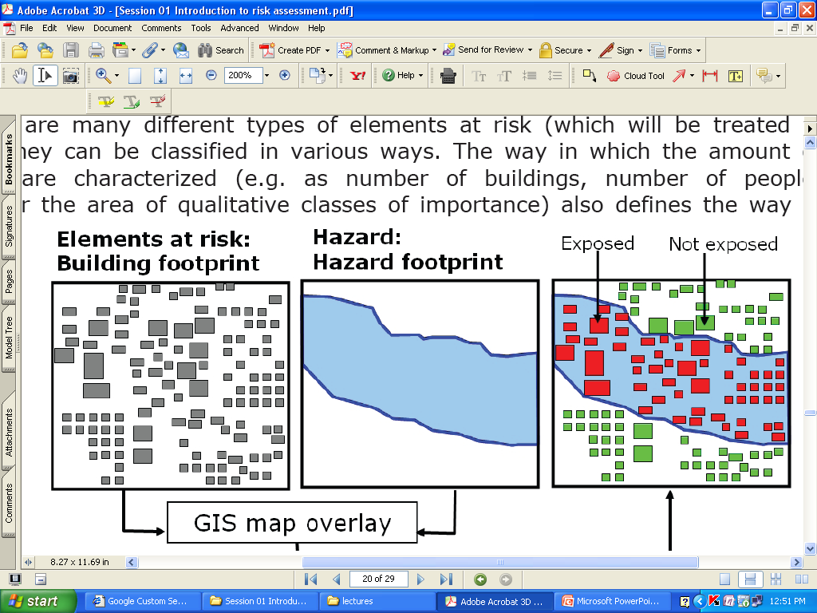
Exposure to Hazard
Notes:
See more on Westen Guidebook 01

Slide 36
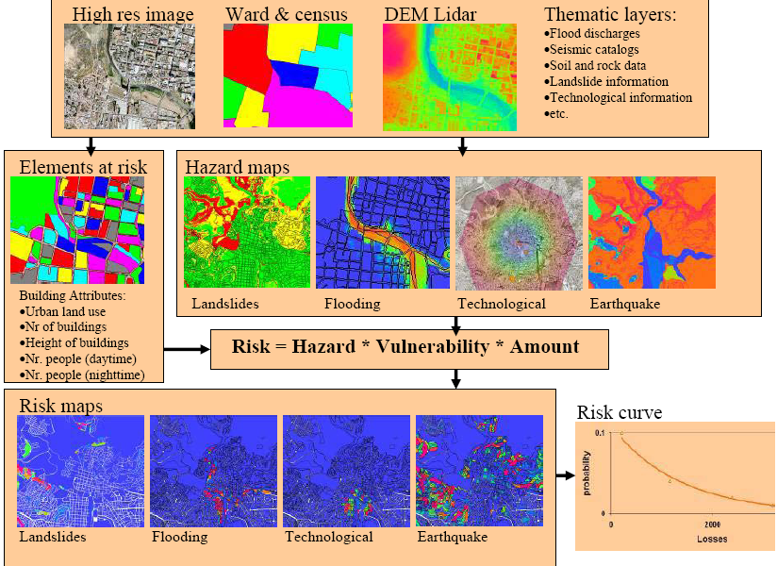
Source: Cees Van Westen, ITC

Slide 37
Summary
Three major components to be considered in disaster management
  Hazard
  Vulnerability
  Capacity/amount of losses
Therefore, disaster risk can be reduced through systematic efforts of
  Reducing hazard exposure,
  Lessening vulnerability and/or
  Developing a greater capacity to face these disasters may reduce the impact of a hazard
Notes:
Capacity of people/community and environment
Example of Vulnerability: poor people can not construct strong houses and there more susceptible to hazard of a hazard.
Capacity: Rich people have more resources and hence have capacity to recover from a disaster's impact. (resources, means, and strength to recover from a disaster)

Slide 38

Discussion/Comment/Question

