Slide 1
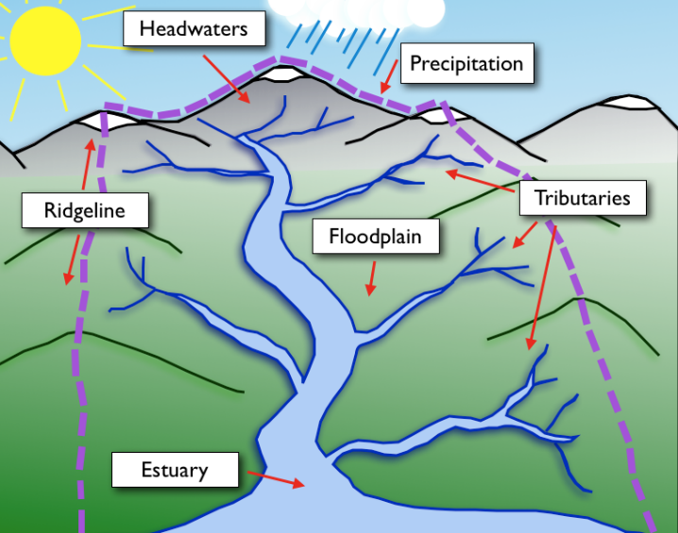
Hydrological Modeling
Hydroinformatics
US Pakistan Center for Advanced Studies in Water
MUET, Jamshoro
Fall, 2026

Slide 2
Learning Objectives
Explain how rainfall is summarized — mean rainfall and variability in time and space.
Describe watershed boundaries, drainage networks, and key basin characteristics.
Understand the water budget — inflows, outflows and storage.

Slide 3
1. Rainfall Analysis
From measured rainfall to rainfall available for runoff

Slide 4
Mean Rainfall
Mean annual rainfall: average annual rainfall over a long period; roughly 30–40 years of records.
Mean monthly rainfall: average rainfall for a given month over multiple years.
Comparing observed annual rainfall with the long-term mean helps identify years with rainfall deficit or surplus.
Use a sufficiently long and continuous record when characterizing climatological rainfall.

Slide 5
Rainfall Characteristics
Rainfall varies in time and space, so a single gauge may not represent an entire catchment.
Storm intensity, duration, and spatial distribution are especially important for runoff generation.
Rainfall analysis provides the input information for rainfall–runoff analysis.

Slide 6
2. Watershed Concepts
The watershed is the basic spatial unit for hydrologic analysis

Slide 7
What is a watershed?
A watershed is the area that contributes flow to a specified point or outlet.
It is a basic hydrologic unit within which measurements, calculations, and predictions are made.
Watersheds can be very small or can encompass major river basins such as the Indus Basin.
Boundaries are commonly defined by topographic divides or ridgelines.

Slide 8
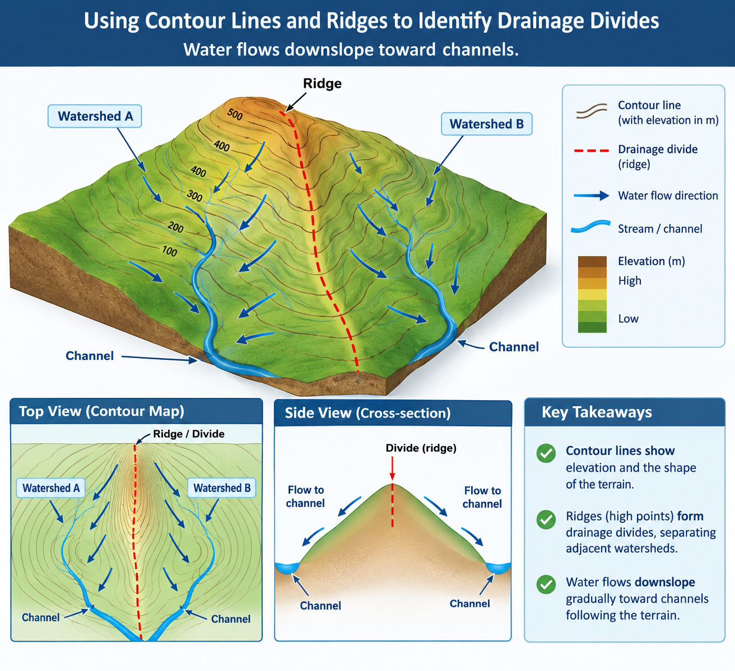
Reading a Watershed from Topography
Use contour lines and ridges to identify drainage divides.
Water flows downslope toward channels.

Slide 9
Watershed Delineation: The Core Idea
Select the outlet or pour point.
Identify the surrounding topographic divide.
Trace the boundary so that all land inside drains toward the outlet.
The resulting polygon represents the contributing watershed.
GIS watershed delineation automates this logic using a DEM and flow-direction/flow-accumulation analysis.

Slide 10
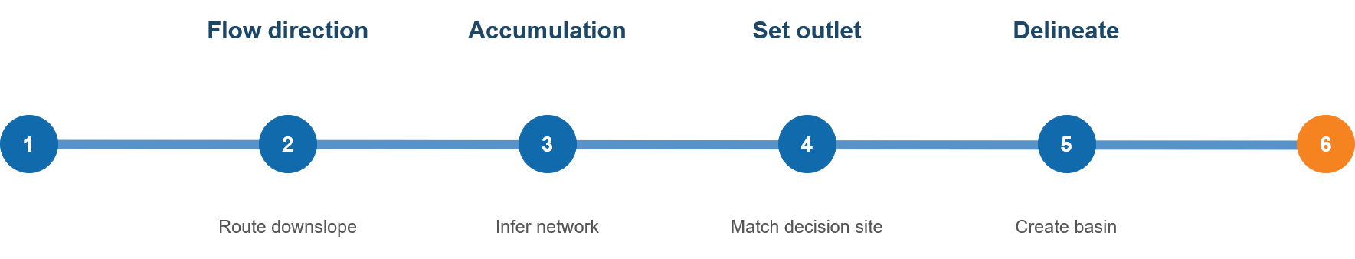
From DEM to Watershed Boundary
21
A computer-generated boundary should be checked against the landscape.
Check the DEM and correct important errors.
Identify flow direction and the stream network.
Set the outlet at the actual decision site.
Delineate the watershed and calculate its area.
Verify channels and drainage paths in the field.
Verify
Correct in the field
Notes:
Reference: https://www.hec.usace.army.mil/software/hec-hms/ ; https://www.nrcs.usda.gov/resources/guides-and-instructions/engineering-field-handbook

Slide 11
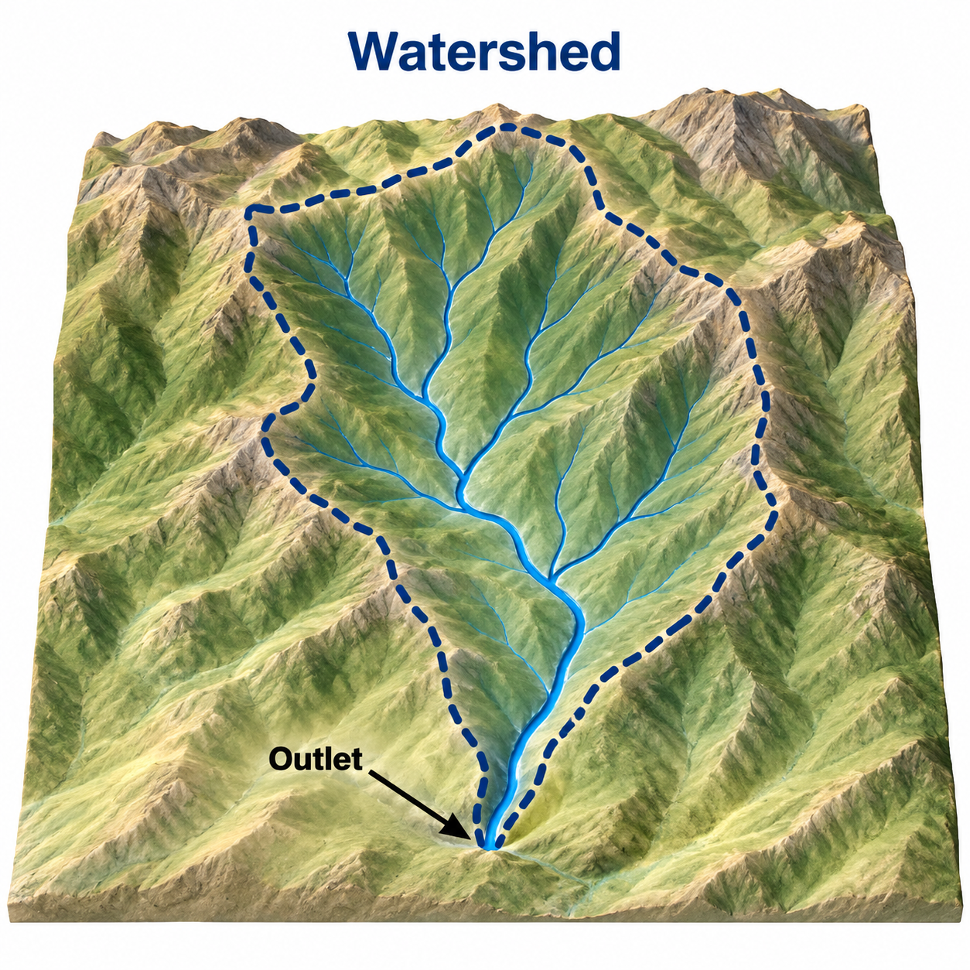
TERRAIN DATA
What a DEM can—and cannot—tell you
01
Reliable uses
Delineation, slope, flow direction, relative relief.
02
Common errors
Road embankments, flat areas, sinks, and poorly represented channels.
03
Field checks
Outlet position, channel continuity, and cross-drainage.
04
Available sources
SRTM and other DEMs; document resolution and date.
FROM MAP TO FIELD
Rainfall–Runoff Processes in Dryland Watersheds

Slide 12
Drainage Network
A drainage network is the set of cells or channels through which surface water flows.
Flow accumulation identifies locations receiving flow from many upstream cells.
A stream can be defined by applying a contributing-area threshold.
The threshold should reflect the scale and purpose of the analysis; it is not a universal value.

Slide 13
Key Basin Characteristics
Drainage area — area contributing flow to a common outlet.
Drainage divide — boundary separating watersheds draining to different outlets.
Drainage density — total stream length per unit basin area.
Stream frequency — number of channels per unit area.
Stream gradient — elevation drop per unit channel length.
Basin relief — highest elevation minus lowest elevation.
Time of concentration — travel time from the hydraulically most distant point to the outlet.

Slide 14
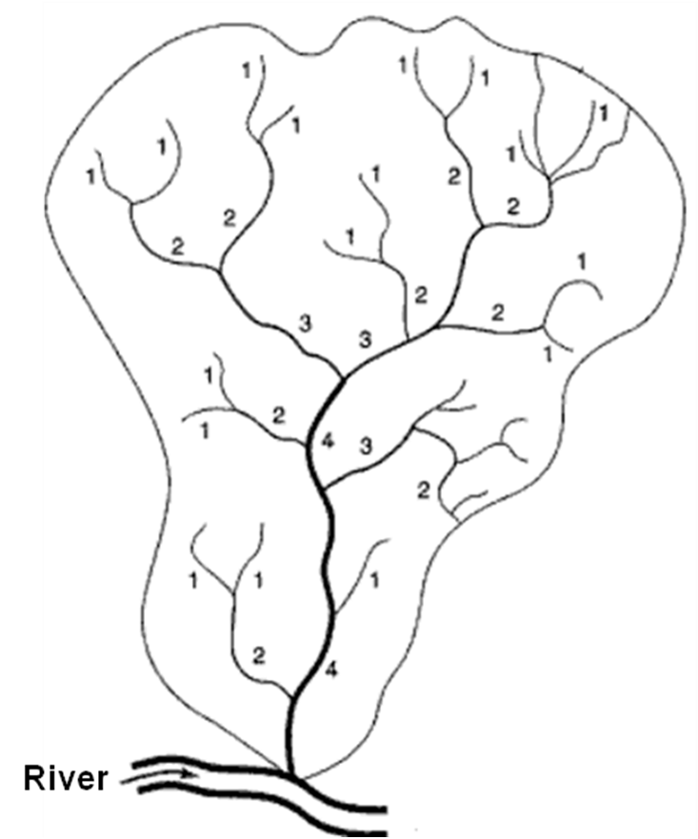
Stream order — Strahler system - 1st through 12th Order by Strahler's (1952)
Stream ordering is a quantitative method for describing the hierarchy of a drainage network.
First-order streams are headwater channels with no upstream tributaries of the same order.
When two streams of the same order join, the downstream segment increases by one order.
When different orders join, the downstream segment retains the higher order.
Strahler's system is widely used for drainage-network analysis.

Slide 15
3. Water Budget
Tracking inflows, outflows and storage

Slide 16
How Water Moves Through a Watershed?
01
Headwaters
Rainfall and snowmelt in the upper areas begin to flow downhill.
02
Tributaries
Small streams collect water from different parts of the watershed and join larger streams.
03
Main Channels
Water flows through the main river or stream, carrying water and sediment downstream.
04
Outlet
Water leaves the watershed through a common outlet, such as a river, lake, reservoir, or sea.
FROM MAP TO FIELD
FAO-organized training | Balochistan Irrigation Department
Rainfall–Runoff Processes in Dryland Watersheds
Notes:
Benefits and exposure occupy the same flow paths.

Slide 17
Basin Water Balance
Inflows: precipitation, surface-water inflow, groundwater inflow, and artificial imports.
Outflows: evaporation, runoff, groundwater outflow, and artificial withdrawals.
Storage: surface water, soil moisture, groundwater, snow/ice, and temporary/intercepted storage.
Hydrologic mass balance: Inflow = Outflow ± change in storage.
Σ Inflows − Σ Outflows = Δ Storage

Slide 18
Key takeaways
Rainfall is the primary atmospheric input, but only part of it becomes runoff — the rest is lost to interception, infiltration and storage.
The watershed provides the spatial framework for hydrologic analysis; topography controls drainage direction and watershed boundaries.
A DEM-derived boundary is a starting point — always check the DEM, set the outlet at the true decision site, and verify channels in the field.
Basin characteristics (area, shape, slope, drainage density, relief, time of concentration) and Strahler stream order describe how a catchment is organised.
The basin water balance ∑ Inflows − ∑ Outflows = Δ Storage connects rainfall, runoff and storage.
18

Slide 19
In-class activity
Delineate a watershed from a DEM and mark the outlet and topographic divide.
List the basin characteristics you would measure and explain what each tells you.
Assign Strahler orders to a simple drainage network.
Write the water-balance equation for a chosen basin and list its inflow, outflow and storage terms.

Slide 20
Quiz: rainfall, watersheds and water budget
1. Mean annual rainfall is best calculated by: (averaging annual totals over a long record, ~30–40 years)
2. A watershed is defined as: (the area that contributes flow to a specified point or outlet)
3. In the Strahler system, when two streams of the same order join, the downstream segment: (increases by one order)
4. Which basin characteristic is the travel time from the hydraulically most distant point to the outlet? (time of concentration)
5. The basin water balance is written as: (∑ Inflows − ∑ Outflows = Δ Storage)
6. Why should a DEM-derived watershed boundary be checked in the field? (DEM errors, outlet position and channel continuity must be verified)
Notes:
Reference: https://www.hec.usace.army.mil/software/hec-hms/ ; https://www.nrcs.usda.gov/resources/guides-and-instructions/engineering-field-handbook
Answer guide: 1. Soil, slope, vegetation, shape, and prior moisture. 2. Maximum discharge. 3. DEM errors, outlet and channel continuity.

Slide 21
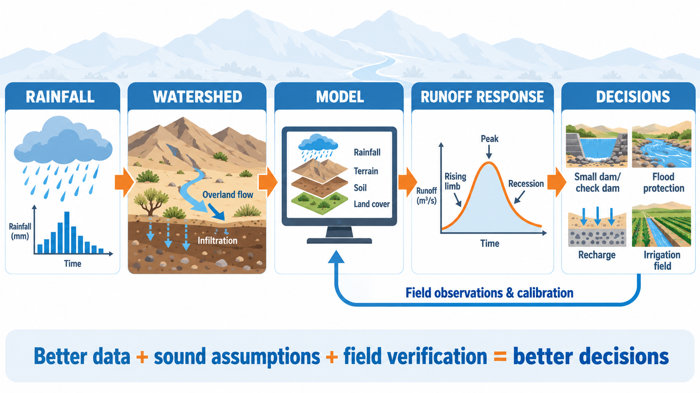
Thank You

