Slide 1
Runoff models
Watershed modeling
USPCASW, MUET
Fall 2026

Slide 2
Learning Objectives
From rainfall to runoff — effective rainfall, infiltration and runoff generation
Hydrograph analysis — rising limb, peak and recession, and what controls hydrograph shape
Rainfall–runoff modeling — inputs, method choice, calibration, validation and trust
Two families of runoff models — peak runoff models and continuous runoff models
The Rational Method — assumptions, the peak-discharge formula and the runoff coefficient
The NRCS Curve Number method — the rainfall–runoff equation, S and initial abstraction
Hydrologic soil groups, antecedent moisture conditions, and the composite curve number
Continuous runoff models — the time-area method and isochrones, and unit hydrograph techniques
Flood hydrographs and the 2013 Sindh floods
Notes:
Source: The McGraw-Hill civil engineering PE exam depth guide: water resources By Emmanuel U. Nzewi.
Catchment is concentrated: that is, rainfall duration is longer than or at least equal to the time of concentration of the watershed.

Slide 3
1. From rainfall to runoff
Effective rainfall, infiltration and runoff generation

Slide 4
From Gross Rainfall to Effective Rainfall
Gross precipitation
Rain measured by gauge
Interception & infiltration
Losses / storage before runoff
Effective rainfall
Portion contributing to streamflow
Effective precipitation = gross precipitation − losses
Effective rainfall is the portion of rainfall that produces a perceptible streamflow response.
Not all rainfall becomes surface runoff; some infiltrates, is stored, or contributes to subsurface flow.

Slide 5
Infiltration and Runoff Generation
Dry soil may initially have a high infiltration capacity.
If rainfall intensity/rate is below infiltration capacity, little or no overland flow occurs, although interflow may still develop.
With continuing rainfall, soil becomes wetter, and infiltration capacity can decline.
When rainfall exceeds the capacity of the soil to absorb water, excess water contributes to runoff.

Slide 6
Rainfall–Runoff Response
A catchment can be treated as a system that transforms rainfall input into streamflow output.
Inputs include rainfall amount, intensity, duration, and spatial distribution.
The catchment controls the transformation through soils, land cover, slope, drainage, and storage.
The observed output is discharge at the catchment outlet.

Slide 7
2. Hydrograph Analysis
From observed rainfall to streamflow

Slide 8
Hydrograph
Hydrograph: discharge plotted against time at a channel location.
Peak
Discharge
Recession
Rising limb
Time

Slide 9
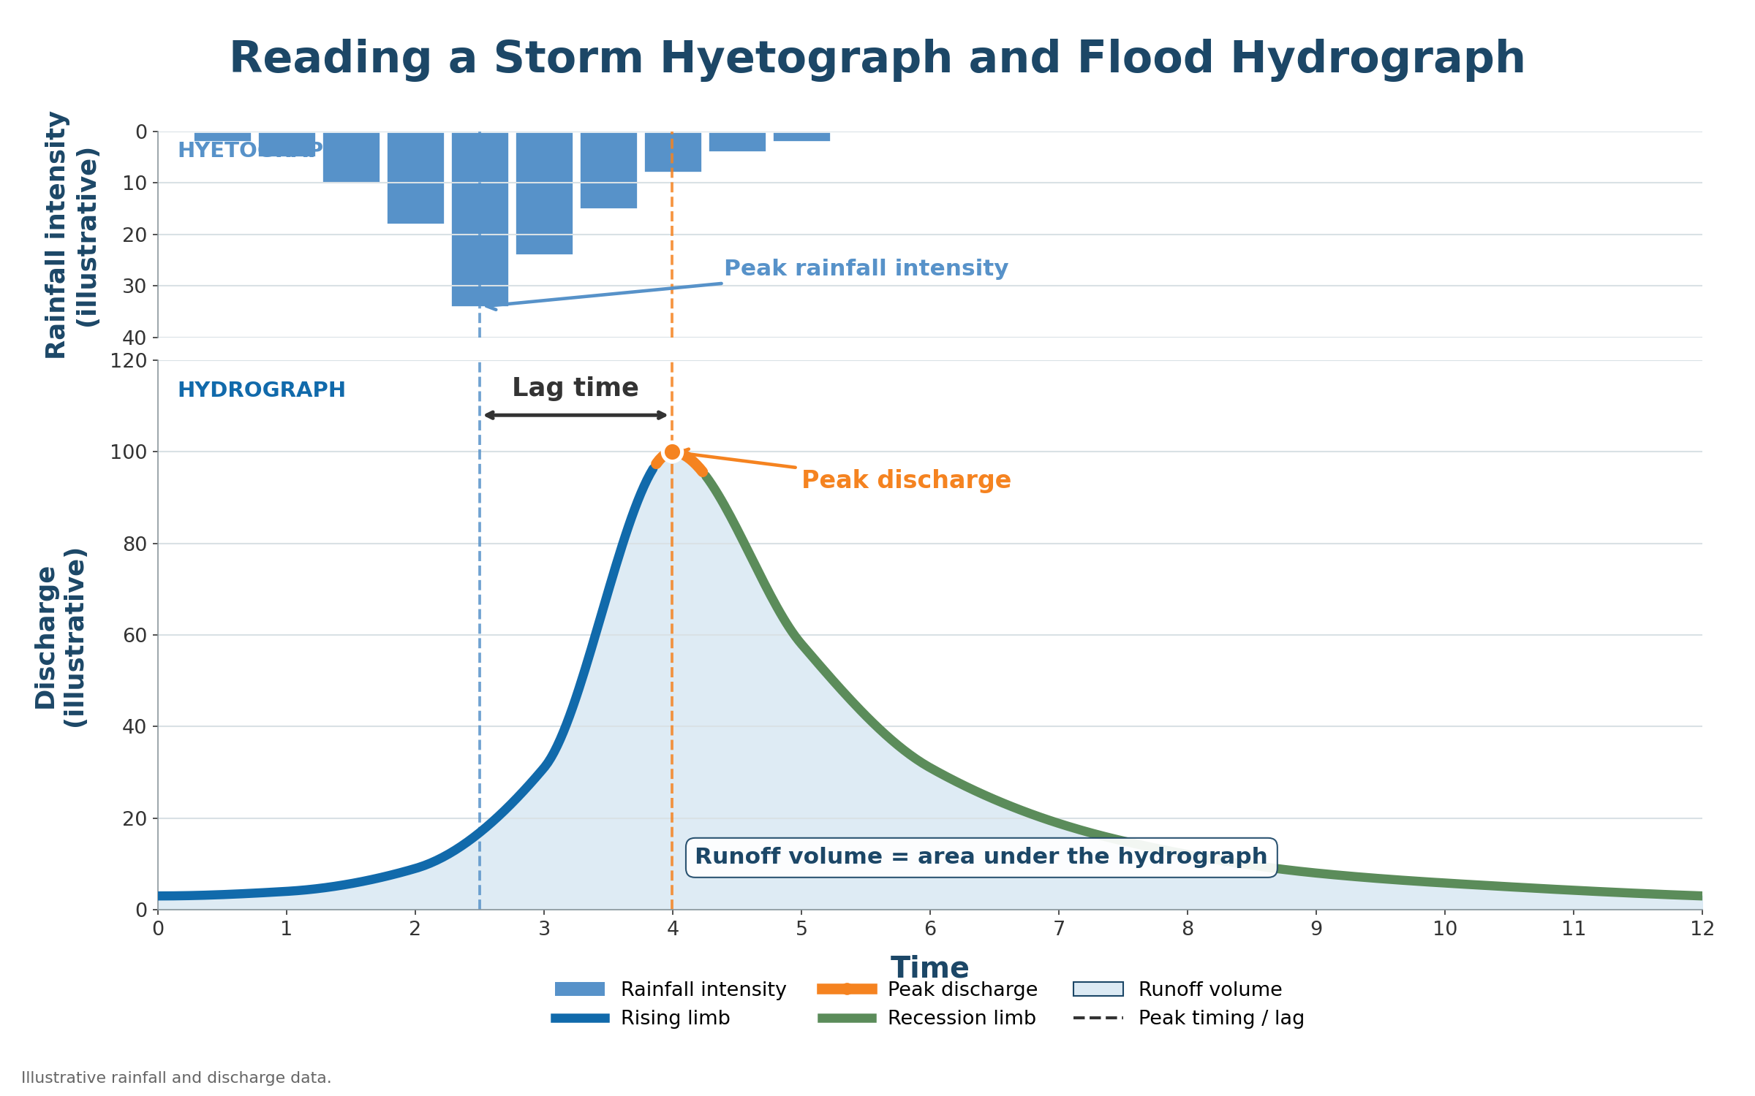
How do we read a Flood Hydrograph?
Peak, timing, and volume—all matter for design.
FAO-organized training | Balochistan Irrigation Department
Notes:
Peak timing and volume depend on watershed and storm conditions.
Reference: https://www.hec.usace.army.mil/software/hec-hms/ ; https://www.nrcs.usda.gov/resources/guides-and-instructions/engineering-field-handbook

Slide 10
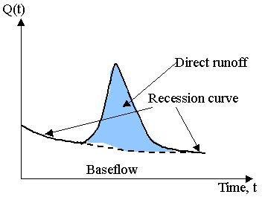
Hydrograph Analysis
Hydrologic response of rainfall at the outlet of an area
Hydrograph: Graph of discharge (cubic feet per second) in a channel vs. time
Area under curve yields the volume of runoff
Stream flow = Direct Runoff + Base flow
Direct Runoff (DRO) = Rainfall Excess or (rainfall – losses)
Source: Prof. Ke-Sheng Cheng
Notes:
Source: usf
Losses = interception, infiltration, dépression Storage, etc. (sometimes called basin recharge)
The term recession curve is sometimes reserved for any descending limb of the hydrograph.
.

Slide 11
What controls hydrograph shape?
Storm/climate
Rainfall Intensity
Rainfall Duration
Rainfall Spatial Distribution
Rainfall Temporal Distribution
Catchment
Catchment Size and Shape
Slope and Elevation
Soil and Land cover
Drainage density, Roughness, and Storage
Antecedent Moisture

Slide 12
How Catchment Characteristics Change Response?
Steeper slopes generally produce faster runoff and a sharper hydrograph response.
Impervious or highly developed surfaces can reduce infiltration and increase rapid runoff.
Larger catchments generally produce greater runoff volume for the same rainfall depth, but their response is often broader and slower.
Vegetation, soil properties, channel length, drainage density, and natural/channel storage also modify the response.
Snowmelt at high elevation can produce broader, lower-peaked flood responses than intense rainfall.

Slide 13
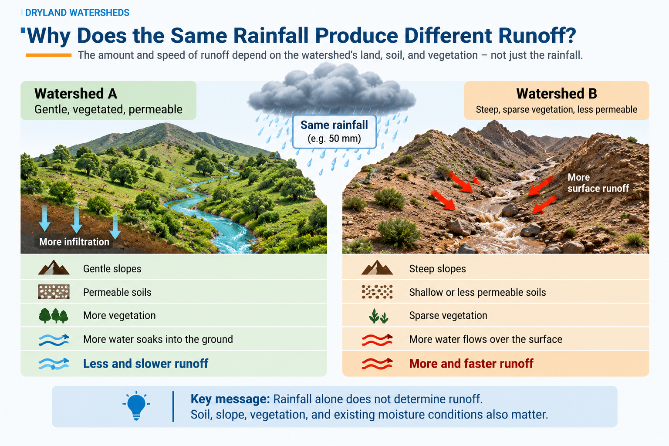
Notes:
Stress that runoff is an event response produced by both the storm and the watershed state.

Slide 14
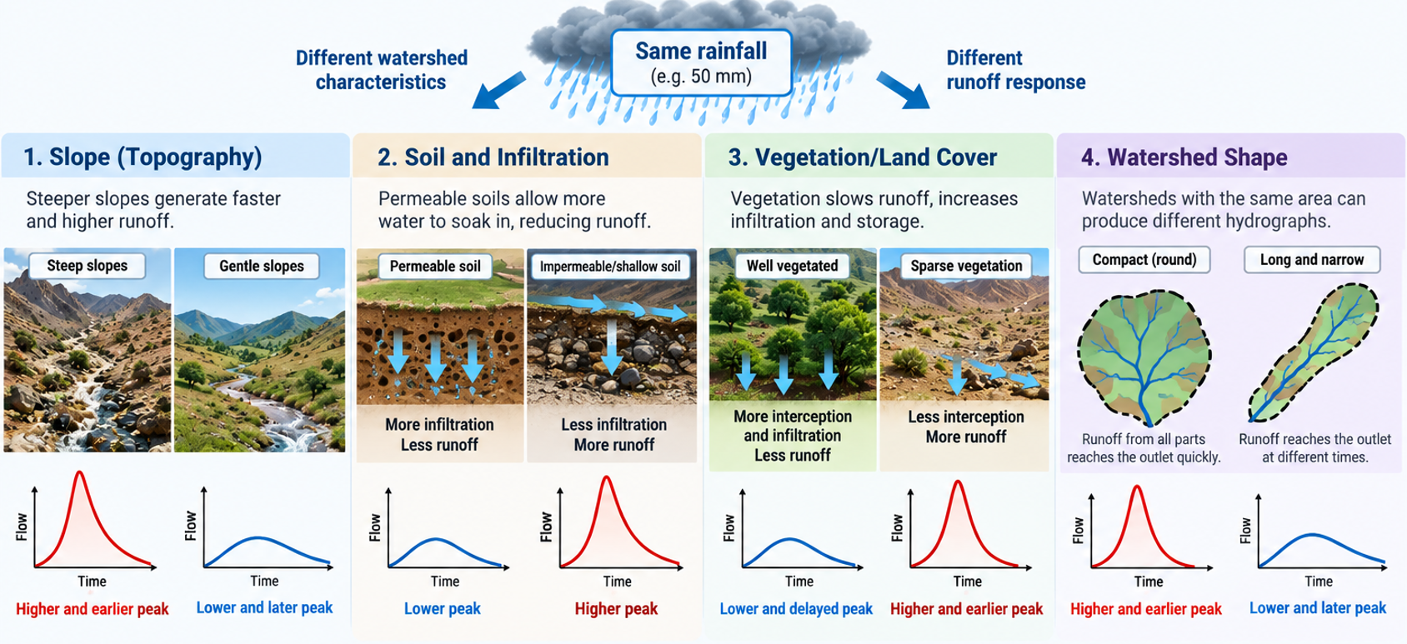
Notes:
Not all rainfall is equivalent, as well.

Slide 15
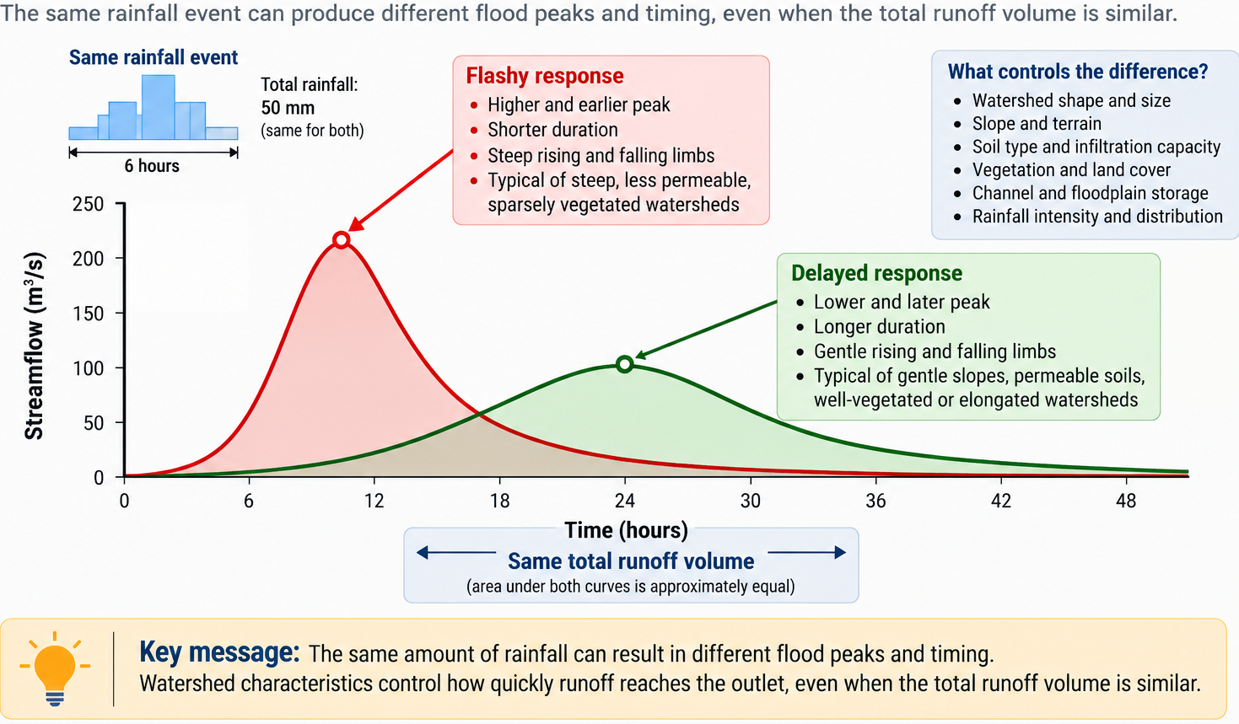
Same monthly rainfall—different runoff risk
10
Notes:
Ask Question: What decision changes when the hydrograph changes?

Slide 16
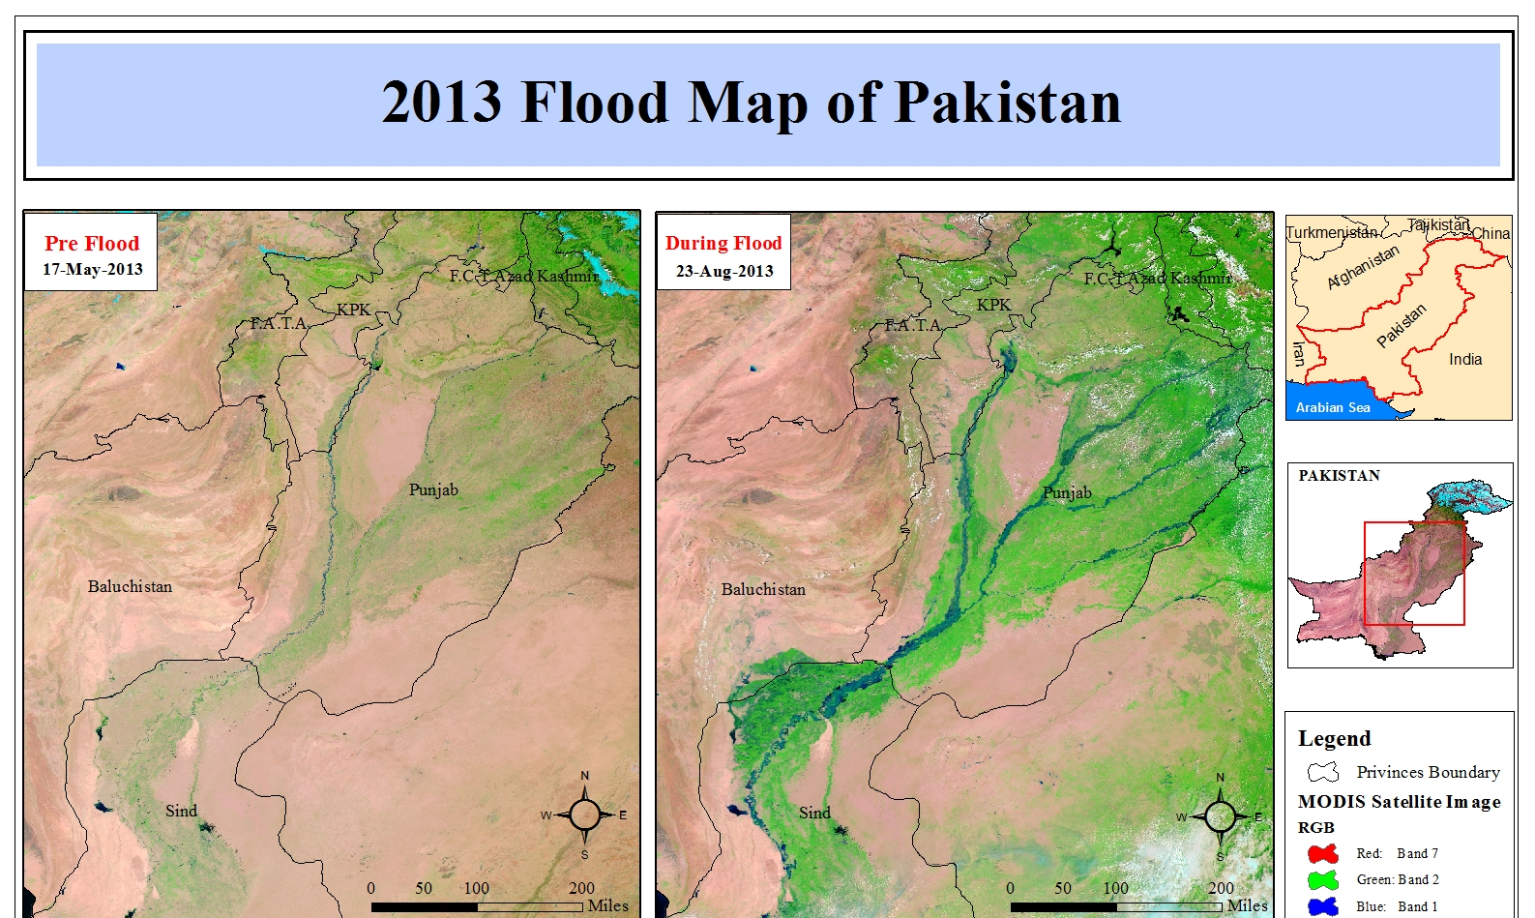
HYDROGRAPHS
Floods 2013 in Sindh
Notes:
Map layout prepared by M. Arslan student MS-5 batch at RS and GISc, IST Karachi Campus.

Slide 17
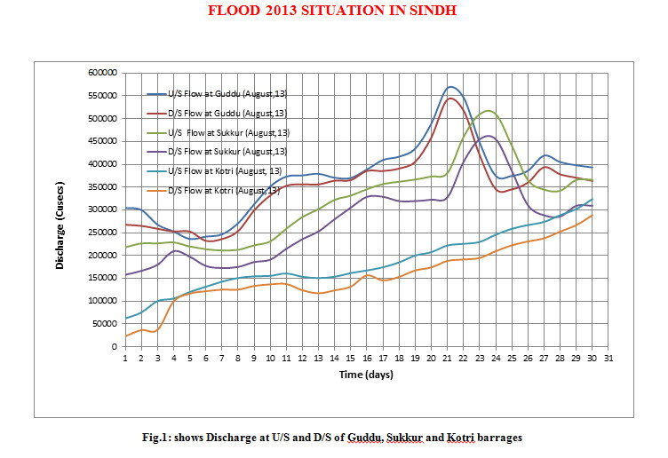
Notes:
Source: SIDA: http://www.sida.org.pk/pages.aspx?id=82

Slide 18
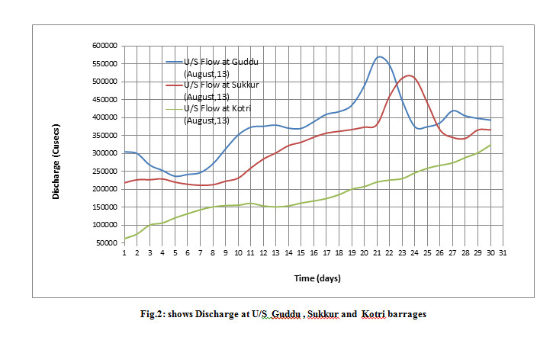

Slide 19
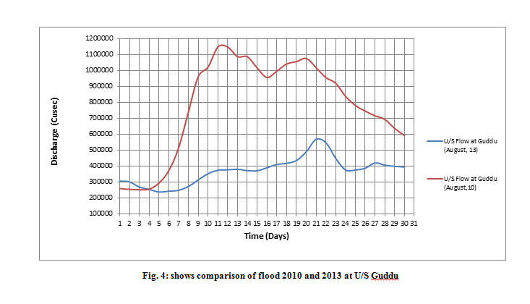

Slide 20
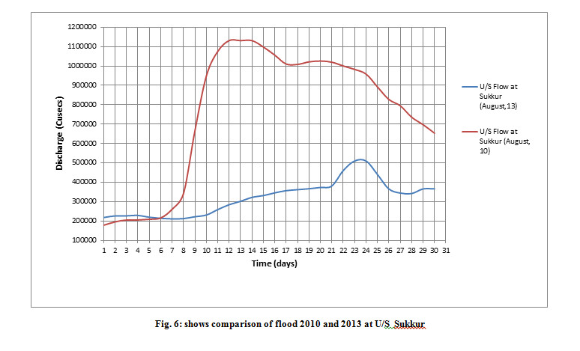

Slide 21
03
Rainfall–runoff modeling
From observed rainfall and catchment characteristics to predicted discharge
Notes:
In drylands, rainfall thresholds and flow connectivity matter more than averages.

Slide 22
Rainfall–Runoff Modeling Concept
Objective: estimate the runoff or streamflow response produced by a rainfall event or rainfall time series.
Inputs may include rainfall, soil properties, land cover, topography, and antecedent conditions.
Observed discharge is used for calibration and evaluation where measurements are available.
Model choice depends on the purpose, data availability, catchment scale, and required level of detail.

Slide 23
A simple Conceptual Model
Rainfall
Input
Catchment
Processes
Runoff
Transformation
Discharge
Output
Losses and storage control how much rainfall becomes effective rainfall.
Catchment routing controls when that water reaches the outlet.

Slide 24
RAINFALL DATA
Gauge and Satellite data are Complements
Gauge strengths
Gauge limitations
Direct point measurement; long local records where maintained.
Sparse coverage; missing values; wind/exposure errors.
Satellite strengths
Satellite limitations
Spatially complete, near-real-time products.
Bias in mountains and intense localized storms; validate locally.
Rainfall–Runoff Processes in Dryland Watersheds
Notes:
- https://gpm.nasa.gov/data/imerg
- https://www.chc.ucsb.edu/data/chirps
- https://community.wmo.int/en/activity-areas/hydrology-and-water-resources

Slide 25
Choosing a rainfall–runoff method
The method should match the decision, watershed scale, and available data.
Rational Method: Estimates peak discharge for suitable small catchments; not event volume.
Curve Number Method: Estimates event runoff depth from rainfall, soil, and land-cover conditions.
Hydrological and Hydraulic (H&H) modeling: Can simulate runoff timing and routing when suitable data are available.
Use local evidence and check assumptions before accepting results.
Notes:
Reference: https://www.hec.usace.army.mil/software/hec-hms/ ; https://www.nrcs.usda.gov/resources/guides-and-instructions/engineering-field-handbook

Slide 26
Regression or ML as a Hydrologic Analysis Tool
Regression can relate runoff or streamflow to explanatory variables when a suitable data record is available.
Regression works best for long time periods.
Possible predictors may include rainfall characteristics, basin descriptors, or other hydrometeorological variables.
Regression is an empirical relationship; it should be evaluated using appropriate goodness-of-fit and validation measures.
26

Slide 27
Can we trust the model results?
A good-looking result is not enough without evidence.
Check rainfall depth, timing, and spatial coverage.
Compare simulated and observed flood peaks, timing, and volume.
Test reasonable ranges of uncertain parameters.
Validate with another event or independent field evidence.
Report uncertainty rather than relying on one number.
Notes:
Reference: https://www.hec.usace.army.mil/software/hec-hms/ ; https://www.nrcs.usda.gov/resources/guides-and-instructions/engineering-field-handbook

Slide 28
4. Two families of runoff models
Peak runoff models and continuous runoff models

Slide 29

Runoff models
Peak runoff models
  Provide only the estimates of peak discharge from the watershed
Continuous runoff models
  This class of runoff models provides storm hydrographs for a given rainfall hyetograph
  Provide an estimate of runoff vs. time series

Slide 30
5. Peak runoff models — the Rational Method
Assumptions, the peak-discharge formula and the runoff coefficient

Slide 31
Peak runoff models
Rational Method
NRCS Method
Notes:
Rational: Deterministic lumped model

Slide 32
Rational Method
To calculate peak runoff from small watersheds
Provides peak runoff rate from a catchment given:
the runoff coefficient C,
the time of concentration T_{c},
the area of the catchment, and
the information to calculate the input or design storm or rainfall event
Notes:
Also called Lloyd Davies Method, 1850
Source: The McGraw-Hill civil engineering PE exam depth guide: water resources By Emmanuel U. Nzewi

Slide 33
Rational Method: Assumptions
Catchment is small (less than 200 acres)
Catchment is concentrated
Rainfall intensity is uniform over the area of study
The runoff coefficient is catch-all coefficient that incorporates all losses of the catchment
Notes:
Source: The McGraw-Hill civil engineering PE exam depth guide: water resources By Emmanuel U. Nzewi.
Catchment is concentrated: that is, rainfall duration is longer than or at least equal to the time of concentration of the watershed.

Slide 34
Rational method: formula
Qp = CI_{i}A
Qp = Peak discharge (cfs)
C = runoff coefficient (function of soil type, landuse/cover, and watershed slope)
I_{i} = average rainfall intensity (in/hr) for a storm duration equal to the time of concentration, T_{c}
A = area (acre)
For runoff coefficient: refer to Bedient Table 6-5, page 381 (more detailed table in McCuen book --will be shared)
Notes:
C = runoff coefficient, ratio of the total runoff rate to the precipitation, dimensionless
Intensity-Duration-Frequency (IDF) curves

Slide 35
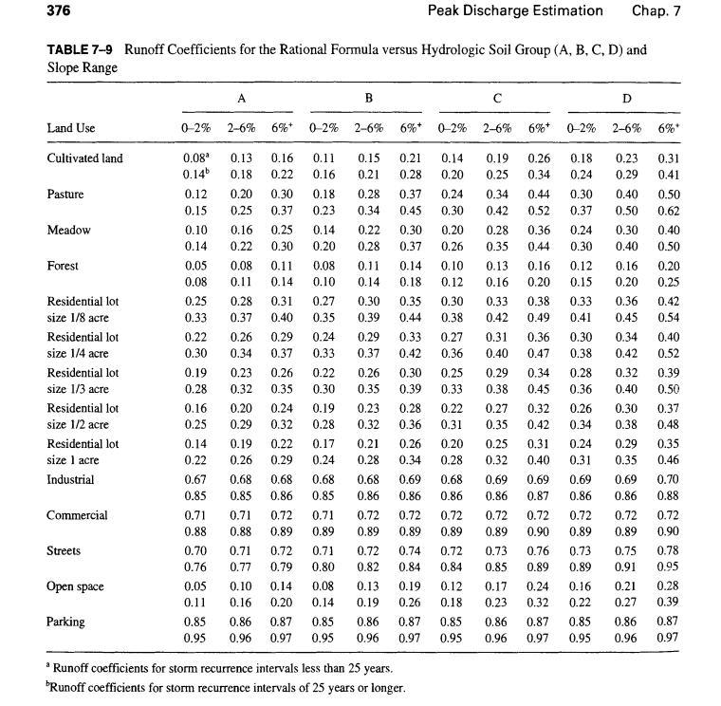
Notes:
Source: Hydrologic Analysis and Design by McCuen (2nd Ed)
Slopes are in %

Slide 36
Key Details of Table 7-9
Parameters covered:
  Land Use / Cover Types: such as agricultural, residential, commercial, industrial, or open/natural land covers like grasslands and forests.
  Hydrologic Soil Groups (A, B, C, D): Classifies soils based on infiltration and transmission rates (from high infiltration sand/gravel types in Group A to low infiltration clay types in Group D).
  Slope Ranges: Categorized by general gradient classes (e.g., flat, rolling, steep), which affect the velocity and volume of surface runoff.
Application: The table values represent empirical runoff coefficients (C) used in peak discharge equations.

Slide 37
Runoff coefficient for nonhomogeneous area
Weighted runoff coefficient based on the area of each land use
Cw = ∑_{j=1}^{n} Cj Aj/ ∑_{j=1}^{n} Aj
Notes:
C reflects the effect of landuse, soil and slope on runoff potential assuming watershed is homogeneous. If drainage basin has different runoff potentials then it’s subdivided.
Example McCuen page 381 (378 in 2nd Edition)

Slide 38
6. The NRCS Curve Number method
The rainfall–runoff equation, S and initial abstraction

Slide 39
NRCS Runoff Curve Number Methods
By the USA Soil Conservation Service (now called the Natural Resources Conservation Service), division of the USDA (US Department of Agriculture)
To predict peak discharge due to a 24-hr storm event
Empirically derived relationships that use precipitation, land cover, hydrologic soil group, and watershed characteristics to estimate runoff depth. When combined with a unit hydrograph method, it can also be used to estimate peak discharge and runoff hydrographs.
More sophisticated approach than the Rational Method

Slide 40
NRCS Curve number
Curve number is a coefficient that reduces the total precipitation to runoff potential, after “losses”
  Evaporation
  Absorption
  Transpiration
  Surface Storage
The higher the CN value, the higher the runoff potential will be
It is essential to use the CN value that best mimics the Ground Cover Type and Hydrologic Condition

Slide 41
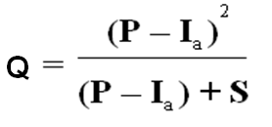
NRCS Rainfall-Runoff Equation
The following equation presents the relationship between accumulated rainfall and accumulated runoff
Where:
Q = accumulated direct runoff (inches or mm)
P = accumulated rainfall (potential maximum runoff) (inches or mm)
I_{a} = initial abstraction including surface storage, interception, evaporation, and infiltration prior to any runoff occurring (inches or mm)
S = potential maximum soil moisture retention after runoff begins (inches or mm)
Note: for P ≤ I_{a}, Q = 0
Equation 1
Notes:
Eq-1 Derived by NRCS from experimental plots for numerous soils and vegetative cover conditions.
The simplified NRCS method can be used for drainage areas up to 2,000 acres.
If P- I_{a} is negative then Q=0
http://www.ctre.iastate.edu/pubs/stormwater/documents/2C-5NRCSTR-55Methodology.pdf

Slide 42
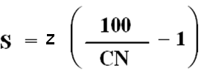
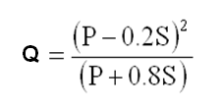
potential maximum retention (S)
Potential maximum retention (S) can be calculated using Equation 2.
Where:
z=10 for English measurement units, or 254 for metric
CN = Runoff Curve Number (0 - 100)
Generally, I_{a} may be estimated as I_{a} = 0.2 S Equation 3
Substituting I_{a} value in Equation 1
Equation 2
Equation 4
Notes:
Equation 2 was developed mainly for small watersheds from recorded storm data that included total rainfall amount in a calendar day but not its distribution with respect to time. Therefore, this method is appropriate for estimating direct runoff from 24-hour or one-day storm rainfall

Slide 43
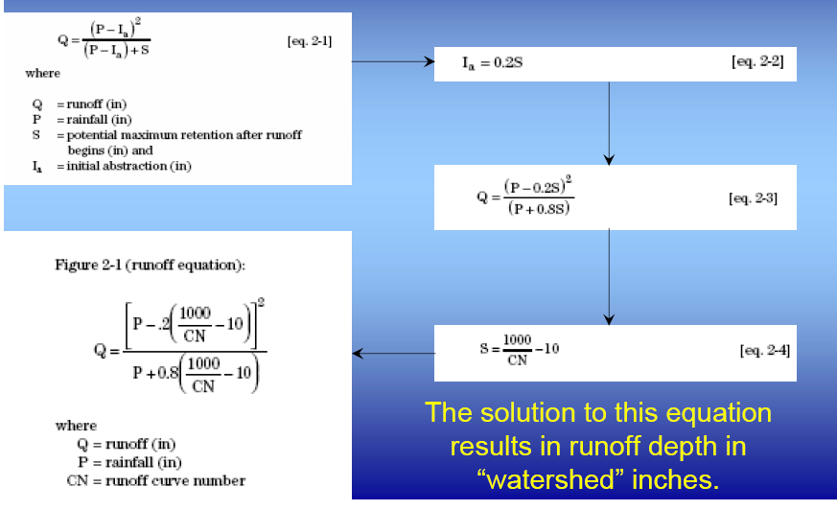
NRCS Runoff equations
Notes:
Source: http://njscdea.ncdea.org/CurveNumbers.pdf

Slide 44
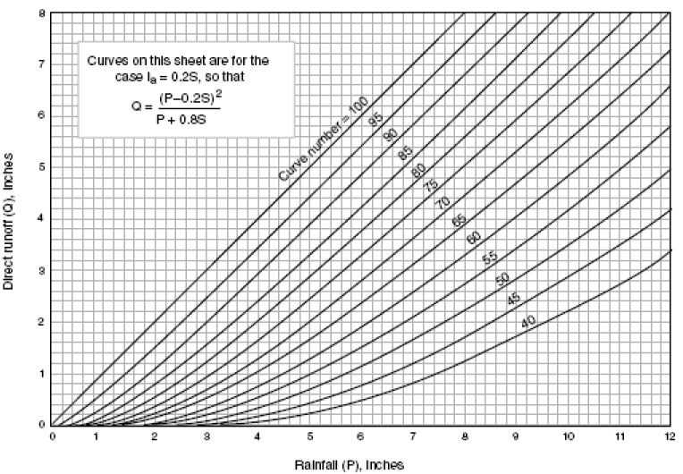
Notes:
Series of curve for different curve numbers

Slide 45
Curve Number CN
The principal physical watershed characteristics affecting the relationship between rainfall and runoff are
  land use, land treatment,
  soil types, and
  land slope.
NRCS method uses a combination of soil conditions and land uses (ground cover) to assign a runoff factor to an area (CN).
CN indicates the runoff potential of an area
  The higher the CN, the higher the runoff potential
Soil properties also influence the relationship between runoff and rainfall since soils have differing rates of infiltration.
Based on infiltration rates, the NRCS has divided soils into four hydrologic soil groups.
Notes:
http://www.ctre.iastate.edu/pubs/stormwater/documents/2C-5NRCSTR-55Methodology.pdf

Slide 46
Hydrologic Soil Groups
Hydrologic Group is a grouping of soils that have similar runoff potential under similar storm and land cover conditions
Group A Soils: High infiltration (low runoff). Sand, loamy sand, or sandy loam. Infiltration rate > 0.3 inch/hr when wet.
Group B Soils: Moderate infiltration (moderate runoff). Silt loam or loam. Infiltration rate 0.15 to 0.3 inch/hr when wet.
Group C Soils: Low infiltration (moderate to high runoff). Sandy clay loam. Infiltration rate 0.05 to 0.15 inch/hr when wet.
Group D Soils: Very low infiltration (high runoff). Clay loam, silty clay loam, sandy clay, silty clay, or clay. Infiltration rate 0 to 0.05 inch/hr when wet.
Effects of Urbanization: Consider the effects of urbanization on the natural hydrologic soil group. For compacted soil, you should make appropriate changes to the selected soil group.
Antecedent soil moisture conditions: AMC I, II, and III
Notes:
Average antecedent soil moisture conditions (AMC II) are recommended for most hydrologic analysis

Slide 47
Antecedent soil moisture conditions-AMC
AMC is the preceding relative moisture of the pervious surfaces prior to the rainfall event
  Low: when there has been little preceding rainfall
  High: when there has been considerable preceding rainfall prior to the modeled rainfall event
ACM I (dry), ACM II (average), and ACM III (wet)
For modeling purposes, we consider watersheds to be AMC II, which is essentially an average moisture condition
For areas with high water table conditions, AMC III antecedent soil moisture conditions may be used.
Notes:
also referred to as Antecedent Runoff Condition (ARC).
http://njscdea.ncdea.org/CurveNumbers.pdf

Slide 48

CNs
  A CN of 100 is to be used for permanent water surfaces such as lakes and ponds
Notes:
http://www.wichita.gov/Government/Departments/PWU/StandardsStormwater/Volume%202-06,%20Chapter%204.pdf

Slide 49
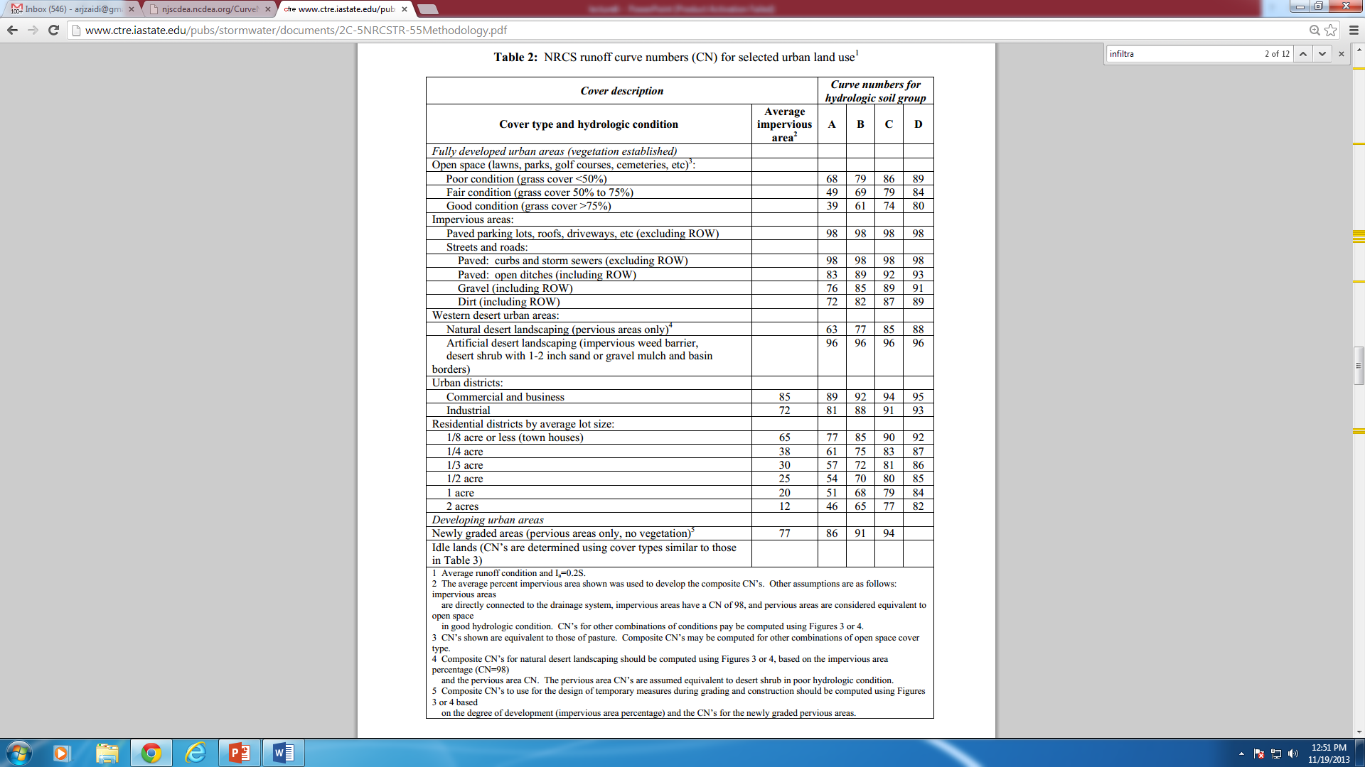
Notes:
http://www.ctre.iastate.edu/pubs/stormwater/documents/2C-5NRCSTR-55Methodology.pdf

Slide 50
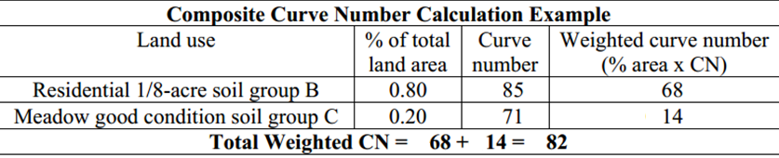
Composite Curve Number
When a drainage area has more than one land use
When Composite CN is used
  The drainage area is considered a uniform land use represented by the composite curve number
  can be calculated by using the weighted method
Notes:
http://www.ctre.iastate.edu/pubs/stormwater/documents/2C-5NRCSTR-55Methodology.pdf

Slide 51
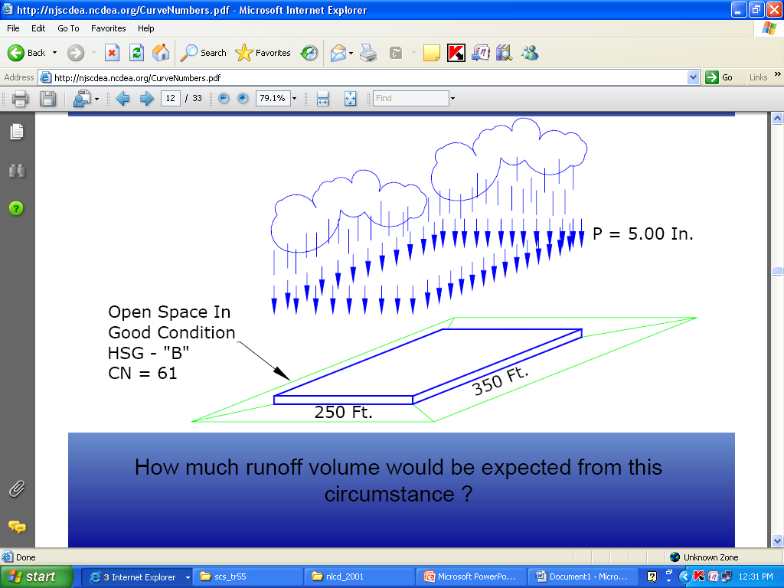
Example
Notes:
Source: http://njscdea.ncdea.org/CurveNumbers.pdf

Slide 52
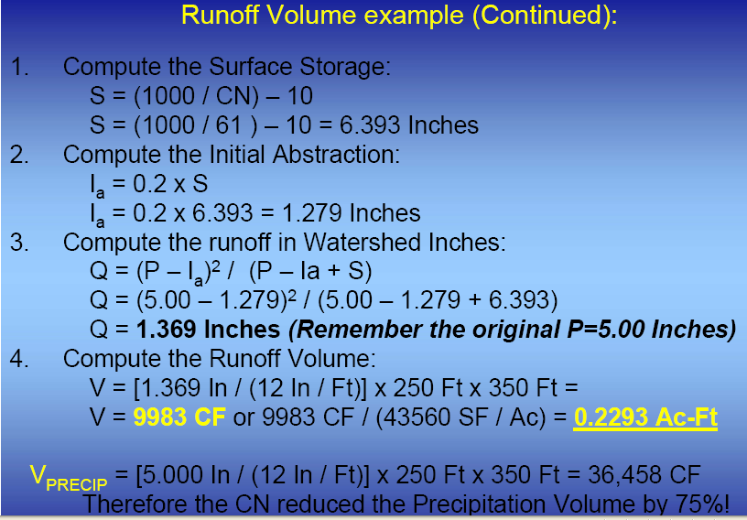

Slide 53
7. Continuous runoff models
The time-area method and unit hydrograph techniques

Slide 54
Continuous Runoff Models
Time area method
Unit Hydrograph Techniques
Notes:
Source: The McGraw-Hill civil engineering PE exam guide: breadth and depth By Roger Dodge Woodson, Kimberly Griffin.

Slide 55
Time Area Method
Develop to address non-uniform rainfall in large areas
Convert rainfall excess into a hydrograph
Concept of time-area histogram is used
This method assumes that outflow hydrograph results from pure translation of direct runoff to the outlet at uniform velocity, ignoring any storage effects in the watershed
Watershed is divided into subareas with distinct runoff translation times to the outlet
Subareas are delineated with isochrones of equal translation time (numbered upstream from the outlet)
Notes:
Source: Bedient page 111

Slide 56
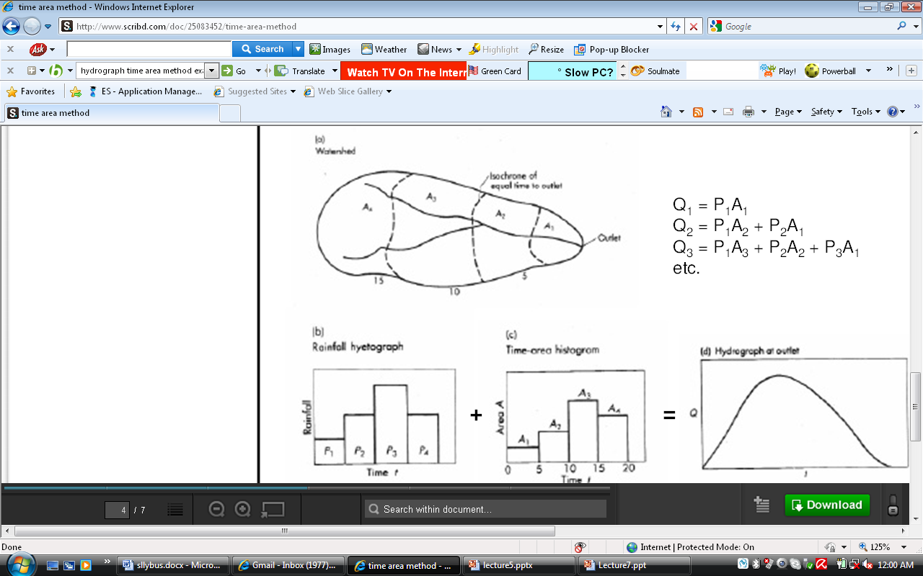
Notes:
Isochrones: a line on a map or diagram connecting places from which it takes the same time to travel to a certain point. Isochrones of equal translation time numbered upstream from the outlet
Source: http://www.scribd.com/doc/25083452/time-area-method

Slide 57
Key takeaways
Only part of the rainfall becomes runoff: effective rainfall = gross rainfall − losses, and runoff is generated when rainfall exceeds the soil's infiltration capacity.
A catchment transforms rainfall input into streamflow output — losses and storage control how much becomes runoff, and routing controls when it arrives.
The hydrograph (rising limb, peak, recession) records the catchment response; the area under the curve is the runoff volume, and its shape reflects both storm and catchment characteristics.
Rainfall–runoff modeling requires appropriate data, clear assumptions, calibration and validation — a plausible hydrograph is not proof of a correct model.
Runoff models fall into two families: peak runoff models (peak discharge only) and continuous runoff models (a full runoff versus time hydrograph).
The Rational Method Qp = C·Ii·A is a lumped peak-discharge model for small, concentrated catchments — it estimates peak flow, not event volume.
Notes:
Source: The McGraw-Hill civil engineering PE exam depth guide: water resources By Emmanuel U. Nzewi.
Catchment is concentrated: that is, rainfall duration is longer than or at least equal to the time of concentration of the watershed.

Slide 58
Key takeaways (continued)
The runoff coefficient C captures soil, land use/cover and slope; a non-homogeneous area needs a weighted C by area.
The NRCS Curve Number method estimates event runoff depth from Q = (P − 0.2S)² / (P + 0.8S), with S = (z / CN) − z.
The higher the CN, the higher the runoff potential; CN depends on land use, soil (hydrologic soil group A–D), slope and antecedent moisture (AMC I/II/III).
Multiple land uses are combined into a composite CN; the same weighting idea applies to the Rational method's runoff coefficient.
Continuous models — the time-area method (isochrones, pure translation, no storage) and unit hydrograph techniques — turn rainfall excess into a hydrograph.
Notes:
Source: The McGraw-Hill civil engineering PE exam depth guide: water resources By Emmanuel U. Nzewi.
Catchment is concentrated: that is, rainfall duration is longer than or at least equal to the time of concentration of the watershed.

Slide 59
In-class activity
A catchment has CN = 80 and receives P = 5.0 inches under average moisture conditions (AMC II).
Compute the potential maximum retention: S = (1000 / CN) − 10.
Compute the initial abstraction: Ia = 0.2 S.
Compute the direct runoff: Q = (P − 0.2S)² / (P + 0.8S).
Discuss how Q would change for a higher CN (say 90) and for a wetter antecedent condition (AMC III).
Notes:
Source: The McGraw-Hill civil engineering PE exam depth guide: water resources By Emmanuel U. Nzewi.
Catchment is concentrated: that is, rainfall duration is longer than or at least equal to the time of concentration of the watershed.

Slide 60
Quiz: runoff models
1. Effective rainfall is best described as:
2. When does excess water begin to contribute to runoff?
3. On a hydrograph, streamflow is made up of:
4. On a hydrograph, the area under the curve represents:
5. Compared with a gently sloping catchment, a steep catchment generally produces:
6. Two watersheds receive the same rainfall but produce different runoff. The most likely reason is:
7. A peak runoff model provides an estimate of:
8. Continuous runoff models provide:
Notes:
Source: The McGraw-Hill civil engineering PE exam depth guide: water resources By Emmanuel U. Nzewi.
Catchment is concentrated: that is, rainfall duration is longer than or at least equal to the time of concentration of the watershed.

Slide 61
Quiz: runoff models (continued)
9. The Rational Method formula is:
10. The Rational Method assumes the catchment is:
11. For a non-homogeneous catchment, the weighted runoff coefficient is computed by:
12. A higher curve number (CN) means:
13. For CN = 75 (English units), the potential maximum retention S is:
14. Which hydrologic soil group has the highest infiltration rate?
15. Which antecedent moisture condition is recommended for most hydrologic analysis?
16. In the NRCS method, what happens when the accumulated rainfall P is less than or equal to the initial abstraction Ia?
Notes:
Source: The McGraw-Hill civil engineering PE exam depth guide: water resources By Emmanuel U. Nzewi.
Catchment is concentrated: that is, rainfall duration is longer than or at least equal to the time of concentration of the watershed.

Slide 62
Thank You

