Slide 1
Perturbation theory through Goldstone diagrams
QM/MM meeting 08/10/2018

Slide 2
Why use diagrams in the first place?
Easily built (especially for the second-order perturbation theory)
Gives a ‘visual’ clue of what’s happening (vs. a bunch of integrals)
Concise because multiple terms can be illustrated simply by interchanging some indices

Slide 3
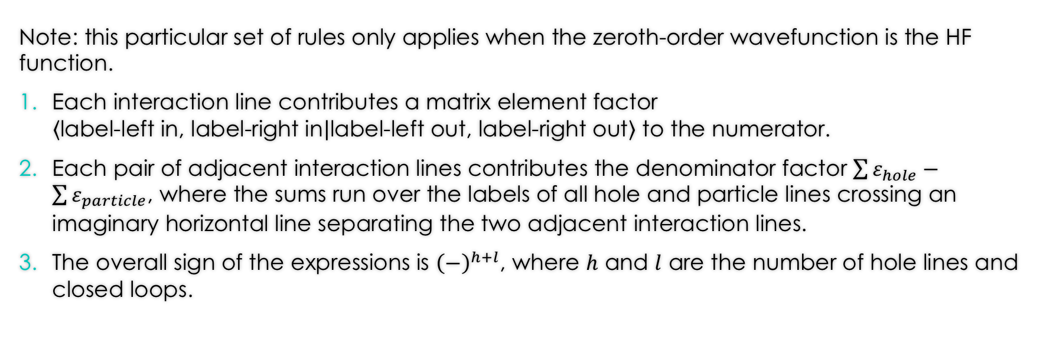
Steps to build a Goldstone diagram
Note: this particular set of rules only applies when the zeroth-order wavefunction is the HF function.
Each interaction line contributes a matrix element factor $\left\langle \text{label}\text{-}\text{left} \text{in}\text{, }\text{label}\text{-}\text{right} \text{in} | \text{label}\text{-}\text{left} \text{out}\text{, }\text{label}\text{-}\text{right} \text{out}\right\rangle$ to the numerator.
Each pair of adjacent interaction lines contributes the denominator factor $\sum{ε_{hole}}−\sum{ε_{particle}}$, where the sums run over the labels of all hole and particle lines crossing an imaginary horizontal line separating the two adjacent interaction lines.
The overall sign of the expressions is ${\left(−\right)}^{h+l}$, where $h$ and $l$ are the number of hole lines and closed loops.

Slide 4
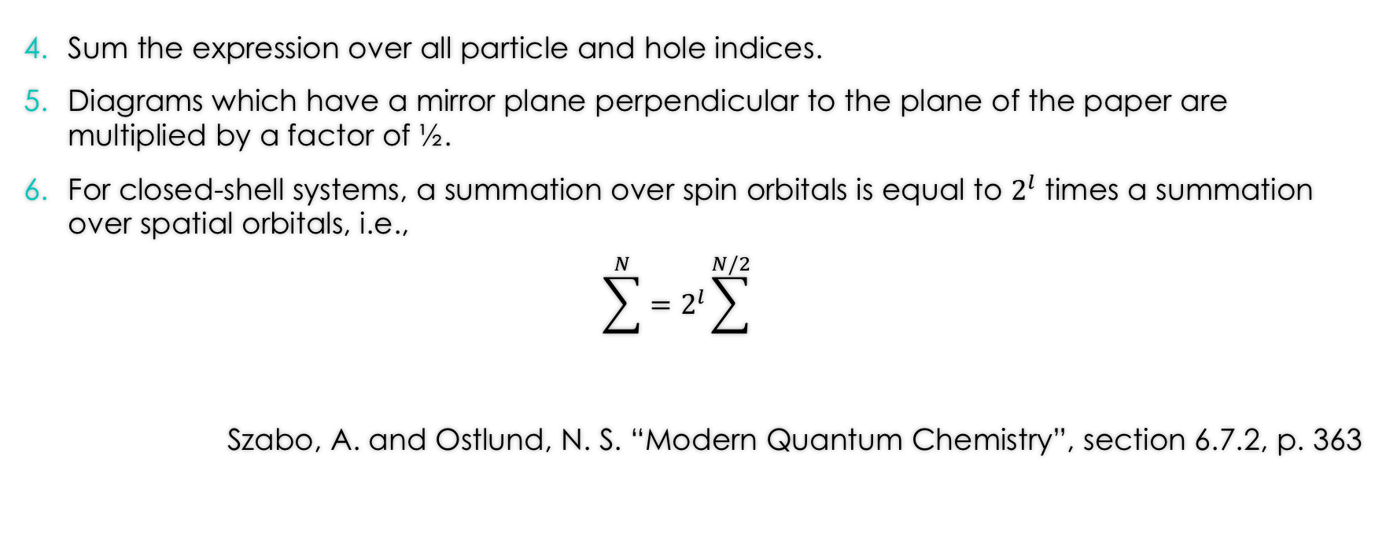
Steps to build a Goldstone diagram (con.)
Sum the expression over all particle and hole indices.
Diagrams which have a mirror plane perpendicular to the plane of the paper are multiplied by a factor of ½.
For closed-shell systems, a summation over spin orbitals is equal to $2^{l}$ times a summation over spatial orbitals, i.e.,
$$\sum^{N}{=2^{l}}\sum^{N/2}{}$$
Szabo, A. and Ostlund, N. S. “Modern Quantum Chemistry”, section 6.7.2, p. 363

Slide 5
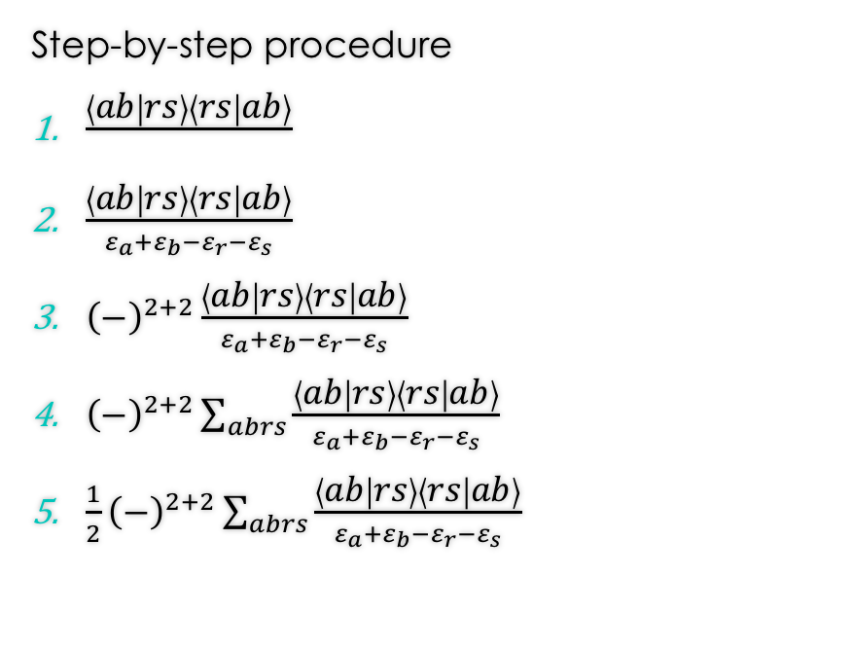
Example 1
Step-by-step procedure
$\frac{\left\langle ab | rs\right\rangle \left\langle rs | ab\right\rangle }{}$
$\frac{\left\langle ab | rs\right\rangle \left\langle rs | ab\right\rangle }{ε_{a}+ε_{b}−ε_{r}−ε_{s}}$
${\left(−\right)}^{2+2}\frac{\left\langle ab | rs\right\rangle \left\langle rs | ab\right\rangle }{ε_{a}+ε_{b}−ε_{r}−ε_{s}}$
${\left(−\right)}^{2+2}\sum_{abrs}{\frac{\left\langle ab | rs\right\rangle \left\langle rs | ab\right\rangle }{ε_{a}+ε_{b}−ε_{r}−ε_{s}}}$
$\frac{1}{2}{\left(−\right)}^{2+2}\sum_{abrs}{\frac{\left\langle ab | rs\right\rangle \left\langle rs | ab\right\rangle }{ε_{a}+ε_{b}−ε_{r}−ε_{s}}}$
r
a
s
b

Slide 6

Example 2
Step-by-step procedure
$\frac{\left\langle ab | rs\right\rangle \left\langle rs | ba\right\rangle }{}$
$\frac{\left\langle ab | rs\right\rangle \left\langle rs | ba\right\rangle }{ε_{a}+ε_{b}−ε_{r}−ε_{s}}$
${\left(−\right)}^{2+1}\frac{\left\langle ab | rs\right\rangle \left\langle rs | ba\right\rangle }{ε_{a}+ε_{b}−ε_{r}−ε_{s}}$
${\left(−\right)}^{2+1}\sum_{abrs}{\frac{\left\langle ab | rs\right\rangle \left\langle rs | ba\right\rangle }{ε_{a}+ε_{b}−ε_{r}−ε_{s}}}$
$\frac{1}{2}{\left(−\right)}^{2+1}\sum_{abrs}{\frac{\left\langle ab | rs\right\rangle \left\langle rs | ba\right\rangle }{ε_{a}+ε_{b}−ε_{r}−ε_{s}}}$
r
s
a
b

Slide 7
Now you try!
Step-by-step procedure
…
…
…
…
…
s
a
t
c
r
b

Slide 8
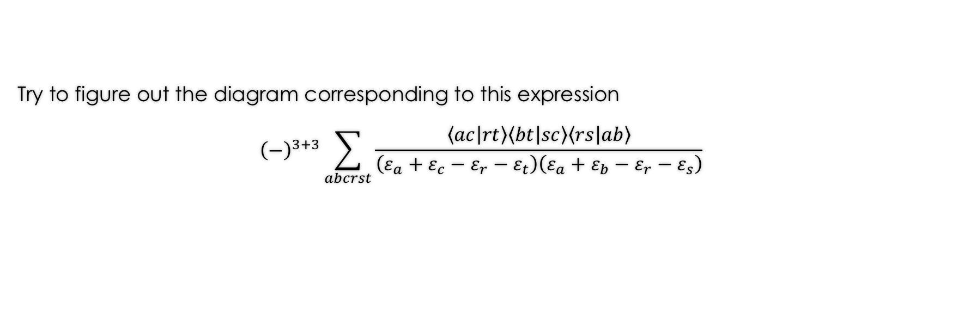
You can also work backwards!
Try to figure out the diagram corresponding to this expression
$${\left(−\right)}^{3+3}\sum_{abcrst}{\frac{\left\langle ac | rt\right\rangle \left\langle bt | sc\right\rangle \left\langle rs | ab\right\rangle }{\left(ε_{a}+ε_{c}−ε_{r}−ε_{t}\right)\left(ε_{a}+ε_{b}−ε_{r}−ε_{s}\right)}}$$

Slide 9
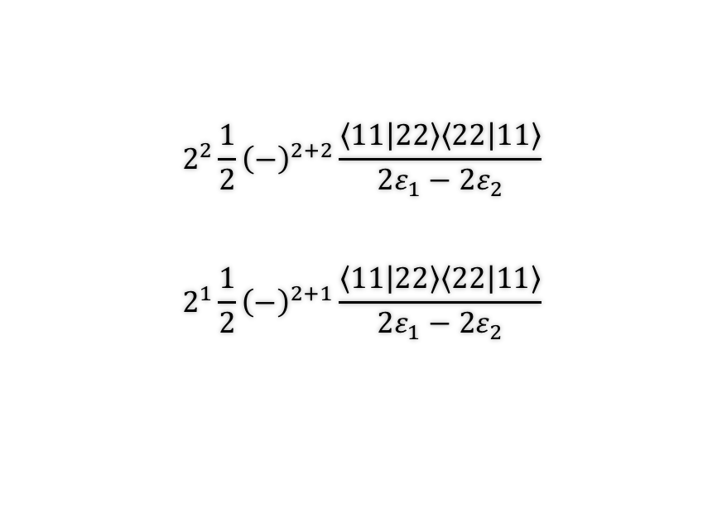
Application on a minimal basis H₂
$$2^{2}\frac{1}{2}{\left(−\right)}^{2+2}\frac{\left\langle 11 | 22\right\rangle \left\langle 22 | 11\right\rangle }{2ε_{1}−2ε_{2}}$$
$$2^{1}\frac{1}{2}{\left(−\right)}^{2+1}\frac{\left\langle 11 | 22\right\rangle \left\langle 22 | 11\right\rangle }{2ε_{1}−2ε_{2}}$$
2
1
2
1
r
s
a
b

Slide 10
Thank you for your attention! Enjoy drawing Goldstone diagrams!
QM/MM meeting 08/10/2018

